Slide 1
Pancreas, Liver, and gallbladder
Metallic 0 Mind

Slide 2
Pancreas
connective tissue forms septa. Which subdivide the gland into lobule.
produce
Exocrine secretion
Endocrine secretion

Slide 3
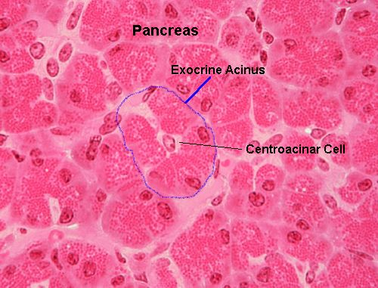
Exocrine secretion:
Duct System
Intercalated ducts :
Composed of centroacinar cells
Intralobular ducts
Interlobular ducts
Main pancreatic duct
Produce proenzymes.
40 to 50 acinar cells form acinus.
Acinar cells:
Shaped like truncated pyramid.
Lie on the basal lamina.
Basal, rounded nucleus.
Basophilic cytoplasm.
Apex has secretory granules (acidophilic)
Basal cell membrane have receptors for CCK and acetylcholine.
Abundance of RER, Mictochondria, polysomes.
Centroacinar cells:
In the lumin of acinus.
Low cuboidal.
Have receptors for secretin and acetylcholine.
No myoepithelial cells.

Slide 4
Endocrine Pancreas
Islets of langerhans :
Surrounded by reticular fibers.
Greater number in the tail region of the pancreas
Cells composing islets of langerhans
Alpha cells α
Secrete glucagon
Beta cells β
Secrete insulin
Delta cells δ
Secrete somatostatin
PP cells
Secrete pancreatic polypeptide
G cells
Secrete gastrin

Slide 5
Liver
General hepatic structure
Irregular connective tissue capsule (Glisson’s capsule)
Parenchymal cells (hepatocytes)

Slide 6
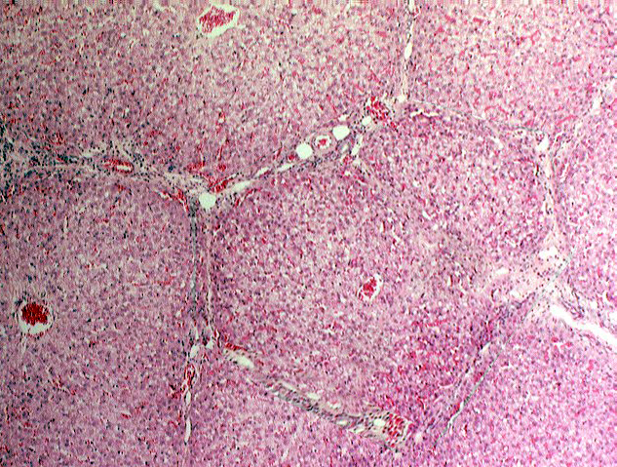
Classic lobules
Connective tissue elements (portal tracts) arrange hepatocytes in hexagon-shaped lobules (classical lobules).
Classical lobules
Contents of portal area
Connective tissue
Lymph vessels
Branch of hepatic artery
Branch of portal vein
Interlobular bile duct (simple cuboidal epithelium)
The place where 3 classical lobules are in contact is called portal area (triads)

Slide 7
Portal Area
hepatocytes
Parenchyma of the liver
Hepatic artery
Hepatic artery
Inlet arteriole
Space of Möll separate limiting plate from the conncective tissue of portal area
Limiting plate (modified hepatocytes) separate portal area from the parenchyma of the liver
Distributing arteriole
hepatocytes

Slide 8
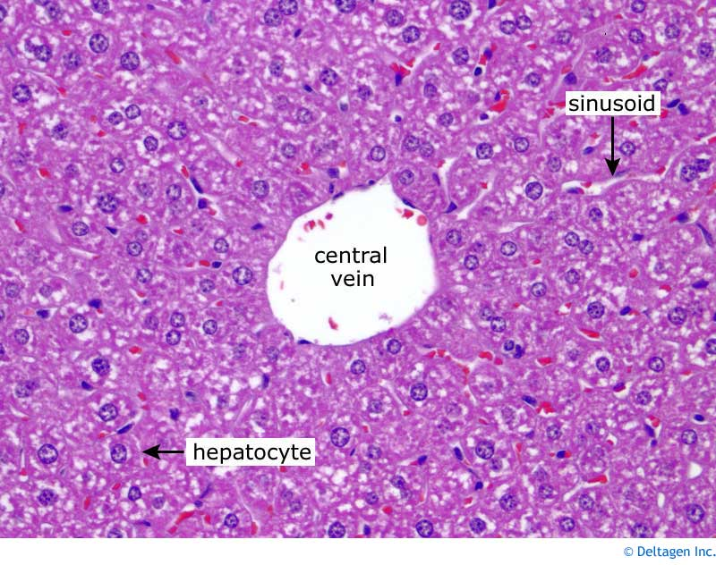
Central vein
Sublobular vein
Collecting veins
Hepatic veins
Venules have 2 sizes
Distributing veins
Inlet venules
Pathway for central vein
Cells are radiating from central vein forming plates of cells separated by sinusoids
Interlobular bile duct are vascularized by peribiliary capillary plexus
Central vein:
At the central of lobule.
Tributary of hepatic veins.

Slide 9
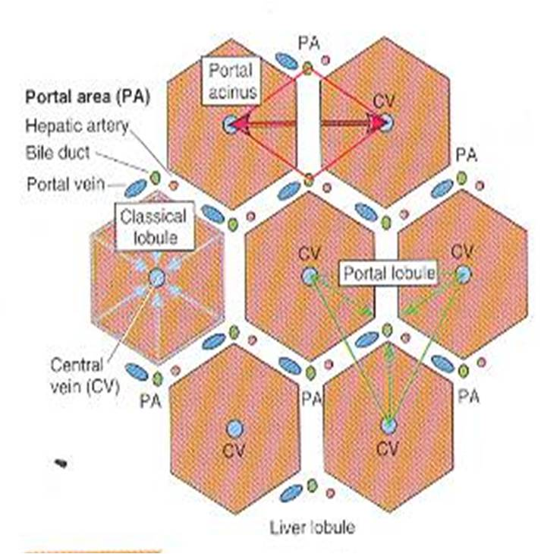
The three concepts of liber lobules
Classical liver lobules:
Blood flows from periphery to the center of lobule into central vein
Portal lobule:
Hepatocytes deliver bile to interlobular duct.
Hepatic acinus (acinus of Rappaport):
Based on blood flow from ditributing arteriole

Slide 10
Hepatic sinusoids
Spaces between hepatocytes
Have two types of cells
Sinusoidal lining cells:
Leaving gap between them.
The cells themselves have fenestrae.
Kupffer Cells:
Associated with the sinusoidal lining cells.
Phagocytic cells.
Have filopodia-like pojections
No basement membrane

Slide 11
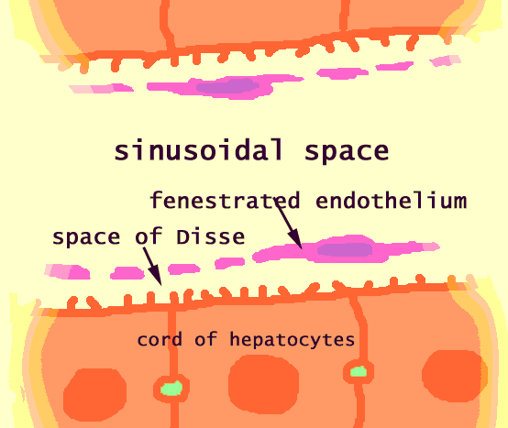
Hepatic sinusoids
Hepatocytes
Hepatic Stellate cells:
Known as Ito cells and fat storing cells.
Functions:
Store vitamin A
Manufacture and release type III collagen.
Secrete growth factor.
Form fibrous connective tissue
Narraow space between them known as perisinusoidal space of Disse
Contents of space of Disse
Microvlli of hepatocytes
Type III collagen fibers (reticular fibers)
Hepatic stellate cells
Pit cells:
Natural killer cells
Basal lamina is absent

Slide 12
Hepatic Ducts
Bile canuliculi
cholangioles
Canals of hering
Interlobular bile ducts
Right and left hepatic ducts
Pathway for bile in liver
Composed of :
Hepatocytes
Low cuboidal cells
Occasional oval cells
Composed of :
Low cuboidal cells
Some ovoid cells

Slide 13
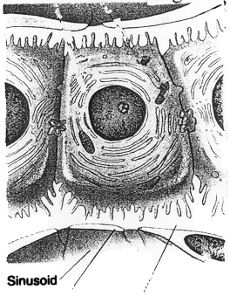
Hepatocytes
Polygonal cells
acidophilic
Plasma membrane have two domains
Other hepatocytes
hepatocyte
sinusoids
1-Lateral domain:
Respnsible for formation of bile canaliculi.
Leakage of bile is prevented by tight junction (fasciae occludentes).
Hepatocyte microvilli project into bile canaliculi.
Hepatocytes plasmalemma is the wall for bile canaliculi.
Have isolated gap junction to communicate with other cells.
2- Sinusoidal Domain:
Have microvilli.

Slide 14
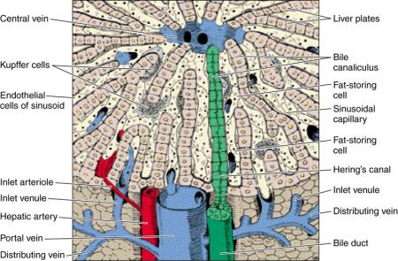
Hepatocytes organelles and inclusions
75% have one nucleus
Remainder have two nuclei
Free ribosomes, RER, SER, golgi apparatus
mitochondria
Endosomes, lysosomes, and perixisomes
Few lipid droplets and glycogen
صورة معبرة

Slide 15
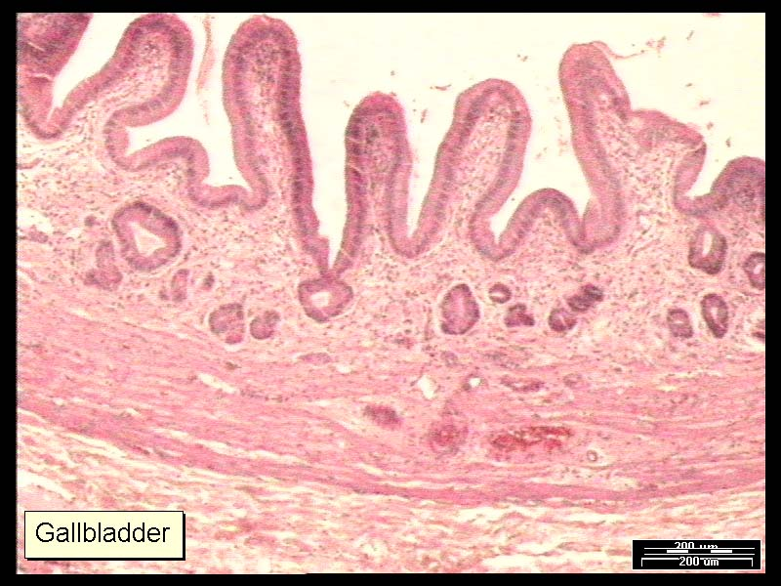
Gallbladder
Mucosa is highly folded into ridges
Wall composed of
epithelium
Lamina propria
Smooth muscle
Serosa/adventita
IF
Loose connective tissue
Not invested:
adventitia
Simple columnar epithelium
Obliquely oriented
No goblet cells no muscularis mucosa
Invested by peritoneum:
serosa

