Slide 1
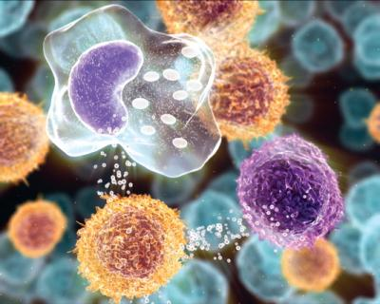
Objectives
INFLAMMATION AND REPAIR
Lecture 4
Patterns of acute inflammation
Chronic inflammation
Systemic effect of inflammation
Upon completion of this lecture, the student should:
Compare and contrast acute vs. chronic inflammation with respect to causes, nature of the inflammatory response, and tissue changes.
Compare and contrast the clinical settings in which different types of inflammatory cells (eg, neutrophils, eosinophils, monocyte-macrophages, and lymphocytes) accumulate in tissues. Compare and contrast the contents of neutrophil and eosinophil granules.
Distinguish between fibrinous, purulent, and serous inflammation.
Define an abscess and fistula.
Describe the systemic manifestations of inflammation and their general physiology, including fever, leukocyte left shift, and acute phase reactants.
Dr. Maha Arafah
Assistant Professor
Department of Pathology
King Khalid University Hospital and King Saud University
Email: marafah@ksu.edu.sa
marafah @hotmail.com
Saturday, October 15,2011

Slide 2
Objectives
Upon completion of this lecture, the student should:
Distinguish between fibrinous, purulent, and serous inflammation.
Define an abscess and fistula.
Compare and contrast acute vs chronic inflammation with respect to causes, nature of the inflammatory response, and tissue changes.
Compare and contrast the clinical settings in which different types of inflammatory cells (eg, neutrophils, eosinophils, monocyte-macrophages, and lymphocytes) accumulate in tissues.
Describe the systemic manifestations of inflammation and their general physiology, including fever, leukocyte left shift, and acute phase reactants.

Slide 3
Morphologic Patterns of Acute Inflammation
Several types of inflammation vary in their morphology and clinical correlates. Why?
The severity of the reaction
specific cause
the particular tissue
site involved

Slide 4
Morphologic Patterns of Acute Inflammation
SEROUS INFLAMMATION
FIBRINOUS INFLAMMATION
SUPPURATIVE OR PURULENT INFLAMMATION
ULCERS

Slide 5
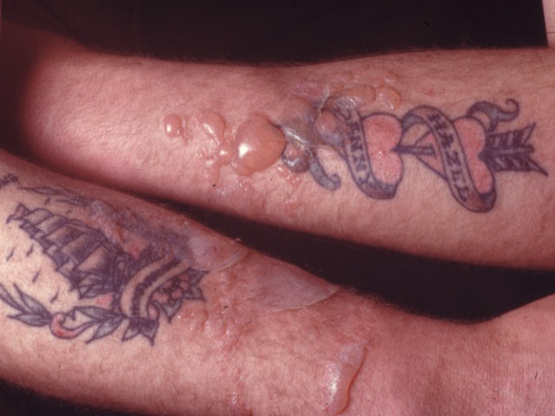
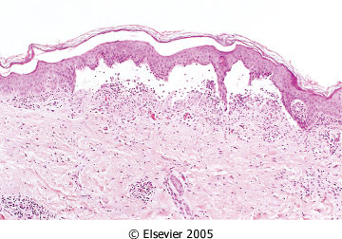
SEROUS INFLAMMATION: marked by the outpouring of a thin fluid

Slide 6
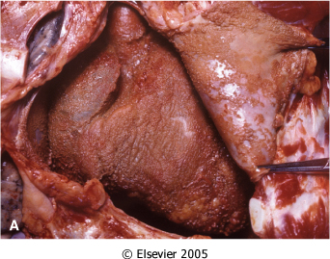
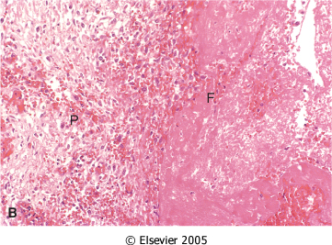
FIBRINOUS INFLAMMATION
A fibrinous exudate is characteristic of inflammation in the lining of body cavities, such as the meninges, pericardium and pleura (larger molecules such as fibrinogen pass the vascular barrier)
Fibrinous exudates may be removed by fibrinolysis, if not: it may stimulate the ingrowth of granulation tissue (organization)

Slide 7
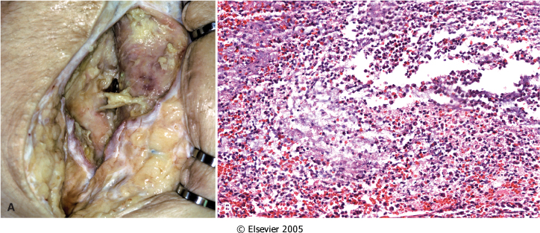
Morphologic Patterns of Acute Inflammation SUPPURATIVE OR PURULENT INFLAMMATION
characterized by the production of large amounts of pus or purulent exudate consisting of neutrophils, necrotic cells, and edema fluid caused by as pyogenic (pus-producing) bacteria

Slide 8
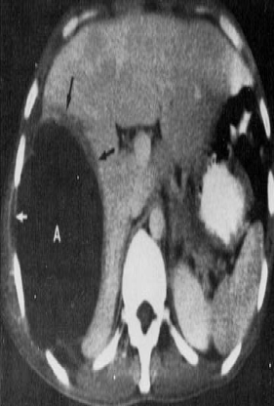
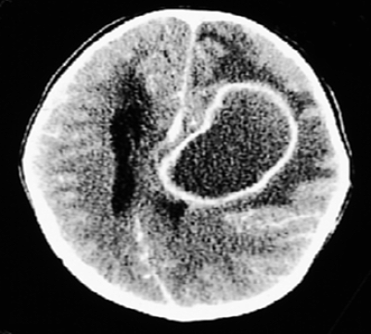
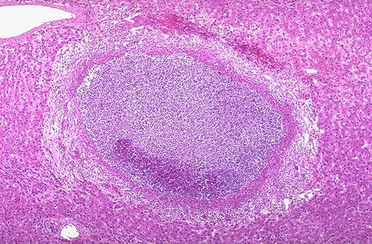
Morphologic Patterns of Acute Inflammation SUPPURATIVE OR PURULENT INFLAMMATION
Abscesses : localized collections of purulent inflammatory tissue caused by suppuration buried in a tissue, an organ, or a confined space

Slide 9
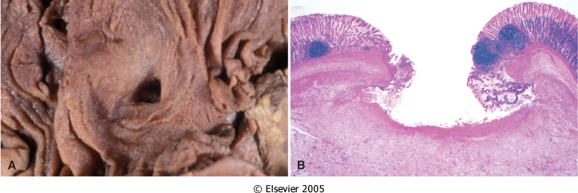
ULCERS
An ulcer is a local defect of the surface of an organ or tissue that is produced by the sloughing (shedding) of inflammatory necrotic tissue
Epithelial Defect
Necrotic base
Fibrinopurulent exudates
Granulation tissue
Fibrosis

Slide 10
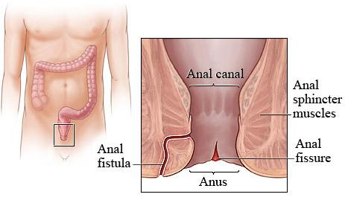
Fistula
A tract between two surfaces.

Slide 12
CHRONIC INFLAMMATION
Occur when the inciting injury is persistent or recurrent or when inflammatory reaction insufficient to degrade the agent (e.g. bacteria, tissue necrosis, foreign bodies)
It can start de novo as new event without preceding acute inflammation (tuberculosis)
It is slow evolving (weeks to months) resulting into fibrosis
It occurs in two major patterns :chronic non specific and specific granulomatous inflammation

Slide 13
MORPHOLOGIC FEATURES OF CHRONIC INFLAMMATION
Infiltration with mononuclear cells include
Macrophages
Lymphocytes
Plasma cells
Eosinophils
Tissue destruction and distortion
induced largely by inflammatory cells.
Healing (fibrosis)
by connective tissue replacement of damaged tissue, accomplished by granulation tissue (proliferation of small blood vessels (angiogenesis) and then fibrosis)
Cells in Acute inflammation:
Neurophils then macrophages

Slide 14
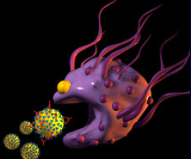
CHRONIC INFLAMMATION Macrophages
This type of inflammation mediated by the interaction of monocyte macrophages with T and B lymphocyte
Monocyte recruited from circulation by various chemotactic factor
In tissue are called: Macrophages
the dominant cellular player in chronic inflammation
The mononuclear phagocyte system

Slide 15
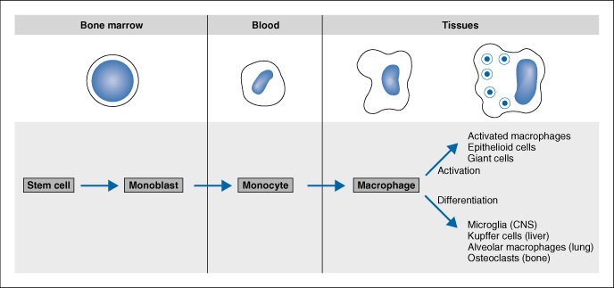
mononuclear phagocyte system
monocytes begin to emigrate into extravascular tissues quite early in acute inflammation and within 48 hours they may constitute the predominant cell type

Slide 16
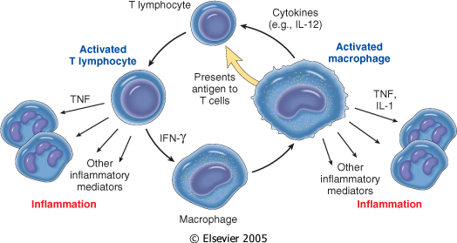
MONONUCLEAR CELL INFILTRATION Macrophages
Macrophages may be activated by a variety of stimuli, including
cytokines (e.g., IFN-γ) secreted by sensitized T lymphocytes and by NK cells
bacterial endotoxins
other chemical mediators

Slide 17
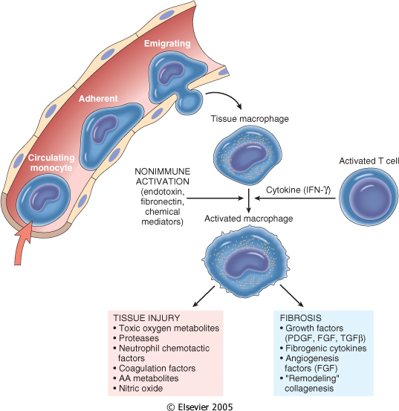
The roles of activated macrophages in chronic inflammation.
Products of macrophages
to eliminate injurious agents such as microbes
to initiate the process of repair
It is responsible for much of the tissue injury in chronic inflammation

Slide 18
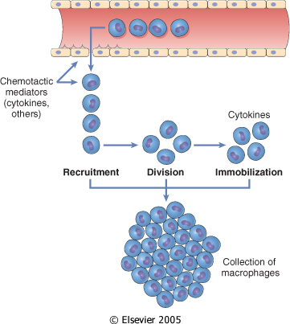
Macrophages
In chronic inflammation, macrophage accumulation persists, this is mediated by different mechanisms:
Recruitment of monocytes from the circulation
Local proliferation of macrophages
Immobilization of macrophages

Slide 19
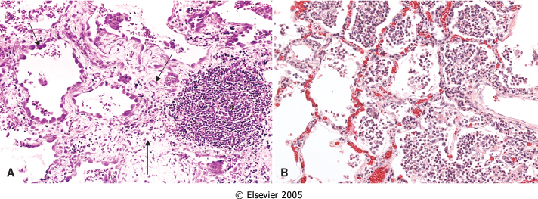
OTHER CELLS IN CHRONIC INFLAMMATION
Lymphocytes
Both T & B Lymphocytes migrates into inflammation site

Slide 20
OTHER CELLS IN CHRONIC INFLAMMATION
Plasma cells
Lymphoid cell (Mature B cells)
Common cell in chronic inflammation
Primary source of antibodies
Antibodies are important to neutralize antigen and for clearance of foreign Ag

Slide 21
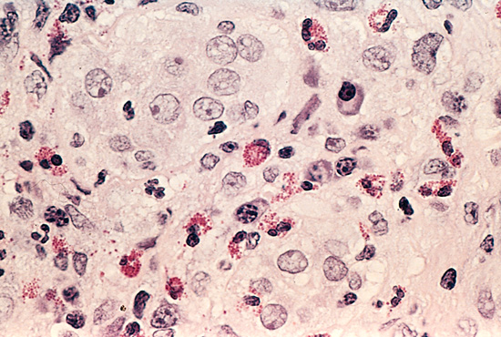
Eosinophils
are abundant in immune reactions mediated by IgE and in parasitic infections
respond to chemotactic agents derived largely from mast cells
Granules contain major basic protein: toxic to parasites and lead to lysis of mammalian epithelial cells

Slide 22
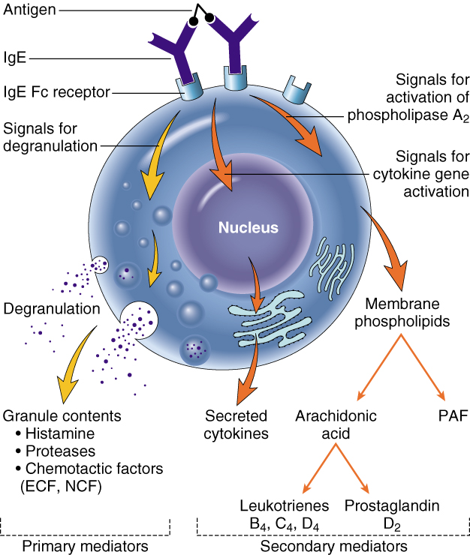
Mast cells
are widely distributed in connective tissues
express on their surface the receptor that binds the Fc portion of IgE antibody ,
the cells degranulate and release mediators, such as histamine and products of AA oxidation

Slide 23
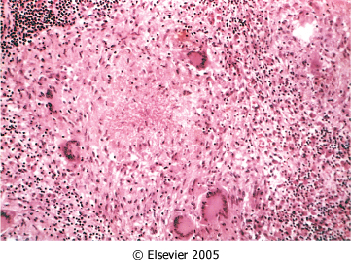
OTHER CELLS IN CHRONIC INFLAMMATION Epithelioid macrophages
GRANULOMATOUS INFLAMMATION
Granulomatous inflammation is a distinctive pattern of chronic inflammatory reaction characterized by focal accumulations of activated macrophages, which often develop an epithelial-like (epithelioid) appearance
Causes:
Infections
Bacterial
Parasitic
Fungal
Inorganic dusts
Foreign bodeis
unknown

Slide 24
Examples of Diseases with Granulomatous Inflammations
Disease | Cause | Tissue Reaction
Tuberculosis | Mycobacterium tuberculosis | Noncaseating tubercle Caseating tubercles
Leprosy | Mycobacterium leprae | Acid-fast bacilli in macrophages; noncaseating granulomas
Syphilis | Treponema pallidum | Gumma: wall of histiocytes; plasma cell
Cat-scratch disease | Gram-negative bacillus | Rounded or stellate granuloma
Sarcoidosis | Unknown etiology | Noncaseating granulomas
Crohn disease | Immune reaction against intestinal bacterial | dense chronic inflammatory infiltrate with noncaseating granulomas

Slide 26
Systemic effects of Inflammation
Acute phase reaction/response
- IL-1 and TNF
- Fever
- Malaise
- Anorexia
Bone marrow
- leukocytosis
- IL-1 + TNF
Lymphoid organs
Liver
-IL-6, IL-1, TNF
-Acute phase proteins
C-reactive protein
Lipopolysaccharide binding protein
Serum amyloid A
a-2 macroglobulin
Haptoglobin
Ceruloplasmin
fibrinogen

Slide 27
Fever Produced in response to Pyrogens
Types of Pyrogens:
Exogenous pyrogens: Bacterial products
Endogenous pyrogens:
IL-1 and TNF
Bacterial products stimulate leukocytes to release cytokines such as IL-1 and TNF that increase the enzymes (cyclooxygenases) that convert AA into prostaglandins.

Slide 28
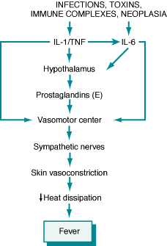
Fever
In the hypothalamus, the prostaglandins, especially PGE₂, stimulate the production of neurotransmitters such as cyclic AMP, which function to reset the temperature set-point at a higher level.
NSAIDs, including aspirin , reduce fever by inhibiting cyclooxygenase and thus blocking prostaglandin synthesis.

Slide 29
Increased erythrocyte sedimentation rate
The rise in fibrinogen causes erythrocytes to form stacks (rouleaux) that sediment more rapidly at unit gravity than do individual erythrocytes.

Slide 30
Inflammation Systemic Manifestations
Leukocytosis:
WBC count climbs to 15,000 or 20,000 cells/μl
most bacterial infection (Neutrophil)
Lymphocytosis:
Infectious mononucleosis, mumps,
German measles
Eosinophilia: bronchial asthma,
hay fever, parasitic infestations
Leukopenia: typhoid fever,
infection with rickettsiae/protozoa

Slide 31
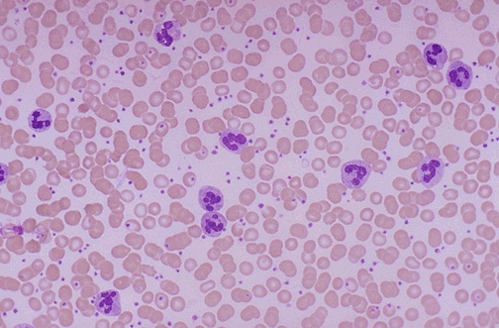
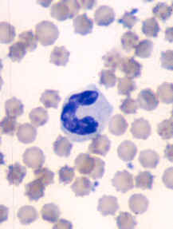
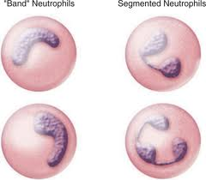
Shift to left
Notes:
Acute inflammation is marked by an increase in inflammatory cells. Perhaps the simplest indicator of acute inflammation is an increase in the white blood cell count in the peripheal blood, here marked by an increase in segmented neutrophils (PMN's).

