Slide 1
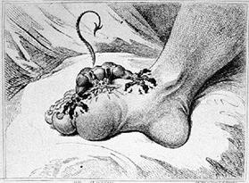
GOUT

Slide 2
OBJECTIVES
At the end of lectures students should :
Define gout
Describe outlines of treatment
Describe treatment of acute gouty arthritis
Describe the mechanism of action , clinical uses & side effects of drugs used in acute attacks

Slide 3
OBJECTIVES ( continue)
Classify drugs used in chronic treatment
Define each group of drugs
Describe the mechanism of action, clinical uses & side effects & drug interactions for drugs used in chronic treatment

Slide 4
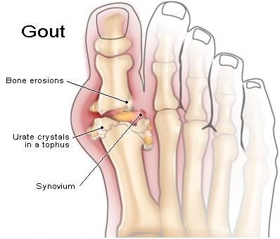
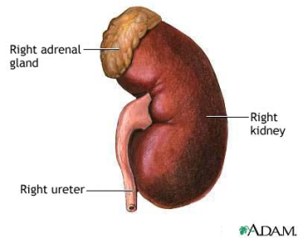


What is gout?
High blood uric acid level
Most uric acid is excreted by kidneys
Blood → monosodium urate
Rare before puberty
♂>♀
Breakdown of product of the body’s purine (nucleic acid) metabolism.

Slide 5
Aetiology of raised uric acid level
Idiopathic decrease in uric acid excretion
(75%)
Increase uric acid production due to increased cell turn over (tumours), increase uric acid synthesis (specific enzyme defect)
High dietary purine intake
Impaired uric acid excretion secondary to thiazide diuretics, chronic renal failure

Slide 6
1
Asymptomatic Stage
2
Acute stage
3
Intercritical stage
4
Chronic stage

Slide 7
What is the treatment of gout ?

Slide 8
Broad lines in treatment of gout
Non-pharmacologic
pharmacologic
Acute gouty arthritis
Prevention of recurrent attack

Slide 9
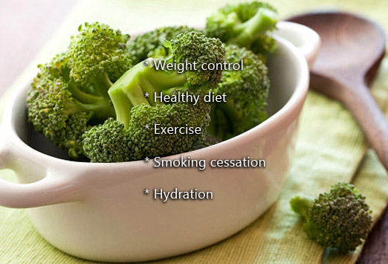
Non-pharmacologic
Therapy

Slide 10
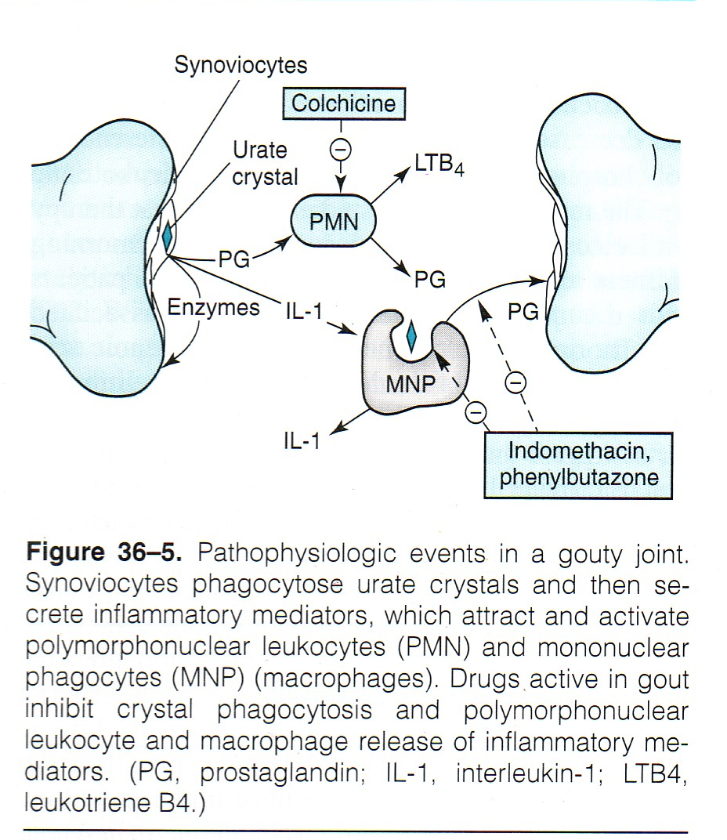

Slide 11
DRUGS USED IN TEATMENT OF GOUT
Most therapeutic strategies for gout involve lowering the uric acid level below the saturation point (<6 mg/dL), thus preventing the deposition of urate crystals.
This can be accomplished by:
interfering with uric acid synthesis with allopurinol
increasing uric acid excretion with probenecid or sulfinpyrazone
inhibiting leukocyte entry into the affected joint with colchicine,
administration of NSAIDs

Slide 12
Acute gouty arthritis
NSAIDs
colchicine
corticosteroid

Slide 13
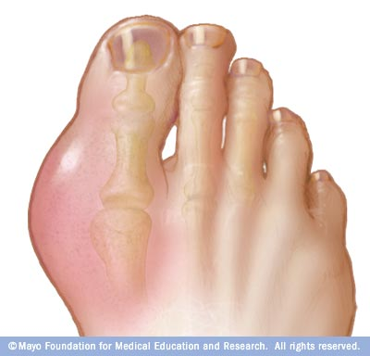
Aaarrrgghhh!!

Slide 14
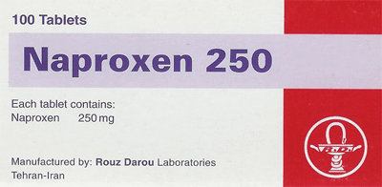
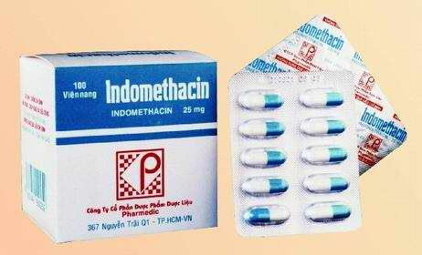
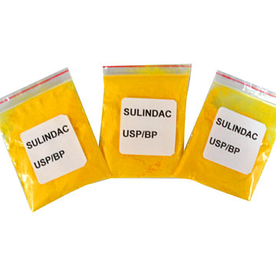
1. NSAIDs

Slide 15
NSAIDs
drugs of choice for young, healthy adults without any other serious medical condition
usually taken orally at their highest safe dosage as long as gout symptoms persist and for three or four days after
low doses of NSAIDs may be used to prevent gout attacks, including in patients who are starting anti-hyperuricemic therapies.

Slide 16
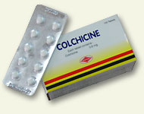
2. Colchicine

Slide 17

OVERVIEW
A plant alkaloid
Used for the treatment of acute gouty attacks and prophylaxis
Neither a uricosuric nor an analgesic agent, yet relieves pain in acute attacks of gout
Prophylactic effect which reduces the frequency of acute attacks

Slide 18
MECHANISM OF ACTIONS
Binds to tubulin > disrupt mobility of granulocytes to affected area
Inhibits the synthesis and release of the leukotrienes B₄ and interleukin-8
Decrease production of TNF-α by macrophages

Slide 19
PHARMACOKINETICS
PHAPHARMACOKINETICS
Administered orally, followed by rapid absorption from the GI tract
Reaches peak plasma levels within 2 hours
Also available combined with probenecid
Recycled in the bile and is excreted unchanged in the faeces or urine.
Use should be avoided in patients with a creatinine clearance of less than 50 mL/min.

Slide 20
THERAPEUTIC USES
The anti-inflammatory activity of colchicine is specific for gout, usually alleviating the pain of acute gout within 12 hours
Colchicine is currently used for prophylaxis of recurrent attacks and will prevent attacks in more than 80 percent of patients.
Treatment for Mediterranean Fever

Slide 21
Adverse effects
Diarrhea is a common adverse effect. May cause nausea, vomiting ,abdominal cramps.
Chronic use may cause, alopecia, bone marrow depression, peripheral neuritis, myopathy.
Also, affect fertility

Slide 22
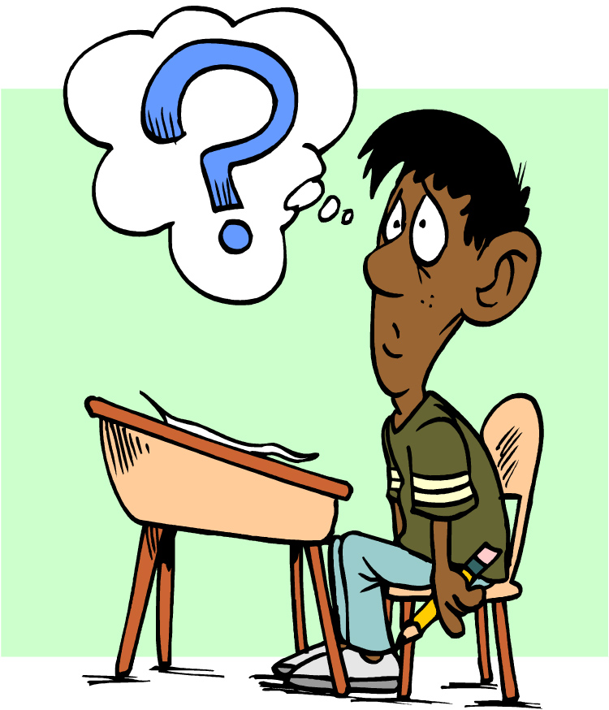
Quiz?
Colchicine is especially useful in treating an acute attack of gout because it achieves which of the following?
A. Decreases uric acid deposition
B. Is potent anti-inflammatory agent C. Impairs leukocyte migration D. Increases the solubility of uric acid
Ans: C

Slide 23
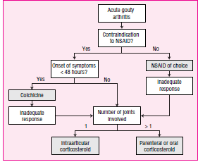

Slide 24
Prevention of recurrent attack
Inhibition of uric acid synthesis Allopurinol
Uricosuric drugs
- Probenacid
- Sulfinpyrazone

Slide 25
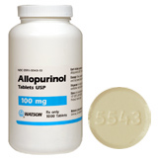
Inhibition of uric acid synthesis

Slide 26
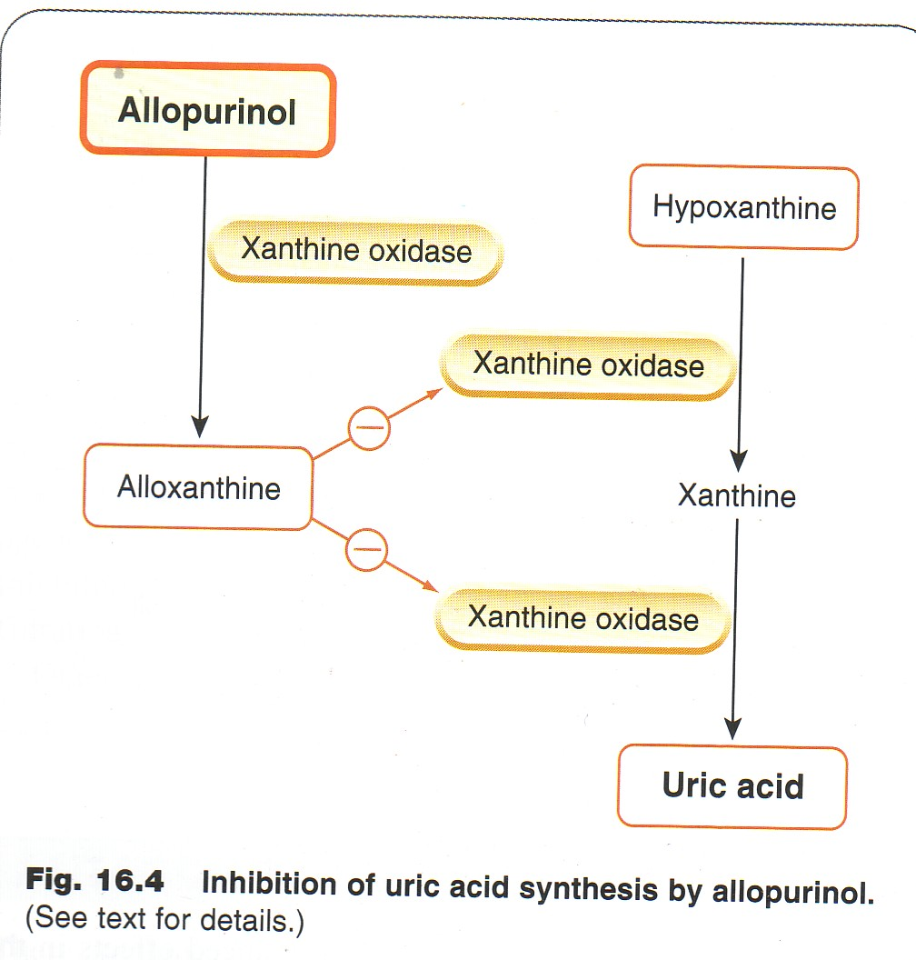

Slide 27
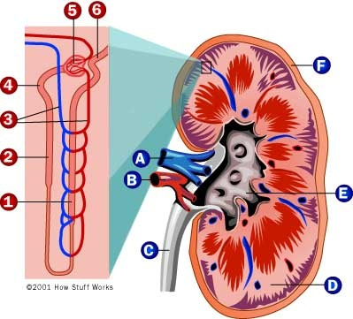
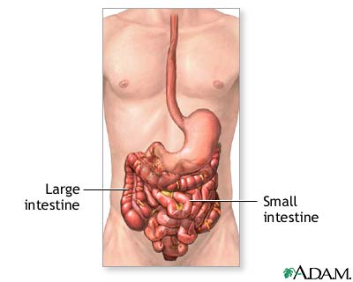
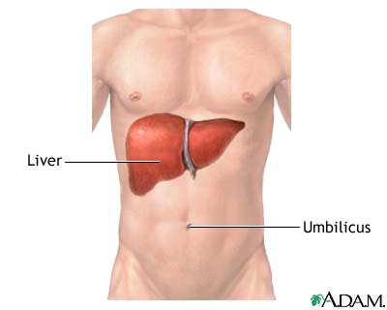
Pharmacokinetics
Notes:
Oral absorption of Allopurinol is found to be 53% ±13. Volume of distribution is found to be 0.87 l/kg and plasma protien binding is < 5%. and metabolism is reported 76%. Renal Excretion accounts for 10% and plasma half life is 1.2 hr.

Slide 28
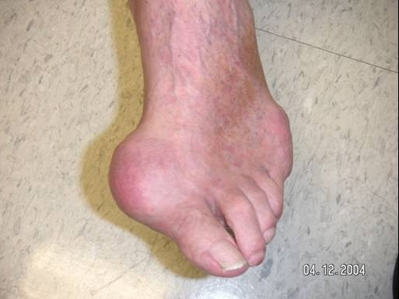
Therapeutic Uses
It is a drug of choice in patients with both gout & coronary artery disease

Slide 29
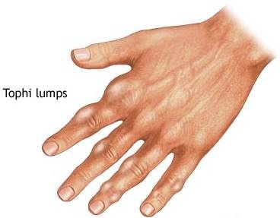

Severe tophaceous deposits (uric acid deposits in tissues)

Slide 30
High serum uric acid in patients with impaired renal functions.

Slide 31
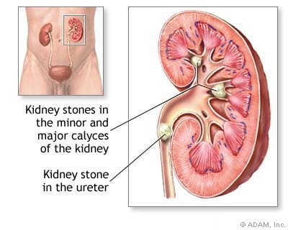
uric acid stones or nephropathy.

Slide 32

used to prevent increased uric acid levels in patients receiving cancer chemotherapy

Slide 33
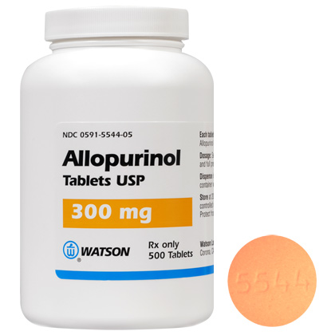
ALLOPURINOL
(SIDE EFFECTS AND
DRUG INTERACTIONS)

Slide 34
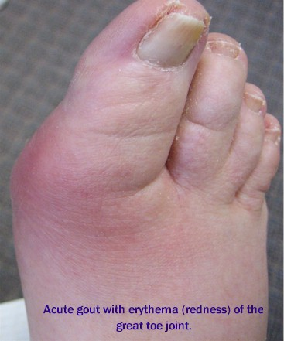
Side Effects (most common)
Prolong and exacerbation
of an acute attack of gout

Slide 35
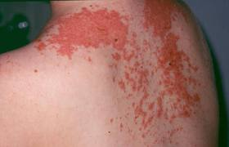
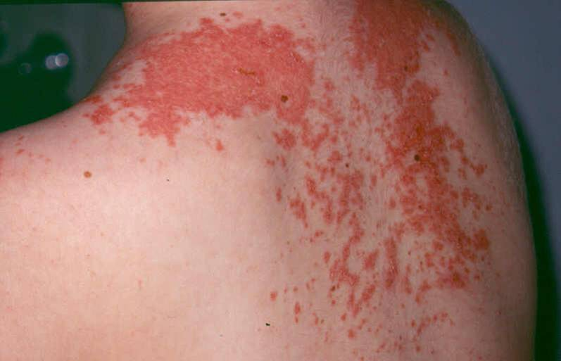
Maculopapular skin rash
Notes:
Maculopapular describes a rash that contains both macules and papules. A macule is a flat discolored area of the skin, and a papule is a small raised bump. A maculopapular rash is usually a large area that is red, and has small, confluent bumps.

Slide 36
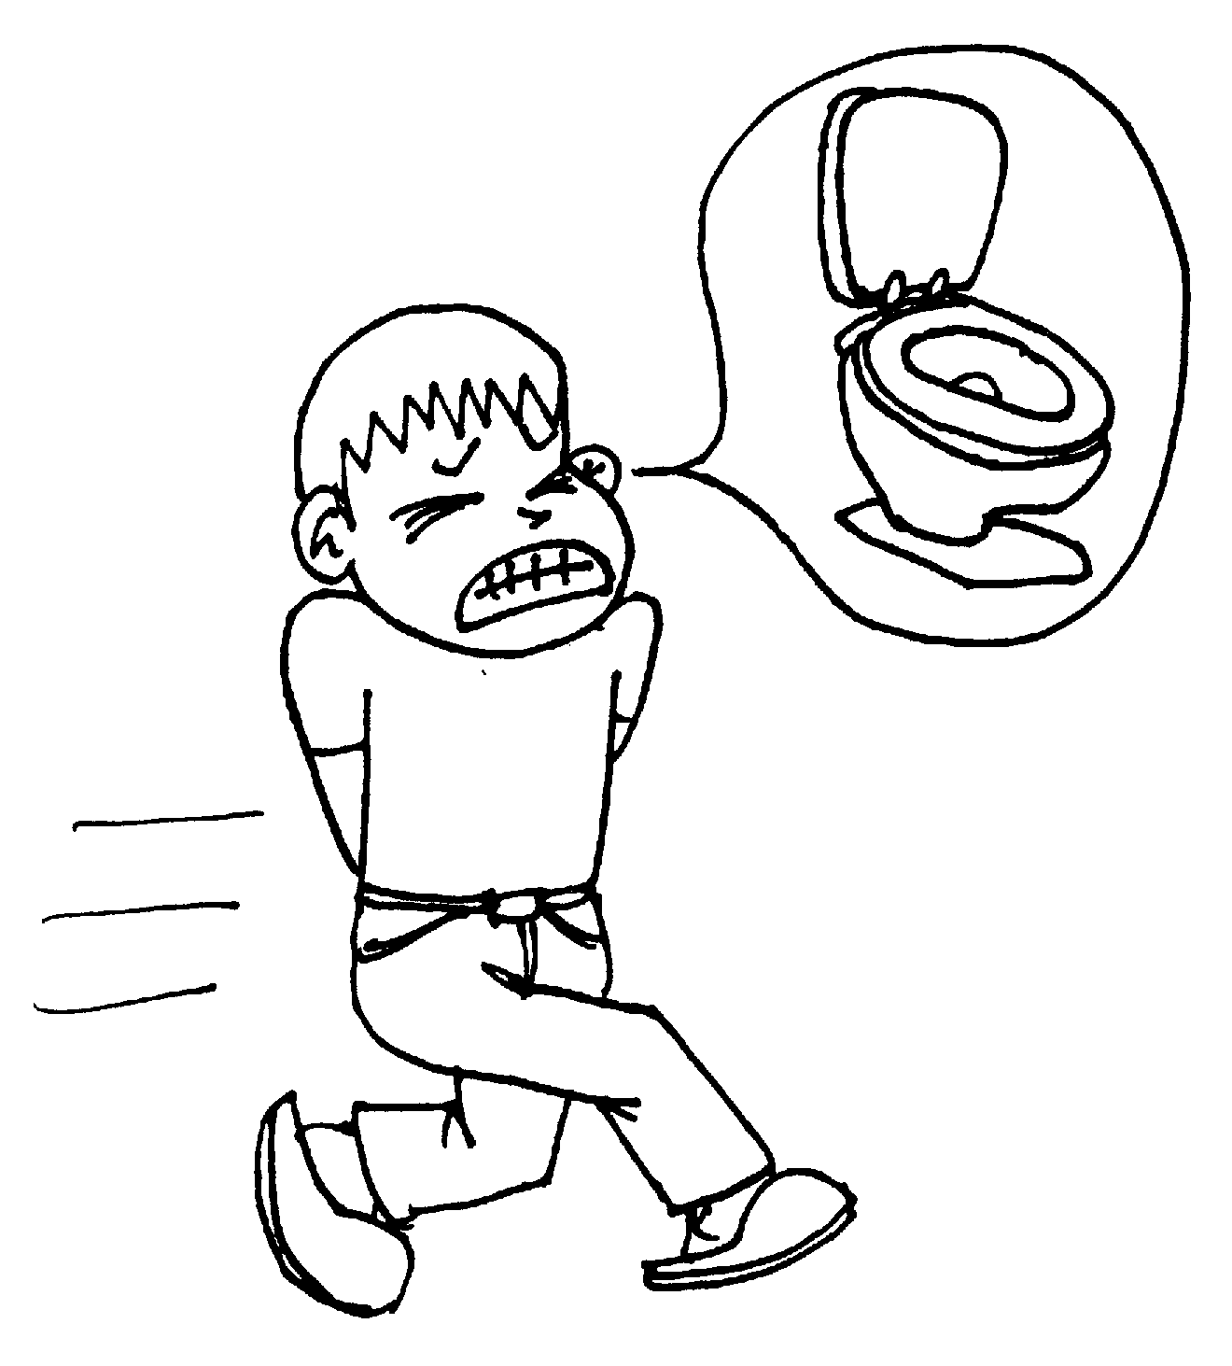
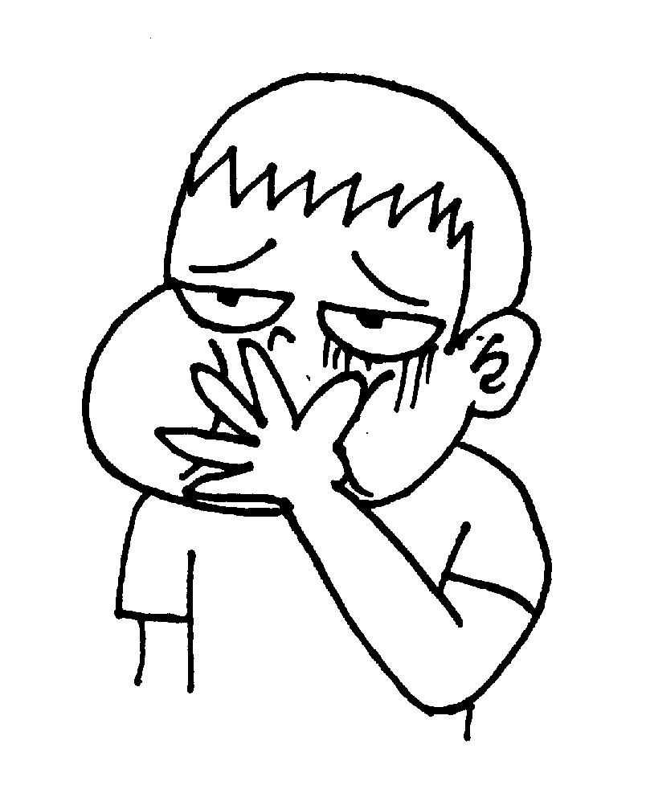
nausea, diarrhea

Slide 37
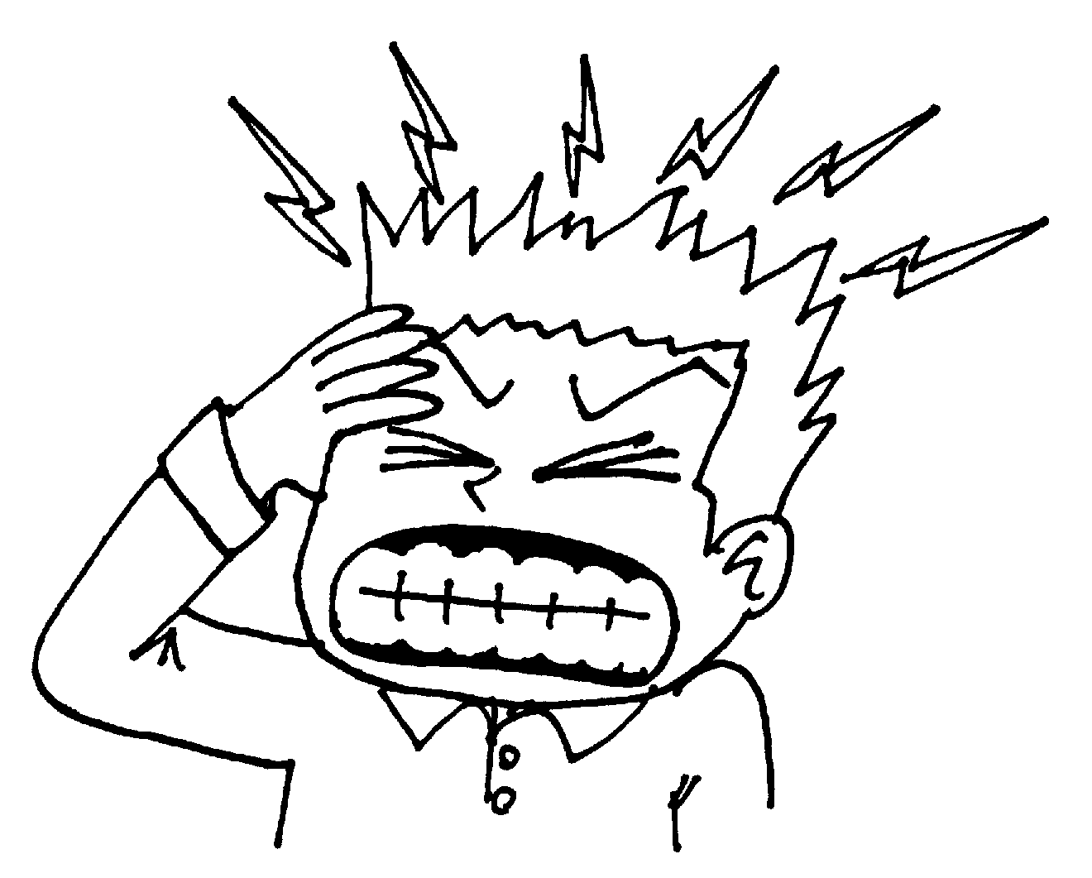
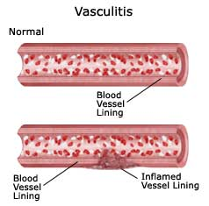
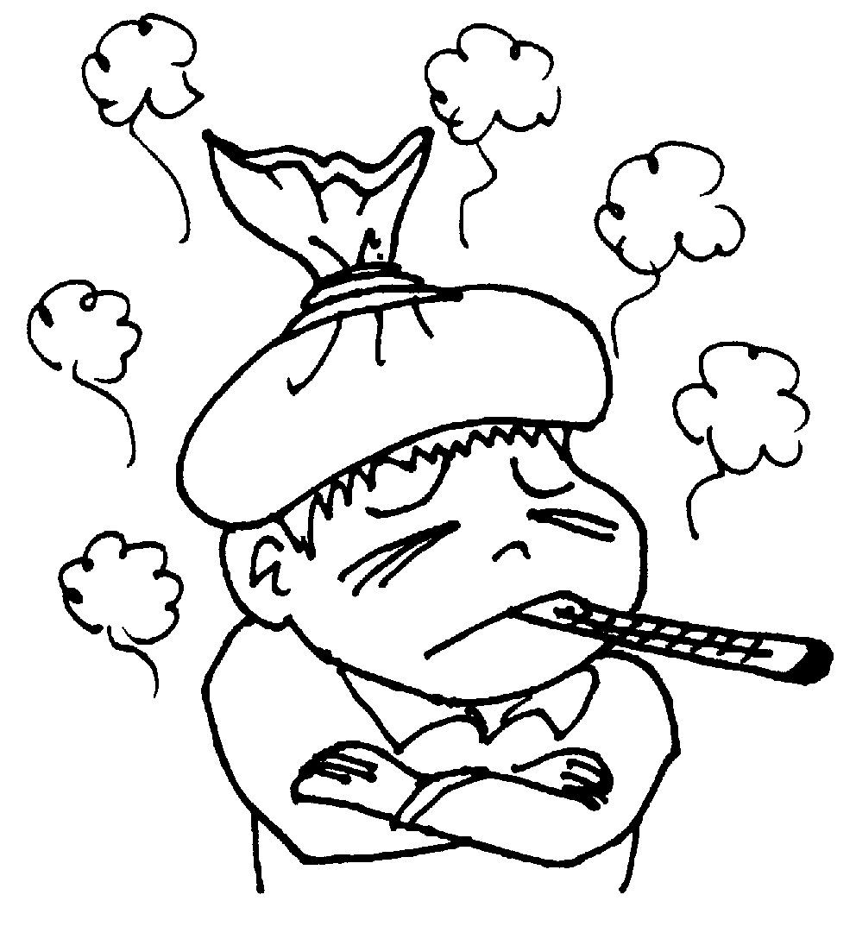
Side Effects (less common)
Body : fever, headache
CVS : vasculitis

Slide 38
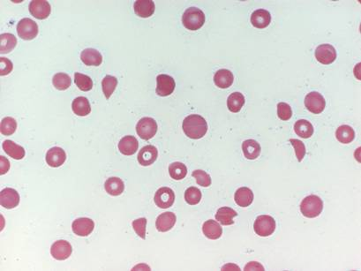
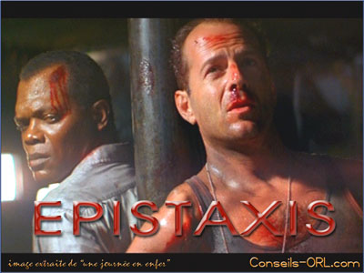

Hemic and Lymphatic:
Thrombocytopenia
Respiratory: Epistaxis

Slide 39
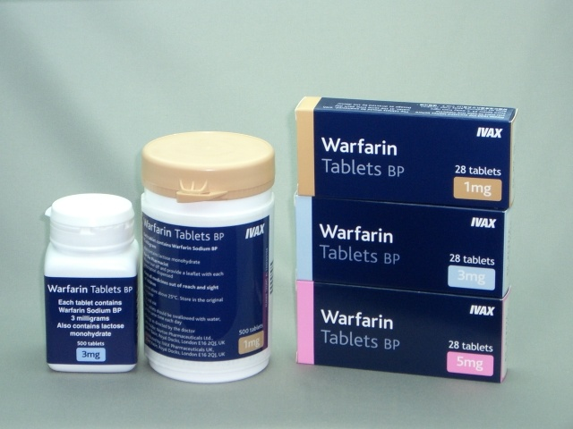
Drug Interactions
With oral anticoagulant:
warfarin
and dicumarol
inhibits their metabolism

Slide 40
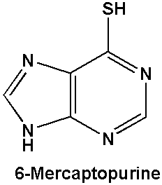
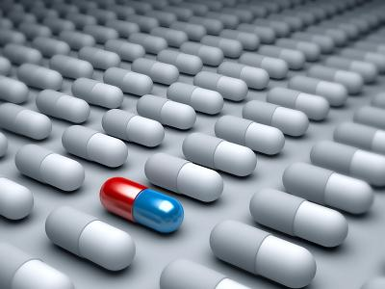
With anticancer :
Reduce the metabolism of
6-mercaptopurine
and azathioprine
Requring reduction of
Dosage up to 75%

Slide 41
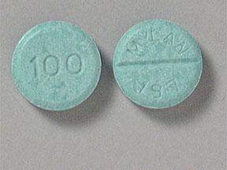
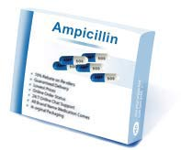
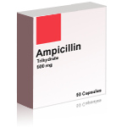
Prolongs half life of
Chlorpropamide
both compete for
excretion in
renal tubule
With ampicillin :
Increases frequency
of skin rash

Slide 42
Quiz?
Acute attacks of gouty arthritis may occur early in treatment with allopurinol because:
  A) allopurinol increases urate synthesis
  B) urate crystals move from tissue to plasma
  C) allopurinol increases release of chemotactic factors
  D) A & B
  E) A, B & C

Slide 43
Quiz?
Allopurinol is useful in treating gout because of which of the following properties?
A. It increases the catabolism of uric acid.
B. It increases the degradation of uric acid.
C. It decreases the production of uric acid.
D. It increases renal excretion of uric acid
Ans:C

Slide 44
Febuxostat
Is a new oral non-purine xanthine oxidase (XO)inhibitor.
Is structurally different from allopurinol& lacks purine ring
More selective and potent inhibitor of XO than allopurinol & has no effect on other enzymes involved in purine or pyrimidine metabolism
Well absorbed orally ( 84%)
Can be given with or without food
Given orally once daily
Metabolized in liver & excreted in in the urine & faeces

Slide 45
Continue
More effective than allopurinol in patients with impaired renal function; no dose adjustment is required in mild-to- moderate renal impairment
Used for treatment of chronic hyperuricemia in gout patients
Given to patients who do not tolerate allopurinol

Slide 46
Adverse effects
Increase number of gout attacks during the first few months of treatment
Increase level of liver enzymes
Nausea, Diarrhea
Headache
Numbness of arm or leg

Slide 47


Uricosuric drugs

Slide 48
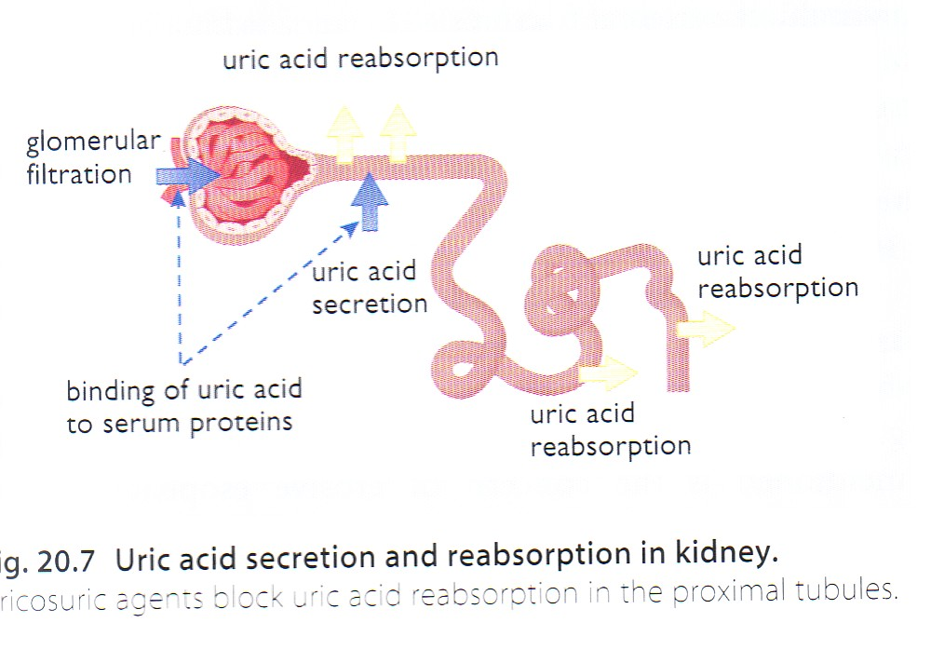

Slide 49
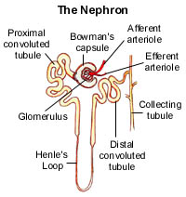
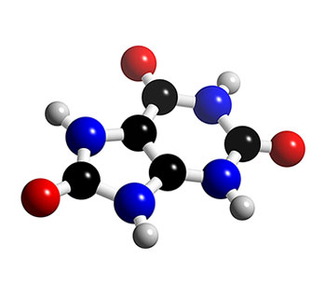
Mechanism of action
Uricosuric drugs ( probenecid, sulfinpyrazone, large dose of aspirin)
decrease the reabsorption of uric acid & increase the amount excreted

Slide 50
Clinical uses
Chronic gout (urine volume should be maintained at a high level, and urinary pH kept alkaline ).
Probenecid is used to prolong the action of some antibiotics e.g. penicillin.

Slide 51


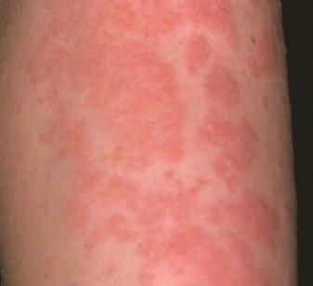
Side effects
Exacerbation of acute attack
Risk of uric acid stone
GIT upset
Allergic rash

Slide 52
Contra-indication
Previous urinary tract stone
Impaired renal function
Recent acute gout
Co-administration of low dose aspirin

Slide 53
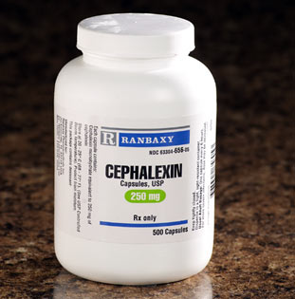
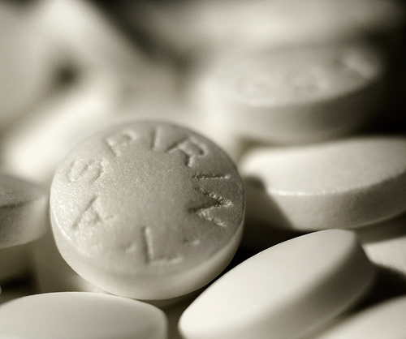
DRUG INTERACTIONS
Aspirin can prevent probenecid from being fully effective

Slide 54
DRUG INTERACTIONS:
Sulfinpyrazone can aggravate peptic ulcer disease
Aspirin products can interfere with sulfinpyrazone's effects
Sulfinpyrazone can enhance the action of certain diabetes medicines

Slide 55
Recombinant mammalian uricase
Pegloticase
Is a uric acid specific enzyme which is a recombinant modified mammalian uricase enzyme
Converts uric acid to allantoin
Given I.V.I➔ peak decline in uric acid level within 24-72 hours

Slide 56
Continue
Used for the treatment of chronic gout in adult patients refractory to conventional therapy
Adverse effects
Infusion reactions
Anaphylaxis
Gout flare
Nephrolithiasis
Arthralgia, muscle spasm
Headache

Slide 57
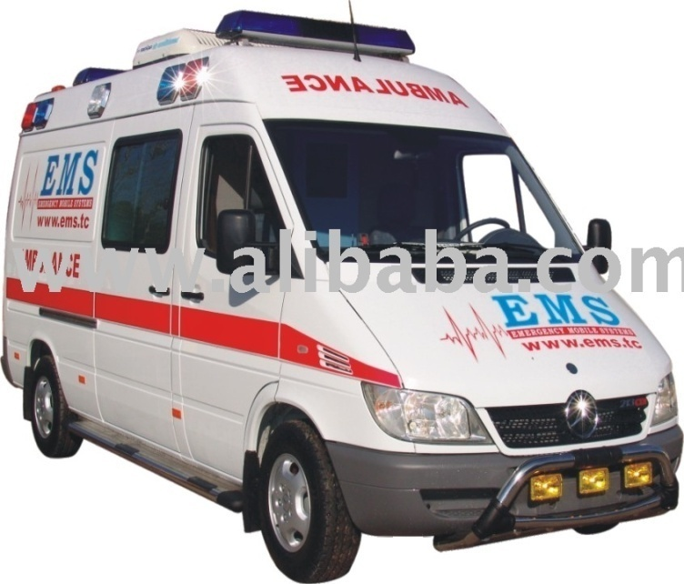
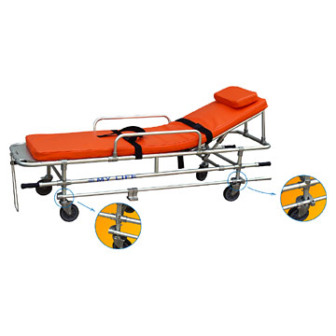
Case
A 52-year-old woman presented with intense pain, warmth, and redness in the first toe on her left foot. Examination of fluid withdrawn from the inflamed joint revealed crystals of uric acid.
Notes:
<procedure, surgery> General term for abdominal surgery

Slide 58
Q1
In the treatment of this woman's acute attack of gout, the advantage of using diclofenac instead of colchicine is that diclofenac is
(A) Less likely to cause acute renal failure
(B) Less likely to cause severe diarrhea (C) Less likely to precipitate sudden gastrointestinal bleeding
(D) More likely to prevent another acute attack
(E) More likely to reduce the symptoms of inflammation

Slide 59
Q2
Over the next 7 months, the patient had two more attacks of acute gout. Her serum concentration of uric acid was elevated. The decision was made to put her on chronic drug therapy to try to prevent subsequent attacks. Which of the following drugs could be used to decrease this woman's rate of production of uric acid?
(A) Allopurinol
(B) Aspirin
(C) Colchicine
D) Hydroxychloroquine
(E) Probenecid

Slide 60
SUMMARY
Gout is a form of arthritis that is characterized by sudden , severe attacks of pain, redness and tenderness.
Gout is caused by deposits of uric acid crystals in a joint
Uric acid is a waste product formed from the breakdown of purines.

Slide 61
SUMMARY ( continue)
Treatment of gout includes :
Treatment of acute attacks
Prevention of future attacks
Treatment of chronic gout

Slide 62
SUMMARY (continue)
Drugs used for acute attacks includes :
NSAIDs ( selective or non-selective)
Colchicine interfere with the migration of granulocytes to the site of inflammation & reduce the release and synthesis of leukotriens
Main adverse effects includes :

Slide 63
SUMMARY ( continue)
Diarrhea
Skin rash
Kidney, liver & CNS injury
Drugs used for chronic treatment includes :
Uricosuric drugs that increase urinary excretion of uric acid

Slide 64
SUMMARY ( continue)
Probenecid & sulfinpyrazone
Their main adverse effects includes :
Gastrointestinal problems
Skin rashes
Leukopenia
Anti-hyperuricemic drugs that reduce the production of uric acid

Slide 65
SUMMARY ( continue)
Allopurinol is an oxidase inhibitor
Used in patients with elevated blood uric acid level
Or in patients with tendency for renal stone formation
Its main adverse effects includes :
Gastric problems

Slide 66
SUMMARY ( continue)
Skin rashes
Leukopenia
Thrombocytopenia
Allopurinol reduces the metabolism of some drugs including azathioprime , this needs reduction of the doses of these drugs up to 75%

