Slide 1
Jugular Venous Pulse and Carotid Arterial Pulse

Slide 2
Objectives
What are the Jugular venous pulse ( JVP) and Carotid arterial pulse ( CAP) ?
The JVP and CAP normal recording
The JVP and CAP correlation to ECG and heart sounds
Difference between JVP and CAP
Abnormalities and clinical importance

Slide 3
Jugular Venous Pulse
The JVP provides an indirect measure of central venous pressure.
The internal jugular vein connects to the right atrium without any intervening valves - thus acting as a column for the blood in the right atrium.
The JVP consists of certain waveforms and abnormalities of these can help diagnose certain conditions.

Slide 5
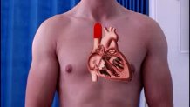
JVP

Slide 6
How to examine?
Use the right internal jugular vein (IJV).
Patient should be at a 45° angle.
Head turned slightly to the left.
Locate the surface markings of the IJV
Locate the JVP - look for the double waveform pulsation (palpating the contralateral carotid pulse will help).
Measure the level of the JVP
Apply the transducer over the carotid artery and connect to recorder.

Slide 7
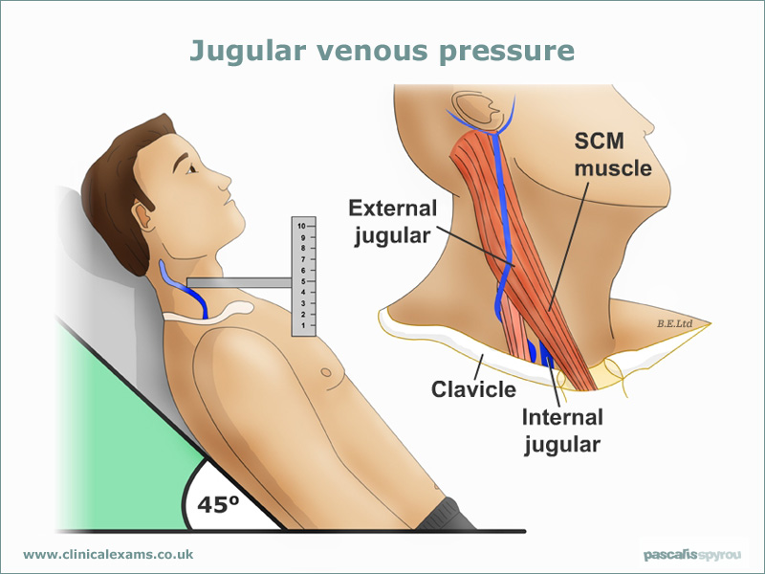
JVP up to 4 cm is normal

Slide 8
JVP tracing

Slide 9
JVP tracing and Cardiac Cycle

Slide 10
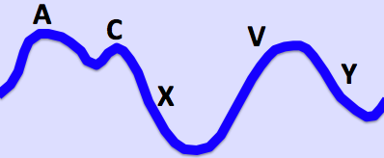
JVP
Wave a : atrial contraction
Wave c: bulging of closed tricuspid into the right atrium during isovolumetric systole
Wave x: the tricuspid valve moves downward
Wave v: venous filling
Wave y: atrial emptying

Slide 11
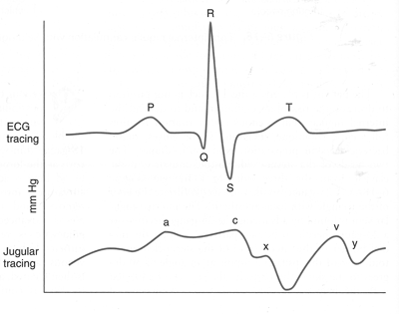
JVP and ECG

Slide 12
JVP, ECG and heart sounds

Slide 13
Some tips…..
In a normal person: the a wave is larger than v wave and x descent is more prominent than y descent
a wave occurs just before S1 or carotid pulse and has a sharp rise and fall
v wave occurs just after arterial pulse and has a slow undulating pattern
x descent occurs between S1 and S2 and y descent will be after S2

Slide 14
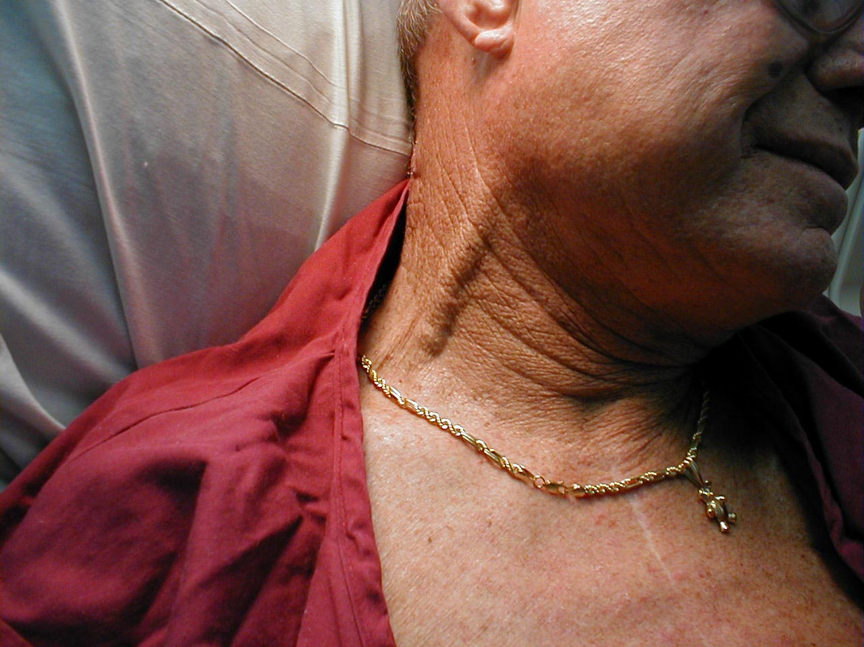
Abnormal JVP
Causes of a raised JVP:
Heart failure
Constrictive pericarditis
Cardiac tamponade
Fluid overload
e.g. renal disease

Slide 15
Prominent a wave
Right heart failure
Tricuspid stenosis
Pulmonary stenosis
Pulmonary hypertension

Slide 16
Cannon a wave
Atrial flutter
Third degree heart block
Ventricular tachycardia

Slide 17
Absent a wave
Atriall fibrillation

Slide 18
Large v wave
Tricuspid regurge

Slide 20
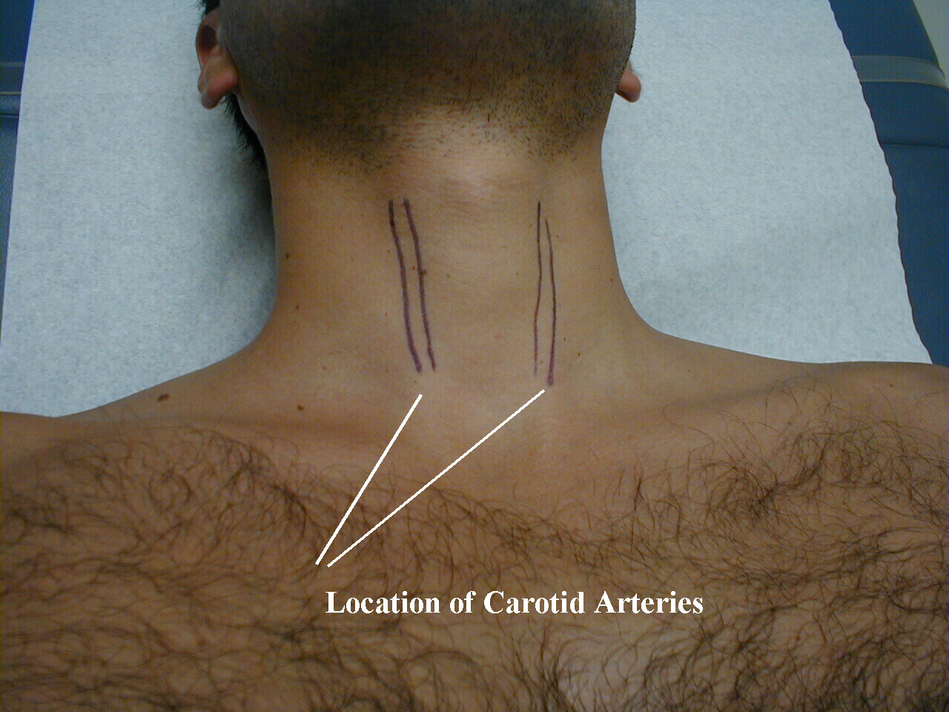
Carotid arterial pulse
Is the heart beat that can felt over the carotid artery.

Slide 21
How to examine
The patient lie supine and the trunk of the patient's body slightly elevated
The fingers should be positioned between the larynx and the anterior border of the sternocleidomastoid muscle at the level of the cricoid cartilage
In palpating the pulse, the degree of pressure applied to the artery should be varied until the maximum pulsation is appreciated.
Apply the transducer over the carotid artery and connect to recorder.

Slide 22
Cont.
Palpation of the carotid artery normally detects a smooth, fairly rapid outward movement beginning shortly after the first heart sound and cardiac apical impulse
The pulse peaks about one-third of the way through systole
This peak is sustained momentarily and is followed by a downstroke that is somewhat less rapid than the upstroke

Slide 23
CAP features
Anacrrotic limb: maximum ejection phase of systole
Dicrotic notch: closure of aortic valve
Dicrotic limb: ventricular diastole

Slide 24
CAP Recording

Slide 25
CAP and JVP with ECG and heart sounds

Slide 27
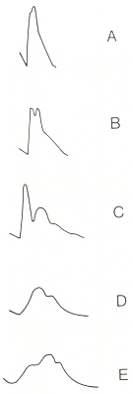
Abnormal carotid pulse
A: hyperkinetic pulse
B: bifid pulse
C: bifid pulse characteristic of IHSS
D: hypokinetic pulse
E: pulsus parvus et tardus
( aortic stenosis)

Slide 28
JVP vs. CAP
The JVP pulse is
Not palpable
Obliterated by pressure
Characterised by a double waveform
Varies with respiration - decreases with inspiration
Hepato- jugular reflex

Slide 29
Thank you

