Slide 1
PELVIS & SACRUM
Dr. Jamila El-Medany
Dr. Essam Eldin Salama

Slide 2
Learning Objectives
At the end of the lecture, the students should be able to :
Describe the bony structures of the pelvis.
Describe in detail the hip bone, the sacrum, and the coccyx.
Describe the boundaries of the pelvic inlet and outlet.
Identify the structures forming the pelvic walls.
Identify the articulations of the bony pelvis.
List the major differences between the male and female pelvis.
List the different types of female pelvis.

Slide 3
BONY PELVIS
Pelvis is the region of the trunk that lies below the abdomen. Bony pelvis is the bowl shaped bony structure that forms the skeleton of this region of body.
Structure:
Pelvis can be regarded as a basin with holes in its walls. The structure of the basin is composed of four bones which are joined by four joints. The bones are:
Two Hip Bones: These form the lateral and anterior walls of the bony pelvis.
Sacrum: It forms most of the posterior wall.
Coccyx: It is a small bone that forms the lower part of posterior wall

Slide 4
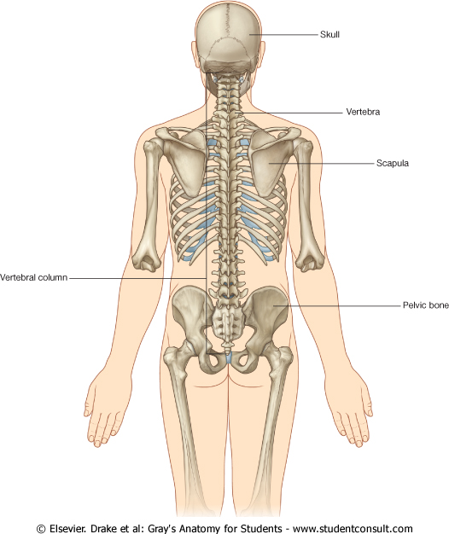
Functions
The skeleton of the pelvis is a basin-shaped ring of bones connecting the vertebral column to the femora.
Its primary functions are to bear the weight of the upper body when sitting and standing; transfer that weight from the axial skeleton to the lower appendicular skeleton when standing and walking; and provide attachments for and withstand the forces of the powerful muscles of locomotion and posture. Compared to the shoulder girdle, the pelvic girdle is thus strong and heavy.
Its secondary functions are to contain and protect the pelvic and abdominopelvic viscera (inferior parts of the urinary tracts, internal reproductive organs); provide attachment for external reproductive organs and associated muscles and membranes.

Slide 5
Pelvic Girdle
It is composed of Two Hip (Coxal) Bones
Each one is a large irregular bone.
Composed of three boness:
Ilium
Ischium
Pubis.
They are joined at the deep socket (Acetabulum)
During childhood, these sections are separate bones.
During puberty, they fuse together to form a single bone.
1.Sacrum 2. Ilium 3. Ischium 4. Pubic bone 5. Pubic symphysis 6. Acetabulum 7. Obturator foramen 8. Coccyx Red line: Terminal line/pelvic brim

Slide 6
Ilium
It is the Upper Flattened Part of the hip bone.
It Possesses:
Iliac Crest: it is an important anatomical landmark below the waist.
It runs between the Anterior and Posterior Superior Iliac Spines.
Below are the corresponding Anterior and Posterior Inferior Iliac Spines.
The Outer Surface:
rough and has three Gluteal Lines.

Slide 7
The Inner surface shows:
Iliac Fossa (forms false pelvis)
Aauricular surface( for articulation with the sacrum).
Iliopectinial (Arcuate) Line:
runs Downwards &
Forwards, it separates between the False & the True pelvis .

Slide 8
Pubis
Forms the Anterior & inferior part.
Has :
Body; bears the Pubic Crest and Pubic Tubercle.
Two pubic Rami:
Superior & Inferior.
They bound the Obturator Foramen, it is closed partially by the obturator membrane.

Slide 9
Ischium
Forms the Inferior and Posterior part.
It has:
Ischial Tuberosity:
It is a roughened area that receives body weight in sitting.
Ischial Spine:
Superior to the tuberosity, it is important especially in pregnant women.
Greater sciatic notch:
Lesser sciatic notch:

Slide 10
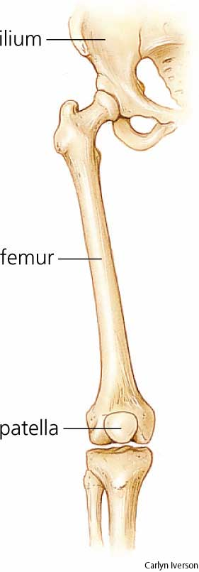
Articulations of Hip Bone
Symphysis Pubis:
A secondary Cartilagenous joint between the two pubic bones
(2) Sacroiliac Joints
Strong synovial joints, between the auricular surfaces of ilium and sacrum.
(2) Hip Joints:
The acetabulum articulates with the head of the femur.

Slide 11
Sacrum
A Single Wedge shaped bone (consists of Five rudimentary vertebrae fused together)
Sacral Promontory:
The anterior and upper margin
It is tilted forward forming the lumbosacral angle.
The anterior and posterior surfaces possess on each side (4 ) Sacral Foramina.
The fused vertebral foramina form the Sacral Canal.
Its lower limit is the Sacral Hiatus .

Slide 12
Coccyx
Consists of (4) vertebrae fused together forming a single Triangular piece

Slide 13
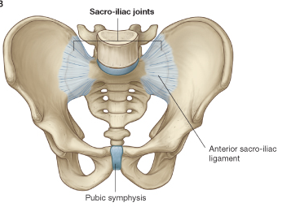
Articulations of Sacrum
Lumbsacral joint:
The upper border articulates with the 5th Lumber vertebra
Sacrococcygeal joint:
The inferior part articulates with the Coccyx
Sacroiliac joints:
Lateral with the Hip bones.

Slide 14
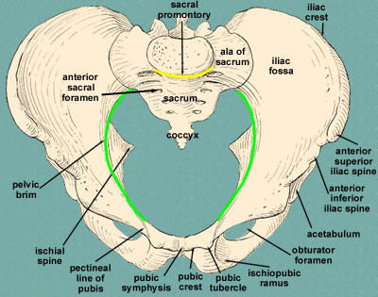
Foramina in bony pelvis
The holes of the basin are called foramina. The Important foramina in the bony pelvis include:
Anterior sacral foramina: These are present on the anterior surface of the sacrum (which forms the posterior surface of the bony pelvis). Through these foramina pass the anterior rami of the sacral spinal nerves.
Greater and lesser sciatic foramina: These are the major foramina of the pelvis. In the bony pelvis, they are present as greater and lesser sciatic notches but by the attachment of sacrotuberous and sacrospinous ligaments, these notches are converted to respective foramina. From these foramina various structures enter and leave the pelvis.
Obturator foramen: Each lateral wall of the pelvis has a large hole, called the obturator foramen. In living subjects, this hole is closed by the obturator membrane except for a small opening, which represents the foramen.
Obturator nerve passes through this small opening.

Slide 15
Fractures of the Bony Pelvis
The weakest parts of the bony pelvis are:
Pubic rami.
Acetabula.
Region of sacroiliac joint.
Alae of the ilium.
Pelvic Fractures can result from direct trauma to the pelvic bones as occurs in car accidents or by forces transmitted to these bones from the lower limbs during falls on the feet.
Pelvic fractures may cause injury to the pelvic soft tissues, blood vessels, nerves and organs.

Slide 16
Subdivision of the Bony Pelvis
The bony pelvis is divided into two parts by the Pelvic Brim.
The brim is formed posteriorly by the sacral promontory, laterally by the iliopectineal line and anteriorly by the symphysis pubis.
Above the pelvic brim lies the false pelvis, which is not of much clinical importance.
Below the brim is the true pelvis

Slide 17
False pelvis
Lies superior to the pelvic brim.
Enclosed by the Fossae of the iliac bones
Forms the inferior region of the abdominal cavity.
Houses the Inferior abdominal organs

Slide 18
True Pelvis
Lies inferior to the pelvic brim.
Encloses the pelvic cavity.
Contains the pelvic organs.
It has :
Inlet
Outlet.
Pelvic walls

Slide 19
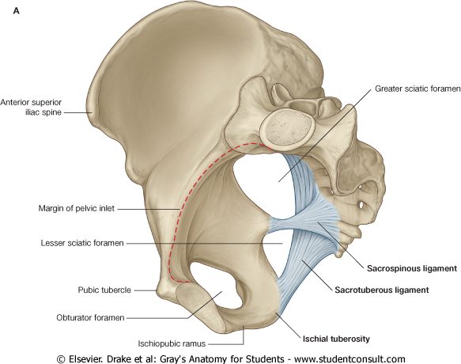
Pelvic Inlet (pelvic Brim)
Bounded by:
Sacral promontory
Iliopectineal lines.
Symphysis pubis.

Slide 20
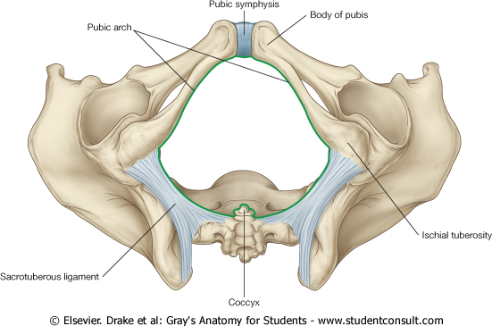
Pelvic Outlet
Bounded by:
Coccyx
Ischial tuberosities.
Pubic arches.

Slide 21
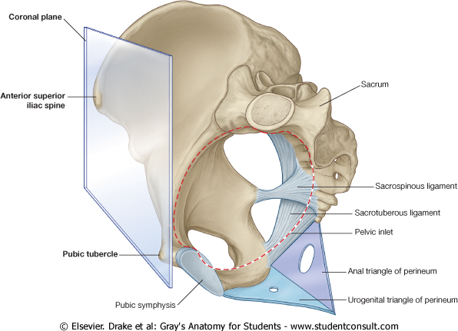
Orientation of the Pelvis
It is the Correct Position of the bony pelvis relative to the trunk (in the anatomical position (it fulfills the following)
1.The anterior-superior iliac spines and the pubic tubercles are in the same vertical plane.
2. The coccyx is in the same horizontal plane as the upper margin of the pubic symphysis.
3. The axis of the pelvic cavity running through the central points of the inlet and the outlet almost parallels to the curvature of the sacrum. In this position:
The anterior surface of the Sacrum is directed downward & forward .
The pelvic surface of symphysis pubis faces is directed upward and backward.

Slide 22
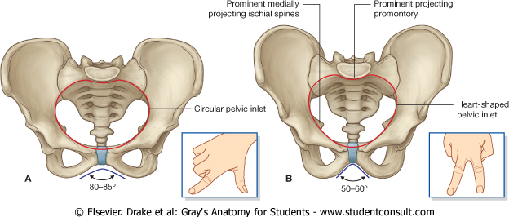
Bony pelvis | Male | Female
General structure | Thick & heavy | Thin, Smaller & lighter
False (major) pelvis | Deep | Shallow
True (lesser) pelvis | Narrow & Deep | Wide & Shallow
Pelvic inlet | Heart shaped | Oval or Rounded
Pelvic outlet | Small | larger because of the everted ischial tuberosities
Pubic arch & subpubic angle | Narrow | Wide
Obturator foramen | Round | Oval
acetabulum | Large | Small

Slide 23
Sacrum
F
Length | Longer | Shorter
Breadth | Narrower | Wider
Curvature | More curved | Less Curved
M

Slide 24
Forensic Medicine & BonyPelvis
Female
Male
For identification of human skeletal remains, the bony pelvis is of prime focus of attention because sexual differences are clearly visible.
Even parts of the pelvis are useful in making a diagnosis of sex.
Pelvic Inlet
Pelvic Outlet
Pelvic Cavity
Pubic Arch

Slide 25
Types of Obstetrical Female Pelvis
(1) Gynaecoid:
the common normal female type
(2) Anthropoid.
(3) Android : common in males.
(if found in a woman it causes hazards to normal vaginal delivery)
(4) Platypelloid: uncommon in both sexes
(2)
(3)
(1)
(4)

Slide 26
Thank you

