Slide 1
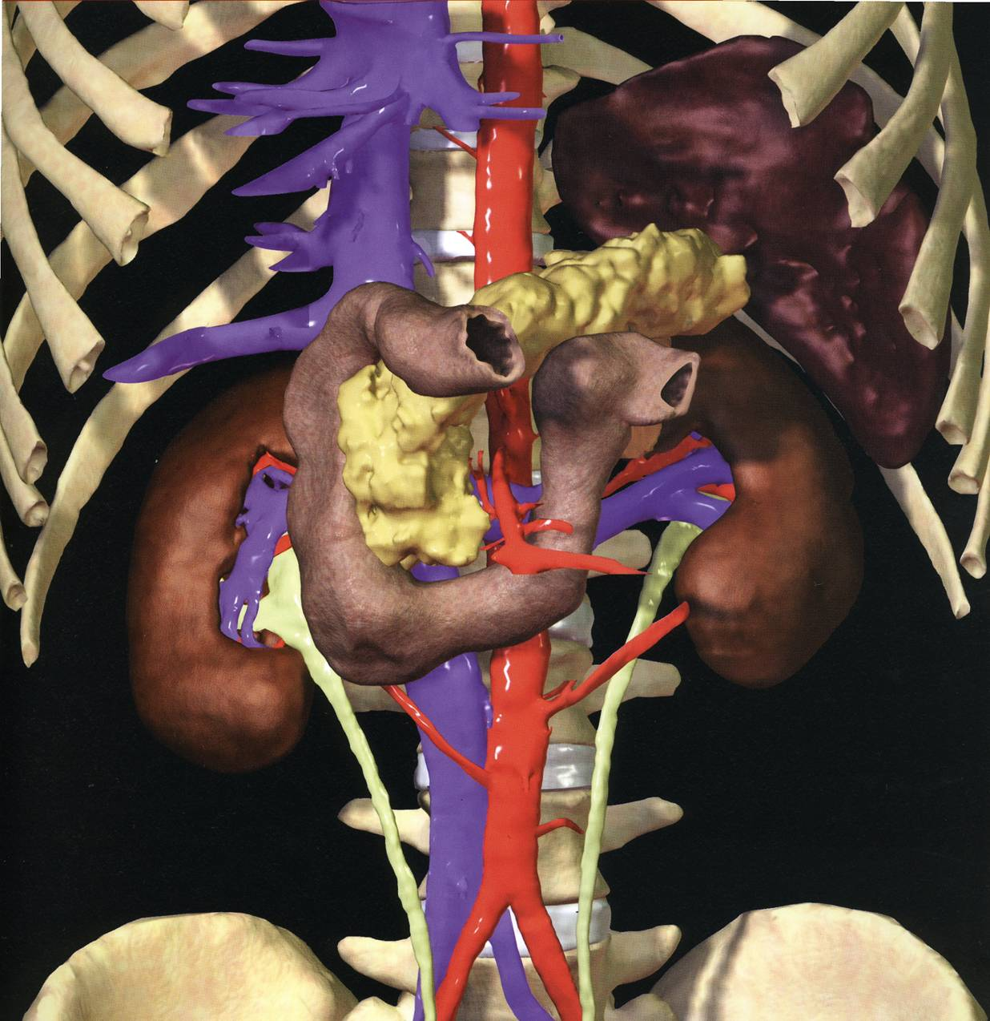
PANCREAS
Dr Jamila Elmedany & Dr Saeed Vohra

Slide 2
OBJECTIVES
By the end of this lecture the student should be able to:
Describe the anatomical view of the pancreas regarding ; location, parts relations, ducts
Arterial supply & Venous drainage
Describe the nerve supply and lymph drainage

Slide 3
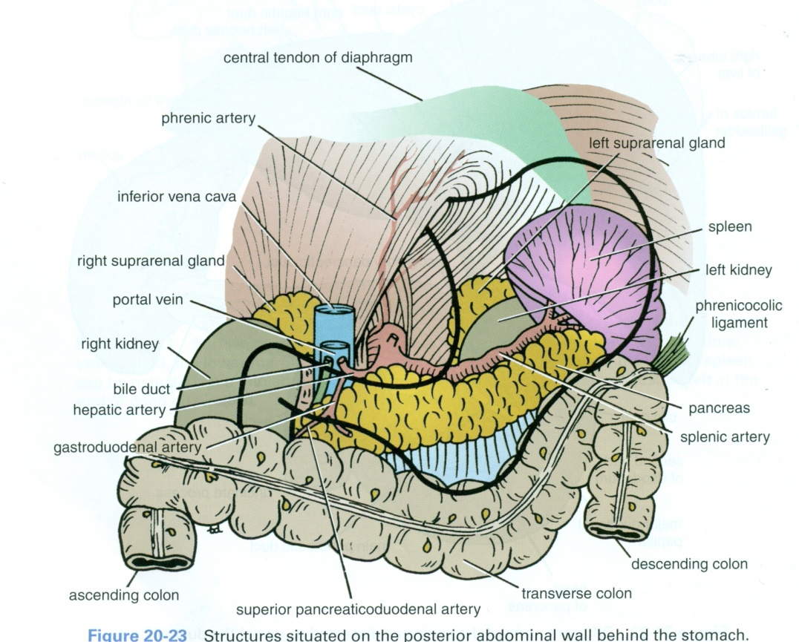
PANCREAS
It is an elongated soft pinkish structure
(60-100) gram in weight & (6-10) inch in length
It is Lobulated?
Because it is surrounded by a fibrous tissue capsule from which septa pass into the gland and divide it into lobes.
The lobes are divided into lobules.

Slide 4
LOCATION
It is a Retro-Peritoneal structure.
It lies on the posterior abdominal wall in the: Epigastrium & Left upper quadrant of the abdomen.
It extends in a transverse oblique direction at the transpyloric plane (1st lumbar vertebral) from the concavity of the duodenum on the right to the spleen on the left.

Slide 5
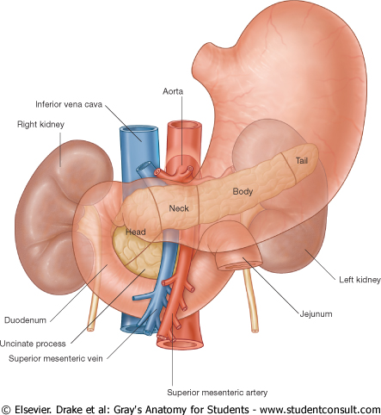
PARTS
It is divided into:
Head, Neck, Body and Tail.
Because of its oblique direction the tail is higher than the head.

Slide 6
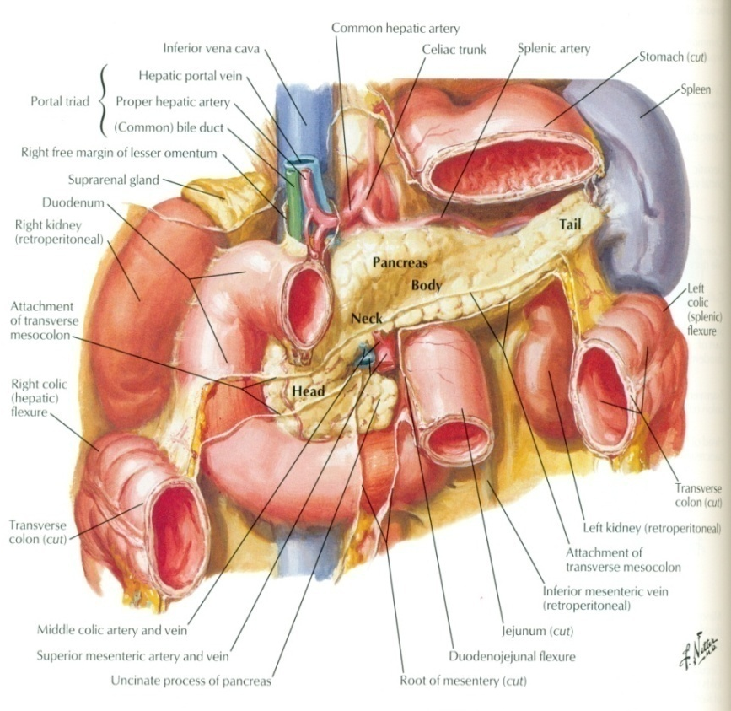
Head of Pancreas
It is disc shaped
Lies within the concavity of the duodenum
Related to the 2nd and 3rd portions of the duodenum.
On the right, it emerges into the neck.
On the left, it Includes Uncinate Process ( an extension of the lower part of the head behind the superior mesenteric vessels)

Slide 7
Structures Posterior to the Head:
(1) Bile Duct runs downwards and may be embedded in it.?
(2) IVC runs upwards.

Slide 8
Neck of Pancreas
It is the constricted portion connecting the head & body of pancreas
It lies in front of:
Aorta
Origin of Superior Mesenteric artery
the confluence of the Portal Vein
Its antero-superior surface supports the pylorus of the stomach
The superior mesenteric vessels emerge from its inferior border

Slide 9
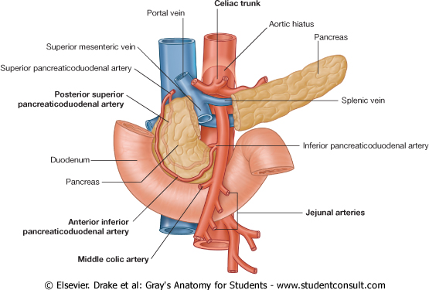
Body of Pancreas
It runs upward and to the left.
It is triangular in cross section.
The Splenic Vein is embedded in its post. Surface
The Splenic Artery runs to the left along the upper border of the pancreas.

Slide 10
Tail of Pancreas
A narrow, short segment
lies at the level of the 12th thoracic vertebra
Ends within the splenic hilum
Lies in the Splenicorenal ligament
Anteriorly, related to: splenic flexure of colon
May be injured during Splenectomy

Slide 11
RELATIONS OF PANCREAS
Anterior to (body & tail):
Stomach separated from by lesser sac
Transverse colon &
transverse mesocolon

Slide 12
Posterior to (body & tail) :
Left Psoas muscle
Left Adrenal gland
Left Renal vessels
Upper 1/3rd of Left kidney
Hilum of the spleen.

Slide 13
FUNCTIONS
Exocrine and Endocrine
The Exocrine portion:
Small ducts arise from the lobules and enter the main pancreatic duct (it begins in the tail), and passes through the body and head where it meets the bile duct.
The Endocrine portion: (Islets of Langerhans) produce insulin & glucagon.

Slide 14
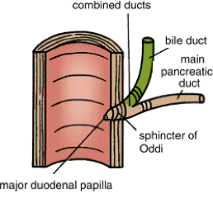
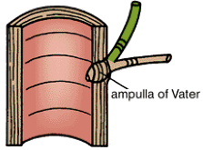
Pancreatic DUCTS
Main P duct :
Joins common bile duct & they open into a small hepatopancreatic ampulla in the duodenal wall (Ampulla of Vater).
The ampulla opens into the lumen of the duodenum through (Major Duodenal Papilla).

Slide 15
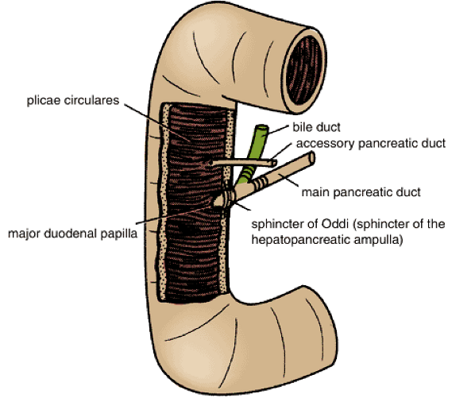
Accessory P duct
(of Santorini)
Drains superior portion of the head
It empties separately into 2nd portion of duodenum at (minor duodenal papilla)

Slide 16
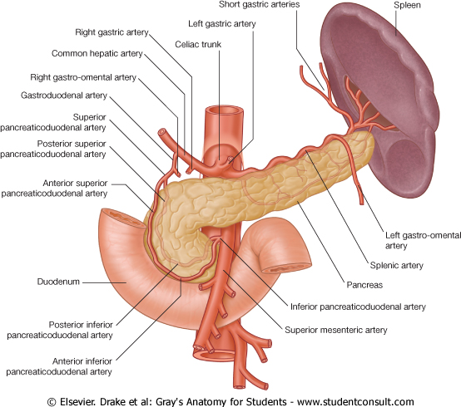
ARTERIAL SUPPLY
Celiac trunk, Superior mesenteric & Splenic arteries
Celiac T → CHA
Gastroduodenal
Superior pancreaticoduodenal
SMA → Inferior pancreaticoduodenal
TO HEAD
Splenic A supplies the Body and Tail of pancreas by about 10 branches
R gastric
Hepatic

Slide 17
VENOUS DRAINAGE
Anterior and posterior arcades drain head and the body
Splenic vein drains the body and tail
Ultimately, end into Portal Vein

Slide 18
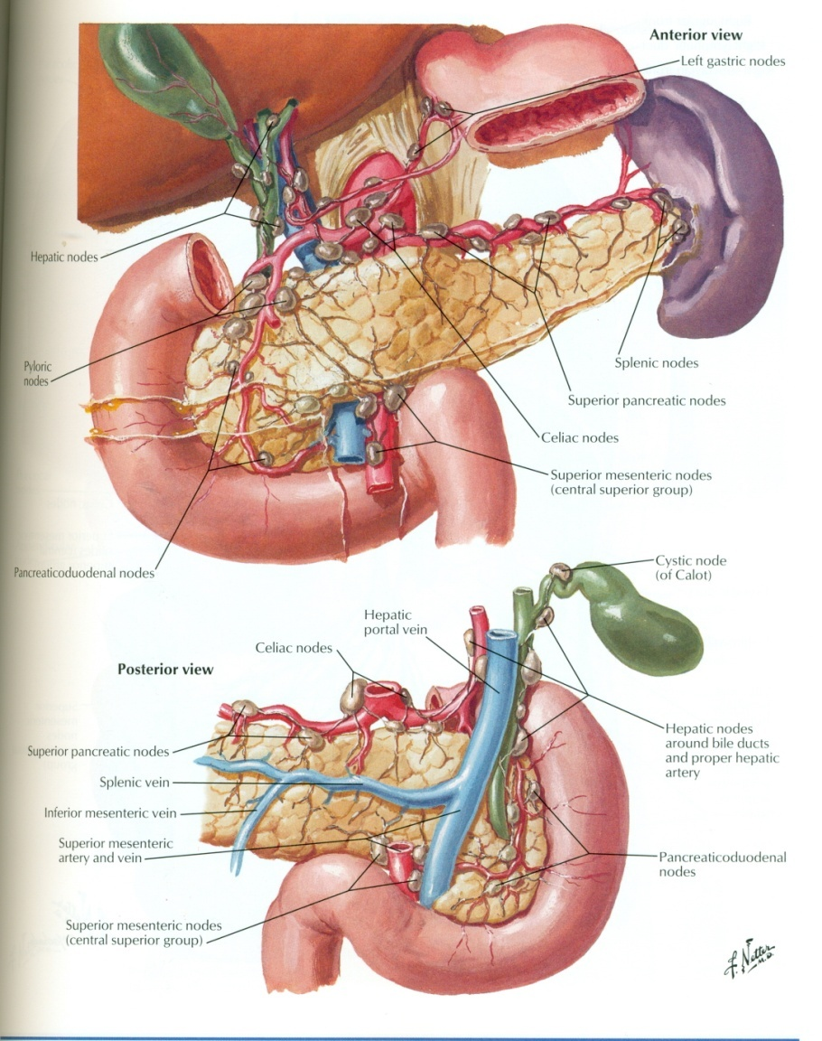
LYMPHATIC DRAINAGE
Rich network drains into nodes along the upper border of the pancreas
Ultimately the efferent vessels drain into the Celiac nodes.
Lymph vessels from the region of the Head pass to
Superior Mesenteric nodes
(Important ?)

Slide 19
NERVE SUPPLY
Sympathetic from the splanchnic nerves , they have a predominantly inhibitory effect
Parasympathetic from the Vagus,
they stimulate both exocrine and endocrine secretions

Slide 20
THANK YOU

