Slide 1
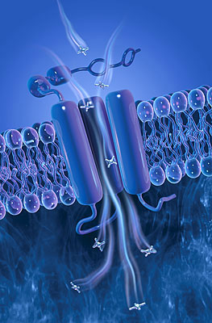
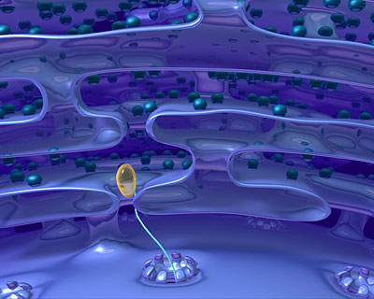
ANTICANCER THERAPY
PART III
ILOs
Encompass how some hormones and antihormones are utilized as anticancer therapy
Identify concept of immunomodulation as an anticancer treatment modality
Justify how biological therapy can halt etiopathogenic cascades in tumor progression and metastasis

Slide 2
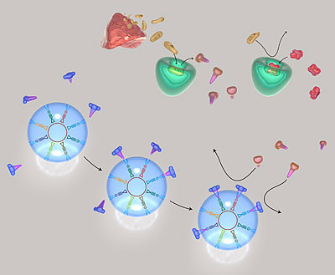
TREATMENT MODALITIES
Surgery
Radiotherapy
Chemotherapy
Hormonal therapy
Immunotherapy
Biological therapy


ANTINEOPLASTIC AGENTS
2. HORMONAL THERAPY
The rational of hormonal therapy for certain carcinomas depend on the fact that some are:
1. HORMONE RESPONSIVE, where the tumor regresses following treatment with a specific HORMONE.; corticosteroids lymphoma
2. HORMONE-DEPENDENT, where removal of a hormonal stimulus causes tumor regression i.e regression is induced by ANTI-HORMONE Progestogens  endometrial cancer , SERM/SERD  estrogen +ve breast cancer in females, GnRH analogues  prostatic cancer in males

Slide 3
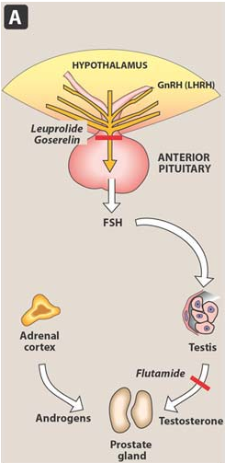
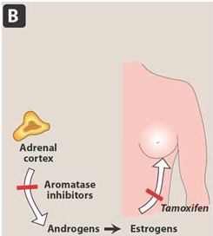
Glucocorticoids
Prednisone
HORMONAL THERAPY
In ALL & lymphomas
Gn RH Agonist
Leuprolide
PROGESTOGENS
Megestrol
Endometrial cancer
Anti-Estrogens
Postmenopusal
Estrogen+ve BC
Aromatase Is
Anastrazole
Premenopusal
Metastiatic BC
SERMS / SERDS
Tamoxifen / Fulvestrant
Anti-Androgen
Flutamide
Prostate cancer

Slide 4
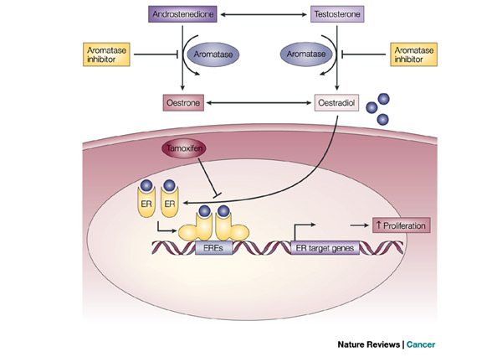
TAMOXIFEN
HORMONAL THERAPY
Binds to estrogen receptors & functions as a competitive partial agonist / antagonist
The response varies being > agonistic or antagonistic depending on the tissue, however in cancer tissue that is sensitive to estrogen in breast or endometrium it exert > antagonistic action
Tamoxifen

Slide 5
Uses
As anticancer in
TAMOXIFEN
Estrogen-dependent breast cancer.(Post-menopausal) as adjuvant to other modalities , in metastatic stages or even as chemopreventive in high risk women for breast cancer
Progesterone-resistant endometrial cancer
Why not effective in pre-menopusal women??
Tamoxifen is ten fold lower in affinity for oestrogen receptors than does estradiol  cannot compete with its levels pre-menopausally
Other indications  protective in heart disease & for osteoporosis
It is given orally , well absorbed, maximum plasma levels 4-6h. It excreted with its metabolite in faeces .
ADRs
Hot flushes, fluid retention, edema
Vaginal discharge & Risk of endometrial cancer
Risk of thromboembolic events

Slide 6
TREATMENT MODALITIES
Surgery
Radiotherapy
Chemotherapy
Hormonal therapy
Immunotherapy
Biological therapy

ANTINEOPLASTIC AGENTS


3. IMMUNOTHERAPY
Rational of immunotherapy is to activate host defenses to act indirectly to mediate anti-tumour effects or directly to modulate tumor differentiation
Interleukin-2  induces &/or expands cytolytic T cells against tumors  in metastatic malignant melanoma & renal cell carcinoma
Interferon-α 2b  activates macrophage phagocytic & T cell cytotolytic activities  in hairy cell leukemia, refractory chronic myeloid leukaemia, advanced malignant melanoma & follicular lymphoma.
Immunostimulatory drugs as; Thalidomide  refractory malignant myeloma & Levamisol  adjunctive in colon cancer

Slide 7
TREATMENT MODALITIES
Surgery
Radiotherapy
Chemotherapy
Hormonal therapy
Immunotherapy
Biological therapy

ANTINEOPLASTIC AGENTS


4. BIOLOGCAL THERAPY
MOLECULARLY TARGETED AGENTS
Developed to target specific
molecules or cellular processes on or within the malignant cell.
By Recombinant Technology
MOA
Biological Therapy
By Non-Recombinant Technology
Molecular
Biological Therapy

Slide 8
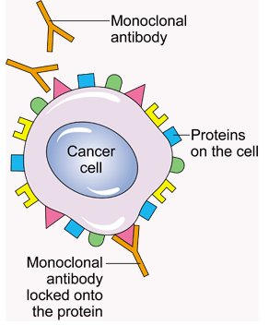
MOA
The mice or hamsters are immunized by the needed molecular target
Lymphocytes producing antibodies are fused with “immortal” human B-lymphocytes
The immortal hybrid can be cloned to produce HUMANIZED ANTIBODIES against a single target antigen
Rituximab  against CD20 expressed on lymphocytes in β cell lymphoma & chronic lymphocytic leukemia
Bevacizumab  against Vascular Endothelium GF R so aborts angiogenesis to suppress metastasis specially in colorectal & lung cancer / induce shrinkage of breast & renal cancer
Cetuximab  Epidermal GFR in many carcinomas as breast, lung, colon,…..
Trastuzumab  HER2/ neu ( a special EGFR) expressed on 30% of breast cancer cells  in metastatic breast cancer

Slide 9
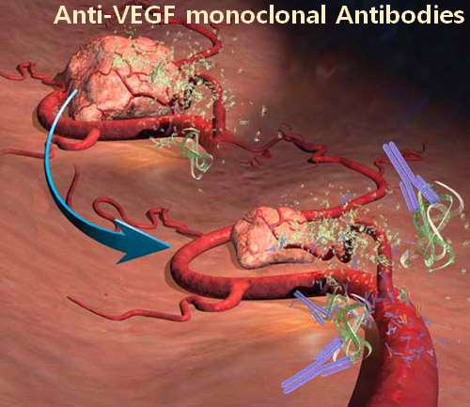
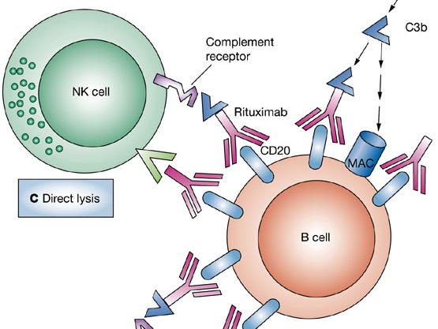
MOA
VEGF over expressed in metasta-sizing lung cancer c.
HER2 over expressed in breast cancer c.
Trastuzumab
VEGF
Rituximab
CD20
Bevacizumab
CD20 over expressed on lymphoma cell

Slide 10
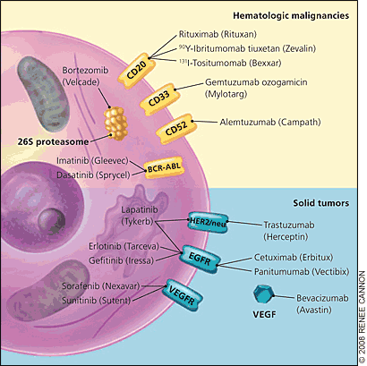
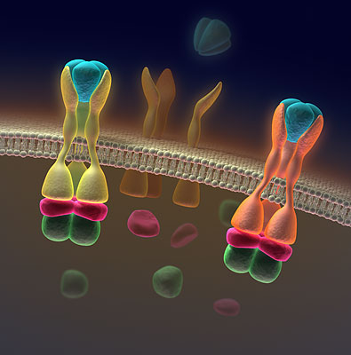
MOA
Molecular

Slide 11
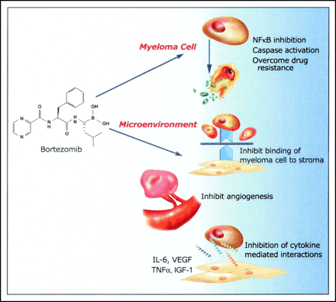
Molecular Therapy
Imatinib (Gleevec, Glivec)  inhibits cytoplasmic TK signaling BCR-ABL present in myeloid leukemia & platelet derived GF in stromal tumors  chronic myeloid leukemia (CML) & gastro-intestinal stromal tumors
Erlotinib (Tarcevac)  inhibits TK linked to EGFR  non-small cell lung cancer
Bortezomib (Velcade)  Proteosome Inhibitor 
inhibit degradation of I_{k}B
inhibit NF_{k}B
refractory multiple myeloma

Slide 12
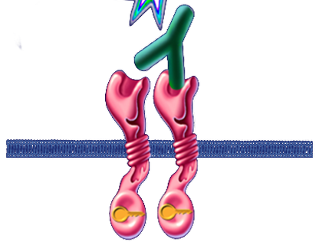
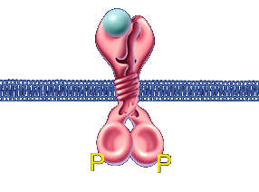
Mechanism of action: TKIs
Cetuximab  MOA  prevents EGF binding
EGFR
TKIs
Inhibits TK activity
Erlotinib  Molecular  –ve TK phosphorylation
Phosphorylation
↓ Proliferation
No Signalling
↑ Apoptosis
P
↓ Invasion
↑ Sensitivity to chemotherapy
P
Akt
MAPK
↓ Metastasis
↓ Adhesion
BCL-2↑
BAX↓
↓ Angiogenesis
M
G₁
Tumor Survival
G₂
S
Tumor Proliferation
Apoptosis
G₁ arrest

Slide 13
GOOD LUCK

Slide 14
Quiz?
Of the following ,which is a cell cycle specific - phase dependent ?
A- alkylating agents
B- hydroxyurea
C- cisplatin
D- bleomycin

Slide 15
Quiz?
Most important toxic effects associated with cancer chemotherapy include all the following except:
A- renal dysfunction
B- allergic reactions
C- sterility
D- bone marrow suppression
E- alopecia

Slide 16
Quiz?
Reactive groups that attack DNA causing inter & intrastrand cross links occurs as a result of administration of:-
A-Cyclophosphamide
B-5-fluorouracil
C-Methotrexate
D-Prednisone
E-Vinca Alkaloids

Slide 17
Quiz?
Which of the following agents used in drug combination regimens to treat lymphomas & Hodgikin’s disease is most likely to cause cardiotoxicity?
(A) Bleomycin
(B) Cisplatin
(C) Etoposide
(D) Doxirubicin
(E) Vinblastine

Slide 18
Quiz?
It is important to monitor serum MTX levels during the initial course of drug treatment because
(A) High MTX levels in the blood require additional leucovorin rescue
(B) Levels of MTX in the blood are predictive of gastrointestinal mucositis
(C) MTX readily penetrates into the cerebrospinal fluid
(D) Renal toxicity due to MTX is likely to occur
(E) Resistance to MTX occurs within a few days

Slide 19
Q2
Maintenance of a high urinary pH is important during methotrexate treatment in this patient because
A) Bladder irritation is reduced
B) It decreases renal tubular injury by the drug
C) Leucovorin toxicity is increased in a dehydrated patient
D) Methotrexate is a weak acid
E) Reabsorption of purine metabolites occurs at high pHpH

Slide 20
Quiz?
Patients complaining of gout & on allopurinol; the co-administration of 6-mercaptopurine will induce:
A- cardiotoxicity
B- retroperitoneal fibrosis
C- nephrotoxicity
D- hepatotoxicity
E- depletion of bone calcium

Slide 21
Quiz?
Cardiotoxicity limits the clinical usefulness of which one of the following antitumor antibiotics?
A- Dactinomycin
B- Doxorubicin
C- Bleomycin
D- Plicamycin
E- mitomycin
Specify a drug that will limit the toxicity

Slide 22
Quiz?
Which of the following is considered to be the effective mechanism of action of the vinca alkaloids?
A- Inhibition of the function of microtubules.
B- Damage and prevention of repair of DNA
C- Inhibition of DNA synthesis
D- Inhibition of protein synthesis
E- Inhibition of purine synthesis

Slide 23
Quiz?
Which of the following is acting in late S-G2 phase of cell cycle, and inhibition of topoisomerase II.
A - vincristine
B- paclitaxel
C- topotecan
D- etoposide

