Slide 1
Primary hyperparathyroidism Surgical Approach
Dr Mohammad AlShehri, Can. Board, FACS, D Med Edu.
Professor of Surgery

Slide 2
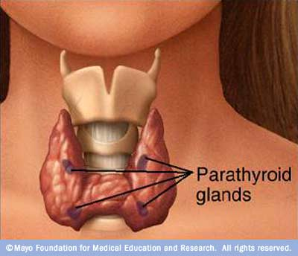

Slide 3
Physiology
Parathormone hormone
Vitamin D
ca

Slide 4
84% | Adenoma
15% | Hyperplasia
1% | Carcinoma

Slide 6
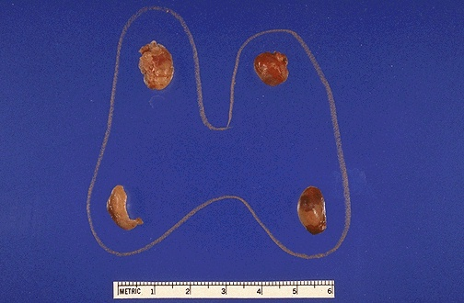

Slide 8
Clinical manifestations
Renal stones
Bone and joint pains
Abdominal groans
Psychic moans
Fatigue overtones

Slide 9
No symptoms
Mild symptoms
Renal symptoms
Bone symptoms

Slide 10
Statistics from Western countries indicate a 0.1-0.5% prevalence rate for PHP.
No evidence for geographical variation

Slide 11
Commonest cause of Hpercalcaemia in society
Uncommon in children
2-3 times in females

Slide 12
Clinical presentation
In the west 60 - 70% detected by routine screening.
Many are asymptomatic

Slide 13
Presentation
Age 30 – 77 ( median 40)
Females 70 %
All have advanced bone disease.
54% have also renal manifestations

Slide 14
40 y old lady
# Lt humerous
Lt Ureteric stone removed 6 y back
Rt Ureteric stone removed 3 y back
Non functioning Lt kidney
S Ca 11.2mg/dl P 2.2mg/ dl

Slide 15
30 y old lady
# Rt Radius
Long H/O generalized bone ache, heart burn & easy fatigue.
Lt ureteric stone removed 5 y back
S Ca 14.3 mg/dl p 2.4mg/dl

Slide 16
45 y old lady
ESRF
Advanced bone disease

Slide 17
Investigations
Serum Calcium
PTH
Serum Phosphate
Chloride

Slide 20
Management
All symptomatic patients should be treated
Asymptomatic ??

Slide 21
Conclusions
PHP is a very underdiagnosed disease in Saudi Arabia.
Patients are not diagnosed early
Complications could be serious and these are avoidable.

Slide 22
Recommendations
The medical community needs to be more aware of the disease.
Specifically the diagnosis should be considered in patients with
bilateral or recurrent renal stones
patients with suggestive radiological bone changes
and naturally in patients with high serum calcium level

Slide 24
Thyroid diseases

Slide 25
Case 1
Fatima is a 30-year old Saudi lady that presented to the Outpatient clinic, complaining of a swelling in the midline of her neck that she had for 2 months.

Slide 26
Case 1
What could this be?
Is it a thyroid swelling?

Slide 27
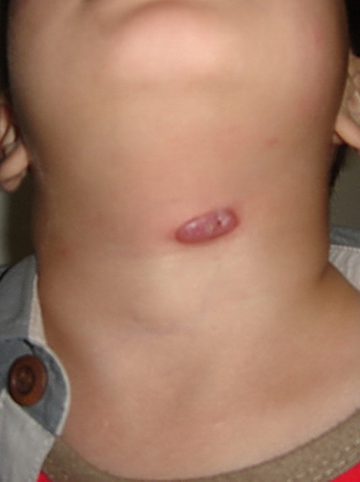
Movement with swallowing
Thyroid
Thyroglossal cyst

Slide 28
Case 1
What could this be?
Is it a thyroid swelling?
If it is a thyroid swelling, what could be the cause of this swelling?

Slide 29
Thyroid cyst
Multinodular goiter
Inflammatory
Benign tumor
malignancy

Slide 30
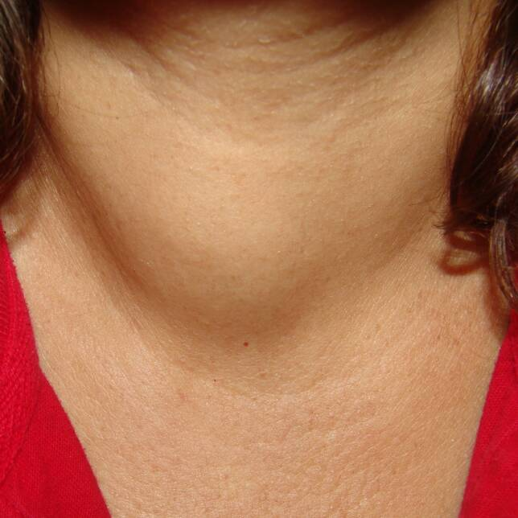
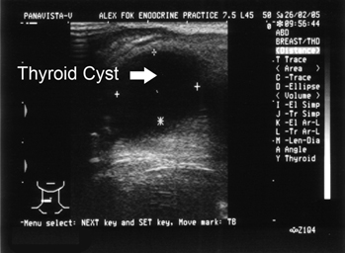

Slide 31
Case 1
What could this be?
Is it a thyroid swelling?
If it is a thyroid swelling, what could be the cause of this swelling?
What points in history, in clinical examination, and investigation will help you to differentiate between all these causes of thyroid swelling?

Slide 32
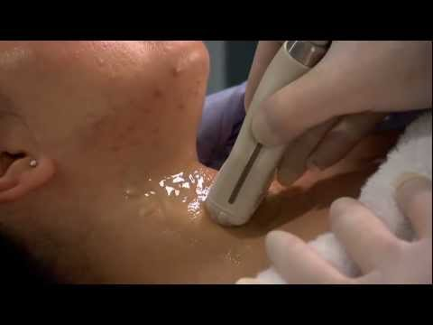
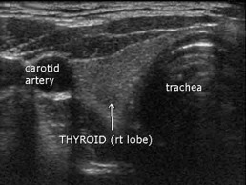

Slide 33
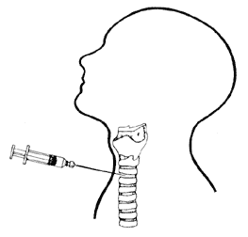

Slide 35
Case 2
Ahmed ( age 28 years) came to the Outpatient clinic complaining of nervousness, palpitations, sweating, and weight loss. Clinical examination revealed the presence of a goitre.

Slide 37
Graves disease
Toxic multinodular goiter
Toxic nodule

Slide 38
Hyperthyroidism
Nervousness
Wt loss + Increased appetite
Heat intolerance
Sweating
Muscular weakness
Menstrual irregularities

Slide 39
Hyperthyroidism
Goiter
Tachycardia +/-Arrhythmias
Warm moist skin
Bruit & thrill
Eye signs

Slide 40
Laboratory
Increases T4, T3
Decreased TSH

Slide 41
Management
Medical
Radio-nuclear iodine
Surgery

Slide 42
Case 3
Aisha is a 55-year old lady that presented to your clinic. Her main complaint is related to some recent difficulty in hearing. The family noticed that she started to have difficulty in understanding, that she gained weight, and her voice started to be coarse.

Slide 43
Laboratory
Decreases T4, T3
Increased TSH

Slide 44
Thyroid cancer
Papillary
Follicular
Medullary
Undefferntiated
Lymphoma

Slide 45
Papillary carcinoma
Accounts for 85%
Appears in early adult life
Lymphatic spread
Good prognosis

Slide 46
Follicular carcinoma
Accounts for about 10%
Differentiation between benign and malignant is not easy
Blood spread
Prognosis not as good

Slide 47
Medullary carcinoma
Accounts for about 7%
Arises from C-Cells
Familial medullary carcinoma 25%
MEN syndrome
Prognosis is not good

Slide 48
Undifferntiated
Accounts for about 1%
Rapidly growing
Locally invasive
Rarely curative

Slide 49
Lymphoma
More common in our part of the world
Usually diagnosed post op
Chemo-radiotherapy.

Slide 50
http://www.powershow.com/view/f7c3a-NzFhY/NECK_SWELLINGS_powerpoint_ppt_presentation
http://www.youtube.com/user/ParathyroidTV?v=sD9st1ZPFrQ

Slide 51
Thank you
myshehri@ksu.edu.sa
Twitter @myshehri

Slide 53
Recommendations
Hyperparathyroidism should be included in undergraduate curriculum and certainly in residency programs.
Developing expertise in parathyroid surgery is required.

Slide 54
Post operative management
Be careful of bone hunger syndrome

