Slide 1
Obsessive Compulsive Disorder (OCD)
AHMAD ALHADI, MD
Psychiatrist and Psychotherapist
KSU, KKUH

Slide 2
OCD
Irresistible, Compelling
Actions or mental
acts
Done in response to obsessions or according to rules …to reduce anxiety or prevent dreaded events or situations
e.g. washing hands
repeatedly
Compulsions
Own: thoughts,
Impulses, images
Intrusive, Insisting, Unwanted
Repetitive
Irrational
e.g. contaminated hands
Time–consuming
at least 1 h/ d
Functioning imp.
Disorder
Obsessions
Notes:
OBSESSIONS: Recurrent, persistent ideas, images or impulses which enter the mind despite patient’s resistance. The patient regards them a silly product of his own mind (coming within the self). Attempts to resist or dispel the unwelcome thoughts or urges lead to severe inner struggle, with intense anxiety.
COMPULSIONS: Repeated compelling acts done in response to obsessions or according to rules that must be
applied rigidly …to reduce anxiety or prevent dreaded events or situations.
Behaviour or mental acts are not connected in realistic way or nexcessive
Healthy people experience occasional intrusive thoughts. It is the persistence, intensity and frequency that make a disorder.
OBSESSIVE COMPULSIVE DISORDER (OCD):
A psychiatric disorder characterized by:
recurrent obsessions or compulsions that are severe enough to be time consuming (> 1 hour a day) or causes marked distress or significant impairment.
the person recognizes that the obsessions or compulsions are excessive and unreasonable.
the disturbance is not due to the direct effect of a medical condition, substance or another mental disorder.
at least two weeks’ duration (ICD-10 criterion).

Slide 3
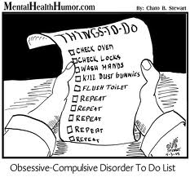

Slide 4
Main themes of OCD
**** sense of danger and/or responsibility.
Contamination ➔ washing.
Pathological doubts ➔ checking, e.g. repeating Ablution, prayers.
Intrusive thoughts (sexual or aggressive acts, divorce) mental acts
Symmetry ➔ slowness
Hoarding
Notes:
Pattern of obsessive-compulsive disorder in eastern Saudi Arabia
OM Mahgoub and HB Abdel-Hafeiz Department of Psychiatry, College of Medicine, King Faisal University, Dammam, Kingdom of Saudi Arabia.
In 32 Muslim Saudis with obsessive-compulsive disorder, compulsive acts (78%) and doubts (66%) were the commonest forms. Religious themes predominated in both the obsessions and compulsions.
THE MAIN THEMES OF OCD
Contamination and washing (e.g. contaminated by one’s own excreta, shaking hands with others, etc.)
Repeated doubts concerning actions that may not have been completed adequately (e.g. ablutions, prayers, gas checking).
Insistence on symmetry: needs to have things in a particular order.
Aggressive or horrific impulses (e.g. fear of harming a child).
Sexual imagery (e.g. violent abnormal sexual practices).
Blasphemous thoughts: obsessions about religious matters.
Obsessional ruminations: internal debates in which arguments for and against even the simplest everyday actions are reviewed endlessly.
Obsessional phobias: obsessional thoughts with fearful content such as thoughts of a harmful use of knives.
THE MAIN THEMES OF OCD
Contamination and washing (e.g. contaminated by one’s own excreta, shaking hands with others, etc.)
Repeated doubts concerning actions that may not have been completed adequately (e.g. ablutions, prayers, gas checking).
Insistence on symmetry: needs to have things in a particular order.
Aggressive or horrific impulses (e.g. fear of harming a child).
Sexual imagery (e.g. violent abnormal sexual practices).
Blasphemous thoughts: obsessions about religious matters.
Obsessional ruminations: internal debates in which arguments for and against even the simplest everyday actions are reviewed endlessly.
Obsessional phobias: obsessional thoughts with fearful content such as thoughts of a harmful use of knives.

Slide 5
Associated features
Excessive self blame & sense of responsibility
Feeling anxious ➔ OCD
Depressive feeling ➔ OCD
OCPD
Notes:
Associated features:
Avoidance of situations that involve the content of the obsessions, such as dirt or contamination.
Anxiety is an important component of OCD. Some rituals (compulsions) are followed by a diminution of anxiety, which reinforces OCD.
Depressive features either secondary or independent to OCD.
Guilt due to a pathological sense of responsibility to such absurd thoughts especially in blasphemous, aggressive and sexual obsessions.
Obsessional symptoms may occur in conditions other than classic OCD disorder for instance in:
Major Depression.
Organic brain disease.
Eating Disorders.
Tic Disorders.
Body dysmorphic disorder.

Slide 6
Epidemiology
Males = Females
Lifetime prevalence = 2-3 %
Mean age of onset = 20 – 25 years

Slide 7
Etiology
Serotonin
Genetic predisposition - ? OCPD
Debate about religious factors
Notes:
Aetiology:
1. Genetic Factors:
OCD have been found in about 7 % of the parents of patients with these disorders.
Few twin studies, monozygotic 50 – 80 % for concordance rate compared to only 25 % in dizygotic twins.
2. Neurobiological hypothesis:
There is evidence that selective serotonin reuptake inhibitors (SSRIs) are effective treatment for OCD. However, there is no evidence of baseline serotonergic dysfunction in OCD patients. Multiple neurotransmitter system is suggested.
MRI and PET have indicated abnormalities in the frontal lobes, cingulum and basal ganglia of OCD patients. More gray matter and less white matter, suggesting a developmental abnormality
3. Psychodynamic Theories:
There are unconscious impulses of aggression or sexual nature. These impulses could potentially cause extreme anxiety which is reduced by the action of the defense mechanisms of repression, isolation, undoing, and reaction formation.
Learning Theory:
Some obsessions are results of abnormalities in mechanisms of learning (avoidance responses).
Aetiology:
1. Genetic Factors:
OCD have been found in about 7 % of the parents of patients with these disorders.
Few twin studies, monozygotic 50 – 80 % for concordance rate compared to only 25 % in dizygotic twins.
2. Neurobiological hypothesis:
There is evidence that selective serotonin reuptake inhibitors (SSRIs) are effective treatment for OCD. However, there is no evidence of baseline serotonergic dysfunction in OCD patients. Multiple neurotransmitter system is suggested.
MRI and PET have indicated abnormalities in the frontal lobes, cingulum and basal ganglia of OCD patients. More gray matter and less white matter, suggesting a developmental abnormality
3. Psychodynamic Theories:
There are unconscious impulses of aggression or sexual nature. These impulses could potentially cause extreme anxiety which is reduced by the action of the defense mechanisms of repression, isolation, undoing, and reaction formation.
Learning Theory:
Some obsessions are results of abnormalities in mechanisms of learning (avoidance responses).

Slide 8
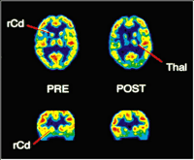
Changes in Cerebral Glucose Metabolic Rate after Treatment of Obsessive-Compulsive Disorder
The PET scans show decreases in glucose metabolic activity in the orbitofrontal cortex and right caudate after both the behavioural therapy sessions and the
Fluoxetine treatment.
Jeffrey M, 1996

Slide 9
D D x
Anxiety, panic and phobia.
Depressive disorders.
Hypochondriasis
Schizophrenia.
Organic mental disorders e.g. PANDAS (Paediatric Autoimmune Neuropsychiatric Disorders Associated with Streptococcal infections)
OCPD: perfectionism, orderliness …
Notes:
Differential Diagnosis:
OCD should be differentiated from other mental disorders in which some obsessional symptoms occur, like:
Depressive disorders
Anxiety, panic and phobia disorders
Hypochondriasis (see chapter 14)
Schizophrenia: some schizophrenic patients have obsessional thoughts, these are usually odd with peculiar content (e.g. sexual or blasphemous). The degree of resistance is doubtful.
Organic disorders: some organic mental disorders are associated with obsessions e.g. encephalitis, head injury, epilepsy, dementia.
Obsessive Compulsive Personality Disorder (see chapter 18)
Although obsessive compulsive personality disorder (OCPD) and OCD have similar names, the clinical manifestations of these disorders are quite different. Obsessive compulsive personality disorder is not characterized by the presence of obsessions or compulsions and instead involves pervasive pattern of preoccupation with orderliness, perfectionism, and control and must begin by early adulthood. If an individual manifests symptoms of both OCPD and OCD, both can be given.
Course and Prognosis:
Differential Diagnosis:
OCD should be differentiated from other mental disorders in which some obsessional symptoms occur, like:
Depressive disorders
Anxiety, panic and phobia disorders
Hypochondriasis (see chapter 14)
Schizophrenia: some schizophrenic patients have obsessional thoughts, these are usually odd with peculiar content (e.g. sexual or blasphemous). The degree of resistance is doubtful.
Organic disorders: some organic mental disorders are associated with obsessions e.g. encephalitis, head injury, epilepsy, dementia.
Obsessive Compulsive Personality Disorder (see chapter 18)
Although obsessive compulsive personality disorder (OCPD) and OCD have similar names, the clinical manifestations of these disorders are quite different. Obsessive compulsive personality disorder is not characterized by the presence of obsessions or compulsions and instead involves pervasive pattern of preoccupation with orderliness, perfectionism, and control and must begin by early adulthood. If an individual manifests symptoms of both OCPD and OCD, both can be given.

Slide 10
Course
Gradual > acute
Chronic
Waxing & waning
Notes:
Course and Prognosis:
In most cases onset is gradual but acute cases have been noted.
The majority have a chronic waxing and waning course with exacerbations related to stressful events.
Severe cases may become persistent and drug resistant.
Prognosis is worse when the patient has obsessive compulsive personality disorder.
Patient’s age, sex, age of onset and duration of OCD showed no significant correlation with outcome.
Good lasting outcome was found to be related to compliance with treatment (exposure and drugs), presence of mood component and family support.

Slide 11
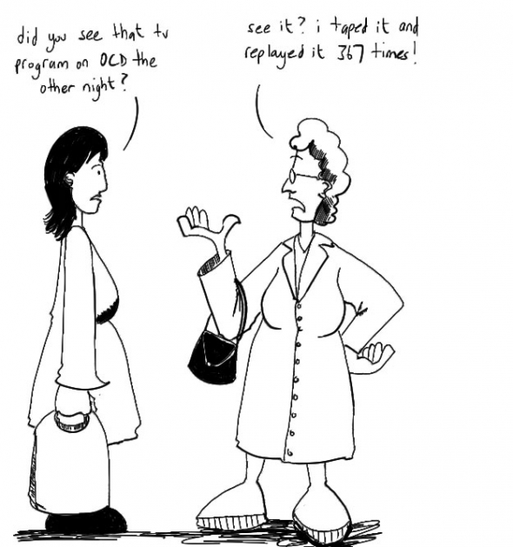

Slide 12
Prognosis
Non – severe
No OCPD
Depressed / anxious mood
Compliance with Tx
Family support
Good p. Factors

Slide 13
Treatment
Pharmaco-behavioral:
Pharmacological:
SSRIs : Fluoxetine - Paroxetine
Clomipramine
Behavioral: exposure & response prevention
Others
Notes:
Treatment:
Search for a depressive disorder and treat it, as effective treatment of a depressive disorder often leads to improvement in the obsessional symptoms.
Reassure the patient that these symptoms are not early signs of madness in case he is worried about such a concern.
Explain the nature of the illness and clarify to the patient the intrusive nature of the obsessions i.e. OCD is against his will. This helps the patient reduce the guilt that results from the sense of responsibility.
Frequent supportive interviews providing continuing hope.
The most effective treatment is pharmacobehavioural approach.
Drugs.
1. Antiobsessional drugs
a. Clomipramine: required doses may reach 200 mg / day.
Selective serotonin-reuptake inhibitors (e.g. Fluvoxamine)
2. Anxiolytics can give some short-term symptomatic relief.
Most Saudi OCD patients are treated with drugs only.
Behaviour therapy (combined with drugs):
It is more effective with prominent compulsions and less effective for obsessional thoughts.
About 60 % may improve greatly though not completely.
Techniques used are:
Exposure to any environmental cue that increase obsessions along with response prevention.
Thought stopping (see Chapter 24).
Mass practice and habituation.
Behaviour therapy may be done at out – patient clinics, day centers or as in – patient. It is important to interview relatives and encourage them to adopt a firm sympathetic attitude to the patient (a family cotherapist).
In-patient behaviour therapy can appreciably be helpful for resistant cases and can reduce patient’s disability, family burden and major demands on health care resources that are incurred by severe chronic OCD patients.
Collaboration with religious leaders is helpful.
Psychosurgery: for severe and resistant incapacitating cases.

Slide 14
Thank you

