Slide 1
Common Adult Fractures
Dr. Abdulrahman Algarni, MD, SSC (Ortho), ABOS
Assistant Professor
Consultant Orthopedic and Arthroplasty Surgeon

Slide 2
objectives
To know the most common mechanisms of injury
Be able to make the diagnosis of common adult fractures
To know and interpret the appropriate x-rays
To know the proper management (conservative Vs operative )
To know the possible complications and how to avoid them.

Slide 3
Upper limbs fractures
Clavicle
Humeral(Proximal, shaft)
Both Bone forearm(Radius, ulna)
Distal Radius

Slide 4
Mechanism of Injuries of the Upper Limb
Mostly Indirect
Commonly described as “ a fall on the outstretched hand “
Type of injury depends on
position of the upper limb at the time of impact
force of injury
age

Slide 5
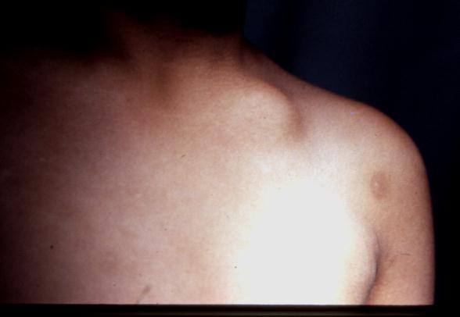
Fracture of the clavicle
Common fracture (2.6%-12% of all fractures, 44%-66% of fractures about the shoulder)
Commonest site is the middle one third (80%)
Mainly due to indirect injury
Direct injury leads to comminuted fracture

Slide 6
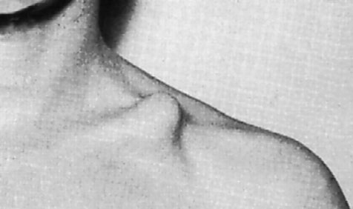
EVALUATION
CLINICAL
splinting of the affected extremity, with the arm adducted
Assess for skin integrity
neurovascular examination is necessary
The chest should be auscultated
RADIOGRAPHIC
Anteroposterior radiographs

Slide 7
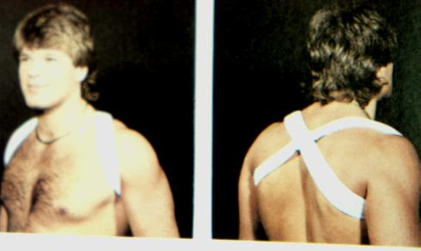
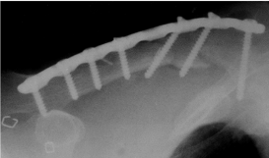
Treatment
Conservative
Operative fixation
arm sling or figure of eight
indicated if there is:
tenting of the skin
open fracture
neurovascular injury
nonunion
Plate and screws

Slide 8
COMPLICATIONS
Neurovascular compromise
Malunion
Nonunion( 85% occurring in the middle third)
Posttraumatic arthritis(AC joint, SC joint)

Slide 9
Proximal Humerus Fractures
Proximal Humerus ( includes surgical and anatomical neck )
comprise 4% to 5% of all fractures
represent the most common humerus fracture (45%)

Slide 10
CLINICAL EVALUATION
pain, swelling, tenderness, painful range of motion, and variable crepitus.
A careful neurovascular examination is essential, axillary nerve function.

Slide 11
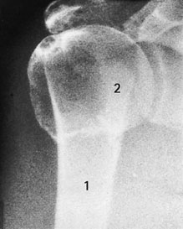
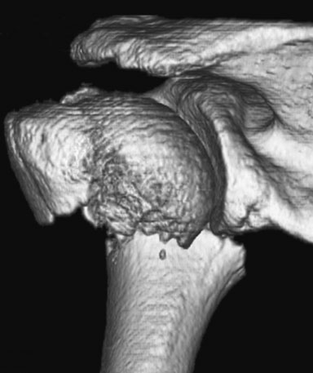
RADIOGRAPHIC EVALUATION
AP and lateral views
Computed tomography
Rule out Fracture-dislocation (four-part)

Slide 12
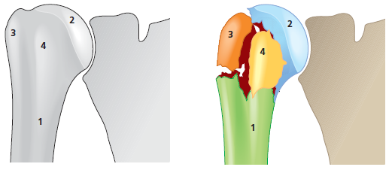
(Neer’s classification)
Four parts:
humeral shaft
humeral head
Greater tuberosity
Lesser tuberosity

Slide 13
(Neer’s classification)
A part is defined as displaced if >1cm of fracture displacement or >45 degrees of angulation

Slide 14
Treatment
Conservative
Operative fixation
Non- or minimally displaced fractures ( less than 5 mm)
85% of fractures are minimally displaced or nondisplaced.
Sling immobilization.
Early shoulder motion at 7 to 10 days.
displaced more than 10 mm.
Three- and four-part fractures
Replacement of humeral head for four-part in elderly

Slide 15
COMPLICATIONS
Osteonecrosis: four-part (13%-34%), three-part(3% to 14%), anatomic neck fractures.
Vascular injury (5% to the axillary artery)
Neural injury(Brachial plexus injury, Axillary nerve injury)
Shoulder stiffness
Nonunion, Malunion, Heterotopic ossification

Slide 16
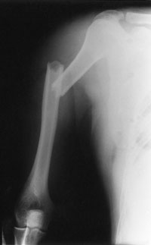
Fractures Shaft of the Humerus
3% to 5% of all fractures
Commonly Indirect injury(Spiral or Oblique)
Direct injuries(transverse or comminuted )
May be associated with Radial Nerve injury

Slide 17
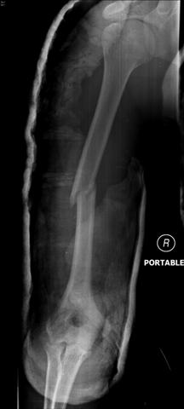
Evaluation
Clinical
Rule out open fractures
careful NV examination, with particular attention to radial nerve function
Radiological
AP and lateral radiographs of the humerus including the shoulder and elbow joints on each view

Slide 18
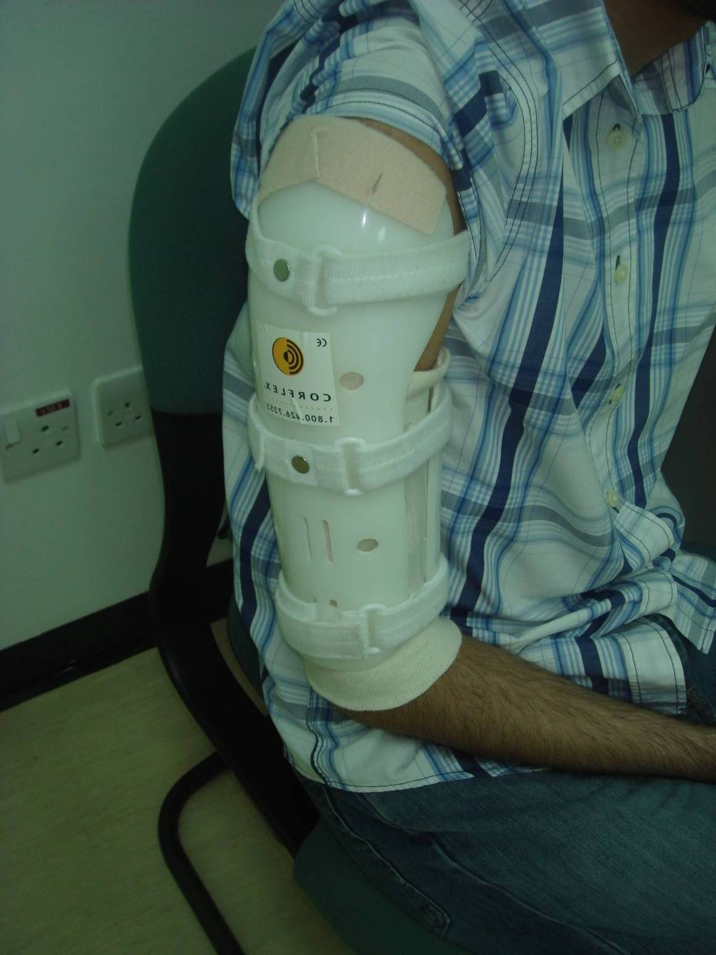
Treatment
Most of the time is Conservative
Closed Reduction in upright position.
U-shaped Slab
Few weeks later Functional Brace may be used

Slide 19
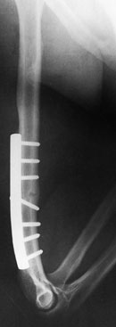
Surgical treatment
Multiple trauma
Inadequate closed reduction
Pathologic fracture
Associated vascular injury
Floating elbow
Segmental fracture

Slide 20
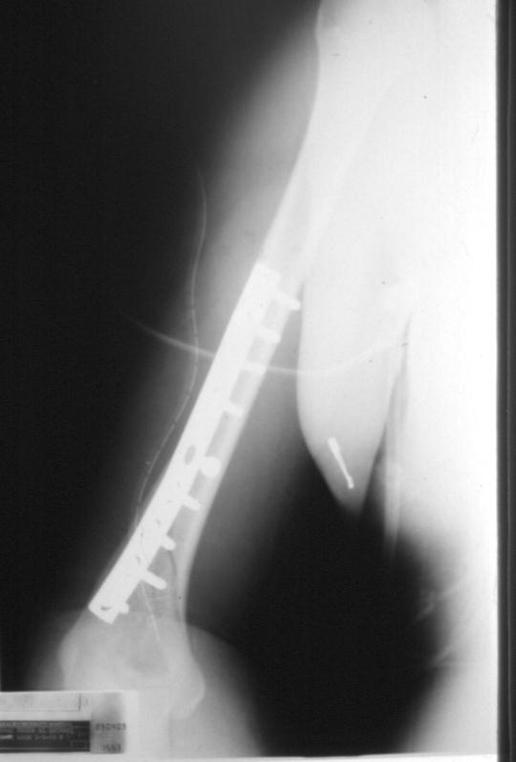
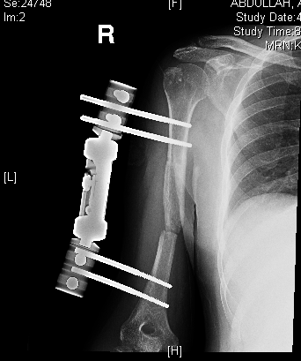
Surgical treatment
Intraarticular extension
Bilateral humeral fractures
Neurologic loss following penetrating trauma
Open fracture

Slide 21
COMPLICATIONS
Radial Nerve Injury (Wrist drop): 12% of fractures
2/3( 8%) Neuropraxia
1/3 ( 4%) lacerations or transection
In open fractures; immediate exploration and ± repair
In closed injuries treated conservatively

Slide 22
forearm (both bone) fractures
Forearm fractures are more common in men than women.
motor vehicle accidents, contact athletic participation, and falls from a height

Slide 23
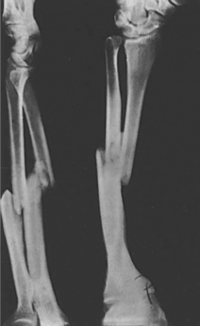
Evaluation
Clinical
gross deformity of the involved forearm.
A careful NV exam
open wound
compartment syndrome
Radiographic
Anteroposterior (AP) and lateral views
(including the two joints)

Slide 24
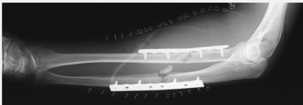
Treatment
Surgical treatment is the rule because of instability.

Slide 25
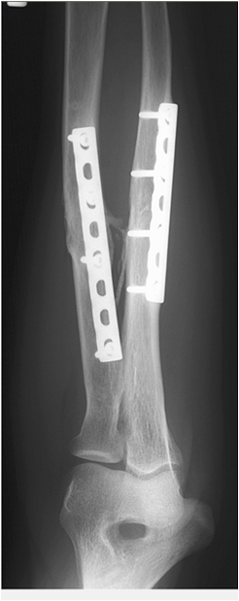
Complications
Nonunion
Compartment Syndrome
Posttraumatic radioulnar synostosis (3% to 9% )
malunion
Infection
Neurovascular injury

Slide 26
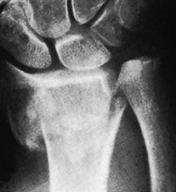
Distal Radius
Distal radius fractures are among the most common fractures of the upper extremity.
one-sixth of all fractures treated in emergency departments

Slide 27
CLINICAL EVALUATION
Swollen wrist with ecchymosis, tenderness, and painful range of motion.
neurovascular assessment: median nerve function(Carpal tunnel compression symptoms are common, 13%-23%)
Look for ?open fracture.

Slide 28
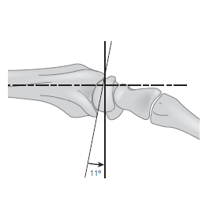
RADIOGRAPHIC EVALUATION
Posteroanterior and lateral views
Radial inclination: averages 23 degrees (range, 13 to 30 degrees)
Radial length: averages 11 mm (range, 8 to 18 mm).
Palmar (volar) tilt: averages 11 degrees (range, 0 to 28 degrees).

Slide 29
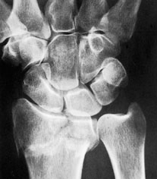
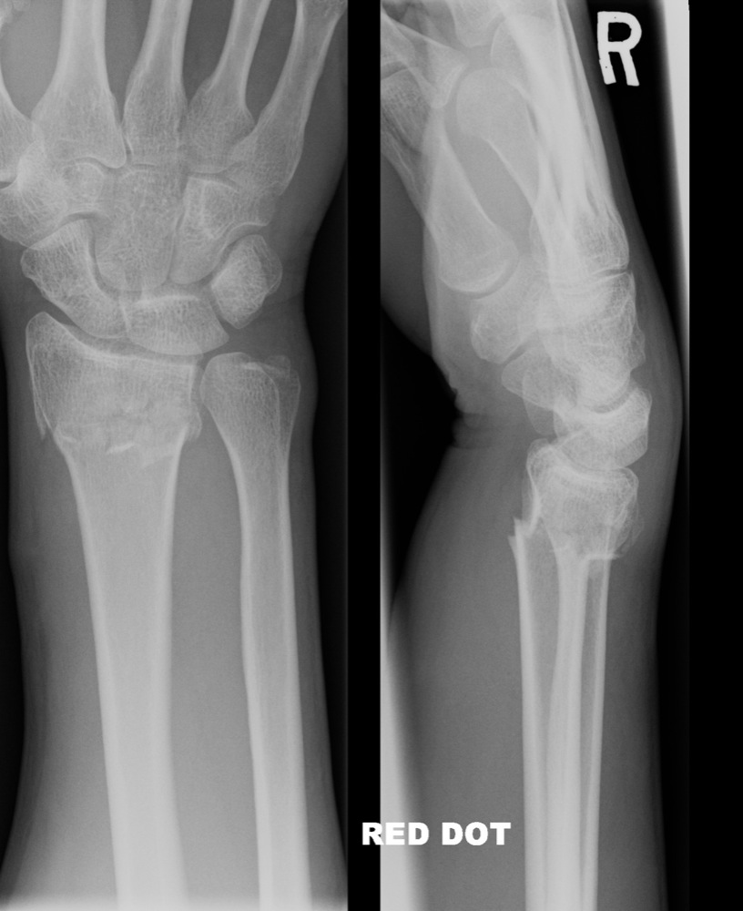
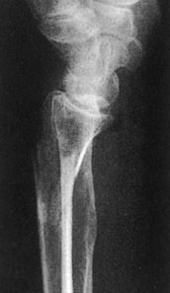
Classification
Articular extension:
Extraarticular Vs intraarticular
Displacement:
Colles’ fracture Vs Smith fracture

Slide 30
Colles’ fracture
Extraarticular fractures.
90% of distal radius fractures
Fall onto a hyperextended wrist with the forearm in pronation.
dorsal displacement and angulation (apex volar) dinner fork deformity
Radial shift, and radial shortening.

Slide 31
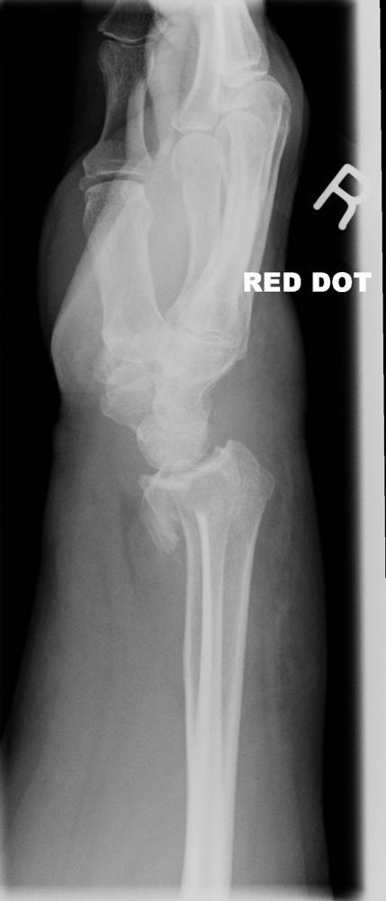
Smith’s fracture ( reverse Colles’ fracture)
A volar displacement
volar angulation (apex dorsal) of the distal radius (garden spade deformity)
a fall onto a flexed wrist with the forearm fixed in supination

Slide 32
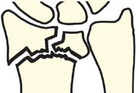
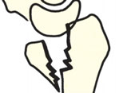
Barton’s fracture
Intraarticular fracture with dislocation or subluxation of the wrist
Dorsal or volar rim of the distal radius is displaced with the hand and carpus.

Slide 33
Barton’s fracture
Volar involvement is more common
fall onto a dorsiflexed wrist with the forearm fixed in pronation
treated surgically

Slide 34
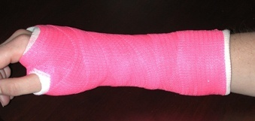
Conservative Treatment
Acceptable radiographic parameters:
Radial length: within 2 to 3 mm of the contralateral wrist.
Palmar tilt: neutral tilt (0 degrees).
Intraarticular step-off: <2 mm.
Radial inclination: <5degree.
Below elbow cast

Slide 35
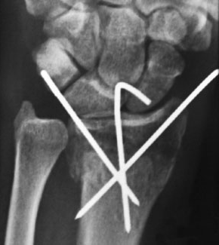
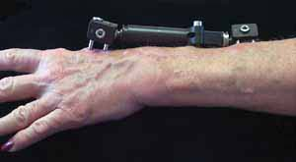
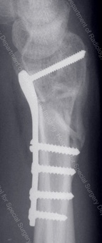
Operative treatment
Unacceptable reduction
Secondary loss of reduction
Articular comminution, step-off, or gap
Barton’s fracture

Slide 36
COMPLICATIONS
Median nerve dysfunction
Malunion
Tendon rupture, most commonly extensor pollicis longus
Midcarpal instability
Posttraumatic osteoarthritis
Stiffness (wrist, finger, and elbow)

Slide 37
Lower limbs Fractures
Pelvic
Proximal femoral fractures( femoral neck, intertrochantric )
Femoral shaft
Tibial shaft
Ankle

Slide 38
Mechanism of fractures
High energy trauma like MVA, fall , except in elderly people or pathological bones
Types of fracture are depend on position of limb during impaction and magnitude of forces applied.
Look at the patient as whole ,not to injured limb alone!
Save life first, then save limb and finally save limb function.

Slide 39
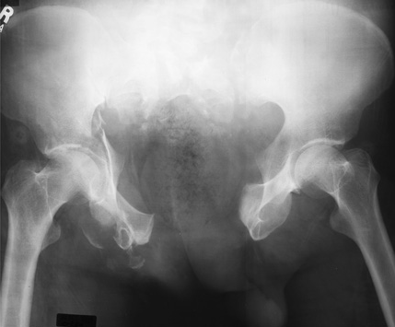
Pelvic fractures
High energy trauma, low energy(simple fall in elderly)
Life threatening fracture
Rule out open fracture(50% risk of death).

Slide 40
Classification

Slide 41
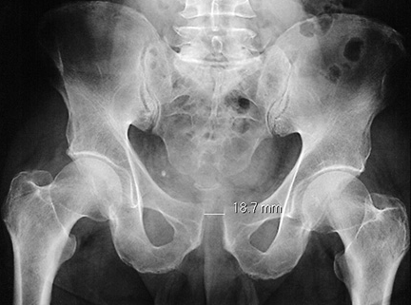
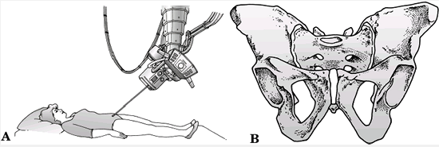
RADIOGRAPHIC EVALUATION
AP of the pelvis
Inlet radiograph
Outlet radiograph
CT

Slide 42
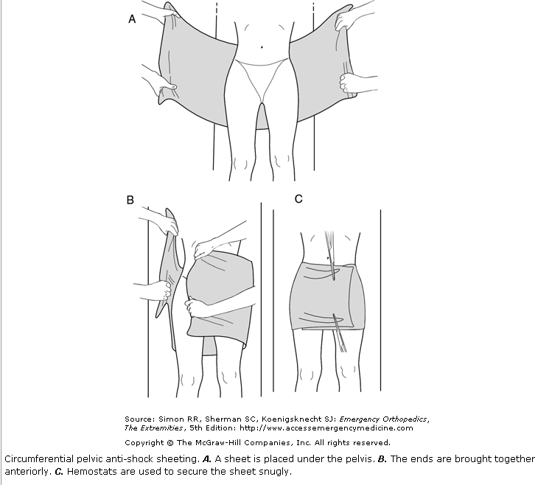
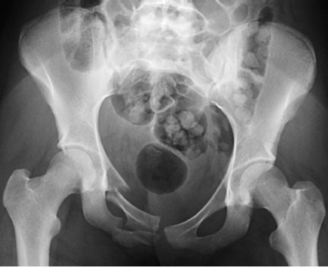
MANEGEMENT
ATLS guidelines
Type A: Conservative treatment

Slide 43
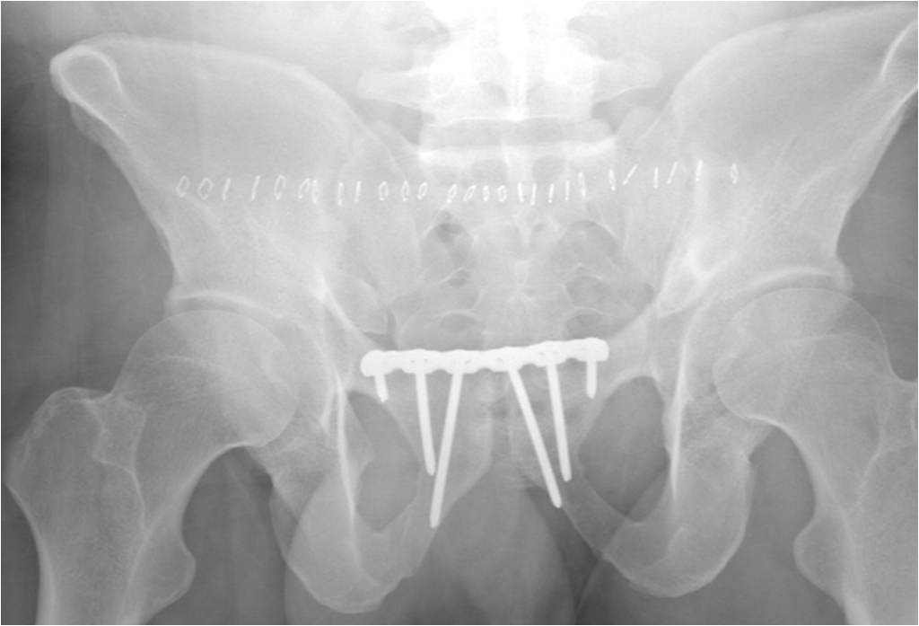
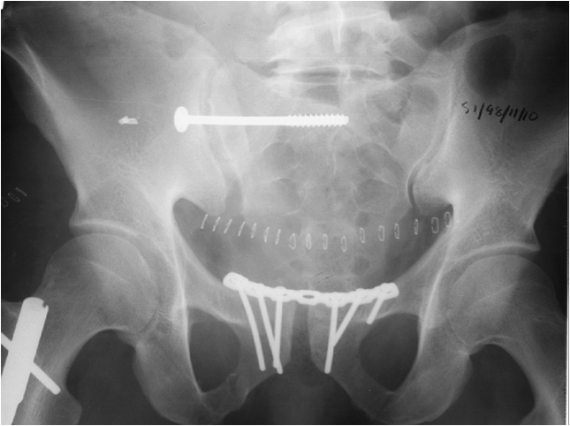
MANEGEMENT
Type B: Anterior fixation
Type C: Both anterior & posterior fixation

Slide 44
Complications
Hemorrhage(hypovolemic shock, life threatening)
Infection up to 25%
Thromboembolism
Bladder (15% )/bowel injuries
Neurological damage ( L5-S1)
Persistent sacro-iliac joint pain
Malunion

Slide 45
Intertrochanteric fractures
Extracapsular
Heals well, low risk for osteonecrosis
elderly, osteoporotic women
Simple fall

Slide 46
Evaluation
Clinical evaluation
Inability to bear-weight
Limb is short, abducted and externally rotated
Radiological evaluation
AP and lateral(cross-table)

Slide 47
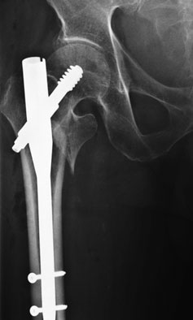
Treatment
Usually operative
Dynamic hip screw(DHS) Proximal femoral nail

Slide 48
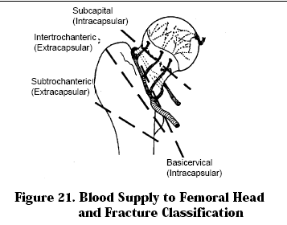
Femoral neck fractures
Intracapsular
Risk of osteonecrosis
High and low mechanism of injuries( young Vs elderly)
Evaluation as for IT fractures

Slide 49
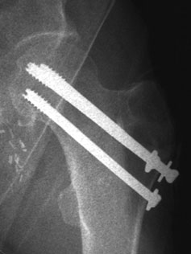
Treatment
Only surgical
Fixation: nondisplaced, displaced and young(45-55 yrs)
Replacement: displaced and elderly

Slide 50
COMPLICATIONS
Nonunion(5% of nondisplaced, 25% of displaced fractures)
Osteonecrosis(10% of nondisplaced, 27% of displaced fractures)
Fixation failure(osteoporotic bone or technical problems )

Slide 51
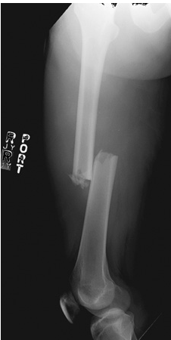
Femoral shaft fractures
High mechanism of energy
Risk of thromboembolism
Inability to bear weight
AP & lateral radiographs(both joints)

Slide 52
Treatment: always surgical
intramedullary nail is the best
Plate fixation

Slide 53
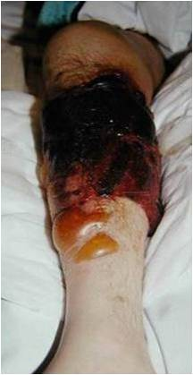
Tibia shaft fracture
High mechanism of energy, crush injuries
High risk of open fractures and compartment syndrome
Inability to bear weight, assess skin and soft tissues
AP & lateral radiographs(both joints)

Slide 54
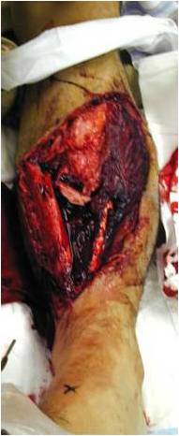
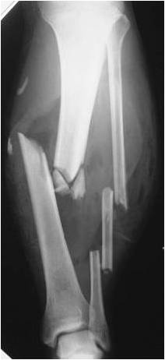
Classification
Open versus closed
Anatomic location: proximal, middle, or distal third
Displacement: percentage of cortical contact

Slide 55
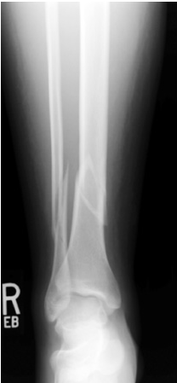
Classification
Spiral fractureof distal tibia (twisting injury)
Transverse fracture of distal tibia (more soft tissues injury due to direct trauma)

Slide 56
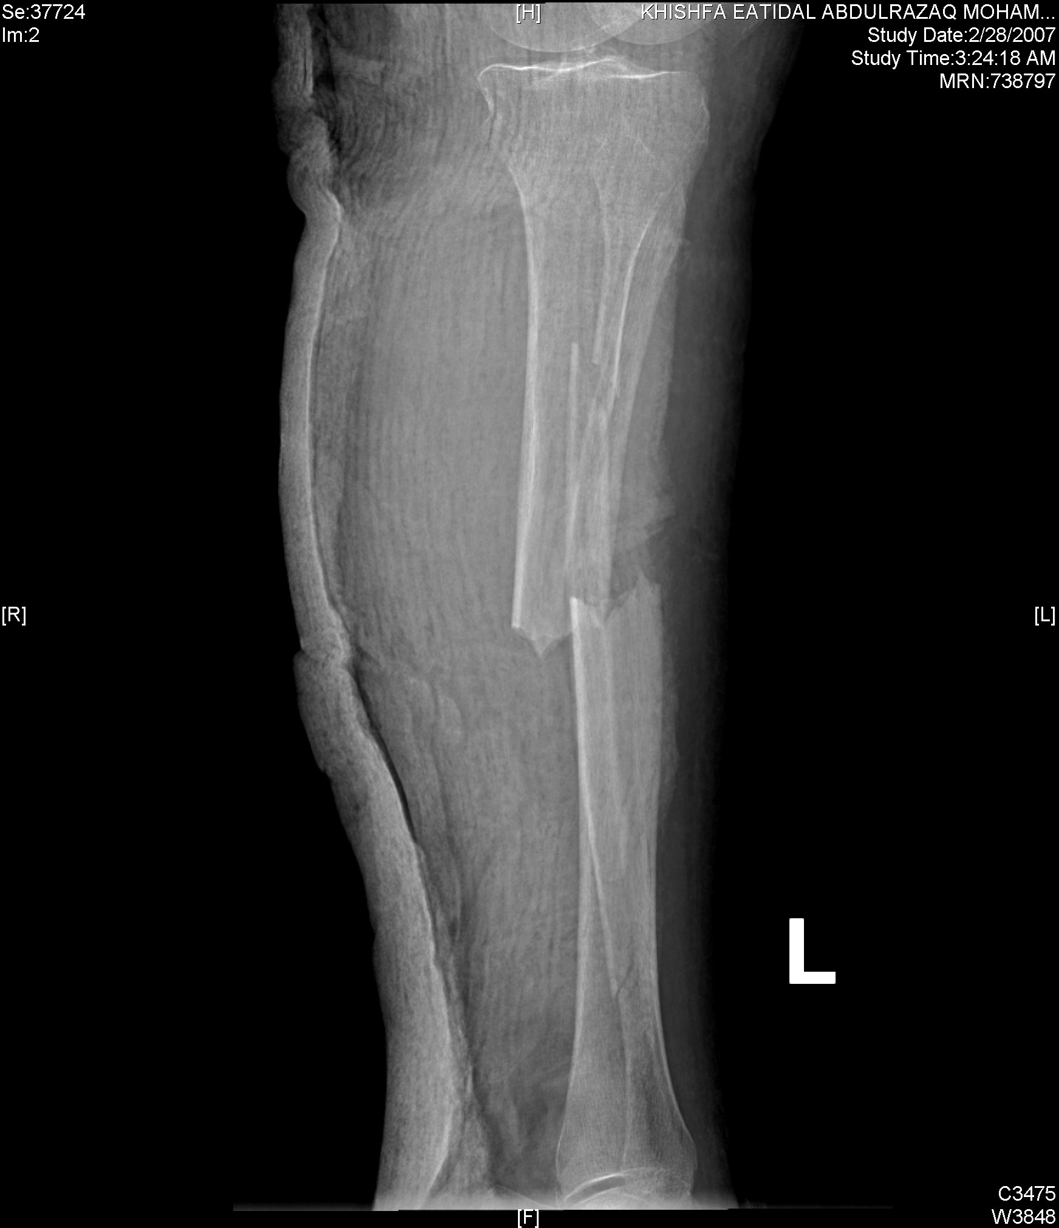
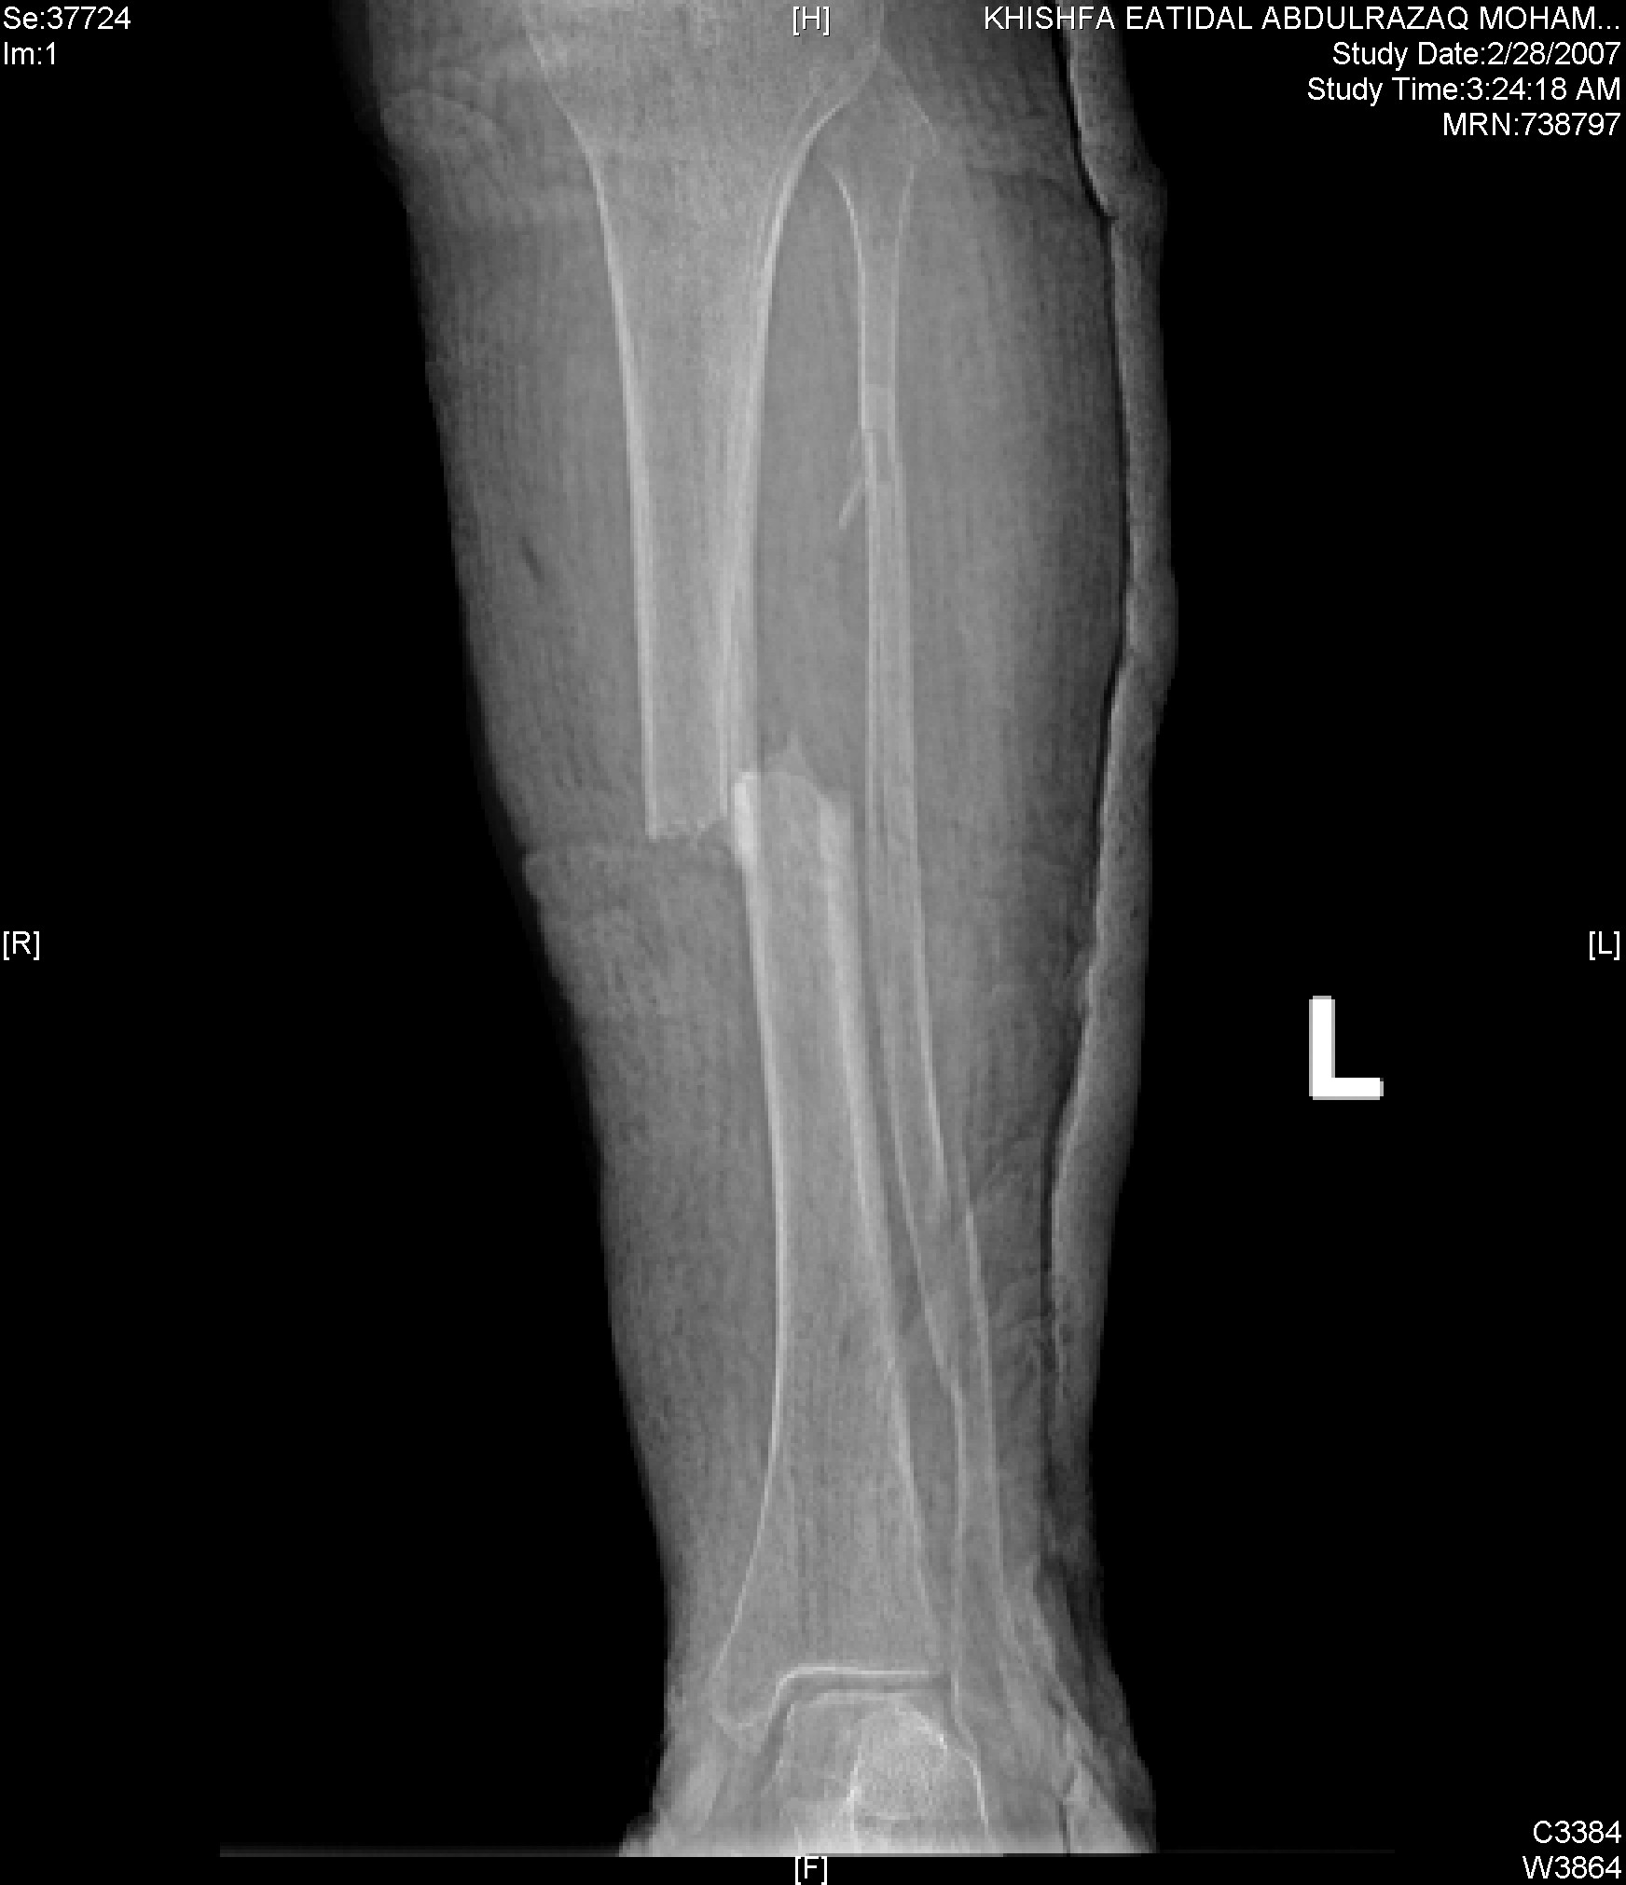
Treatment
Open versus closed
Both conservative and Surgical
Surgical is the best

Slide 57
Conservative
Shortening <1cm
Angulation in varus/valgus plane< 5 degree
Angulation in anter-posterior plane <10 degrees
Rotation neutral to slight external rotation.
bone apposition >50%

Slide 58
Conservative
Long leg cast (5 degrees of flexion) for 4-6 weeks
patella-bearing cast(Sarmiento) or fracture brace.
The average union time is 16±4 weeks

Slide 59
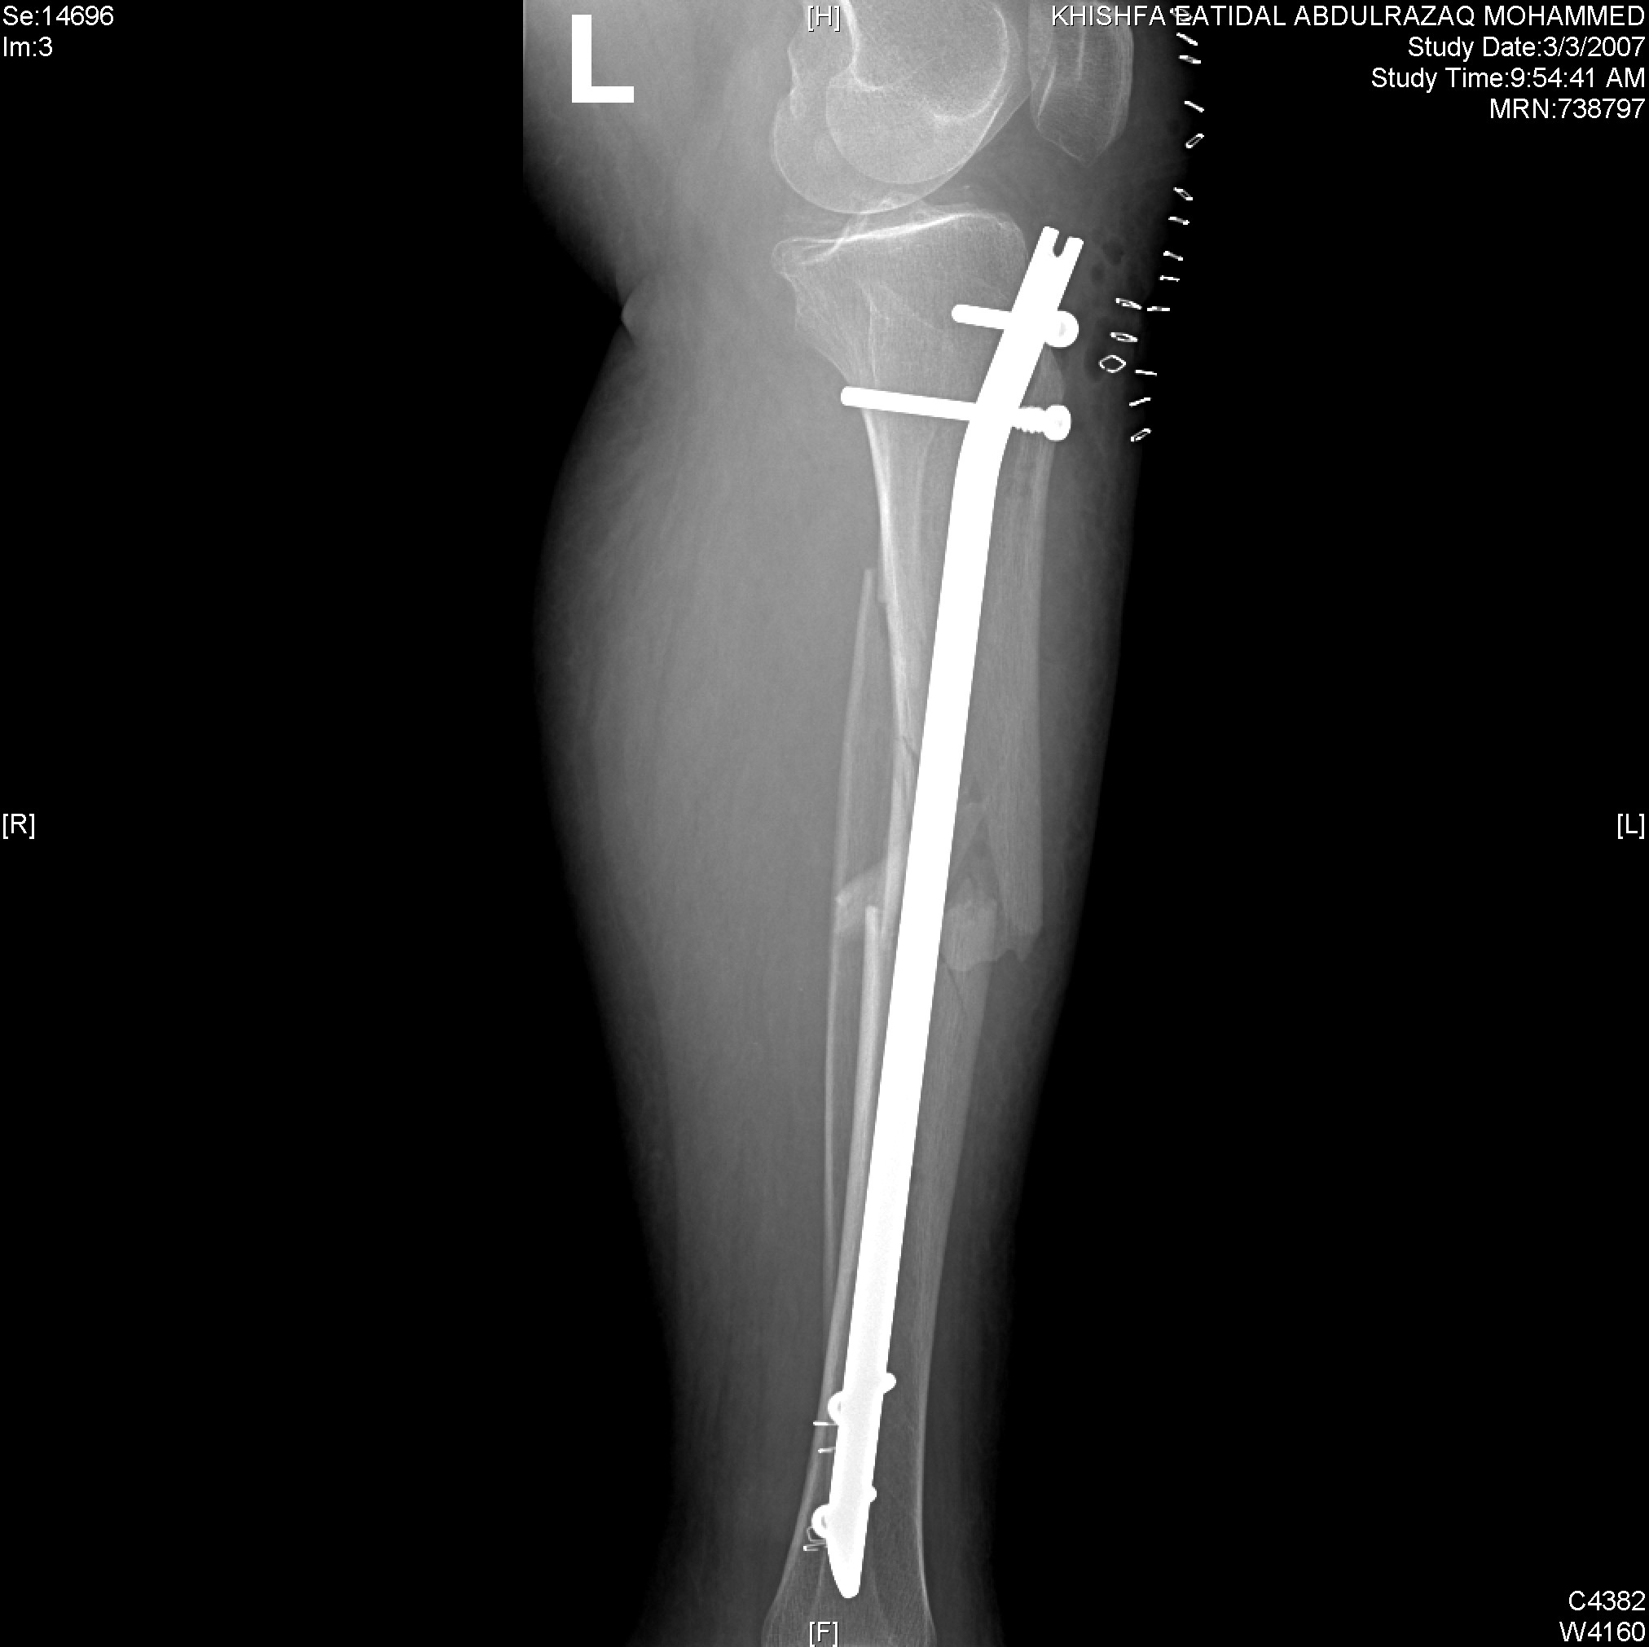
Operative treatment
Intramedullary (IM) Nailing is the best treatment for mid shaft tibia fracture
The most complication is anterior knee pain!!

Slide 60
External fixation
Open fracture with severe soft tissue injury.

Slide 61
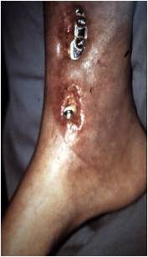
Plate fixation
97% success rates
Complication: infection, wound breakdown, nonunion
increase with higher-energy injury patterns.

Slide 62
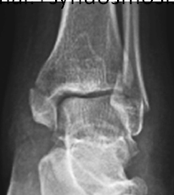
Ankle Fractures
Incidence increased in elderly women
Most ankle fractures are isolated malleolar fractures
Open fractures are rare < 2%.
Mechanism of injury: position of the foot at time of injury, the magnitude, direction, and rate of loading

Slide 63
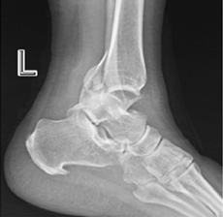
EVALUATION
Clinical
A dislocated ankle should be reduced and splinted immediately (before radiographs if clinically evident)
RADIOGRAPHIC
AP, Lateral and mortise views

Slide 64
AP view
Tibiofibula overlap of <10 mm is abnormal: syndesmotic injury.
Tibiofibula clear space of >5 mm is abnormal: syndesmotic injury
Talar tilt

Slide 65
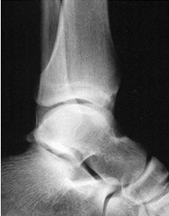
Lateral view
The dome of the talus should be centered under the tibia and congruous with the tibial plafond
Posterior tibial malleolous fractures can be identified

Slide 66
Mortise view
Foot in 15 degrees of internal rotation
A medial clear space
Tibiofibular overlap
Talar shift

Slide 67
Denis –Weber classification
A. Infra-syndesmotic
B. Trans-syndesmotic
C. Supra-syndesmotic: usually syndesmosis is torn

Slide 68
Treatment
Conservative: Below knee cast
Surgical:
Failed conservative treatment
Type C fractures
Type B with sndysmosis injury
Fracture-dislocation
Displaced bimallolar fracture

Slide 69
complications
Post traumatic arthritis
Stiffness
Skin necrosis
Malunion or nonunion
Wound infection
Regional complex pain syndrome

