Slide 1
Presentation and Management of spinal cord lesions

Slide 3
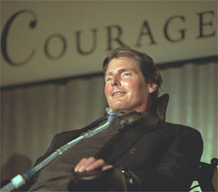

Slide 4
Anatomy
Bones spinal cord
33 vertebrae
7 cervical,
12 thoracic,
5 lumbar, and
5 sacral vertebrae
4 fused coccygeal
31 bilaterally paired spinal nerves
8 cervical (C)
12 thoracic (T)
5 lumbar (L)
5 sacral (S)
and 1 coccygeal (Co)
extends from the foramen magnum down to the level of the first and second lumbar vertebrae.
Below L2 continue as a leash of nerve roots known as cauda equina
Prolongation of the pia matter forms filum terminale

Slide 5
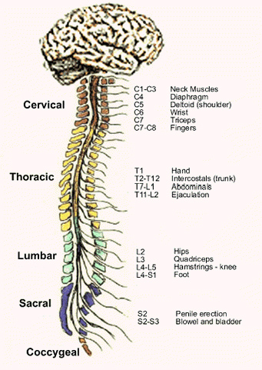

Slide 7
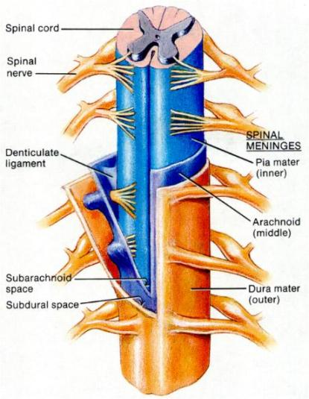
Spinal Meninges
Connective tissue membranes
Dura mater: outermost layer; continuous with epineurium of the spinal nerves
Arachnoid mater: thin
Pia mater: bound tightly to surface
Forms the filum terminale
anchors spinal cord to coccyx
Forms the denticulate ligaments that attach the spinal cord to the dura

Slide 8
Spinal Meninges
Spaces
Epidural: external to the dura
Anesthestics injected here
Fat-fill
Subdural space: serous fluid
Subarachnoid: between pia and arachnoid
Filled with CSF

Slide 9
Blood supply of the spinal cord
Consist of 1 anterior & 2 posterior spinal arteries→arise from vertebral arteries

Slide 10
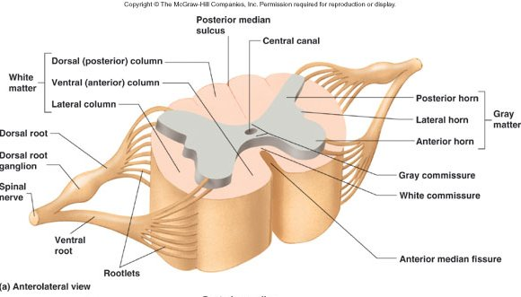
Gray matter: neuron cell bodies, dendrites, axons
Divided into horns
Posterior (dorsal) horn
Anterior (ventral) horn
Lateral horn
White matter
Myelinated axons
Divided into three columns
Ventral
Dorsal
lateral
Each of these divided into sensory or motor tracts

Slide 11
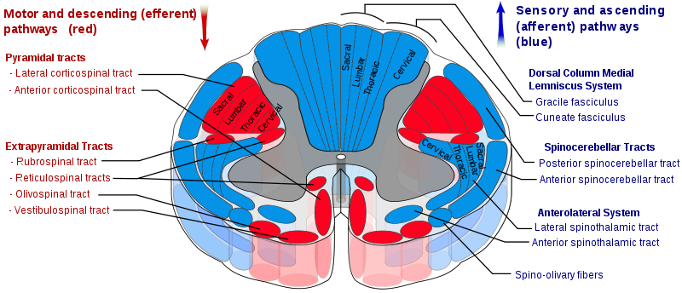
sensory tracts
Devided into :
1- dorsal column : carries touch – proprioception - vibration
2- anterolateral (spinothalamic ) : carries pain – temperature

Slide 12
The dorsal column axons do not decussate immediately at the spinal cord but they rather synapse with secondary axons at the medulla which form internal arcuate fibers . Thats where decussation occurs .
The spinothalamic neurons however enter the spinal cord and ascend 2 or 3 levels then synapse and decussate . So decussation occurs at the spinal cord

Slide 13
Motor ( corticospinal ) tracts
Devided into anterior and lateral tracts
Decussation occurs mainly at medullary pyramids (90%)
Lateral tract : involved with distal motor control (limbs)
Anterior tract : involved with axial muscle control

Slide 14
Spinal Cord Disorders
Transection (cross sectioning) at any level results in total motor and
sensory loss in body regions inferior to site of damage.
If injury in cervical region, all four limbs affected (quadriplegia)
If injury between T1 and L1, only lower limbs affected (paraplegia)
Hemisection (brown sequard) : contralteral loss of pain and temprature and ipsilateral loss of motor, proprioception , touch and vibration
Amyotrophic Lateral Sclerosis (aka, Lou Gehrig’s disease)
Progressive destruction of anterior horn motor neurons and fibers of the pyramidal tracts
Lose ability to speak, swallow, breathe.
Death within 5 yrs

Slide 15
Poliomyelitis
Virus destroys anterior horn motor neurons
Victims die from paralysis of respiratory muscles
Virus enters body in feces-contaminated water (public swimming pools)
Spinal shock:
- transient period of functional loss that follows an injury to spinal cord
Results in immediate depression of all reflex activity caudal to lesion.
Bowel and bladder reflexes stop, and all muscles (somatic and visceral) below the injury are paralyzed and insensitive. (so: bradycardia and hypotension might occur if lesion is in cervical level)
Neural function usually returns within a few hours following injury
If function does not resume within 48 hrs, paralysis is permanent.
It does not referr to circulatory collapse and doesn’t necessarily cause it, unlike neurogenic shock

Slide 16
Spinal shock should not be confused with Neurogenic shock , in which injury to CNS results in loss of sympathetic stimulation to circulatory system, resulting in hypotension and bradycardia.
It is an emergency
Tx of neurogenic shock : IV fluids, dopamine, vasopressin, norepenepherine or ephedrine and atropine.

Slide 17
Anterior spinal artery supply the anterior 2/3 of the cord →injury→affect corticospinal, lateral spinothalamic & autonomic interomedial pathway→ anterior spinal cord syndrome : paraplegia , loss of pain and temperature sensation
Posterior spinal arteries supply the dorsal column
→injury→ posterior spinal cord syndrome : loss of proprioception distally

Slide 18
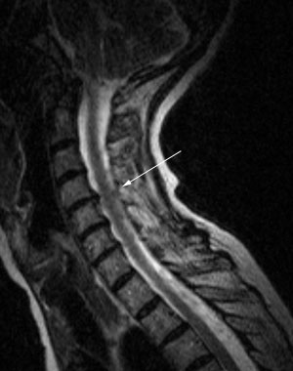
Spinal stenosis
Causes :
- congenital.
- degenerative.
- trauma.

Slide 19
Congenital spinal stenosis
The patient is born with a narrow spinal canal due to abnormally formed parts of the spine.
This condition is most common in patients with a short stature, such as achondroplastic dwarves.

Slide 20
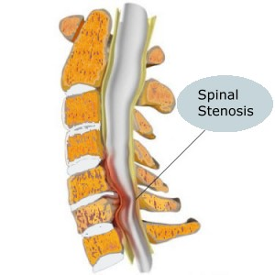
Other causes of spinal stenosis
aging process (most common cause ).
herniated discs.
bone and joint enlargement.
spondylolisthesis.
bone spurs.

Slide 21
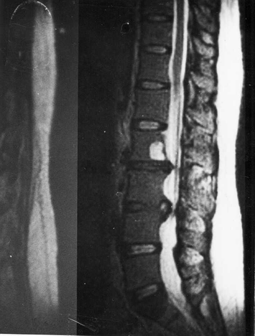
Cauda equina syndrome
Cauda equina syndrome (CES) is a serious neurologic condition in which there is acute loss of function of the lumbar plexus, neurologic elements (nerve roots) of the spinal canal below the termination (conus) of the spinal cord.
Causes : ( compression )
Tumors and, trauma , stenosis ,
inflammation ( paget’s disease,
ankylosing sponodylitis .. Etc )

Slide 22
Clinical presentation : lower limb motor loss, sphincter weakneses ( incontinence ) , sexual dysfunction , saddle anesthesia.
Dx : by MRI or CT
Treatment : surgical decompression and treating the cause.
Ideally within 48 hrs

Slide 23
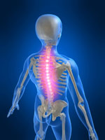
infections

Slide 24
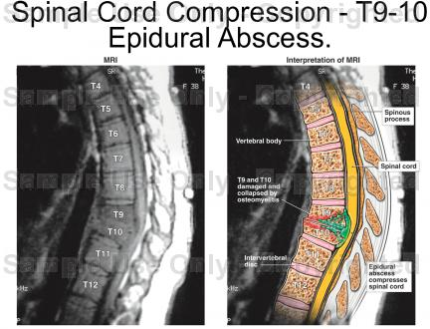
Epidural abscess
Spread through:
hematogenous route ( skin , UTI)
Adjacent focus
Direct inoculation(surgery , anesthesia)
Usually bacterial
( staphylococcus aureus is common)

Slide 25
Risk factor for epidural abscess
immunodeficiency
Diabetes mellitus
TB
AIDS
Alcoholism
Chronic renal failure
Intravenous drug abuse
Malignancy
Spinal procedure or surgery
Spinal trauma

Slide 26
Epidural abscess
Most common sites :
thoracic
lumbar
cervical
Signs and symptoms :
fever
Sever pain over the affected area
Weakness
Paraplagia
Back furuncle

Slide 27
Epidural abscess
Diagnosis :
MRI is the test of choice
Lumbar puncture is contraindicated
Treatment :
Surgical drainage and antibiotic
corticosteroid.
may need urgent surgical decompression by laminectomy.

Slide 28
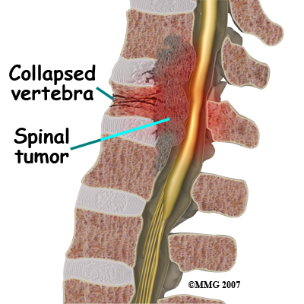
Spinal Tumors

Slide 29
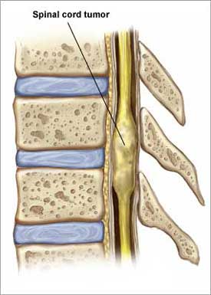
Spinal Tumors
Tumors are classified into 3 types according to their site:
extradural ( between the meninges and spine bones)
intradural extramedullary (within meninges)
intradural intramedullary ( inside the cord)

Slide 30
Spinal tumors
Most spinal tumors are extradural – about 85%
primary tumors:
originating in the spine
secondary tumors
result of the spread of cancer from other locations primarily the lung, breast, prostate, kidney, or thyroid gland.
Any type of tumor may occur in the spine, including lymphoma, leukemic tumors, myeloma, and others. A small percentage of spinal tumors occur within the nerves of the spinal cord itself, most often consisting of ependymomas and other gliomas.

Slide 31
Spinal tumors
17% have Multiple level involvement.
Metastatic lesion mostly found in Thoracic spine.
Myelopathy develops over days to weeks.
Acute SCC does occur if tumor enlarges very rapidly due to hemorrhage or if a vertebral body suddenly collapses

Slide 32
Symptoms of spinal tumors
Pain , numbness or sensory changes, motor problems and loss of muscle control.
Pain can feel as if it is coming from various parts of the body.
Numbness or sensory changes can include decreased skin sensitivity to temperature and progressive numbness or a loss of sensation, particularly in the legs.
Motor problems and loss of muscle control can include muscle weakness, spasticity (in which the muscles stay stiffly contracted), and impaired bladder and/or bowel control.

Slide 33
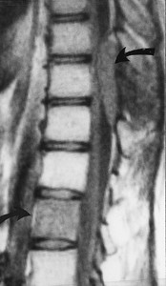
Extradural tumors
The most common spinal tumor – 85%
mostly metastatic
Arise from osseous element of spinal column
Grow rapidly
Primary ; Lung, Breast, prostate and kidney

Slide 34
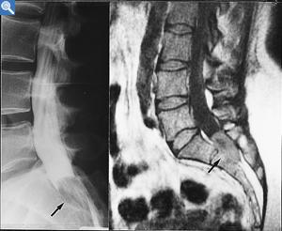
Intradural extramedullary tumors
Inside the dura but outside the spinal cord
e.g. Meningioma, Neurinoma
Arise from the dural sheath around the cord or showann cell sheath around the spinal root

Slide 35
Intradural extramedullary tumors
Multiple tumors in Pt. with neurofibromatosis
Can grow extradurally into retropleural or retroperitoneal through intervertebral foramen

Slide 36
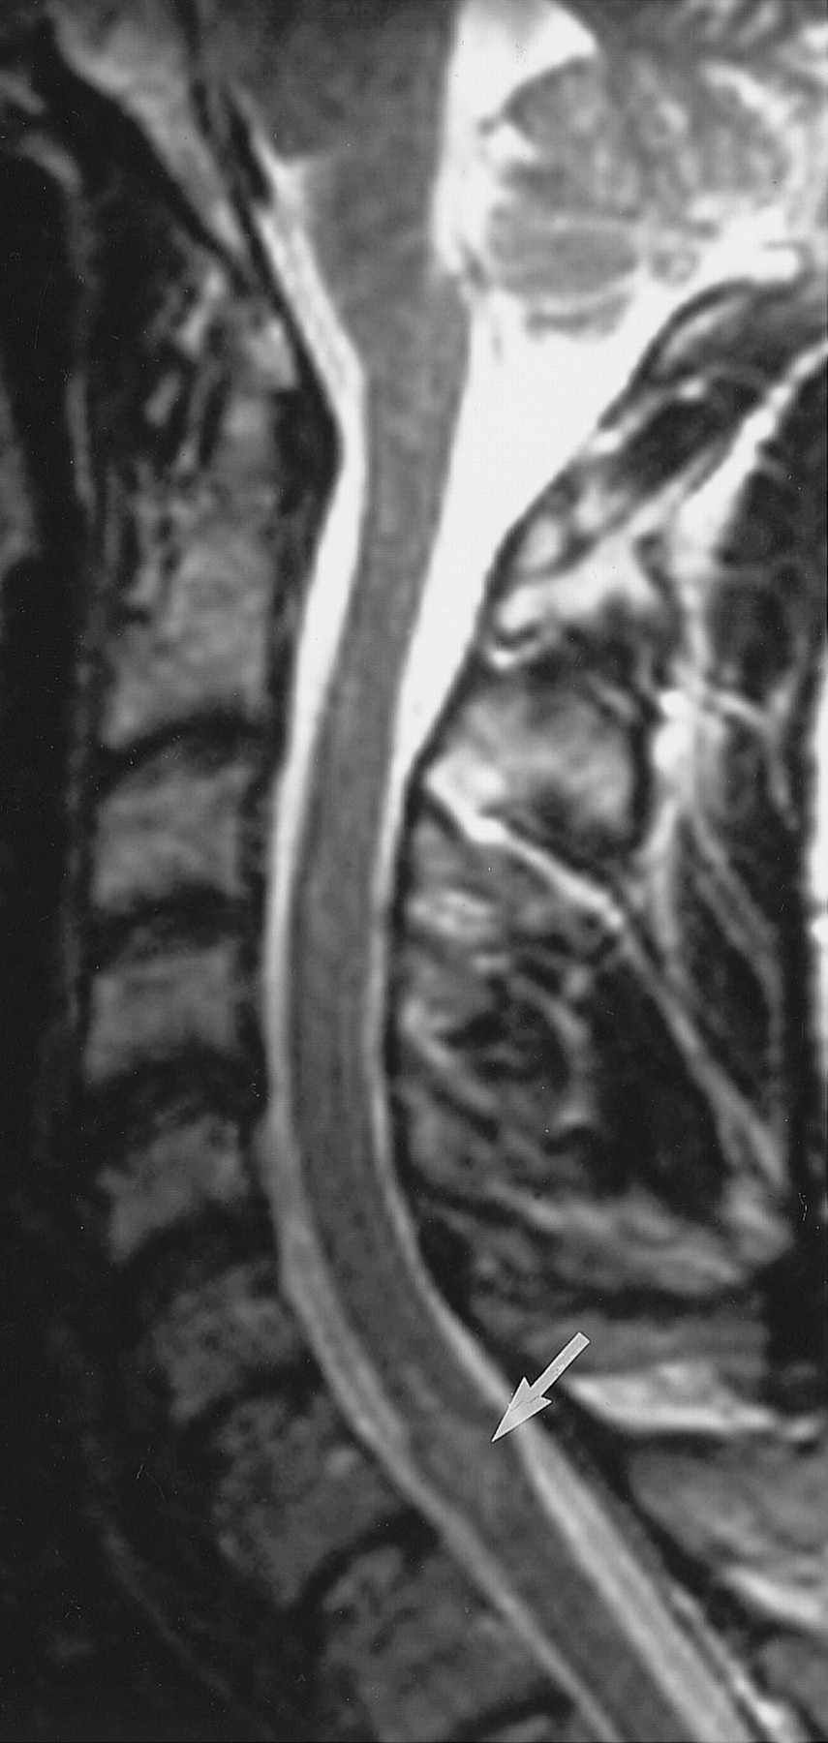
Intradural intramedullary tumors
Inside the spinal cord
Rare
Examples: ependymoma, astrocytoma
Arise from glial elements of spinal cord or trapped ectodermal elements.
More common in children

Slide 37
Intradural intramedullary tumors
Astrocytoma of spinal cord is the most common intramedullary tumor of childhood
Ependymoma of spinal cord is the most common intramedullary tumor of adulthood
Well demarcated

Slide 38
Investigations
Plain X-rays : erosions , vertebral collapse , enlarged intervertebral foramina , calcification in tumor ( meningioma )
Myelography “contrast material is injected into the thecal sac fluid surrounding the spinal cord and nerve root within the spinal canal”
CT
MRI ( study of choice )

Slide 39
Treatment
Surgical excision is the treatment for extramedullary tumors
Radiation therapy for intramedullary tumors and metastatic lesions
Chemotherapy can be considered in patients with progression of disease after radiation therapy

Slide 40
Cervical Spondylotic Myelopathy (CSM)
Spondylosis :
diffuse degenerative and hypertophic changes of the dics , intervertebral joints , and ligaments
CSM :
spondylosis casuing myelopathy from cord compression

Slide 41
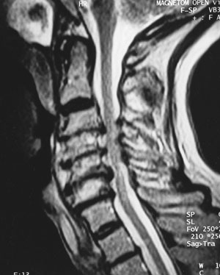
Cervical Spondylotic Myelopathy (CSM)
Signs and symptoms :
Spasticity and hyperreflexia
Upper extremity weakness and atrophy
Loss of lower extremity proprioception
Diagnosis :
MRI is the study of choice
Treatment :
Cervical laminectoym , anterior decompression and fusion

Slide 42
Transverse myelitis
Transverse myelitis (TM) is a neurologic syndrome caused by inflammation of the spinal cord.
Causes :
Viral: herpes simplex, herpes zoster, cytomegalovirus
Bacterial: Mycoplasma pneumoniae, syphilis, TB
Postvaccinal (rabies, cowpox)
SLE
MS
sarcoidosis

Slide 43
Cervical Spondylotic Myelopathy
Spondylosis :
diffuse degenerative condition with narrowing of IVD and osteophyte formation.
Symptoms:
painful , tender cervical spin.( radiate to the shoulder)
Stiff nick.
Diminished reflexes in the arms.
Sensory loss.
LMN weakness.

Slide 44
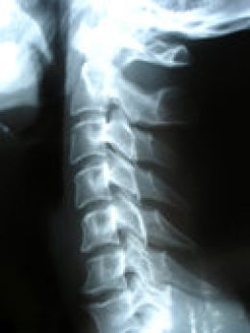
Investigation:
AP and lateral radiographs .
MRI

Slide 45
Treatment :
ABC .
Collar .
NSAIDs .
Short wave diathermy .
Gentle traction .
Decompress the nerve root .

Slide 46
Spinal truma
Spinal cord trauma is damage to the spinal cord. It may result from
direct injury to the cord itself.
indirectly from damage to surrounding bones, tissues, or blood vessels.
Spinal cord injury causes weakness and sensory loss at and below the point of the injury.
we can divide spinal trauma into 3 levels according to its location in the spinal cord ( cervical - thoracic – Lumbosacral ).

Slide 47
mechanisms of spinal cord injury
Primary mechanisms :
Primary cell death happens at the time of injury. It is due to direct mechanical forces such as shear,laceration, and compression
Secondary mechanisms:
secondary cell death that evolves over a period of days
to weeks.
hypoxia, ischemia, intracellular and extracellular ionic shifts, and programmed cell death or apoptosis.

Slide 48
Cervical
20-30% occur at the C5-6 level; 60-75% occur at the C6-7
signs and symptoms:
pain in the neck when turning or tilting the head.,There is often associated muscle tightness and spasms.
Injuries at the C-1/C-2 levels will often result in loss of breathing,
C3 vertebrae and above : Typically results in loss of diaphragm function
C4 : Results in significant loss of function at the biceps and shoulders.
C5 : Results in potential loss of function at the shoulders and biceps, and complete loss of function at the wrists and hands.
C6 : Results in limited wrist control, and complete loss of hand function.
C7 and T1 : Results in lack of dexterity in the hands and fingers, but allows for limited use of arms.

Slide 49
Cervical
Additional signs and symptoms of cervical injuries include
bradycardia, hypotension and sweating .
dysreflexia .

Slide 50
upper Cervical

Slide 51
lower Cervical

Slide 52
Thoracic
Pain over spine.
T1 to T8 : Results in the inability to control the abdominal muscles. Accordingly, trunk stability is affected.
T9 to T12 : Results in partial loss of trunk and abdominal muscle control.

Slide 53
Thoracic

Slide 54
Lumbar
The most common levels L4-5 and L5-S1.
The onset of symptoms is characterized by a sharp,burning, stabbing pain radiating down the posterior or lateral aspect of the leg. exacerbated by sitting and bending.
Bowel and bladder dysfunction.

Slide 55
Lumbar

Slide 56
Investigations
A CT scan or MRI of the spine may show the location and extent of the damage and reveal problems such as blood clots (hematomas).
Myelogram (an x-ray of the spine after injection of dye) may be necessary in rare cases.
Somatosensory evoked potential (SSEP) testing or magnetic stimulation may show if nerve signals can pass through the spinal cord.
Spine x-rays may show fracture or damage to the bones of the spine.

Slide 57
Treatment
ABC
Spine Immobilization , collar and BP control.
In cervical injuries higher than C5, intubation and respiratory support are usually needed.
Corticosteroids, rest, analgesics and muscle relaxant.
Surgery (decompression laminectomy ).
Extensive physical therapy and other rehabilitation interventions are often required after the acute injury has healed.

Slide 58
Spinal cord compression (scc)
The act of exerting an abnormal amount of pressure on the spinal cord.
Causes and risk factors :
- Traumatic injury.
- Spinal cord tumors.
- Spinal stenosis.
- Ruptured disks.
- Abscesses.
- Arteriovenous malformations.
- Degenerative diseases, such as arthritis.

Slide 59
Spinal cord compression (scc)
Symptom:
Back pain
Paralysis and loss sensation.
Urinary and fecal incontinence.
Hyperreflexia.

Slide 60
Investigations
X-Ray
MRI
CT or CAT scan
EMG
Myelogram
Discogram
Bone Scan

Slide 61
Treatment
ABC
Spine Immobilization , collar and BP control .
intubation and respiratory support are usually needed.
Corticosteroids.
Radiotherapy.
Chemotherapy.

Slide 62
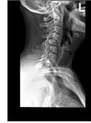
How to read it…?

