Slide 1
Adrenal gland
Omar benhusain
Supervised by Dr. Abdulaziz Al-Saif

Slide 2
introduction

Slide 3
Outlines:
Anatomy and physiology of adrenal glands
Presentation and management of common adrenal gland conditions including:
Pheochromocytoma.
Cushing's syndrome
Primary Aldosteronism (Conn’s syndrome).
Adrenocortical carcinoma
Incidental adrenal mass.

Slide 4
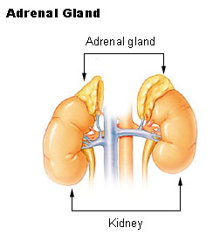
Anatomy:
Located between superomedial aspect of the kidneys and the diaphragm, at the level of the eleventh rib.
Each gland weights about 4G.
They are surrounded by connective tissue.
They are separated from the kidneys by fibrous tissue.
Both glands have different relation.
Right gland:
• Anteromedially with IVC.
• Anterolaterally with the liver.
Left gland:
• Spleen, stomach and the pancreas.

Slide 5
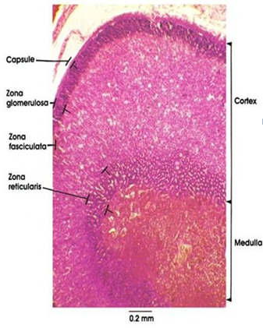
Each gland is surrounded by a fibrous capsule,
and has two parts:
The cortex:
• Yellow because of its high lipid content.
• Approx. 80-90% of the glands volume.
The medulla:
• Reddish-brown in color
Embryologically:
• The cortex (mesoderm).
• Medulla (chromaffin ectodermal cells of
the neural crest).

Slide 6
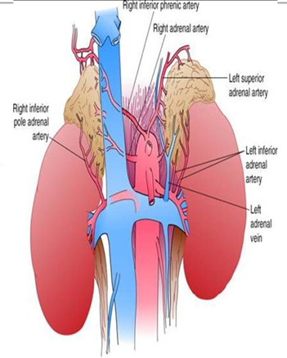
Blood supply:
Superior suprarenal arteries.
Middle suprarenal arteries.
Inferior suprarenal arteries.
Venous Drainage:
Right suprarenal into the IVC.
Left joined by inferior phrenic vein, into the left renal vein.

Slide 7
Lymphatic drainage:
To the lumber lymph nodes.
Nerve supply:
Celiac plexus.
Thoracic splanchnic nerves, mainly myelinated persynaptic sympathetic fibers.

Slide 8
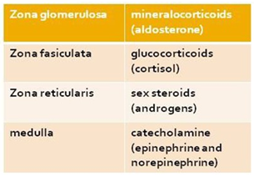
Histology:
The most distinctive feature of the adrenal is its partitioning into cortex and medulla.
The medulla is fairly homogeneous
The cortex has 3 zones:
• Zona glomerulosa.
• Zona fasiculata.
• Zona reticularis.

Slide 9
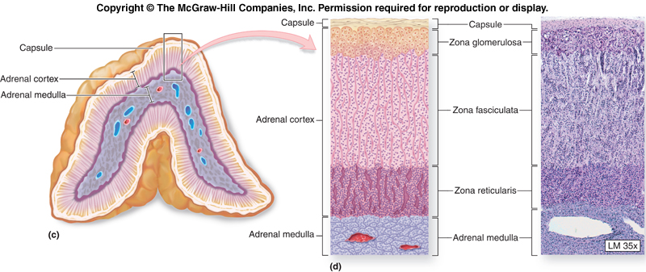

Slide 10
Glucocorticoids (cortisol)
Average secretion (15-20mg/day)
Secretion is controlled by ACTH.
Stimulated by pain, stress, hypoxia, hypothermia, trauma, and hypoglycemia.
It’s essential for life.
• Stimulation of Gluconeogensis.
• Anti-inflammatory effect.
• Suppression of the immune response.
• Maintenance of the BP.

Slide 11
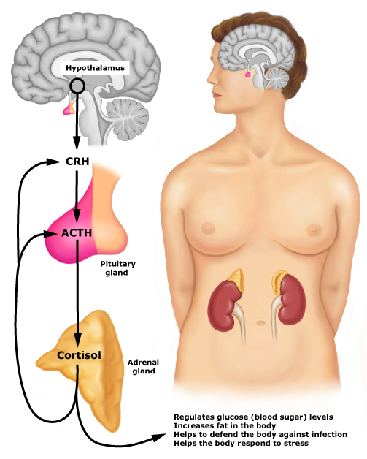

Slide 12
Sex Steroids (Androgens)
In males, adrenal androgens play a minor role.
In female, adrenal androgens are the major androgen and they are responsible for development of axillary & pubic hair and for libido.

Slide 13
Mineralocorticoids (Aldosterone)
Regulated primarily by the renin-angiotensin system.
Stimulated by:
• Decreased renal blood flow.
• Decreased plasma Na⁺
• Increased sympathetic tone.
Actions:
• Na⁺ reabsorption.
• K⁺ and H⁺ excretion.

Slide 14
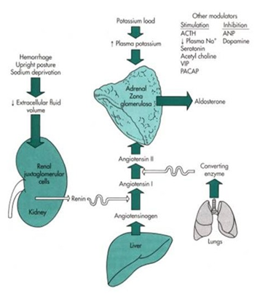

Slide 15
Adrenal Medulla: A Modified Sympathetic Ganglion
Sympathetic stimulation:
• Catecholamine release to blood
• Epinephrine
• Norepinephrine
Metabolites such as metanephrines, normetanephrines, and vanillylmandelic acid.

Slide 16
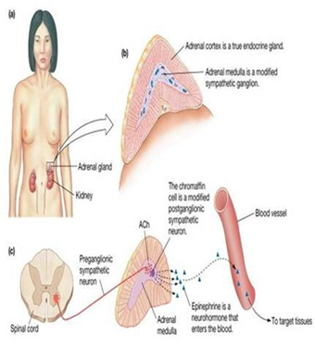

Slide 17
Catecholamine: Activity
Stimulate the “fight or flight” reaction.
Increased plasma glucose levels.
Increased cardiovascular function.
Increased metabolic function.
Decreased gastrointestinal and genitourinary function.

Slide 18
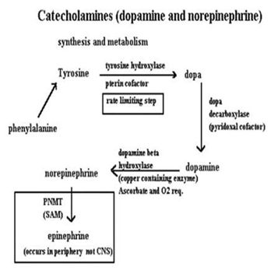

Slide 19
Pheochromocytoma

Slide 20
Pheochromocytoma:
A neuroendocrine tumor of the medulla of the adrenal gland (originating in the chromaffin cells).
Tumors arise outside of the adrenal gland, are termed: extra-adrenal pheochromocytomas, or paraganglioma.
Secretes excessive amounts of catecholamines, usually adrenaline (epinephrine) if it’s in the adrenal gland (not extra-adrenal), and noradrenaline (norepinephrine).

Slide 21
Diagnosis:
1. History:
The classic history:
Spells characterized by headaches, palpitations, and diaphoresis in association with severe hypertension.
In the absence of these 3 symptoms and hypertension, the diagnosis may be excluded.
The spells may vary in occurrence from monthly to several times per day (frequency).
The duration may vary from seconds to hours.
Typically, they worsen with time.

Slide 22
Other symptoms:
Tremor, nausea, weakness, anxiety, epigastric pain, flank pain, constipation, weight loss.
Pheochromocytomas are known to occur in certain familial syndromes. These include MEN 2A and 2B, Neurofibromatosis type I (von Recklinghausen disease), and VHL (von Hippel-Lindau) disease.

Slide 23
Precipitants of a hypertensive crisis:
Anesthesia induction.
Opiates.
Dopamine antagonists.
Cold medications.
Radiographic contrast media.
Drugs that inhibit catecholamine reuptake, such as tricyclic antidepressants and cocaine.
Childbirth.

Slide 24
2. Examination:
Hypertension (paroxysmal in 50% of cases), postural hypotension (from volume contraction), hypertensive retinopathy, weight loss, pallor, fever, tremor.
Tachyarrhythmias, pulmonary edema, cardiomyopathy, ileus.
Café-au-lait spots:
These are patches of cutaneous pigmentation that vary from 1-10 mm and occur any place on the body. Characteristic locations include the axillae and intertriginous areas (groin). It varies from light to dark brown.

Slide 25
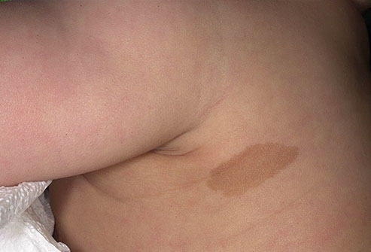

Slide 26
3. lab:
Blood test: analysis of free metanephrine in blood plasma. High levels are indicative of pheochromocytoma.
Hyperglycemia, hypercalcemia.
Urine test: 24-hour urinary excretion of catecholamines and their metabolites (metanephrines, vanillylmandelic acid).

Slide 27
4. Imaging
CT abdomen: sensitivity 85-95%.
MRI: more sensitive than CT (100%).
MIBG Scan:
¹²³I or ¹³¹I labelled Meta-Iodo-Benzyl-Guanidine.
MIBG catecholamine precursor taken up by the tumor.
Inject MIBG scan at 24h, 48h, and 72h.

Slide 28
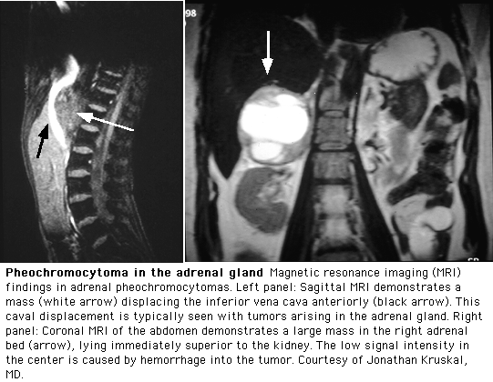

Slide 29
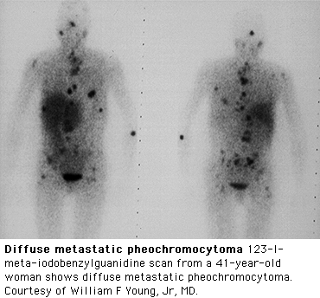

Slide 30
Management:
Surgical resection of the tumor is the treatment of first choice, either by open laparotomy or laparoscopy. (either benign or malignant)
Preoperative preperation:
α-adrenergic blocker (Phenoxybenzamine) to control hypertension and to permit re-expansion of intravascular volume.
β-Adrenergic blockade (Propranolol) to control tachycardia or arrhythmias.
Patients with cardiopulmonary dysfunction may require a pulmonary artery catheter (Swan-Ganz) perioperatively.

Slide 31
Intraoperative:
Use an arterial line, cardiac monitor, and Swan-Ganz catheter. Administer stress-dose steroids if bilateral resection is planned.
laparoscopic adrenalectomy if <8 cm.
If the pheochromocytoma is intra-adrenal, remove the entire adrenal gland.
In the case of a malignant pheochromocytoma, resect as much of the tumor as possible.
All patients should be monitored in the surgical intensive care unit in the immediate postoperative period.

Slide 32
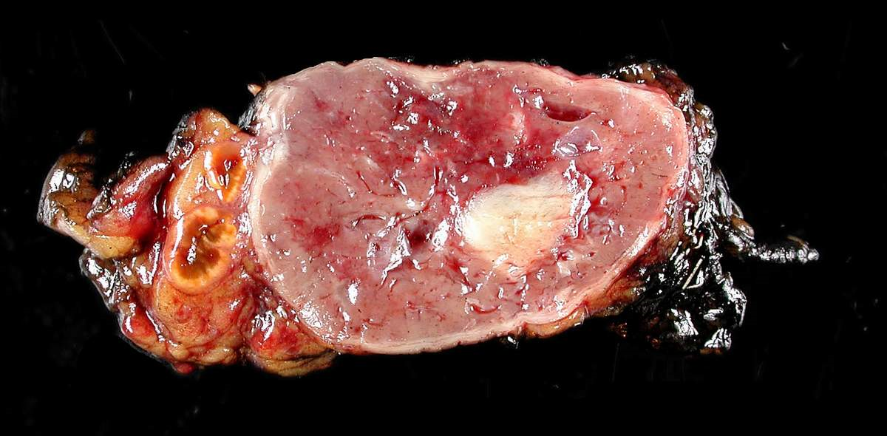

Slide 33
Cushing’s syndrome

Slide 34
Cushing’s syndrome:
Cushing’s syndrome is a hormone disorder caused by high levels of cortisol in the blood.
Results from exogenous steroid administration or excess endogenous cortisol secretion.

Slide 35
Pathophysiology
The most common cause of Cushing's syndrome is iatrogenic, administration of exogenous glucocorticoids or ACTH.
Hyper-secretion of ACTH from the anterior pituitary gland (Cushing's disease) is the most common pathologic cause (70% of cases) of endogenous hypercortisolism.
Abnormal secretion of cortisol from a primary adrenal adenoma or carcinoma is the cause of hypercortisolism in 10% to 20% of cases.
In approximately 15% of cases, Cushing's syndrome is caused by ectopic secretion of ACTH or an ACTH-like substance from a small-cell bronchogenic carcinoma, carcinoid tumor, pancreatic carcinoma.

Slide 36
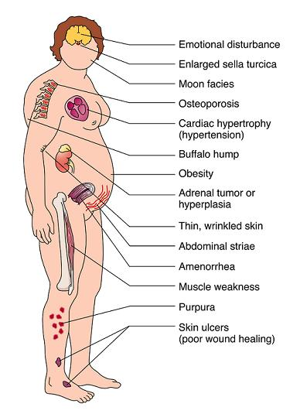
Diagnosis:
1. History and physical exam.

Slide 37
2. Lab:
1. Screening test for hypercortisolism:
24-hour measurement of the urinary excretion of free cortisol.
Urinary excretion of more than 100 µg/day of free cortisol in two independent collections is virtually diagnostic of Cushing's syndrome.
2. Confirm Cushing's syndrome:
An overnight dexamethasone suppression test (dexamethasone, 1 mg orally at 11 PM and measurement of plasma cortisol at 8 AM).

Slide 38
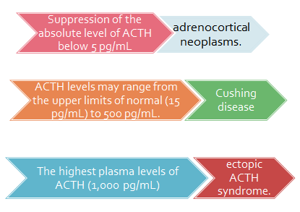
3. Localaization : immunoradiometric assay is the best method of determining the cause of hypercortisolism.
To distinguish a pituitary from an ectopic source of ACTH: standard high-dose dexamethasone suppression testing is used.

Slide 39
3. Imaging
Patients with ACTH-independent hypercortisolism, CT scan or MRI scan of the adrenal gland have more than 95% sensitivity.
Pituitary MRI scan.
CT scan of the chest to identify a tumor producing ectopic ACTH.

Slide 40
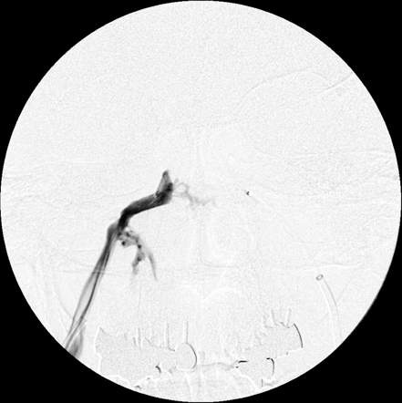
4. Petrosal Sinus Sampling:
Distinguish pituitary from ectopic source.
Rt. Inferior Petrosal Sinus

Slide 41
treatment
Trans-sphenoidal resection of an ACTH-producing pituitary tumor is successful in 80% or more of cases of Cushing's disease.
Treatment of ectopic ACTH syndrome involves resection of the primary lesion, if possible.
Primary adrenal causes of Cushing's syndrome are treated by removal of the adrenal gland containing the tumor.
All patients who undergo adrenalectomy for primary adrenal causes of Cushing's syndrome require perioperative and postoperative glucocorticoid replacement because the pituitary-adrenal axis is suppressed.

Slide 42
Conn’s syndrome

Slide 43
Primary aldosteronism (Conn‘s syndrome)
Is a syndrome of hypertension and hypokalemia caused by hypersecretion of the mineralocorticoid aldosterone.
Causes:
An aldosterone-producing adrenal adenoma (APA) in two thirds of cases and is one of the few surgically correctable causes of hypertension.
Idiopathic bilateral adrenal hyperplasia (IHA) 30% to 40%.
Adrenocortical carcinoma.

Slide 44
Diagnosis:
1. History & physical exam:
Hypertension.
Fatigue.
Muscle weakness.
Cramping.
Headaches.
Palpitations.
High blood pressure.
Edema is absent.

Slide 45
2. Lab:
Hypokalemia <3.5 mEq/L.
Elevated aldosterone >15 ng/dL.
Hypernatremeia.
Normal cortisol.

Slide 46
Confirmation of primary aldosteronism:
Ratio of plasma aldosterone (PA) activity to PRA (plasma renin aldosterone).
PA/PRA ratio (obtained in the morning) 20 or greater (with a PA ≥15 ng/dL) provide a sensitivity of 100% and a specificity of 80%, indicating the need for further study.

Slide 47
3. Imaging:
Adrenal CT scan or MRI.
Sensitivity 90%.

Slide 48
Treatment
Surgical removal of an APA through a posterior or laparoscopic approach, cure or improvement of hypertension and hyperkalemia in more than 90% of the patients.
Spironolactone (200 to 400 mg/day) preoperatively for 2 to 3 weeks to control B.P. and to correct hypokalemia.
Patients with IHA should be treated medically with spironolactone (200 to 400 mg/day). A potassium-sparing diuretic (such as amiloride) and calcium channel blockers have also been used.

Slide 49
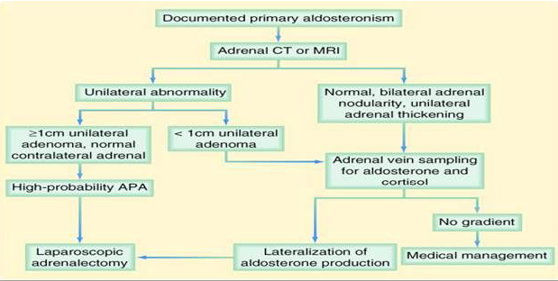

Slide 50
Adrenocortical Carcinoma

Slide 51
Adrenocortical Carcinoma:
Rare aggressive malignancy; most patients present with (locally advanced disease: means aggressive destruction of the gland and the surrounding blood vessels and surrounding tissue, it is step before metastasis).
Female : male , 2.5-3 : 1 , male usually present at older age.
Most patients with AC present with advanced disease that is characterized by multiple abdominal or extra-abdominal metastatic masses (stage IV disease).
Metastatic disease, most often involving the lung, lymph nodes, liver, or bone.

Slide 52
Presentation:
Hormonally active: Syndromes of adrenal hormone overproduction may include rapidly progressive hypercortisolism, hyperaldosteronism, or virilization. (30%-60%).
Non functioning silent: typically present with fever, weight loss, abdominal pain and tenderness, back pain, abdominal fullness, or symptoms related to metastases. 40%.

Slide 53
Management:
History & physical exam.
Lab: screening tests that can exclude excess hormone production when evaluating all primary adrenal masses.
Imaging: CT or MRI (THE STUDY OF CHOICE).
Large adrenal masses (>6 cm) that extend to nearby structures on CT scanning likely represent carcinoma.

Slide 54
Definitive diagnosis of adrenocortical carcinoma requires operative and pathologic demonstration of nodal or distant metastases. Any adrenal neoplasm weighing more than 50g should be considered malignant.

Slide 55
Treatment:
Complete surgical resection of locally confined tumor.
Surgical debulking of locally advanced adrenocortical carcinoma.
Chemotherapy with mitotane may be somewhat effective.
Overall, the prognosis is poor.

Slide 56
Incidental Adrenal Mass

Slide 57
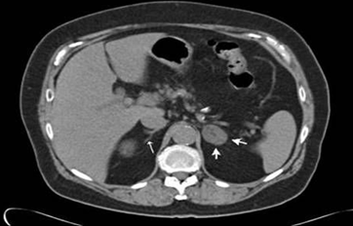
Incidental Adrenal Mass
Detected in 0.6-1.5% in pt. undergoing CT abdomen for another reason.
Frequency of Various Tumors in Major Series of Adrenal Incidentalomas:
• Nonfunctioning adenoma (60%)
• Pheochramocytoma (7.2%)
• Subchnical Cushing's (6.6%)
• Adrenocortical cancer (8.6%)
• Myelolipoma (3.6%)

Slide 58
Approach to patient with incidentaloma:
History & physical examination.
Biochemical evaluation:
24-hour urine for measurement of metanephrines and catecholamines.
1-mg overnight dexamethasone suppression test.
Plasma aldosterone concentration and plasma renin activity
Imaging: CT adrenal.
Biopsy: rarely indicated.

Slide 59
Indication for surgery:
Hormonally active tumor.
Non functional adrenal mass if > 6 cm, or sign of malignancy on imaging.
Nonfunctioning mass < 4cm: Observation with CT or MRI 3 to 4 month s and again for 1 year.

Slide 60
Technique of Adrenalectomy
Four open surgical approaches that have:
Anterior transabdominal.
Posterior retroperitoneal.
Lateral flank.
Thoracoabdominal.
Laparoscopic adrenalectomy: the standard for removal of benign adrenal lesions.

Slide 61
Notes

Slide 62
Difficulty in adrenal gland surgery:
Very deep structure covered by huge organs like liver, whatever the approach it will take long time to find it.
Venous drainage (right one drain to IVC so any injury will lead to massive venous bleeding which will be so difficult to control, also the left one to renal vein, which also if bleed (disaster). Also generally venous bleeding needs a big effort to control bleeding comparing to arteries also it will make the view very difficult.
Living without adrenal gland is impossible without adrenal gland, one or half of the gland is enough. Of course patients can live with supplement after adrenalectomy, for catecholamines we give the precursors, also they can be secreted from other sites of the body.
Common ex. Of extracellular fluid loss : diarrhea and vomiting
3 F’s of sympathetic activation : fight, fright, and flight.

Slide 63
Patients with pheochromocytoma may present with hypertensive crisis for the first time, very high B.P. like 220/110 mmHg. In these case the FIRST priority is to control BP, after that The BEST initial screening investigation is abdomen U/S to check for any suprarenal mass. U/S is an excellent method it can detect as small as 0.5 cyst in the adrenal (operator dependent).
Some surgeons believe it is more easier to do posterior approach just below the last rib. But here also they may face access limitation.
Pheochromocytoma patient need careful monitoring in SICU.
(the doctor said put all the lines you know and you do not know: NG tube, foley catheter, peripheral line……)

Slide 64
24 h urine: we ask p. to start urinate at 8 a.m. not to collect this urine at this point of time, but every urine after this should be collected till next 8 am.
Transphenoidial is through the nose in semicitting position under X RAY GUILDNESS …… Almost once a month done in our hospital .
CLASSIC picture of conns ( middle age, severe HTN that need 4 medication to control BP AND symptoms of hypokalemeia commonl fatigue, weakness.
Incedentaloma : once discovered do other CT OR MRI after 3-4 months the after one year.

Slide 65
Living without adrenal gland is impossible without adrenal gland , one or half of the gland is enough. Of course patients can live with supplement after adrenelectomy , for catecholamines we give the precoursours, also theycan be secreted from other sites of the body .
U should observe the pattern of blood pressure, it is much important than one isolated reading in diagnosing pheochromocytoma
Peri and Post op care of pheo pt is to be monitored in ICU for 24 hr
2 anesthetist stick to the pt all the time
And the most important point the doctor mentioned is (it is not good to be angry) ☺

Slide 66
Thank you

