Slide 1
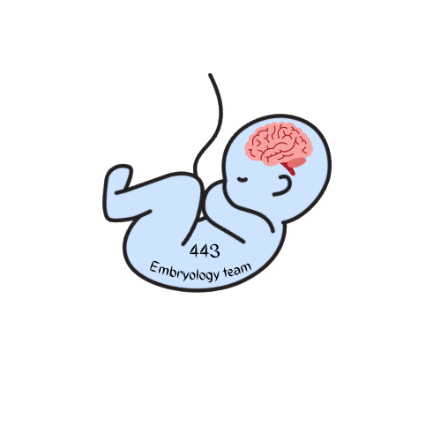
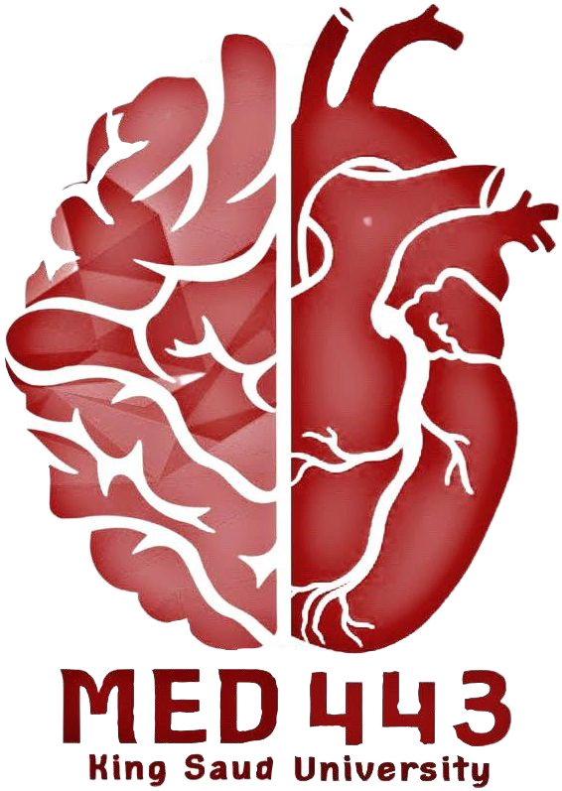
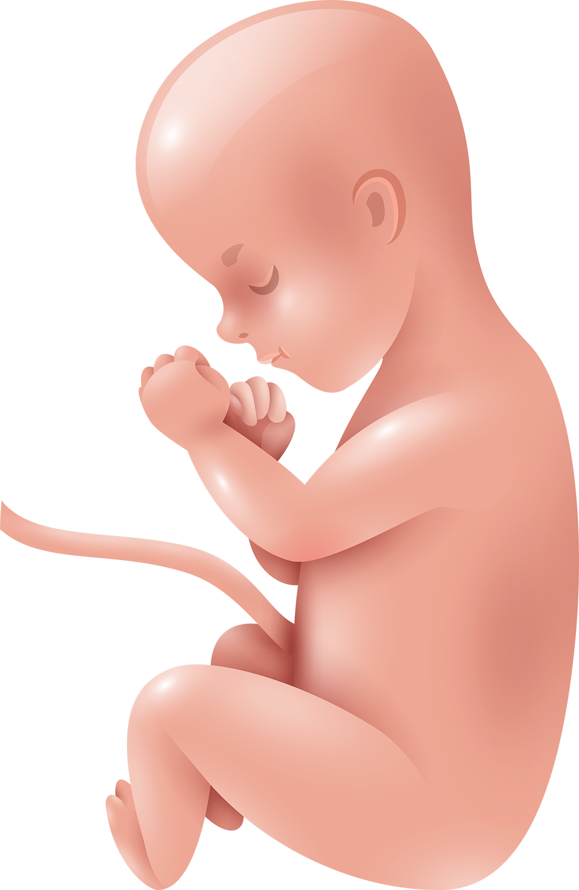
Embryological Development
of the Spinal Cord and
Vertebral Column
Neuropsychiatry Block
Color Index: -Main Text
-Important
-Female Slides
-Male Slides
-Dr’s Notes
-Extra

Slide 2
Objectives
Describe the development of the spinal cord from the neural tube.
List the layers of the spinal cord and its contents.
List subdivisions of mantle & marginal zones.
List meningeal layers and describe positional changes of spinal cord.
Describe development of vertebral column from sclerotomic portion of paraxial mesoderm.
Describe chondriﬁcation & ossiﬁcation stages in vertebral development.
Describe spina biﬁda and its types.

Slide 3
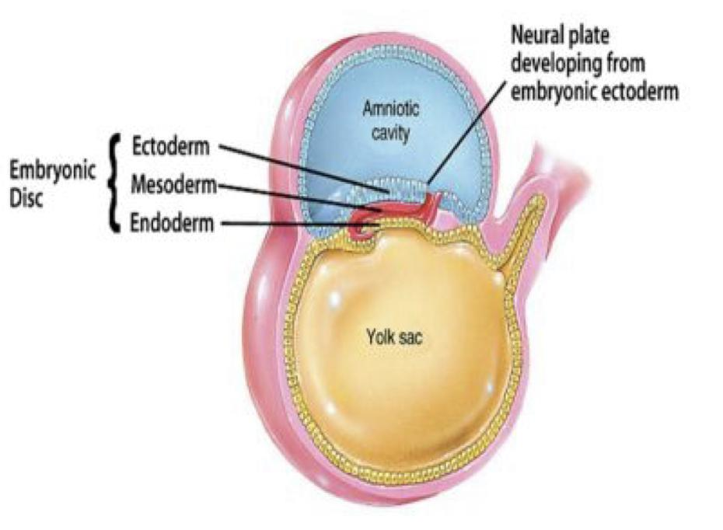
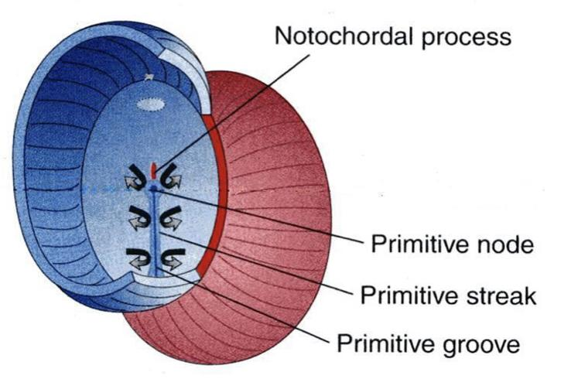
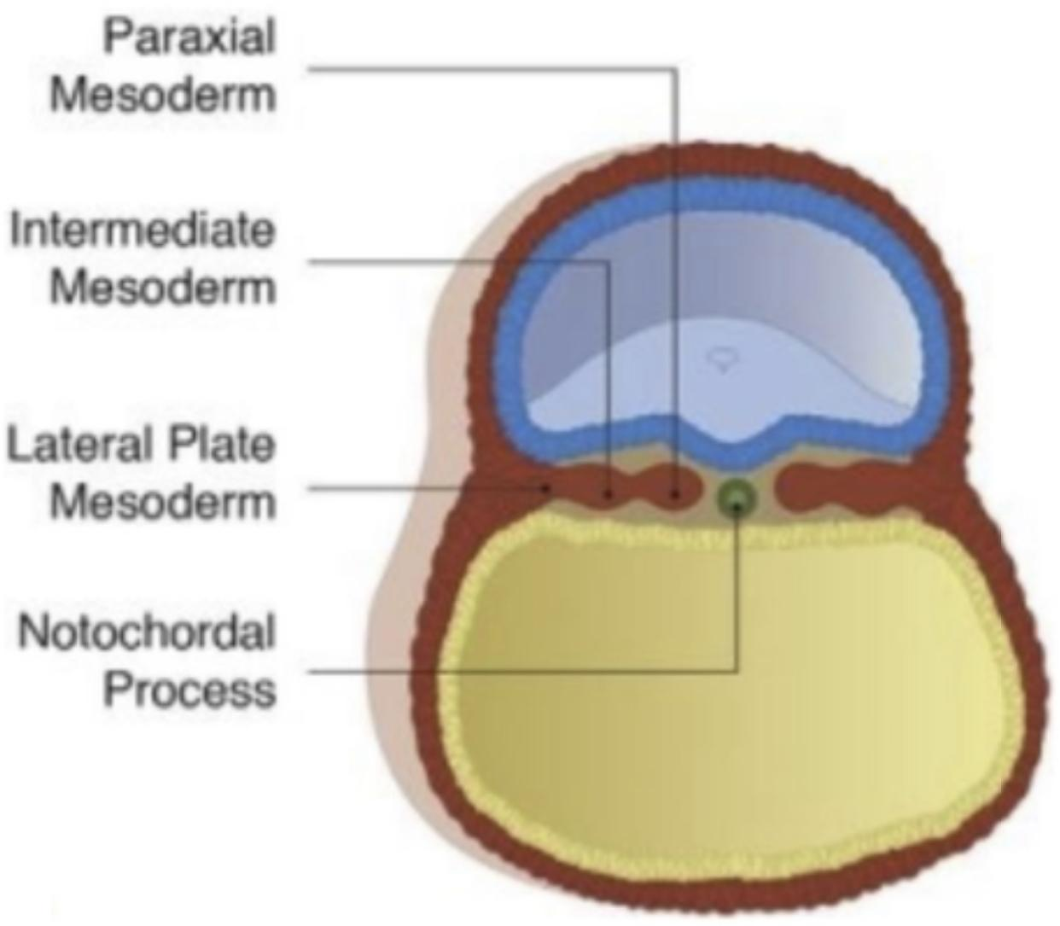
Female slides
Introduction
2nd Week
Cavity |  | Lined By
Amniotic Cavity |  | Epiblast (the primitive ectoderm)
Yolk Sac Cavity |  | Hypoblast (the primitive endoderm)
3rd Week
3 Germ Layers
Ectoderm
Endoderm
Mesoderm is undeveloped
Mesoderm is Present
Mesoderm starts to appear between the Epiblast and Hypoblast
Intraembryonic Mesoderm
These structures are present inside the amniotic cavity:
(on the surface of the ectoderm above the other 2 germ layers)
- Primitive node.
- Primitive streak.
- The Intraembryonic mesoderm and the Notochord are between the ectoderm and endoderm, “but they do not come in contact as seen in the pic on the right”

Slide 4
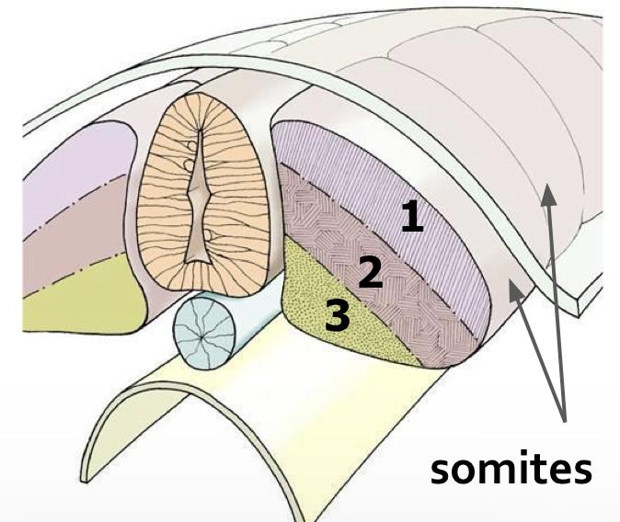
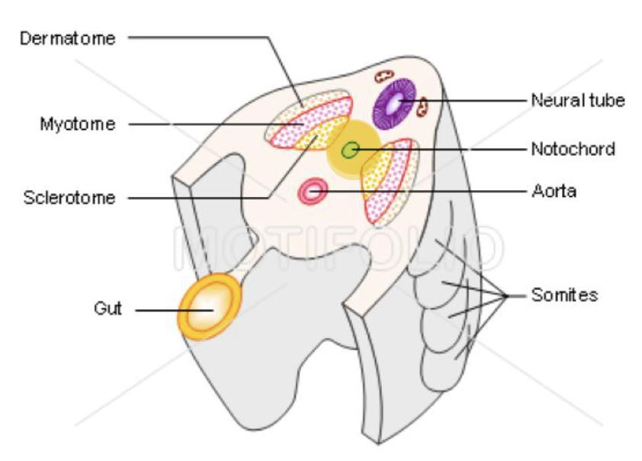
Intraembryonic Mesoderm cont..
Introduction
- The mesoderm is located between ectoderm and endoderm except in the central axis of embryo where notochord is found.
- What is the ﬁrst sign of specialization of mesoderm? the appearance of notochord.
Mesoderm diﬀerentiates into 3 parts:
(They appear on the lateral sides of notochord”the first sign of mesoderm”, see the pic on)
Lateral Mesoderm
“Double sheets”
Paraxial Mesoderm
Intermediate Mesoderm
Divides into segments called :
Somites
Each somite divides into 3 parts:
Sclerotome
form the vertebrae and ribs
Myotome
forms the skeletal muscles of the neck, trunk & limbs
Dermatome
forms the dermis of the skin on the
dorsal part of the body

Slide 5
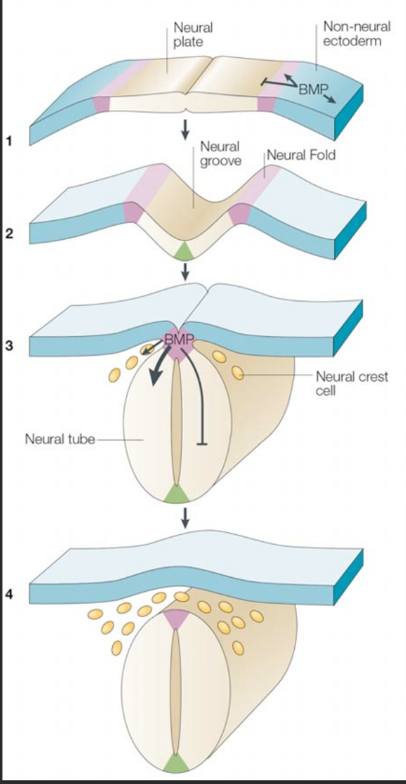
Development of the Neural Tube
Notochord stimulates Neural tube formation which in turn stimulates the development of the vertebral column.
What is the Neural Tube?
It is a derivative of the ectoderm overlying the notochord that gives rise to the brain and the spinal cord.
How does the Neural Tube develop?
Highly Recommend
1
Ectodermal cells above/dorsal to notochord thickens to form the “neural plate”
2
A longitudinal groove develops in the neural plate “neural groove” Neural plate folds to form “neural groove” with prominent neural folds
3
The margins of the neural plate (neural folds) approach each other(with deepening of the neural groove) and fuse to form the neural tube.
4
The neural folds fuse and a neural tube is formed, The tube then separates from the overlying ectoderm
How does the Neural Tube closes?
1
Closure of the neural tube begins in the future neck region (4th somite), then proceeds cranially and caudally
2
The most cranial and caudal ends of the tube still open as:
1- Anterior (cranial) neuropores: which closes at day 25 forming lamina terminalis
2- Posterior (caudal) neuropores: which closes at day 27
-The lumen of the tube will give:
1- Ventricles of the brain
2- Central canal of spinal cord

Slide 6
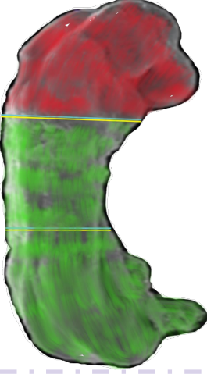
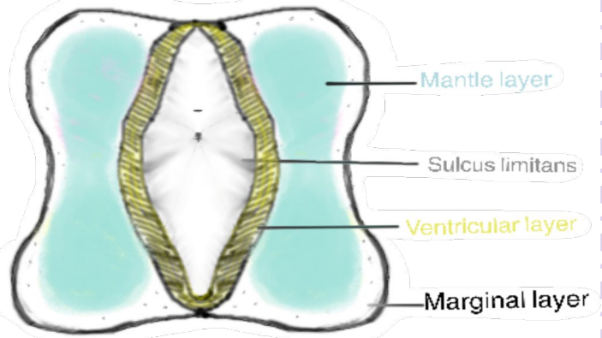
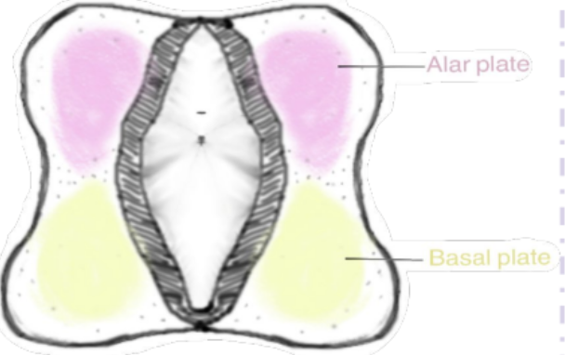
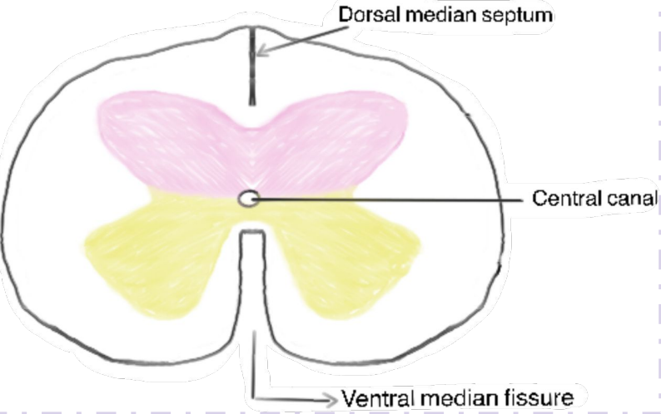
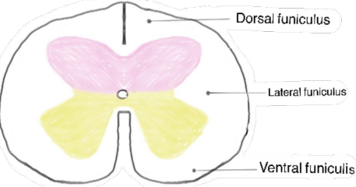
Development of Spinal Cord
Highly Recommend
-Neural tube differentiates into 2 regions:
1- Upper (cranial) ⅓ ➔ Brain Region
2- Lower( caudal ) ⅔ ➔ Spinal Cord Region
-Neural tube cells ”neuroepithelial” arranged in 3 layers:
1- Inner ventricular zone of undifferentiated cells.
2- Middle mantle zone of cell bodies of neurons (future grey matter).
3- Outer marginal zone of nerve fibers (axons) of neurons (future white matter).
-Neurons of mantle layer (future grey matter) differentiate into 2 areas separated by sulcus limitans (a longitudinal groove) into:
1- Dorsal alar plate (future dorsal horn): containing sensory neurons.
2- Ventral basal plate (future ventral horn): containing motor neurons.
-Proliferation and bulging of both alar & basal plates result in formation of:
1- Longitudinal Dorsal median septum.
2- Longitudinal Ventral median fissure.
3- Narrowing of the lumen of the neural tube to form small central canal.
- Marginal layer (future white matter) increases in size due to addition of ascending, descending and intersegmental nerve fibers.
- It divides into: dorsal, ventral and lateral funiculi (White columns).
- Myelination of nerve fibers starts at the 4th month and continues during 1st (2 years of) postnatal period.
- Motor fibers gets myelinated before sensory fibers.
- Myelination starts in the PNS, then the spinal cord, the brain stem, and the brain last.
So after nerve injury, both motor and sensory axons have the ability to regenerate and are given a proper pathway.
*Unmyelinated axon conduction velocity: 0.5 – 10 m/s
*Myelinated axon conduction velocity (Saltatory conduction) : up to 150 m/s

Slide 7
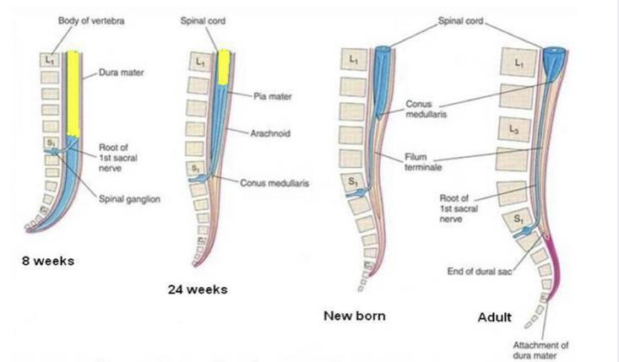
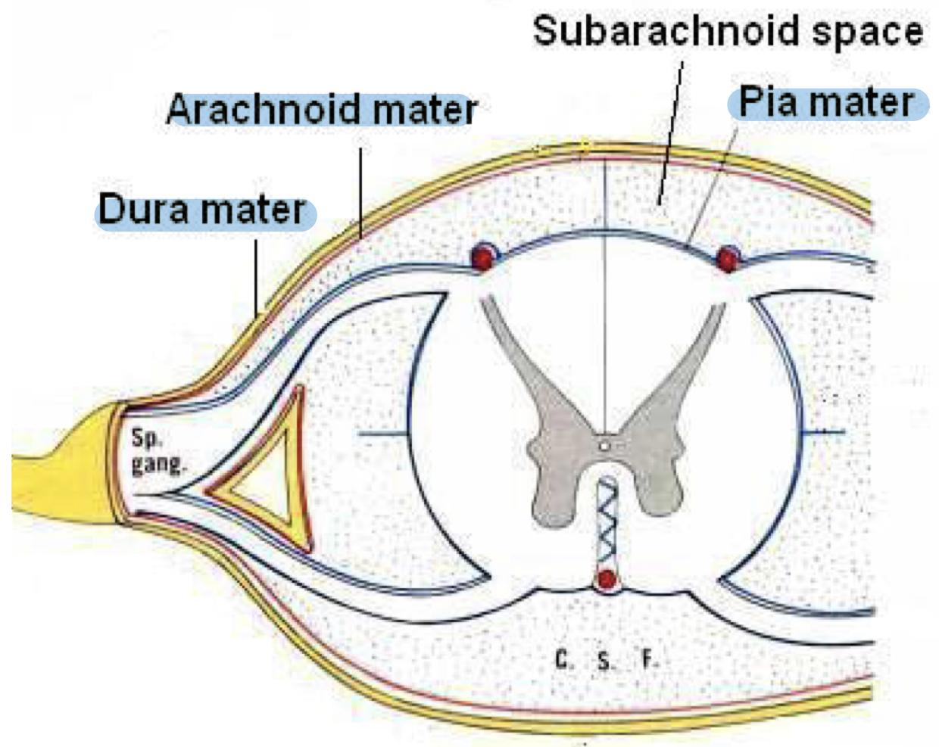
Positional Changes of Spinal Cord
-Initially, the spinal cord occupies the whole length of the vertebral canal.
-But As a result of the faster growth of vertebral column, the caudal end of the spinal cord (conus medullaris) shifts gradually to a higher level.
3rd month/ 8th week ➔ same length as vertebral canal(vertebral column)
24 weeks➔ Spinal cord at level of to S1
Birth ➔ spinal cord terminates at 3rd lumbar vertebra
Adult ➔Spinal cord terminates at L1-L2
Meninges
There are 3 membranes covering the neural tube:
Dura Mater
The outer thick layer, MESODERMAL in origin.
Arachnoid Mater
The middle layer, ECTODERMAL in origin.
Pia Mater
The Inner thin layer, ECTODERMAL in origin.
A cavity appears between the arachnoid & the pia mater (Subarachnoid space) & becomes filled with Cerebrospinal fluid (CSF).

Slide 8
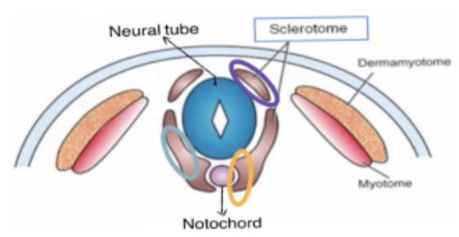
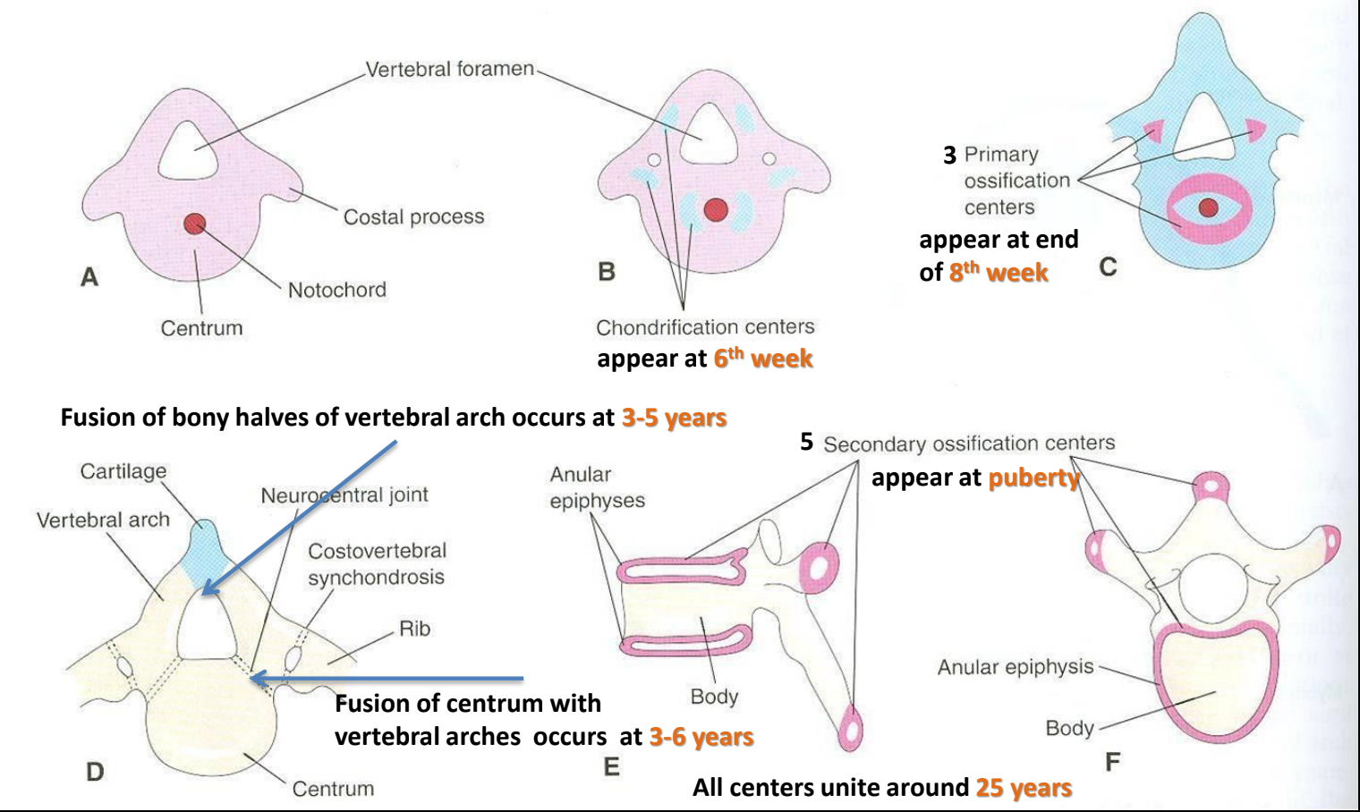
Development of Vertebra
Paraxial mesoderm
Somite
Ventromedial Part
(Sclerotome)
Sclerotome
Is the ventromedial part that gives vertebrae and ribs.
Somite
1
Male slides
Sclerotome around neural tube:
forms the vertebral (neural) arch.
2
Sclerotome around notochord:
forms the body of vertebra.
3
Sclerotome in body wall near to neural tube & notochord:
forms costal process which gives the ribs in the thoracic region.
important
Vertebral Development
Mesenchymal Stage
Chondrification Stage
Primary Ossification Stage
Appear at end
of 8th week
Appear at 6th week
Stage of Fusion
Stage of Secondary Ossification

Slide 9
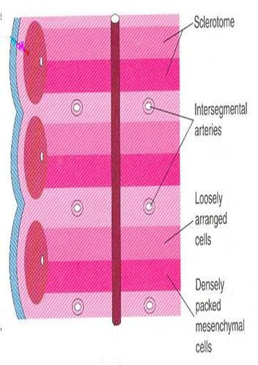
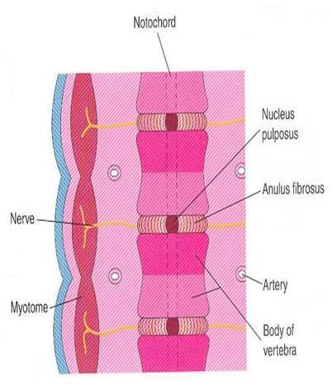
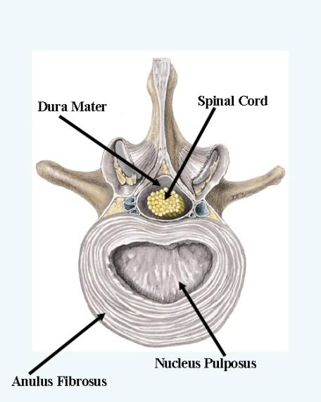
Formation of body of vertebra
The vertebral column develops from the ventromedial parts (sclerotomes) of the somites
At week 4, each sclerotome is formed of:
1-A cranial part of loosely arranged cells.
2-A caudal part of densely packed cells
(of more condensed tissue).
.
The caudal part of each sclerotome/somite
fuses with the cranial part of consecutive/succeeding
sclerotome/somite to form the body of the
vertebra , called the centrum
(body primordium)
-Each centrum develops from 2 adjacent sclerotomes.
-Thus the bodies of the vertebrae are intersegmental in origin.
-The fused sclerotomes grow in 2 directions:
(A) Dorsally around neural tube and form the vertebral (neural) arch.
(B) Ventrolaterally to form costal processes that give rise to ribs in thoracic region
Fate of notochord:
-In the region of the bodies of vertebrae: It degenerates.
-Between bodies of vertebrae: It forms the central part, ’nucleus pulposus’ of the intervertebral discs
N.B: Annulus fibrosus (the other part of the intervertebral discs) is formed by the mesoderm surrounding the notochord.

Slide 10
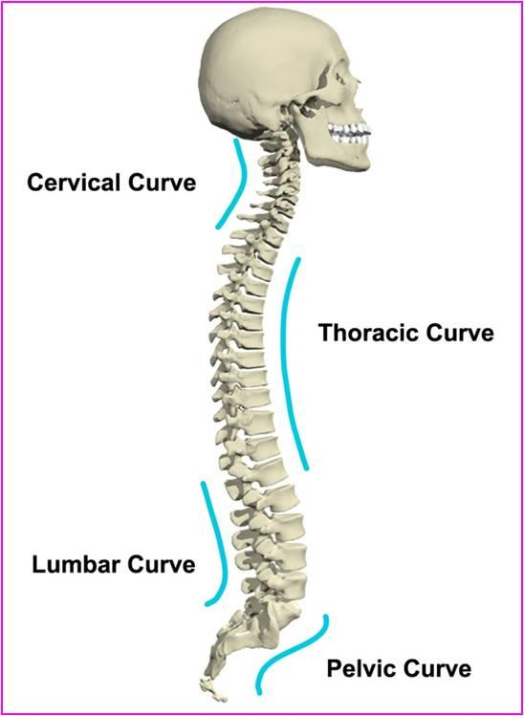
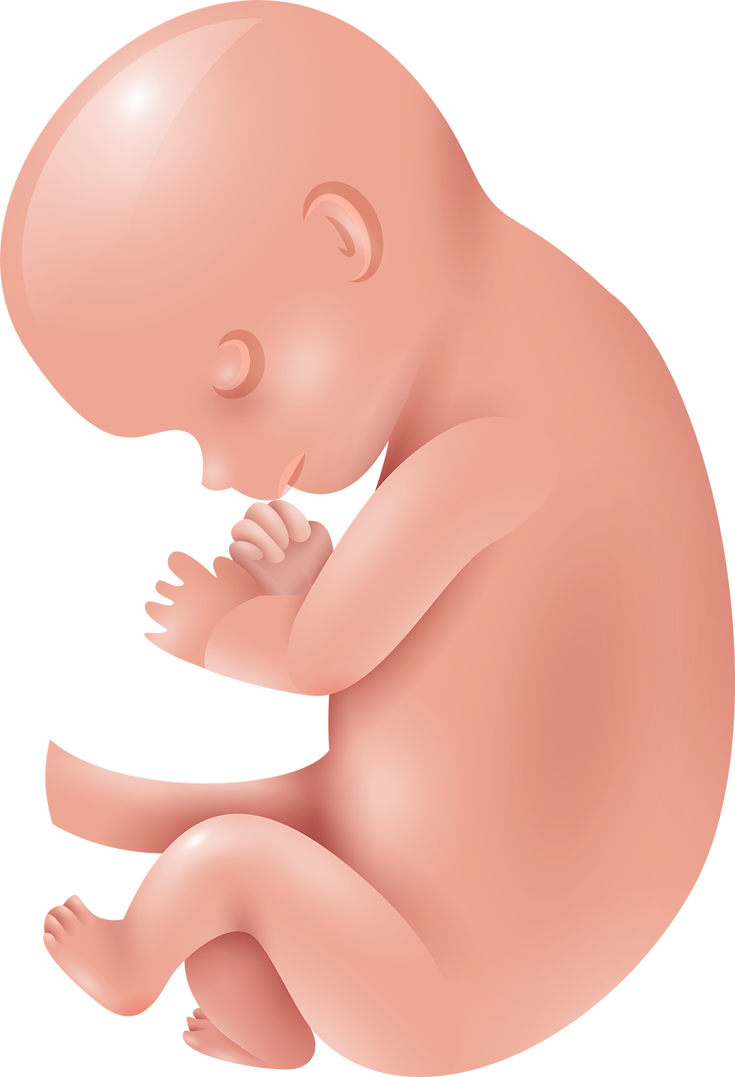
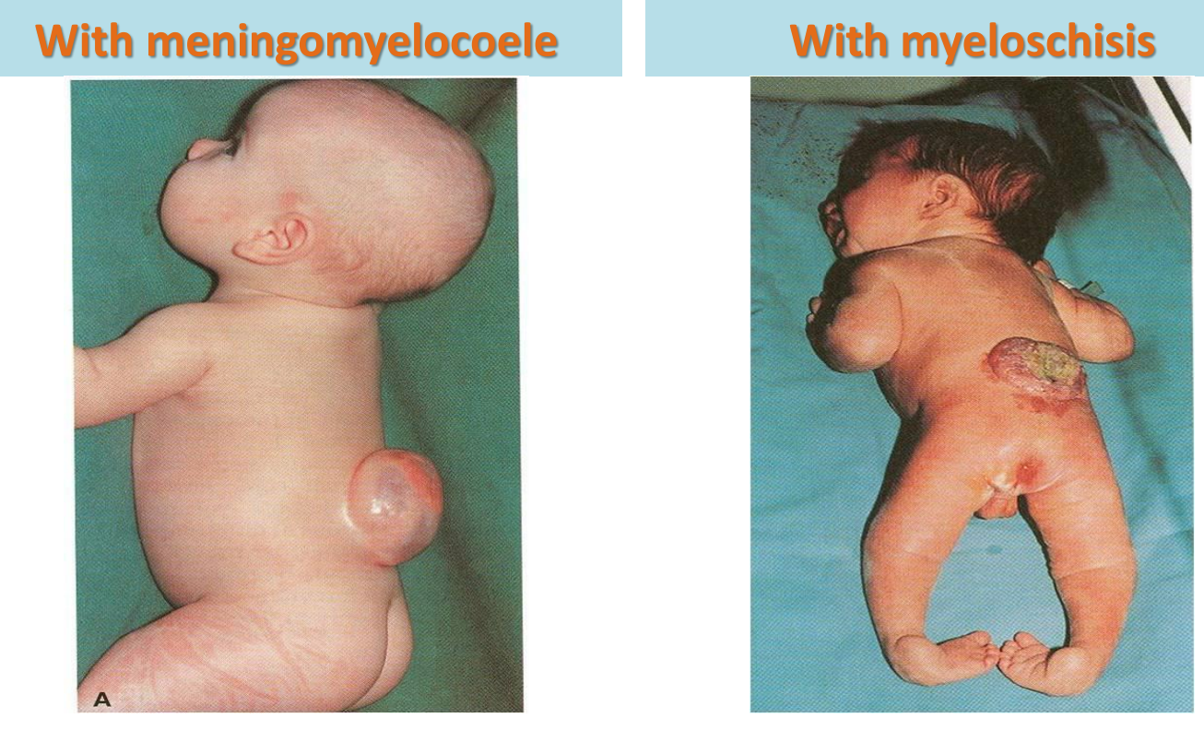
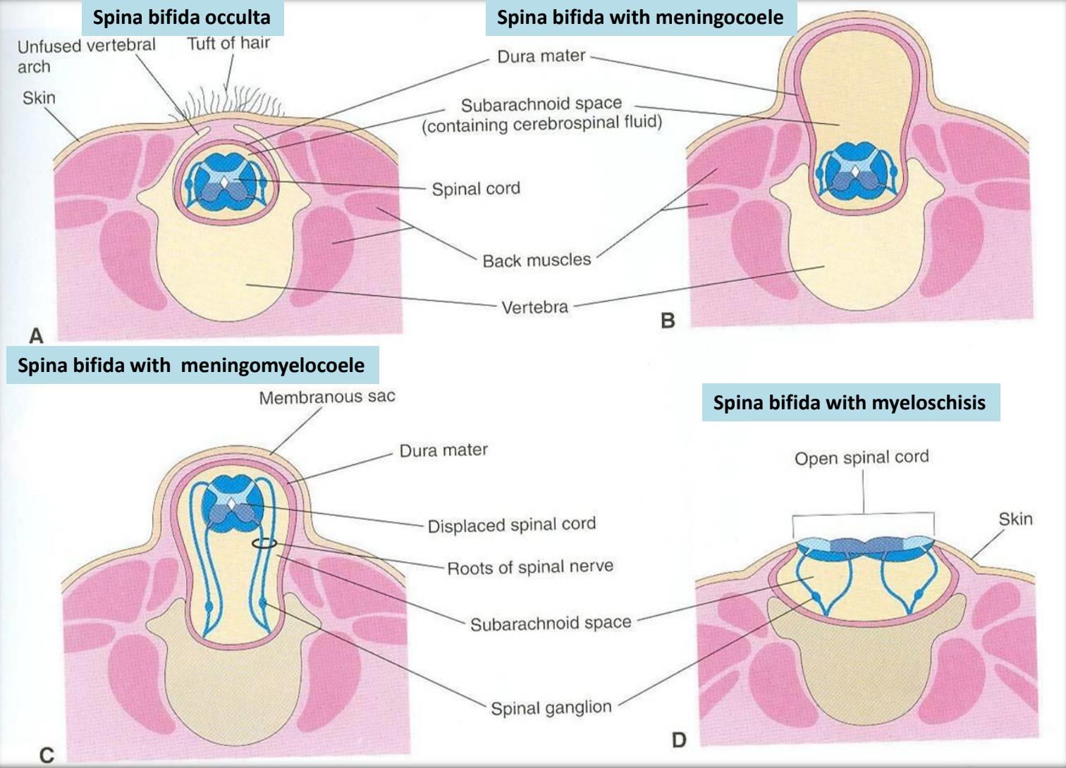
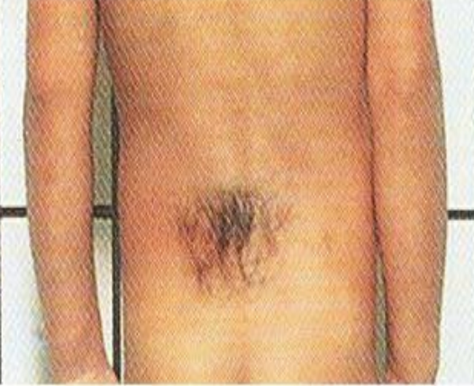
Curvatures of Vertebral Column
Primary Curvatures (concave anterior): develop prenatally
Thoracic
Pelvic or Sacral
Secondary curvatures (convex anterior): develop postnatally
Cervical: concave posteriorly
-as a result of lifting the head
Lumbar: concave posteriorly
-as a result of walking
-Help support trunk, upper body
Spina Bifida
Cause: Failure of fusion of the halves of vertebral arches.
Incidence: 0.04%-0.15%.
Sex: More frequent in females.
Types: 1-Spina bifida cystica (80%).
2- Spina bifida occulta (20%).
Spina Bifida Cystica |  | Spina Bifida Occulta
The open type. Most severe and complex form of spina bifida |  | The closed type
It usually involves serious neurological problems. A portion of the nerves and the spinal cord are exposed outside the body |  | Only one vertebra is affected
Neurological symptoms are present Subdivided into: 1-Spina bifida with meningocoele: protrusion of sac containing meninges and cerebrospinal fluid. 2-Spina bifida with meningomyelocoele: protrusion of sac containing meninges with spinal cord and/or nerve roots. 3-Spina bifida with myeloschisis: spinal cord is open due to failure of neural folds to develop. |  | Subdivided into: 1- Spinal dermal sinus 2- Tethered cord No clinical symptoms. Skin overlying it is intact, sometimes covered by a tuft of hair Usually doesn’t involve underlying neural tissue

Slide 11
Summary
Important
The spinal cord develops from the caudal 2/3 of the ectodermal neural tube.
Layers of spinal cord are (from inside outward): ventricular, mantle (future grey matter) and marginal (future white matter).
Mantle layer differentiates into dorsal alar plate (with sensory neurons) & ventral basal plate (with motor neurons) separated by sulcus limitans.
Marginal layer is divided into dorsal, lateral & ventral funiculus.
Myelination of nerve fibers starts at 4 th month & continues during the 1st postnatal period.
Motor fibers myelinate before sensory fibers.
Meninges are 3 membranous sac covering the neural tube (from outside inward): dura (mesodermal in origin), arachnoid and pia (both are ectodermal in origin).
A cavity between arachnoid & pia matters (subarachnoid space) contains cerebrospinal fluid.
During development the end of spinal cord shifts its position: at 24 weeks (level of S1), at birth (level of L3), adult position (level of L1-L2).

Slide 12
Summary
Important
Vertebral column develops from sclerotomic portion of paraxial mesoderm.
Sclerotome around neural tube forms vertebral (neural) arch.
Sclerotome around notochord forms body of vertebra. Each body develops from 2 adjacent sclerotomes.
Notochord forms nucleus pulposus portion of the intervertebral discs.
Chondrification centers appear at 6th week.
Three primary ossification centers appear at 8th week.
Fusion between halves of neural arch occurs at 3-5 years, between neural arch & body at 3-6 years.
Five secondary ossification centers appear at puberty and fuse around 25 years.
Spina bifida is due to failure of fusion of the halves of the neural (vertebral) arch. It may be occulta (20%, closed type, no symptoms) or cystica (80%, open type, with symptoms).

Slide 13
MCQs:
1- Which one of the following regions of spinal cord contains cell bodies of sensory neurons?
A-Alar plate | B-Ventricular zone | C-Basal plate | D-Dorsal funiculus
2-At which one of the following periods of life fusion between vertebral arch & body of vertebra occurs?From male’s doctor
A-8th week | B-Puberty | C-3-6 years | D-Around 25 years
3-Regarding spina bifida which one of the following statements is correct?From male’s doctor
A-The closed type is more frequent than the open type. | B-The closed type presents with clinical symptoms. | C-Spina bifida is due to failure of fusion between the halves of vertebral arch. | D-In cases of spina bifida with meningocoele, the spinal cord is open.
4-Middle mantle zone of neural tube is made of ?
A) Undiﬀerentiated cells | B) Nerve ﬁbers | C) White matter | D) Cell bodies of neurons
5-The spinal cord occupies the length of vertebral canal down to level of L3 at ?
A) 8 weeks | B) 24 weeks | C) New born | D) Adult
Answers: 1-A 2-C 3-C 4-D 5-C

Slide 14
Team Leaders:
Jouri Almaymoni
Mohammed Alqutub
Team Members:
Salma Alkhlassi
Nazmi M Alqutub
Raghad Albuqami
Nazmi A Alqutub

