Slide 1
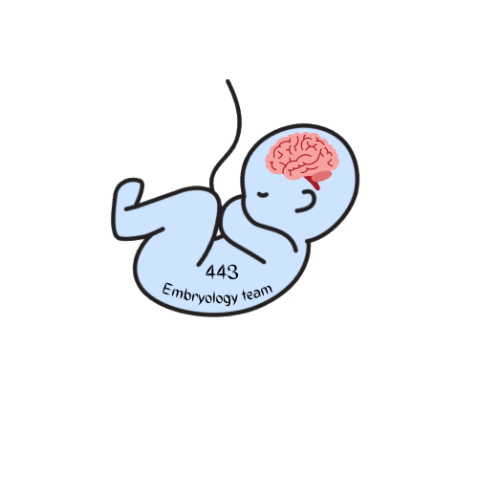
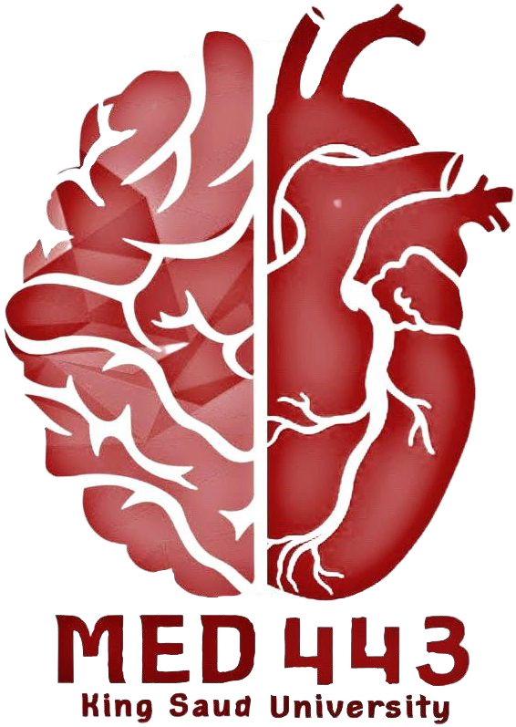
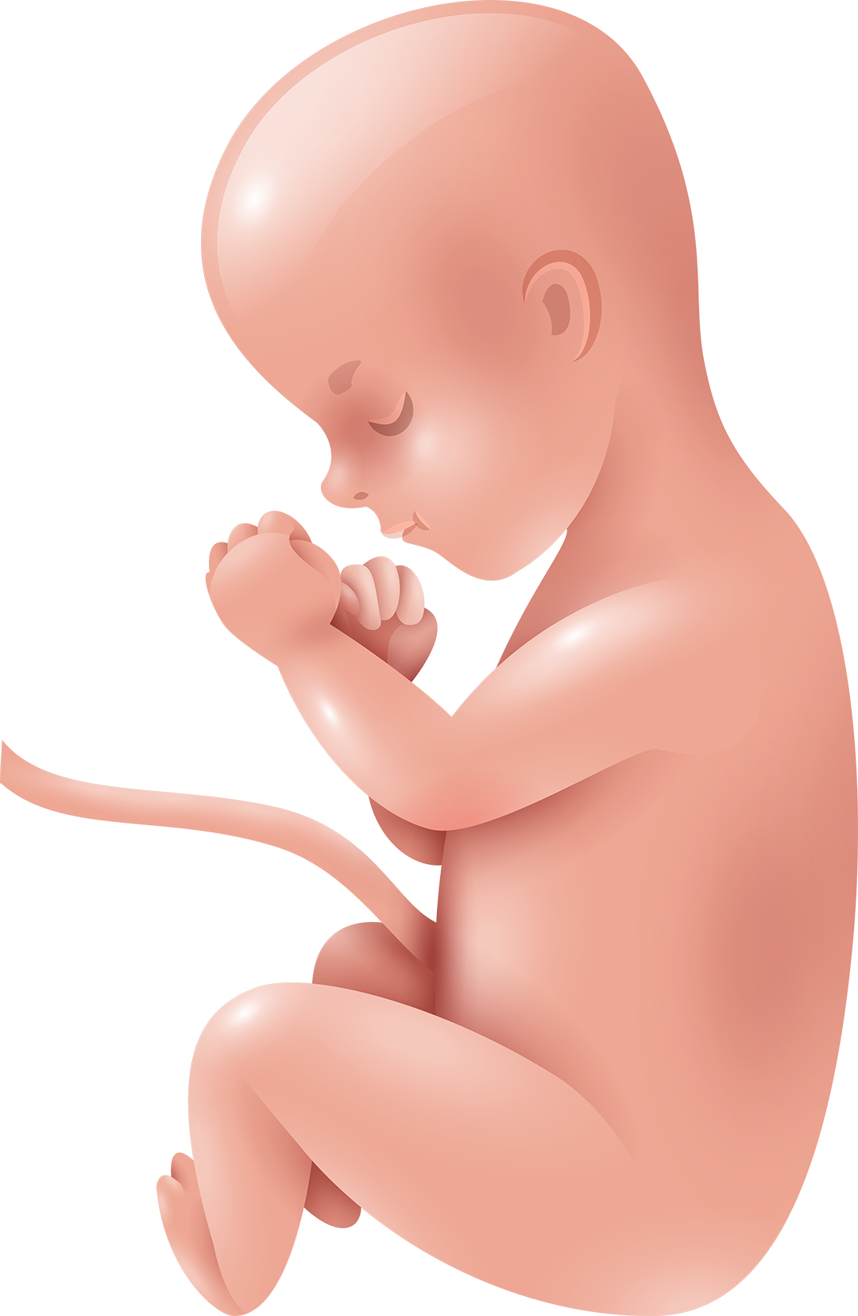
DEVELOPMENT OF CEREBRUM & CEREBELLUM
Neuropsychiatry Block
Color Index: -Main Text
-Important
-Female Slides
-Male Slides
-Dr’s Notes
-Extra

Slide 2
Objectives
Describe the formation of the neural tube.
List the 3 brain vesicles and their derivatives.
Describe the brain flexures.
Describe briefly the development of the cerebrum.
Describe briefly the development of the cerebellum.
List important congenital anomalies related to the development of CNS.

Slide 3
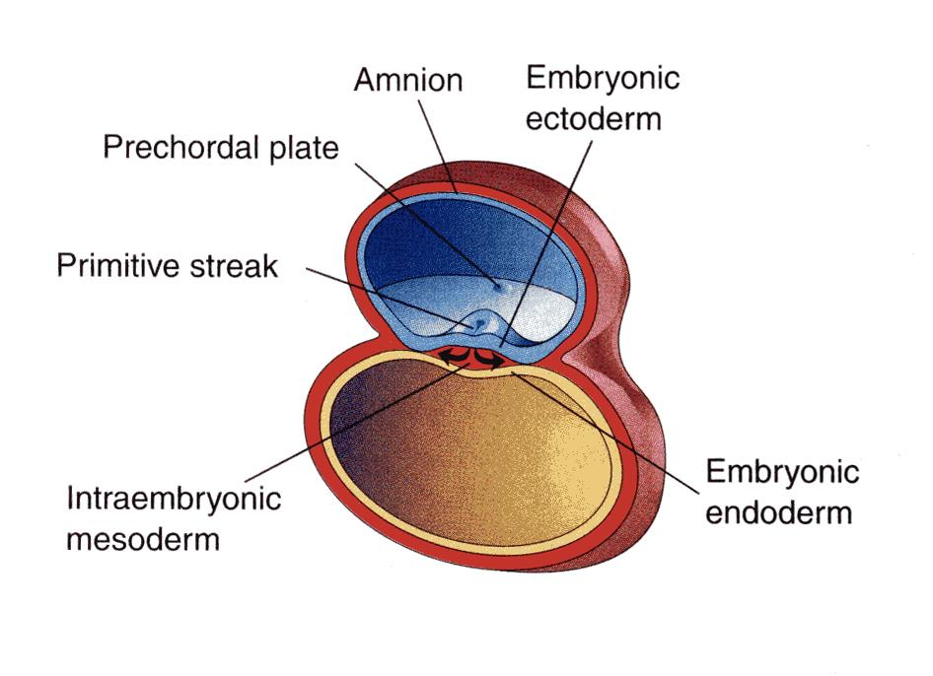
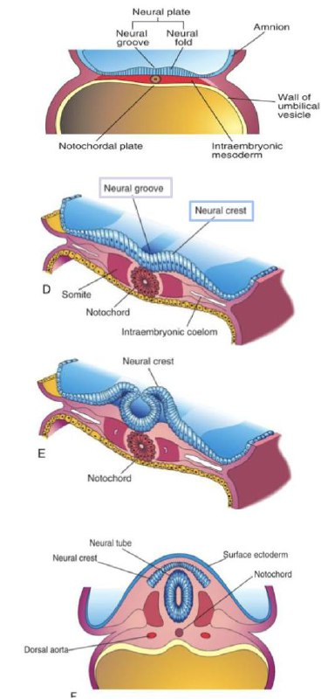
Introduction
Female Slides
By the beginning of the 3rd week of development, three germ cell layers become established:
1
Ectoderm
2
Mesoderm
3
Endoderm
Early Development of Neural Tube
Video
During the middle of the 3rd week the dorsal to notochord dorsal midline ectoderm undergoes thickening to form the neural plate (neuroectoderm).
1
The margins of the plate become elevated, forming neural folds.
So a longitudinal groove develops in the neural plate
(midline depression) called the neural groove is formed.
2
3
The margins of the neural plate (The 2 neural folds) approach to each other and then fuse together, thus sealing the neural groove and creating the neural tube. (complete close).
Formation of neural tube is completed by the middle of 4th week.

Slide 4
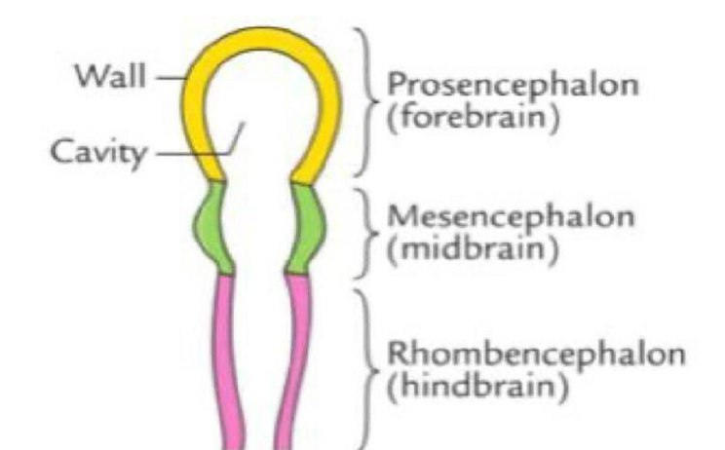
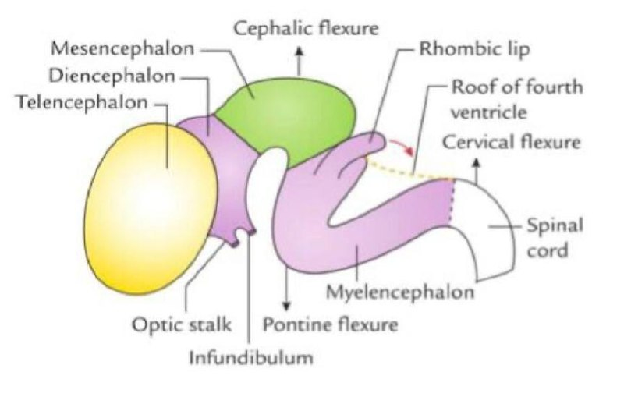
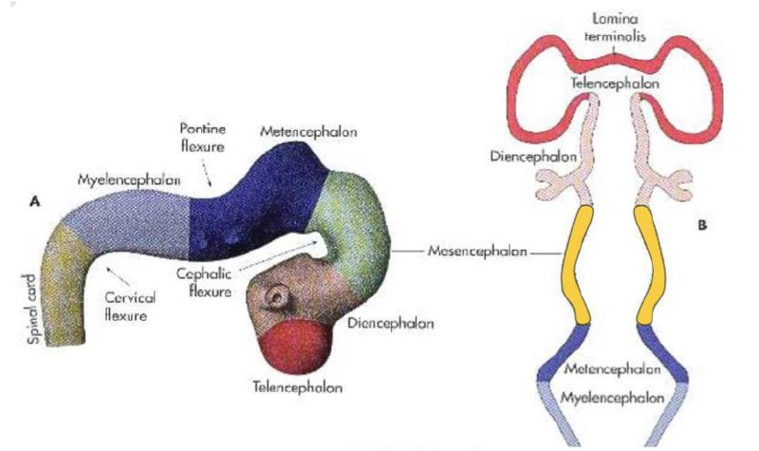
Neural Tube Development
Three- primary brain vesicles stage ,the cranial part / upper end of Neural tube dilates and shows 3 vesicles stage / primary vesicles:
End of 4th
week
1
2
3
Prosencephalon (Forebrain)
Mesencephalon (Midbrain)
Rhombencephalon (Hindbrain)
(The brain develops from the cranial part of neural tube)
The neural tube / brain grows rapidly and faster than the cranial cavity. So it bends twice ventrally, producing two flexures.
And later on it bend once dorsally producing 3rd flexure
by 4th
week
Formation of the neural tube is completed by the middle of the fourth week.
Midbrain flexure
(cephalic flexure)
-between the prosencephalon &
the mesencephalon
(midbrain)
-in (midbrain) region
Cervical flexure
between: the
Hindbrain
(Rhombencephalon) & the
spinal cord
Lateral Pontine flexure
appears in the hindbrain, unequal growth of the brain
between the 2 flexures produces pontine flexure,
in the opposite direction, resulting in thinning of the roof of the
hindbrain.
5th
week
Further differentiation distinguishes five secondary brain
vesicles from the primary vesicles (Five Vesicles Stage):
Prosencephalon divides into:
Mesencephalon (Midbrain)
Rhombencephalon divides into:
2 lateral Telencephalon
(cerebral hemisphere)
Metencephalon
(Pons-Cerebellum)
1 median Diencephalon
(Thalamus family)
Myelencephalon
(Medulla oblongata)

Slide 5
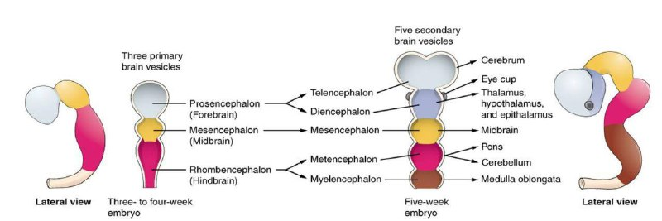
Primary Brain Vesicles
PRIMARY BRAIN VESICLES | SECONDARY BRAIN VESICLES | DERIVATIVES IN MATURE BRAIN | CAVITY
PROSENCEPHALON (FOREBRAIN) | TELENCEPHALON | CEREBRAL HEMISPHERE | LATERAL VENTRICLES
 | DIENCEPHALON | THALAMUS, HYPOTHALAMUS, EPITHALAMUS, SUBTHALAMUS | THIRD VENTRICLE
MESENCEPHALON (MIDBRAIN) | MESENCEPHALON | MIDBRAIN | CEREBRAL ACQUEDUCT
RHOMBENCEPHALON (HINDBRAIN) | METENCEPHALON | PONS, CEREBELLUM | FOURTH VENTRICLE
 | MYELENCEPHALON | MEDULLA OBLONGATA
Differentiation of Forebrain Vesicle
The forebrain (prosencephalon) vesicle differentiates into:
1- Median part (diencephalon)
2-Two lateral cerebral vesicles (telencephalic vesicles)
Their lumen gives the 2 lateral ventricles and the 3rd ventricle (median)
Both cavities communicating with each other through a wide interventricular foramen.
The cerebral hemispheres expand in all directions ( as it grows it continues to enclose the rostral end of the cranial tube).
A part of their medial wall becomes thin, flat and it is the site of development of choroid plexus in the lateral ventricle.

Slide 6
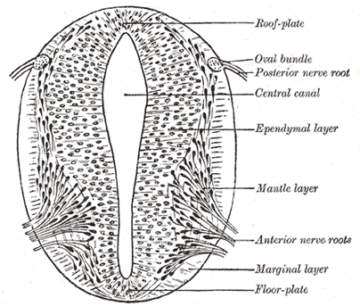
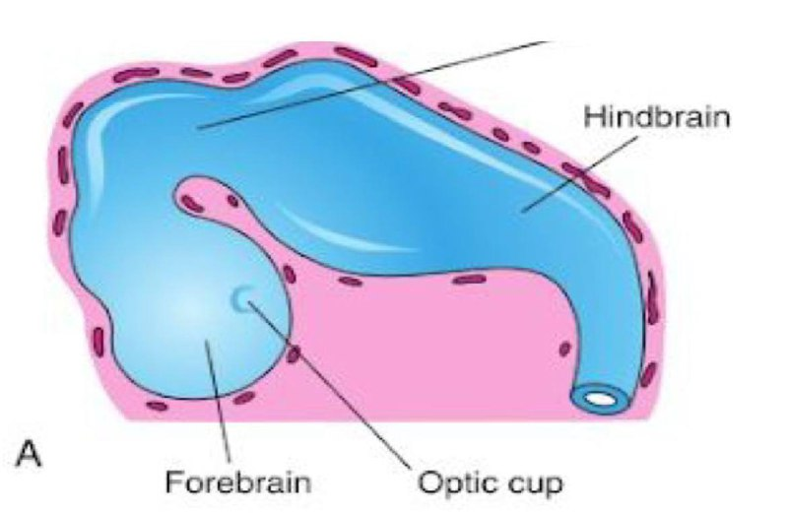
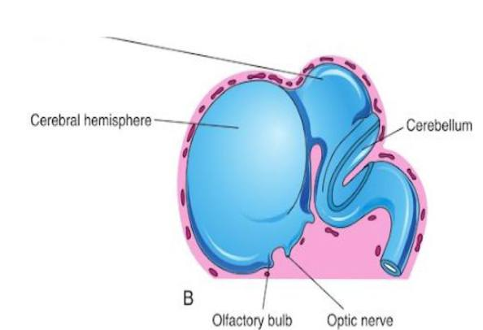
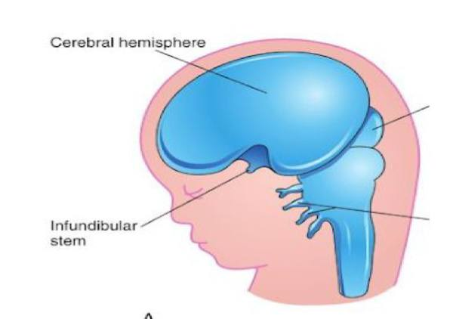
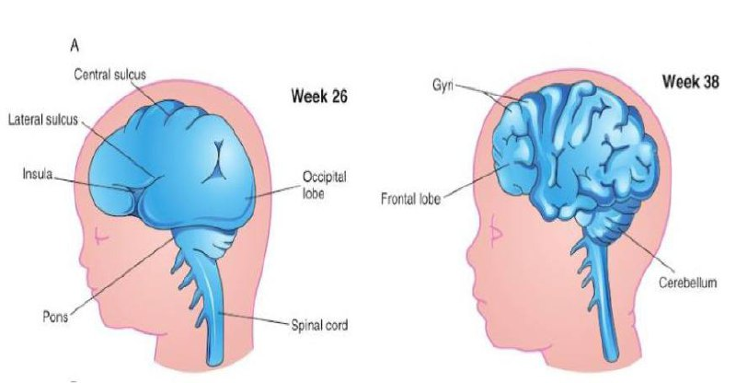
Development of The Cerebrum
The cerebrum develops from the telencephalon, and it is formed of 3 layers:
Ependymal: lining the cavity of the lateral ventricle.
Mantle: nerve cells forming the grey matter.
Marginal: nerve fibers forming the white matter.
As development proceeds, the following changes occur:
-most of the nerve cells in mantle layer migrate to the site of marginal layer (outside) forming the cerebral cortex.
-Some cell do not migrate and remains to form basal ganglia (nuclei).
1
DAY 32 of pregnancy
2
WEEK 16
Cerebral hemisphere
first appear (by 5th week) as pair of bubble-like outgrowth
of telencephalon.
Oval, rapidly growing
hemispheres, have
expanded back to cover the diencephalon.
3
End of the 3rd month
4
4th month
Surfaces of cerebral
hemispheres are
smooth.
-Grey matter grows faster than white matter, so, the cortex becomes folded into gyri separated by sulci that increase the surface area of brain/ cortex without requiring an extensive increase in cranial size.
-The detailed pattern of gyri & sulci varies somewhat from an individual to another.

Slide 7
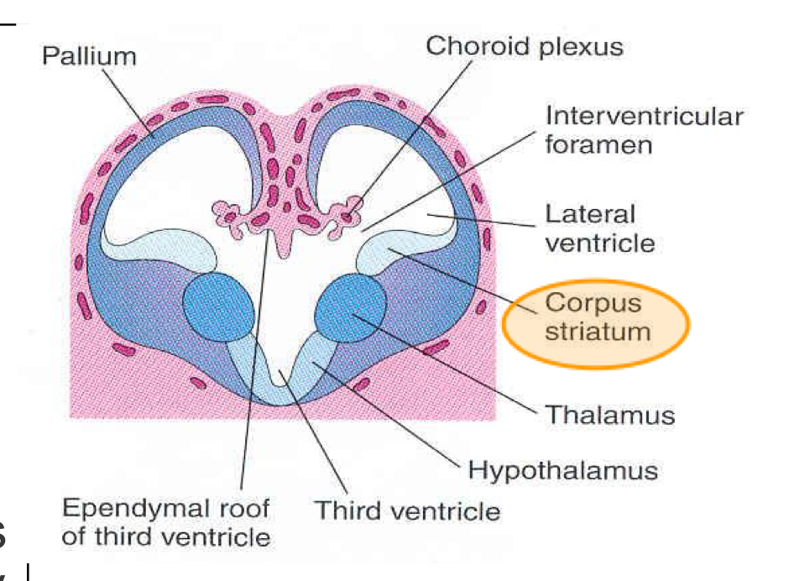
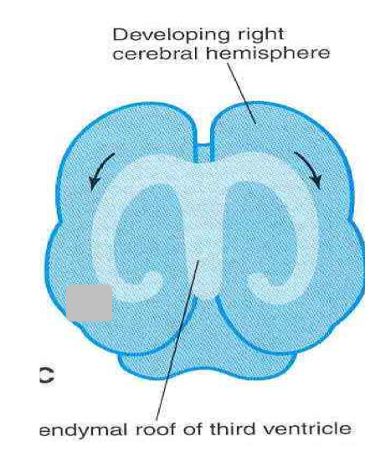
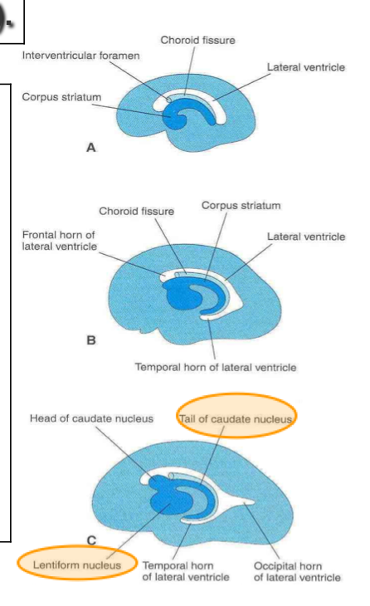
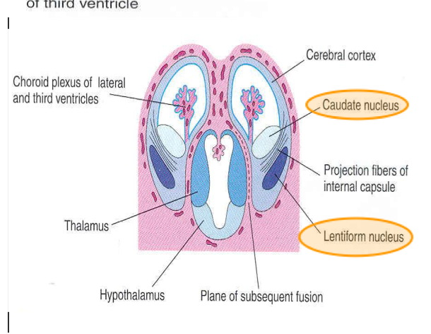
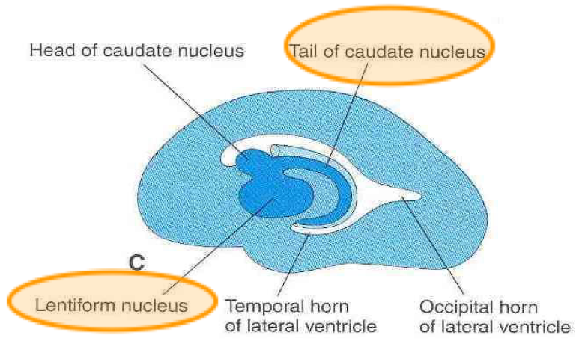
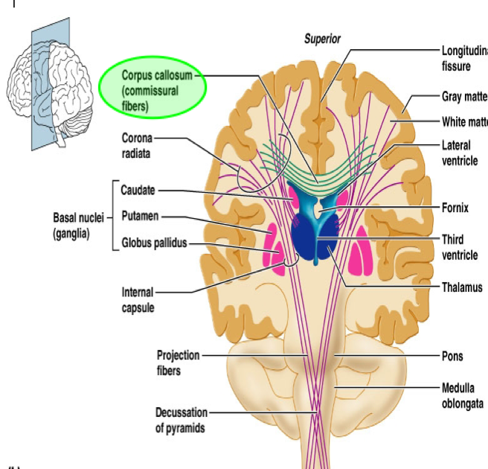
Development of The Cerebrum
Development of Corpus striatum (part of basal ganglia):
1- It is the Basal Ganglia Nuclei in the cerebral hemisphere
2- Appears as a swelling in 6th week in the floor of each cerebral hemisphere. As the cerebral cortex differentiates and the fibers passing to and from it, they pass through corpus striatum.
3- Corpus striatum now divides into: Caudate nucleus & Lentiform nucleus.
4- This pathway of fibers Forms Internal capsule.
5- Further expansion of cerebral hemispheres gives C-shape appearance to the hemisphere and its cavity (lateral ventricle). Initially, the surface of the hemispheres is smooth. As grey matter grows faster than white matter,The cortex becomes folded into sulci and gyri that increase the surface area of the cortex without requiring an extensive increase in cranial size.
6- Caudate nucleus elongates and assumes the shape of lateral ventricle (remains related to it).
Development of cerebral commissures :
As cerebral cortex develops, group of fibers (commissures) connect the corresponding regions of cortex(of the cerebral hemispheres), these are:
- Lamina terminalis
- Optic chiasma
- Anterior commissure
- Posterior commissure
- Hippocampal commissure
- Habenular commissure
- Corpus callosum (is a major commissural fibres that connect the two cerebral hemispheres + the largest)
The cortex covering the external surface of corpus striatum grows relatively slower than the other cortices, so it is overgrown by the rest of the hemisphere and lies in the depth of the lateral sulcus as a buried cortex, hidden from view This is called the insula.So the insular lobe is a portion of cerebral cortex that has been invaginated to lie deep within the lateral sulcus

Slide 8
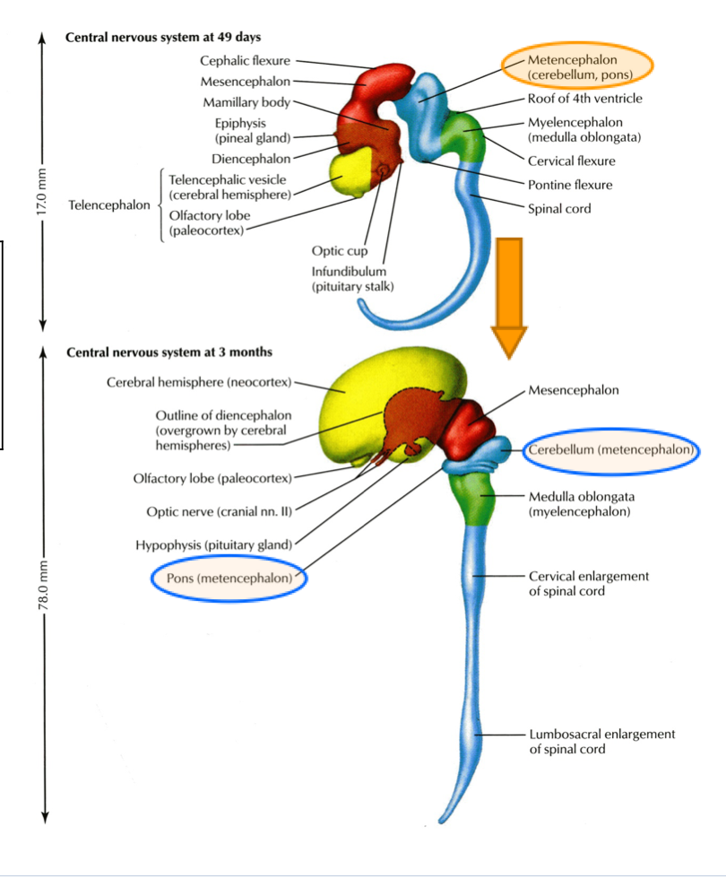
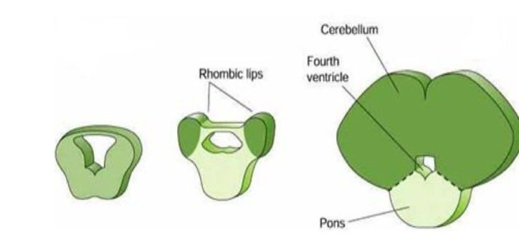
Development of The Cerebellum
Cerebellum:
- The cerebellum develops from the dorsal part of the metencephalon.
- Metencephalon develops into pons (anteriorly) and overlying cerebellum (posteriorly).
- Pontine flexure results in:
1- Moving alar plates (part of dorsal side of neural tube of hindbrain) laterally then pending medally.
2- Stretching and thinning of the roof plate of the fourth ventricle
3- Widening of the cavity to form 4th ventricle.
Metencephalon: changes in alar plates:
- The two lateral sides of dorsal parts of alar plate thicken to form rhombic lips which projects caudally over the roof plate of fourth ventricle and unite with each other in the midline that will give rise to cerebellum
- Some neuroblasts migrate from the mantle layer to marginal layer and form the cerebellar cortex
- Other remains in the mantle layer and give rise to the deep cerebellar nuclei
- The cerebellar peduncles (fibres connecting between the midbrain & cerebellum) develop later as the axons of the deep cerebellar nuclei of the cerebellar nuclei grow out to reach the brain stem
As the cerebellar hemispheres develops they undergo a complicated process of transverse folding to form closely packed, leaf-like transverse gyri called folia separated by fissures. These processes of fissure formation and foliation continue postnatally and throughout embryonic, fetal, and they vastly (extremely) increase the surface area of the cerebellar cortex.

Slide 9
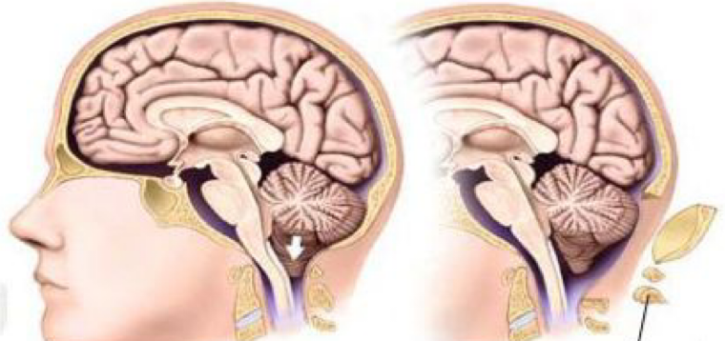
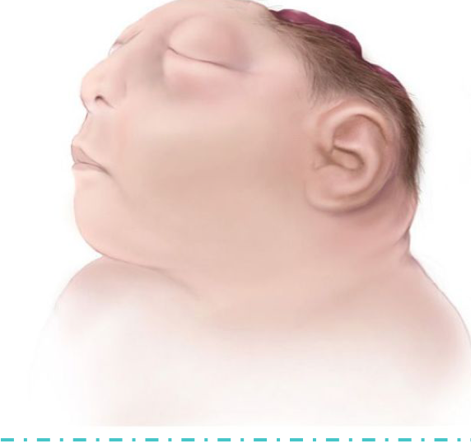
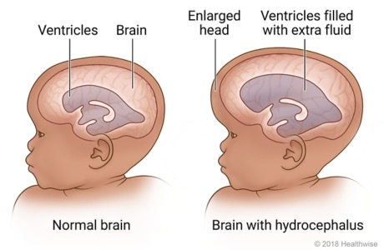
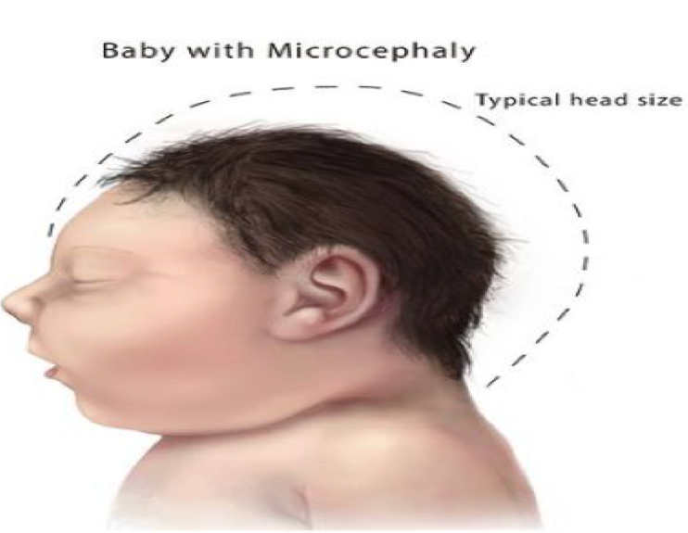
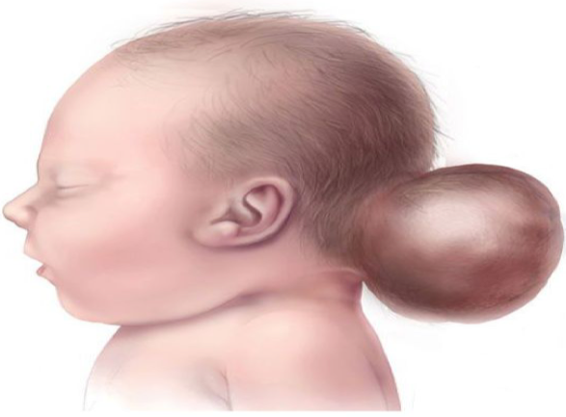
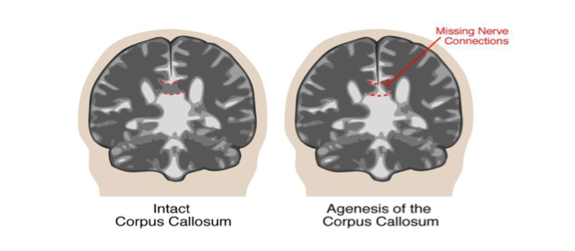
Congenital anomalies of the brain
Important
Most of the anomalies manifested by seizures(changes in electrical activity), mental retardation, cerebral palsy (absence of oxygen mostly during delivery).
Arnold-chiari malformation: | -Herniated part of cerebellum through the foramen magnum leading to CSF obstruction. so Hydrocephalus results. Aqueductal stenosis and brain tumors. -A condition in which brain tissue extends into the spinal canal. It occurs when a part of the skull is abnormally small, pressing on the brain and forcing it downward.
Anencephaly | -The brain and skull are minute and the infant does not survive. -Is the absence of a major portion of the brain, skull, and scalp that occurs during embryonic development. It is a cephalic disorder that results from a neural tube defect that occurs when the rostral (head) end of the neural tube fails to close.
Hydrocephalus | The most common cause is a flow obstruction, by hindering the free passage of CSF through the ventricular system and subarachnoid space.
Microcephaly | Abnormal small head ( circumference ) which is a congenital condition associated incomplete brain development.
Cranium bifidum: | Cranium bifidum with or without meningocele & meningoencephalocele.
Agenesis of corpus callosum | The corpus callosum is partially or completely absent.

Slide 10
MCQs:
1- Formation of Neural Tube is completed by the middle of ?
A) 3rd week | B) 4th week | C) 5th week | D) 6th week
2- The Prosencephalon, Mesencephalon and the Rhombencephalon appear in ?
A) 5th week | B) 6th week | C) 7th week | D) 8th week
3- The nerve cells of the Mantel layer of the telencephalon forms the ?
A) Thalamus | B) Lateral ventricle | C) Grey matter | D) White matter
4- The cerebral hemisphere first appear as a pair of bubble-like outgrowth of the Telencephalon in ?
A) Day 16 | B) Week 16 | C) End of 3rd month | D) Day 32
5- The processes of fissure formation and foliation ............ ?
A) Stops after embryonic life | B) Continues through postnatal life | C) Stops at 6th month | D) Stops at 3rd month
6- ..................... is an anomaly where the brain and skull are minute and the infant does not survive?
A) Hydrocephalus | B) Arnold-chiari | C) Microcephaly | D) Anencephaly
Answers : 1-B , 2-A , 3-C , 4-D , 5-B , 6-D

Slide 11
Team Leaders:
Jouri Almaymoni
Mohammed Alqutub
Team Members:
Salma Alkhlassi
Nazmi M Alqutub
Raghad AlBuqami
Nazmi A Alqutub

