Slide 1
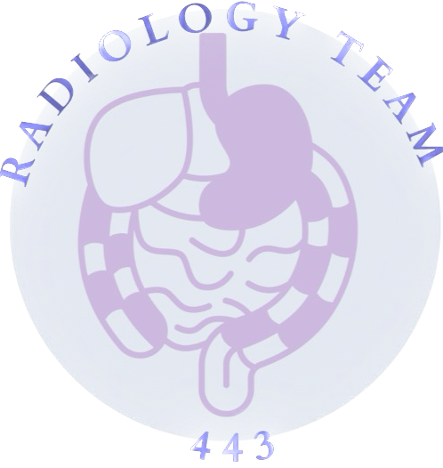
Radiology of The Abdomen
LECTURE 1
DR. Mohammed Ayesh
DR. Noura Molla
COLOR INDEX:
MAIN TEXT
MALE’S SLIDES
FEMALE’S SLIDES
IMPORTANT
DOCTOR’S NOTES
EXTRA INFO
EDITING FILE

Slide 2
Objective
To know radiology modalities used in abdomen imaging mainly GI tract.
To know advantages and disadvantages of each modality.
To know indications and contraindications of each modality.
Overview on normal abdomen appearance and common pathologies including:
Pneumoperitoneum
Peptic ulcer
Bowel obstruction
Inflammatory bowel disease
Large bowel masses / malignancies

Slide 3
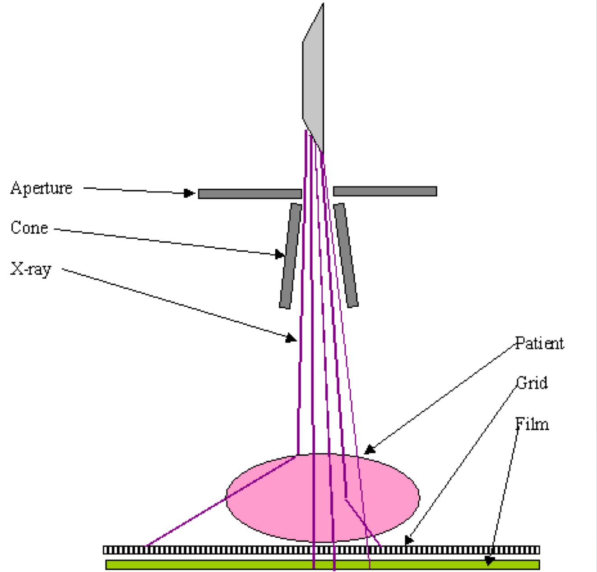
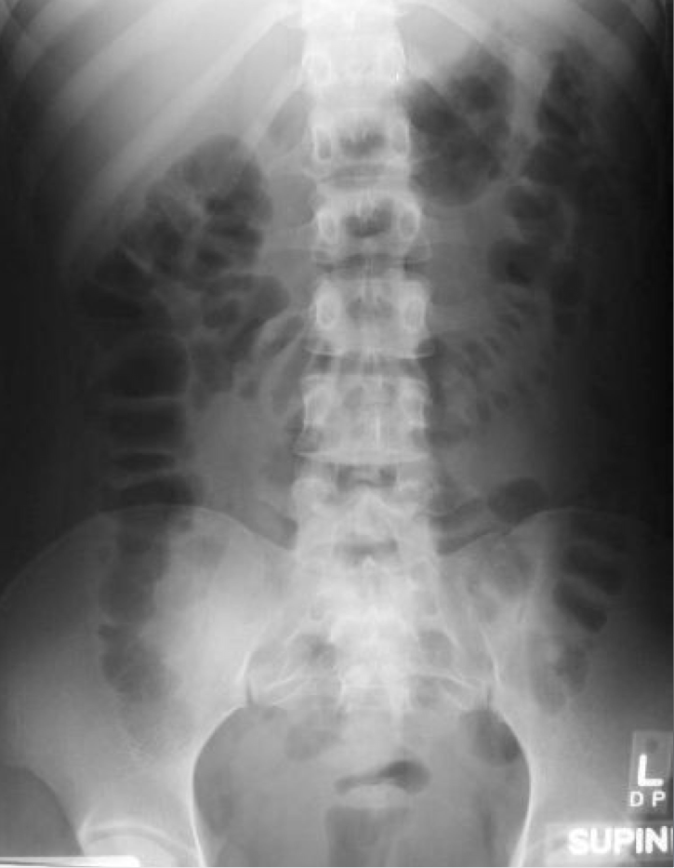
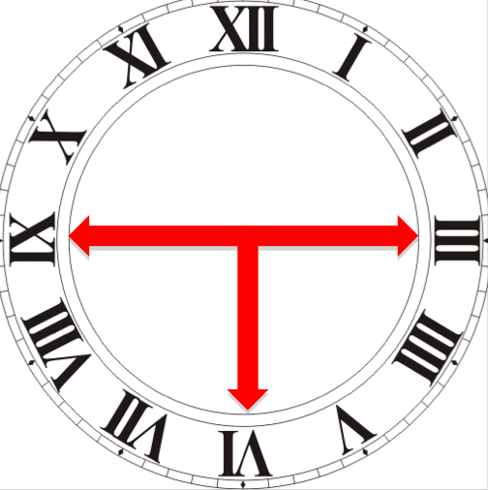
X-Ray
Definition
◦ X-ray is a form of radiation, that are focused into a beam
◦ They can pass through most object including the human body
◦ When X-rays strike a piece of photographic ﬁlm, they make a picture
Advantage | ◦ Widely available ◦ Cheap ◦ Excellent in diagnosing free air in the abdomen ◦ Good in diagnosing bowel obstruction & stones/calciﬁcation (e.g. renal stone)
Disadvantage | ◦ Radiation ◦ Poor soft tissue details (1)
Indications | ◦ Abdominal pain ◦ Bowel (Intestinal) obstructions ◦ Others: foreign body, Supportines lines, etc
C.I | Pregnancy, Even though the radiation very minimal
Interpretation (2) | ◦ White → Bone and calciﬁcation ◦ Grey → Soft tissue ◦ Black → Air
◦ Masses
◦ Trauma
◦ Stones
When is the presence of air in X-rays considered normal?
◎ Stomach: almost always air in stomach
◎ Small bowel: usually small amount of air in 2 or 3 loops
◎ Large bowel: almost always air in rectum and sigmoid,
varying amount of gas in rest of large bowel
3, 6, 9 Rule
Maximum Normal Diameter of bowel:
Small bowel → 3cm
Large bowel → 6cm
Caecum → 9cm

Slide 4
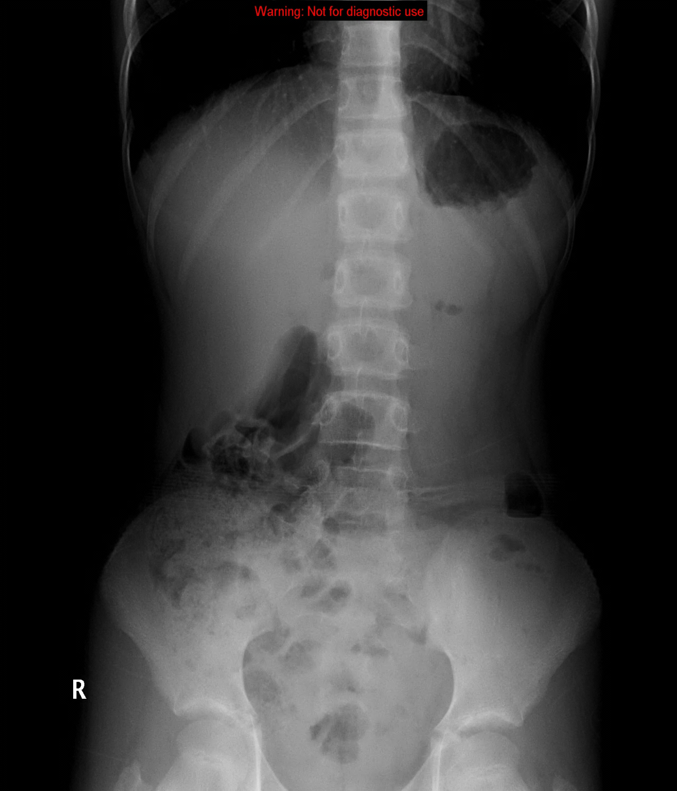
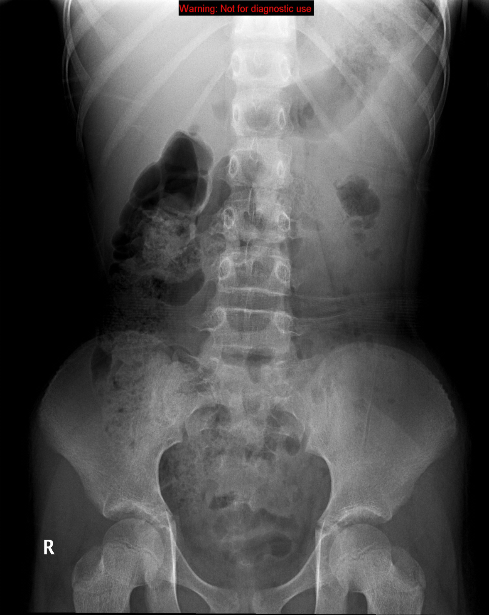
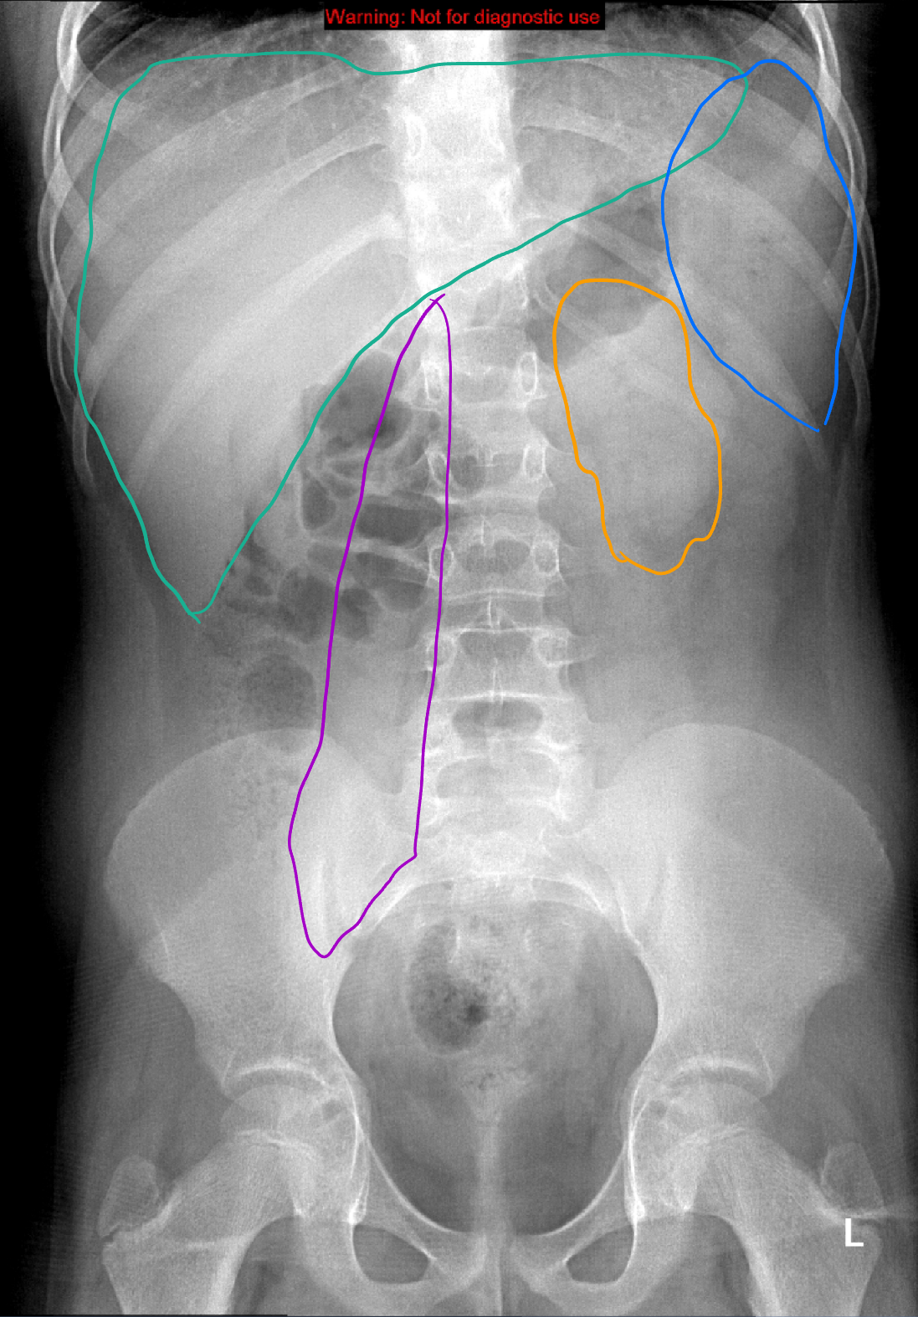
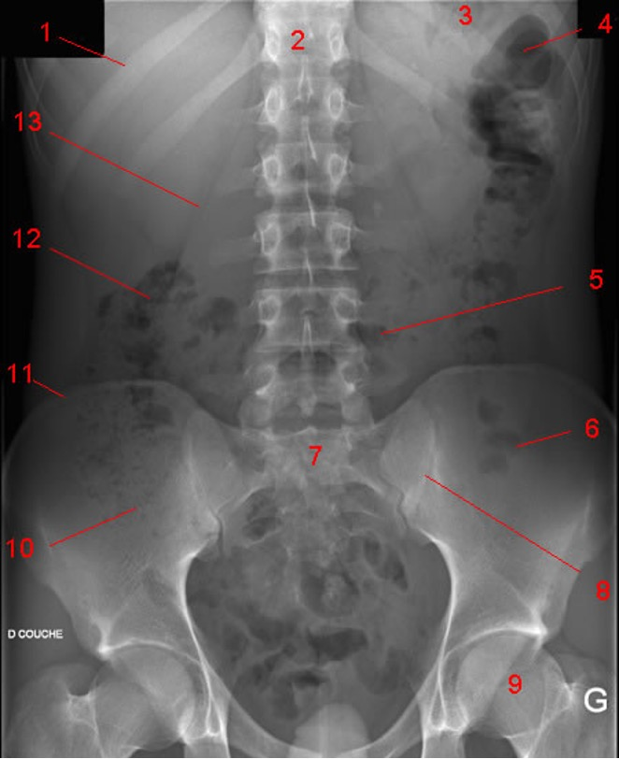
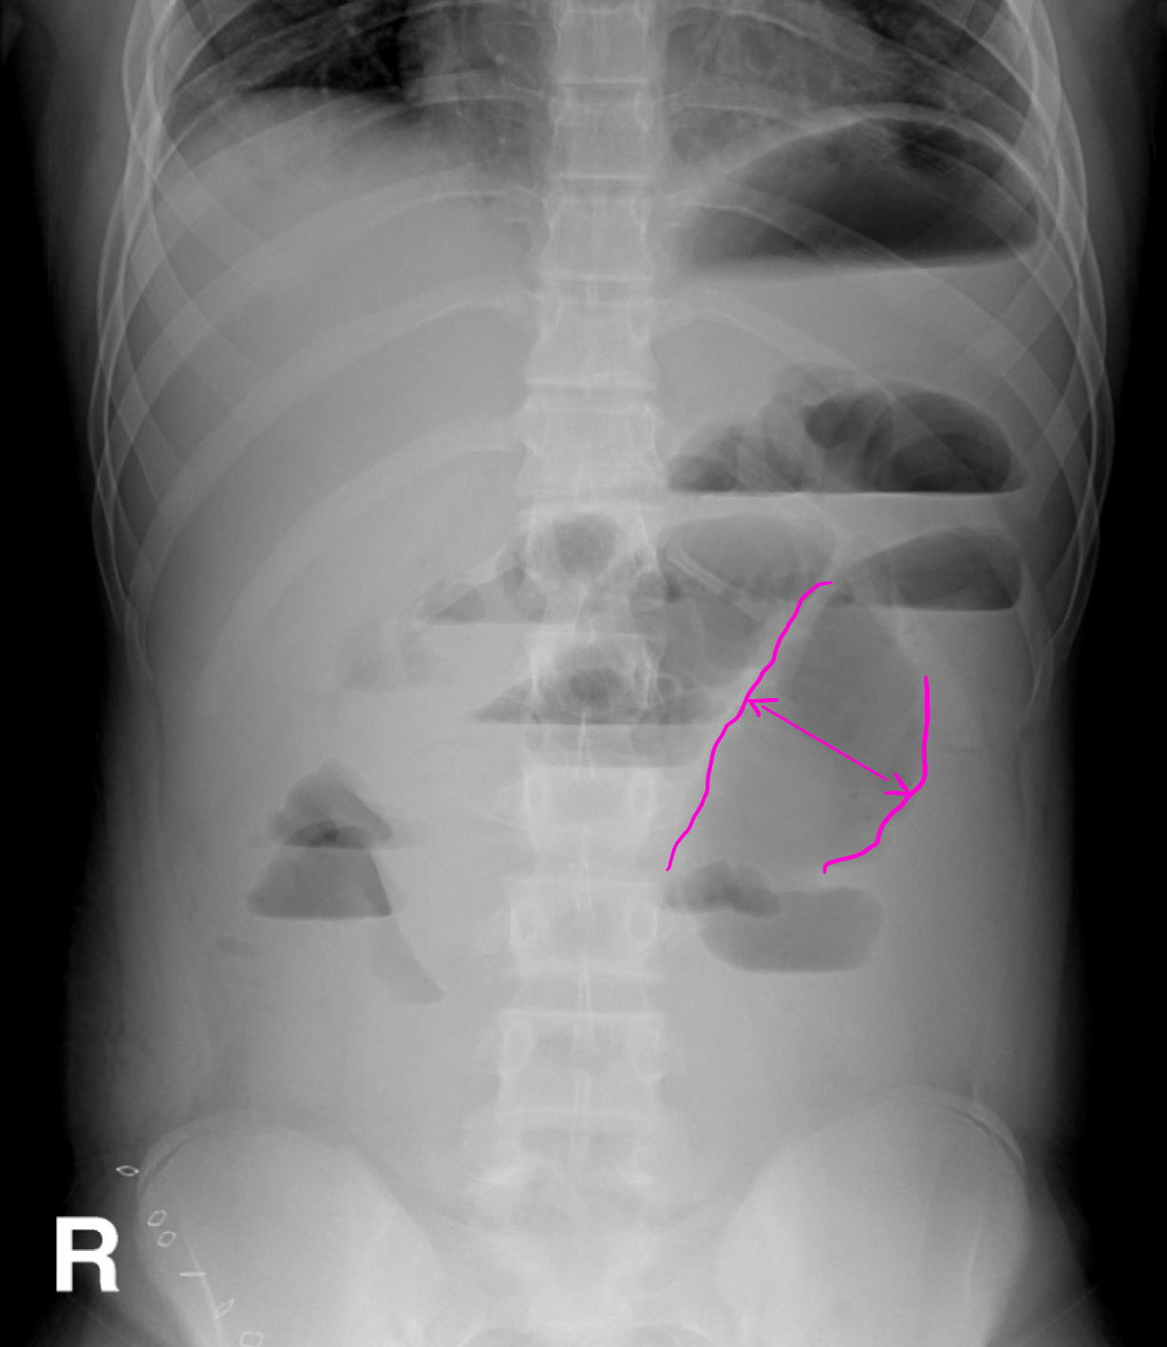
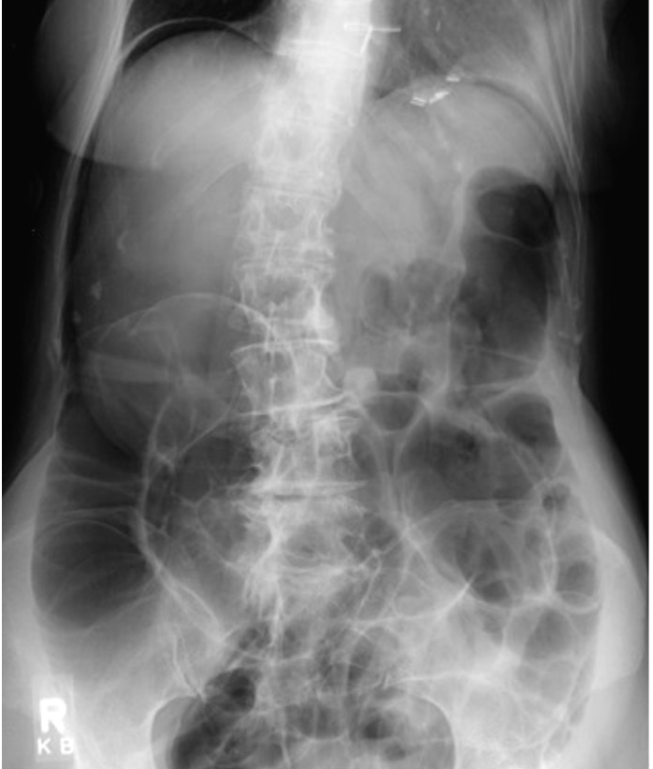
X-Ray
Always keep in mind the image in the opposite side of you
Normal abdominal X-Ray
Stomach
Small bowel
Liver
Spleen
Kidneys
Psoas muscles
(4)
Large bowel
Rectum
Standing position (3)
Supine position (3)
14
1. 11th rib
2. T12
3. Gas in stomach
4. Splenic flexure
5. Transverse colon
6. Gas in sigmoid
7. Sacrum
8. SI joint (sacroiliac joint)
9. Femoral head
10. Gas in caecum
11. Iliac crest
12. Hepatic flexure
13. Psoas margin
14. Liver
15. Left kidney
16. Bladder
Spleen
15
Kidney
Liver
Psoas muscles
16
Abnormal abdominal X-Ray
Dilated bowel loops
Air fluid levels
(5)
Bowel obstruction
Air in the diaphrma, outside the bowel loops (pneumoperitonium) (6)

Slide 5
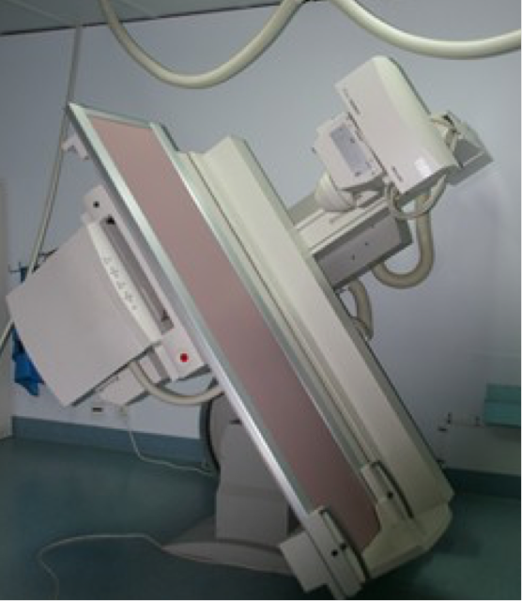
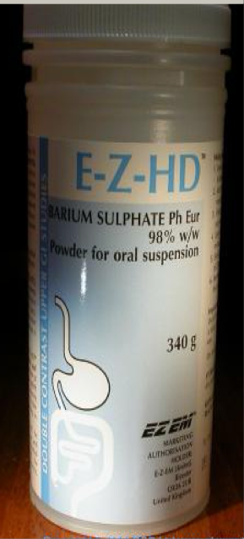
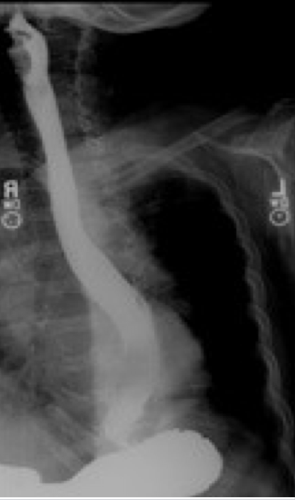
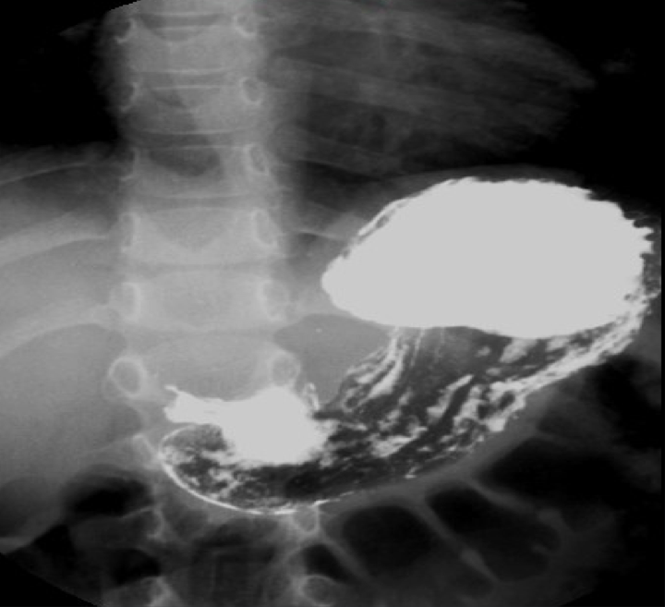
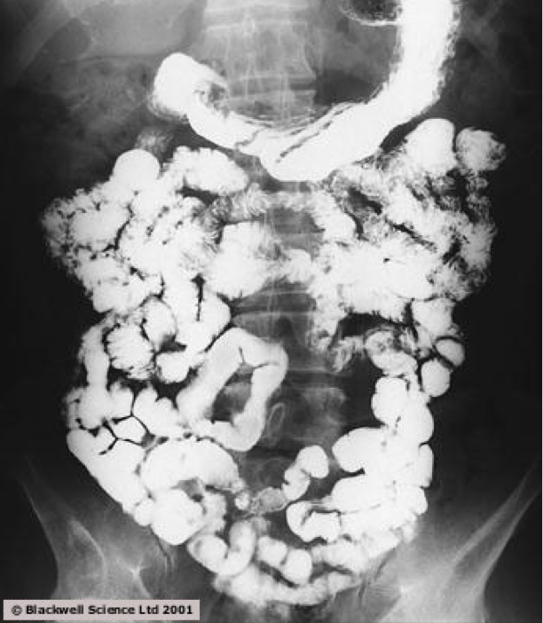
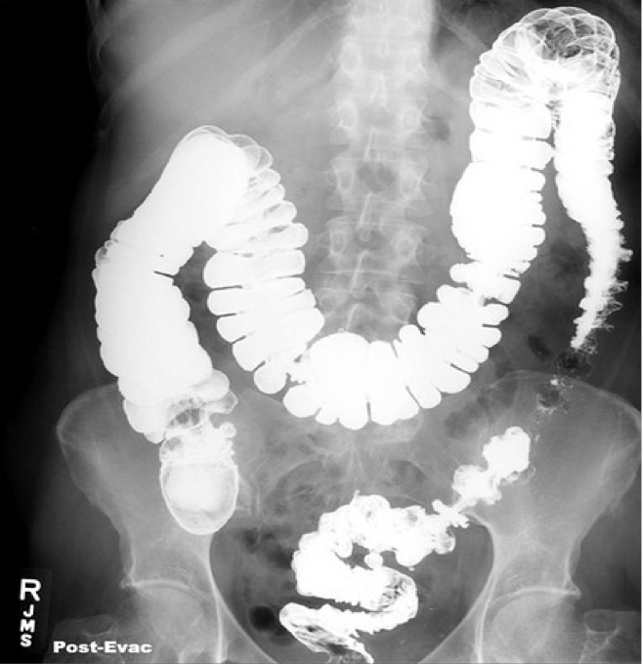
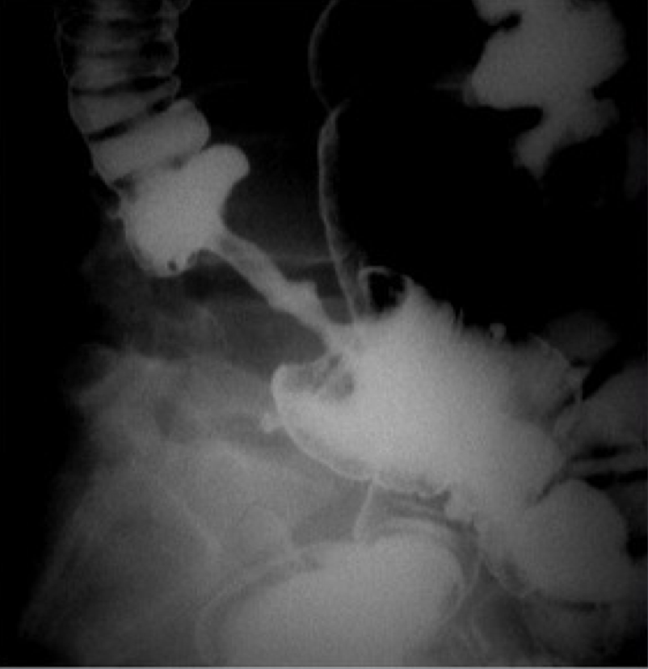
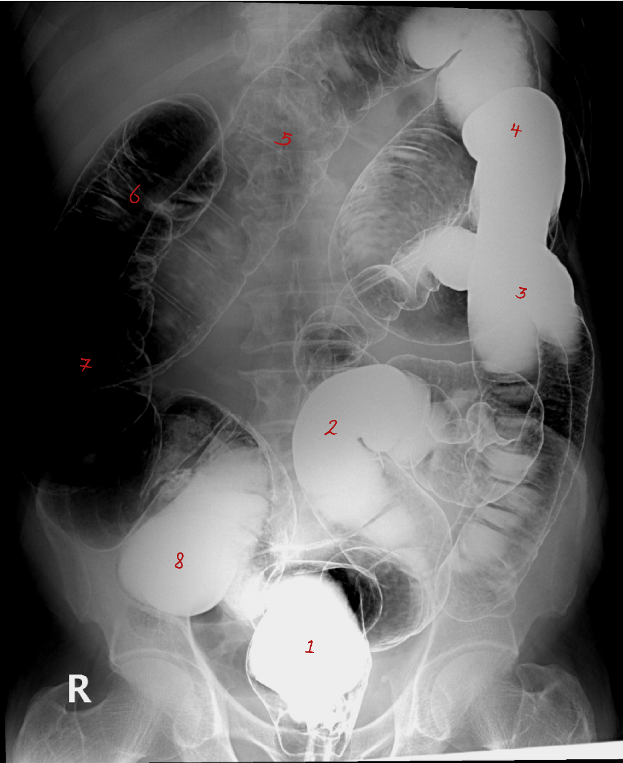
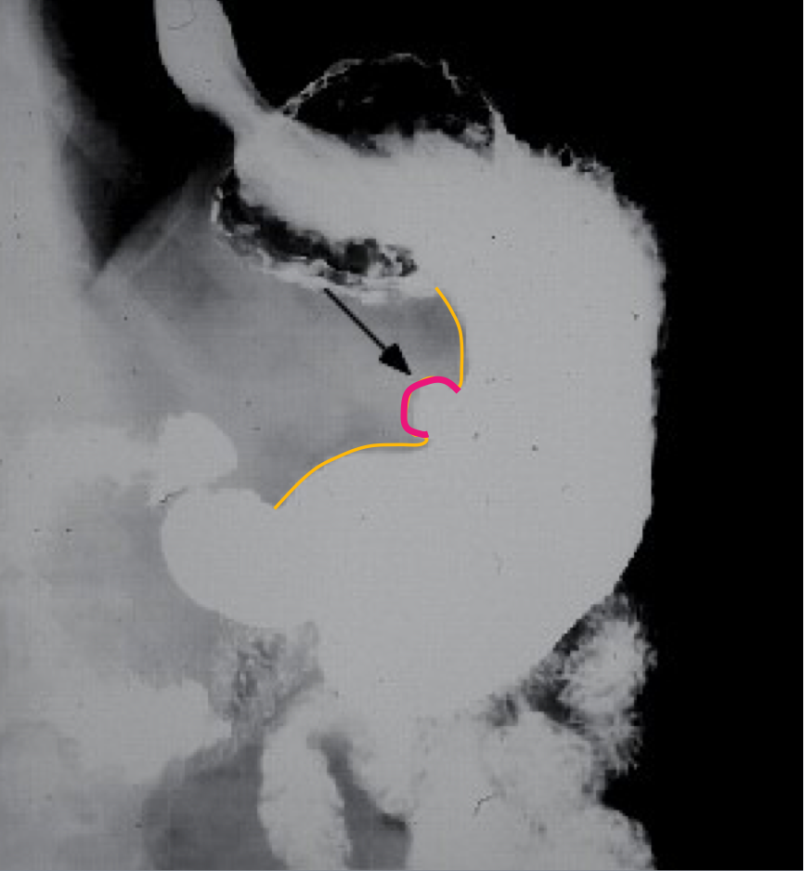
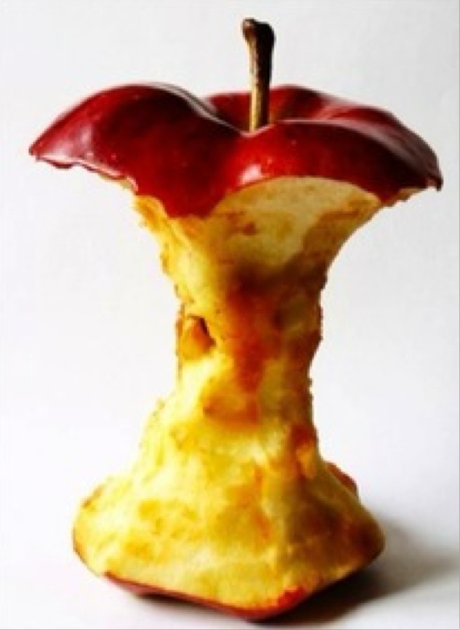
Fluoroscopy (X-ray + Oral contrast)
Definition
It is the same as X-rays, but the difference between them is that X-rays take
snapshots of internal tissues in a single moment, whereas fluoroscopy can
provide continuous (dynamic), real-time moving video of your internal tissues.
Advantage | ◦ Available ◦ Relatively cheap ◦ Excellent in evaluation the bowel lumen and mucosa
Disadvantage | ◦ Radiation ◦ Poor in evaluating extra luminoal pathologies
Indications | ◦ Assessing the mucosal outline ◦ Abdominal pain ◦ Gastroesophageal reﬂux
C.I | ◦ Pregnancy ◦ Bowel obstruction -it will worse the patient symptoms because bowel is already maximally dilated, if you adding some barium (which is thick) → extra ﬂuid- ◦ Bowel perforation (with barium type of contrast).
◦ Masses
◦ Inﬂammatory bowel diseases
◦ Post surgical, leak.
The best modality to assess each part of the GI system (7)
Barium swallow
↓
esophagus
Barium meal
↓
Stomach
Barium follow through
↓
small bowel
Barium enema
↓
large bowel
Normal abdomen
Abnormal abdomen
Type of study: Barium enema
1. Rectum
2. Sigmoid colon
3. Descending colon
4. Splenic flexure
5. Transverse colon
6. Hepatic flexure
7. Ascending colon
8. cecum
Peptic ulcer disease
Type of study: Barium enema
Diagnosis: Colon mass/malignancy
(Apple core appearance)
Dye mixed with air

Slide 6
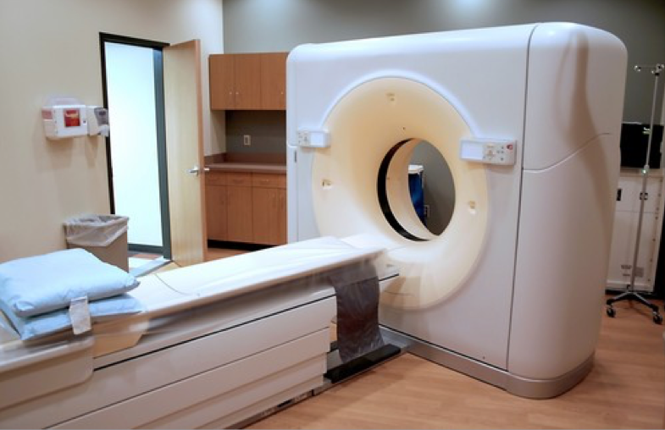
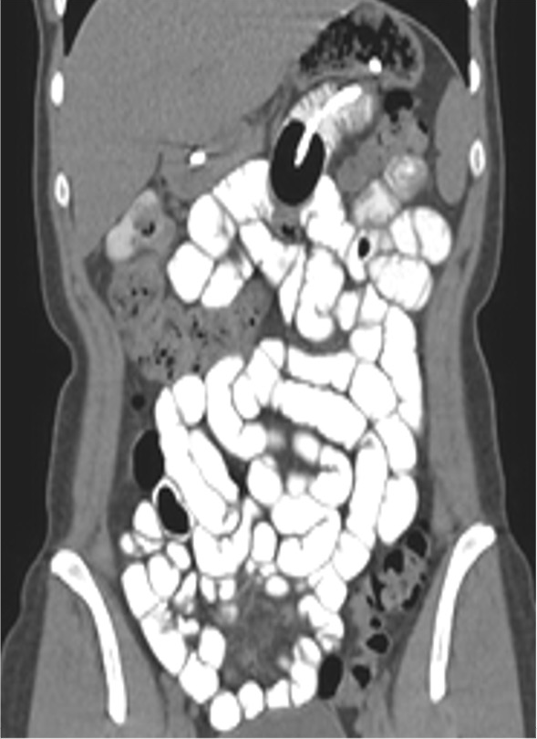
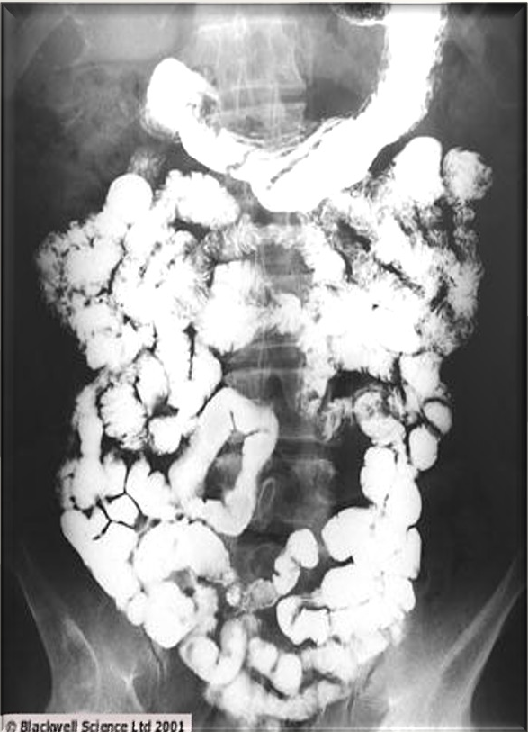
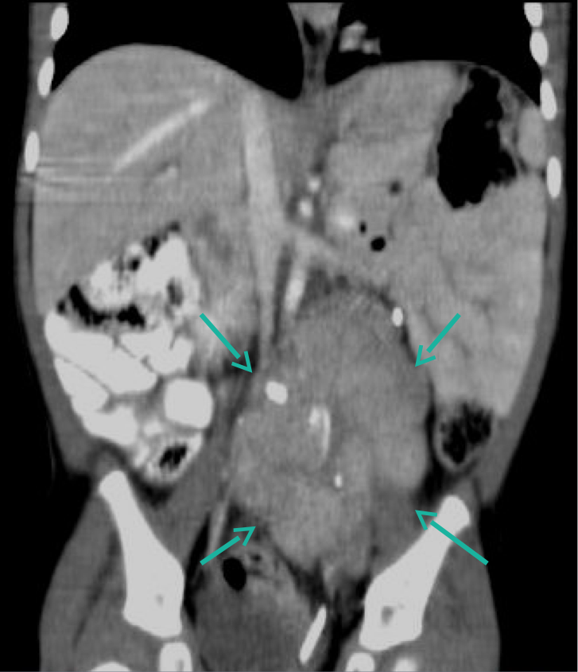
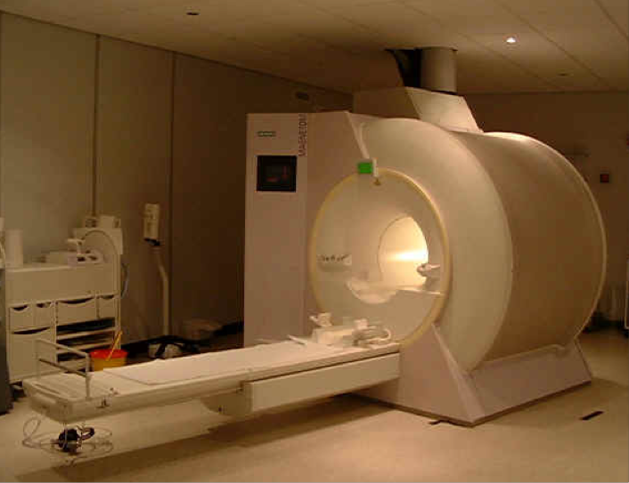
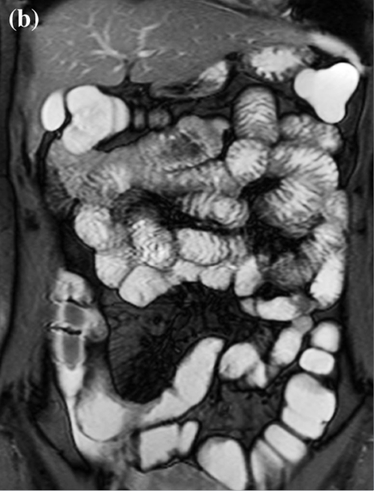
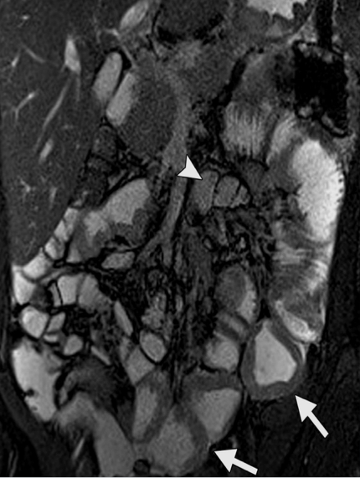
CT scan
Multiple X-ray
Advantage | ◦ Available ◦ Short scan time ◦ Much more soft tissue and bone details ◦ Excellent in diagnosing extra-luminal lesions ◦ Excellent in diagnosing the cause of bowel obstruction
Disadvantage | ◦ Radiation ◦ Sometimes need intravenous contrast (renal disease) ◦ Relatively expensive
Indications | ◦ To look for bowel obstruction cause ◦ To diagnose intra-abdominal masses
C.I | ◦ Pregnancy ◦ No IV contrast in renal failure ◦ Unstable patients (severe trauma/ICU)
Pictures
◦ Abdominal pain
◦ Trauma
Normal abdomen
Abnormal abdomen
Mass outside the bowel causing mass effect
The oral contrast will reveal the specific characteristics of the small bowel to you. And this is a much better view of the liver.
MRI
Dr: True or false: MRI uses large number of x-ray?
False. False.
Advantage | ◦ Relatively safe in pregnancy (no radiation) ◦ Give much more soft tissue details ◦ Excellent in diagnosing abdominal solid organ lesion: liver, spleen, kidneys
Disadvantage | ◦ Expensive ◦ Long scanning time ◦ Sensitive to motion
Indications | ◦ Abdominal solid organ masses ◦ Inflammatory bowel disease
C.I | ◦ Uncooperative patients ◦ Early pregnancy (relative contraindication) ◦ No IV contrast renal failure (relative contraindication)
Pictures
Normal abdomen
Abnormal abdomen
Diagnosis: Inflammatory bowel disease
Signs: Bowel wall thickening
الجدار كأنه مرسوم بقلم حاد
الجدار كأنه مرسوم بمحدد

Slide 7
Extra
Dr Notes
Wide of things appears as gray, all of this is soft tissue. but you can’t see (distinguish) which soft Tissue is this.
Gas allows for much greater penetration than bone, which permits very little. The picture depends on how much x-ray energy reaches the film behind the patient or behind the item..
why is the air distribution in the stomach here different than the air distribution here? It's the gravity
We are looking at all of these shadows because sometimes we're not gonna be able to see the boundaries of the psoas muscle. That means probably the patient has a large intra-abdominal mass that is obscuring the psoas muscle. So, we were going to ask for a CT scan to assess for more details.
There's no mixing of the air and fluid and the content when they stop flowing, either due to obstruction or paralytic ileus, the paralysis of the small intestine. Where will the air disappear to? Above. This is known as the air fluid level, or numerous air fluid levels, and it is related to the suggestion of intestinal blockage.
always we have to check underneath the diaphragm, if there is any amount of free air in here as well.
There are two different kinds of dieting. Dasrographon is one of them, and barium is the other. Therefore, we do not recommend using barium if you suspect a leak or a preparation because it is very powerful for the proteinal cavity and can irritate it. We can utilize the dasrographon for bowel preparation, although barium is not recommended.
Summary
Test | Indications | Contraindications
X-ray | ◦ Abdominal pain ◦ Bowel (Intestinal) obstructions ◦ Foreign body, Supportines lines, etc ◦ Masses ◦ Trauma ◦ Stones | Pregnancy
Fluoroscopy | ◦ Assessing the mucosal outline ◦ Abdominal pain ◦ Gastroesophageal reﬂux ◦ Masses ◦ Inﬂammatory bowel diseases ◦ Post surgical, leak. | ◦ Pregnancy ◦ Bowel obstruction ◦ Bowel perforation (with barium type of contrast)
CT scan | ◦ To look for bowel obstruction cause ◦ To diagnose intra-abdominal masses ◦ Abdominal pain ◦ Trauma | ◦ Pregnancy ◦ No IV contrast in renal failure ◦ Unstable patients (severe trauma/ICU)
MRI | ◦ Abdominal solid organ masses ◦ Inflammatory bowel disease | ◦ Uncooperative patients ◦ Early pregnancy (relative contraindication) ◦ No IV contrast renal failure (relative C.I)

Slide 8
MCQ
Q1. According to the 3, 6, 9 rule that indicates the maximum normal diameter of bowel, which of the following is the measurement of the small bowel ?
A. 3cm | B. 6cm | C. 9cm | D. 12cm
Q2. What is the type of ﬂuoroscopy contrast for evaluating the small bowel mucosa ?
A. Barium swallow | B. Barium meal | C. Barium follow through | D. Barium enema
Q3. What is the best radiological modality for evaluating the cause of bowel obstruction?
A. X-ray | B. Fluoroscopy | C. CT scan | D. MRI
Q4. A 59-year-old man complains of progressive weakness. He reports that his stools are very dark. Physical examination demonstrates fullness in the right lower quadrant. Colon cancer is suspected. Which of the following radiological ﬁndings is speciﬁc to the diagnosis?
A. Air under diaphragm | B. Dilated bowel loops | C. Air ﬂuid levels | D. Apple core appearance
Answers: 1. A 2. C 3. C 4. D

Slide 9
TEAM LEADRS
Danah Almuhaisen
Abdurahman Alshahwan
TEAM MEMBERS
Aroub Almahmoud
Norah Almania
Reuf Alahmari

