Slide 1
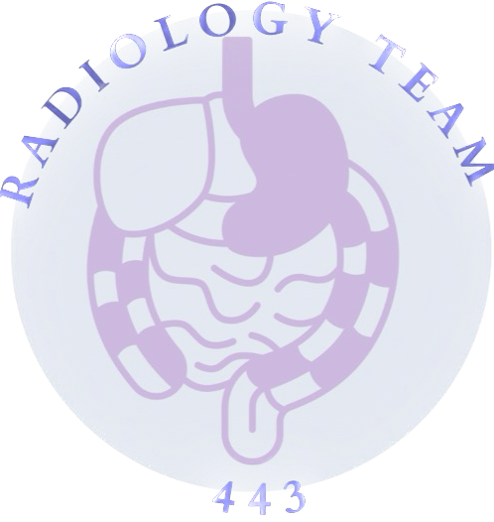
Ultrasound Of Liver And Gallstone
LECTURE 2
COLOR INDEX:
MAIN TEXT
MALE’S SLIDES
FEMALE’S SLIDES
IMPORTANT
FEMALE DOCTOR’S NOTES
MALE DOCTOR’S NOTES
EXTRA INFO
EDITING FILE

Slide 2
Objectives
Introduction to US.
Indications of liver and gallbladder US.
Normal anatomy and radiological appearance.
Pathology of liver and gallbladder.
Common pathological cases.
Female doctor’s notes are important

Slide 3
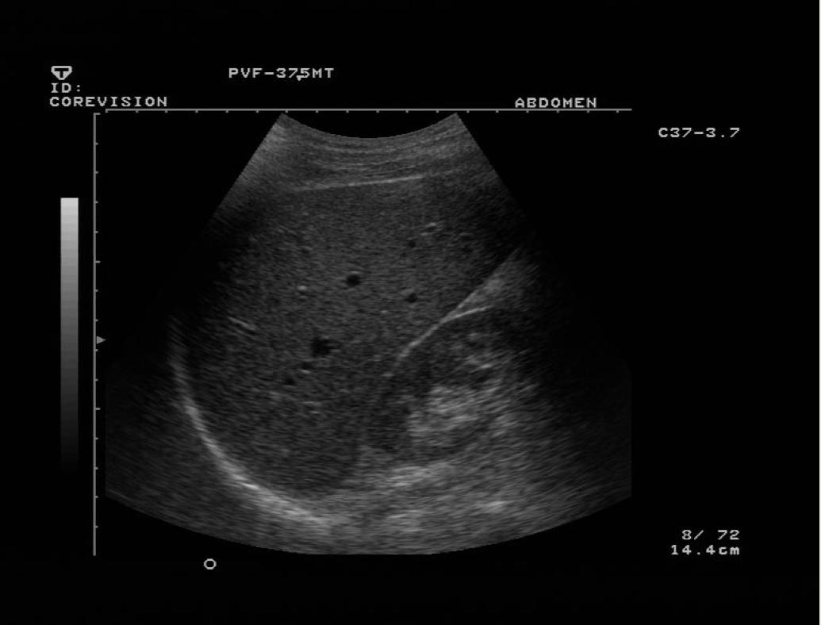
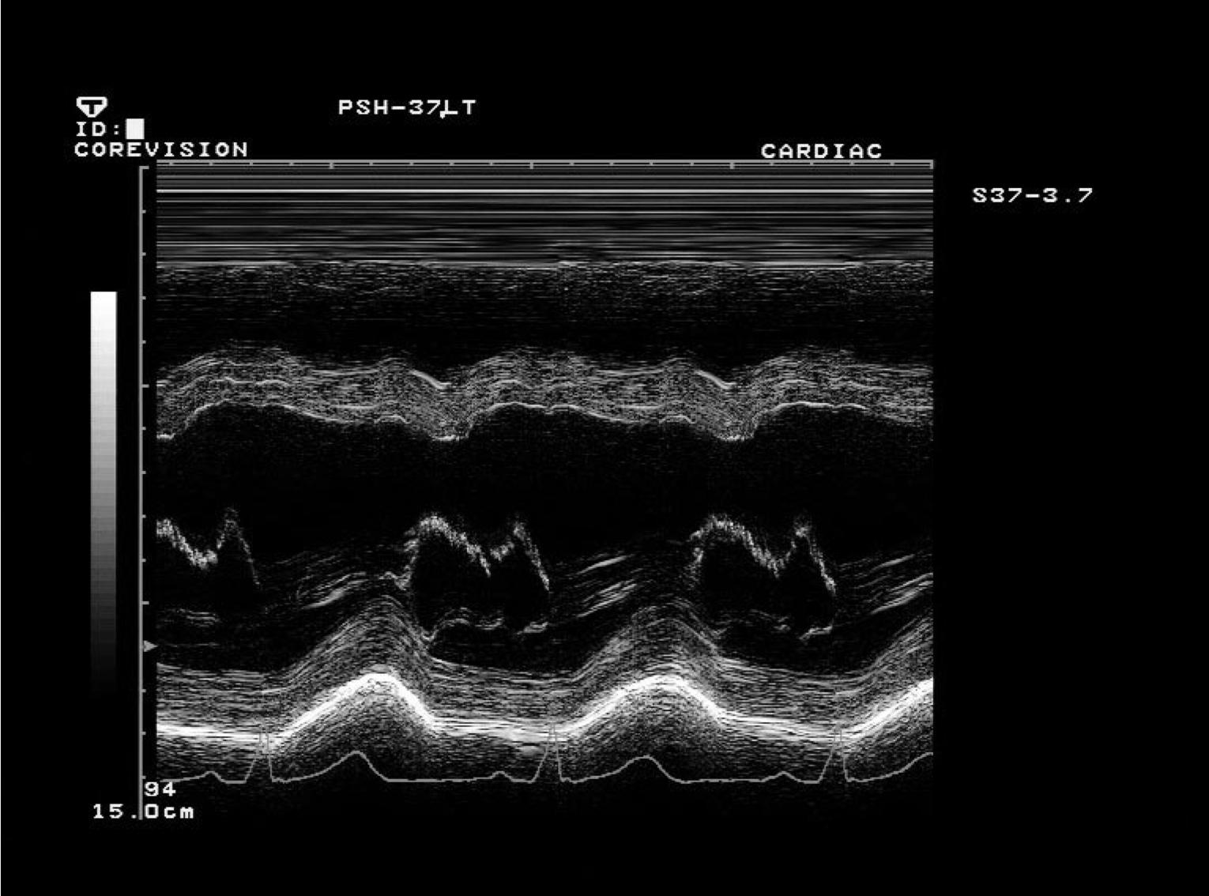
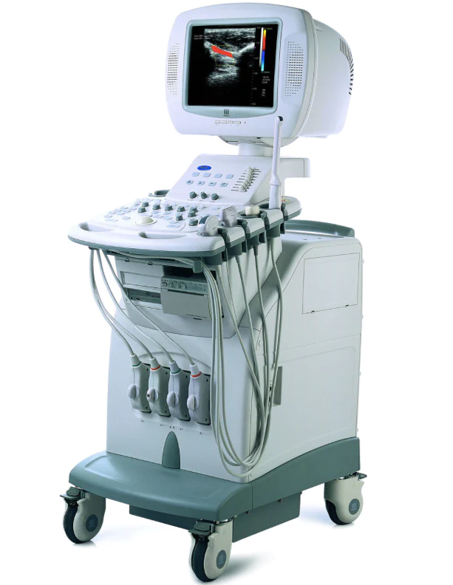
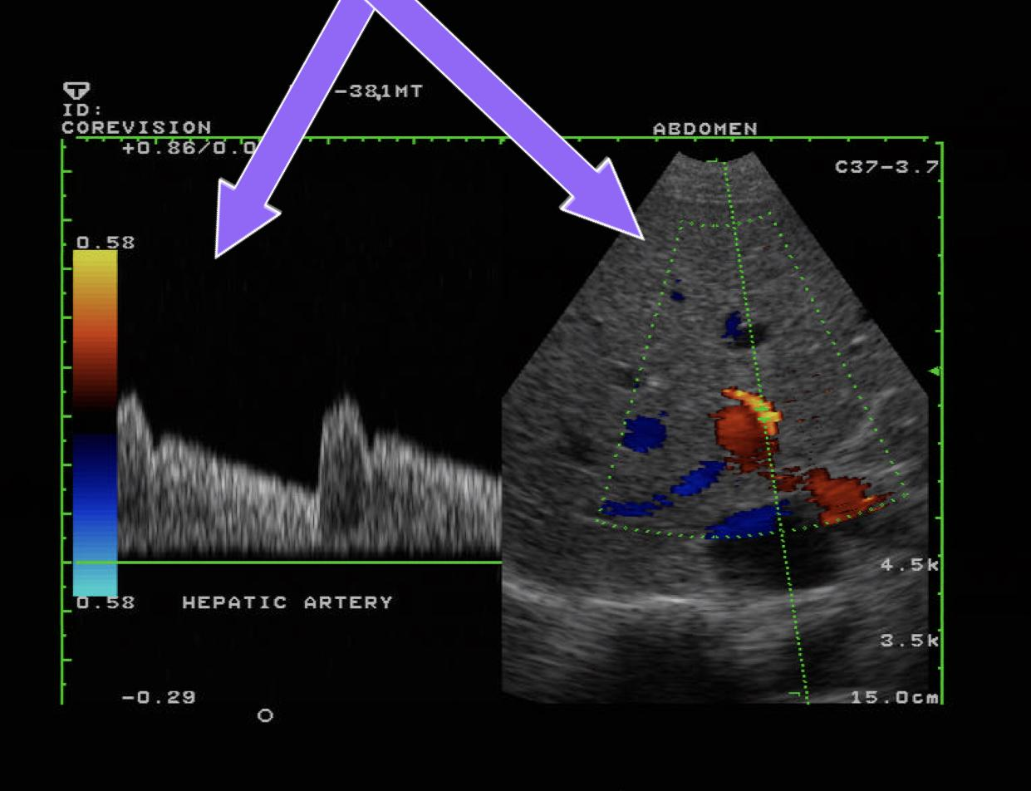
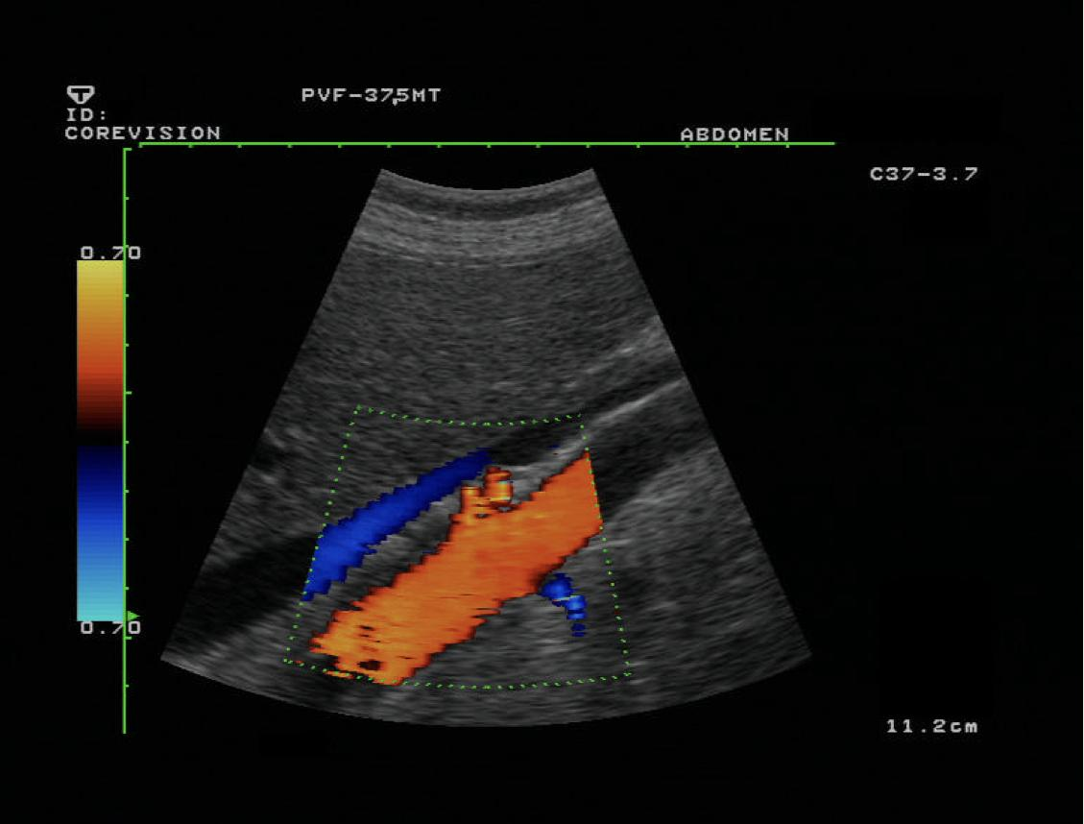
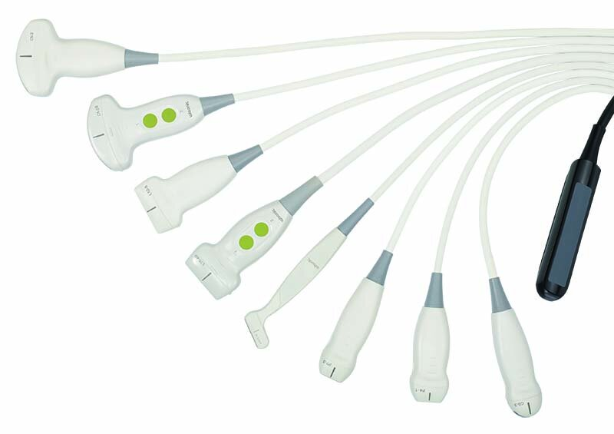
Introduction to Ultrasound
Definition | - A diagnostic technique in which ULTRA=high-frequency sound waves penetrate the body, bounce around, and produce multiple echoes; these echo patterns can be viewed as an image on a computer screen. - Frequency ranges used in medical Ultrasound imaging are 2 - 20 MHz.
US Machine | Robes:
Advantages of US | - noninvasive - inexpensive. - Easy and available. - Safe and non-ionizing.
Disadvantages of US | - Inability to penetrate gas or bone. (they’re the enemies of US, because they’re going to cause posterior shadowing that prevents us from seeing beyond them) - Operator dependant. -it depends on the skills of the technachine, which is different from one to another (which makes it inaccurate) - Less sensitive in some situations.
Modes
B- MODE (grey scale imaging) - With it we can see the organs. |  | M- MODE - It’s used in pregnancy: to measure the heartbeats early on the fetus (presented as waves of motion)
DUPLEX - To check the speed of the movement of the pulsation we will turn on the duplex mode it will show us the waveform of the flow within the vessel |  | COLOR DOPPLER - If we want to see the vascular structures we will transfer to the color doppler, which is just a button within the machine, we press it and it’ll show us colors of the vascular structures with the direction of the flow - In the screen: veins system represented with blue arterial system represented with red
Machine:

Slide 4
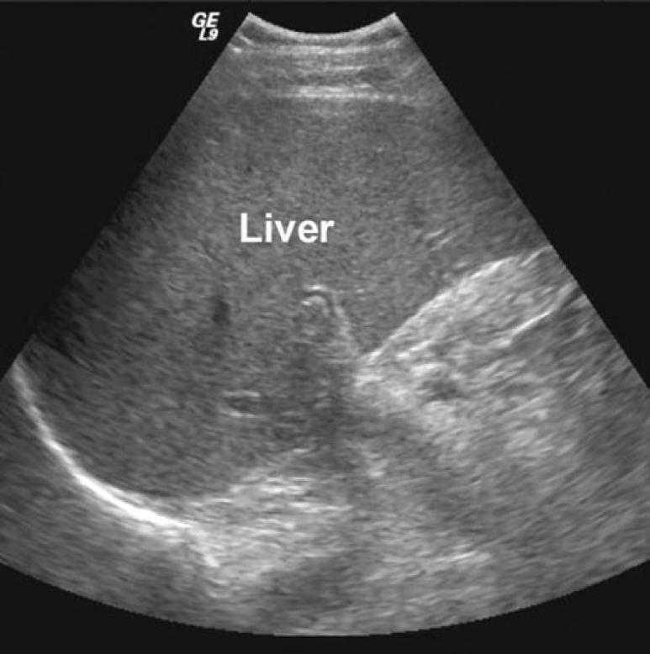
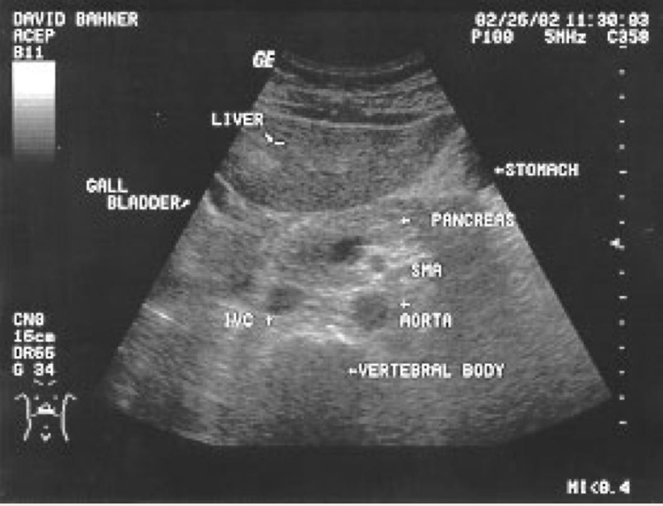
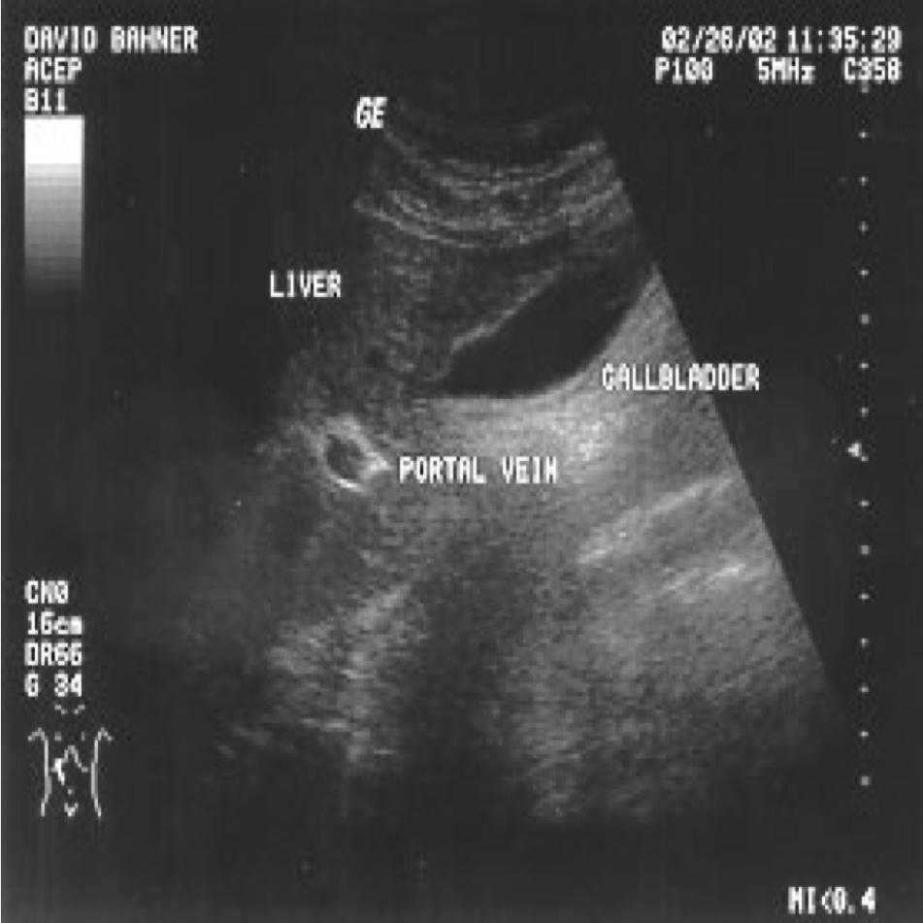
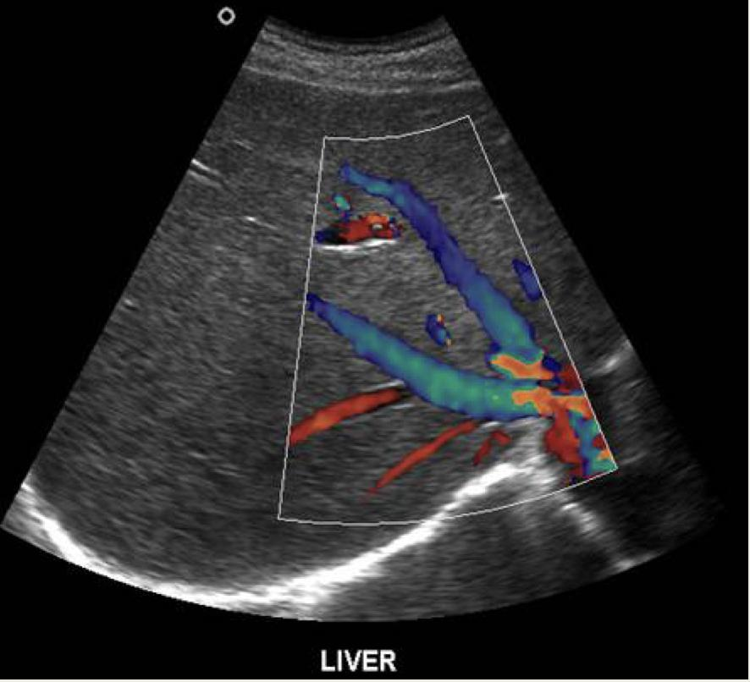
Normal Anatomy and Radiological
Appearance
We have to always pay attention to how the patient is lying down
Anterior Aspect:
Posterior Aspect:
Hepatic veins and arteries
Normal Anatomy and
Radiological Appearance
Indications of Liver and Gallbladder US
- Right upper quadrant pain. (the most common)
- Jaundice. so we’re checking on why does the patient have biliary obstruction
- High liver function test. so we’re going to test the liver itself
- Fever work up. so the patient has cholangitis or something else
- Screening for metastasis. (especially in patients with cirrhosis)
Pathology of the Liver
(keep this in mind during the examination)
in US: dark: fluid (blood, gastric juice, bile,..)
white (echogenic): calcification, bone, or air
grey and in between: everything else
- (1)Size. it could be larger or smaller (the normal size: around 15-16cm in the midclavicular line)
- Diffuse liver disease. we can know it by: changing of the shade of the grey of the liver
- Focal liver disease. such as masses
- Hepatic vascularity.
- Biliary system obstruction/pathology.
(1): in case of hepatomegaly: the liver will be enlarged
causes of hepatomegaly: viral hepatitis, metastases, early part of the cirrhosis, congestive heart failure, and storage diseases such as amyloidosis
in case of cirrhosis (late stages) (in early stages: enlargement of the liver, remember?): small and shrunken liver, with irregular outline +hypertension +/- focal lesions such as hepatocellular carcinoma

Slide 5
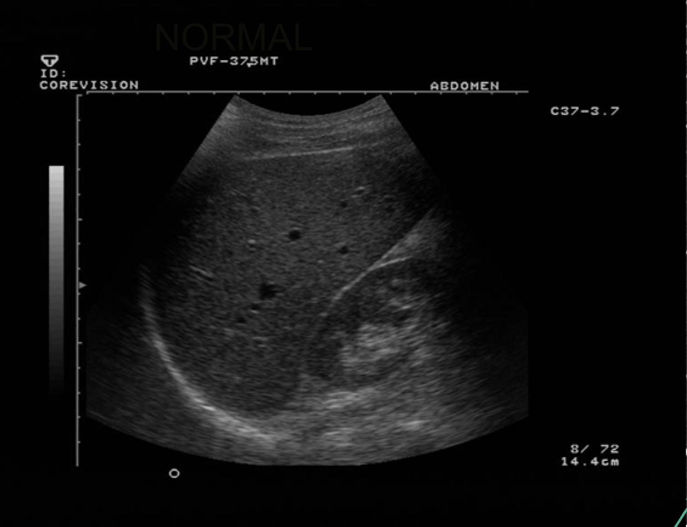
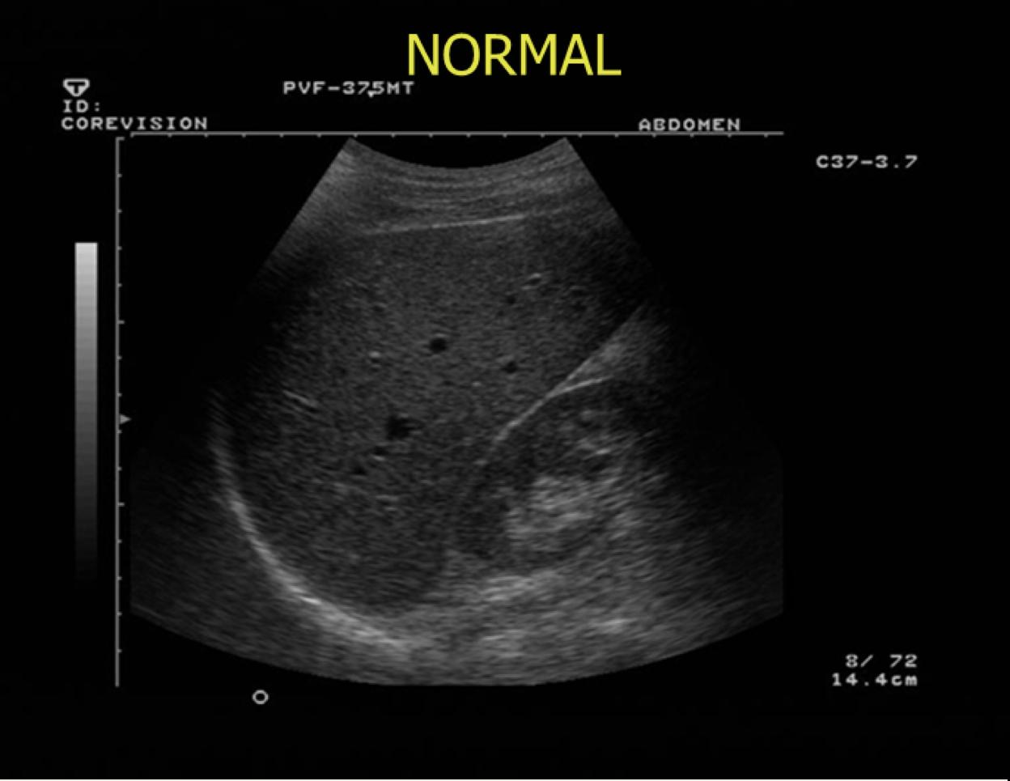
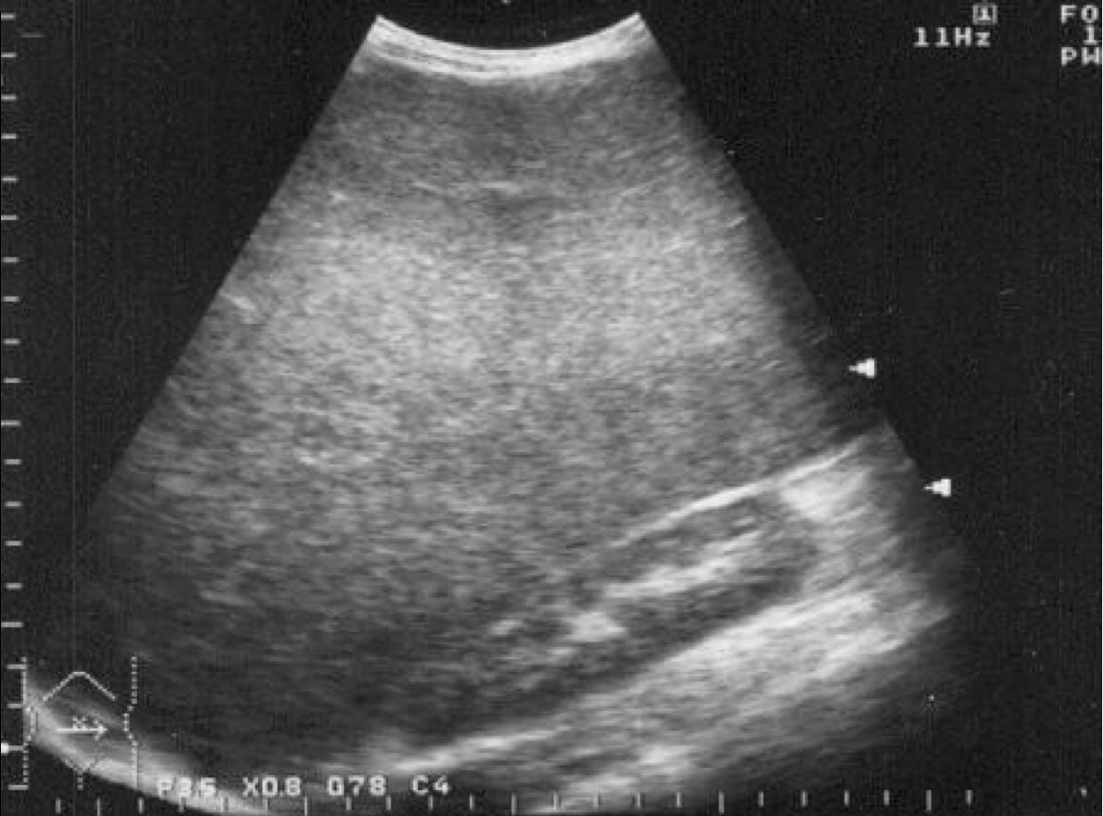
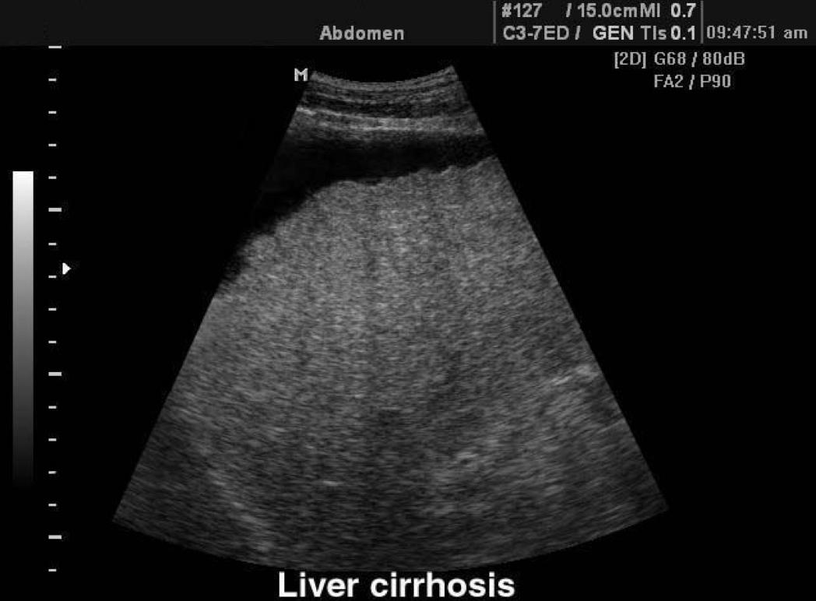
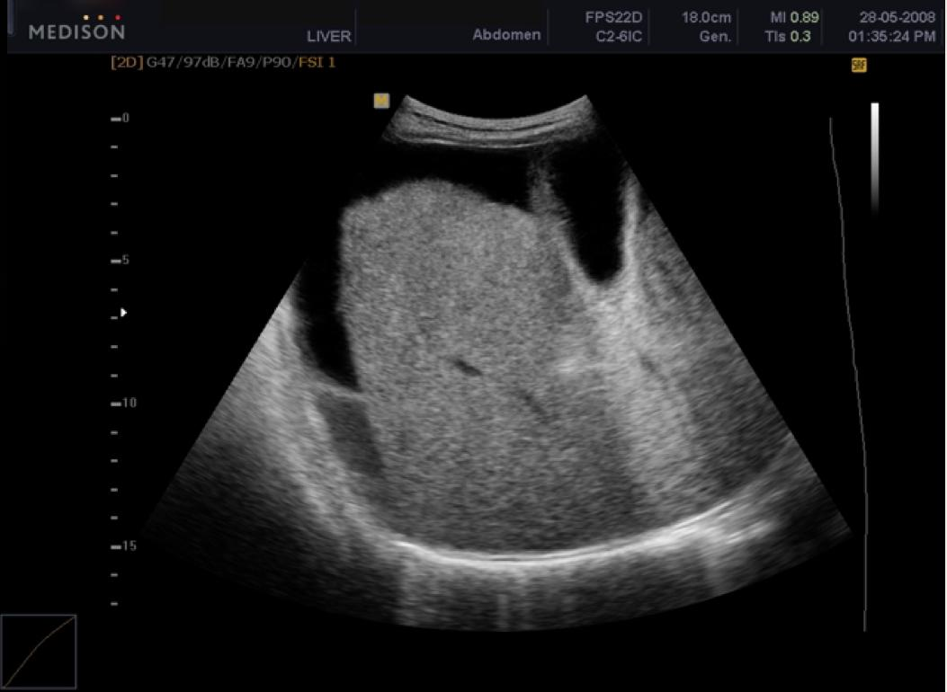
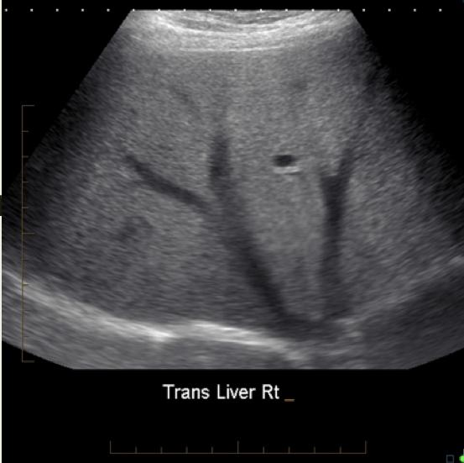
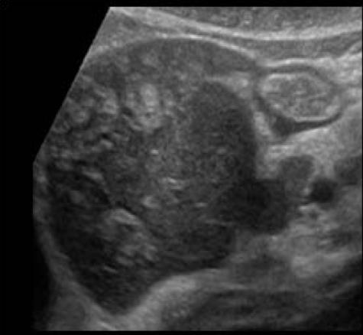
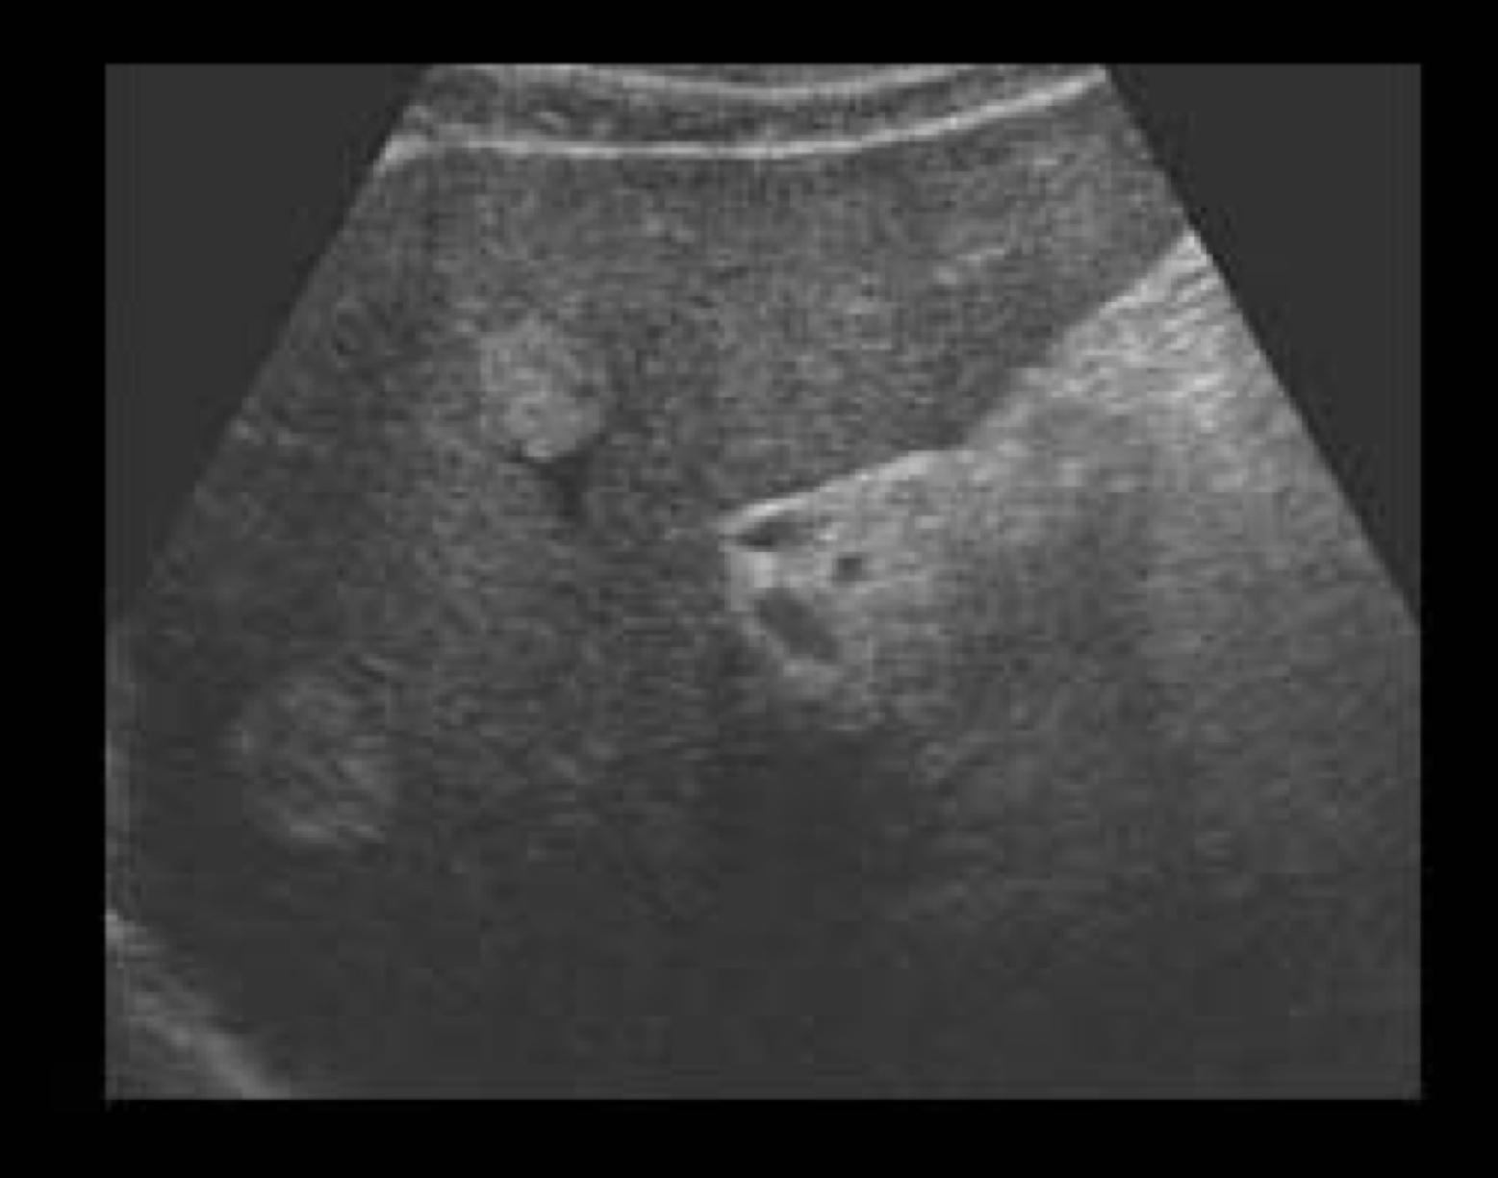
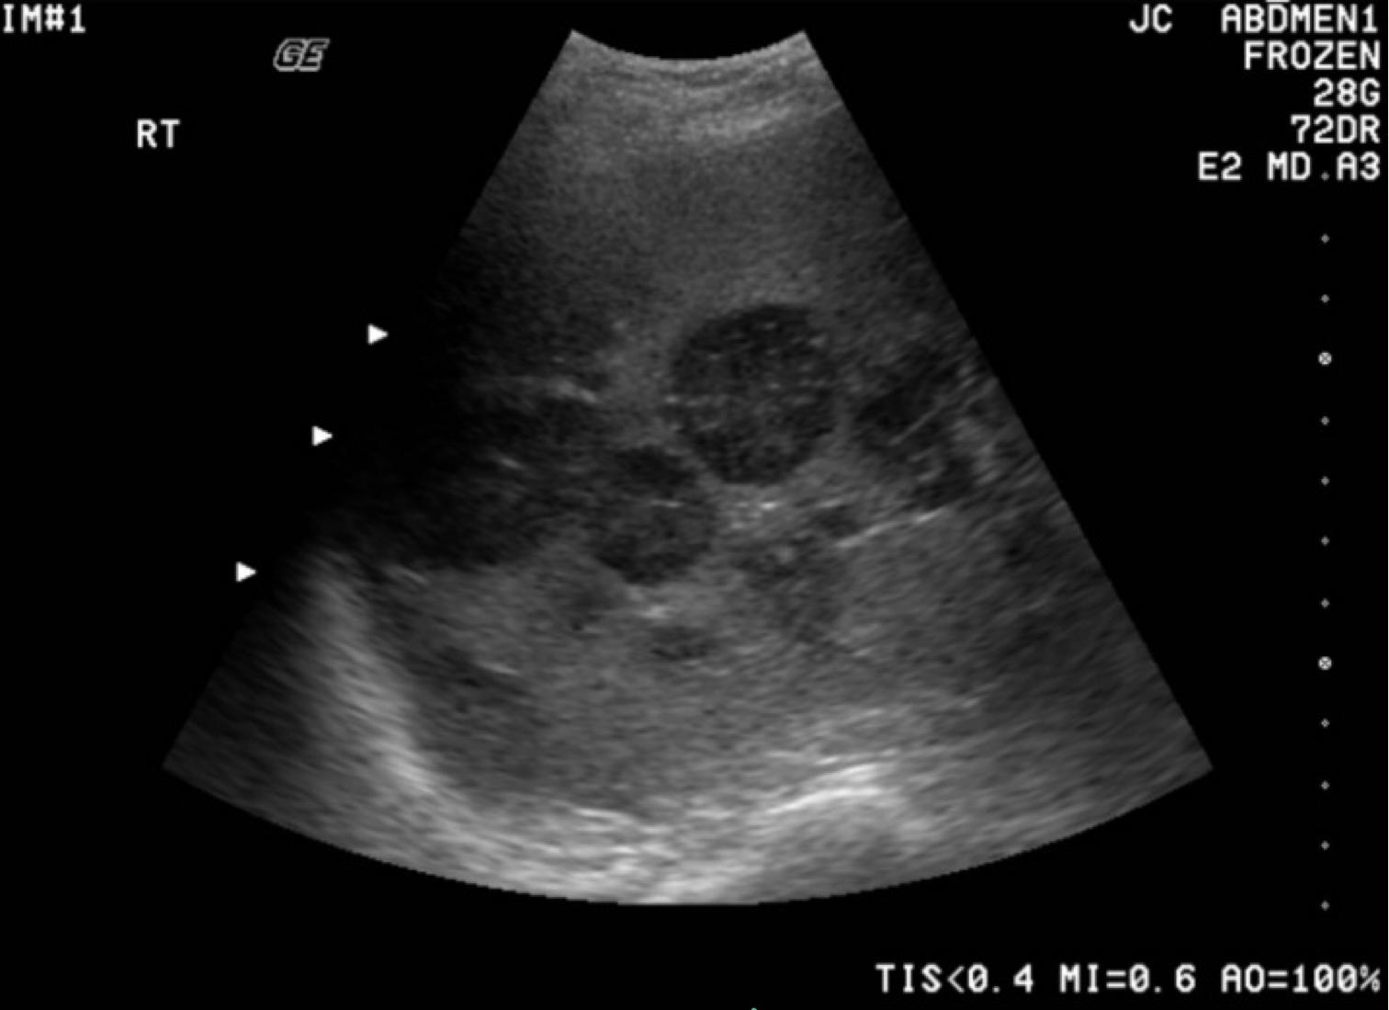
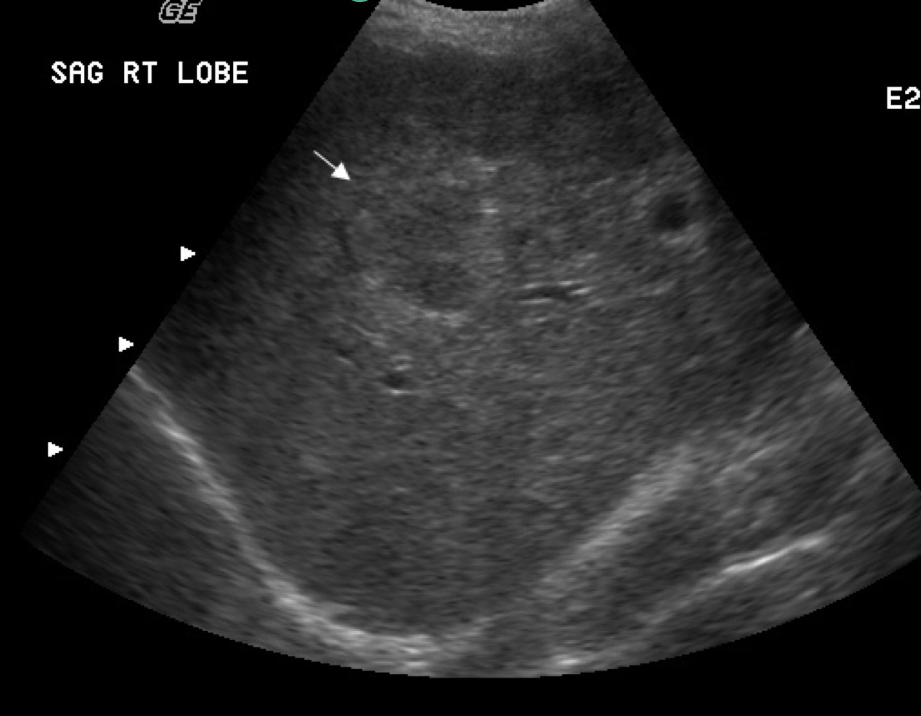
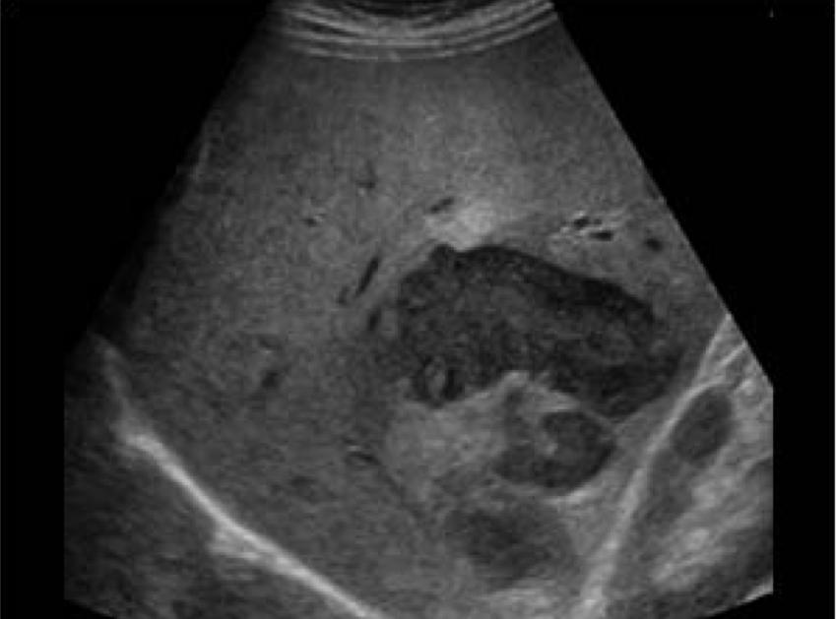
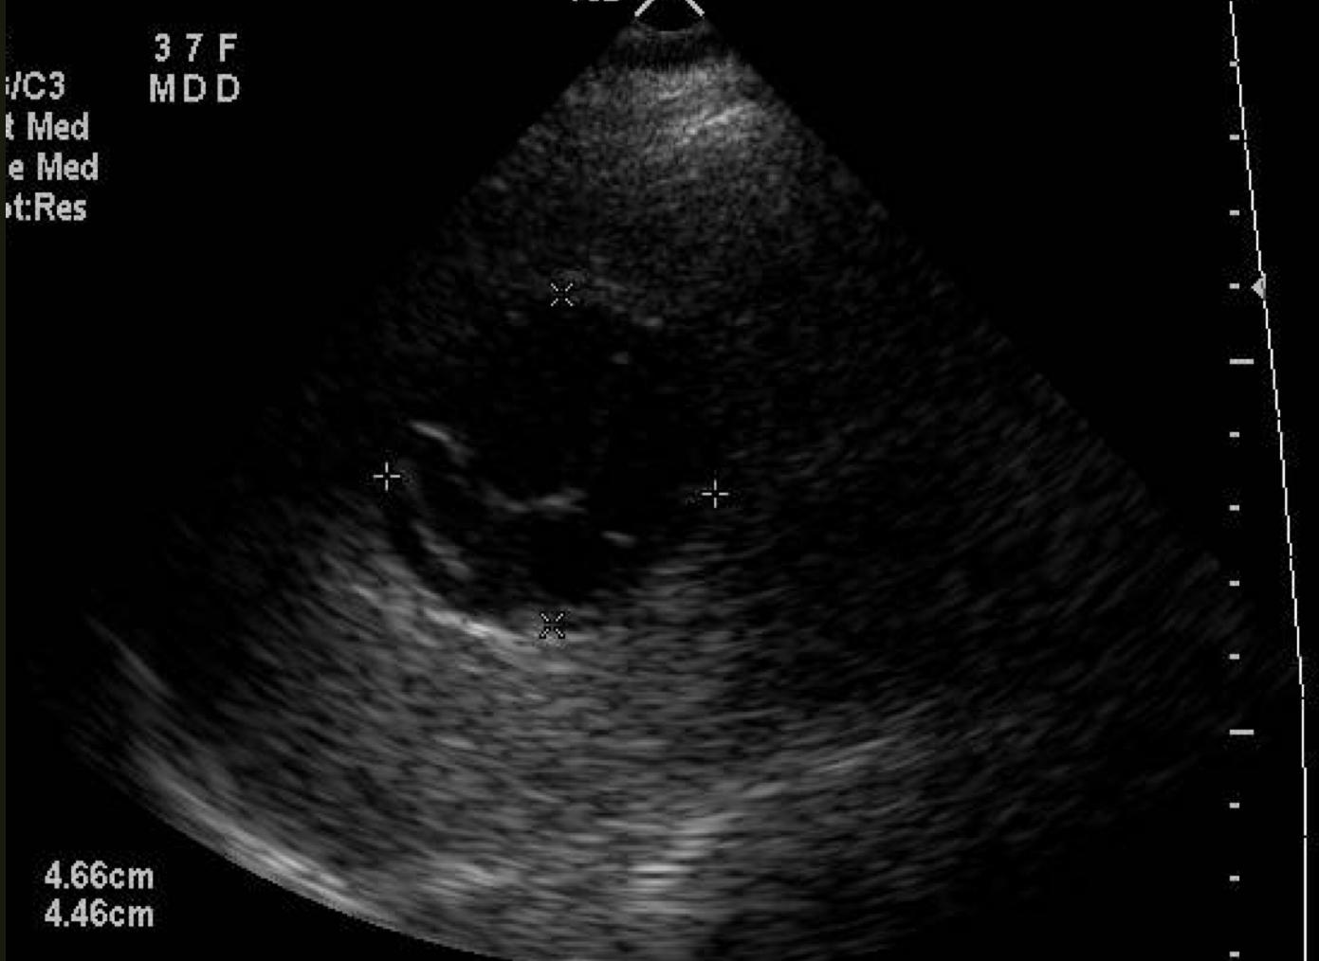
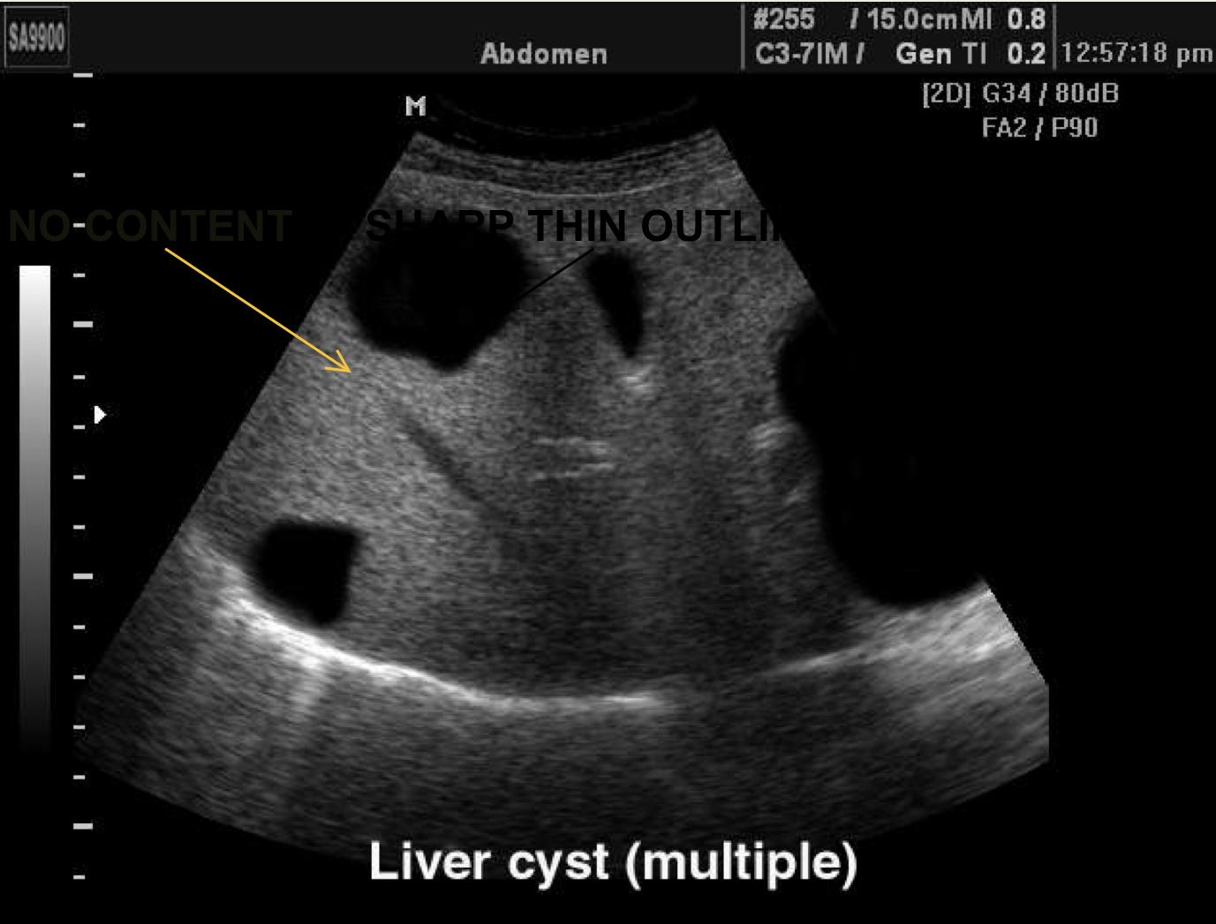
Pathology of the Liver
Size abnormality
Diffuse abnormality منتشر بسبب ال infiltration
Focal liver lesions | Benign tumor: Hemangioma. (vascular lesion) (most common) Malignant tumor: - Primary eg. Hepatocellular carcinoma. - Secondary metastasis it could be anywhere from the body especially the colon and breast eg. Colon breast. Infective: - Abscess - hydatid cyst. Congenital: -Hepatic cyst. (1): (fluid would cause posterior enhancement enabling us to see what beyond the fluid in details)
Normal liver size:
Normal liver size:
Enlarged liver:
Smaller liver with irregular wall and free fluid +/- focal lesion:
واصل للkidney
-Hepatomegaly:
Infective eg: viral hepatitis
Neoplastic eg: metastasis
Degenerative eg: early cirrhosis
Raised venous pressure eg Congestive cardiac failure.
- Storage disorder, e.g. amyloidosis
- Myeloproliferative disorder e.g. Polycythaemia rubra vera.
The diagnosis of: liver cirrhosis
(liver here is not clear and not smooth due to cirrhosis)
Small shrunken liver:
Late cirrhosis:
Shrunken liver with irregular outline
Ascites
Portal hypertension.
+- focal lesion.
Diffuse increase in parenchymal echogenicity(whiter than normal) | Diffuse decrease in parenchymal echogenicity(darker than normal)
- Diffuse fatty infiltration. - Other infiltrative: 1- Malignant disease 2- Infectious disease 3- Glycogen storage disease | (darker than normal because of edema) - Acute hepatitis. - Other: Malignant infiltration. (in this case it could be whiter or darker)
Hemangiomas
Metastasis
usually appears brighter than the background liver
multiple lesions, rounded nodules like
HCC
Liver abscess
we can see darker lesions in the liver which are usually irregular
Hydatid cyst
Liver cyst (multiple)
we can see the inner wall of this cyst is left up (water lily appearance)
(1) simple cyst that contains fluid only

Slide 6
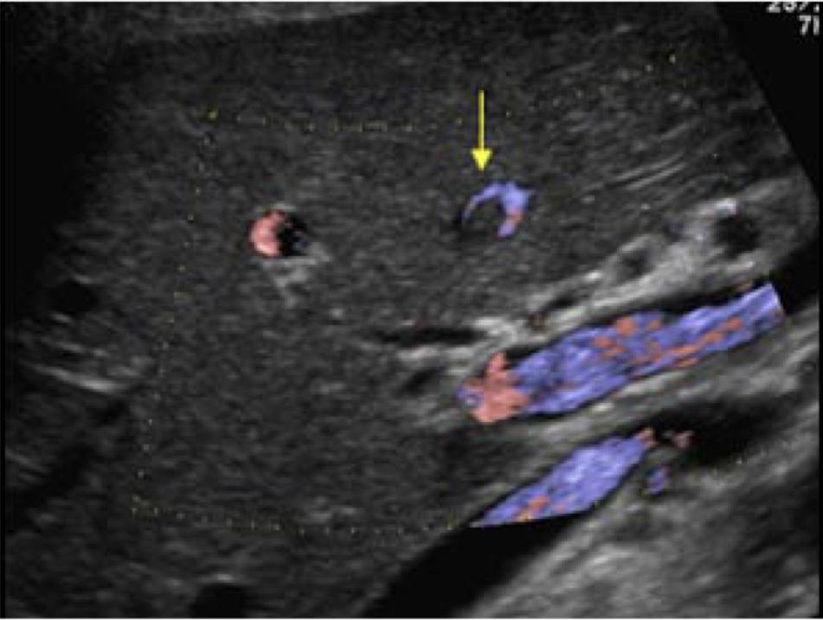
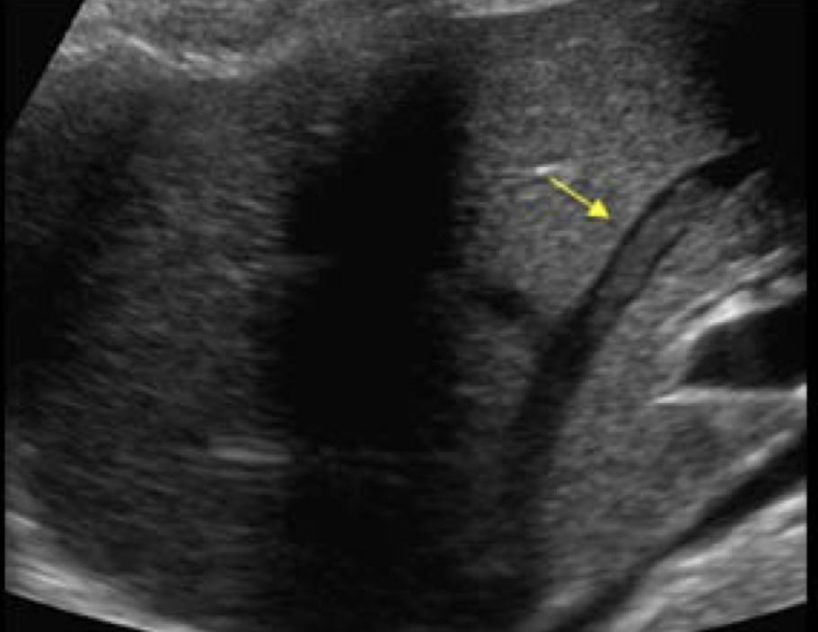
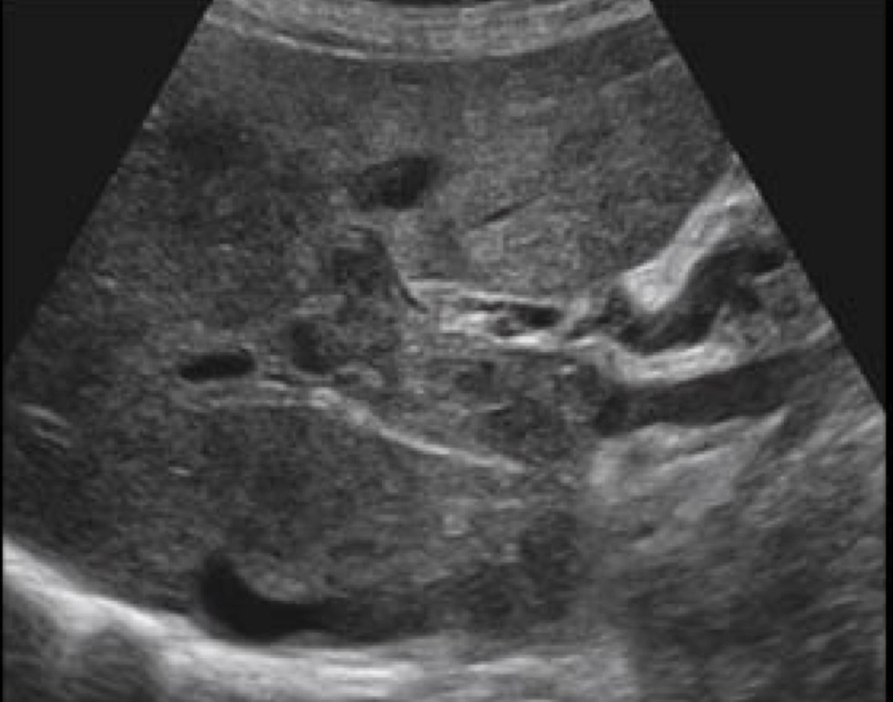
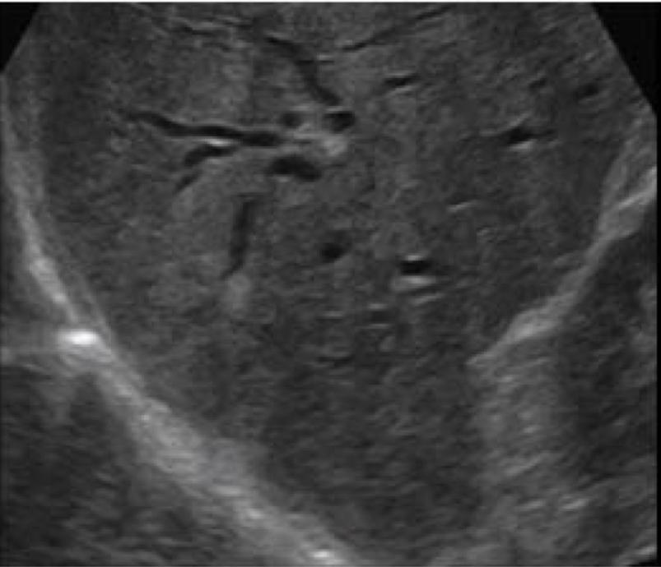
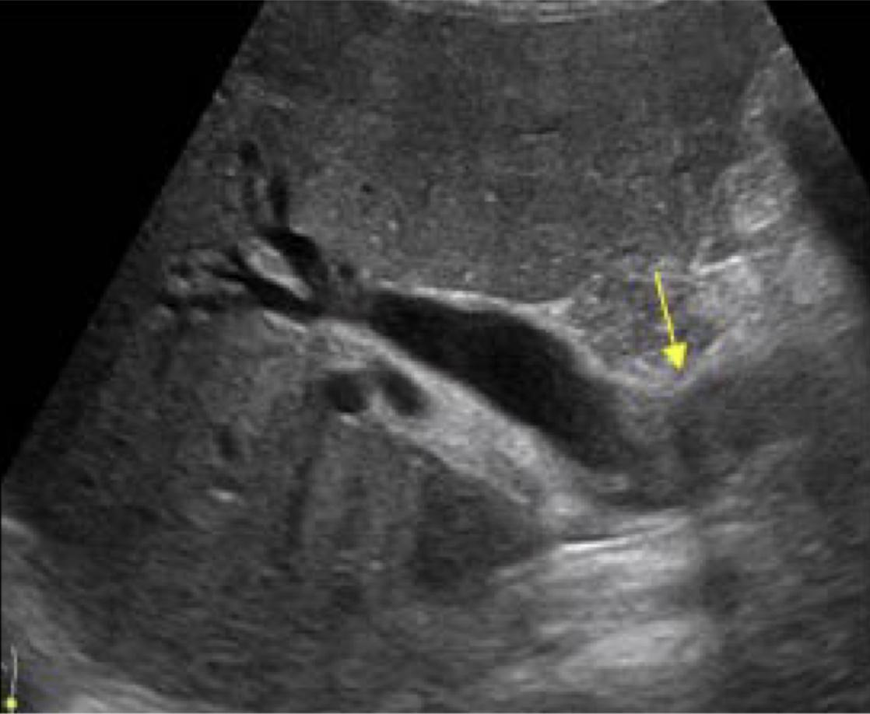
Pathology of the Liver, cont.
Vascular abnormality (hepatic vascularity) | Portal venous system: - thrombosis. - Portal hypertension. Hepatic venous system: - Thrombosis - (Budd Chiari syndrome).
Biliary abnormality | - Abnormalities: 1- Intra-hepatic biliary radicals. Less than 3mm which is the normal size of the intrahepatic bile duct 2- Extra-hepatic “CBD” Less than 8mm which is the normal size of the extrahepatic bile duct - Causes of dilatation & obstruction: 1- Intra-luminal: Stone & mass. or injury due to trauma or surgery 2- Mural: (within the wall) stricture (benign & malignant) 3- Extrinsic: (outside the bile duct, but piercing on it) Compression mass & Lymph node
Hepatic vein thrombosis
Portal vein thrombosis

Slide 7
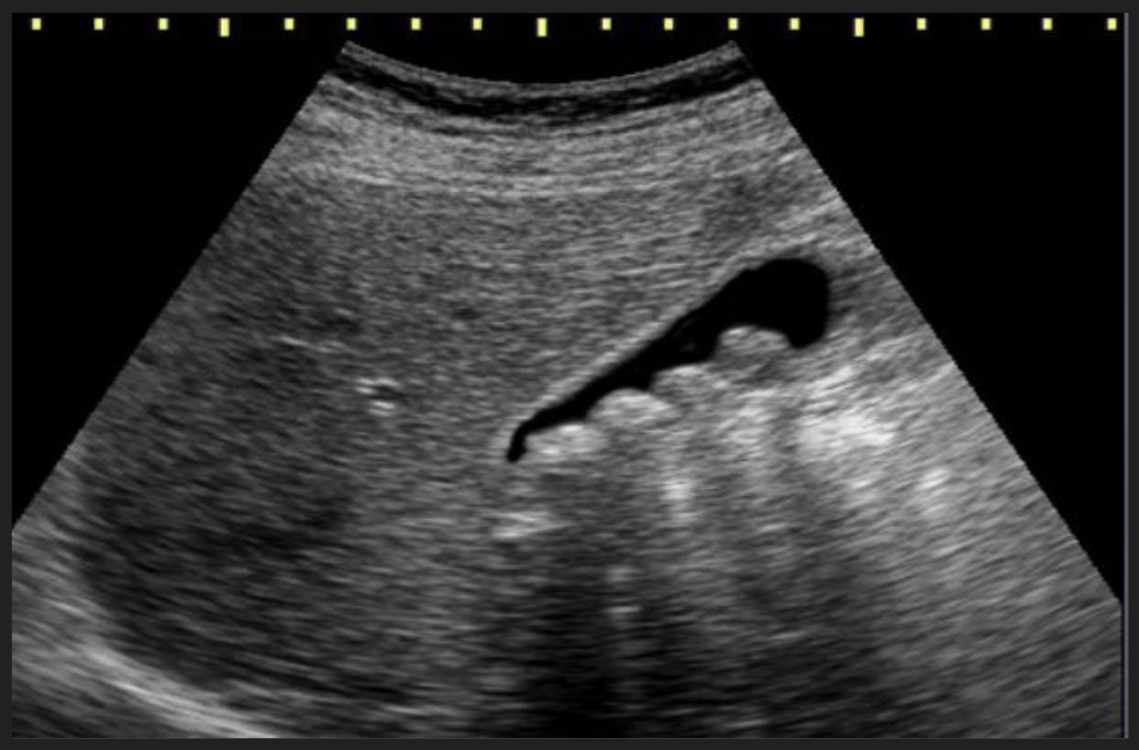
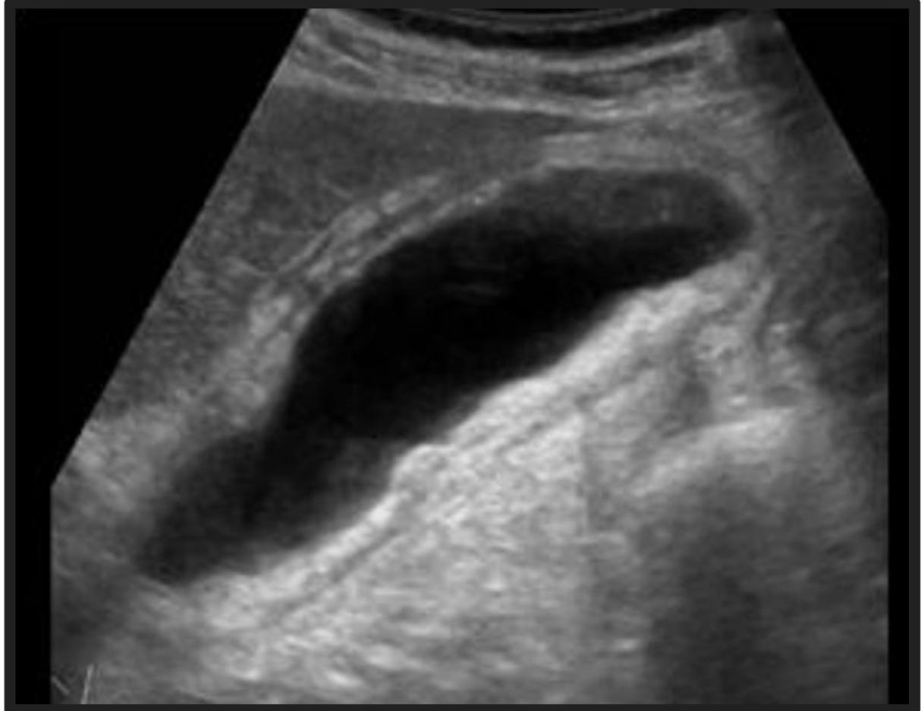
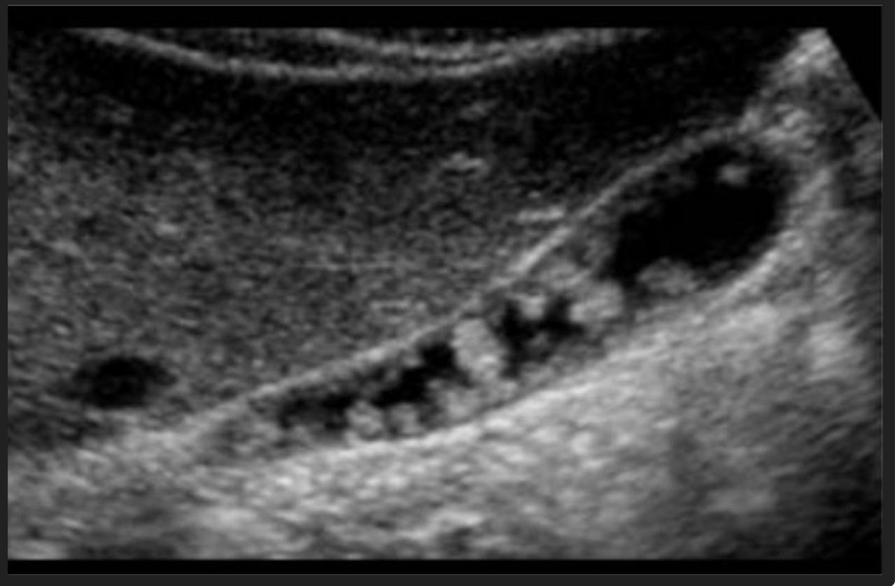
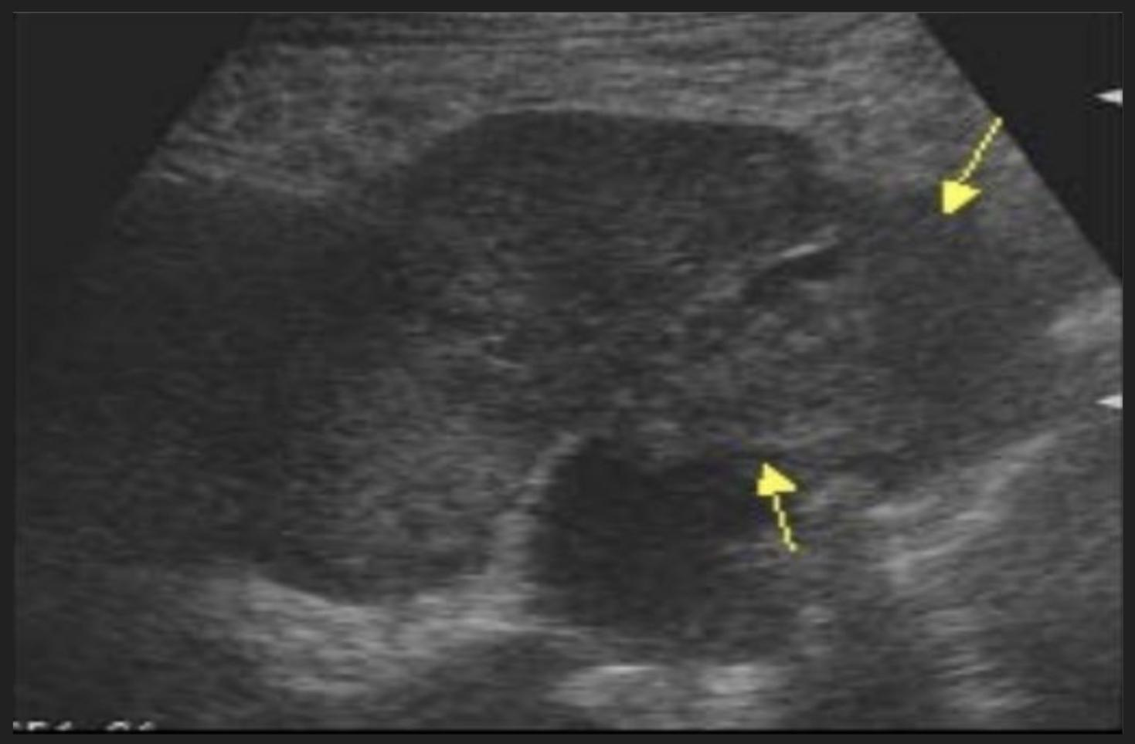
Pathology of Gallbladder
Intra-Luminal Pathology | Mural Pathology
Gall stone: Acoustic shadowing.
-Mural thickening:
Primary: Cholecystitis.
Secondary:
mostly because of edema
(Because of the calcification formed by condensed bile material)
-Cardiac failure.
-Cirrhosis.
-Ascites.
-Hypoalbuminemia.
-Renal failure.
(liver failure)
-Polyps: No acoustic shadowing.
-How we differentiate between gallstones and polyps?
(Polyps: is the soft tissue that’s arising from the wall into the lumen, while the gallstones are moving within the bile.)
(The presence of acoustic shadowing or not.)
We can’t see the gallbladder clearly.
-Intraluminal:
Mass lesion.
+- invasion.
Gallbladder carcinoma.
Its upper part is filled with soft tissue because of gallbladder cancer.

Slide 8
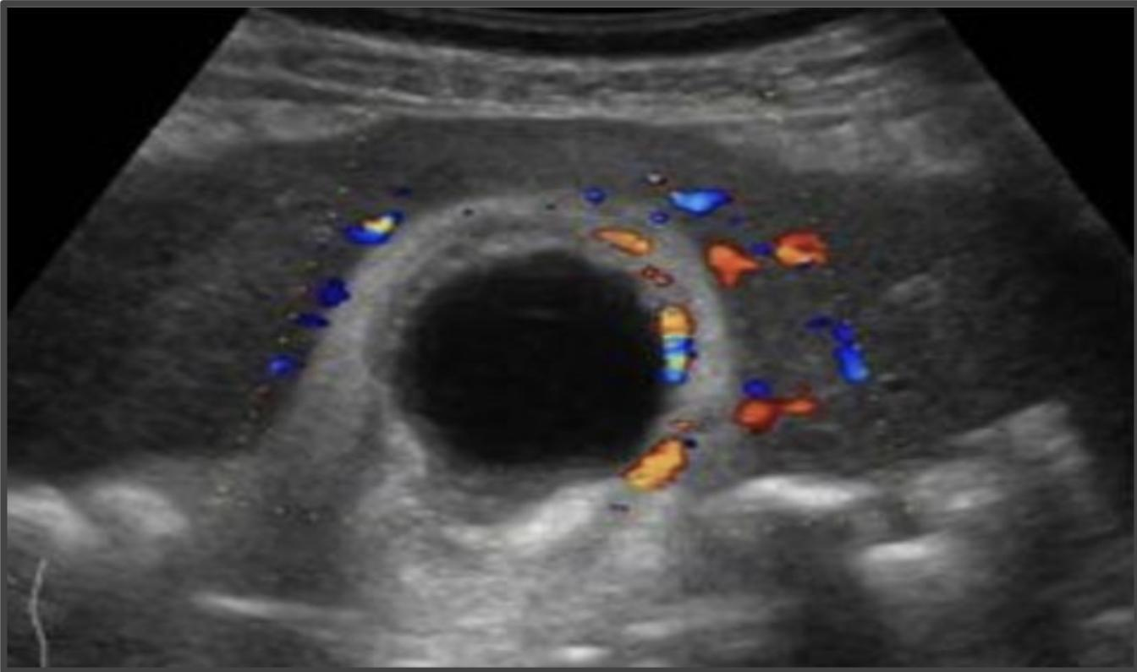
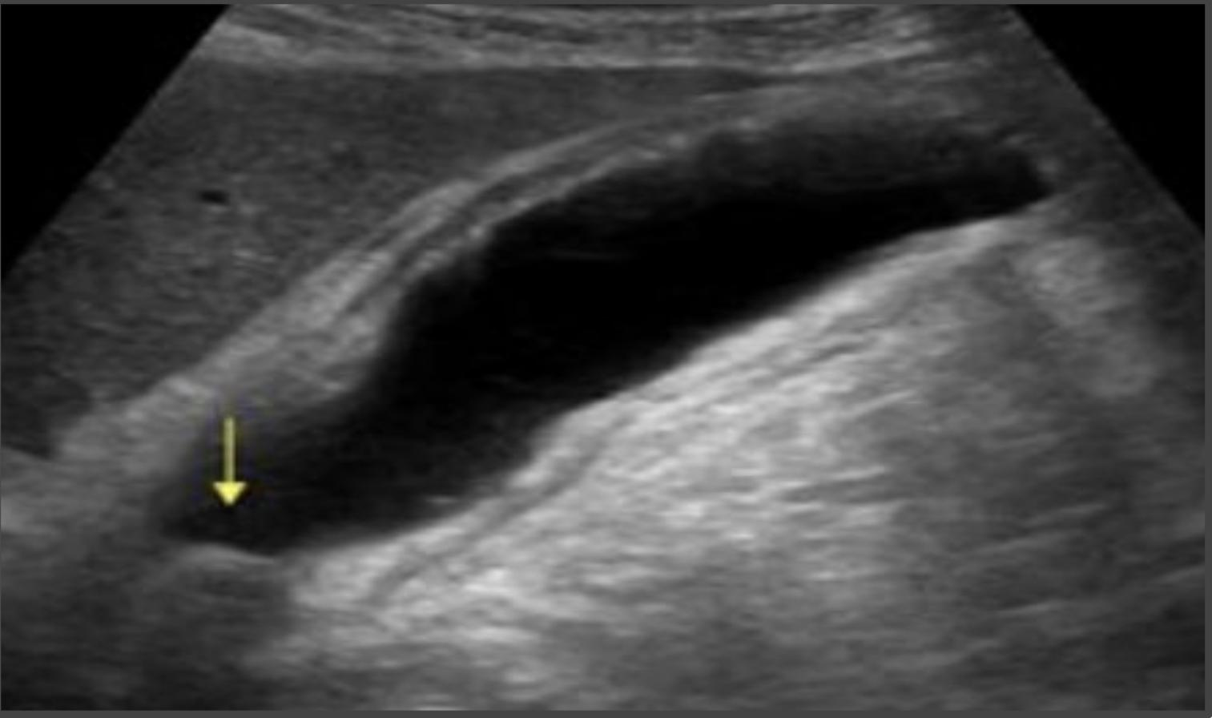
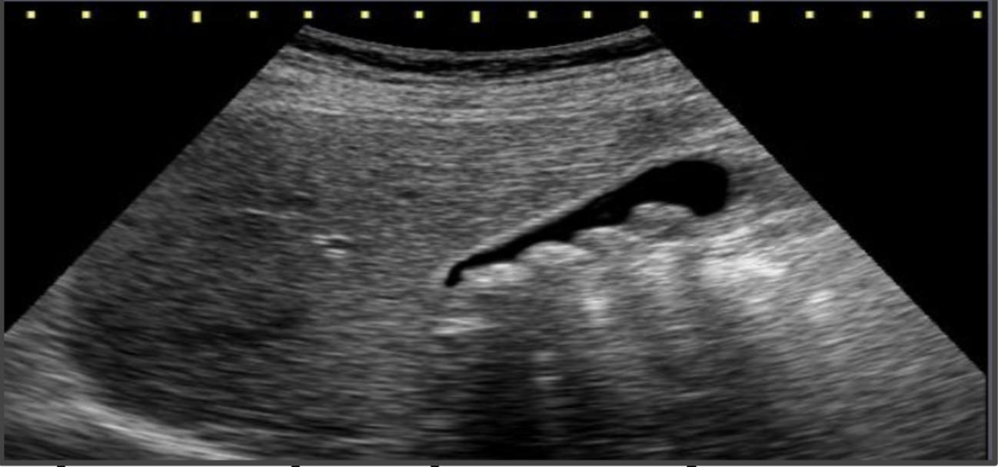
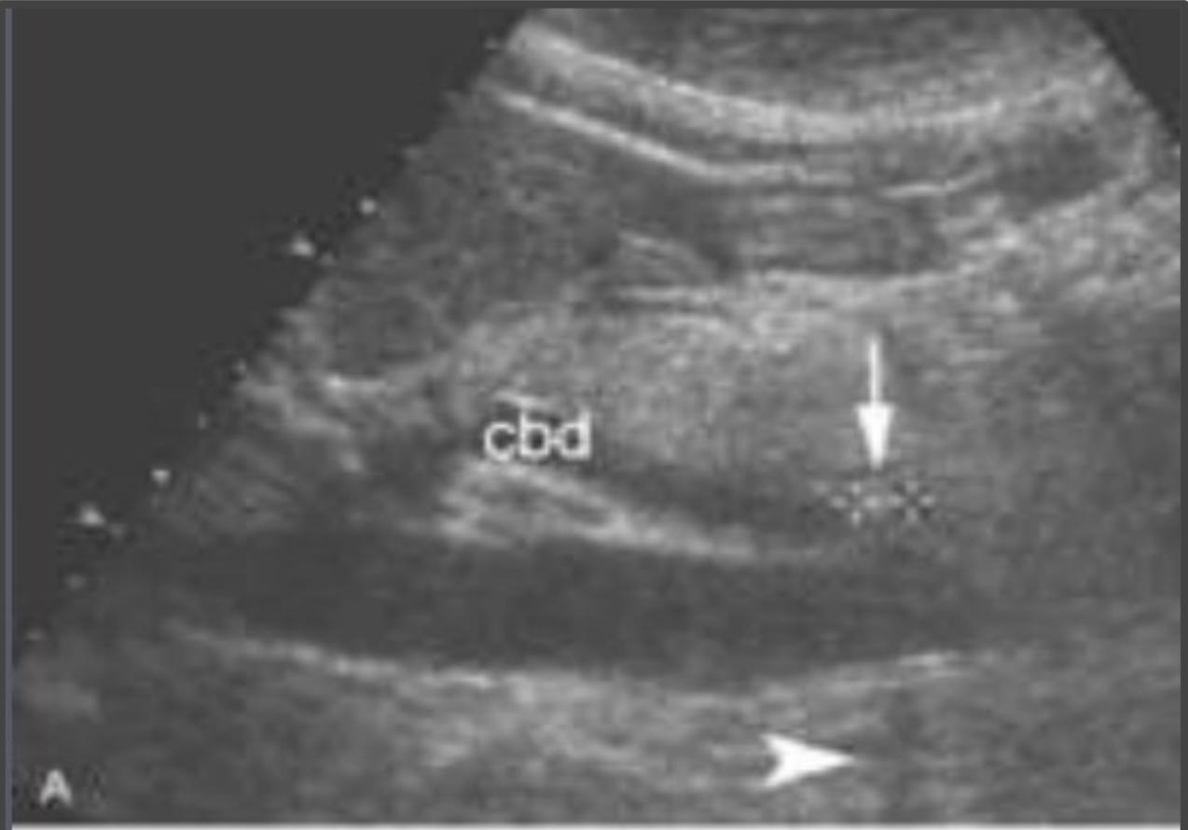
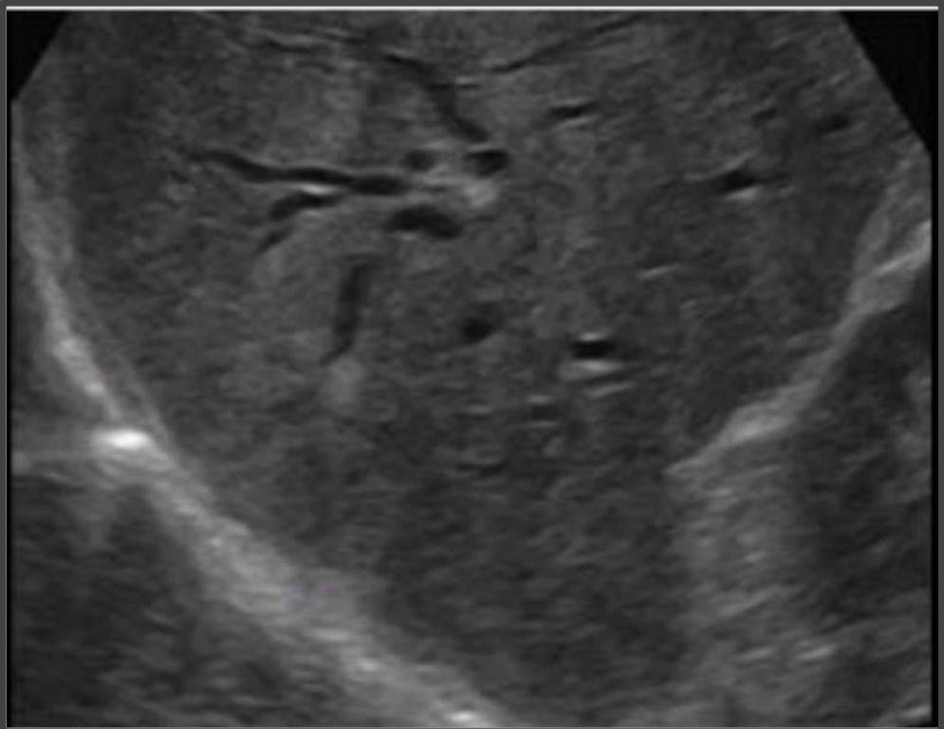
Common pathological cases
These cases will not come in the exam but for better understanding
Case One
Middle aged woman presented to the emergency department with fever and right upper quadrant pain. On examination, she looks ill, febrile and in pain with Right upper quadrant tenderness. Labs show elevated liver enzymes and high WBC count.
Interpretation: Thickening of Gallbladder wall above 3mm, Gallbladder distention, Pericholecystic fluid, Hyperemia, Gallstone on the neck.
Diagnosis: Acute calcular stone cholecystitis.
Case two
Middle aged woman presented to the surgical outpatient clinic with 2 years history of recurrent right upper quadrant pain mild to moderate in severity. The pain radiates to the right shoulder and is aggravated by fatty meals. On examination, The woman appears obese and is not distressed, febrile or jaundiced. Labs show normal liver enzymes.
Interpretation: Multiple oval shaped echogenic structures seen within the gallbladder causing acoustic shadowing. No wall thickening & no hyperemia.
Diagnosis: gallbladder stones.
Case three
Middle aged man presented to the emergency room with severe right upper quadrant pain and yellowish discoloration of skin and sclera. On examination he looks ill, jaundiced and in pain but not febrile. Labs show elevated liver enzymes.
Interpretation: Dilated intrahepatic and extrahepatic biliary system. Echogenic structure seen within common biliary duct.
Diagnosis: Common biliary duct stone causing upstream biliary obstruction (choledocholithiasis).

Slide 9
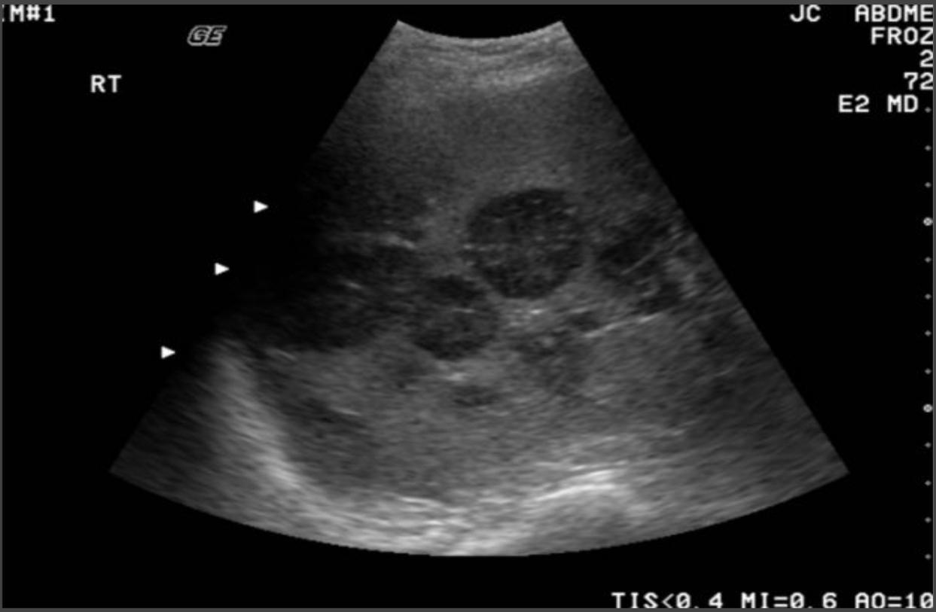
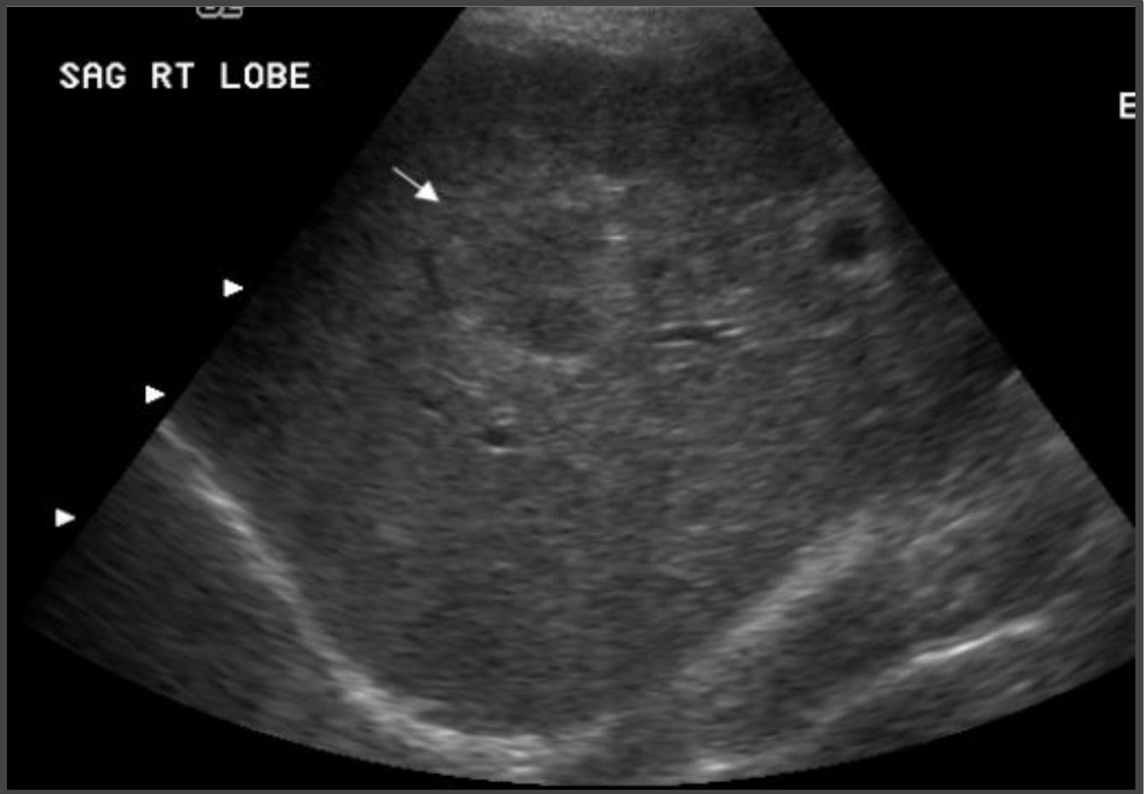
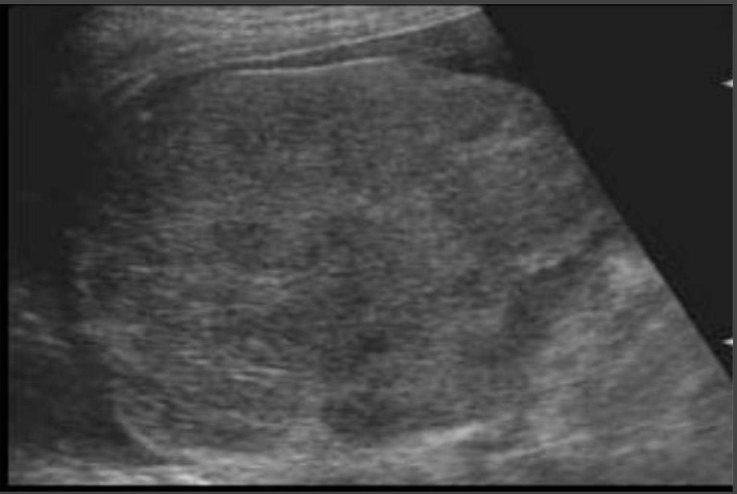
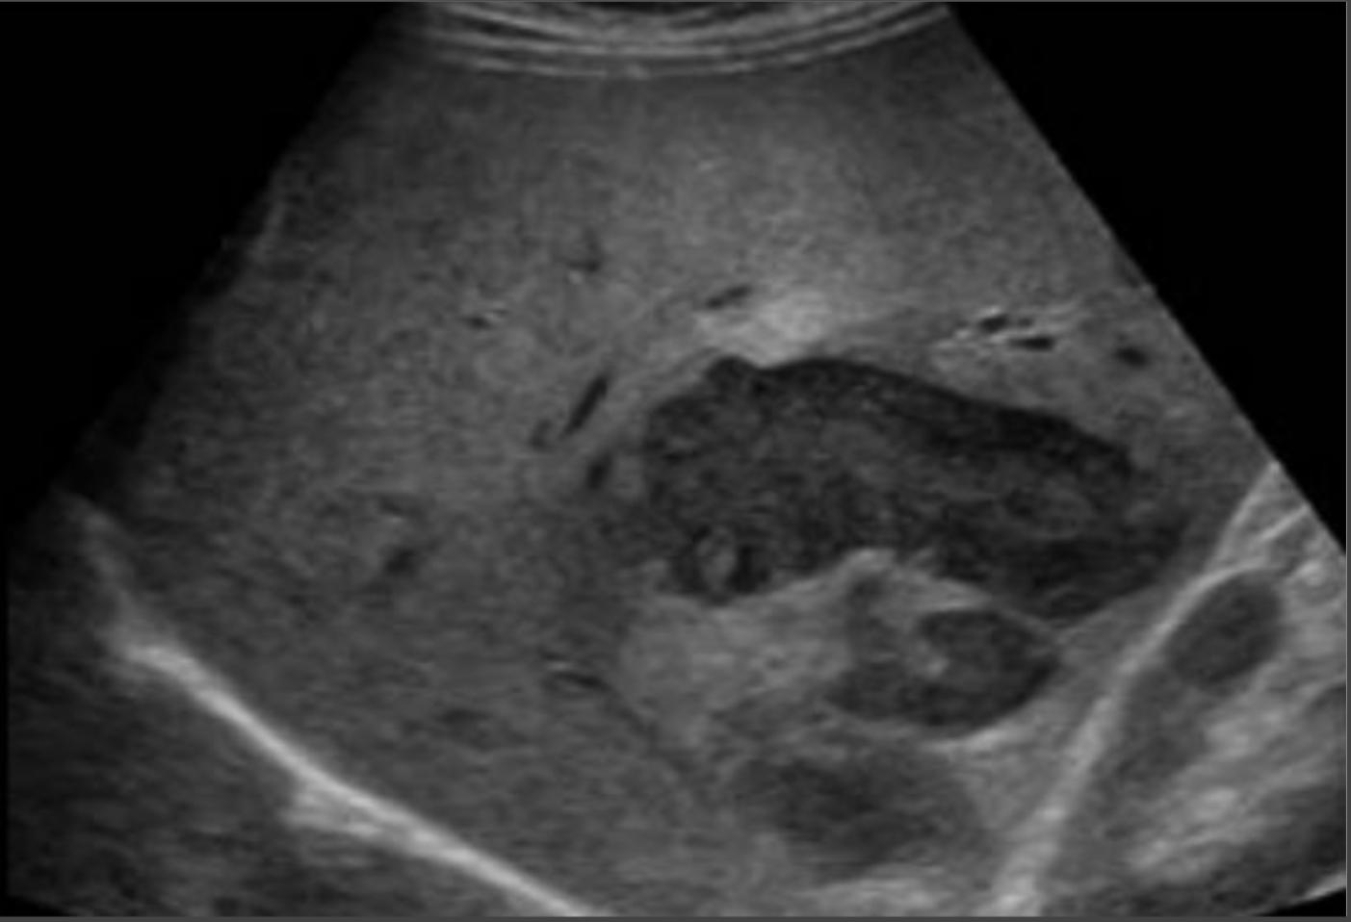
Common pathological cases
These cases will not come in the exam but for better understanding
Case four
Old man recently discovered to have colonic cancer presented to primary health care clinic with vague upper abdominal pain. On examination he appears thin & ill but not febrile or jaundiced. Mild abdominal tenderness and enlarged liver with irregular outline is noted. Labs show mild elevation in liver enzymes.
Interpretation: Multiple hypoechoic focal hepatic lesions. Diagnosis: Metastatic liver lesions.
Case five
Middle aged man who is a known case of Hepatitis C virus for 10 years. He presented to GI outpatient clinic with history of weight loss, Indigestion and mild abdominal pain. No fever. On examination, he appeared ill, slim, mildly jaundiced but not febrile. Abdomen: bulging flanks, Dilated tortuous vessels around umbilicus. Mild diffuse abdominal tenderness, Labs show high liver enzymes.
We have to do screening from time to time for patients with cirrhosis, because there’s a high risk of developing HCC.
Interpretation: Shrunken liver with irregular outline, Heterogeneous appearance, Focal hypoechoic lesion.
free fluid.
Diagnosis: Cirrhotic liver with Hepatocellular carcinoma.
(HCC secondary to cirrhosis).
Case six
Young man who is known for being an IV drug addict presented to the emergency room with high fever, chills, upper abdominal pain and vomiting. On examination he looks very ill, febrile and in pain. Right upper quadrant tenderness is noted. Labs show high Liver enzymes and high WBCs
To differentiate between liver abscess and metastasis using ultrasound:
we’re going to turn “the color deeper”on:
-in case of metastasis: the vessels will be present.
-in case of liver abscess: the vessels aren’t present.
Interpretation: Focal hypoechoic liver lesion with ill defined outline.
Diagnosis: Liver abscess.

Slide 10
MCQs
Q1: Which of the following is not an advantage of ultrasound?
A: noninvasive | B: non ionizing | C: operator dependent | D: inexpensive
Q2: Intrahepatic biliary radicals is considered a biliary abnormality in which the intrahepatic bile duct size would be:
A: less than 3mm | B: more than 3mm | C: less than 8mm | D: more than 8mm
Q3: In case of liver cirrhosis, how would the liver appear with the ultrasound?
A: enlarged liver | B: small liver with regular outlines | C: enlarged liver with irregular wall and free fluid | D: small shrunken liver
Q4: How would polyps in the gallbladder appear with the ultrasounds?
A: it will be moving within the bile | B: presented with acoustic shadowing | C: presented with no acoustic shadowing | D: A&C
Answers:
1:C 2:A 3:D 4:C

Slide 11
TEAM LEADRS
Danah Almuhaisen
Abdurahman Alshahwan
TEAM MEMBERS
Aroub Almahmoud
Norah Almania
Reuf Alahmari
Naif Alateeq

