Slide 1
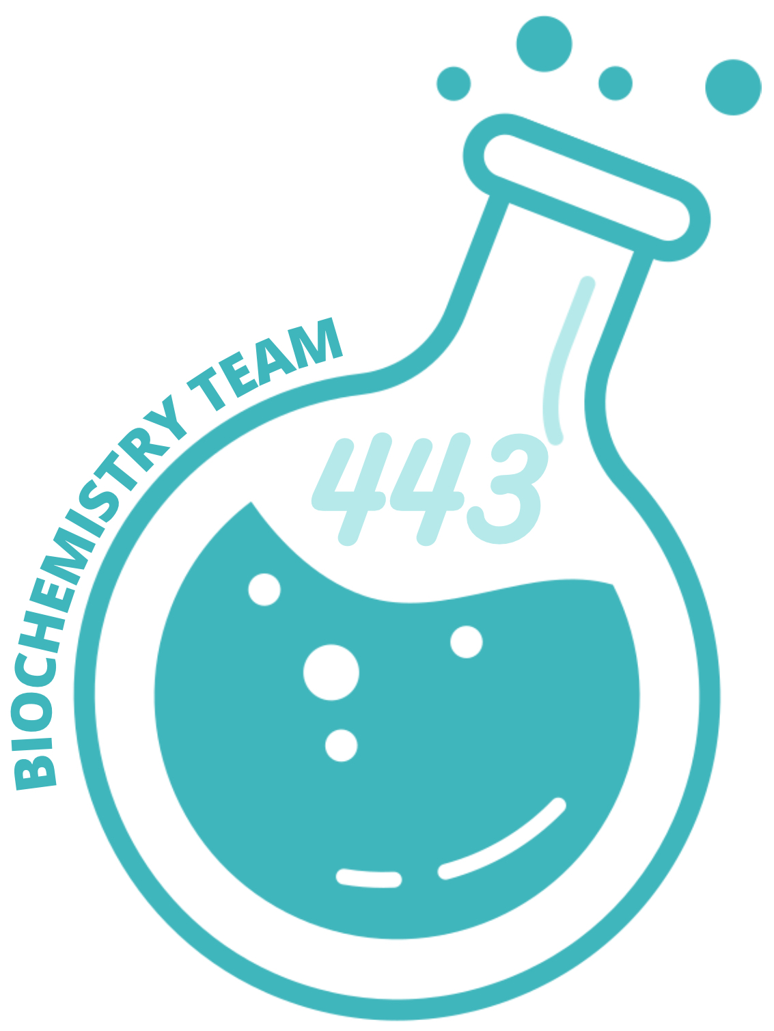
CAH & Testicular Feminization Syndrome
Reproductive Block

Slide 2
Objectives
Adrenal steroidogenesis
Congenital adrenal hyperplasia syndrome:
Types
Biochemical characteristics
Clinical manifestations
Testicular feminization syndrome
This Lecture was presented by:
Dr.Ahmed Mujammami / Dr.Rana Hasanato
Editing File
COLOR INDEX
Main Text
Important
Male Slides
Female Slides
Dr’s Notes
Extra

Slide 3
Adrenal glands
comprise 3 separate hormone systems:
1
2
Zona fasciculata
& reticularis:
Secrete cortisol & the adrenal androgens.
3
Adrenal medulla:
Secretes catecholamines (mainly epinephrine).
Zona glomerulosa:
Secretes aldosterone.
Glucocorticoids:
Steroids with cortisol-like activity
Potent metabolic regulators and immunosuppressants
Mineralocorticoids:
Steroids with aldosterone-like activity
Promote renal sodium reabsorption
Hermaphroditism or Intersex
Definition
A person who has neither standard male or standard female anatomy, Discrepancy between type of gonads and the external genitalia
Types:
Female pseudohermaphrodite (FPH, only ovary) gonad is clear (ovary)
but external genitalia
are either virilized
or ambiguous.
Male
pseudohermaphrodite (MPH, only testis)
gonad is clear (testes) but
external genitalia are
either female
or ambiguous.
True hermaphrodite (ovary plus testis)
Depend on gonads

Slide 4
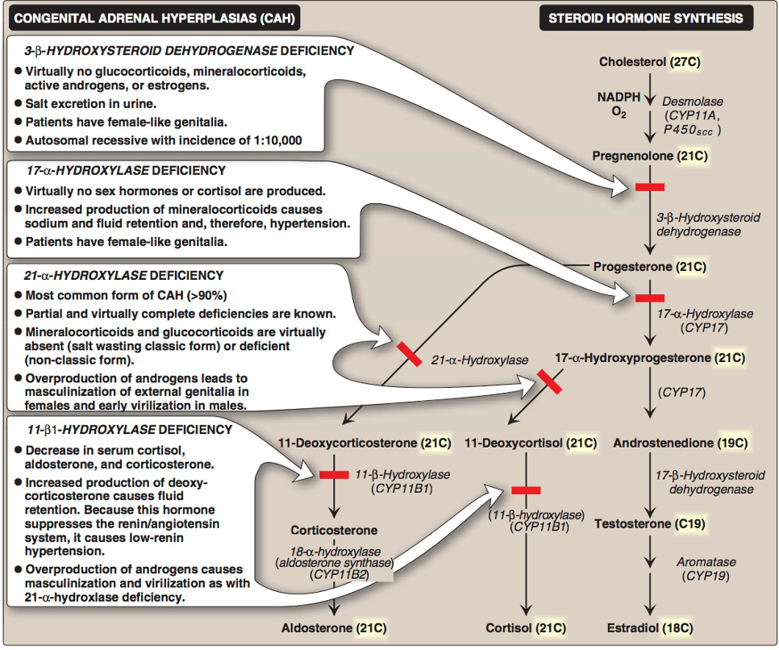
Steroidogenesis and Congenital adrenal hyperplasia syndrome
It is the result of an inherited enzyme defect in steroid biosynthesis.
The adrenals::
Cannot secrete cortisol → absent negative feedback to the pituitary → ACTH continues to drive steroid biosynthesis → adrenal hyperplasia and accumulation of cortisol precursors (depending on which enzyme is lacking).
Cannot secrete aldosterone → electrolyte disturbances:
Hyponatremia (Low Na+)
Hyperkalemia (High K+)
The condition might be fatal unless diagnosed early.
Types of CAH Syndromes
21 a-Hydroxylase deficiency most common
11 b-Hydroxylase deficiency
17 a-Hydroxylase deficiency
3 b-Hydroxysteroid dehydrogenase deficiency least common
21 a-Hydroxylase deficiency
General Info | The most common type of CAH (90%). Autosomal recessive condition.
Patho-genesis | Impaired synthesis of both cortisol & aldosterone. ↓ [cortisol]→ ↑ACTH secretion → Adrenal gland hyperplasia. Accumulated 17-α-hydroxyprogesterone are diverted to the biosynthesis of sex hormones →signs of androgen excess: Ambiguous genitalia in newborn girls (FPH). Ovaries are present . Rapid postnatal growth in both sexes. Severe cases: mineralocorticoid deficiency (complete) → salt & H2O loss → hypovolemia/hypotension & shock → neonatal adrenal crisis. Note: Late presentation (adult life) is possible in less severe cases.
Clinical picture | Complete enzyme defect ¹→ ↑ stimulation of adrenal androgen production → virilization/masculinization in baby girls & precocious puberty in boys. Partial enzyme defect ²→ late onset form → menstrual irregularity & hirsutism in young females. Misdiagnosed with PCOS
- Accumulation vs deficient Enzymes above^
- It is the most common among other enzymes deficiencies
1) Mutation of the active site of the enzyme .
2) Mutation of any part of the enzyme other
than the active site.

Slide 5
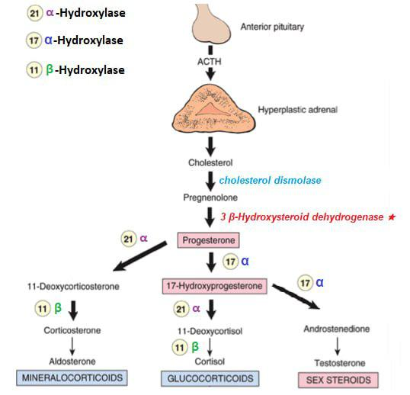
21 a-Hydroxylase Deficiency Cont.
All Types / Syndromes are required (This Figure is VERY Important)
Read
IMPORTANT
Dr. Notes:
90% of the cases are due to 21 a-Hydroxylase deficiency
Autosomal recessive condition.
Cortisol & Aldosteron are absent or very low
High level of sex hormones
Increase virilization of female “masculinization”
Early puberty on male
Very Very IMPORTANT to differentiate between
21 a-Hydroxylase deficiency = Hypotension due to low levels of Aldosterone.
11 B-Hydroxylase deficiency = Hypertension due to high levels of 11-deoxycorticosterone with mineralocorticoid effect (salt and water retention).
Click HERE for better quality

Slide 6
21 a-Hydroxylase Deficiency cont..
Genetics | Mutations in the CYP21 gene: Deletions, Nonsense, Missense. DNA testing of CYP21: For prenatal diagnosis and confirmation of diagnosis. | When we give ACTH to: Normal baby → high cortisol level Baby with deficient enzyme → high 17-α-hydroxyprogesterone For newborn CAH diagnosis: When we start early measuring, it can be like we are detecting the 17-α-hydroxyprogesterone of the mother, so we wait for 24-36 hrs then we take the sample to make sure that elevation of the enzyme is from baby not from maternal blood
Diagnosis | Serum sample taken at least 2 days after birth (earlier samples may contain maternally derived 17-α-hydroxyprogesterone): ↑ plasma [17-α hydroxyprogesterone] as early as 4 days after birth but not before 2 days. Measure the precursor not the enzyme itself. Classic (complete) deficiency: is characterized by markedly elevated serum levels of 17-α-hydroxyprogesterone. Late-onset (partial) deficiency: may require corticotropin (ACTH) stimulation test: Measure baseline and stimulated levels of 17-α- hydroxyprogesterone. Because it’s the most common High level of 17-α-hydroxyprogesterone after stimulation is diagnostic.
11B-Hydroxylase Deficiency
Leads to high concentrations of 11-deoxycortisol.
Leads to high levels of 11-deoxycorticosterone with mineralocorticoid effect (salt and water retention).
Suppresses renin/angiotensin system → low renin hypertension.
Masculinization in females (FPH) and early virilization in males.
Will accumulate
Increased production in this pathway
X
X
These pathways will be blocked

Slide 7
Disorders of Male Sexual Differentiation
They are rare group of disorders.
The defect may be in:
Androgen receptors (inactive androgen receptors → target tissues cannot respond to stimulation by circulating testosterone e.g. Testicular feminization syndrome)
Control of Testicular Function by The Gonadotropins:
Hypothalamus
+
-
GnRH
+
-
-
Anterior Pituitary
FSH
LH
+
Testis
+
Large amounts of unutilized Testosterone are converted to Estradiol in the peripheral tissues.
Inhibin
Testosterone
Aromatase
Spermatogenesis
Peripheral Tissue
Testicular Feminization Syndrome (TFS)
1
46, XY karyotype (Normal Male).
2
X-linked recessive disorder.
Androgen receptor
resistance.
(can't bind to receptor)
High testosterone blood level.
In peripheral tissue, testosterone will be converted by aromatase into estradiol.
Feminization
Patients have normal testes & produce normal amounts of müllerian-inhibiting tissue factor (MIF)1, therefore, affected individuals do not have fallopian tubes, a uterus, or a proximal (upper) vagina .
Med438 : Sertoli cells secrete Müllerian inhibitory factor (MIF also known as, anti mullerian hormone)
that suppresses Estradiol development of paramesonephric ducts.
3
4
The problem is not the production of testosterone, But how to utilise the testosterone in the blood and how to uptake it by the cell is the problem
= (Receptor Mutation)

Slide 8
Clinical picture
Complete androgen insensitivity syndrome (CAIS) | Partial androgen insensitivity syndrome (PAIS)
- Female external genitalia with normal labia. - Clitoris. - Vaginal introitus (MPH: male pseudohermaphrodite) | - Mildly virilized female external genitalia female external genitalia (clitorimegaly without other external anomalies) to mildly undervirilized male external genitalia (hypospadias and/or diminished penile size).
Complete androgen insensitivity syndrome (CAIS) | Partial androgen insensitivity syndrome (PAIS)
- Female external genitalia with normal labia. - Clitoris. - Vaginal introitus (MPH: male pseudohermaphrodite) | - Mildly virilized female external genitalia female external genitalia (clitorimegaly without other external anomalies) to mildly undervirilized male external genitalia (hypospadias and/or diminished penile size).
Laboratory Diagnosis
Karyotype: differentiate an under-masculinized male from a masculinized female. Result : 46, XY
Increased (or normal) testosterone and dihydrotestosterone blood levels.
Fluorescent in situ hybridization (FISH): Presence of a “Y” chromosome can be confirmed by probes for the SRY region of the Y chromosome.
These offer a much quicker turnaround time than conventional karyotypes.
DNA tests and mutation analysis for androgen receptor gene:
Complete or partial gene deletions, point mutations, or small insertions deletions
Further Investigations
Imaging studies “Pelvic Ultrasound “
Absence of fallopian tubes and uterus

Slide 9
Lecture Summary
Zona glomerulosa | Aldosterone
Zona fasciculata | Cortisol
Zona reticularis | Androgens
Hermaphroditism
True hermaphrodite
Female Pseudohermaphrodite (FPH)
Male Pseudohermaphrodite (MPH)
Ovary + Testis
Only ovary
Only testis
Congenital Adrenal Hyperplasia (CAH)
Deficiency | Glucocorticoid | Mineralocor ticosteroids | Androgens | Features | Accumulated Hormones | Notes
21-α-Hydroxylase | ↓ | ↓ “Hypovolem ia and shock” | ↑ | Rapid growth ♀: -Masculinization - Virilization - FPH - Male-like genitalia ♂: - Early virilization - Precocious puberty | 2 days after birth ↑ plasma 17- α-hydroxyprogesterone | - Most common CAH - CYP21 gene mutation - Autosomal recessive
11-β-Hydroxylase | ↓ | ↓ | ↑ | ♀: -Masculinization - FPH ♂: - Early virilization | - ↑ 11-deoxycortisol - ↑ 11-deoxycorticosterone → ↓ RAS → low-renin HTN. | -
17-α-Hydroxylase | No | ↑ “HTN” | No | Female-like genitalia | - | -
3-β-Hydroxysteroid dehydrogenase | No | No “Salt excretion in urine” | No | Female-like genitalia | - | Autosomal recessive
Testicular Feminization Syndrome (TFS) | Androgen Insensitivity Syndrome
Genetics | X-linked recessive disorder 46, XY karyotype |  |  | Diagnosis | Blood: ↑ testosterone Peripheral: testosterone → estradiol (feminization)
Pathology | Androgen receptor resistance |  |  | Clinical Picture | Normal testes & MIF No fallopian tube, uterus, proximal/upper vagina
1. Complete androgen insensitivity syndrome (CAIS) |  |  |  | 2. Partial androgen insensitivity syndrome (PAIS)
Female external genitalia Normal labia, clitoris, and vaginal introitus (MPH) |  |  |  | Mildly virilized female external genitalia to mildly undervirilized male external genitalia - Clitorimegaly without other external anomalies - Hypospadias and/or diminished penile size
Laboratory Diagnosis | Karyotype: differentiate an under masculinized male from a masculinized female. | FISH: SRY region of Y chromosome | Blood: ↑/N testosterone & dihydrotestosterone | DNA tests + mutation analysis for androgen receptor gene | Pelvic US: No fallopian tubes and uterus.

Slide 10
MCQs
Q1. Which one of the following is the most common enzyme deficiency in case of congenital adrenal hyperplasia?
A. 17-α-Hydroxylase | B. 21-α-Hydroxylase | C. 11-β-Hydroxylase | D. 3-β-Hydroxysteroid dehydrogenase
Q2. 21-α-Hydroxylase enzyme deficiency leads to an increase in which one of the following circulating hormones?
A. Aldosterone | B. Cortisol | C. 11-Deoxycorticosterone | D. 17-α-Hydroxyprogesterone
Q3. Which of the following represent Congenital adrenal hyperplasia?
A. True Hermaphrodite | B. Male Pseudohermaphrodite | C. Female Pseudohermaphrodite | D. 46 XX
Q4. Which of the following is related to Testicular feminization syndrome?
A. SRY region analysis by FISH | B. Autosomal Recessive | C. 46.XX karyotype | D. Female Pseudohermaphrodite
Q5. Which one of the following is a finding in a patient with Testicular feminization syndrome?
A. True Hermaphrodite | B. Increased Mullerian inhibiting hormone | C. Inactive androgen receptors | D. Female Pseudohermaphrodite
Q6. Deficiency of 3-β-Hydroxysteroid dehydrogenase will have Which one of the following features?
A. Male like Genitalia | B. Female like Genitalia | C. Both Female & Male Genitalia | D. Low Renin Hypertension
A1. B A2. D A3. C A4. A A5. C A6. B

Slide 11
Team leaders
Remaz Almahmoud Mohammed Alqutub
Team members
Remas Aljeaidi
Sarah Alshahrani
Fatimah Alghamdi
Rahaf Alslimah
Rawan Alqahtani
Reema Almotairi
Nazmi M Alqutub
Nazmi A Alqutub
Abdullah Almissaind
Biochemistry.med443@gmail.com

