Slide 1
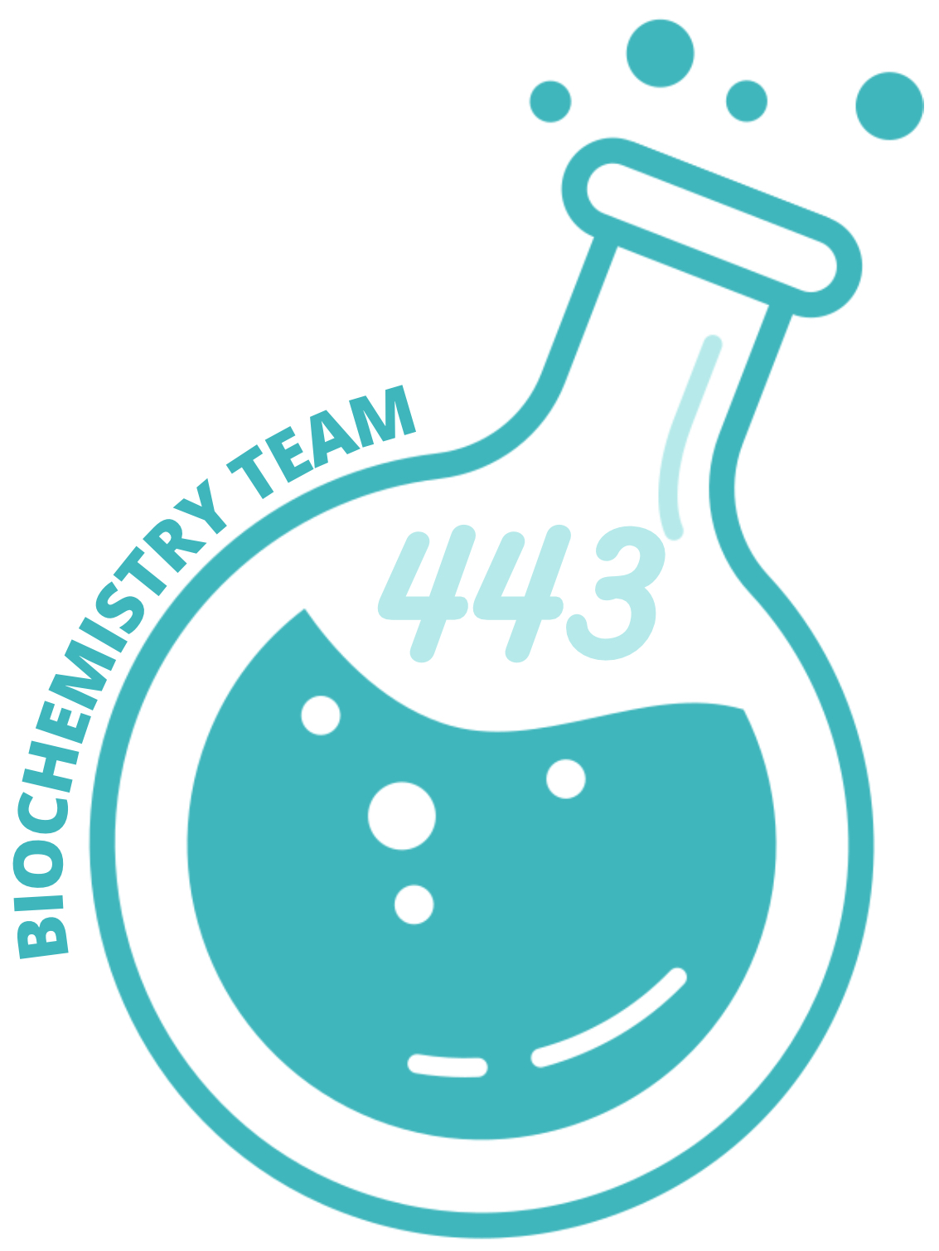
Investigation
of infertile couples
Reproductive Block

Slide 2
Objectives
Identify the causes of infertility in men and women
Understand the diagnostic approaches to infertility in men and women
Interpret the results of investigation of infertility in men and women
This Lecture was presented by:
Dr.Usman Ghani / Dr.Sumbul
Editing File
COLOR INDEX
Main Text
Important
Male Slides
Female Slides
Dr’s Notes
Extra

Slide 3
Infertility / Subfertility
Infertility / subfertility:
Definition
failure of a couple to conceive (get pregnant) after one year of regular, unprotected intercourse (without oral contraceptives).
Female < 35 years → investigations after 1 year
> 35 years → after six months
> 35 + risk factors (family history..) → start investigations right away
1
failure of a couple to conceive (get pregnant) after one year of regular, unprotected intercourse (without oral contraceptives).
Female < 35 years → investigations after 1 year
> 35 years → after six months
> 35 + risk factors (family history..) → start investigations right away
May be caused by endocrine problems:
- Females: common (1/3rd of patients).
- Males: rare, rarely caused by hormone dysfunction.
Causes:
May be caused by endocrine problems:
Females: common (1/3rd of patients).
Males: rare, rarely caused by hormone dysfunction.
In some couples no cause can be identified.
In some couples no cause can be identified.
1. Clinical History Taking | 2. Physical Examination
Previous pregnancies - 1ry or 2ry infertility? | Hypothalamo-pituitary disorders
Use of contraceptives - Fertility ↓ for several months after stopping them | Cushing syndrome - Check BMI & central obesity - Related more to women infertility
Serious illness | Thyroid disorders
Past chemo / radiotherapy - Affect number of oocytes | Hirsutism, acne (PCOS)
Congenital abnormalities | Galactorrhea - Lactation in the absence of pregnancy - Most common due to hyperprolactinemia
Drug usage - Affect hormone levels
Sexually transmitted disease
Frequency of intercourse
Clinical History Taking | Physical Examination
Previous pregnancies - 1ry or 2ry infertility? | Hypothalamo-pituitary disorders
Use of contraceptives - Fertility ↓ for several months after stopping them | Cushing syndrome - Check BMI & central obesity - Related more to women infertility
Serious illness | Thyroid disorders
Past chemo / radiotherapy - Affect number of oocytes | Hirsutism, acne (PCOS)
Congenital abnormalities | Galactorrhea - Lactation in the absence of pregnancy - Most common due to hyperprolactinemia
Drug usage - Affect hormone levels
Sexually transmitted disease
Frequency of intercourse

Slide 4
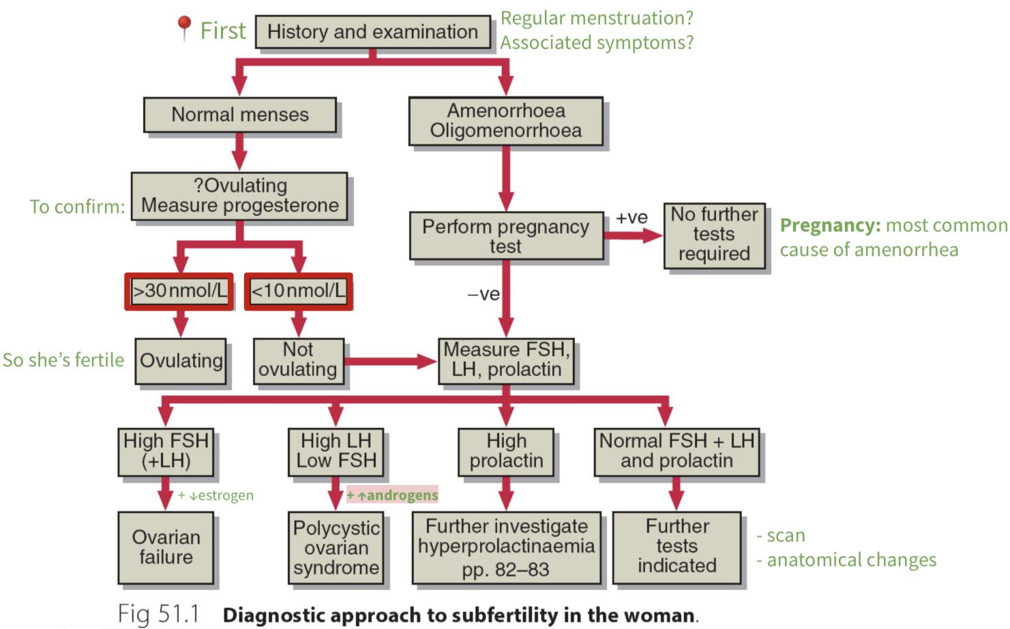
Endocrine investigations in subfertile women
Endocrine Investigations
in subfertile Women
Investigations are based on the phase of menstrual cycle.
1
Investigations are based on the phase of menstrual cycle.
Serum progesterone should be measured in the middle of luteal phase ( day 21 ). 7 days before the end of the cycle, if cycle is
30 days → measure on day 23 for at least 3 cycles then avg. is taken.
2
Serum progesterone should be measured in the middle of luteal phase ( day 21 ). 7 days before the end of the cycle, if cycle is 30 days → measure on day 23 for at least 3 cycles then avg. is taken.
High progesterone (>30 nmol/L) → indicates ovulation. No. 1 investigation If low, then do more investigations
3
High progesterone (>30 nmol/L) → indicates ovulation. No. 1 investigation If low, then do more investigations
When do we need hormone measurement? oligomenorrhea or amenorrhea. Progesterone will be much lower
4
When do we need hormone measurement? oligomenorrhea or amenorrhea. Progesterone will be much lower
Endocrine causes of female infertility:
5
Endocrine causes of female infertility:
↑ secretion of ovarian androgens: - Obesity - insulin resistance (diabetes)
PCOS (major cause)
Primary ovarian failure: - Postmenopausal hormonal pattern: ↑ gonadotrophins +↓oestradiol - Hormone replacement therapy can be given (doesnʼt treat infertility).
Hyperprolactinemia
Cushing syndrome
Hypogonadotropic hypogonadism: - Due to: hypothalamic- pituitary lesion - Rare - ↓ gonadotropin / oestradiol. - Malnourished female (low weight/ severe prolonged sickness)
↑ secretion of ovarian androgens:
- Obesity
- insulin resistance (diabetes)
PCOS (major cause)
Primary ovarian failure:
Postmenopausal hormonal pattern: ↑ gonadotropins +↓oestradiol
Hormone replacement therapy can be given (doesnʼt treat infertility).
Hyperprolactinemia
Cushing syndrome
Hypogonadotropic hypogonadism:
Due to: hypothalamic- pituitary lesion, Rare
↓ gonadotropin / oestradiol. Malnourished female

Slide 5
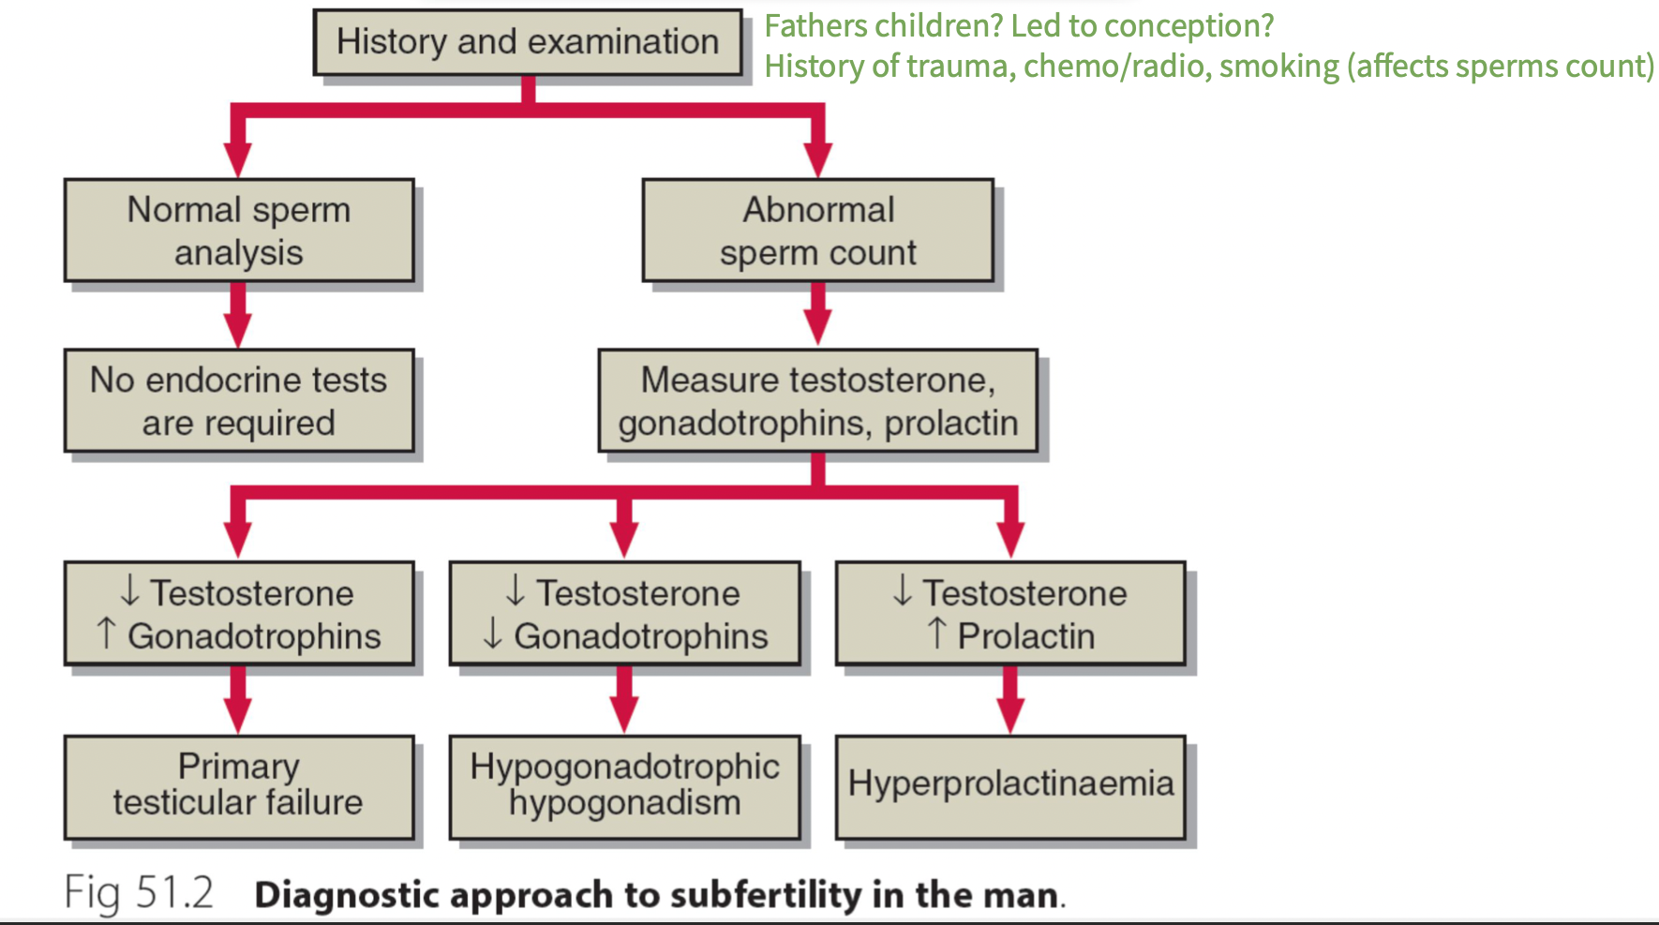
Endocrine Investigations
in subfertile Man
1
4
Endocrine investigations in subfertile man
1
Eugonadal men + normal sperm analysis → no endocrine investigations.
2
Endocrine causes of infertility in men are rare.
Eugonadal men + normal sperm analysis → no endocrine investigations.
3
In hypogonadal men, we should measure: - Testosterone - Gonadotropins
4
Semen analysis : Volume - liquefaction time - sperm count - motility - presence of abnormal spermatozoa, PH - WBCs .
5
Endocrine investigations in subfertile men:
Primary testicular Failure:
Due to damage in the testes (Interstitial ,tubular)
low testosterone + high gonadotropins
Hyperprolactinemia ( a rare cause in men)
Hypothalamic-pituitary Disease:
Decreased testosterone with low/normal gonadotropins
suggests hypogonadotropic hypogonadism
Primary testicular Failure : - Due to damage in the testes (Interstitial ,tubular) - low testosterone + high gonadotropins
Hyperprolactinemia ( a rare cause in men)
Hypothalamic-pituitary Disease: - Decreased testosterone with low/normal gonadotropins - suggests hypogonadotropic hypogonadism

Slide 6
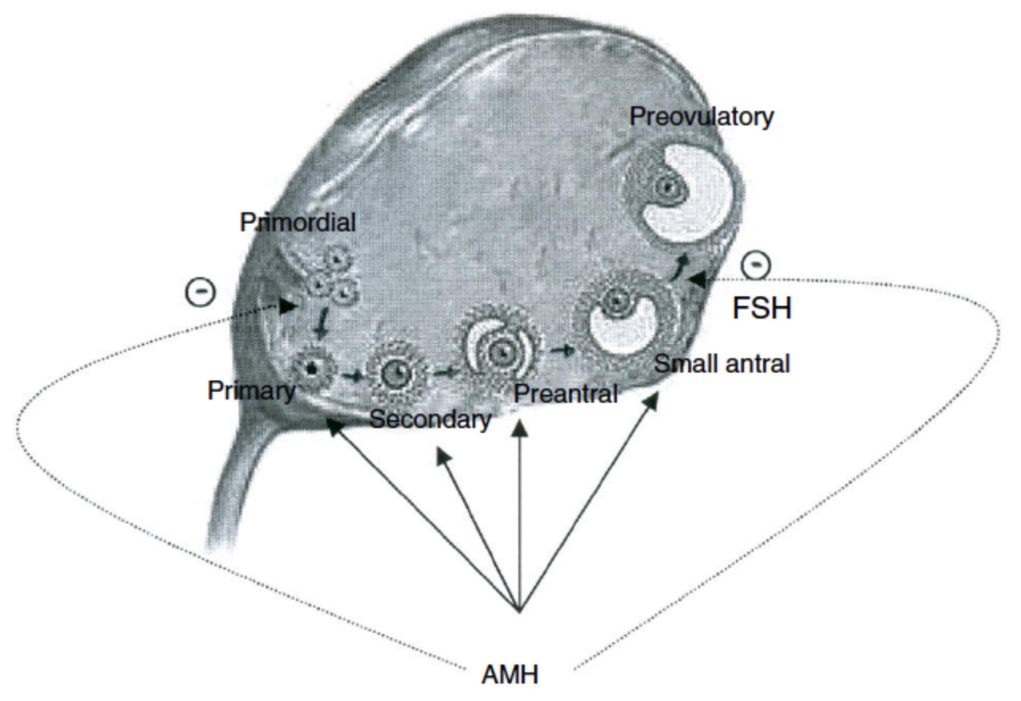
Anti Mullerian Hormone (AMH)
Hyperprolactinemia
Anti mullerian hormone (AMH)
Definition
Secreted by
Asses
Prolactin : an anterior pituitary hormone.
Regulation of prolactin secretion: (tightly regulated)
- Stimulated by TRH from hypothalamus.
- Inhibited by dopamine from hypothalamus.
Acts directly on the mammary glands to control lactation.
↑ prolactin → gonadal function impairment → infertility in both sexes.
Early indications:
- Women: amenorrhea and galactorrhea
- Men: none (Adenoma→compress optic nerve→vision disturbance and headache)
Causes of hyperprolactinemia:
◎ A polypeptide hormone called Mullerian- inhibiting substance.
◎ growing ovarian follicles, Secretion is proportional to follicular development.
◎ ovarian reserve and female fertility.
◎ Ovarian reserve: number and quality of oocytes in the ovaries.
A polypeptide hormone called Mullerian- inhibiting substance.
Secreted by: growing ovarian follicles
- Secretion is proportional to follicular development.
Asses: ovarian reserve and female fertility. - Ovarian reserve: number and quality of oocytes in the ovaries.
In the ovary, it inhibits the:
- Initial recruitment of primary follicles from primordial follicles.
- Sensitivity of antral follicles to FSH during cyclical recruitment.
- premature depletion of follicles. ( So it delays menopause)
The number of remaining primordial follicles correlate with the number of growing follicles.
Since only growing follicles produce AMH → AMH plasma levels reflect the number of remaining primordial follicles .
In the ovary, it inhibits the:
1
2
3
Initial recruitment of primary follicles from primordial follicles.
Sensitivity of antral follicles to FSH during cyclical recruitment.
premature depletion of follicles. ( So it delays menopause)
The number of remaining primordial follicles correlate with the number of growing follicles.
↓ FSH Sensitivity
↓ Recruitment
1
2
3
Since only growing follicles produce AMH → AMH plasma levels reflect the number of remaining primordial follicles.
1
4
Stress
Prolactinoma
Other pituitary disease
Seizures
AMH and folliculogenesis
Hyperprolactinemia
5
6
7
Primary hypothyroidism: prolactin is stimulated by TRH
Drugs : -Estrogens -Phenothiazines -Metoclopramide -α-methyl dopa
Idiopathic hypersecretion: impaired secretion of dopamine (usually inhibits prolactin release).
Hormone affected | Prolactin, an anterior pituitary hormone.
Regulation of Prolactin | Stimulated by TRH from hypothalamus. Inhibited by dopamine from hypothalamus.
Target | Acts directly on the mammary glands to control lactation.
Abnormal secretion | ↑ prolactin → gonadal function impairment → infertility in both sexes.
Early indication | Women: amenorrhea and galactorrhea. Men: none
Diagnosis | Diagnosis: exclude stress, drugs, other diseases, Differential diagnosis: Prolactinoma , Idiopathic hypersecretion
Causes | 1. Stress 2. Prolactinoma 3. Other pituitary disease 4. Seizures
↓ FSH Sensitivity
Diagnosis: exclude stress, drugs, other diseases,
Differential diagnosis:
- Prolactinoma (check by radiological examination)
- Idiopathic hypersecretion
To differentiate between them → TRH stimulation test Prolactin does not increase → prolactinoma Prolactin increases → idiopathic hypersecretion
↓ Recruitment
AMH and folliculogenesis
5. Primary hypothyroidism: prolactin is stimulated by TRH
6. Drugs : Estrogens, Phenothiazines, Metoclopramide, α-methyl dopa
7. Idiopathic hypersecretion: impaired secretion of dopamine
(usually inhibits prolactin release).

Slide 7
Take Home Messages
Endocrine causes of infertility are more common in women than men
In women serum progesterone >30 nmol/L indicates ovulation
Hyperprolactinemia is a rare cause of male infertility

Slide 8
MCQs
Q1. Which one of the following would you measure first in a 27 year old woman with regular menses and is unable to conceive for a year?
A. Prolactin | B. FSH | C. LH | D. Progesterone
Q2. Which one of the following indicates primary ovarian failure?
A. Low FSH, LH & Estradiol | B. Elevated FSH, LH & Estradiol | C. Low FSH, LH & Elevated Estradiol | D. Elevated FSH,LH & Low Estradiol
Q3. Which one of the following hormones is most appropriate in determining female infertility in terms of ovarian follicle quality and reserve?
A. FSH | B. Anti-Mullerian hormone | C. LH | D. CA-125
Q4. Which one of the following indicates ovulation in females with regular menstruation?
A. High Progesterone levels on day 21 >30 nmol/l | B. High Progesterone levels on day 2 >30 nmol/l | C. Low Progesterone levels on day 21 >30 nmol/l | D. Low Progesterone levels on day 2 >30 nmol/l
Q5. Which one of the following does not cause women infertility?
A. Hypogonadotropic Hypogonadism | B. Hypoprolactinemia | C. Cushing’s Syndrome | D. Polycystic Ovary Syndrome
Q6. Which of the following drugs could cause Hyperprolactinemia?
A.Bromocriptine | B. Cabergoline | C. Metoclopramide | D. Cycloset
A1. D A2. D A3. B A4. A A5. B A6. C

Slide 9
Team leaders
Remaz Almahmoud Mohammed Alqutub
Team members
Remas Aljeaidi
Sarah Alshahrani
Fatimah Alghamdi
Rahaf Alslimah
Rawan Alqahtani
Reema Almotairi
Nazmi M Alqutub
Nazmi A Alqutub
Abdullah Almissaind
Biochemistry.med443@gmail.com

