Slide 1
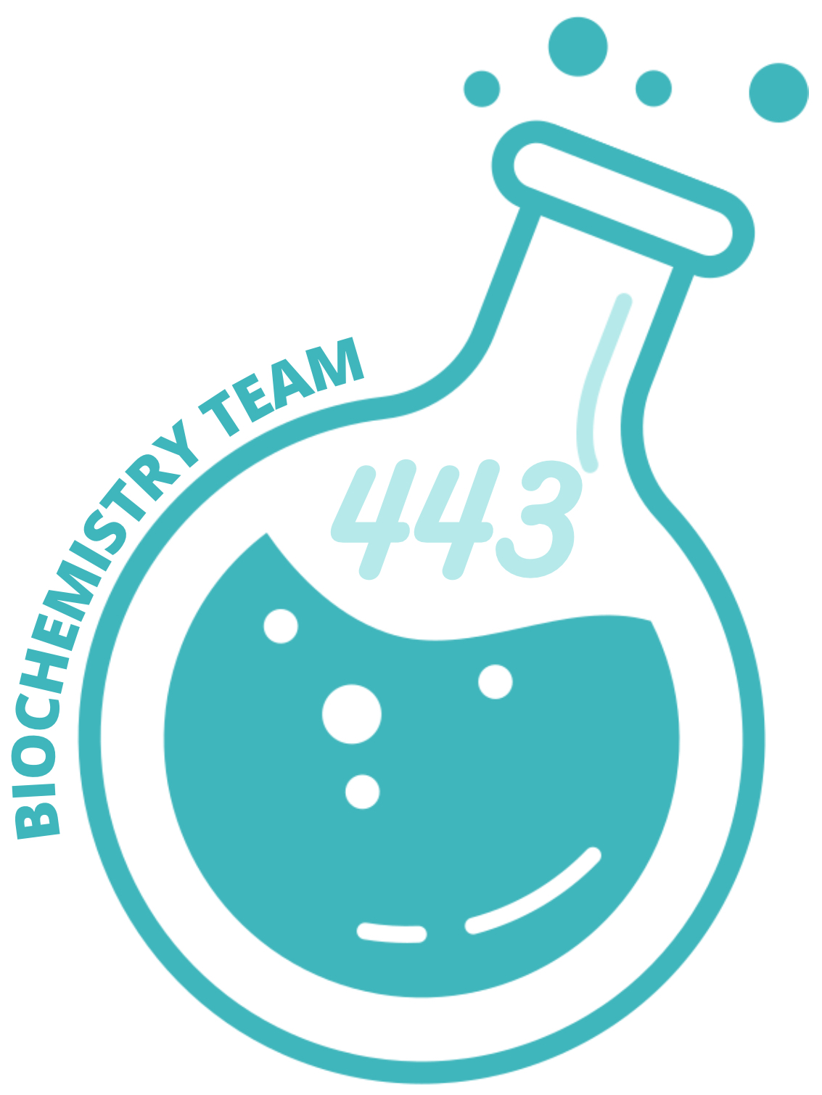
Biomarkers of
ovarian cancer & cysts
Reproductive Block

Slide 2
Objectives
Discuss the risk factors and possible causes of polycystic ovarian syndrome (PCOS) and ovarian cancer
Comprehend the role of insulin resistance and hypersecretion of androgens in the development of
PCOS
Identify avenues for the diagnosis and treatment of PCOS and ovarian cancer
Assess the diagnostic significance of CA-125 in ovarian cancer
This Lecture was presented by:
Dr.Zeyad Kordee / Dr.Sumbul Fatma
Editing File
COLOR INDEX
Main Text
Important
Male Slides
Female Slides
Dr’s Notes
Extra

Slide 3
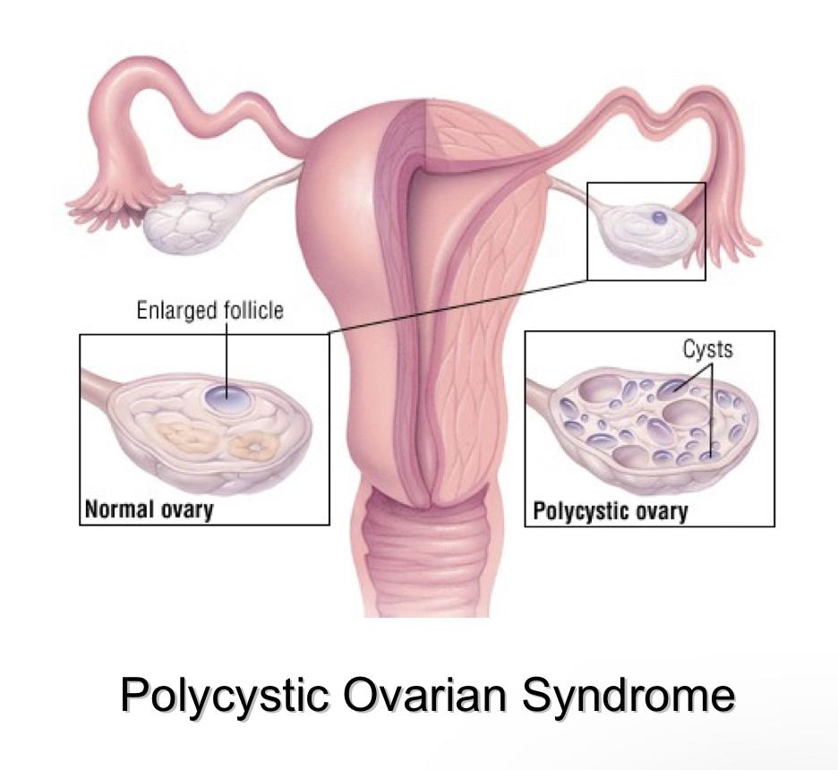
Polycystic Ovarian Syndrome (PCOS)
Polycystic Ovarian Syndrome (PCOS)
Polycystic Ovarian Syndrome (PCOS)
Formation of multiple small cysts in the ovaries. In ultrasound: # of cysts ≥ 12 or more. Affects 5-10% of women (20% in some populations). A major cause of infertility in women. Usually size of the ovaries increases + presence of multiple immature cysts (immature follicles) which started growing but could not become mature. Their growth became arrested due to impaired levels of hormones
Strongly correlated to | Family history. Obesity (40%). Hirsutism. Chronic anovulation. Glucose intolerance. Hypersecretion of luteinizing hormone (LH) and androgens (testosterone). Usually we do not measure LH alone. Ratio of LH to FSH is imp. Normally, FSH is higher. In PCOS, LH is 2 times FSH (2:1) Low levels of SHBG (sex hormone-binding globulin). Normally, 80% of androgens are bound to SHBG. 18-19% bound to albumin, and 1-2% are free. In PCOS, ↓SHBG → ↑free androgens (testosterone) → show effect
Causes | Exact cause of the syndrome is unknown. May be multifactorial (genetic and environmental). Probable causes: Insulin resistance causes excessive androgen production in ovaries (common). Abnormalities in ovaries, adrenal and pituitary glands.
Endocrine changes in PCOS
Insulin resistance.
Hyperlipidemia. (obesity related)
Hypertension.
Menstrual disorders.
↑LH
↓FSH
↑Plasma (Oestrone)
Stimulation of ovarian stroma & theca by LH
Anovulation
Aromatisation in adipose tissue
Hirsutism
1- Affect the ovaries :
↑Synthesis of Androgen
↑Androgen & free androgens
Compensatory hyperinsulinemia: 2 effects
1- Affect the liver:
↓SHBG
Obesity
Insulin resistance
↓SHBG

Slide 4
Polycystic Ovarian Syndrome (PCOS)
Polycystic Ovarian Syndrome (PCOS)
Diagnosis | Diagnostic criteria for PCOS : European Society for Human Reproduction & Embryology (ESHRE) and American Society for Reproductive Medicine (ASRM) recommendation: At least two of the following features are required for PCOS diagnosis: (for adults; in case of teenagers, all 3 features should be present to diagnose PCOS.) Oligo-ovulation or anovulation manifested as oligomenorrhea or amenorrhea. Hyperandrogenism (clinical and biochemical evidence of androgen excess). Polycystic ovaries (as deﬁned by ultrasonography). Diagnosis done by measuring : Free testosterone: Total testosterone is less sensitive, increased androgens in PCOS. Sex hormone-binding globulin: (SHBG;decreased in PCOS) Luteinizing hormone: (LH; high in 60% cases) LH to FSH ratio is more important Follicle stimulating hormone: Normal or low Fasting blood glucose Insulin Lipids Ovarian ultrasound : 30% of patients do not have ovarian cysts despite having symptoms
Treatment | Aim of treatment: interrupt the cycle of obesity, insulin resistance, excess androgens Reduce LH levels ( by oral and contraceptives ) Combination of estrogen & progesterone Reduce body weight Increase FSH levels (by clomiphene, etc.) Latest drug is letrozole, an aromatase inhibitor Estrogen replacement therapy: In select women after careful risk counseling (Risk of developing cancer)

Slide 5
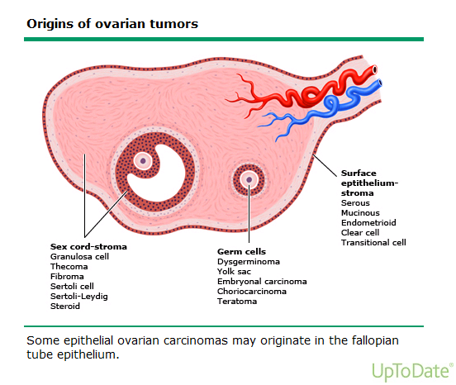
Ovarian Cancer
Ovarian Cancer
A leading cause of death because of gynecologic cancer
Due to malignant transformation of ovarian epithelial cells
Most common type of ovarian cancer
A leading cause of death because of gynecologic cancer
Due to malignant transformation of ovarian epithelial cells
Most common type of ovarian cancer
Ovarian Cancer Subtypes:
Ovarian Cancer Subtypes
1
2
Mucinous (36%)
Mucinous epithelial
tumors
3
Endometrioid
(8%): endometrial
tumors
Serous (46%): surface epithelial tumors
1
2
Mucinous (36%)
Mucinous epithelial
tumors
3
Endometrioid
(8%): endometrial
tumors
Serous (46%): surface epithelial tumors
Ovarian Cancer Risk factors:
Nulliparity (woman with no childbirth or pregnancy)
Increase in Age is a risk factor and its important.
Family history of breast, ovarian, colorectal cancer
(first degree relatives).
Mutations in BRCA1 and BRCA2 genes (most common).
Carriers of BRCA1 mutations have a risk 44% .
Premenopausal breast cancer or ovarian cancer indicates
higher risk for hereditary.
Ashkenazi Jews have higher risk of ovarian cancer.
Nulliparity (woman with no childbirth or pregnancy)
Increase in Age is a risk factor and its important.
Ovarian Cancer Risk Factors
Family history of breast, ovarian, colorectal cancer
(first degree relatives).
Nulliparity (woman with no childbirth or pregnancy)
Increase in Age is a risk factor and its important.
Family history of breast, ovarian, colorectal cancer
(first degree relatives).
Mutations in BRCA1 and BRCA2 genes (most common).
Carriers of BRCA1 mutations have a risk 44% .
Premenopausal breast cancer or ovarian cancer .
indicates higher risk for hereditary.
Ashkenazi Jews have higher risk of ovarian cancer.
Mutations in BRCA1 and BRCA2 genes (most common).
Carriers of BRCA1 mutations have a risk 44% .
Biomarkers & Diagnosis:
Premenopausal breast cancer or ovarian cancer . indicates higher risk for hereditary.
Epithelial ovarian cancer is commonly diagnosed at a later stage, Due to non-specific symptoms such as abdominal pain, bloating, early satiety, nausea, etc.
Ashkenazi Jews have higher risk of ovarian cancer.
Most patients (75%) have advanced-stage tumor upon diagnosis
Biomarkers and diagnosis
Diagnosis includes:
History taking Age of menarche, Pregnancy, Family history
Physical examination pelvic mass
Ultrasound cysts maybe not detected cuz very small
Measurement of serum CA-125 levels should be significantly high along with the previous factors
Epithelial ovarian cancer is commonly diagnosed at a later stage Due to non-specific symptoms such as abdominal pain, bloating, early satiety, nausea, etc.
Most patients (75%) have advanced-stage tumor upon diagnosis
Epithelial ovarian cancer is commonly diagnosed at a later stage Due to non-specific symptoms such as abdominal pain, bloating, early satiety, nausea, etc.
Biomarkers and diagnosis
Most patients (75%) have advanced-stage tumor upon diagnosis
Diagnosis includes:
History taking Age of menarche, Pregnancy, Family history
Physical examination pelvic mass
Ultrasound cysts maybe not detected cuz very small
Measurement of serum CA-125 levels should be significantly high along with the previous factors

Slide 6
Cancer antigen 125 (CA-125)
The only serum marker of epithelial ovarian cancer
Cancer Antigen 125 (CA-125)
A cell surface glycoprotein expressed in the epithelium of all tissues. Normally absent in serum
1
The only serum marker of epithelial ovarian cancer
CA-125 is elevated in ovarian cancer
>35 U/ml is considered positive
2
A cell surface glycoprotein expressed in the epithelium of all tissues.
Normally absent in serum
Recommended as an annual test for women with family history of ovarian cancer
3
CA-125 is elevated in ovarian cancer >35 U/ml is considered positive
CA-125 is associated with stages of ovarian cancer
4
Recommended as an annual test for women with family history of ovarian cancer
Cancer antigen 125 (CA-125)
5
A non-specific marker
False positive CA-125 conc.are found in benign conditions such as:
Endometriosis
Uterine leiomyomas
Pelvic inflammatory disease
During the first trimester of pregnancy
During menstruation
Some patients (< 50 years) have elevated CA-125 due to unrelated malignant mass.
CA-125 is not a marker of choice for ovarian cancer screening due to:
Low prevalence of ovarian cancer
High false-positive rate
CA-125 Elevated in:
CA-125 is associated with stages of ovarian cancer
A non-specific marker
False positive CA-125 conc. are found in benign conditions such as:
Endometriosis
Uterine leiomyomas
Pelvic inflammatory disease
During the first trimester of pregnancy
During menstruation
Some patients (< 50 years) have elevated CA-125 due to unrelated malignant mass.
CA-125 is not a marker of choice for ovarian cancer screening due to:
Low prevalence of ovarian cancer
High false-positive rate
From team 439
False = Benign condition
Positive= elevated CA-125
50% of patients with stage I
90% of patients with stage II
>90% of patients with stage III and IV
Cancer antigen 125 (CA-125)
A non-specific marker
False positive CA-125 conc.are found in benign conditions such as:
CA-125 useful in:
CA-125 Elevated in:
Endometriosis
1
2
3
50%
90%
>90%
1
Monitoring patient’s response to chemotherapy
.
Success of surgery (de-bulking procedures)
Annual testing for women with family history of ovarian cancer
Uterine leiomyomas
◎ 50% of patients with stage I
◎ 90% of patients with stage II
◎ >90% of patients with stage III and IV
Pelvic inflammatory disease
CA-125 Useful in:
During the first trimester of pregnancy
Monitoring patient’s response to chemotherapy
Success of surgery
(de-bulking procedures)
Annual testing for women with family history of ovarian cancer
During menstruation

Slide 7
Take Home Massage
PCOS is strongly correlated to insulin resistance and endocrine abnormalities.
Although a nonspecific biomarker, CA-125 is important for staging and follow-up of ovarian cancer treatment

Slide 8
MCQs
Q1. In which of the following can the levels of CA-125 be useful?
A. Monitoring patient response to chemotherapy. | B. Biomarker for PCOS. | C. Associated with high risk of ovarian cancer. | D. Marker of choice for ovarian cancer.
Q2. PCOS is treated by ?
A. Progesterone replacement therapy. | B. Estrogen replacement therapy | C. Decrease FSH levels | D. Increase LH levels
Q3. How to treat PCOS?
A. Reduce FSH | B. Reduce LH | C. Decrease estrogen | D. Decrease insulin sensitivity
Q4. False positive CA-125 concentration are found in all of the following conditions EXCEPT?
A. Endometriosis | B. uterine leiomyoma | C. pelvic inflammatory disease | D. ovarian cancer
Q5.Which ONE of the following is the cause of ovaries to produce androgens in case of PCOS?
A. High levels of FSH | B. Coeliac disease | C. Insulin resistance | D. Ovarian cyst
Q6. Which of the following stages of ovarian cancer in which 50% of people have high CA-125?
A. Stage 1 | B. Stage 2 | C. Stage 3 | D. Stage 4
A1. A A2. B A3. B A4. D A5. C A6. A

Slide 9
Team leaders
Remaz Almahmoud Mohammed Alqutub
Team members
Remas Aljeaidi
Sarah Alshahrani
Fatimah Alghamdi
Rahaf Alslimah
Rawan Alqahtani
Reema Almotairi
Nazmi M Alqutub
Nazmi A Alqutub
Abdullah Almissaind
Biochemistry.med443@gmail.com

