Slide 1
Abdominal pain
Dr. Muhammad Faisal Al-Mubarak
Assistant Professor
Consultant Gastroenterologist and Advanced Endoscopist
Department of internal medicine, college of medicine, king saud university

Slide 2
Lecture outline
Sample questions for lecture topics
Anatomy and physiology of abdominal pain
Acute abdominal pain identification and examples
Chronic abdominal pain identification and examples

Slide 3
Clinical scenarios
A 36-year-old female with history of autoimmune thyroiditis on 75 mcg of levothyroxine PO once daily presents to her endocrinologist for an urgent visit for progressive fatigue. On further detailed history taking the patient complains of new-onset non-bloody chronic diarrhea for the past 4 months and rash on her arms bilaterally (see image). Patient denies recent traveling or sick contacts. Work-up including serum TSH and free T4 is within normal limits. CBC is notable for new onset microcytic anemia. Iron panel with findings of decreased ferritin and serum iron; and increased total iron binding capacity (TIBC).
anti-tissue transglutaminase (anti-tTG) level
diagnostic colonoscopy to rule out ulcerative colitis
bone marrow biopsy to assess for myelodysplastic syndrome (MDS)
stool culture and parasitology to rule out helminthic infections

Slide 4
A 63-year-old male with history of CAD on aspirin presents to his primary care provider’s office with epigastric pain for the past 2 months that is made worse with fasting. The pain is associated with early satiety and epigastric bloating without diarrhea or constipation. Patient denies unintentional weight loss. The pain is described as stabbing and localized. Notable blood work is positive for iron deficiency anemia.
The likely diagnosis of patient’s presentation is:
- acute pancreatitis
- mesenteric ischemia
- peptic ulcer disease
- irritable bowel syndrome

Slide 5
In the aforementioned clinical scenario, the best next step in management is:
- obtain an US abdomen
- order a CT scan of the abdomen and pelvis
- outpatient referral to cardiology for cardiac workup
- arrange for an upper endoscopy

Slide 6
A 22-year-old female medical student is seen by the student health clinic for two-year history of abdominal pain and diarrhea that has been recently progressive. The pain is described in the mid abdomen and hypogastrium and is associated with diarrhea. The abdominal pain and diarrhea is worse when the patient sits for her final exams. The patient denies melena, hematochezia, weight loss, rash, or arthralgia. Blood work including CBC, CMP and CRP is within normal limits.
The likely diagnosis of patient’s presentation is:
Crohn’s disease
Irritable bowel syndromes (IBS)
Celiac disease
Endometriosis

Slide 7
Anatomy and physiology of abdominal pain
Factors affecting pain perception in the abdomen:
nature of the stimulus
type of neuroreceptor
anatomy of the neural pathways from the site of injury to the CNS

Slide 8
Pain resulting from abdominal pathology is transduced in different ways by sensory afferent fibers that travel with the autonomic and somatic nervous systems
Crosstalk between the two systems can result in yet more variation in the perception of abdominal distress.
This unique neuroanatomy results in three distinct types of pain: visceral, somatic-parietal, and referred.

Slide 9
Perception of abdominal pain based on pain type
1. Visceral Pain: vague in both onset and localization and perceived as a dull sensation in the abdominal midline
2. Somatic-Parietal Pain: intense, sharp, and well localized
3. Referred pain: perceived at a point distant from the inciting pathology and may be perceived to be outside the abdomen entirely

Slide 10
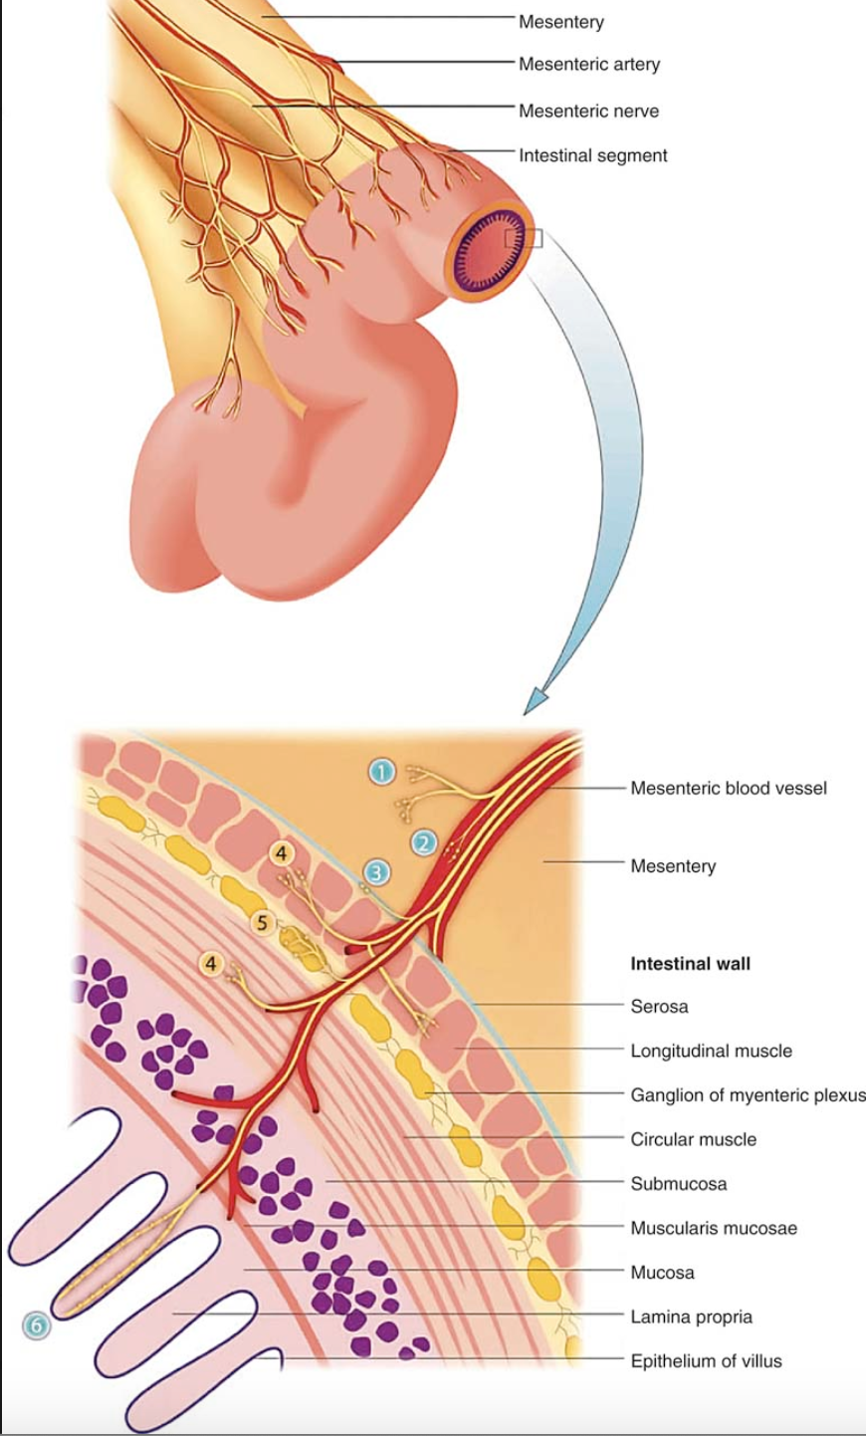
A. Visceral pain

Slide 11
A. Visceral pain
Visceral pain results from stretch and distention transduced by mechanoreceptors and, in more severe situations, the presence of inflammatory mediators detected by the silent nerve endings.
Cutting and burning of abdominal viscera is not perceived as noxious e.g. polypectomy vs gaseous overdistention during colonoscopy

Slide 12
B. Somatic-Parietal Pain
Somatic-parietal pain arising from noxious stimulation of the parietal peritoneum: more intense and precisely localized > visceral pain.
example of this type of pain: acute appendicitis, in which early vague periumbilical visceral pain originating within the appendix is followed by localized somatic-parietal pain at McBurney’s point that is produced by inflammatory involvement of the parietal peritoneum adjacent to the appendix.
Somatic-parietal abdominal pain is usually aggravated by movement or vibration.

Slide 13
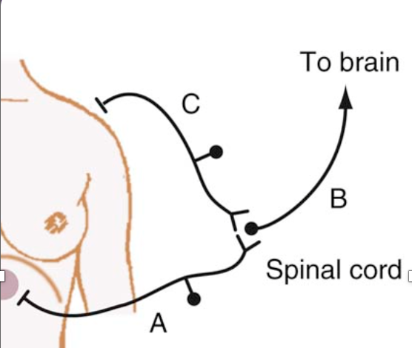
C. Referred pain
Referred pain is felt in areas remote from the diseased organ and results when visceral afferent neurons and somatic afferent neurons from a different anatomic region converge on second-order neurons in the spinal cord at the same spinal segment.

Slide 14
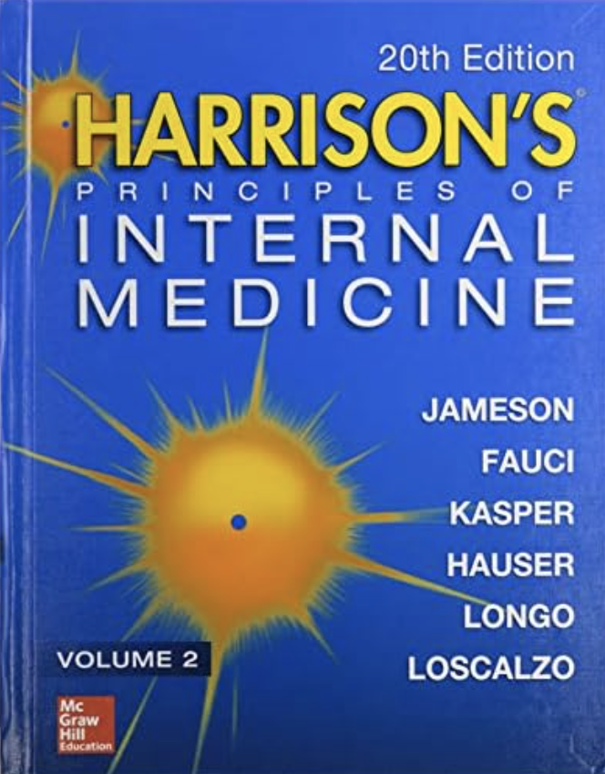
Approach to abdominal pain
A. Hx taking!

Slide 15
Chronology
Ruptured aortic aneurysm
Renal or biliary colic
- biliary or renal pain
- gastroenteritis
- ruptured aortic aneurysm
- appendicitis
Appendicitis
Gastroenteritis

Slide 16
Intensity and Character
Acute abdominal pain presentations based on severity:
1. prostrating and physically incapacitating → severe life-threatening disease e.g. perforated viscus, ruptured aneurysm, or severe acute pancreatitis.
2. gradual onset, colicky and intermittent accompanied with nausea and vomiting e.g. obstruction of a hollow viscus e.g. SBO, renal colic, or biliary pain, present with gradual onset of cramping pain that follows a sinusoidal pattern of intense pain alternating with a period of relief.
3. gradually increasing discomfort, vague and poorly localized, becoming more localized as the pain intensifies, e.g., inflammation, as with acute appendicitis or diverticulitis.

Slide 17
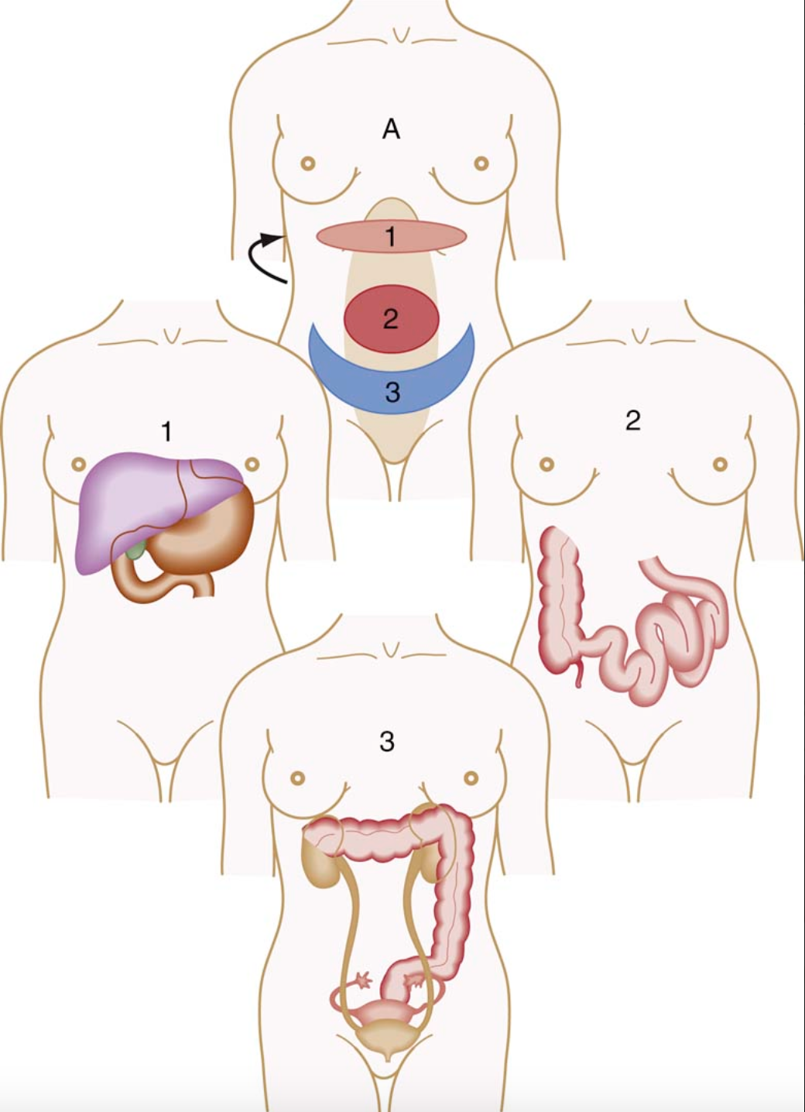
location

Slide 18
Aggravating and Alleviating Factors
The relationship of pain to positional changes, meals, bowel movements, and stress may yield important diagnostic clues.
Patients with peritonitis lie motionless, whereas those with renal colic may writhe in an attempt to find a comfortable position.
Certain foods exacerbate pain. A classic example is the relationship between the intake of fatty foods and development of biliary pain.
Pain associated with duodenal ulcer is often alleviated by meals. By contrast, patients with gastric ulcer or chronic mesenteric ischemia may report exacerbation of pain with eating.

Slide 19
Associated Symptoms
constitutional symptoms (e.g., fever, chills, night sweats, weight loss, myalgias, arthralgias)
digestive function (e.g., anorexia, nausea, vomiting, flatulence, diarrhea, constipation), and jaundice
dysuria, changes in menstruation, and pregnancy should be solicited from the patient
Clear vomitus suggests gastric outlet obstruction, whereas feculent vomitus suggests more distal small bowel or colonic obstruction.

Slide 20
PMH_{x}
Previous experience with similar symptoms suggests a recurrent problem. Patients with a history of partial SBO, renal calculi, or pelvic inflammatory disease are likely to have recurrences.
A patient whose presentation suggests intestinal obstruction, and who has no prior surgical history, deserves special attention because of the likelihood of surgical pathology such as a hernia or neoplasm.
Patients with a systemic illness, such as scleroderma, SLE, nephrotic syndrome, porphyria, or sickle cell disease, often have abdominal pain as a manifestation of the underlying disorder.

Slide 21
Approach to abdominal pain
B. Physical examination!

Slide 22
Steps of abdominal P_{x}
Inspection
Auscultation
Palpation
Percussion

Slide 23
Laboratory w/u
Hx + Px are insufficient for sole and firm diagnosis of acute abdominal pain presentation
Basic labs to be ordered CBC with diff, CMP looking at BUN, Cr, and glucose levels is useful
Urine or serum pregnancy testing must be performed in all women of reproductive age
Liver panel, amylase, and lipase for epigastric pain

Slide 24
Imaging studies
CT scan
US FAST
US of the RUQ
MRI
HIDA scan (^{99m}Tc-labeled hydroxyl iminodiacetic acid)

Slide 25
Background, #acute abdominal pain
frequent complaint prompting emergency department presentation.
~ 40% of ER presentation for abdominal pain have nonspecific findings
60% of causes are surgical disorders that warrant further evaluation and intervention.
In a small number, life-threatening pathologies are present.

Slide 26
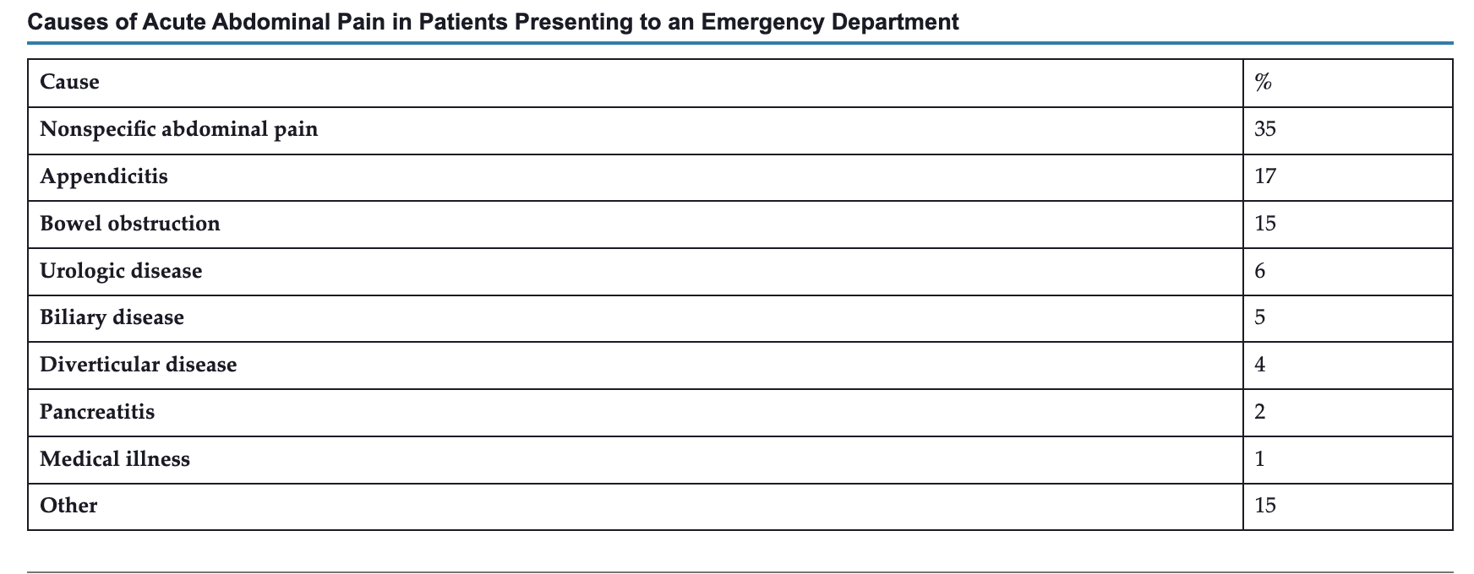
#acute abdominal pain
Acute abdominal pain:
Definition: pain of less than 1 week in duration.
Medical attention sought within the first 24 to 48 hours

Slide 27
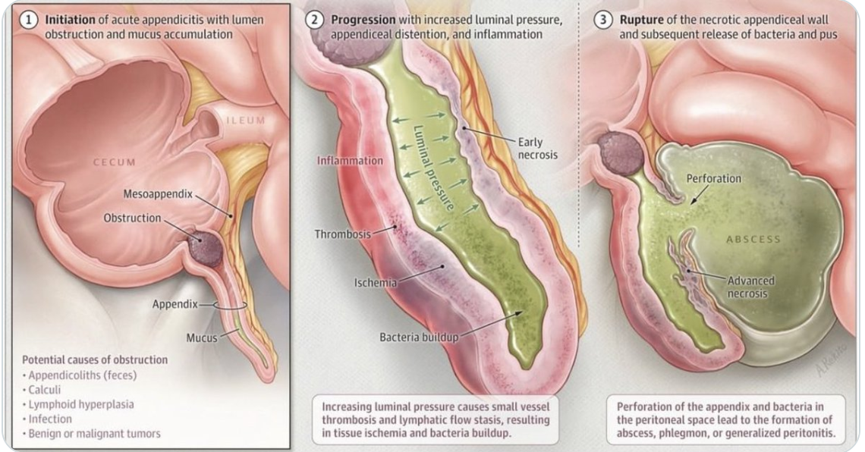
Acute appendicitis
lifetime risk of appendicitis is 8.6% for males and 6.7% for females in Western countries and ~ 17% in males and 13.5% in Asia.
Clinical presentation:
prodromal symptoms of anorexia, nausea, and vague periumbilical pain
6 to 8 hours later, pain migration to RLQ + peritoneal signs develop.

Slide 28
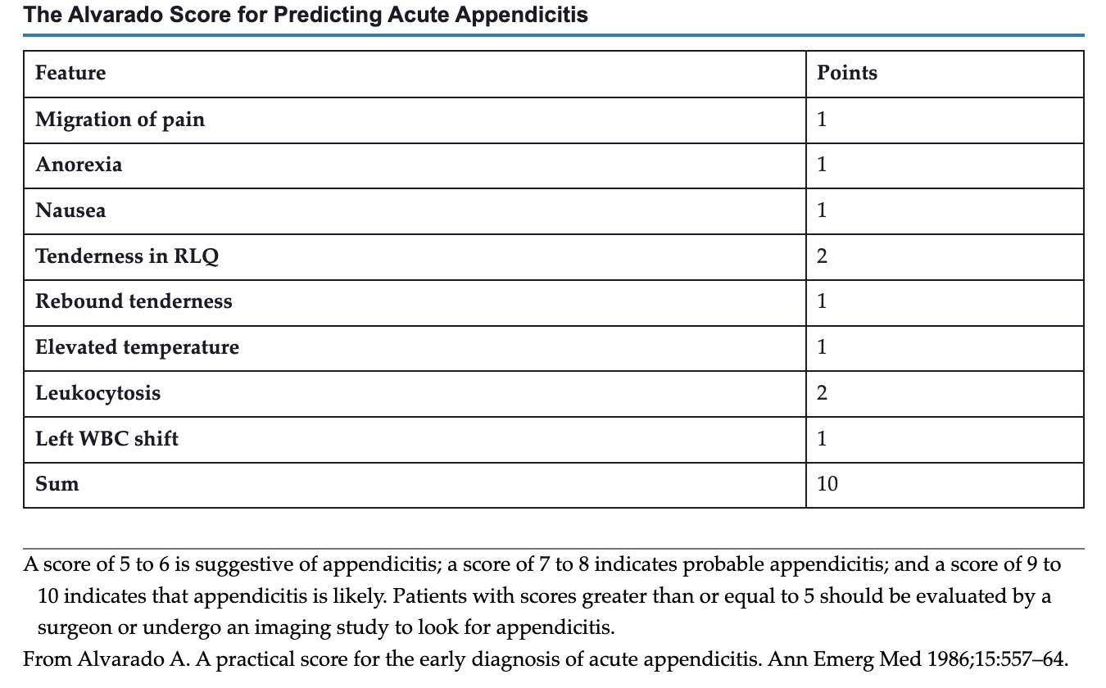
Imaging studies:
CT, US, MRI

Slide 29
acute appendicitis
In children, mesenteric adenitis (or lymphadenitis) is frequently mistaken for acute appendicitis but is often preceded by a sore throat and is self-limited.
Mesenteric adenitis may also be caused by Yersinia enterocolitica → acute appendicitis mimicker

Slide 30
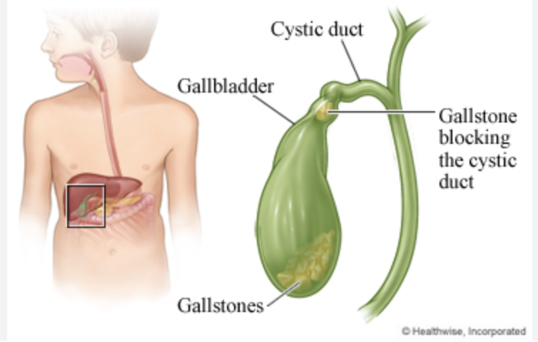
Acute Biliary Disease
spectrum between biliary pain (“biliary colic”) and acute cholecystitis
Biliary pain is a syndrome of RUQ or epigastric pain, usually postprandial, caused by transient obstruction of the cystic duct by a gallstone; it is self-limited, generally lasting less than 6 hours.
Acute cholecystitis is, in most cases, caused by persistent obstruction of the cystic duct by a gallstone. Compare this to acalculous cholecystitis.

Slide 31
Clinical presentation of acute cholecystitis
The pain usually is a dull ache that is localized to the RUQ or epigastrium with radiation around the back to the right scapula. Nausea, vomiting, and low-grade fever are common.
On examination, RUQ tenderness, guarding, and Murphy sign (inspiratory arrest on palpation of the RUQ) are typical.
The WBC count is usually mildly elevated but may be normal.
Mild elevations in serum total bilirubin and alkaline phosphatase levels are common.

Slide 32
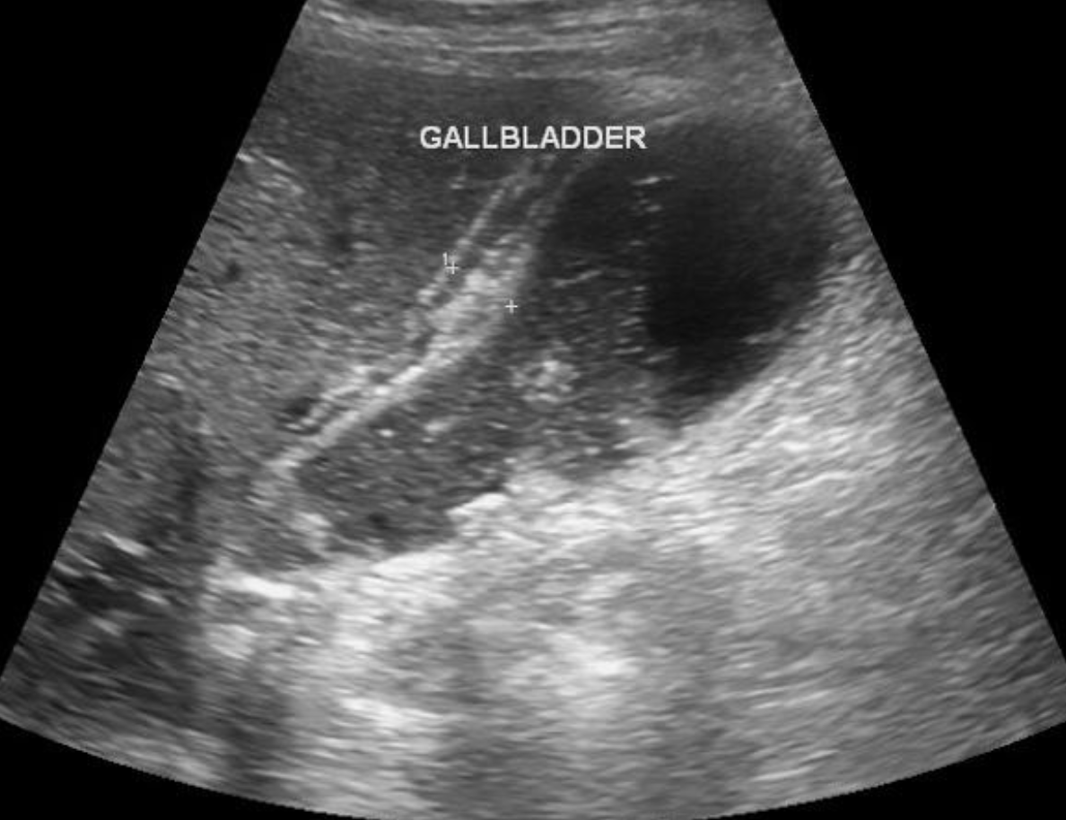
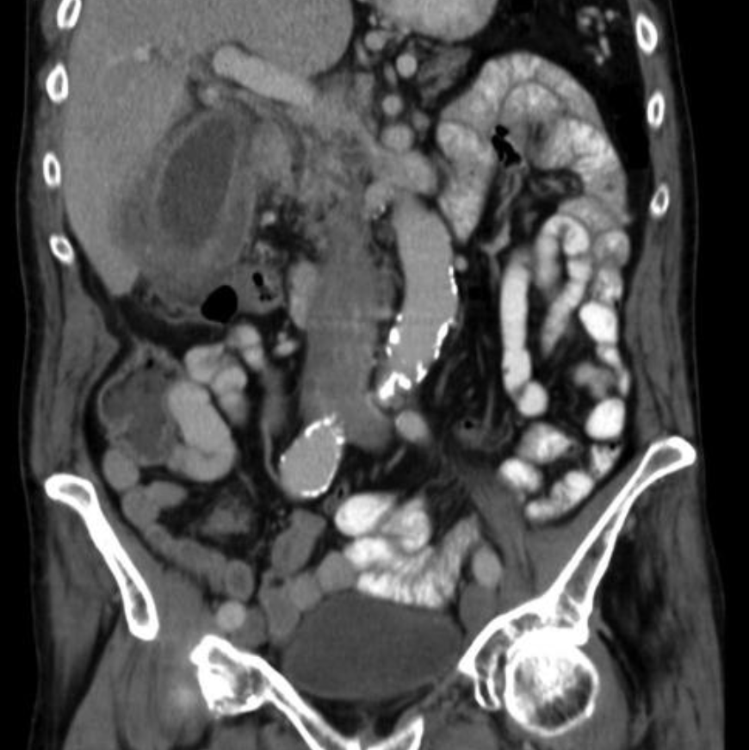
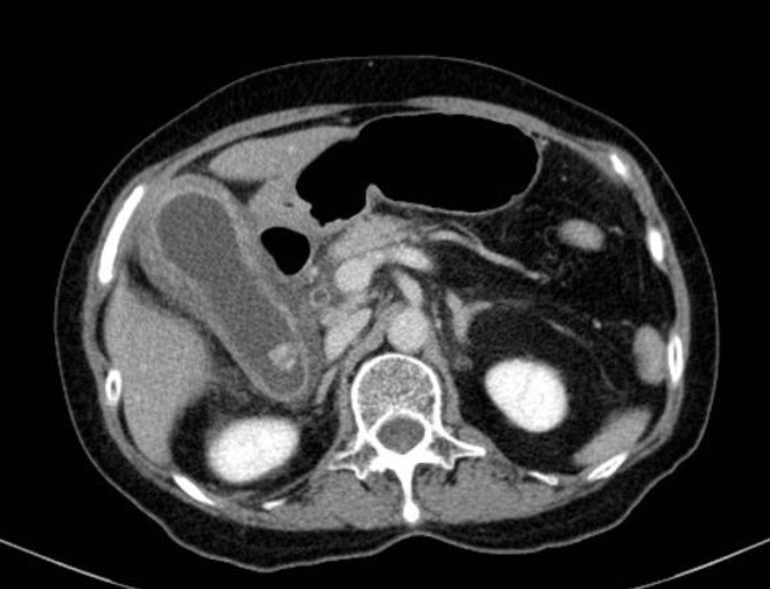
Imaging findings of acute cholecystitis

Slide 34
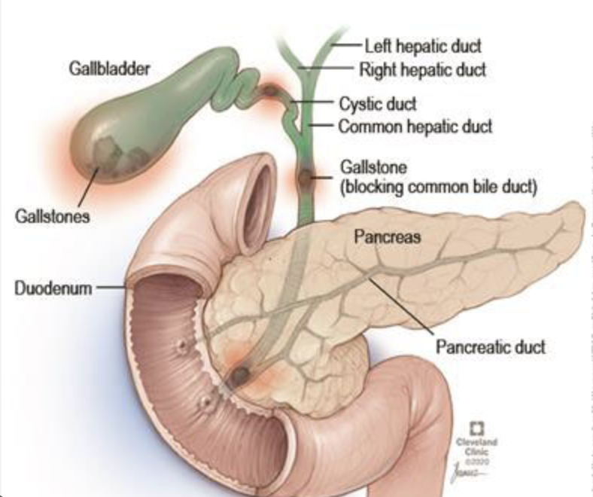
Acute cholangitis
Mainly in setting of choledocholithiasis
Charcot’s triad:
Intermittent RUQ pain + jaundice + fever
Reynold’s pentad:
Charcot’s triad + metabolic encephalopathy and hemodynamic instability.

Slide 35
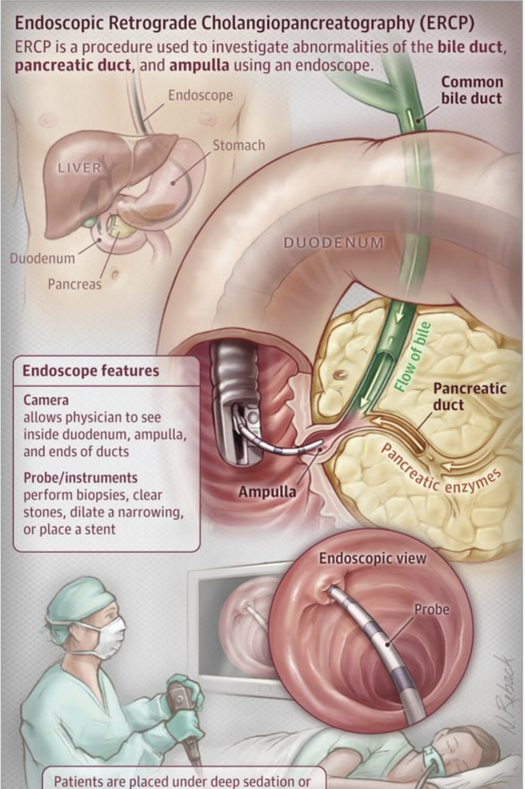
Acute cholangitis
Management: IV antibiotics and Endoscopic retrograde cholangiopancreatography (ERCP)

Slide 36
Acute pancreatitis
Acute pain in the epigastrium that is constant, unrelenting, radiating to the back or left scapular region.
Fever, anorexia, nausea, and vomiting are typical.
Physical examination reveals an acutely ill patient in considerable distress.
Patients are usually tachycardic and tachypneic.
Abdominal examination reveals hypoactive bowel sounds and marked tenderness to percussion and palpation in the epigastrium. Abdominal rigidity is a variable finding.

Slide 37
In rare patients, flank or periumbilical ecchymoses (Grey-Turner or Cullen sign, respectively) develop in the setting of pancreatic necrosis with hemorrhage.
Depending on the cause and severity of pancreatitis, serum electrolyte, calcium, and blood glucose levels and liver biochemical test and arterial blood gas results may be abnormal.
US is useful for identifying gallstones as a potential cause of pancreatitis. CT is reserved for patients with severe or complicated pancreatitis.

Slide 38
Acute pancreatitis Diagnosis per revised Atlanta classification, 2/3 for Dx.
1. abdominal pain consistent with the disease
2. a threefold increase in serum amylase or lipase levels
3. imaging findings consistent with acute pancreatitis

Slide 39
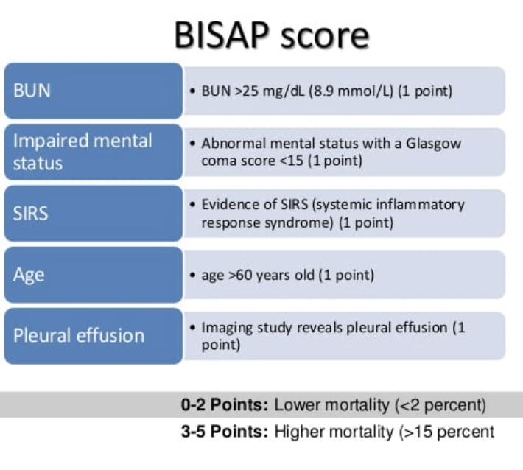
Most cases of acute pancreatitis are mild and self-limited
20% local or systemic complications, including hypovolemia and shock, renal failure, liver failure, acute hypoxemic respiratory failure via ARDS, and hypocalcemia.
Severity index scores for acute pancreatitis:
APACHE II score, Ranson’s criteria, and BISAP score.

Slide 40
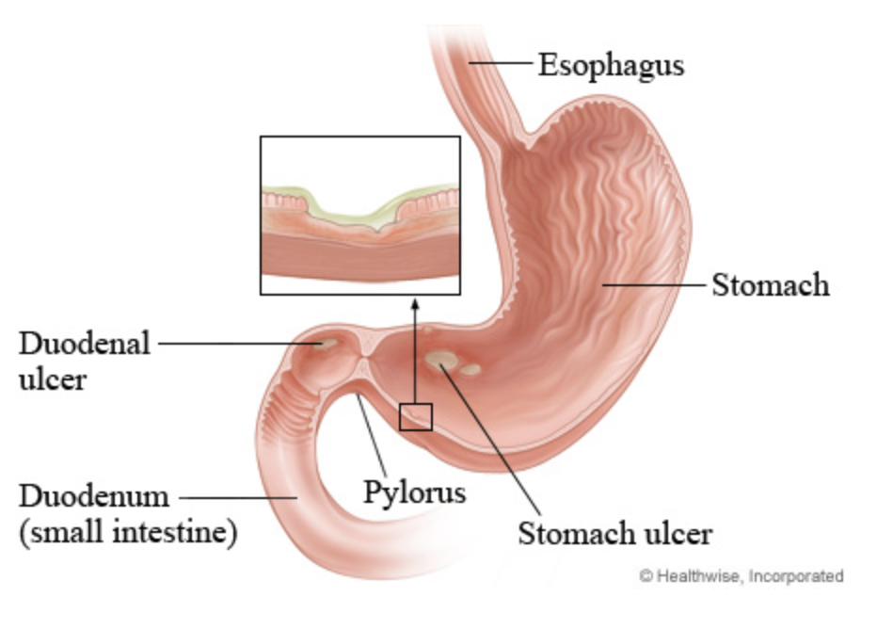
Peptic ulcer disease (PUD)
The term PUD is used to include ulcerations and erosions in the stomach and duodenum
lesions are called “peptic” because the enzyme pepsin, proteolytic at an acidic pH plays a major role in causing the mucosal breaks.
Majority of peptic PUD is driven by Helicobacter pylori (Hp).

Slide 41
PUD Epidemiology
As many as 4 million people worldwide are affected by PUD.
Hp infection acquired during childhood or adolescence became manifested as peptic diseases in later years.
As Hp infection gradually declined in the population over time, the prevalence of infection also gradually shifted from a younger toward older age groups.
The incidence of DU and GU has declined in parallel with the decline in the prevalence of Hp infection, likely a result of improved sanitary conditions and a safer food and water supply.

Slide 42
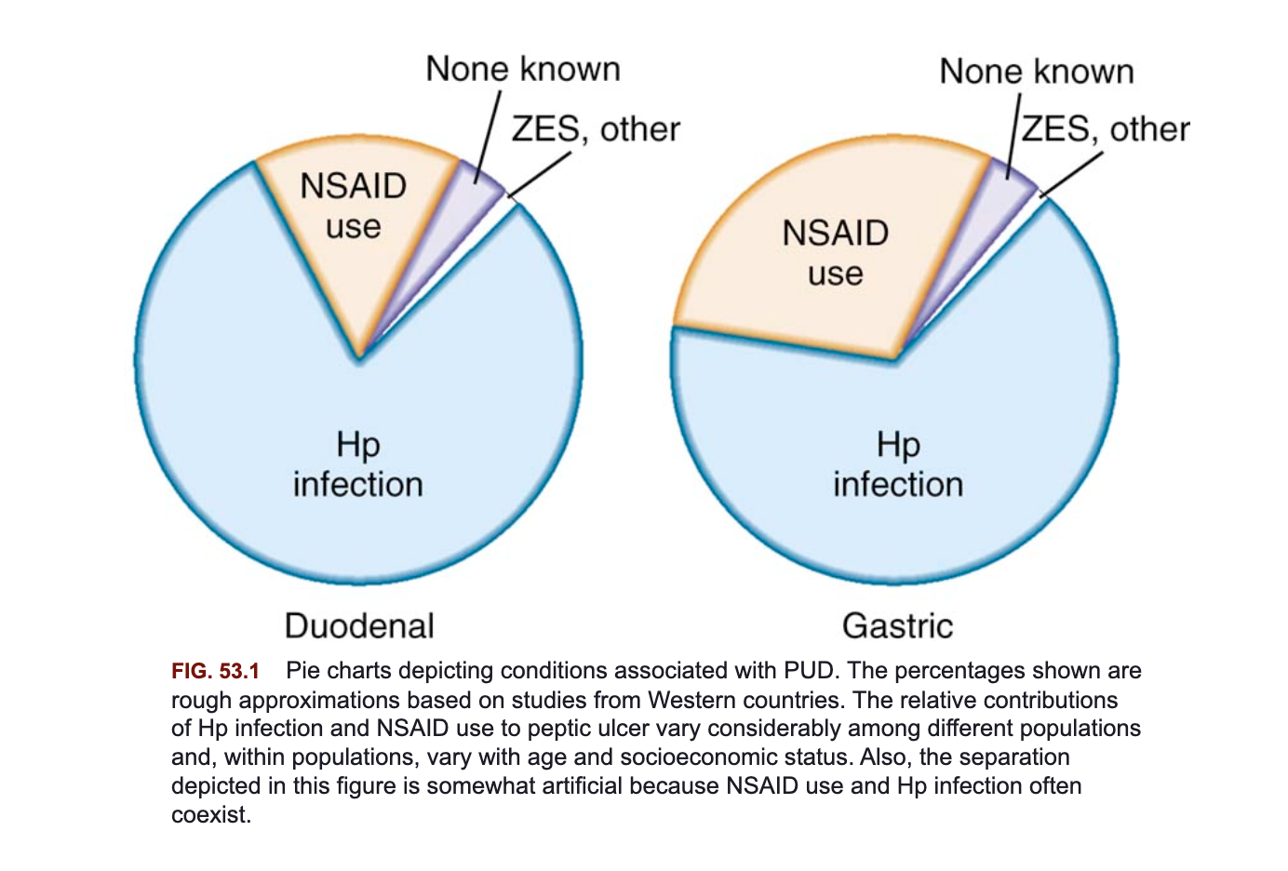
Pud etiology

Slide 43
PUD pain is mainly epigastric pain.
Pain is typically associated with hunger, occurs at night, and is often relieved by food and antacids.
Often patients complain of dyspeptic symptoms such as nausea, bloated sensation, and fullness.
Chronic NSAID users, typically older adult patients, can present with ulcer bleeding or perforation without prior ulcer symptoms.

Slide 44
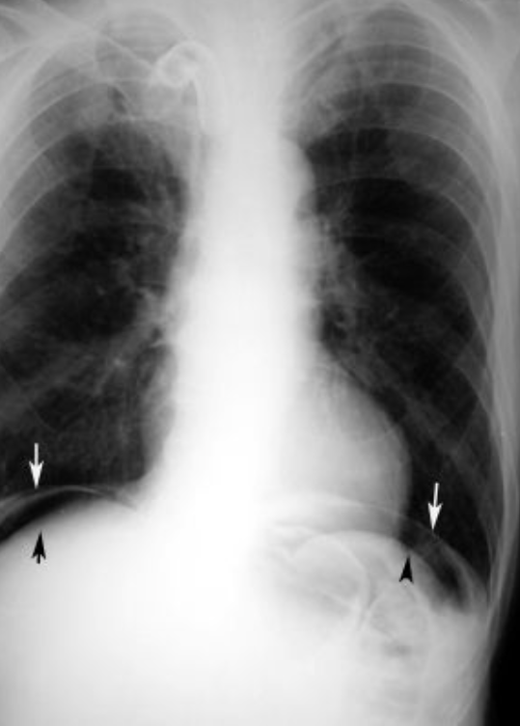
Perforated Peptic Ulcer
5% of patients with PUD present with perforation
Improved therapeutic modalities, including PPIs, eradication of Hp, and endoscopic methods for control of hemorrhage, have reduced the number of patients with PUD who require surgical intervention

Slide 45
Patients with a perforated peptic ulcer typically present with the sudden onset of severe diffuse abdominal pain. These patients may be able to specify the precise moment of the onset of symptoms. In the usual case, the afflicted patient presents acutely with excruciating abdominal pain, often without prodromal symptoms.
Abdominal examination reveals peritonitis, with rebound tenderness, guarding, and abdominal muscular rigidity.
Distinguishing perforated ulcer from other causes of a perforated viscus (e.g., perforated colonic diverticulum, perforated appendicitis) may not be possible.

Slide 46
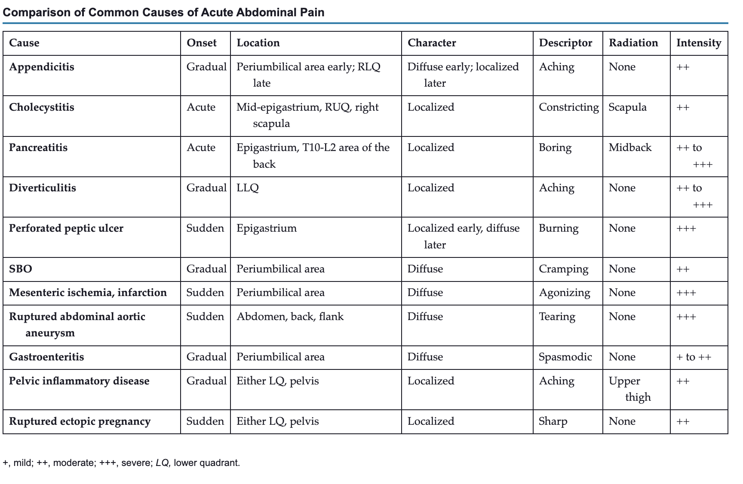
Acute abdominal pain presentations

Slide 47
Chronic abdominal pain and examples etiologies for abdominal pain
Abdominal pain occurring for 6 months, either constantly or intermittently.
Evaluation begins with a detailed history and careful physical examination.
The differential diagnosis is extensive and includes functional disorders and so-called organic disorders.

Slide 48
Irritable bowel syndrome (IBS)
IBS is a functional bowel disorder, characterized by abdominal pain and disordered bowel habit.
The exact etiology remains unknown, and it is unlikely that there is one unifying explanation.
The condition affects up to 10% of people and represents a considerable financial burden to health services.

Slide 49
Ibs clinical presentation
The pain in IBS may be either aggravated or relieved by defecation, and its onset is associated with an increase or decrease in stool frequency, or with looser or harder stools.
The pain often is poorly localized, waxes and wanes, may be aggravated by eating, and can occur in any part of the abdomen, although it more typically is located in the lower abdomen.
Exacerbation of pain by life events or difficult life situations is common.
Abdominal pain that is continuous or unrelated to defecation or that is induced by menstruation, urination, or physical activity is unlikely to be explained by IBS.

Slide 50
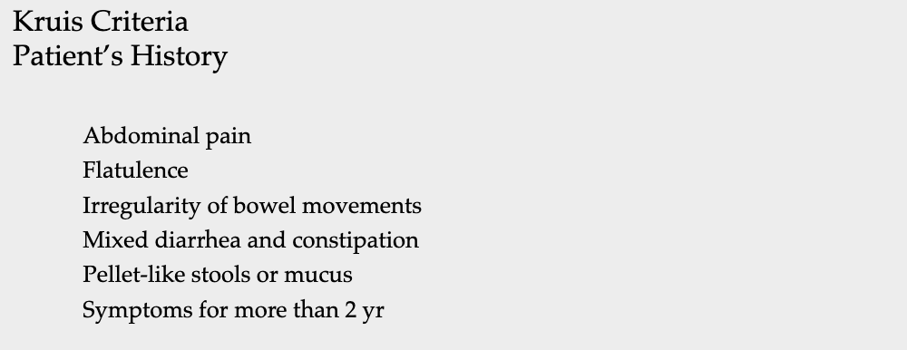
Criteria for ibs diagnosis

Slide 51
Alarming symptoms → NOT IBS
Blood in stool
Weight loss
Decreased appetite
Pain worse at night
Nocturnal diarrhea
EIM: arthralgia, jaundice, elevated LFTs, rash, blurry vision, and conjunctivitis.

Slide 52
Ibs management
Guidelines for the management of IBS recommend that a positive diagnosis should be made clinically, without the need for recourse to investigations to exclude organic disease.
However, available symptom-based diagnostic criteria perform only modestly, although this can be improved by incorporating other items from the clinical history and a limited panel of investigations.

Slide 53
There is no role for exhaustive investigation to confirm the diagnosis, although screening for celiac disease and bile acid diarrhea may be of value, as these conditions can present with similar symptoms. Dietary changes, including a low fermentable oligo-, di-, and mono-saccharides and polyols (FODMAP) diet or soluble fiber, can improve symptoms in some people.

Slide 54
management
Medical therapy with antispasmodics, laxatives, secretagogues, drugs acting on opioid and 5-hydroxytryptamine receptors, antidepressants, and antibiotics, and alternative approaches such as psychological therapies and probiotics have been demonstrated to be more effective than placebo in systematic reviews of randomized controlled trials.
Despite the use of these interventions, the condition is likely to follow a chronic relapsing and remitting course, and no therapy is proven to alter the natural history.

Slide 55
Celiac disease
Celiac disease is a chronic, immune-mediated enteropathy that is triggered by the ingestion of gluten in genetically susceptible individuals.
The disease is characterized by small intestinal villus atrophy with concomitant elevations in antibody levels against gliadin and tissue transglutaminase.
The prevalence of both diagnosed and undiagnosed celiac disease has increased in recent decades. Patients can present with a myriad of symptoms related to malabsorption (including weight loss, diarrhea, and iron deficiency anemia) and extra-intestinal symptoms including metabolic bone disease, infertility, and neuropsychiatric disorders. Celiac disease is treated with complete avoidance of dietary gluten.

Slide 56
epidemiology
Involves wide geographic distribution and affects individuals from multiple and diverse ethnic and racial backgrounds.
The overall prevalence of celiac disease in Europe has been estimated at 1%, with the highest reported prevalence of 2.4% in Finland.
Factors such as predominant HLA haplotype, timing of introduction of gluten into the diet, differences in the gliadin concentration of infant formulas, and interobserver variation in interpreting small intestinal biopsy findings might explain differences in prevalence.

Slide 57
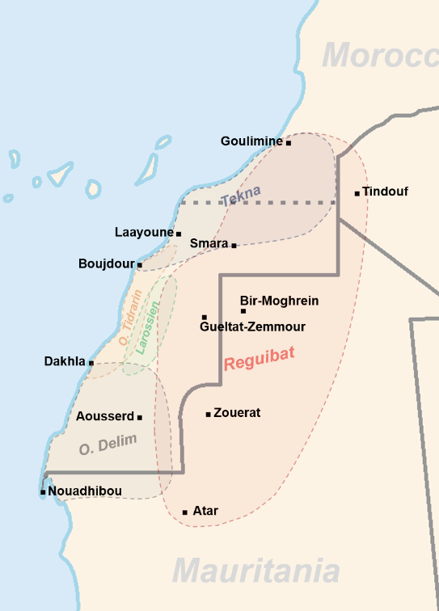
Celiac disease is particularly prevalent in the Punjab region of northwest India, where wheat rather than rice has, for many generations, been a staple of the diet.
The condition has been reported in blacks, Arabs, Hispanics, Israeli Jews, Sudanese of mixed Arab-black descent, and Cantonese and is particularly high among the Saharawi population in northwest Africa.

Slide 58
Clinical presentation
Many adults present with GI symptoms including diarrhea, steatorrhea, abdominal bloating, flatulence, and weight loss similar to those seen in childhood celiac disease.
Diarrhea often is episodic
Nocturnal, early morning, and postprandial diarrhea are common.

Slide 59
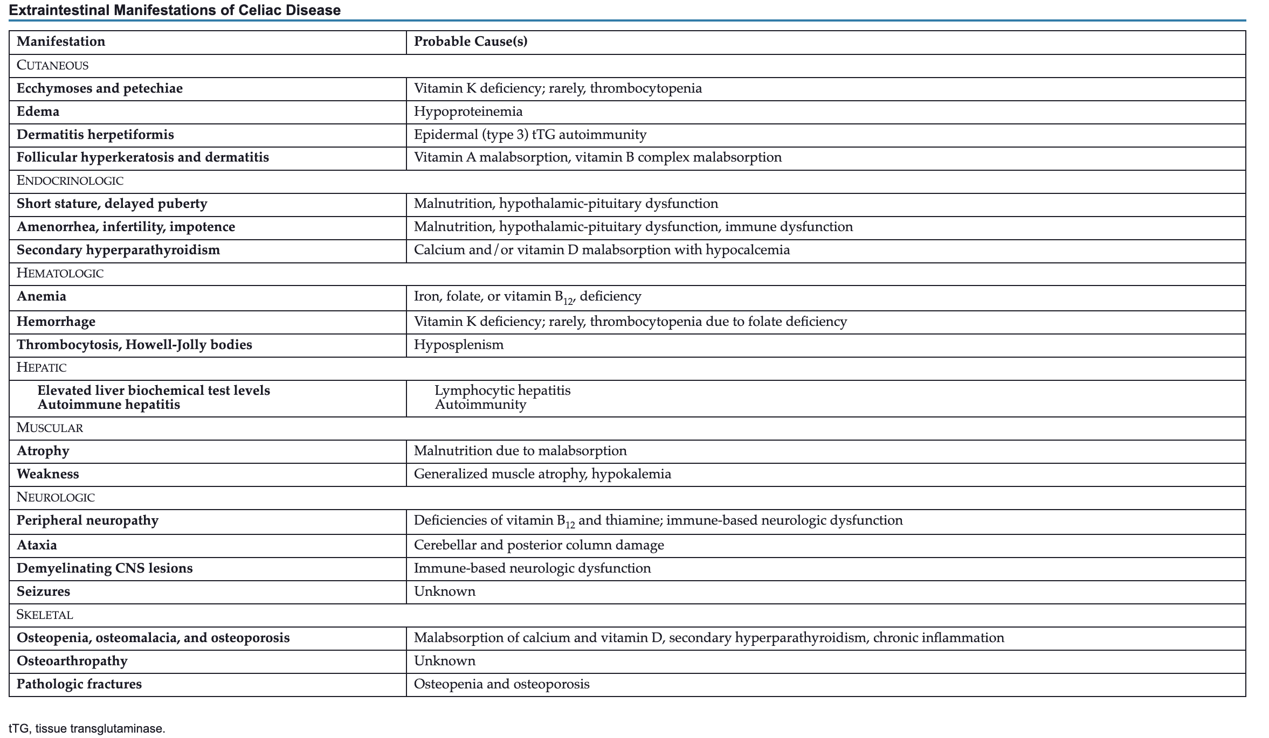
In certain instances, celiac disease might have non-specific presentation that mimics small intestinal malabsorptive disorders.

Slide 60
diagnosis
celiac serology tests and small intestinal biopsy via EGD are the most reliable diagnostic tests for celiac disease.
Most serological assay specific for diagnosis and monitoring of celiac disease is IgA tTG assay.

Slide 61
Treatment
Following a gluten-free diet (GFD)
Recommend referral to a nutritionist to assist with GFD
Refractory celiac disease refers to persistent villus atrophy and malabsorption despite strict gluten avoidance, and in a subset of individuals who have a clonal T-cell receptor rearrangement, can be a precursor to enteropathy associated T-cell lymphoma.

Slide 62
Clinical scenarios
A 36-year-old female with history of autoimmune thyroiditis on 75 mcg of levothyroxine PO once daily presents to her endocrinologist for an urgent visit for progressive fatigue. On further detailed history taking the patient complains of new-onset non-bloody chronic diarrhea for the past 4 months and rash on her arms bilaterally (see image). Patient denies recent traveling or sick contacts. Work-up including serum TSH and free T4 is within normal limits. CBC is notable for new onset microcytic anemia. Iron panel with findings of decreased ferritin and serum iron; and increased total iron binding capacity (TIBC).
anti-tissue transglutaminase (anti-tTG) level
diagnostic colonoscopy to rule out ulcerative colitis
bone marrow biopsy to assess for myelodysplastic syndrome (MDS)
stool culture and parasitology to rule out helminthic infections

Slide 63
A 63-year-old male with history of CAD on aspirin presents to his primary care provider’s office with epigastric pain for the past 2 months that is made worse with fasting. The pain is associated with early satiety and epigastric bloating without diarrhea or constipation. Patient denies unintentional weight loss. The pain is described as stabbing and localized. Notable blood work is positive for iron deficiency anemia.
The likely diagnosis of patient’s presentation is:
- acute pancreatitis
- mesenteric ischemia
- peptic ulcer disease
- irritable bowel syndrome

Slide 64
In the aforementioned clinical scenario, the best next step in management is:
- obtain an US abdomen
- order a CT scan of the abdomen and pelvis
- outpatient referral to cardiology for cardiac workup
- arrange for an upper endoscopy

Slide 65
A 22-year-old female medical student is seen by the student health clinic for two-year history of abdominal pain and diarrhea that has been recently progressive. The pain is described in the mid abdomen and hypogastrium and is associated with diarrhea. The abdominal pain and diarrhea is worse when the patient sits for her final exams. The patient denies melena, hematochezia, weight loss, rash, or arthralgia. Blood work including CBC, CMP and CRP is within normal limits.
The likely diagnosis of patient’s presentation is:
Crohn’s disease
Irritable bowel syndromes (IBS)
Celiac disease
Endometriosis

Slide 66
Questions or suggestions

Slide 67
References and recommended resources for reading
Sleisenger and Fordtran's Gastrointestinal and Liver Disease
Harrison’s Manual of Medicine, 20th edition

