Slide 1
Approach to Acid Base
Nephrology

Slide 2
Introduction
pH in the body is tightly regulated for normal physiology and cell function (proteins denature if they are in abnormal pH)
Normal Arterial pH 7.36 – 7.44

Slide 3
pH equation
pH= 6.1 + log [HCO3/(0.03xpCO2)]
HCO3 measured in meq/L
pCO2 measured in mmHg

Slide 4
H2O equation
CO2 + H2O ←→ H2CO3 ←→HCO3 + H

Slide 5
Regulation and Buffer systems

Slide 6
Definitions

Slide 7
Approach

Slide 8
Step 1.
Take a thorough history and physical examination, look for clues that may lead to the abnormalities in pH
Vomiting
Diarrhea
Hypoventilation
Respiratory disease
Medications (laxatives, diuretics, etc)
Diabetes
etc
Vomiting for example, causes loss of acid and gastric contents, which suggests development of alkalosis

Slide 9
Step 2
Look at the pH:
Determine if this is
Normal 7.35 – 7.45 (No abnormality or mixed acidosis and alkalosis)
Low <7.35 (acidemic)
High >7.45 (alkalemic)

Slide 10
Step 3 - a
Determine the primary abnormality that is causing the abnormal pH
If the pH is acidemic (<7.35), then look for
Low HCO₃ (Metabolic) or High PCO₂ (Respiratory)
If the pH is alkalemic (>7.45), then look for
High HCO₃ (Metabolic) or Low PCO₂ (Respiratory)

Slide 11
Step 3 - b
If pH is normal, rule out mixed acidosis and alkalosis
Look for high or low PCO₂
Look for high or low HCO₃
Low PCO2 suggests respiratory alkalosis
High PCO2 suggests respiratory acidosis
Low HCO₃ suggests metabolic acidosis
High HCO₃ suggests metabolic alkalosis
Determine what is being mixed

Slide 12
Step 4
After determining the primary abnormality, check for compensation
Compensation is the mechanism by which the body adapts to either acidosis or alkalosis, it will fully correct the abnormality
For example
A patient has diabetic ketoacidosis, pH is 7.29, HCO3 is 15
Expected PCO2 by using Winter’s formula
PCO2 = 1.5 x HCO3 + 8 ( ±2 )
= 1.5 x 15 + 8 = 30.5
So you expect the PCO2 in this patient to be in the range of 28.5– 32.5
If the PCO2 in this patient is higher than 32.5 → consider additional respiratory acidosis
If the PCO2 in the patient is lower than 28.5 → consider additional respiratory alkalosis

Slide 13
Step 4
Compensation calculations

Slide 14
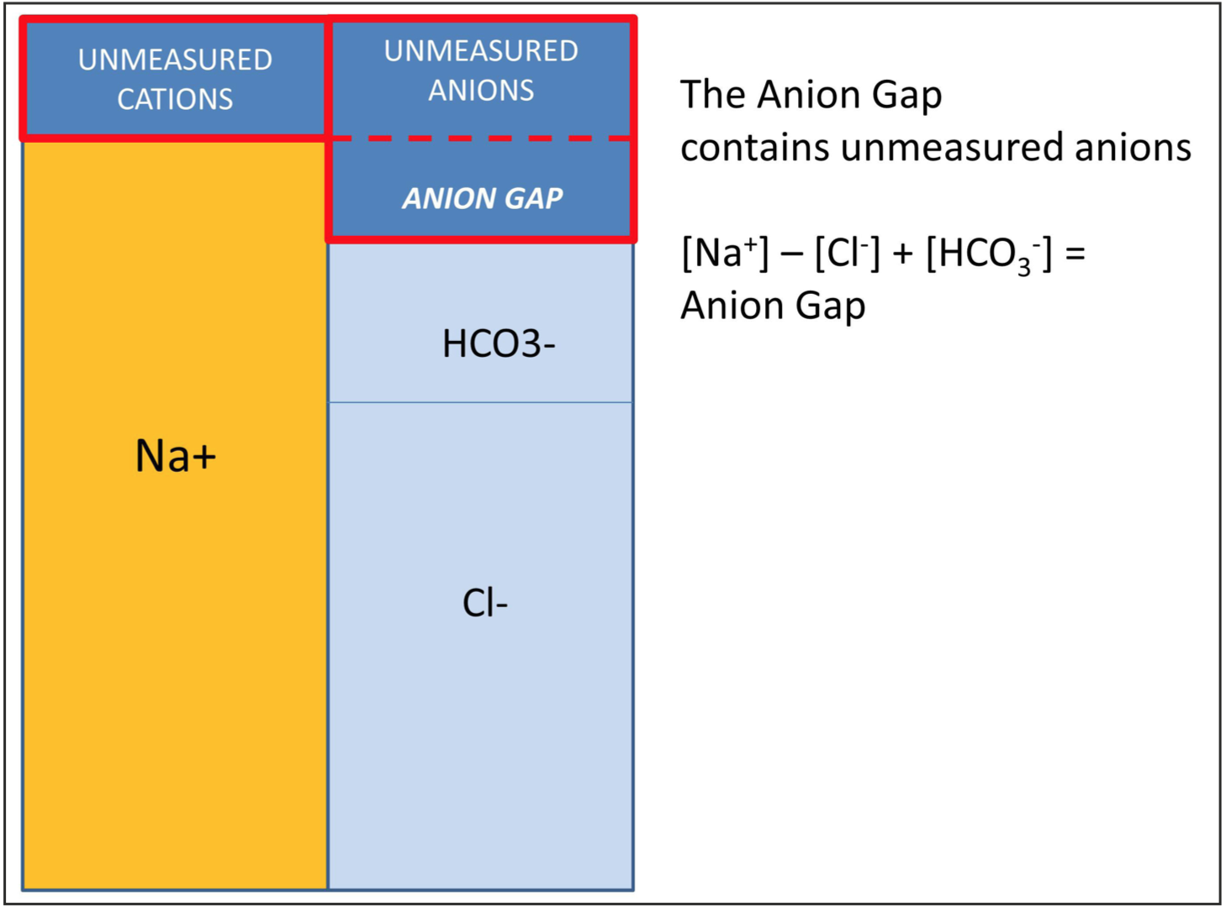
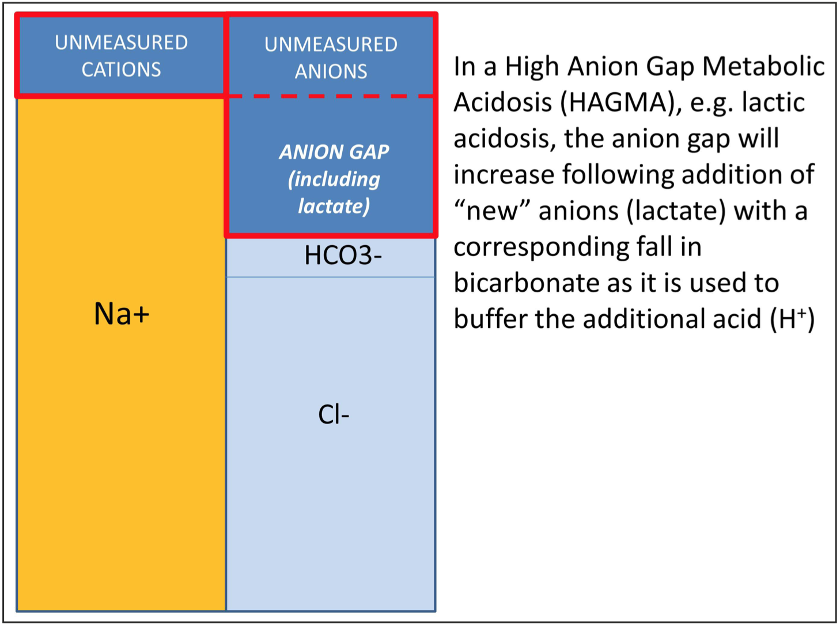
Step 5
Albumin is the main unmeasured anion
To overcome the effects of the hypoalbuminemia on the AG, the corrected AG can be used which is AG + (0.25 X (40-albumin) expressed in g/L
Calculate the anion gap (AG)
AG = Na – (Cl + HCO₃)

Slide 15
Delta ratio
Delta ratio = (change in anion gap) / (change in bicarbonate)
(The normal anion gap is assumed to be 12, and the normal HCO₃ is assumed to be 24.)
Interpretation of the generated ratio:
0.4 = normal anion gap metabolic acidosis
0.4-0.8 = mixed high and normal anion gap acidosis exists.
0.8-1.0 = purely due to a high anion gap metabolic acidosis
1.0-2.0 = still purely a high anion gap metabolic acidosis
Over 2.0 = high anion gap acidosis with pre-existing metabolic alkalosis

Slide 16
Case 1
40 yo gentleman presenting to ER with coma labs : pH 7.14/ pCO2 15; Na 138/ K 6.4/ Cl 100/ HCO3 5; BS 6/ Urea 7/ S- OSM 340/ ETOH 0/ALB 40
Funduscopic showed optic neuritis
How do you approach the differential of this acid base disorder?

Slide 17
Answer
1. Acidosis or alkalosis - ACIDOSIS
2. Metabolic or respiratory- METABOLIC
3. Compensation appropriate- YES
4. Anion gap – HIGH (138 – 105 =23)
5. Δ gap = Δ HCO3 - YES
6. Osmolar gap – YES (340 – 289 = 51)
Corrected anion gap = 2.5 X (4-albumin)

Slide 18
Case 2
An elderly man present with tachypnea, diarrhea and weakness labs - pH 7.24/ pCO2 24; Na 140/ K 6.7/ Cl 120 / HCO3 10; urine pH 5.0/ U Na 40/ U K 20/ U Cl 50
How do you approach the differential of this acid base disorder?

Slide 19
Answer
1. Acidosis or alkalosis - ACIDOSIS
2. Metabolic or respiratory- METABOLIC
3. Compensation appropriate - YES
4. Anion gap – NORMAL (10)
5. Δ gap = Δ HCO3 - YES
6. Osmolar gap - NONE

Slide 20
Urine Anion Gap
HCO3 is either resorbed (prox) or regenerated (distal)
To regenerate HCO3 - NH4 is formed distally
In an acidic urine Na+K+NH4 = Cl
NH4 can not be measured therefore
Cl > Na+K if NH4 is present → Normal DISTAL FX
If Cl < or = Na+K then distal urinary acidification is impaired (UAG abnormal)

Slide 21
Ammonium Secretion

Slide 22
NH4 response to acid load

Slide 23
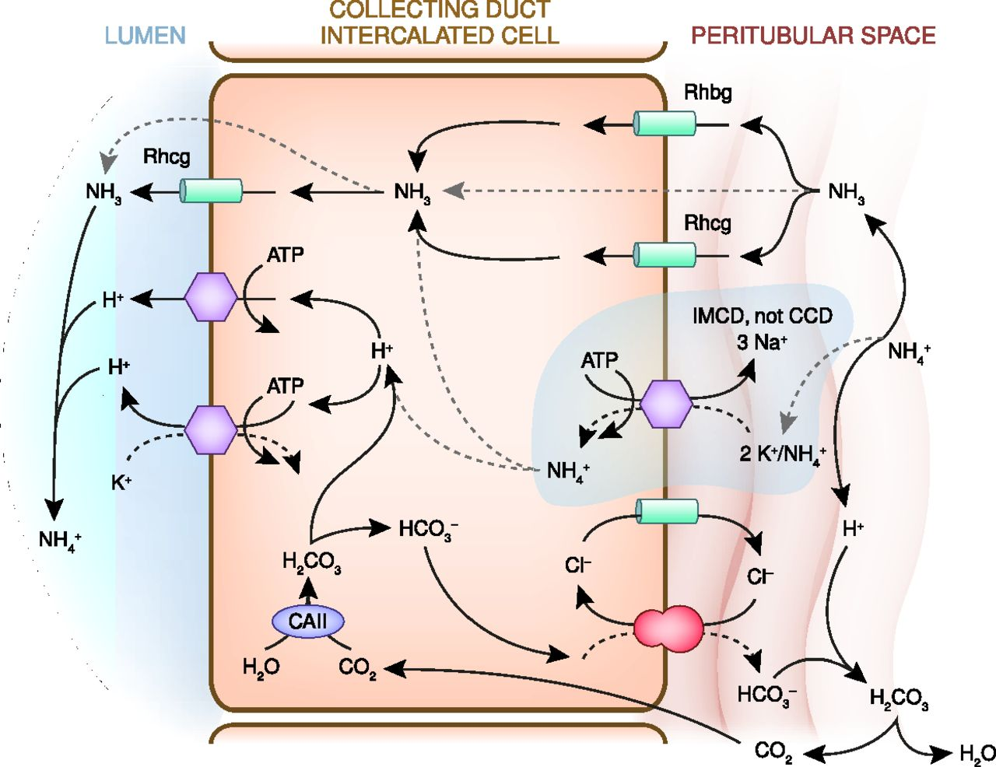
Kidney regulation

Slide 24
Urine Anion Gap
Urine Anion Gap the urine anion gap is useful in distinguishing disorders with normal ammonium excretion from those with abnormal excretion
Normal UAG – Proximal RTA or non renal acidosis (diarrhea etc.) (Cl > Na + K)
Abnormal UAG - CKD (lack of NH4 production), distal RTA Type I and IV or aldosterone deficiency) (Cl ≤ Na + K)

Slide 25
Hyperchloremic Metabolic Acidosis Normal Urine NH4 (Cl > Na + K)
This is due to HCO3 loss with normal distal tubular function
GI - loss of HCO3 due to diarrhea, urinary diversion or pancreatic fistulae
Renal - proximal RTA (type 2) leads to renal HCO3 loss with normal distal regeneration.
May be associated with other proximal defects (Fanconi’s), hypergammaglobulinemia, drugs (toluene, toperimate, zonisamide, tenofovir, azetazolamide) or multiple myeloma

Slide 26
Hyperchloremic Metabolic Acidosis Abnormal Urine NH4
Classic Distal - a defect in the proton pump leads to a U pH >5.5 and acidosis (Type 1) (ampho B, HyperPTH, Sjogren’s, medullary sponge kidney Hyperkalemic Distal - a defect in the aldo sensitive collecting duct leads to acidosis and hyperkalemia with preserved renal acidification (Type 4) (obstruction , aldo resistance) NH3 Defect - CKD leads to abnormal NH3 production with preserved urinary acidification (GFR < 30)

Slide 27
Non Anion Gap Acidosis

Slide 28
Case 3
A normotensive body builder presents with weakness
Labs : pH 7.54/ pCO2 45; Na 140/ K 2.8/ Cl 95/ HCO3 38;
U Cl 50 U Na 70
Repeat U Cl < 20
How do you approach the differential of this acid base disorder?

Slide 29
Answer
1. Acidosis or alkalosis - ALKALOSIS
2. Metabolic or respiratory - METABOLIC
3. Compensation appropriate – YES
4. Anion gap – NORMAL (7)
5. Δ gap = Δ HCO3 – YES
6. Osmolar gap - NONE

Slide 30
Cl responsiveness
Generation - loss of HCl from kidneys or GI tract
Maintenance - because of prerenal state, hyperaldosteronism, and hypokalemia the body is unable to excrete HCO3
Cl responsive - when Cl is given it will shut off the maintenance phase and allow the kidney to excrete HCO3 by restoring volume and normalizing aldosterone production
Cl unresponsive - even when Cl is given it will not shut off aldosterone production

Slide 31
Cl responsiveness
When NaCl and KCl are given they restore volume and replete K and Cl shutting off aldosterone production
This plus the correction of the prerenal state allow the kidneys to excrete excess HCO3
Treatment - administration of NaCl and KCl

Slide 32
Maintenance of Metabolic Alk

Slide 33
Cl responsive
Diuretic alkalosis - U Cl < 20 after diuretics are stopped
Chloridarrhea - congenital or villous adenoma
Posthypercapnic - usually with chronic respiratory acidosis
Gastric alkalosis - hypokalemia due to renal K wasting
Milk Alkali – hypercalcemia, AKI, and alkalosis Cystic Fibrosis – skin Cl loss

Slide 34
Cl unresponsive
This group of disorders is all have elevated aldosterone or defects in kidney
However, this is not volume (NaCl) responsive but rather volume independent
Administration of NaCl will not inhibit aldo nor will it correct the prerenal state
Treatment - diamox, HCl, spironolactone

