Slide 1
GI Bleeding Approach
Dr Nahla Azzam
Professor of Medicine and Consultant of Gastroenterology
King Saud University

Slide 2
Case 1
A 65 years old male referred for evaluation of 4 months HX of weight loss, fatigue , and weakness. He also gave history of passing dark stool intermittently for the last 3 months. He is known DM on insulin , hyperlipedemia on statin and occasionally aspirin

Slide 3
What other information you would like to ask?

Slide 4
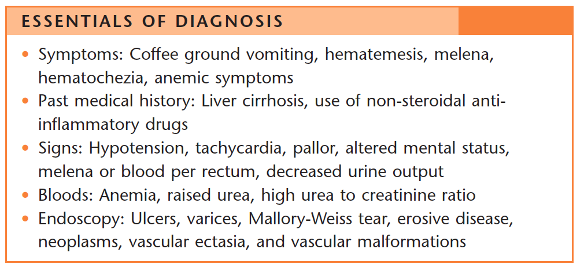

Slide 5
What is the likely diagnosis?

Slide 6
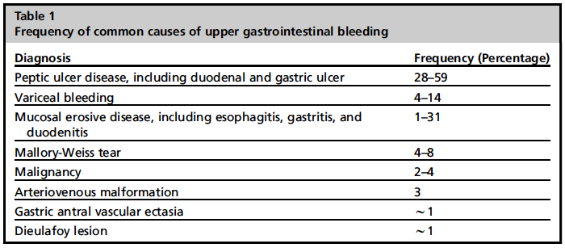
Causes of UGIB
Gibson et al. Gastrointest Endosc Clin N Am 2011;21:583-96.

Slide 7
What will be the next step?

Slide 9
Case 2
A 42 years old male complaining of chronic recurrent epigastric pain which worsen recently especially when he is fasting
For the last 2 days he started to have frequent vomiting associated with blood
He is not known to have any chronic medical problems and not on any medications

Slide 10
What is the best next step in the approach of such patient?

Slide 11
Detailed HX
Full Physical examination

Slide 12
How would you assess the bleeding severity?

Slide 13
Risk Stratification
Glasgow- Blatchford Score (GBS)
Rockall Score
Modified-GBS
AIMS65

Slide 14
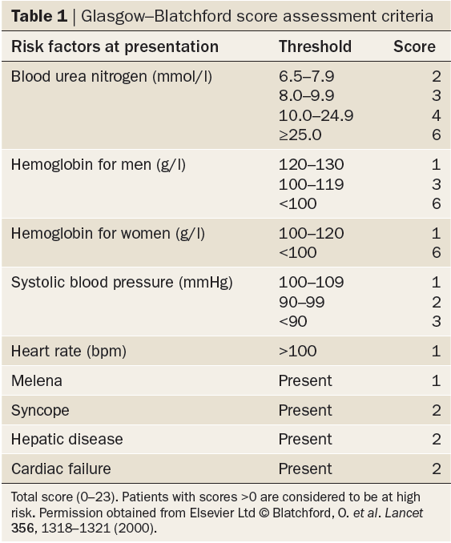
Urea
CBC
Physical
History
Bardou et al. Nat Rev Gastroenterol Hepatol 2012;9:97-104.
Notes:
Diagnosis and management of nonvariceal upper gastrointestinal bleeding

Slide 15
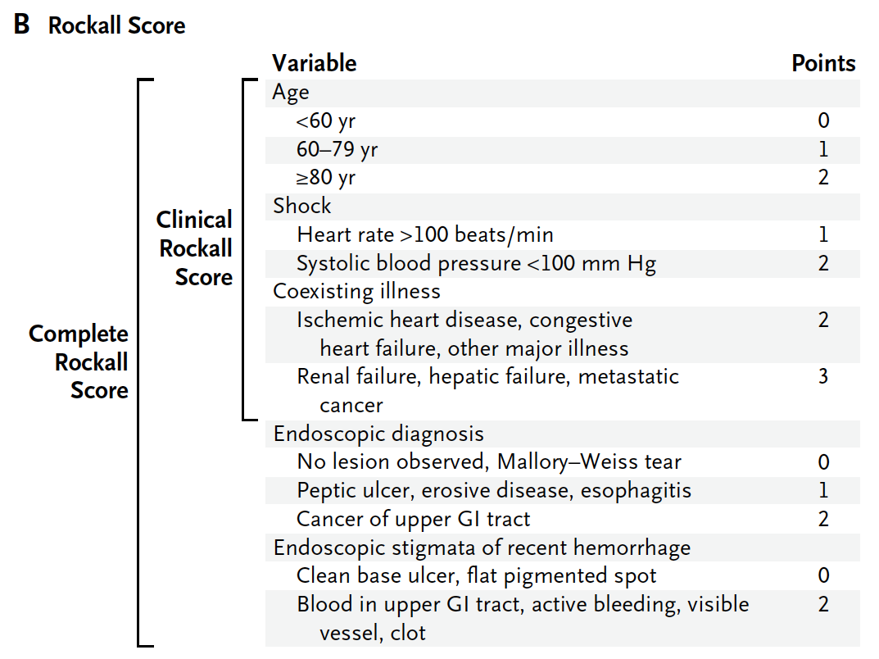
History
Physical
History
Hearnshaw et al. Aliment Pharmacol Ther 2010;32:215-24.
Notes:
Panel B
shows the Rockall score, with point values assigned for each of three clinical
variables (age and the presence of shock and coexisting illnesses) and
two endoscopic variables (diagnosis and stigmata of recent hemorrhage).
The complete Rockall score ranges from 0 to 11, with higher scores indicating
higher risk. Patients with a clinical Rockall score of 0 or a complete
Rockall score of 2 or less are considered to be at low risk for rebleeding
or death. Data are from Blatchford et al.16 and Rockall et al.17 GI denotes
gastrointestinal. To convert the values for blood urea nitrogen to milligrams
per deciliter, divide by 0.357.

Slide 16
What is the diagnosis and the associated risk factors?

Slide 17
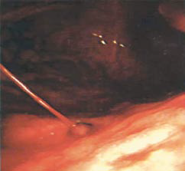
Spurting Blood
Gralnek et al. N Engl J Med 2008;359:928-37.
Notes:
High-risks lesions are those that spurt blood (Forrest grade IA, Panel A),
ooze blood (grade IB, Panel B), contain a nonbleeding visible vessel (grade IIA,
Panel C), or have an adherent clot (grade IIB, Panel D). Low-risk lesions are
those that have a flat, pigmented spot (grade IIC, Panel E) or a clean base
(grade III, Panel F).

Slide 18
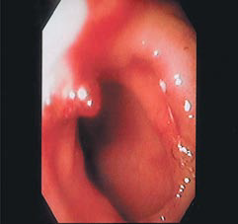
Non-bleeding Visible Vessel
Gralnek et al. N Engl J Med 2008;359:928-37.

Slide 19
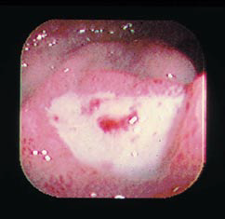
Flat, Pigmented Spot
Gralnek et al. N Engl J Med 2008;359:928-37.

Slide 20
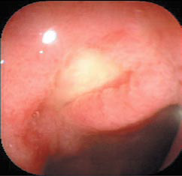
Clean Base
Gralnek et al. N Engl J Med 2008;359:928-37.

Slide 21
Risk factors for Upper GI Bleeding

Slide 22
H pylori
Patients with bleeding peptic ulcers should be tested for H. pylori
Receive eradication therapy if present
Confirmation of eradication
Negative H. pylori diagnostic tests obtained in the acute setting should be repeated
Barkun et al. Ann Intern Med 2010;152:101-13.

Slide 23
Case 3
A 52 years old lady presented to ER with one day history of vomiting of fresh blood. She also notices passing black tarry stool. She is feeling dizzy and unwell
Past HX of jaundice no other medical problems and not on any medications
Clinically jaundiced and pale
Vital signs BP 100/70 pulse 110/min
Abdomen examination showed liver span of 7 cm and spleen felt 3 fingers below costal margin with few spider nevi seen over chest

Slide 24
what is the likely diagnosis of this case and list 4 common aetiology ?

Slide 25
Clinical Manifestations of liver Cirrhosis

Slide 27
What is the priority in the management of this patient?

Slide 28
IV Fluid Resuscitation

Slide 29
What is the target Hb and INR prior to the endoscopy for this cases?

Slide 30
3- Blood Transfusions
The role of transfusion in clinically stable patients with mild GI bleeding remains controversial, with uncertainty at which hemoglobin level transfusion should be initiated
Literature suggesting poor outcomes in patients managed with a liberal transfusion
Marik PE, Corwin HL. Crit Care Med 2008; 36: 2667 – 2674
Restellini S, Kherad O, Jairath V et al. Aliment Pharmacol Ther 2013; 37: 316 – 322

Slide 31
3- Blood Transfusions (cont’d)
The restrictive RBC transfusion had significantly improved survival and reduced rebleeding
Villanueva C, Colomo A, Bosch A et al. N Engl J Med 2013; 368: 11 – 21

Slide 32
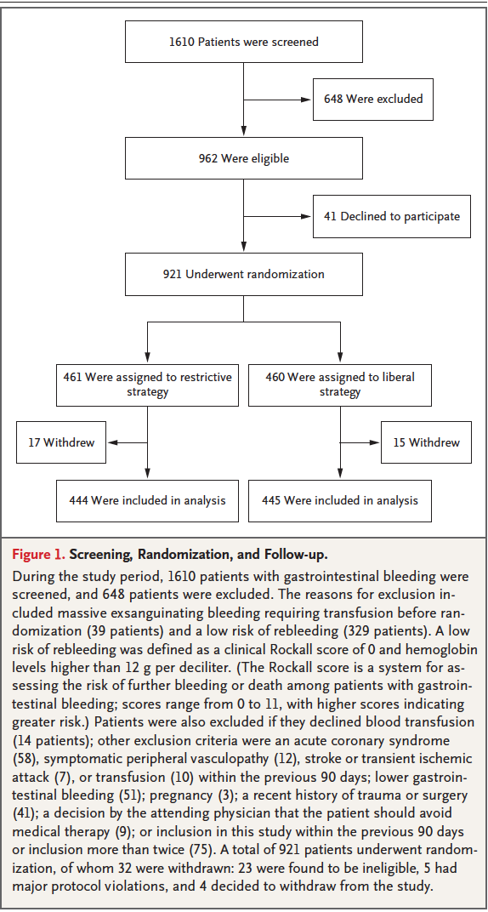
3- Blood Transfusions (Cont’d)
7 gm/dl
9 gm/dl

Slide 33
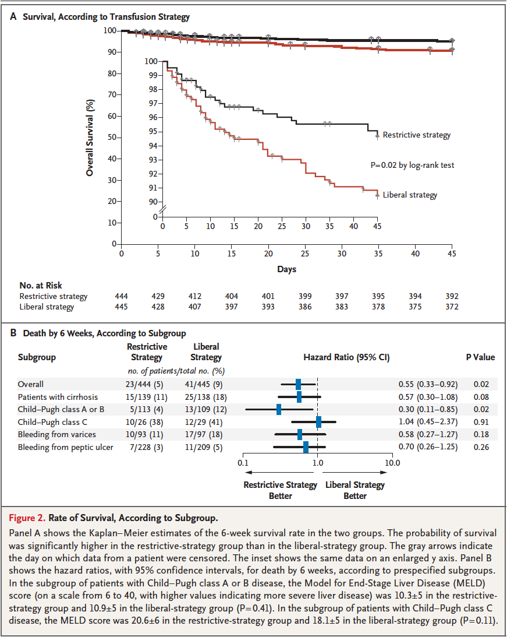
3- Blood Transfusions (Cont’d)

Slide 34
Patients receiving anticoagulants
Correction of coagulopathy is recommended
Endoscopy should not be delayed for a high INR unless the INR is supratherapeutic
Barkun et al. Ann Intern Med 2010;152:101-13.

Slide 35
Timing and need for early endoscopy
Definition of early endoscopy
Ranges from 6 to 24 hours AFTER INITIAL PRESENTATION
May need to be delayed or deferred:
Active acute coronary syndromes
Suspected perforation
Barkun et al. Ann Intern Med 2010;152:101-13.

Slide 36
Case 4
A 47 years old male known to have alcoholic liver disease presented with hematemesis of large amount and dizziness after resuscitation an upper GI endoscopy done which showed multiple large oesophageal varix which was banded , however 12 hrs post endoscopy he continued to have melena with drop of Hb and hypotension

Slide 37
What is the next step in the patient management?

Slide 38
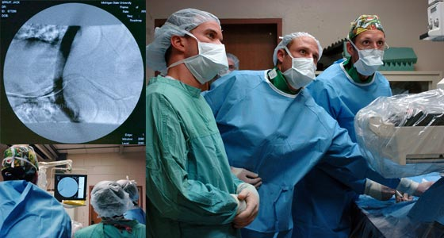
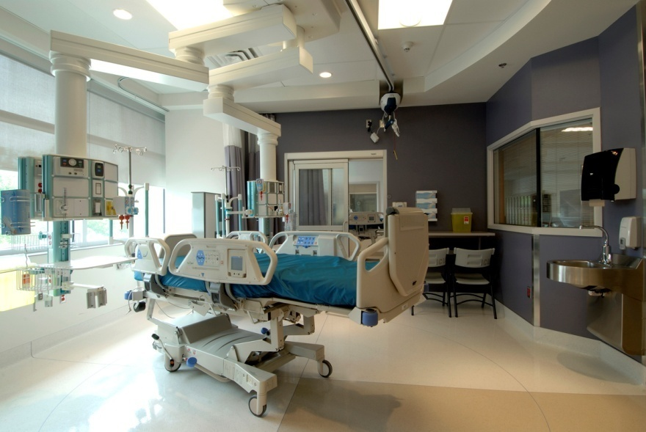
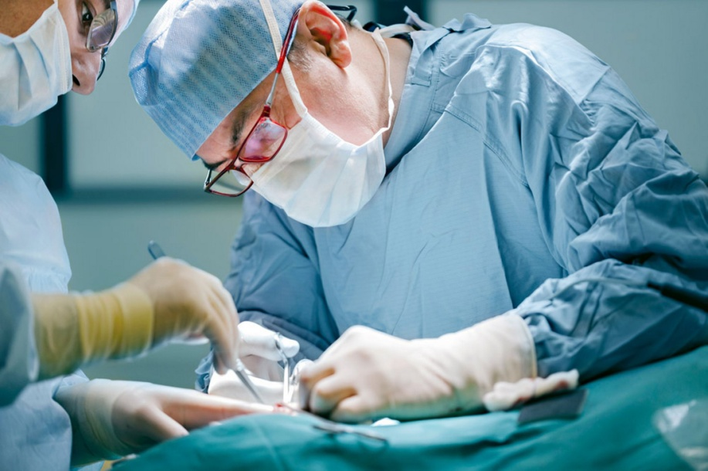
YOU ARE NOT ALONE
Gastroenterology
Interventional Rad.
Intensive Care
Surgery

Slide 39
Summary for steps of GI bleeding approach
1- Initial assessment
2- Hemodynamic status and resuscitation
3- Blood transfusions
4- Risk assessment & stratification
5- Pre-endoscopic medical therapy
6- Timing of endoscopy
7- Endoscopic therapy
8- Post-endoscopy

Slide 40
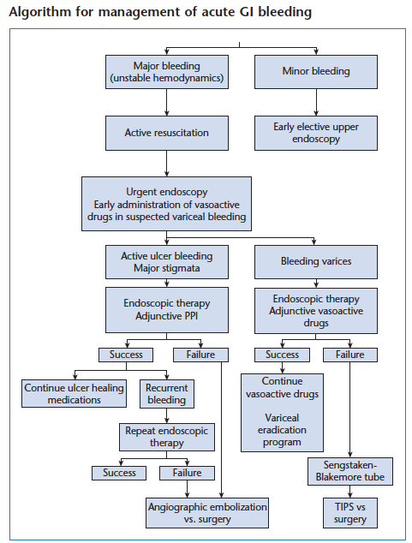

Slide 41
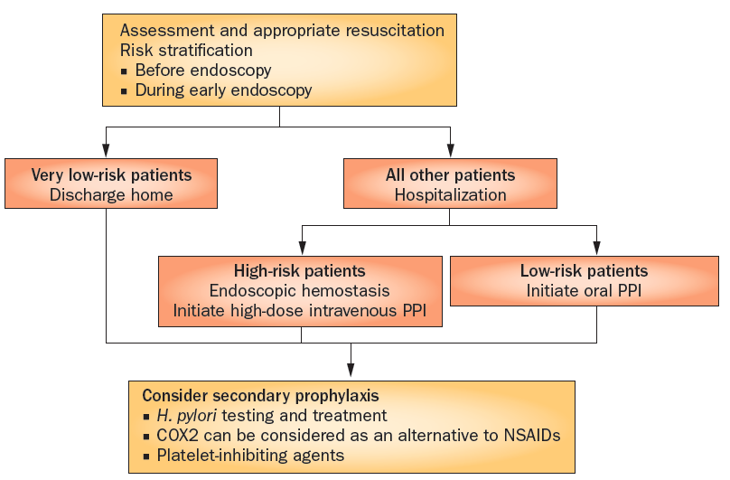
Bardou et al. Nat Rev Gastroenterol Hepatol 2012;9:97-104.
Notes:
Algorithm for optimal management of nonvariceal upper gastrointestinal bleeding. On presentation with UGIB, appropriate resuscitation should be carried out. Patients should be assessed and those at very low risk may be discharged. All other patients should be admitted as inpatients and categorized as low-risk or high-risk groups to determine treatment options. Oral PPI therapy can be adequate for low-risk patients but those at high risk should be treated with endoscopy and intravenous, high-dose PPI. All patients should be considered for secondary prophylaxis, including Helicobacter pylori testing and treatments, use of COX2 antagonists as an alternative to NSAIDs, and PPI for those taking low-dose aspirin. Abbreviations: COX2, cyclooxygenase 2 (also known as prostaglandin G/H synthetase 2); UGIB, upper gastrointestinal bleeding.

Slide 42
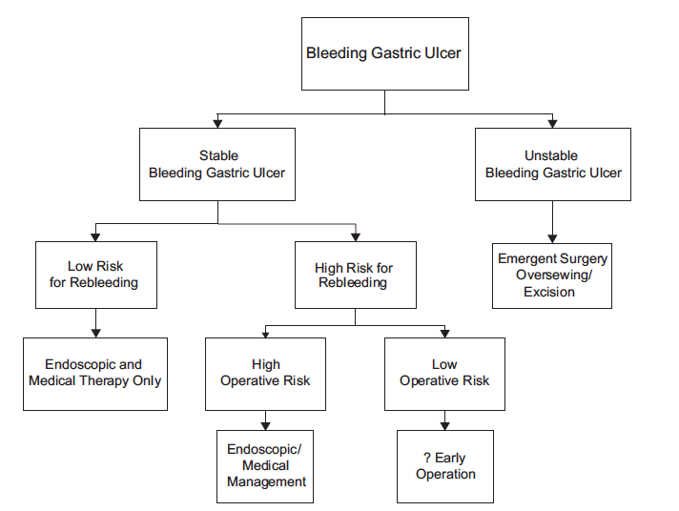
When to go to surgery?
Notes:
Management of Nonvariceal Upper Gastrointestinal Bleeding. Bingener, 2011

Slide 43
Conclusions
Resuscitation should be initiated prior to any diagnostic procedure
Gastrointestinal endoscopy allows visualization of the stigmata, accurate assessment of the level of risk and treatment of the underlying lesion
Intravenous PPI therapy after endoscopy is crucial to decrease the risk of cardiovascular complications and to prevent recurrence of bleeding
Helicobacter pylori testing should be performed in the acute setting
Bardou et al. Nat Rev Gastroenterol Hepatol 2012;9:97-104.
Notes:
Diagnosis and management of nonvariceal upper gastrointestinal bleeding

