Slide 1
PELVIC WALLS, FLOOR; & JOINTS

Slide 2
PELVIC WALL

Slide 3
The pelvis is the region of the trunk that lies below the abdomen.
Although the abdominal and pelvic cavities are continuous, even the two regions are described separately.

Slide 4
The Pelvis

Slide 5
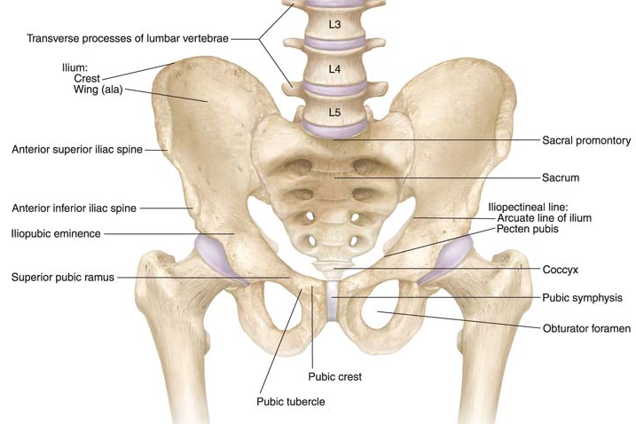
The bony pelvis provides a strong, stable connection between the trunk and the lower extremities.

Slide 6
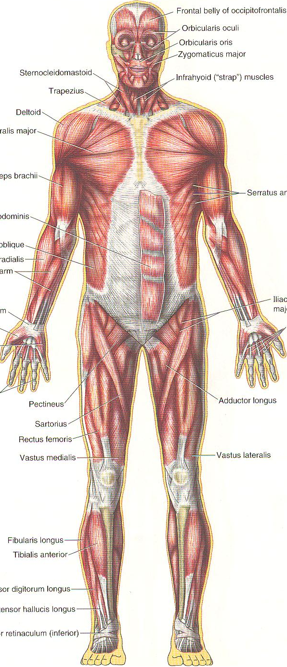
The main functions of the
pelvis are:
to transmit the weight of the body from the vertebral column to the femurs;
to contain, support, and protect the pelvic viscera; and
to provide attachment for trunk and lower limb muscles.

Slide 7
The bony pelvis is composed of four bones:
the two hip bones, which form the lateral and anterior walls, and
a sacrum and a coccyx, which are part of the vertebral column and form the back wall.

Slide 8
The two hip bones articulate with each other anteriorly at the symphysis pubis and posteriorly with the sacrum at the sacroiliac joints.
The bony pelvis contains the lower parts of the intestinal and urinary tracts and the internal organs of reproduction.
The pelvis is divided into two parts by the pelvic brim.
Above the brim is the false pelvis, which forms part of the abdominal cavity.
Below the brim is the true pelvis.

Slide 9
The pelvic brim is formed by:
the sacral promontory (anterior and upper margin of the first sacral vertebra) behind,
the ileopectineal lines (a line that runs downward and forward around the inner surface of the ileum) laterally, and
the symphysis pubis (joint between bodies of pubic bones) anteriorly.

Slide 10
ORIENTATION OF THE PELVIS

Slide 11
In the standard anatomic position, the front of the symphysis pubis and the anterior superior iliac spines lie in the same vertical plane.

Slide 12
FALSE PELVIS

Slide 13
The false pelvis is bounded behind by the lumbar vertebrae, laterally by the iliac fossae and the iliacus muscles, and in front by the lower part of the anterior abdominal wall.
The false pelvis supports the abdominal contents and after the 3rd month of pregnancy helps support the gravid uterus.

Slide 14
TRUE PELVIS

Slide 15
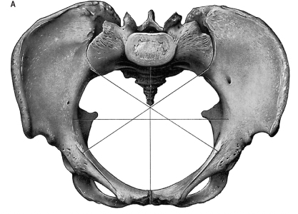
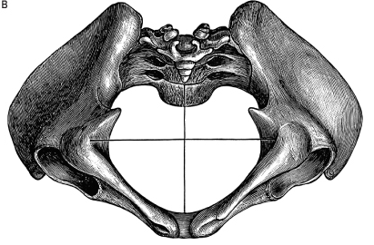
The true pelvis has:
an inlet
an outlet
and a cavity

Slide 16
The pelvic inlet, or pelvic brim, is bounded posteriorly by the sacral promontory, laterally by the iliopectineal lines, and anteriorly by the symphysis pubis.

Slide 17
The pelvic outlet is bounded:
posteriorly by the coccyx,
laterally by the ischial tuberosities, and
anteriorly by the pubic arch.

Slide 18
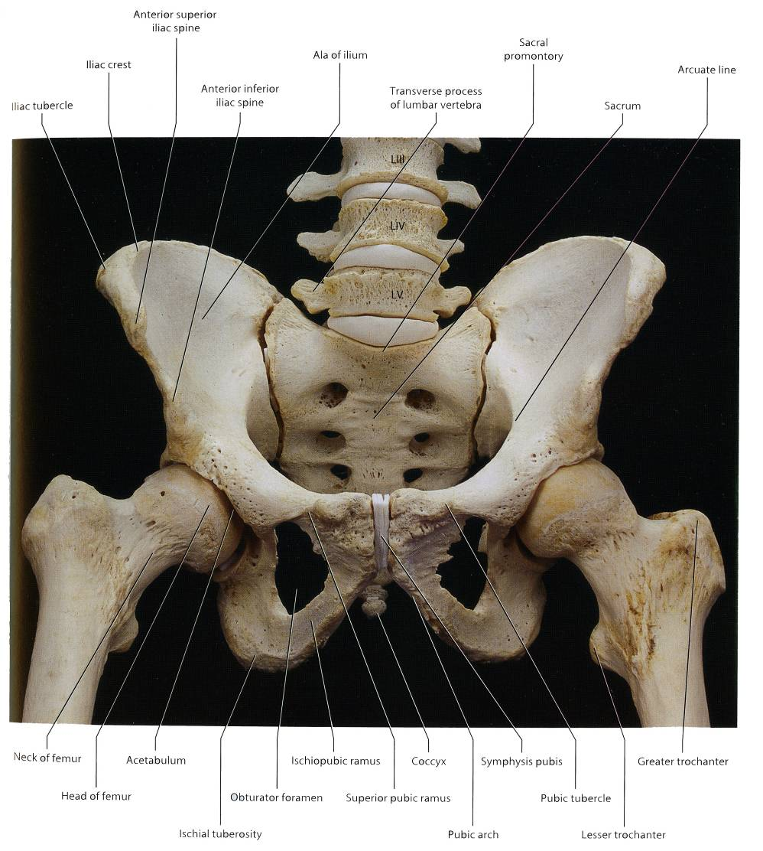
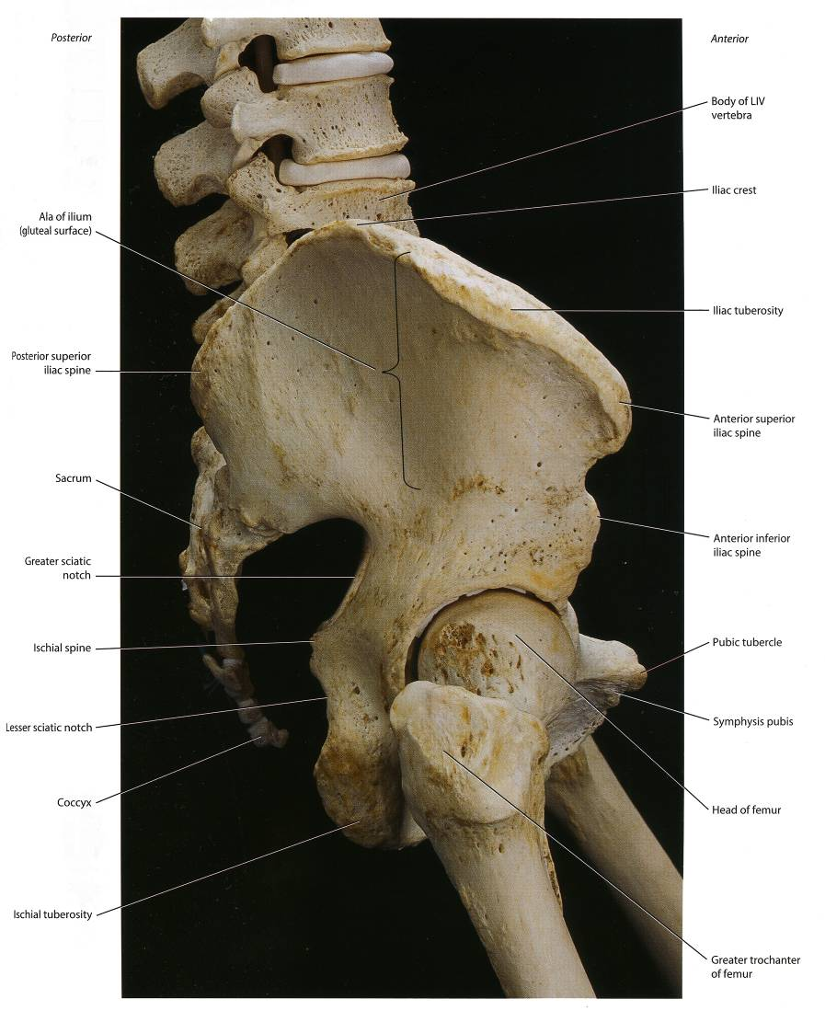
The pelvic outlet does not present a smooth outline but has three wide notches:
Anteriorly, the pubic arch is between the ischiopubic rami, and,
laterally, are the sciatic notches.

Slide 19
The sciatic notches are converted by the sacrotuberous and sacrospinous ligaments into the greater and lesser sciatic foramina.

Slide 20
The pelvic cavity is continuous above with the abdominal cavity at the pelvic brim & limited below by the pelvic diaphragm.
It is a short, curved canal, with a shallow anterior wall and a much deeper posterior wall.

Slide 21
Pelvic Walls & its Structures

Slide 22
The walls of the pelvis are formed by bones and ligaments that are partly lined with muscles covered with fascia and parietal peritoneum.
The pelvis has anterior, posterior, and lateral walls and an inferior wall or floor.

Slide 23
ANTERIOR PELVIC WALL

Slide 24
The anterior pelvic wall is formed by the posterior surfaces of the bodies of the pubic bones, the pubic rami, and the symphysis pubis.

Slide 25
POSTERIOR PELVIC WALL

Slide 26
The posterior pelvic wall is extensive and is formed by the sacrum and coccyx and by the piriformis muscles and their covering of parietal pelvic fascia.

Slide 27
Sacrum

Slide 28
The sacrum consists of five rudimentary vertebrae fused together to form a single wedge-shaped bone with a forward concavity.
The upper border or base of the bone articulates with the fifth lumbar vertebra.
The narrow inferior border articulates with the coccyx.

Slide 29
Laterally, the sacrum articulates with the two iliac bones to form the sacroiliac joints.

Slide 30
The vertebral foramina together form the sacral canal.
The laminae of the fifth sacral vertebra, and sometimes those of the fourth, fail to meet in the midline, forming the sacral hiatus.

Slide 31
The anterior and posterior surfaces of the sacrum possess on each side four foramina for the passage upper four sacral nerves.

Slide 32
The sacrum is usually wider in proportion to its length in the female than in the male.

Slide 33
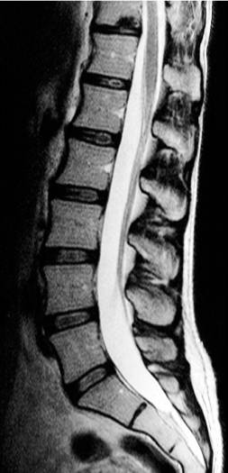
The sacrum is tilted forward so that it forms an angle with the fifth lumbar vertebra, called the lumbosacral angle.

Slide 34
Coccyx

Slide 35
The coccyx consists of four vertebrae fused together to form a small triangular bone, which articulates at its base with the lower end of the sacrum.

Slide 36
Piriformis Muscle

Slide 37
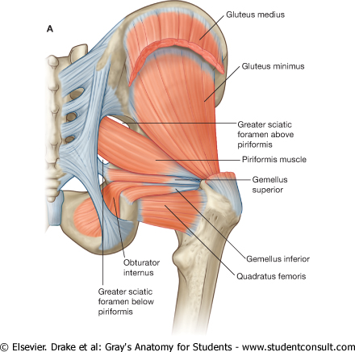
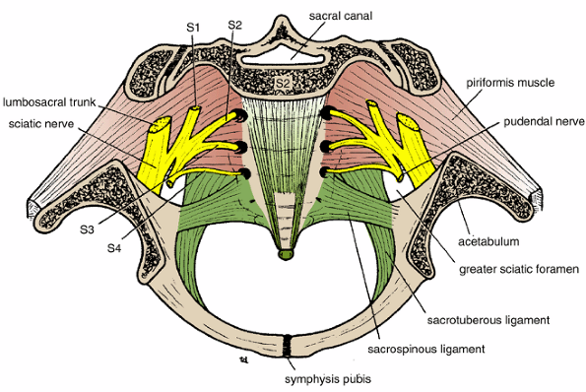
The piriformis muscle arises from the front of the lateral masses of the sacrum and leaves the pelvis to enter the gluteal region by passing laterally through the greater sciatic foramen.
It is inserted into the upper border of the greater trochanter of the femur.
Action: It is a lateral rotator of the femur at the hip joint.
Nerve supply: It receives branches from the sacral plexus.

Slide 38
LATERAL PELVIC WALL

Slide 39
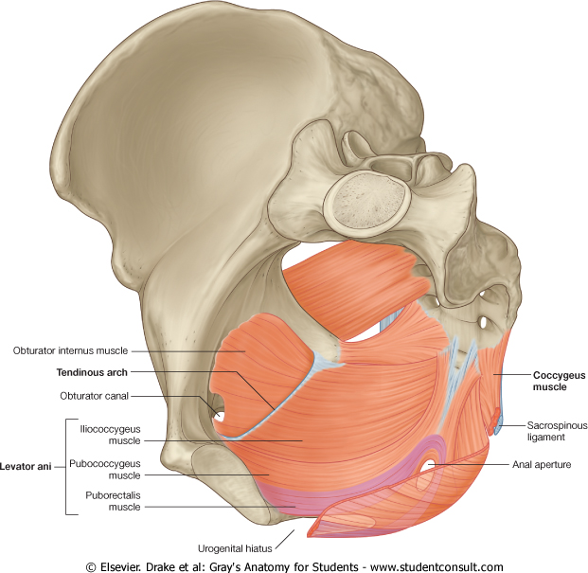
The lateral pelvic wall is formed by part of the hip bone below the pelvic inlet, the obturator membrane, the sacrotuberous and sacrospinous ligaments,
and the obturator internus muscle and its covering fascia.

Slide 40
In children each hip bone consists of ilium, ischium, & pubis.
The three bones join acetabulum.
At puberty, these three bones fuse together to form one large, irregular bone.

Slide 41
Obturator Membrane

Slide 42
The obturator membrane is a fibrous sheet that almost completely closes the obturator foramen, leaving a small gap, the obturator canal, for the passage of the obturator nerve and vessels as they leave the pelvis to enter the thigh.

Slide 43
Sacrotuberous Ligament

Slide 44
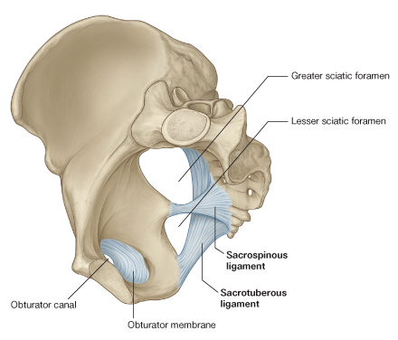
The sacrotuberous ligament is strong and extends from the lateral part of the sacrum and coccyx and the posterior inferior iliac spine to the ischial tuberosity.

Slide 45
Sacrospinous Ligament

Slide 46
The sacrospinous ligament is strong and triangle shaped.
It is attached by its base to the lateral part of the sacrum and coccyx and by its apex to the spine of the ischium.
The two ligaments also convert the greater and lesser sciatic notches into the greater and lesser sciatic foramina.

Slide 47
Obturator Internus Muscle

Slide 48
The obturator internus muscle arises from the pelvic surface of the obturator membrane and the adjoining part of the hip bone.
The muscle fibers converge to a tendon, which leaves the pelvis through the lesser sciatic foramen and is inserted into the greater trochanter of the femur.

Slide 49
Action: The obturator internus is a lateral rotator of the femur at the hip joint.
Nerve supply: The muscle is supplied by the nerve to the obturator internus, a branch from the sacral plexus.

Slide 50
INFERIOR PELVIC WALL, OR PELVIC FLOOR PELVIC DIAPHRAGM
The pelvic diaphragm is consists of levator ani & coccygeus muscles

Slide 51
Levator Ani Muscle

Slide 52
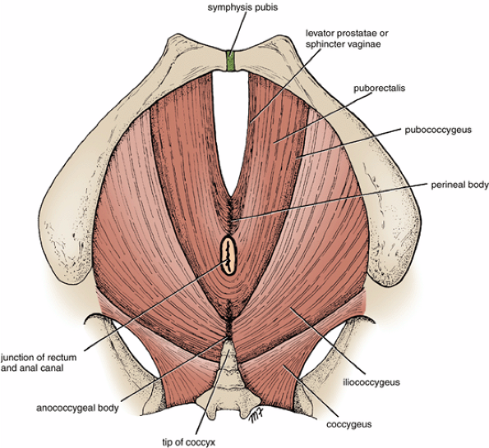
The levator ani muscle is a wide thin sheet originating from the back of the body of the pubis.
It is divided into 3 fiber types:
Anterior fibers
Intermediate fibers
Posterior fibers

Slide 53
1. Anterior fibers: The levator prostatae or sphincter vaginae form a sling around the prostate or vagina & are inserted into a mass of fibrous tissue perineal body, in front of the anal canal.

Slide 54
2. Intermediate fibers: the puborectalis forms a
sling around the junction of the rectum and anal
canal.

Slide 55
The pubococcygeus passes posteriorly to be inserted into a small fibrous mass, called the anococcygeal body, between the tip of the coccyx and the anal canal.

Slide 56
3. Posterior fibers:
The iliococcygeus is inserted into the anococcygeal body and the coccyx.

Slide 57
Action:
The levatores ani muscles of the two sides form an efficient muscular sling that supports and maintains the pelvic viscera in position.
They also have an important sphincter action on the anorectal junction, and in the female they serve also as a sphincter of the vagina.
Nerve supply: This is from the perineal branch of the fourth sacral nerve and from the perineal branch of the pudendal nerve.

Slide 58
Coccygeus Muscle

Slide 59
This small triangular muscle arises from the spine of the ischium and is inserted into the lower end of the sacrum and into the coccyx.
Action: The two muscles assist the levatores ani in supporting the pelvic viscera.
Nerve supply: From a branch of the fourth and fifth sacral nerves.

Slide 60
Pelvic Joints

Slide 61
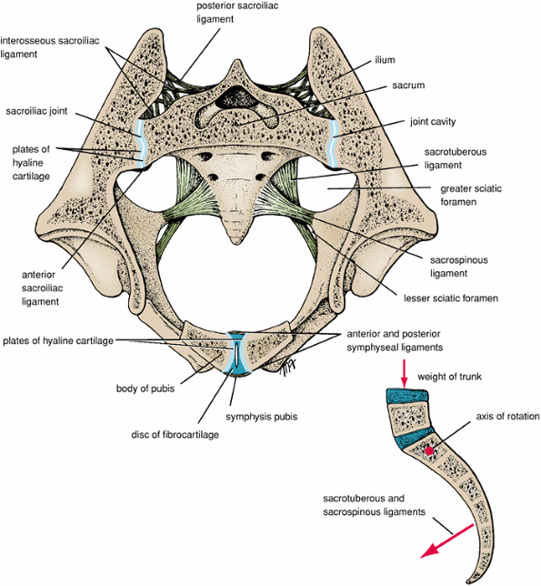
Sacroiliac Joints
Synovial joints formed between the sacrum and the iliac bones. The strong posterior and interosseous sacroiliac ligaments suspend the sacrum between the two iliac bones.
Movements
A small but limited amount of movement is possible at these joints.
Nerve Supply
The nerve supply is from branches of the sacral spinal nerves.

Slide 62
Symphysis Pubis
The symphysis pubis is a cartilaginous joint between the two pubic bones. The joint is surrounded by ligaments that extend from one pubic bone to the other.
Movements
Almost no movement is possible at this joint.
Sacrococcygeal Joint
The sacrococcygeal joint is a cartilaginous joint between the bodies of the last sacral vertebra and the first coccygeal vertebra. The sacrum and coccyx are joined by ligaments.
Movements
Extensive flexion and extension are possible at this joint.

Slide 63
The Female Pelvis
Deformities of the pelvis may be responsible for dystocia (difficult labor).
The gynecoid type, present in about 41% of women, the android type, present in about 33% of white females and 16% of black females, is the male or funnel-shaped pelvis with a contracted outlet.
The anthropoid type, present in about 24% of white females and 41% of black females, is long, narrow, and oval shaped.
The platypelloid type, present in only about 2% of women, is a wide pelvis flattened at the brim, with the promontory of the sacrum pushed forward.

Slide 64
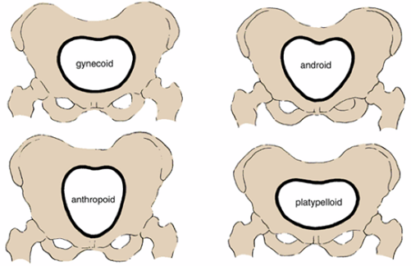

Slide 65
Thank you

