Slide 1
PELVIC VESSELS AND NERVES

Slide 2
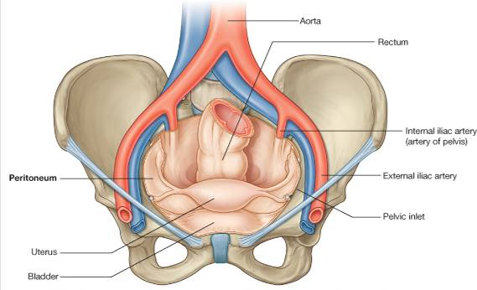
COMMON ILIAC ARTERY
CIA ends at the pelvic inlet in front of the sacroiliac joint
divides into external and internal iliac artery

Slide 3
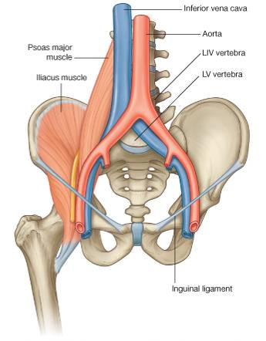
EXTERNAL ILIAC ARTERY
Follows the pelvic brim and runs along the medial border of the iliopsoas muscle

Slide 4
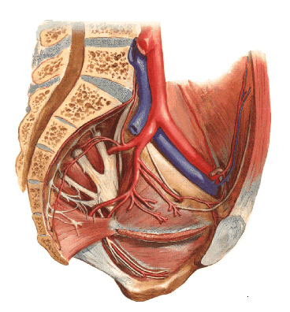
The external iliac artery gives off the inferior epigastric artery

Slide 5
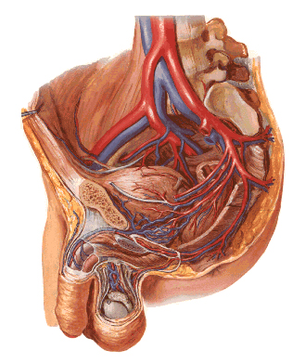
The external iliac artery also gives off the deep circumflex iliac artery

Slide 6
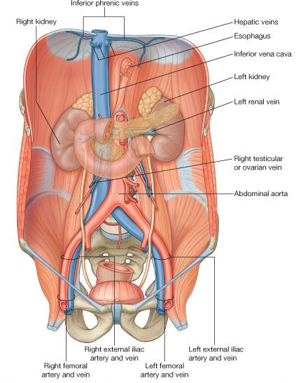
Below the inguinal ligament, the external iliac artery becomes the femoral artery

Slide 7
Arteries of the True Pelvis
Internal iliac artery
Superior rectal artery
Ovarian/Testicular artery
Median sacral artery

Slide 8
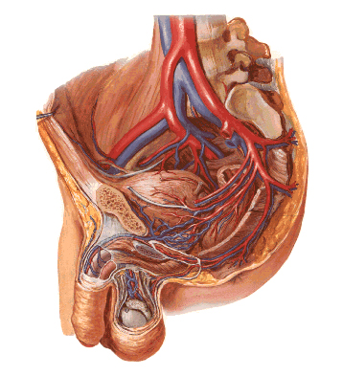
The internal iliac artery passes down into the pelvis
At the upper margin of the greater sciatic foramen it divides into:
anterior division
posterior division
It's branches supply the:
pelvic viscera
perineum
pelvic walls
buttocks

Slide 9
Branches of the Internal Iliac Artery

Slide 10
BRANCHES OF THE ANTERIOR DIVISION
UMBILICAL ARTERY
The distal portion of this artery is obliterated and has become the …
medial umbilical ligament

Slide 11
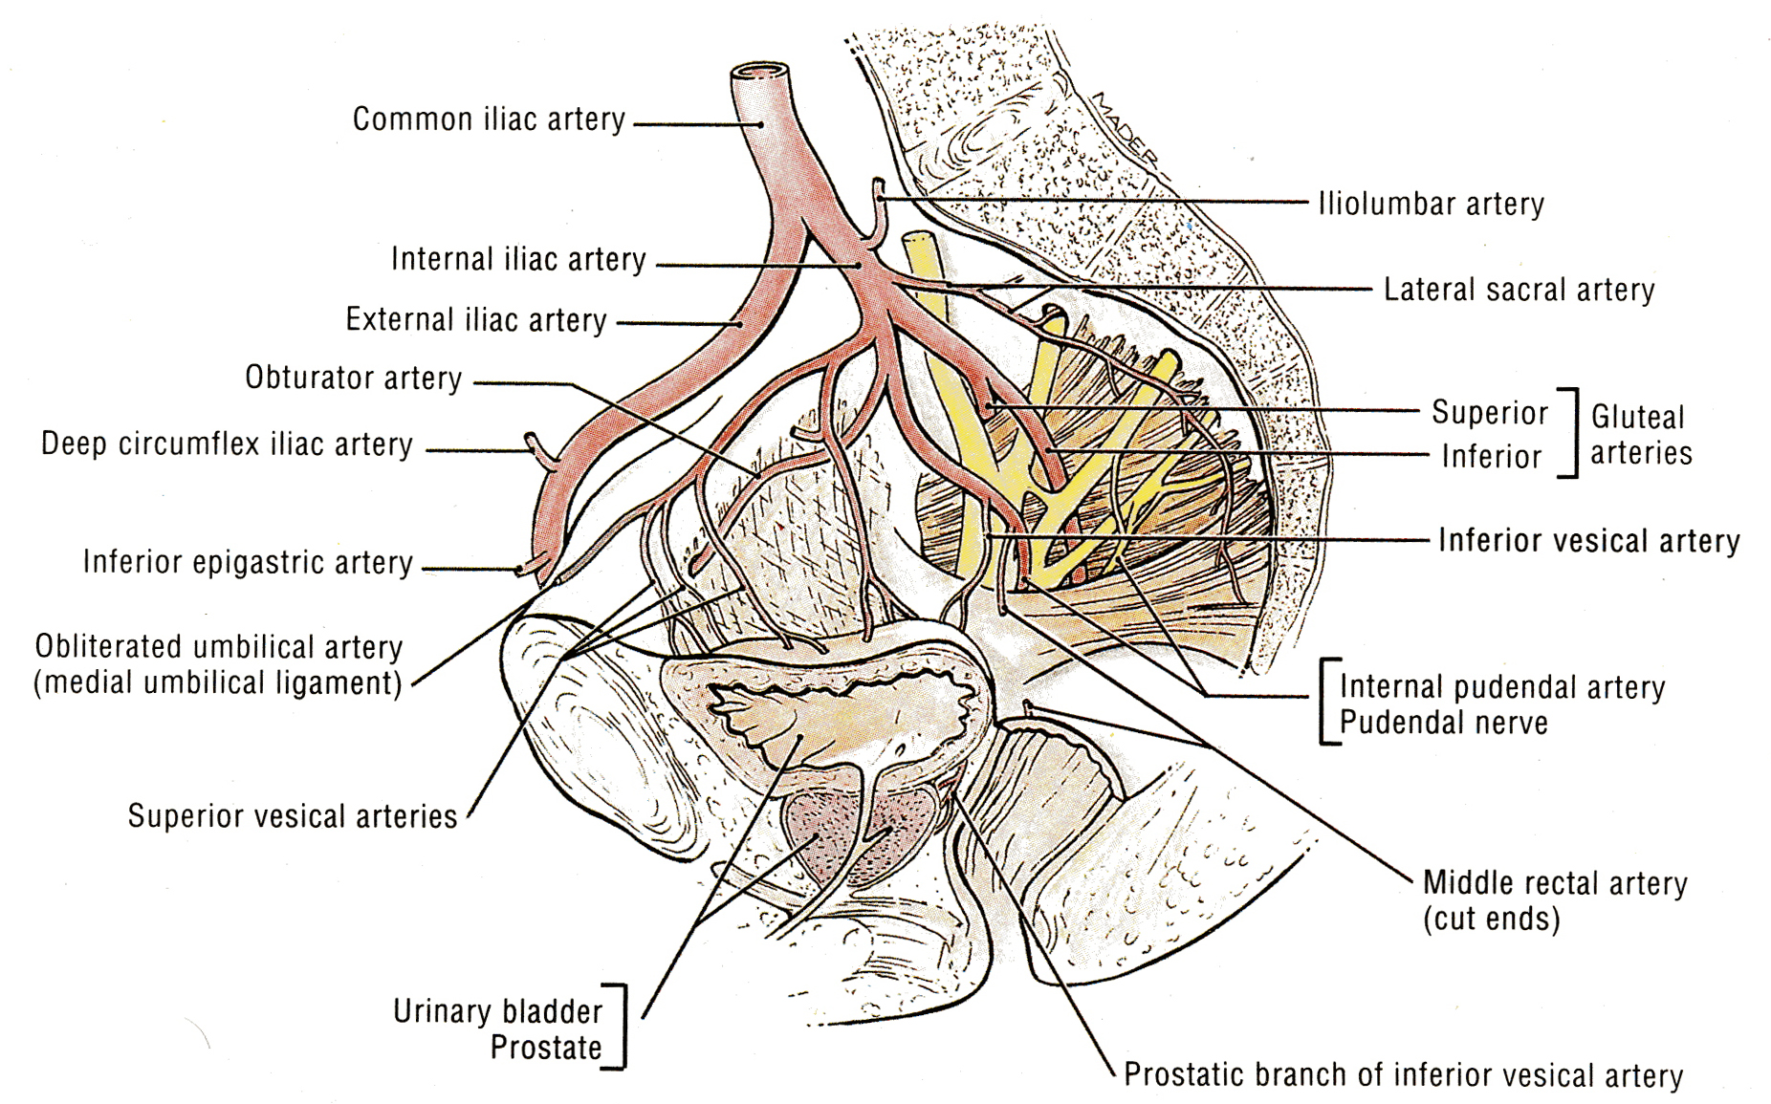
From it's proximal part, the umbilical artery gives off the superior vesical arteries
They supply the upper portion of the bladder

Slide 12
OBTURATOR ARTERY
It runs forward along the lateral wall of the pelvis
It leaves the pelvis through the obturator canal

Slide 13
INFERIOR VESICAL ARTERY
It supplies the lower portion of the bladder

Slide 14
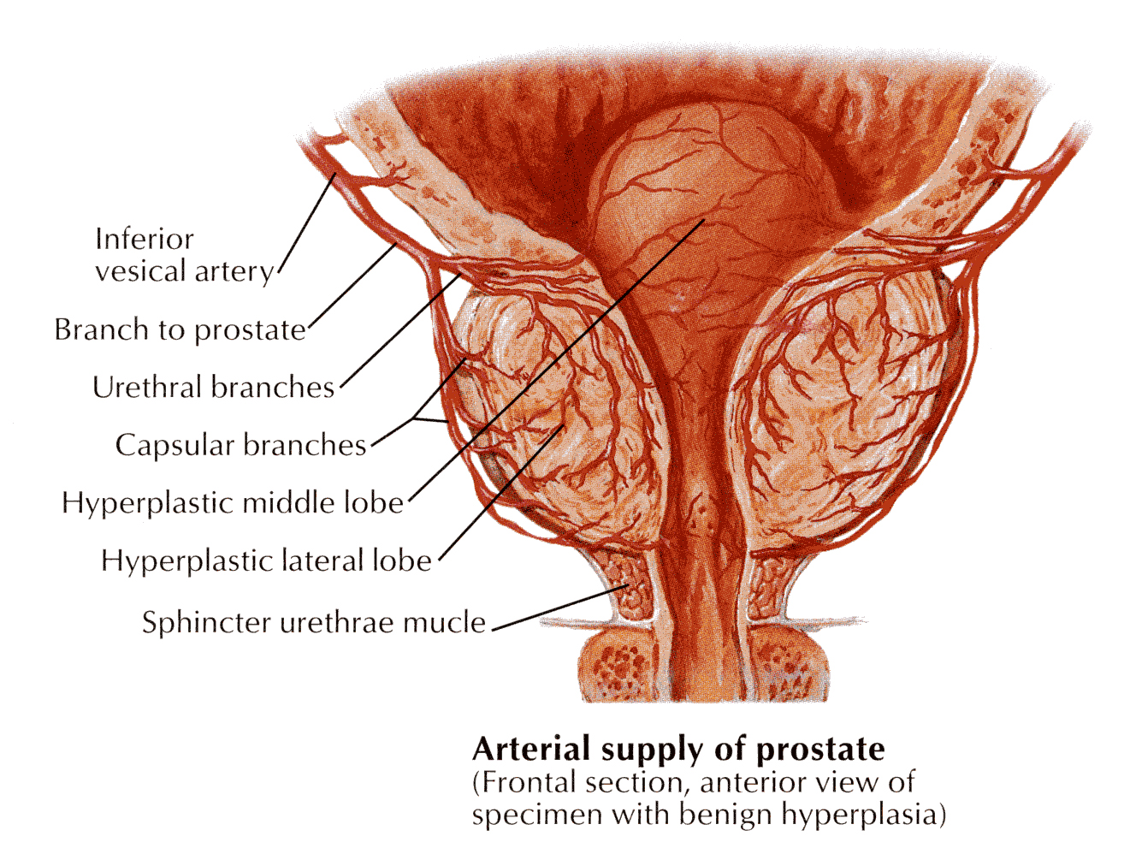
In the male, the inferior vesical artery also supplies the prostate and the seminal vesicles

Slide 15
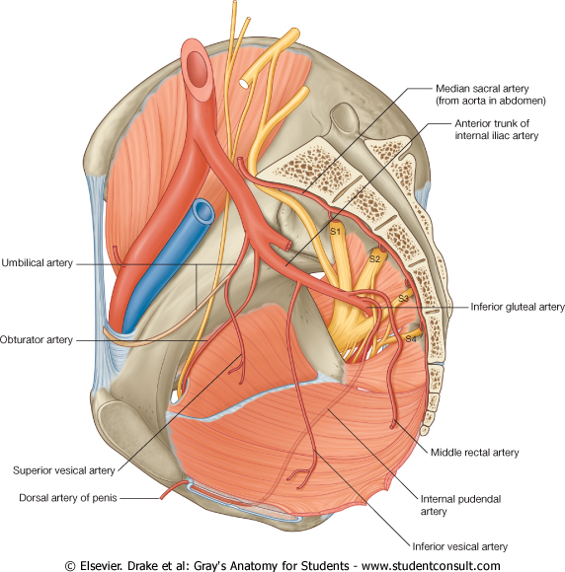
MIDDLE RECTAL ARTERY
usually arises with the inferior vesical artery
supplies the muscles of the lower rectum

Slide 16
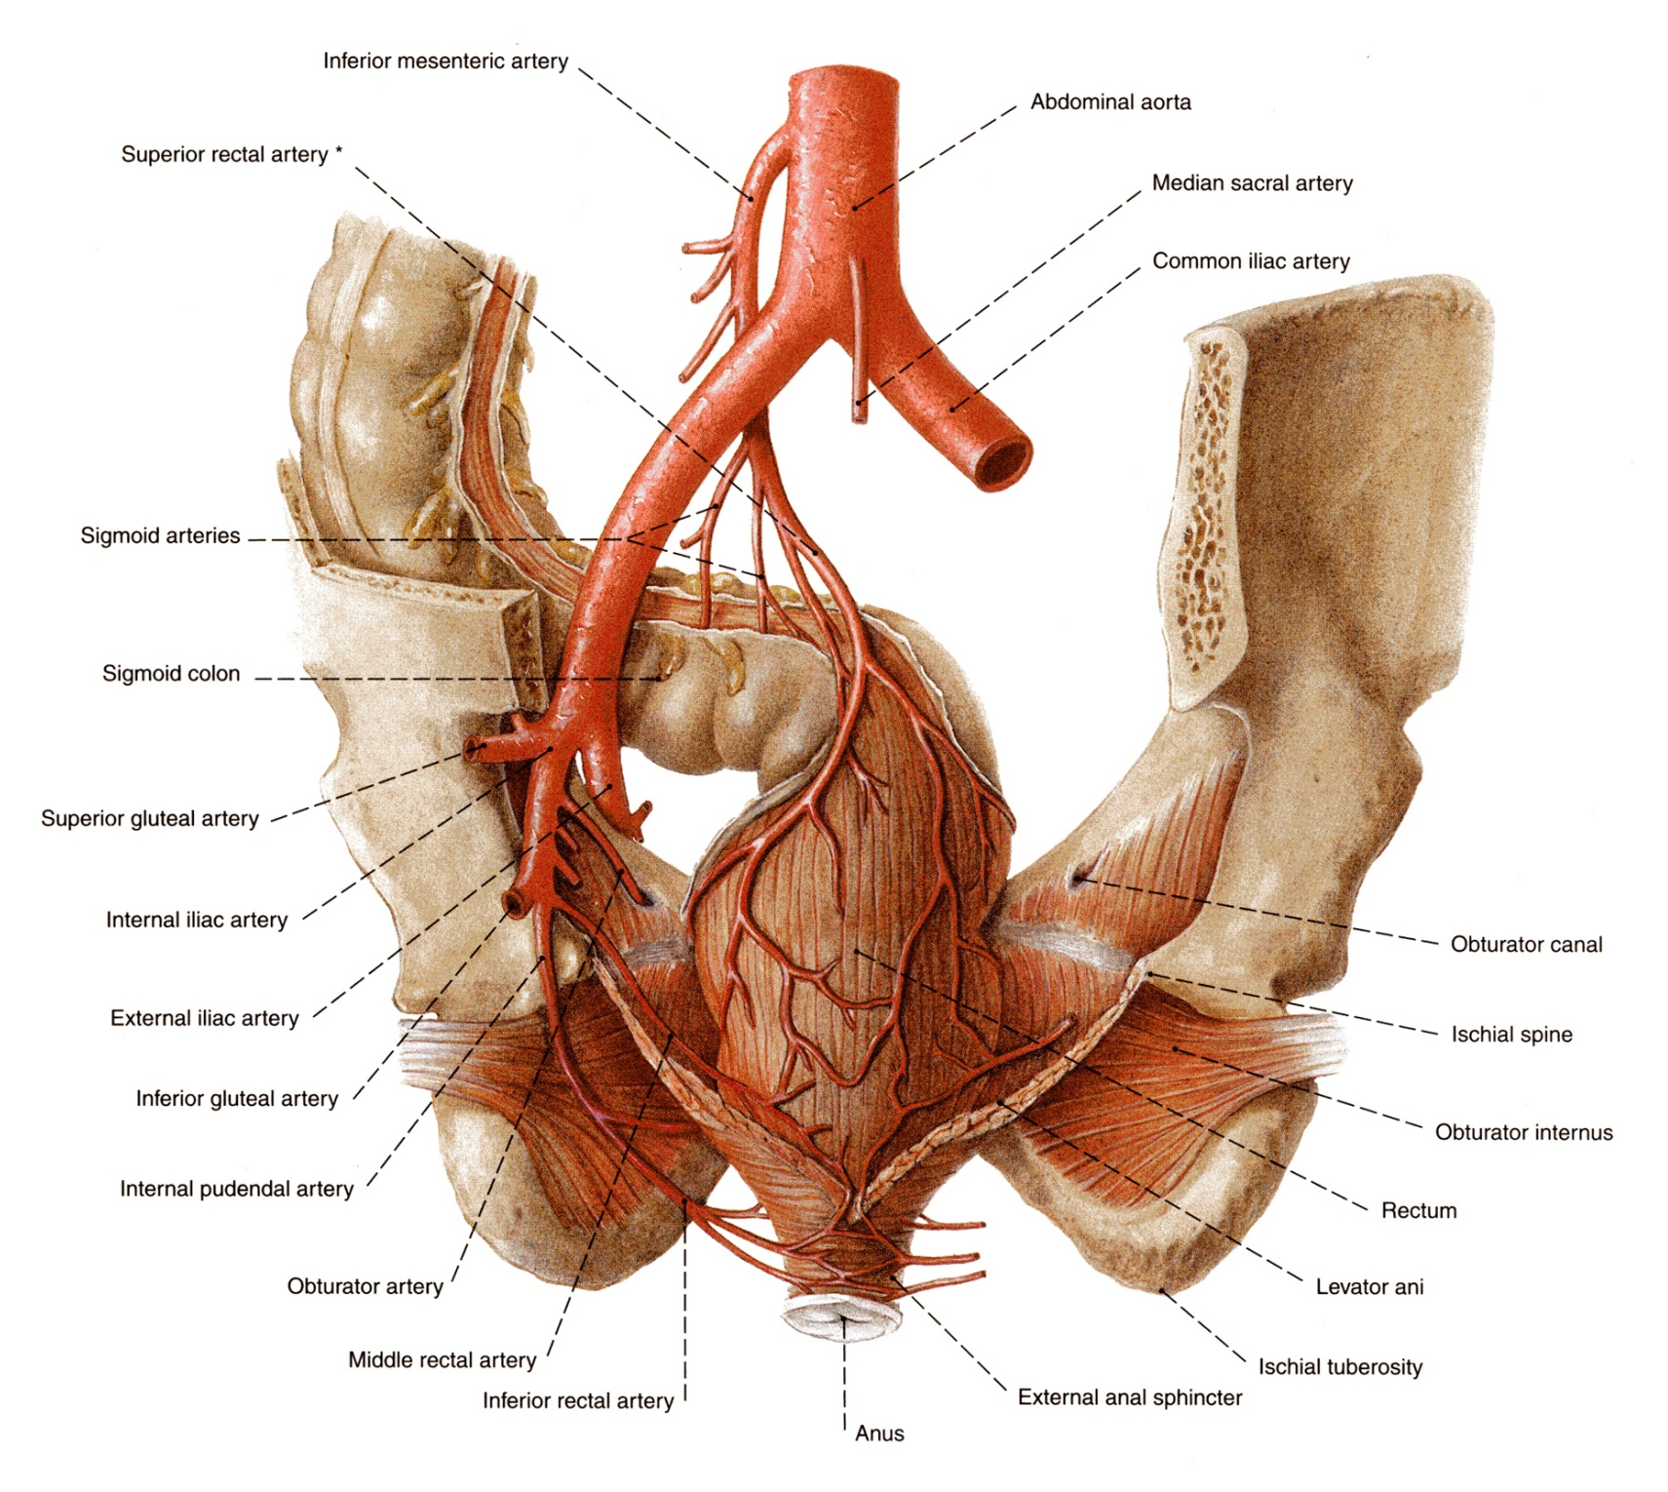
The middle rectal artery anastomoses with the superior and inferior rectal arteries

Slide 17
INTERNAL PUDENDAL ARTERY
leaves the pelvis through the greater sciatic foramen

Slide 18
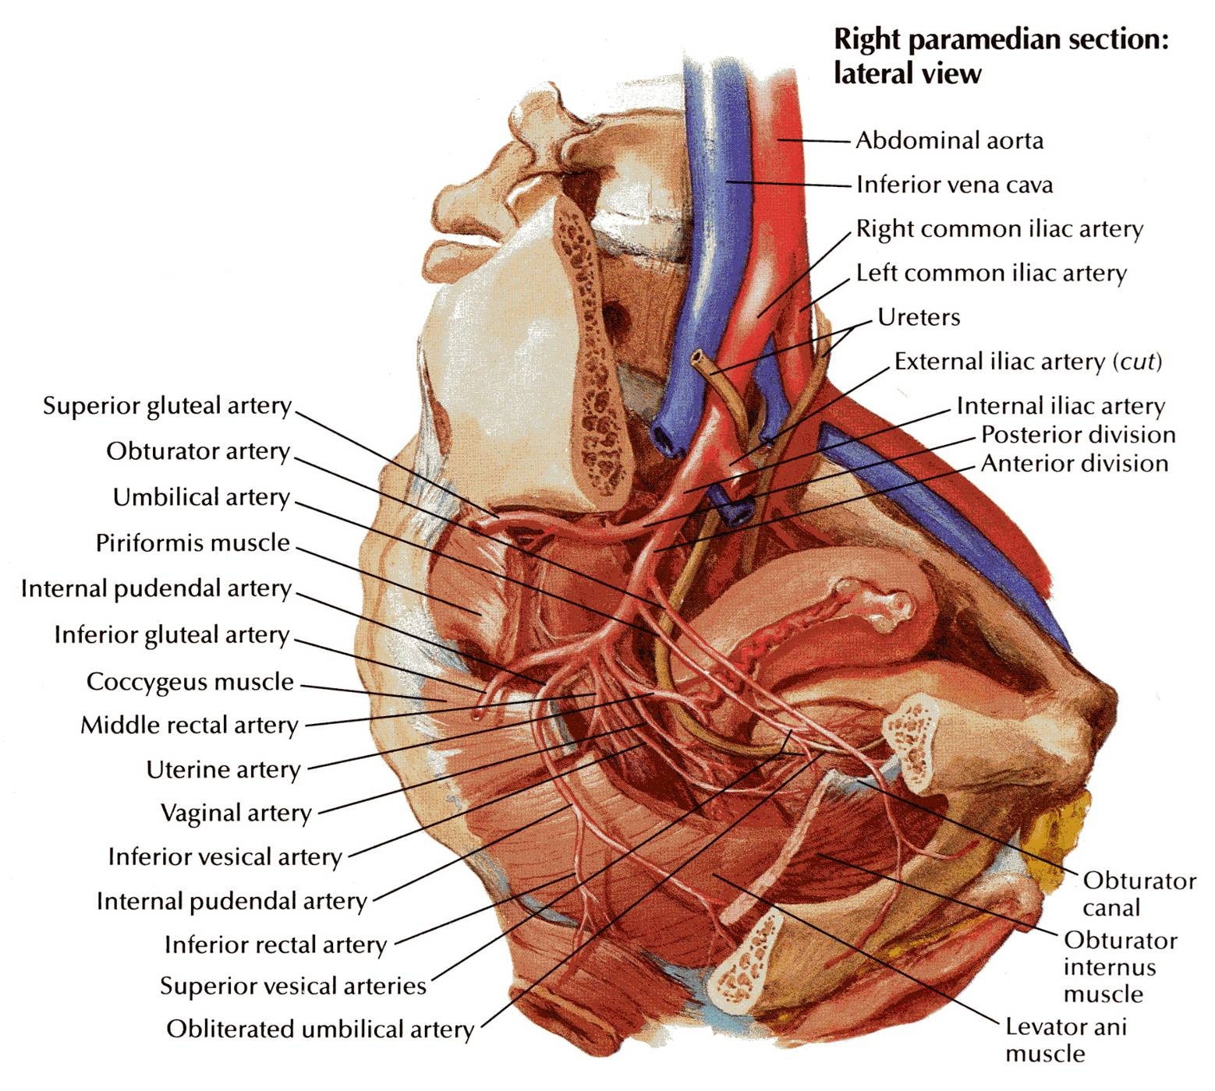
The internal pudendal artery enters the gluteal region below the piriformis muscle
It then enters the perineum through the lesser sciatic foramen and passes forward in the pudendal canal
It supplies the musculature of the anal canal
It also supplies the skin and muscles of the perineum

Slide 19
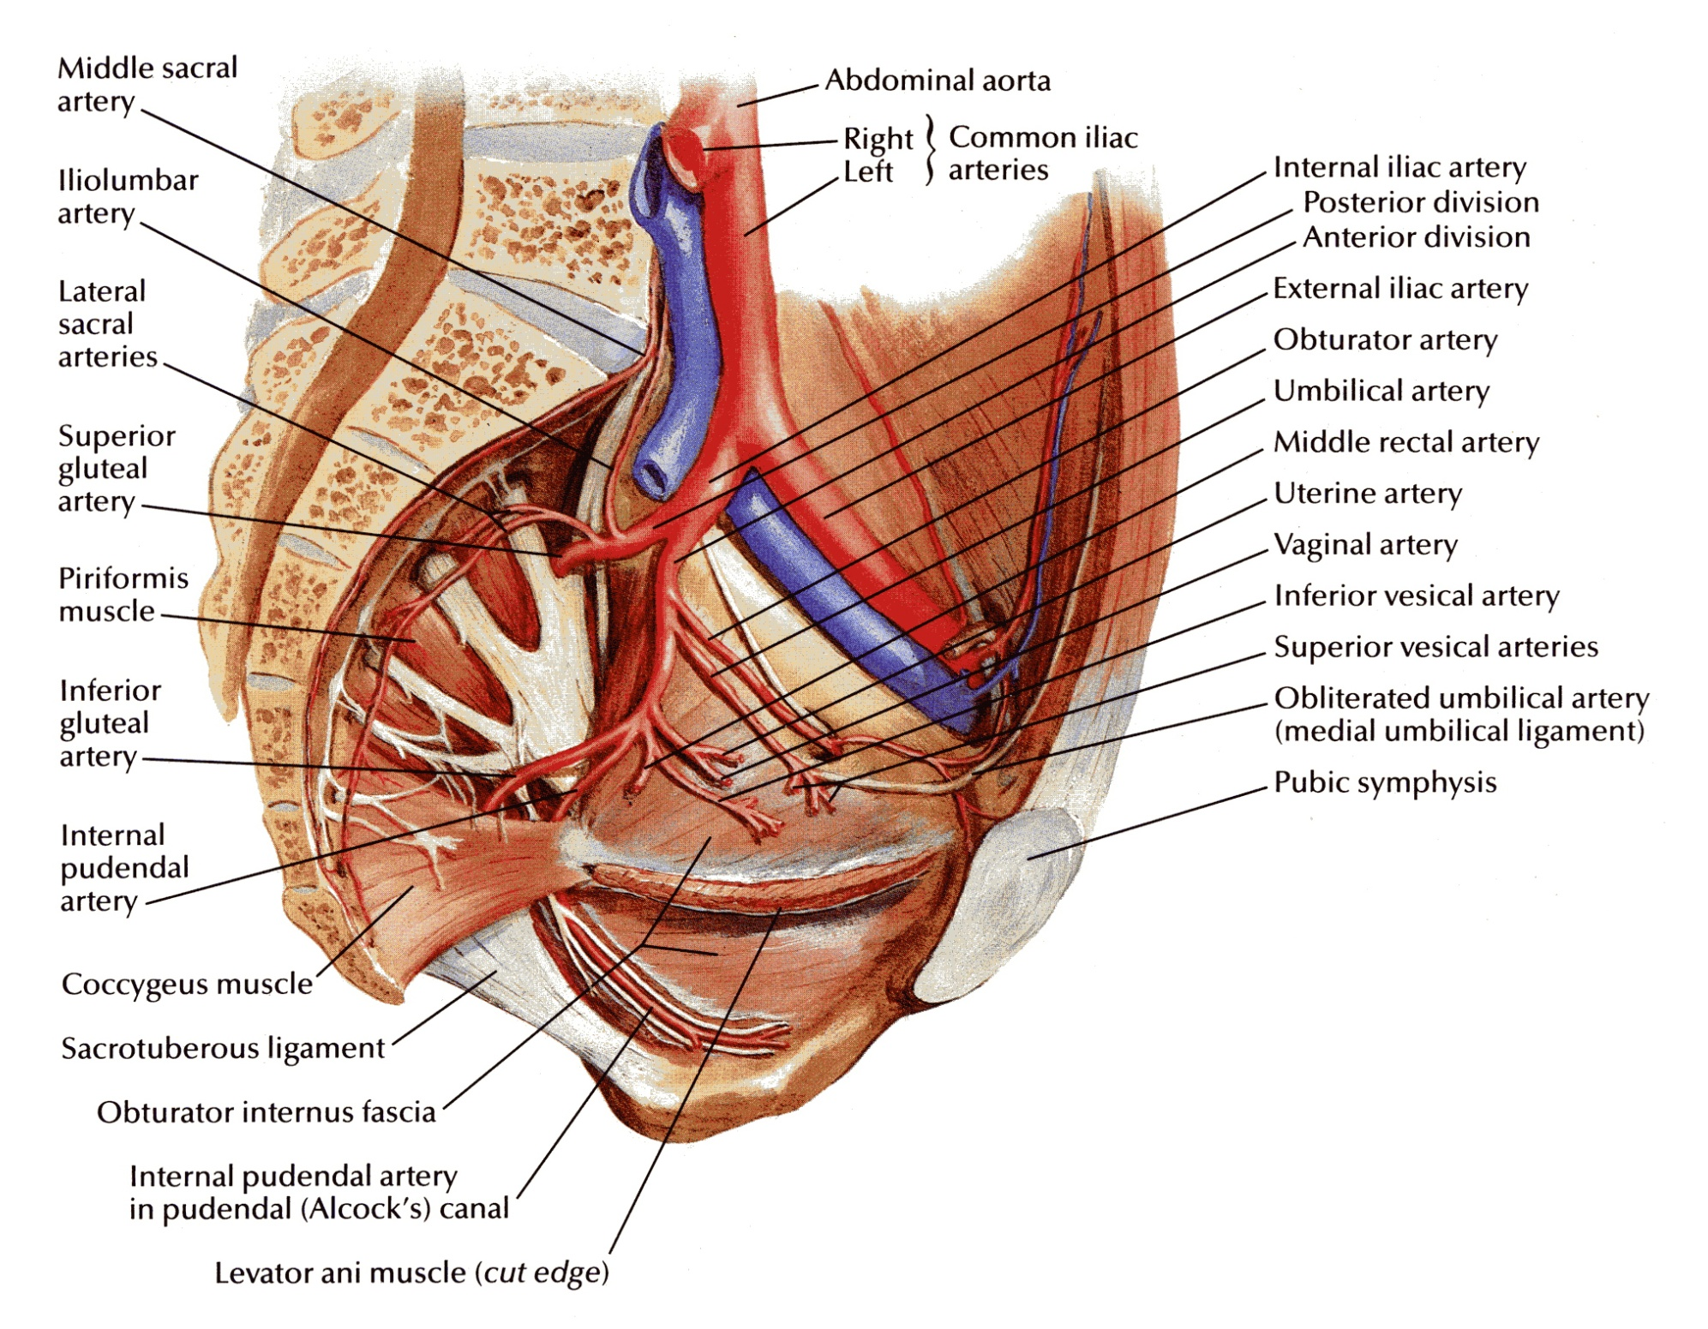
INFERIOR GLUTEAL ARTERY
leaves the pelvis through the greater sciatic foramen below the piriformis muscle
passes between the 1st and 2nd or the 2nd and 3rd sacral nerves

Slide 20
UTERINE ARTERY
runs medially on the floor of the pelvis
crosses the ureter superiorly
passes above the lateral fornix of the vagina to reach the uterus
ascends between the layers of the broad ligament along the lateral margin of the uterus

Slide 21
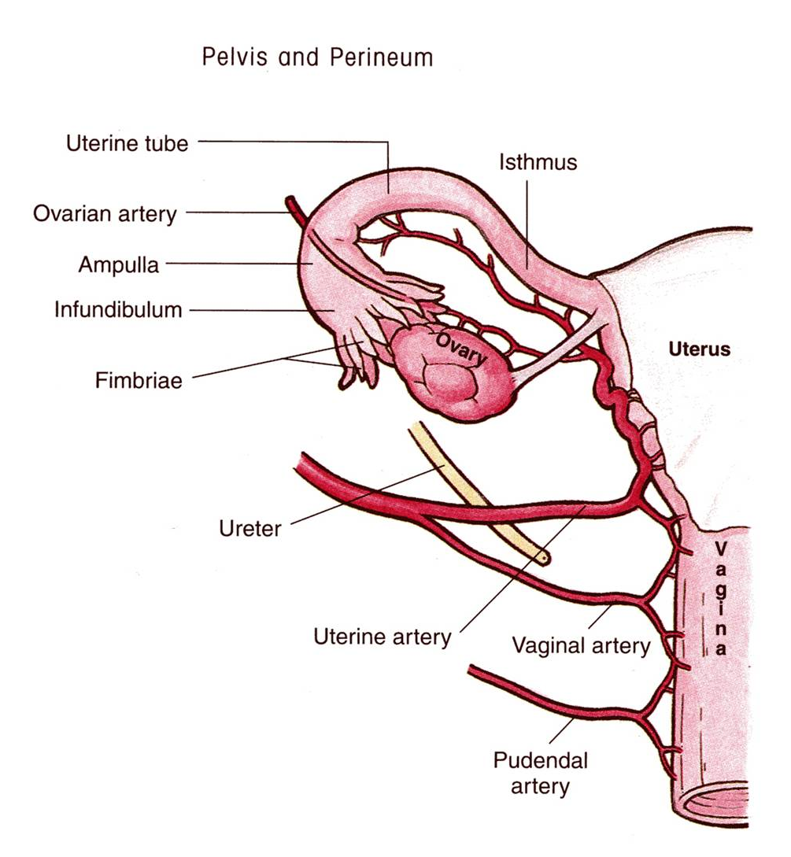
The uterine artery ends by following the uterine tube laterally
It anastomoses there with the ovarian artery
It gives off a vaginal branch

Slide 22
VAGINAL ARTERY
It supplies the base of the urinary bladder and the vagina
(In the male, the base of the urinary bladder would be supplied by the inferior vesical artery)

Slide 23
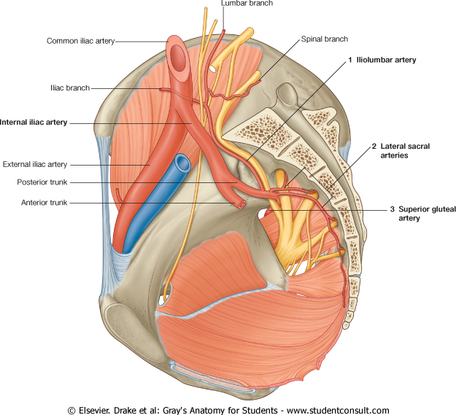
BRANCHES OF THE POSTERIOR DIVISION
ILIOLUMBAR ARTERY
ascends across the pelvic inlet
runs posterior to the external iliac vessels, psoas and iliacus muscles
LATERAL SACRAL ARTERIES
descends in front of the sacral plexus
gives off branches to neighboring structures

Slide 24
SUPERIOR GLUTEAL ARTERY
leaves the pelvis through the greater sciatic foramen above the piriformis muscle

Slide 25
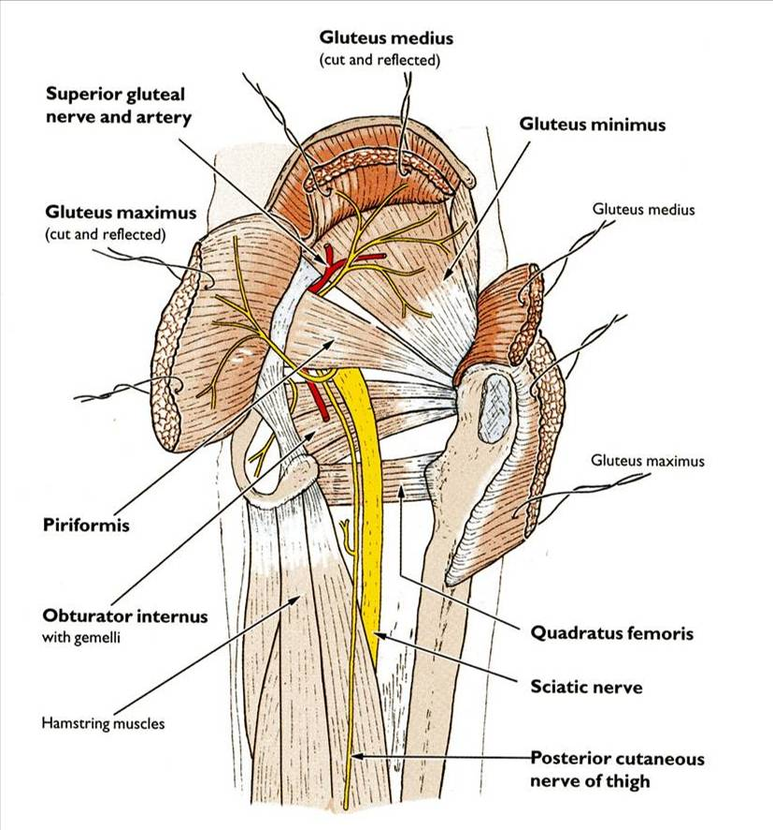
The superior gluteal artery supplies the gluteal region

Slide 26
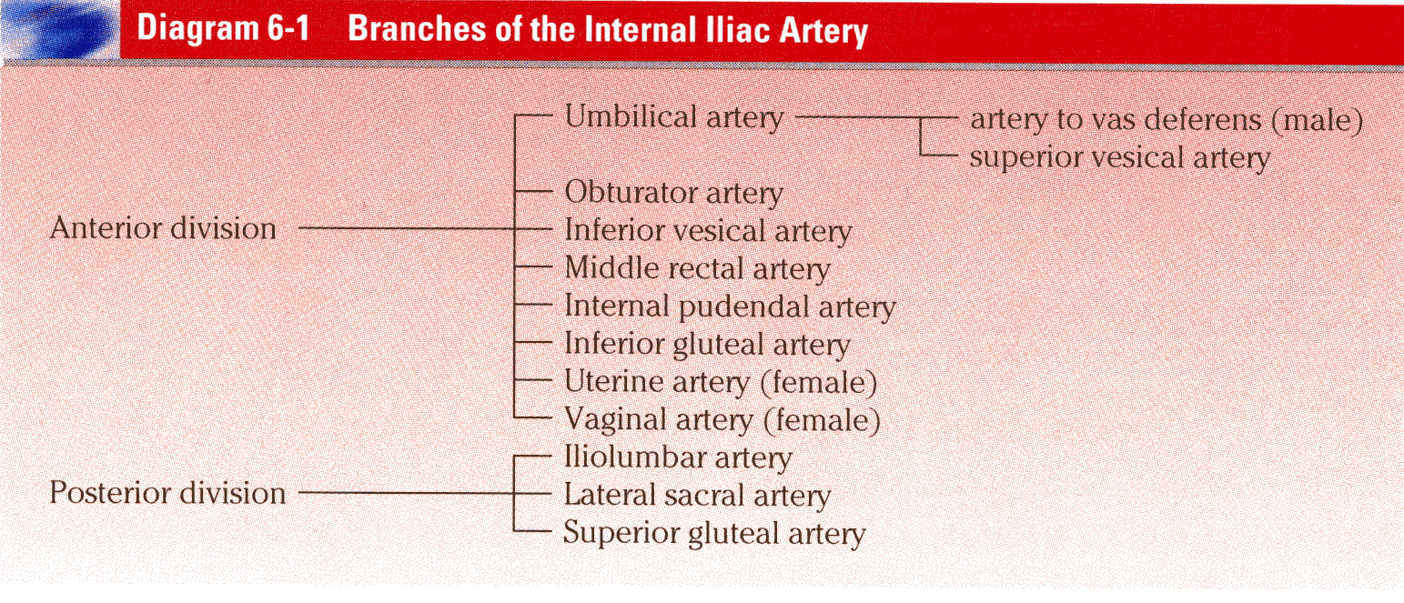
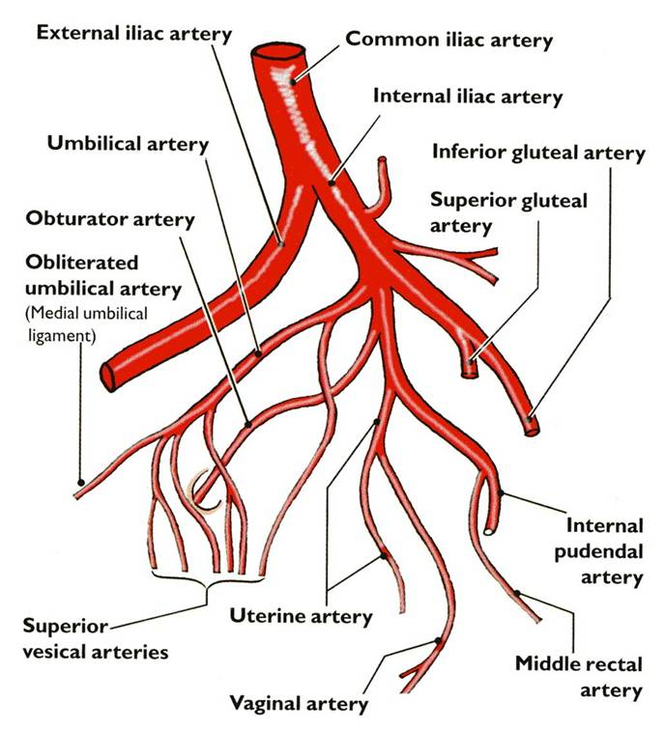
IN BRIEF…

Slide 27
OTHER PELVIC ARTERIES

Slide 28
SUPERIOR RECTAL ARTERY
a direct continuation of the inferior mesenteric artery

Slide 29
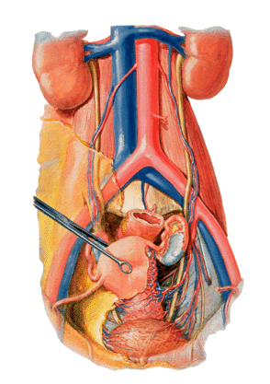
OVARIAN ARTERY
arises from the abdominal aorta
at the pelvic inlet, it crosses the external iliac artery

Slide 30
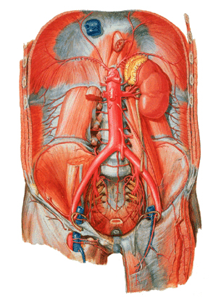
MEDIAN SACRAL ARTERY
It arises at the bifurcation of the aorta
It descends over the anterior surface of the sacrum and the coccyx

Slide 31
PELVIC VEINS

Slide 32
EXTERNAL ILIAC VEIN
a direct continuation of the femoral vein
begins at the inguinal ligament
runs on the medial side of the artery
joins the internal iliac vein to form the common iliac vein
The external iliac vein receives the inferior epigastric and the deep circumflex iliac vein

Slide 33
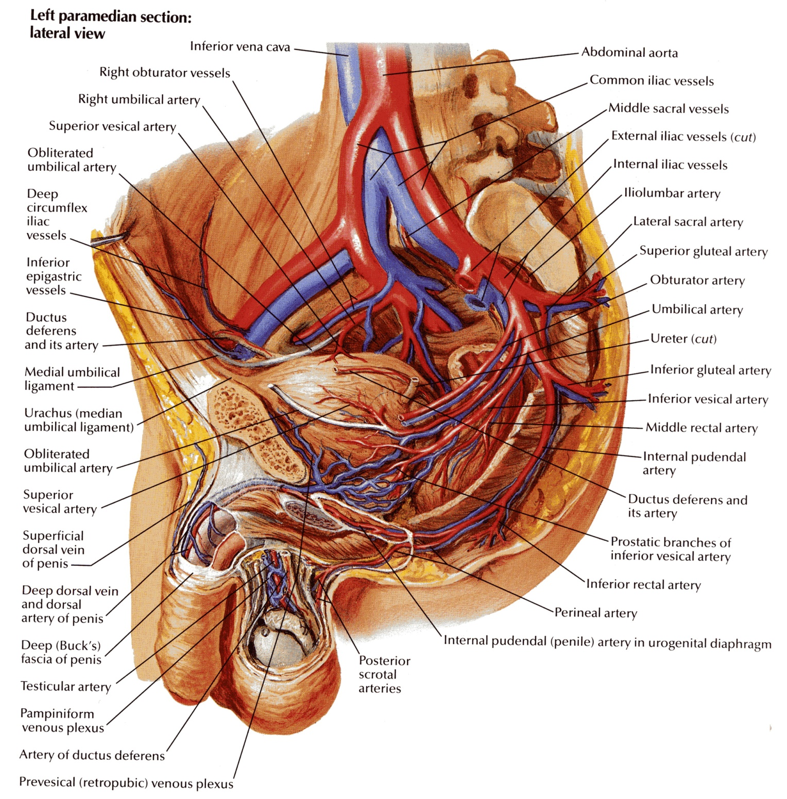
INTERNAL ILIAC VEINS
collect tributaries corresponding to the branches of the internal iliac artery
joins the external iliac vein in front of the sacroiliac joint to form the common iliac vein

Slide 34
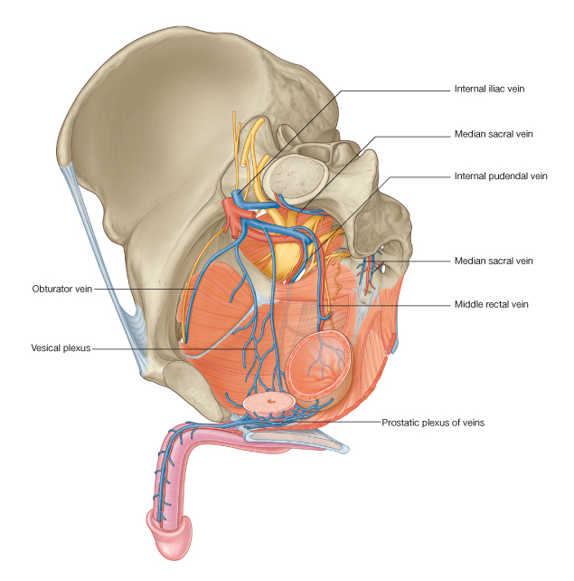
MEDIAN SACRAL VEINS
accompany the corresponding artery
join the left common iliac vein

Slide 35
LYMPHATICS OF THE PELVIS
The lymph nodes and vessels are arranged in a chain along the main blood vessels.
The nodes are named after the blood vessels with which they are associated.
Thus, there are external iliac nodes, internal iliac nodes, and common iliac nodes.

Slide 36
NERVES OF THE PELVIS

Slide 37
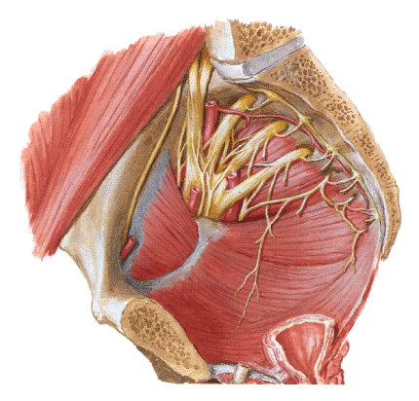
SACRAL PLEXUS
The sacral plexus lies on the posterior pelvic wall in front of the piriformis muscle.

Slide 38
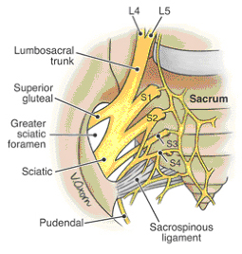
The sacral plexus is formed from the anterior rami of the fourth and fifth lumbar nerves and the anterior rami of the first, second, third, and fourth sacral nerves.
The fourth lumbar nerve joins the fifth lumbar nerve to form the lumbosacral trunk.
The lumbosacral trunk passes down into the pelvis and joins the sacral nerves as they emerge from the anterior sacral foramina.

Slide 39
RELATIONS OF THE SACRAL PLEXUS
Anteriorly
The internal iliac vessels and their branches, and the rectum

Slide 40
RELATIONS OF THE SACRAL PLEXUS
Posteriorly
The piriformis muscle

Slide 41
Branches to the lower limb that leave the pelvis through the greater sciatic foramen
The sciatic nerve (L4 and 5; S1, 2, and 3), the largest branch of the plexus and the largest nerve in the body
The superior gluteal nerve
The inferior gluteal nerve
The nerve to the quadratus femoris muscle
The nerve to the obturator internus muscle
The posterior cutaneous nerve of the thigH

Slide 42
BRANCHES OF THE SACRAL PLEXUS TO THE PELVIC MUSCLES, PELVIC VISCERA AND THE PERINEUM

Slide 43
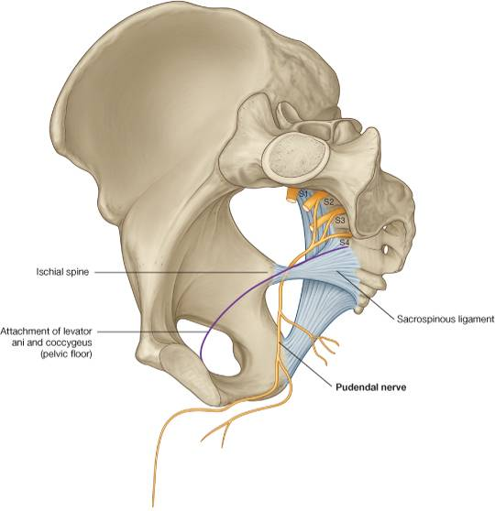
PUDENDAL NERVE
The pudendal nerve (S2, 3, and 4) leaves the pelvis through the greater sciatic foramen and enters the perineum through the lesser sciatic foramen

Slide 44
NERVE TO THE PIRIFORMIS

Slide 45
PELVIC SPLANCHNIC NERVES
The pelvic splanchnic nerves are the sacral part of the parasympathetic system and arise from the second, third, and fourth sacral nerves.
They are distributed to the pelvic viscera.

Slide 46
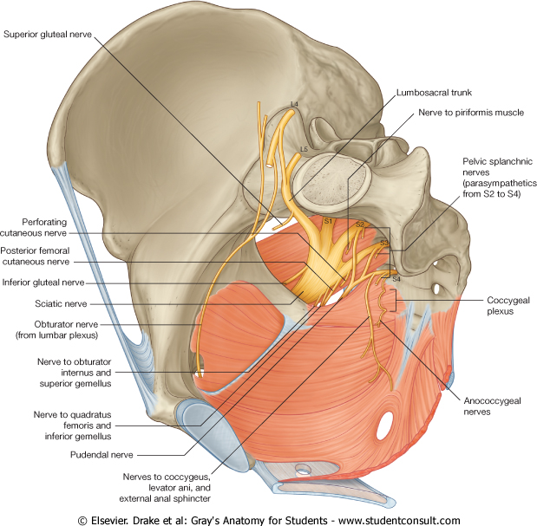
PERFORATING CUTANEOUS NERVE
The perforating cutaneous nerve supplies the skin of the lower medial part of the buttock

Slide 47
IN BRIEF

Slide 48
Branches of the Sacral Plexus and Their Distribution
Branches | Distribution
Superior gluteal nerve | Gluteus medius, gluteus minimus, and tensor fasciae latae muscles
Inferior gluteal nerve | Gluteus maximus muscle
Nerve to piriformis | Piriformis muscle
Nerve to obturator internus | Obturator internus and superior gemellus muscles
Nerve to quadratus femoris | Quadratus femoris and inferior gemellus muscles
Perforating cutaneous nerve | Skin over medial aspect of buttock
Posterior cutaneous nerve of thigh | Skin over posterior surface of thigh and popliteal fossa, also over lower part of buttock, scrotum, or labium majus
Sciatic nerve (L4, 5; S1, 2, 3) Tibial portion | Hamstring muscles (semitendinosus, biceps femoris [long head], adductor magnus [hamstring part]), gastrocnemius, soleus, plantaris, popliteus, tibialis posterior, flexor digitorum longus, flexor hallucis longus, and via medial and lateral plantar branches to muscles of sole of foot; sural branch supplies skin on lateral side of leg and foot
Common peroneal portion | Biceps femoris muscle (short head) and via deep peroneal branch: tibialis anterior, extensor hallucis longus, extensor digitorum longus, peroneus tertius, and extensor digitorum brevis muscles; skin over cleft between first and second toes. The superficial peroneal branch supplies the peroneus longus and brevis muscles and skin over lower third of anterior surface of leg and dorsum of foot
Pudendal nerve | Muscles of perineum including the external anal sphincter, mucous membrane of lower half of anal canal, perianal skin, skin of penis, scrotum, clitoris, and labia majora and minora

Slide 49
BRANCHES OF THE LUMBAR PLEXUS

Slide 50
LUMBOSACRAL TRUNK
Part of the anterior ramus of the fourth lumbar nerve emerges from the medial border of the psoas muscle and joins the anterior ramus of the fifth lumbar nerve to form the lumbosacral trunk.
This trunk now enters the pelvis by passing down in front of the sacroiliac joint and joins the sacral plexus.

Slide 52
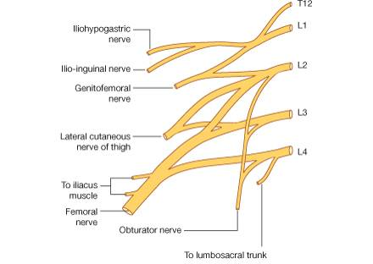
OBTURATOR NERVE
The obturator nerve is a branch of the lumbar plexus (L2, 3, and 4).

Slide 53
The obturator nerve emerges from the medial border of the psoas muscle in the abdomen, and accompanies the lumbosacral trunk down into the pelvis.

Slide 54
The obturator nerve crosses the front of the sacroiliac joint and runs forward on the lateral pelvic wall in the angle between the internal and external iliac vessels.

Slide 55
On reaching the obturator canal (that is, the upper part of the obturator foramen, which is devoid of the obturator membrane), the obturator nerve splits into anterior and posterior divisions that pass through the canal to enter the adductor region of the thigh.

Slide 56
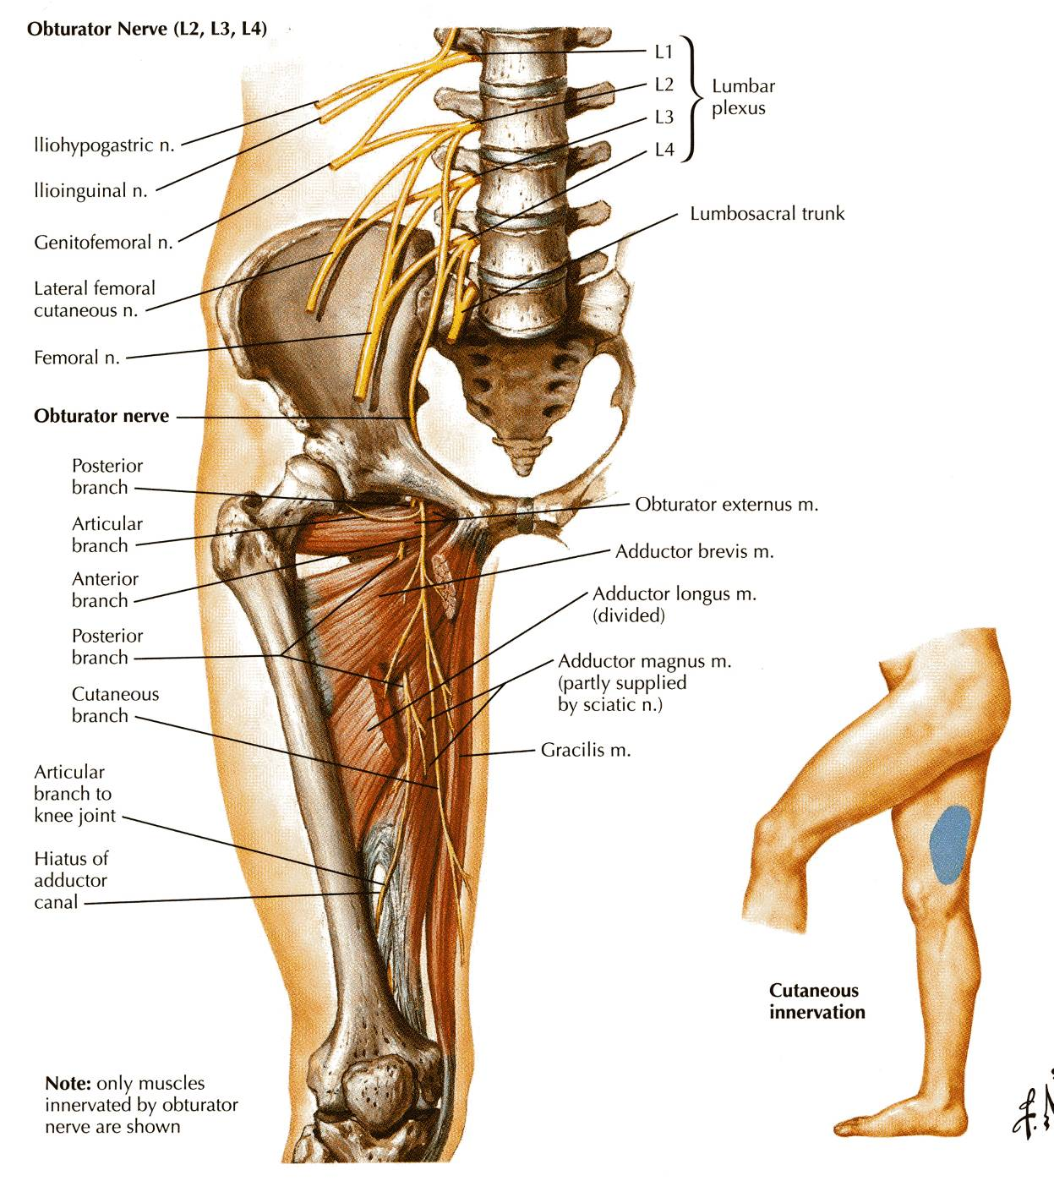

Slide 57
PELVIC BRANCHES OF THE OBTURATOR NERVE
The obturator nerve gives off sensory branches to supply the parietal peritoneum on the lateral wall of the pelvis.

Slide 58
AUTONOMIC NERVES

Slide 59
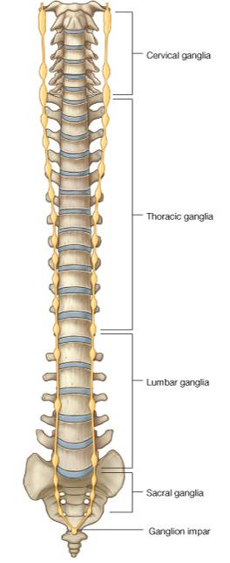
PELVIC PART OF THE SYMPATHETIC TRUNK
The pelvic part of the sympathetic trunk is continuous above, behind the common iliac vessels, with the abdominal part.
It runs down behind the rectum on the front of the sacrum, medial to the anterior sacral foramina.
The sympathetic trunk has four or five segmentally arranged ganglia.
Below, the two trunks converge and finally unite in front of the coccyx.

Slide 60
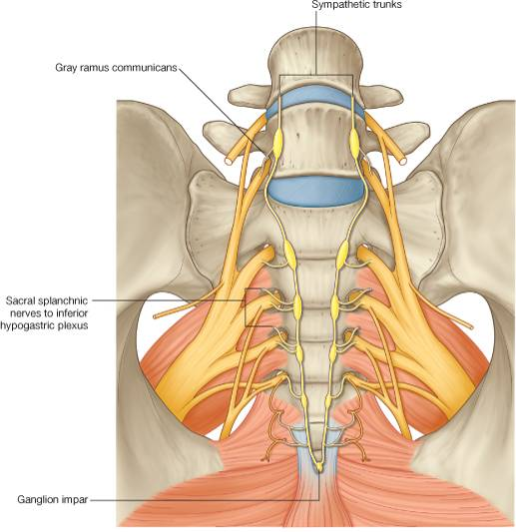
BRANCHES
Gray rami communicantes to the sacral and coccygeal nerves
Fibers that join the hypogastric plexuses

Slide 61
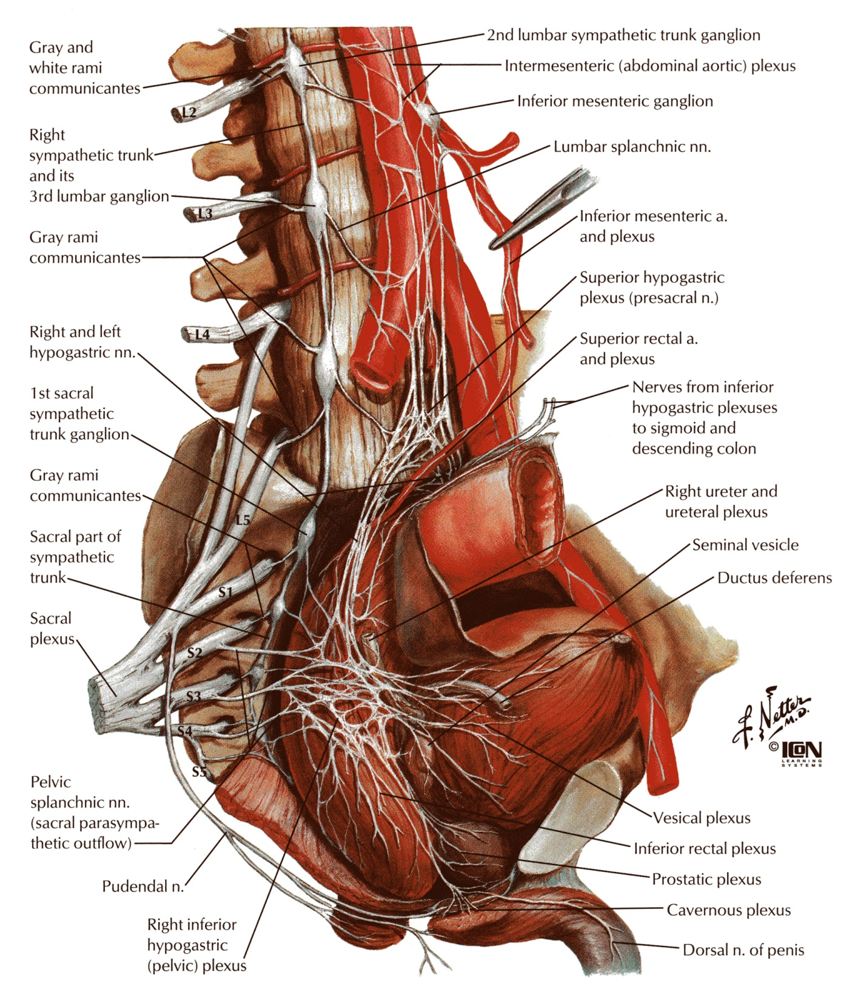
PELVIC SPLANCHNIC NERVES
The pelvic splanchnic nerves form the parasympathetic part of the autonomic nervous system in the pelvis.
The preganglionic fibers arise from the second, third, and fourth sacral nerves and synapse in ganglia in the inferior hypogastric plexus or in the walls of the viscera.

Slide 62
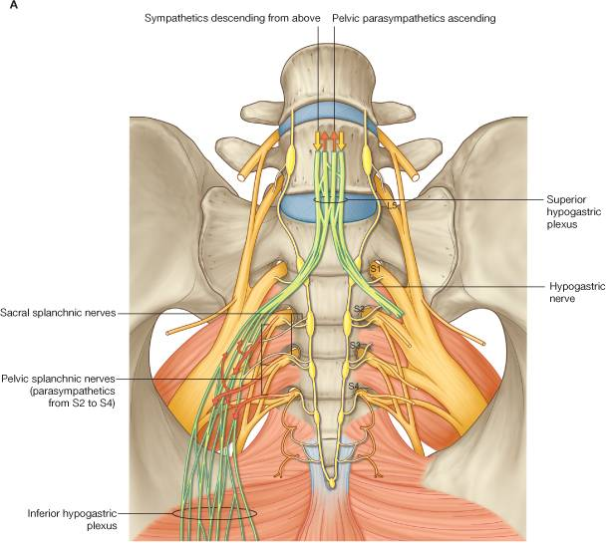
Some of the parasympathetic fibers that begin in the pelvis ascend through the hypogastric plexuses and thence via the aortic plexus to the inferior mesenteric plexus.

Slide 63
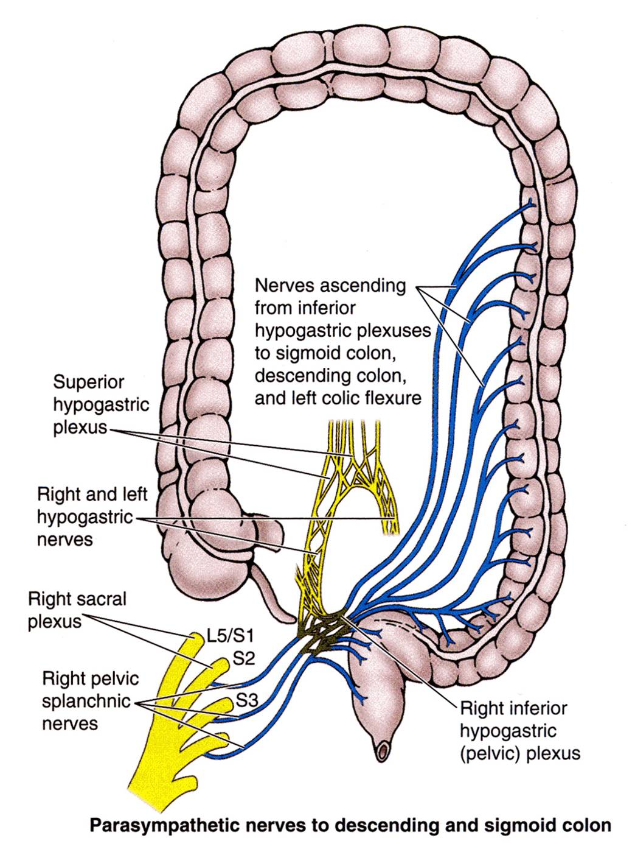
These parasympathetic fibers are then distributed along branches of the inferior mesenteric artery to supply the large bowel from the left colic flexure to the upper half of the anal canal.

Slide 64
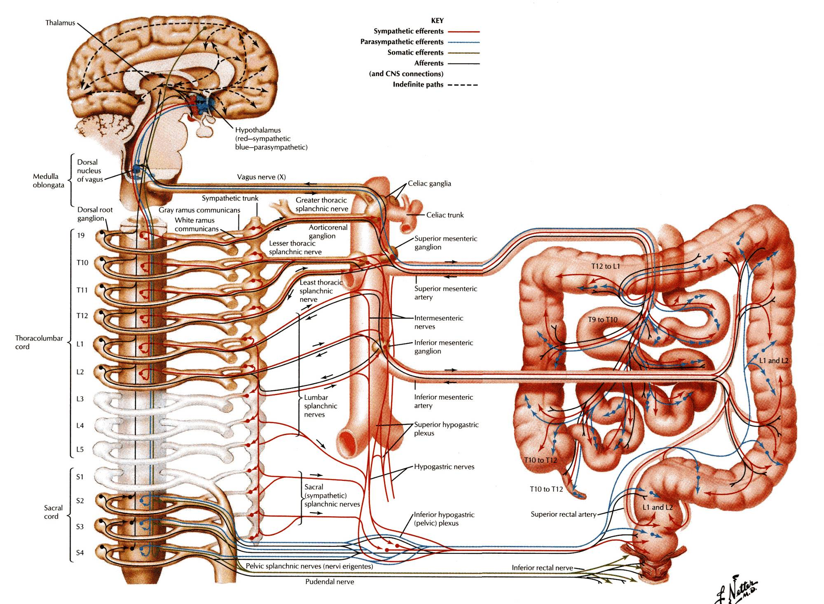
x
x
x
x
x
x
x
x
x
x

Slide 65
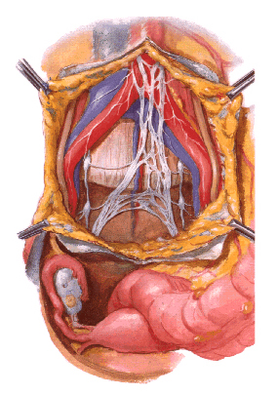
SUPERIOR HYPOGASTRIC PLEXUS
The superior hypogastric plexus is situated in front of the promontory of the sacrum.

Slide 66
The superior hypogastric plexus is formed as a continuation of the aortic plexus and from branches of the third and fourth lumbar sympathetic ganglia.
It contains sympathetic and sacral parasympathetic nerve fibers and visceral afferent nerve fibers.

Slide 67
The superior hypogastric plexus divides inferiorly to form the right and left hypogastric nerves.

Slide 68
INFERIOR HYPOGASTRIC PLEXUSES
The inferior hypogastric plexuses lie on each side of the rectum, the base of the bladder, and the vagina.
Each plexus is formed from a hypogastric nerve (from the superior hypogastric plexus) and from the pelvic splanchnic nerve.

Slide 69
Each inferior hypogastric plexus contains postganglionic sympathetic fibers, preganglionic and postganglionic parasympathetic fibers, and visceral afferent fibers.
Branches pass to the pelvic viscera via small subsidiary plexuses.

Slide 70
Thank you

