Slide 1
Urogenital triangle
Superficial & deep perineal pouches, Urogenital diaphragm

Slide 2
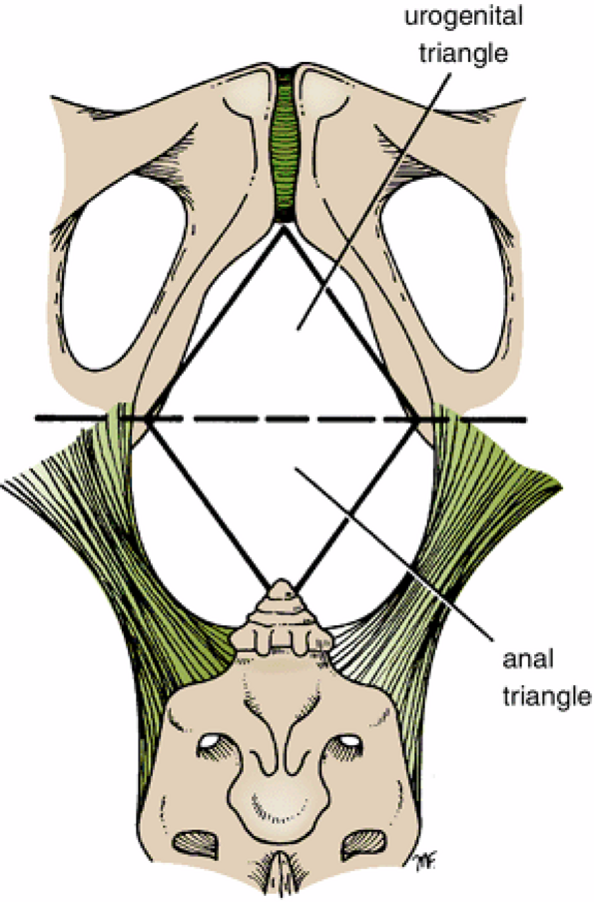
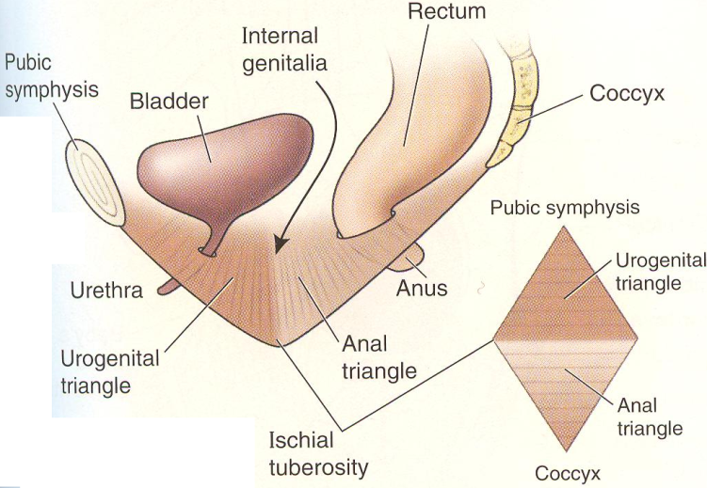
Urogenital Triangle
The urogenital triangle is bounded in front by the pubic arch and laterally by the ischial tuberosities

Slide 3
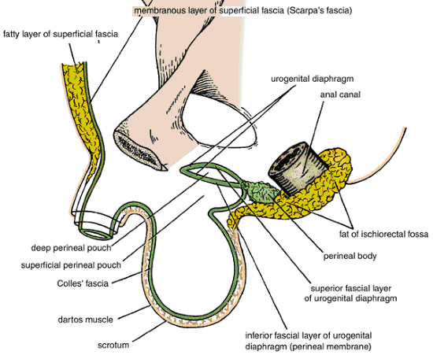
Superficial Fascia
The superficial fascia of the urogenital triangle can be divided into a fatty layer and a membranous layer.
The fatty layer (Camper’s fascia) is continuous with the fat of the ischiorectal fossa and the superficial fascia of the thighs. In the scrotum, the fat is replaced by smooth muscle, the dartos muscle. The dartos muscle contracts in response to cold and reduces the surface area of the scrotal skin
The membranous layer (Colles' fascia) is attached posteriorly to the posterior border of the urogenital diaphragm & laterally to the margins of the pubic arch; anteriorly it is continuous with the membranous layer of superficial fascia of the anterior abdominal wall (Scarpa's fascia). The fascia is continued over the penis (or clitoris) as a tubular sheath. In the scrotum (or labia majora) it forms a distinct layer

Slide 4
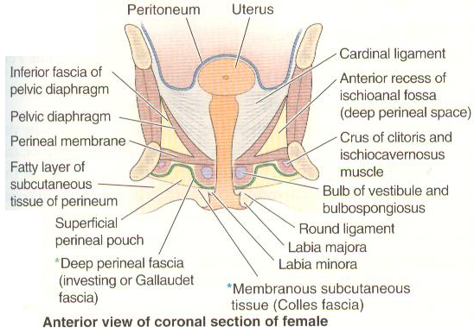
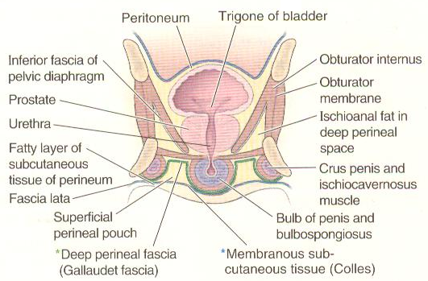
Superficial Perineal Pouch
The superficial perineal pouch is a potential space between the membranous layer of subcutaneous tissue & the perineal membrane, bounded laterally by the ischiopubic rami.

Slide 5
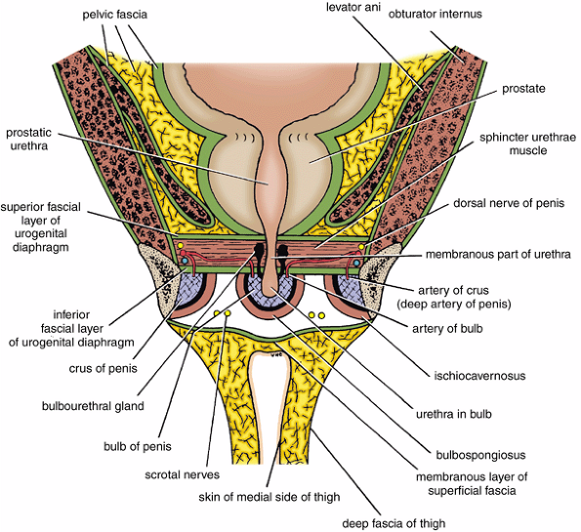
Urogenital Diaphragm
The urogenital diaphragm is a triangular musculofascial diaphragm situated in the anterior part of the perineum. It is formed by the sphincter urethrae muscle & deep transverse perineal muscles, which are enclosed between a superior and an inferior layer of fascia of the urogenital diaphragm. The inferior layer of fascia is often referred to as the perineal membrane.

Slide 6
Deep perineal pouch
The space between the perineal membrane & the inferior fascial layer of pelvic diaphragm & laterally the obturator fascia

Slide 7
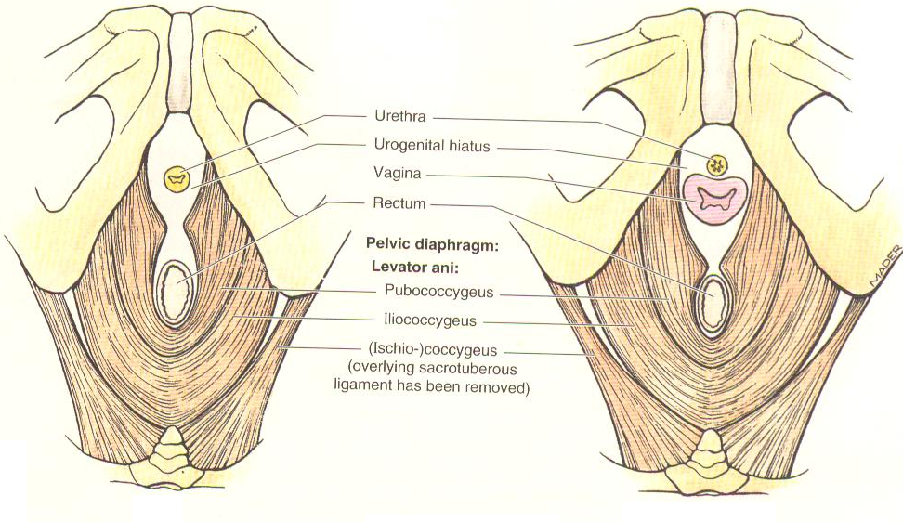
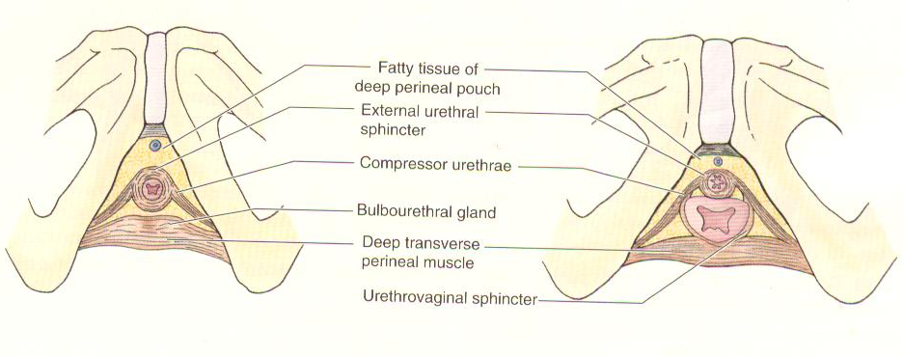
Male
Female
Layers of perineum

Slide 8
Male
Female
Layers of perineum

Slide 9
Layers of perineum
Male
Female

Slide 10
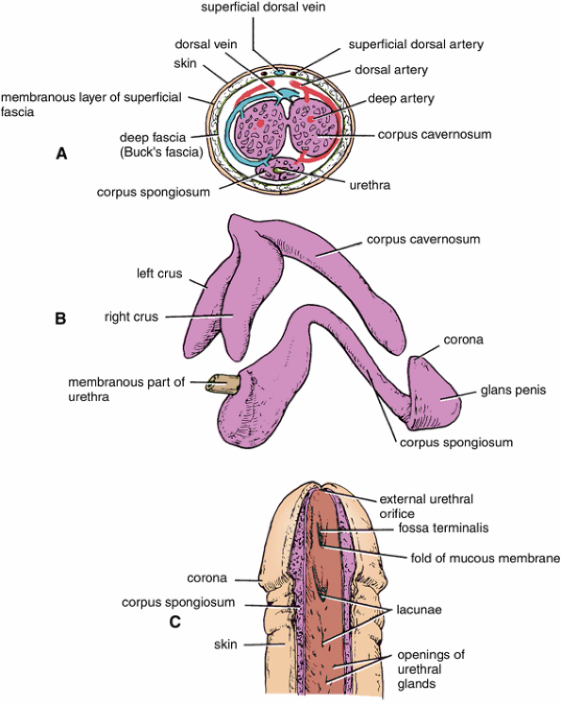
Contents of the Male Urogenital Triangle
Penis
Location and Description
The penis has a root, & a body
Root
Root is made up of 3 erectile tissue called the bulb of the penis. (paired corpora cavernosa dorsally & single corpora spongiosum ventrally) & the right and left crura of the penis.
Bulb
The bulb is attached to the undersurface of the urogenital diaphragm, traversed by the urethra and is covered on its outer surface by the bulbospongiosus muscles
The bulb is continued forward into the body of the penis and forms the corpus spongiosum.
Note that the anatomical position of the penis is erect; when the penis is flaccid, its dorsum is directed anteriorly

Slide 11
Crura
Each crus is attached to the side of the pubic arch and is covered on its outer surface by the ischiocavernosus muscle. The two crura converge anteriorly and come to lie side by side in the dorsal part of the body of the penis, forming the corpora cavernosa.

Slide 12
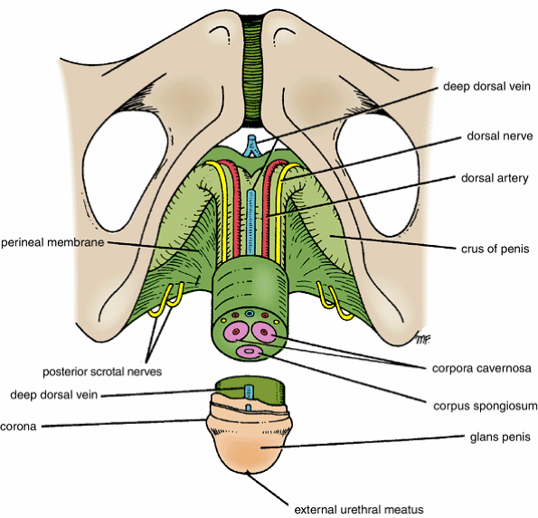
Body of the Penis
The body of the penis is composed of 3 cylinders of erectile tissue enclosed in a tubular sheath of fascia (Buck's fascia). The erectile tissue is made up of two corpora cavernosa (dorsal) & a single corpus spongiosum (ventral). Distally the corpus spongiosum expands to form the glans penis on its tip is a slitlike orifice of the urethra, called the external urethral meatus.
The prepuce or foreskin is a hoodlike fold of skin that covers the glans. It is connected to the glans just below the urethral orifice by a fold called the frenulum.

Slide 13
Blood Supply
Arteries
The corpora cavernosa are supplied by the deep arteries of the penis the corpus spongiosum is supplied by the artery of the bulb. In addition, there is the dorsal artery of the penis. (branches of internal pudendal artery)
Veins
The veins drain into the internal pudendal veins.
Lymph Drainage
Superficial inguinal nodes & internal iliac nodes.
Nerve Supply
Pudendal nerve & the pelvic plexuses

Slide 14
Scrotum
Location and Description
The scrotum is an outpouching of the lower part of the anterior abdominal wall and contains the testes, the epididymides, and the lower ends of the spermatic cords.
The wall of the scrotum has the following layers:
Skin
Superficial fascia; the dartos muscle, which is smooth muscle, replaces the fatty layer of the anterior abdominal wall, and Scarpa's fascia (membranous layer) is now called Colles' fascia.
External spermatic fascia derived from the external oblique
Cremasteric fascia derived from the internal oblique
Internal spermatic fascia derived from the fascia transversalis
Tunica vaginalis, which is a closed sac that covers the anterior, medial, and lateral surfaces of each testis

Slide 15
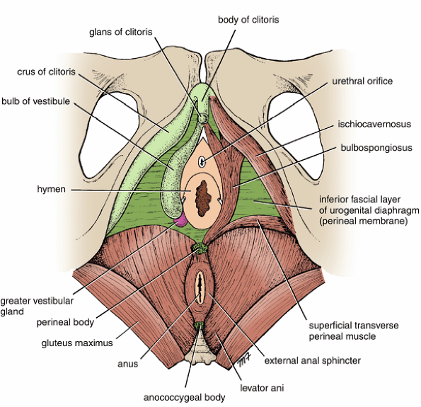
Contents of the Superficial Perineal Pouch in the Male
The superficial perineal pouch contains structures forming the root of the penis, & muscles that cover them (bulbospongiosus & ischiocavernosus muscles). These muscles compress the penile part of the urethra and empty it of residual urine or semen. The anterior fibers also compress the deep dorsal vein of the penis, obstructing the venous drainage of the erectile tissue and thereby assisting in the process of erection of the penis.

Slide 16
Superficial Transverse Perineal Muscles
The superficial transverse perineal muscles lie in the posterior part of the superficial perineal pouch. Each muscle arises from the ischial ramus and is inserted into the perineal body. The function of these muscles is to fix the perineal body in the center of the perineum.
Nerve Supply
All the muscles of the superficial perineal pouch are supplied by the perineal branch of the pudendal nerve.

Slide 17
Perineal Body
This small mass of fibrous tissue is attached to the center of the posterior margin of the urogenital diaphragm. It serves as a point of attachment for the following muscles: external anal sphincter, bulbospongiosus muscle, and superficial transverse perineal muscles.

Slide 18
Contents of the Deep Perineal Pouch in the Male
The deep perineal pouch contains
Membranous urethra
Sphincter urethrae
Bulbourethral glands
Deep transverse perineal muscles
Internal pudendal vessels and their branches,
Dorsal nerves of the penis.
Sphincter Urethrae Muscle
The sphincter urethrae muscle surrounds the urethra in the deep perineal pouch. It arises from the pubic arch on the two sides and passes medially to encircle the urethra

Slide 19
Erection of the Penis
Erection in the male is gradually built up as a consequence of various sexual stimuli. Pleasurable sight, sound, smell, and other psychic stimuli, fortified later by direct touch sensory stimuli from the general body skin and genital skin, result in a bombardment of the central nervous system by afferent stimuli.
Efferent nervous impulses pass down the spinal cord to the parasympathetic outflow in the second, third, and fourth sacral segments. The parasympathetic preganglionic fibers enter the inferior hypogastric plexuses and synapse on the postganglionic neurons. The postganglionic fibers join the internal pudendal arteries and are distributed along their branches, which enter the erectile tissue at the root of the penis. Vasodilatation of the arteries occurs, producing a great increase in blood flow through the blood spaces of the erectile tissue. The corpora cavernosa and the corpus spongiosum become enlarged with blood and expand, compressing their draining veins against the surrounding fascia. By this means, the outflow of blood from the erectile tissue is retarded so that the internal pressure is further accentuated and maintained. The penis thus increases in length and diameter and assumes the erect position.
Once the climax of sexual excitement is reached and ejaculation takes place, or the excitement passes off or is inhibited, the arteries supplying the erectile tissue undergo vasoconstriction. The penis then returns to its flaccid state.

Slide 20
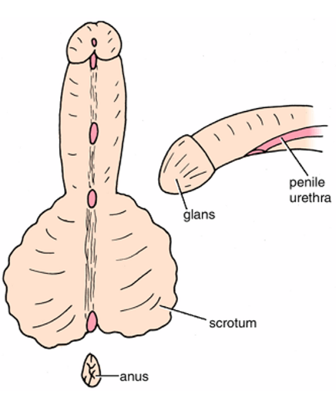
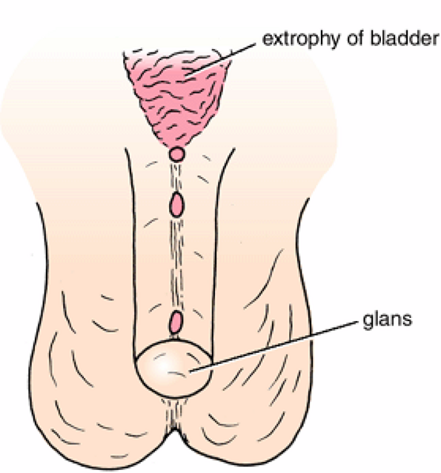
Circumcision
Circumcision is the removing the greater part of the prepuce, or foreskin.
Hypospadias
The external meatus is situated on the ventral or undersurface of the penis/perineum
Epispadias
The external meatus is situated on the dorsal surface of penis/perineum

Slide 21
Contents of the Female Urogenital Triangle
In the female, the triangle contains
External genitalia
Orifices of the urethra and the vagina.
Clitoris
Location and Description
The clitoris, which corresponds to the penis in the male, is situated at the apex of the vestibule anteriorly. It has a structure similar to the penis. The glans of the clitoris is partly hidden by the prepuce.

Slide 22
Root of the Clitoris
The root of the clitoris is made up of 3 masses of erectile tissue called the bulb of the vestibule and the right and left crura of the clitoris.
The bulb of the vestibule corresponds to the bulb of the penis, but because of the presence of the vagina, it is divided into two halves. It is attached to the undersurface of the urogenital diaphragm and is covered by the bulbospongiosus muscles.
The crura of the clitoris correspond to the crura of the penis and become the corpora cavernosa anteriorly. Each remains separate and is covered by an ischiocavernosus muscle

Slide 23
Body of the Clitoris
The body of the clitoris consists of the two corpora cavernosa covered by their ischiocavernosus muscles. The corpus spongiosum of the male is represented by a small amount of erectile tissue leading from the vestibular bulbs to the glans.
Glans of the Clitoris
The glans of the clitoris is a small mass of erectile tissue that caps the body of the clitoris. It is provided with numerous sensory endings. The glans is partly hidden by the prepuce.
Blood Supply, Lymph Drainage, and Nerve Supply
The blood supply, lymph drainage, and nerve supply are similar to those of the penis.

Slide 24
Contents of the Superficial Perineal Pouch in the Female
The superficial perineal pouch contains structures forming the root of the clitoris and the muscles that cover them, namely, the bulbospongiosus muscles and the ischiocavernosus muscles
Superficial Transverse Perineal Muscles
The superficial transverse perineal muscles are identical in structure and function to those of the male.
Nerve Supply
All the muscles of the superficial perineal pouch are supplied by the perineal branch of the pudendal nerve
Perineal Body
The perineal body is larger than that of the male and is clinically important.

Slide 25
Contents of the Deep Perineal Pouch in the Female
The deep perineal pouch contains
Part of the urethra
Part of the vagina
Sphincter urethrae, pierced by the urethra and the vagina
Deep transverse perineal muscles
Internal pudendal vessels and their branches
Dorsal nerves of the clitoris
Erection of the Clitoris
Sexual excitement produces engorgement of the erectile tissue within the clitoris in exactly the same manner as in the male

Slide 26
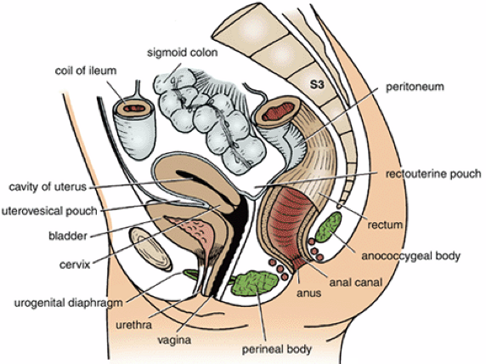
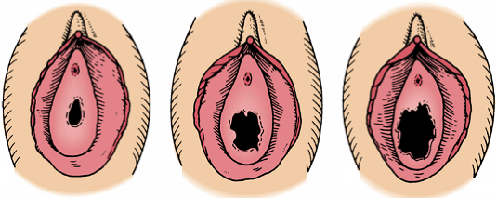
Vagina
Location and Description
The vagina not only is the female genital canal but also serves as the excretory duct for the menstrual blood & forms part of the birth canal.
This muscular tube extends upward and backward between the vulva and the uterus. It measures about 3 in. (8 cm) long. The cervix of the uterus pierces its anterior wall. The vaginal orifice in a virgin possesses a thin mucosal fold, called the hymen, which is perforated at its center.
had sexual
intercourse
virgin
multiparous

Slide 27
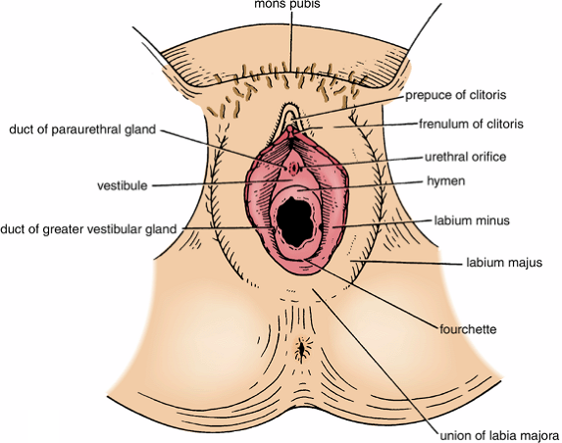
Greater Vestibular Glands
The greater vestibular glands are a pair of small mucus-secreting glands that lie under cover of the posterior parts of the bulb of the vestibule and the labia majora . Each drains its secretion into the vestibule by a small duct, which opens into the groove between the hymen and the posterior part of the labium minus. These glands secrete a lubricating mucus during sexual intercourse.
Vulva
The term vulva is the collective name for the female external genitalia and includes the mons pubis, labia majora and minora, the clitoris, the vestibule of the vagina, the vestibular bulb, and the greater vestibular glands.

Slide 28
The Vulva and Pregnancy
An important sign in the diagnosis of pregnancy is the appearance of a bluish discoloration of the vulva and vagina as a result of venous congestion. It appears at the 8th to 12th week and increases as the pregnancy progresses.

Slide 29
Thank you

