Slide 1
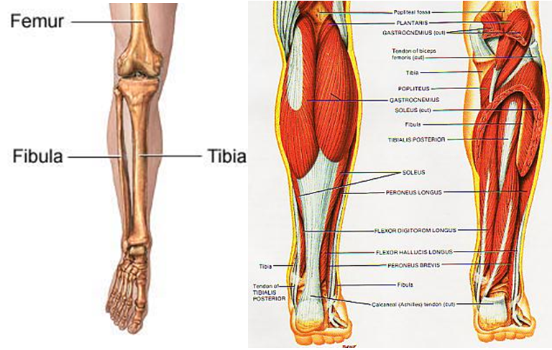

BACK OF THE LEG
KSU
College of Medicine
Anatomy (121 ANA)
Bilal M.. K. Marwa

Slide 2

BACK OF THE LEG

Slide 3
BACK OF THE LEG
KSU
College of Medicine
Anatomy (121 ANA)
هذه سلايدات المحاضرة التي ألقيتها لقروب أ يوم الأثنين 25/5/2009، حيث أنهم تقبلوني بينهم، علمًا أن د/ فوهره كانت مقررة عليه المحاضرة،
لم أرفع هذه المحاضرة إلا لعموم 428 سواء كانوا (أ) او الشرفاء من (ب) الذين سلموا من العقد النفسية، والذين إن وجدوا بي ما لا يعجبهم قالوا لي بكل صراحة، لأننا يفتضر بنا أن نكون إخوان
إن وجدتم بي ما تودون نصحي به فلا أظن أن من الصعب الوصول لي في أي وقت..
أما حركات الطفولة فقد كبرنا منها، ممن هدفهم طفولي، كاعتبار كل ما يصدر منا تنافسًا، والحقيقة أنه تعاون
Bilal M.. K. Marwa

Slide 4
BACK OF THE LEG
KSU
College of Medicine
Anatomy (121 ANA)
Bilal M. K. Marwa

Slide 5
LECTURE OVERVIEW
SKIN
Cutaneous Nerves
Superficial Veins
Muscles
Muscles of posterior fascial compartment
Superficial Group
Supply
Arterial Supply
Nerve Supply
Deep Group
Lymph vessels

Slide 6
BACK OF THE LEG
KSU
College of Medicine
Anatomy (121 ANA)
Skin
Muscles
Supply
Skin
Cutaneous Nerves
- Superphicial Veins
Bilal M.. K. Marwa

Slide 7
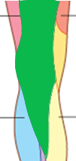
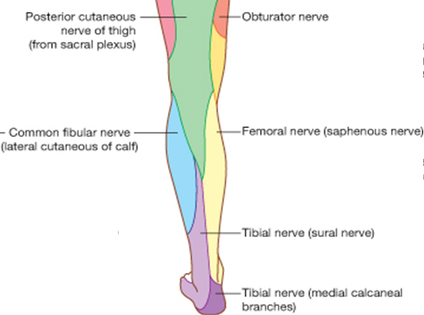
Cutaneous Nerves
Skin of the back of the leg
Posterior cutaneous nerve of the thigh supplies:
  skin over the popliteal fossa
  Upper part of the back of the leg

Slide 8

Cutaneous Nerves
Skin of the back of the leg
Lateral cutaneous nerve of the calf: branch of the common peroneal nerve supplies:
  Skin on upper part of posterolateral surface of the leg

Slide 9
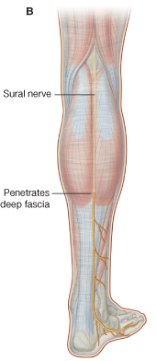
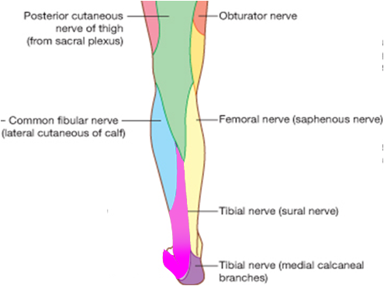
Cutaneous Nerves
Skin of the back of the leg
Sural nerve: branch of tibial supplies
  Skin on the lower part of the posterolateral surface of the leg

Slide 10
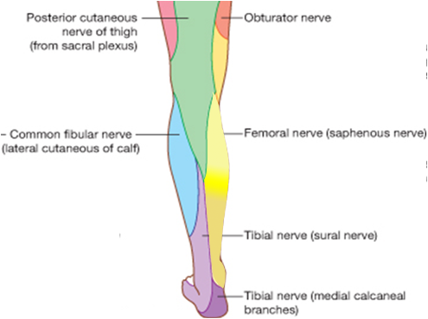
Cutaneous Nerves
Skin of the back of the leg
Saphenous nerve: branch of femoral nerve:
  Branches supply skin on posteromedial surface of the leg

Slide 11
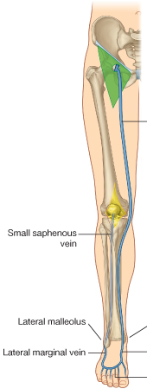
Superficial veins
Small Saphenous vein:
  Beginning: lateral part of dorsal venous arch of the foot.
  Route:
    ascends behind lateral maleoulus (with sural nerve)
    Follows lateral border of tendo calcaneous then runs up the middle of back of the leg
    Pierces deep fascia passing between 2 heads of gastrocnemius inlowerpart of popliteal fossa
  End: in popliteal vein (variation)
  Tributaries:
    Numerous small veins from back of the leg
    Communicating veins with deep leg veins
    Anastomosing branches running upward and medially to join greater saphenous vein

Slide 12
Lymph Vessels
Come from: skin and superficial fascia on the back of the leg.
Drainage route: upward, then
  Either forward around medial side of leg, ending in vertical group of superficial inguinal nodes
  Or Drain into popliteal nodes.

Slide 13
BACK OF THE LEG
KSU
College of Medicine
Anatomy (121 ANA)
Skin
Muscles
Supply
Muscles
Superficial group
Deep Group
Bilal M.. K. Marwa

Slide 14
Contents of the Posterior Fascial Compartment of The Leg
A septum called deep transverse fascia divides the muscles of the posterior compartment into (1) superficial and (2) deep
Blood supply: posterior tibial artery
Nerve supply: Tibial nerve
→ 3 muscles
  Gastrocnemius
  Plantaris
  Soleus
→ 4 muscles
  popliteus
  Flexor digitorum longus
  Flexor hallucis longus
  Tibialis posterior

Slide 15
Superficial Group
Action: together act as powerful plantar flexors of the ankle joint
  Providing main propulsive force in walking and running

Slide 16
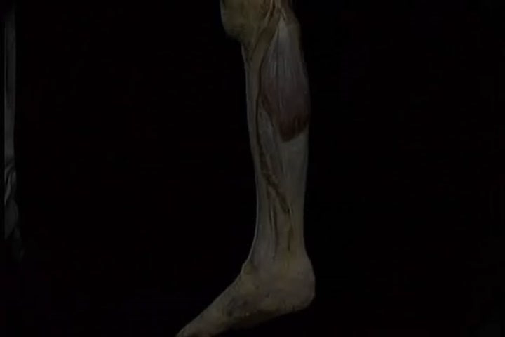
BACK OF THE LEG
KSU
College of Medicine
Anatomy (121 ANA)
Bilal M.. K. Marwa

Slide 17
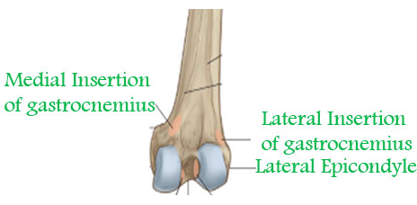
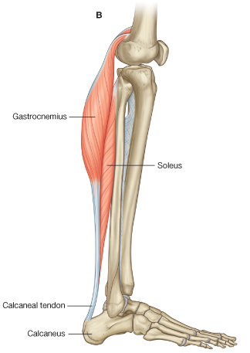
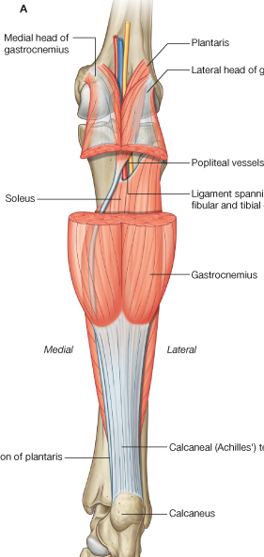
Superficial group:
1. Gastrocnemius
Origin:
  Lateral head: lateral condyle of the femur.
  Medial head: above the medial condyle
    popliteal surface of the femur
Insertion: Via tendo calcaneus into posterior surface of calcaneus
Action: plantar flexion of foot, flexion of knee

Slide 18
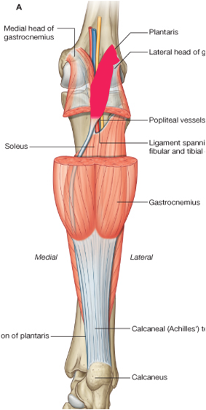
Superficial group:
2. Plantaris
Small fusiform muscle Similar to palmaris longus in forearm
May be absent or doubled
Origin: lateral supracondylar ridge of the femur.
Insertion: into posterior surface of calcaneus
  long ribbon- like tendon descends between Gastrocnemius & soleus.
  then on medial side of tendo calcaneus into the back of the calcaneus (they don’t merge)
Action: plantar flexion of foot, help in flexion of knee

Slide 19
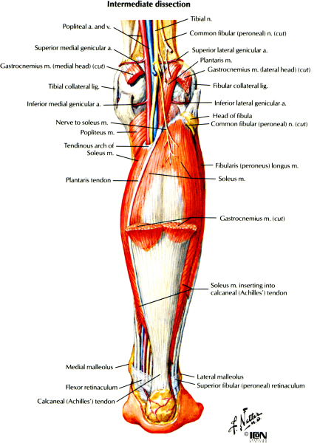
Superficial group:
3. Soleus
A broad flat muscle that forms the main bulk of the calf.
Origin: Shafts of tibia and fibula
Insertion: Via tendo calcaneus into posterior surface of calcaneus
Action: plantar flexion of foot

Slide 20
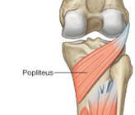
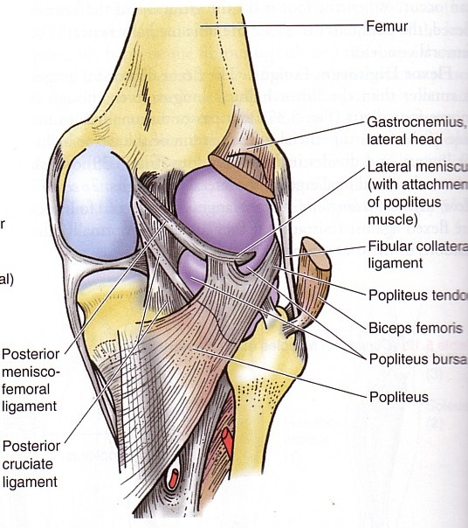
Deep group:
1. Popliteus
Origin: Lateral surface of lateral condyle of femur
  Arises intracapsular, takes a partial origin from the mensicus
  Its tendon separates the mensicus from the legament of the knee, to make it freer and adapt to condylar surfaces of femur and tibia
Insertion: posterior surface of the tibia above the soleal line.
Action: flexion of the knee,
  unlocking knee joint (lateral rotation of femur on tibia)

Slide 21
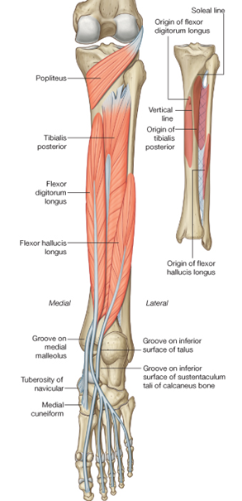
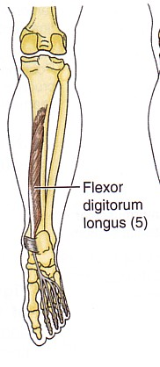
Deep group:
2. Flexur Digitorum Longus
Origin: Posterior surface of shaft of tibia
Insertion: Bases of distal phalanges of lateral four toes
    Each pierces the tendon of flexor digitorum brevis of the sole
Action:
  Planter flexion of the terminal phalanx of the lateral 4 toes.
  Assists in planter flexion of the foot

Slide 22
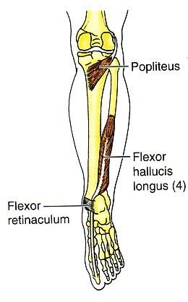
Deep group:
3. Flexur Hallucis Longus
Origin: Posterior surface of shaft of fibula
Insertion: Base of distal phalanx of big toe
Action:
  Planter flexion of the distal phalanx of the big toe
  Assists in planter flexion of the foot.
  Maintenance of medial longitudinal arch of the foot

Slide 23
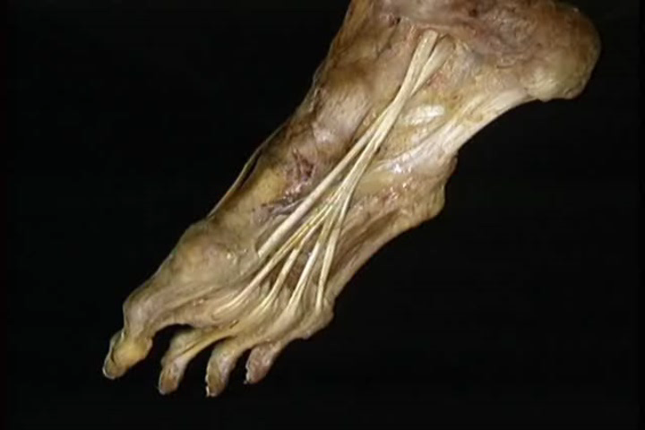
BACK OF THE LEG
KSU
College of Medicine
Anatomy (121 ANA)
Bilal M.. K. Marwa

Slide 24
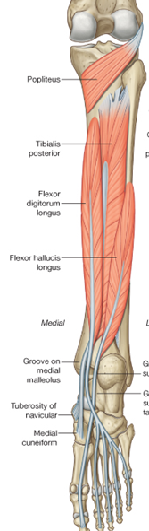
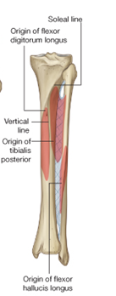
Deep group:
4. Tibialis Posterior
Origin:
  Back of interosseous membrane.
  Back of tibia lateral to vertical line
  Back of fibula medial to medial crest
Insertion:
  All tarsus except talus.
  The main insertion into tuberosity of the navicular bone.
  It is also inserted into the base of 2nd,3rd& 4th metatarsal bones.

Slide 25
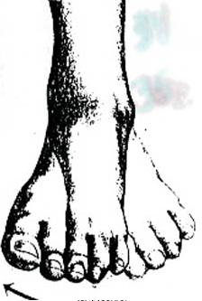

Deep group:
4. Tibialis Posterior
Action:
  Planter flexion of the distal phalanx of the big toe
  Assists in planter flexion of the foot.
  Inverts foot at subtalar and transverse tarsal joints
  Supports medial longitudinal arch of the foot

Slide 26
BACK OF THE LEG
KSU
College of Medicine
Anatomy (121 ANA)
Skin
Muscles
Supply
Supply
Nerve Supply
Arterial Supply
Bilal M.. K. Marwa

Slide 27
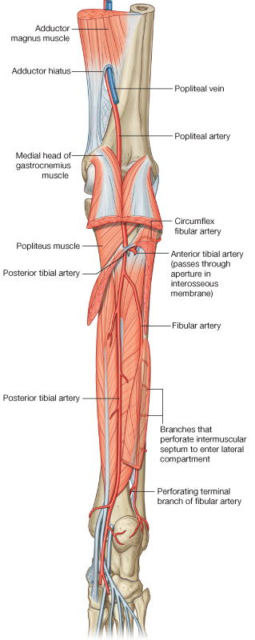
Arterial Supply:
Posterior Tibial Artery
Begins as the poploteal artery divides to give posterior & anterior tibial arteries.
Begin: at level of the distal border of popliteus muscle
Route:
  Passes downward deep to Gastrocnemius & soleus & deep to transverse fascia of the leg
  It descends on posterior surface of tibialis posterior
  Its lower part lies on back of tibia covered by skin & fascia only
  It passes behind the medial malleolus to the sole deep to flexor retinaculum
Termination: divide into medial and lateral plantar aa.

Slide 28
Arterial Supply:
Posterior Tibial Artery
Branches:
  Peroneal Artery (large)
    Arises close to the origin of posterior Tibial a.
    Gives nutrient artery to the fibula & descends behind it.
    Gives muscular branches
    End: Shares in anastomosis around the ankle
    Perforating branch: pierces interosseous membrane to reach lower part of front of leg
  Muscular branches
  Nutrient artery to tibia
  Anastomotic branches

Slide 29
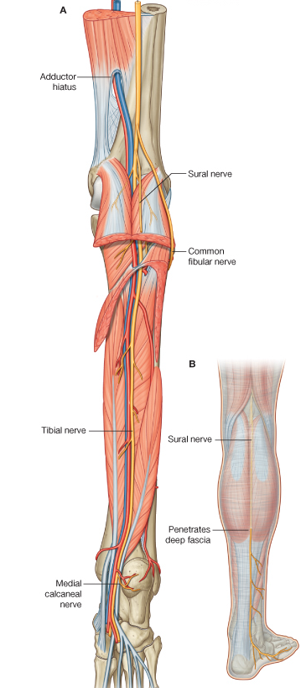
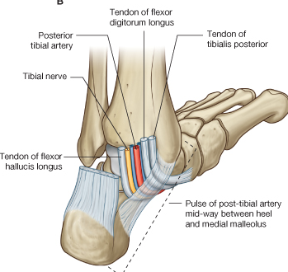
Nerve Supply:
Tibial Nerve
Begin: Larger of the 2 terminal branches of sciatic nerve in the lower 1/3 of back of thigh
Route:
  It bisects the popliteal fossa
  It passes deep to the Gastrocnemius and soleus
  It lies on posterior surface of tibialis posterior
  It accompanies the posterior tibial artery.
    N. medial to a., then crosses to become lateral
  It passes behind the medial malleolus to reach the sole, deep to flexor retinaculum

Slide 30
Nerve Supply:
Tibial Nerve
Branches:
  Muscular branches
  Medial calcaneal branch to
  Articular to ankle joint
End: divide into medial and lateral plantar nn.

Slide 31
BACK OF THE LEG
KSU
College of Medicine
Anatomy (121 ANA)
Clinical Note
Bilal M.. K. Marwa

Slide 32
Deep Vein Thrombosis and Long-Distance Air Travel
Passengers who sit immobile for hours on long-distance flights are very prone to deep vein thrombosis in the legs.
Thrombosis of the veins of the soleus muscle gives rise to mild pain or tightness in the calf and calf muscle tenderness.
However, deep vein thrombosis can also occur with no signs or symptoms.
Should the thrombus become dislodged, it passes rapidly to the heart and lungs, causing pulmonary embolism, which is often fatal.
Preventative measures include stretching of the legs every hour to improve the venous circulation

