Slide 1
By bandar alsubaie
Clinical notes

Slide 2
Liver Trauma
The liver is a soft , friable structure enclosed in a fibrous capsule .
Fractures of the lower ribs or penetrating wounds of the thorax or upper abdomen on the right side are the common causes of liver injury.

Slide 3
Because the bile duct, hepatic artery and portal vein are distributed in a segmental manner (appropriate ligation) of these structures allows the surgeon to remove large portion successfully.

Slide 4
Subphrenic spaces
-normal: it’s potential spaces only and the potential surfaces are in contact.
-abnormal: accumulation of gas or fluid will separate the surfaces.
-in gastric ulcer : loss of liver dullness , accumulation of gas over anterior surface of liver and subphrenic spaces

Slide 5
gallstones
المغص الصفراوي Biliary colic
it’s caused by spasm of the smooth muscle of the wall of gallbladder in an attempt to expel a gallstone.
Afferent nerve celiac plexus and splanchnic nerves thoracic segment of the spinal cord.
The referred pain is felt in the right upper quadrant or epigastrium T 7,T8,T9.

Slide 6
-The obstruction of bile duct by gallstone or tumor in pancreas cause jaundice.
-the stone in the hepatopancreatic ampulla result in the passage of bile to pancreatic duct cause pancreatitis.
-gallstones have been known to ulcerate through the gallbladder wall to transverse colon or duodenum.
-maybe cause obstruction of ileocecal junction.

Slide 7
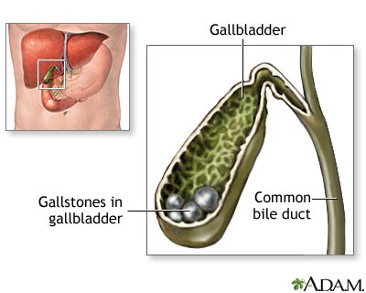

Slide 8
Acute Cholecystitis
إلتهاب المرارة
-Inflammation of gallbladder may cause irritation of subdiphragmatic parietal peritoneum which supplied by phrenic nerve (c3,c4.c5) .
-The referred pain over shoulder because the skin of this area is supplied by supraclavicular nerve (c3,c4).

Slide 9
Portal-Systemic anastomoses
-The normal way through the liver.
-when the normal way block, the communication well be in another area as follows:

Slide 10
Systemic part | Portal part | site
Azygos vein | left gastric vein | At the lower third of the esophagus
middle rectal veins and inferior rectal veins | superior rectal vein | Halfway down the anal canal
inferior epigastric vein | paraumbilical veins | The paraumbilical veins
renal vein, suprarenal vein, paravertebral vein, and gonadal vein | right colic vein, middle colic vein, left colic vein | Retroperitoneal

Slide 11
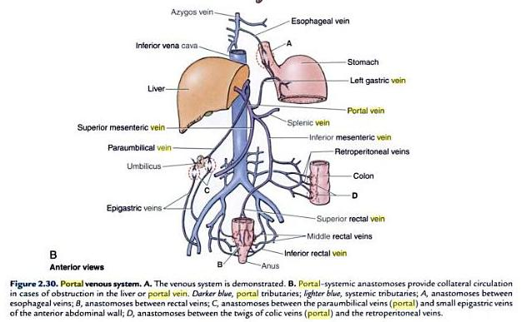

Slide 12
Renal Mobility
The kidneys are maintained in their position by:
~Intra-abdominal pressure
~Perirenal fat
~Renal fascia
If the perirenal fat the mobility lead to cause renal colic, kinking of ureter and effect the suprarenal gland.

Slide 13
Kidney Trauma
it’s protected by:
~lower ribs.
~lumbar muscles.
~vertebral column.
Renal injury can result in rapid blood loss because 25% of C.O. go to kidneys .

Slide 14
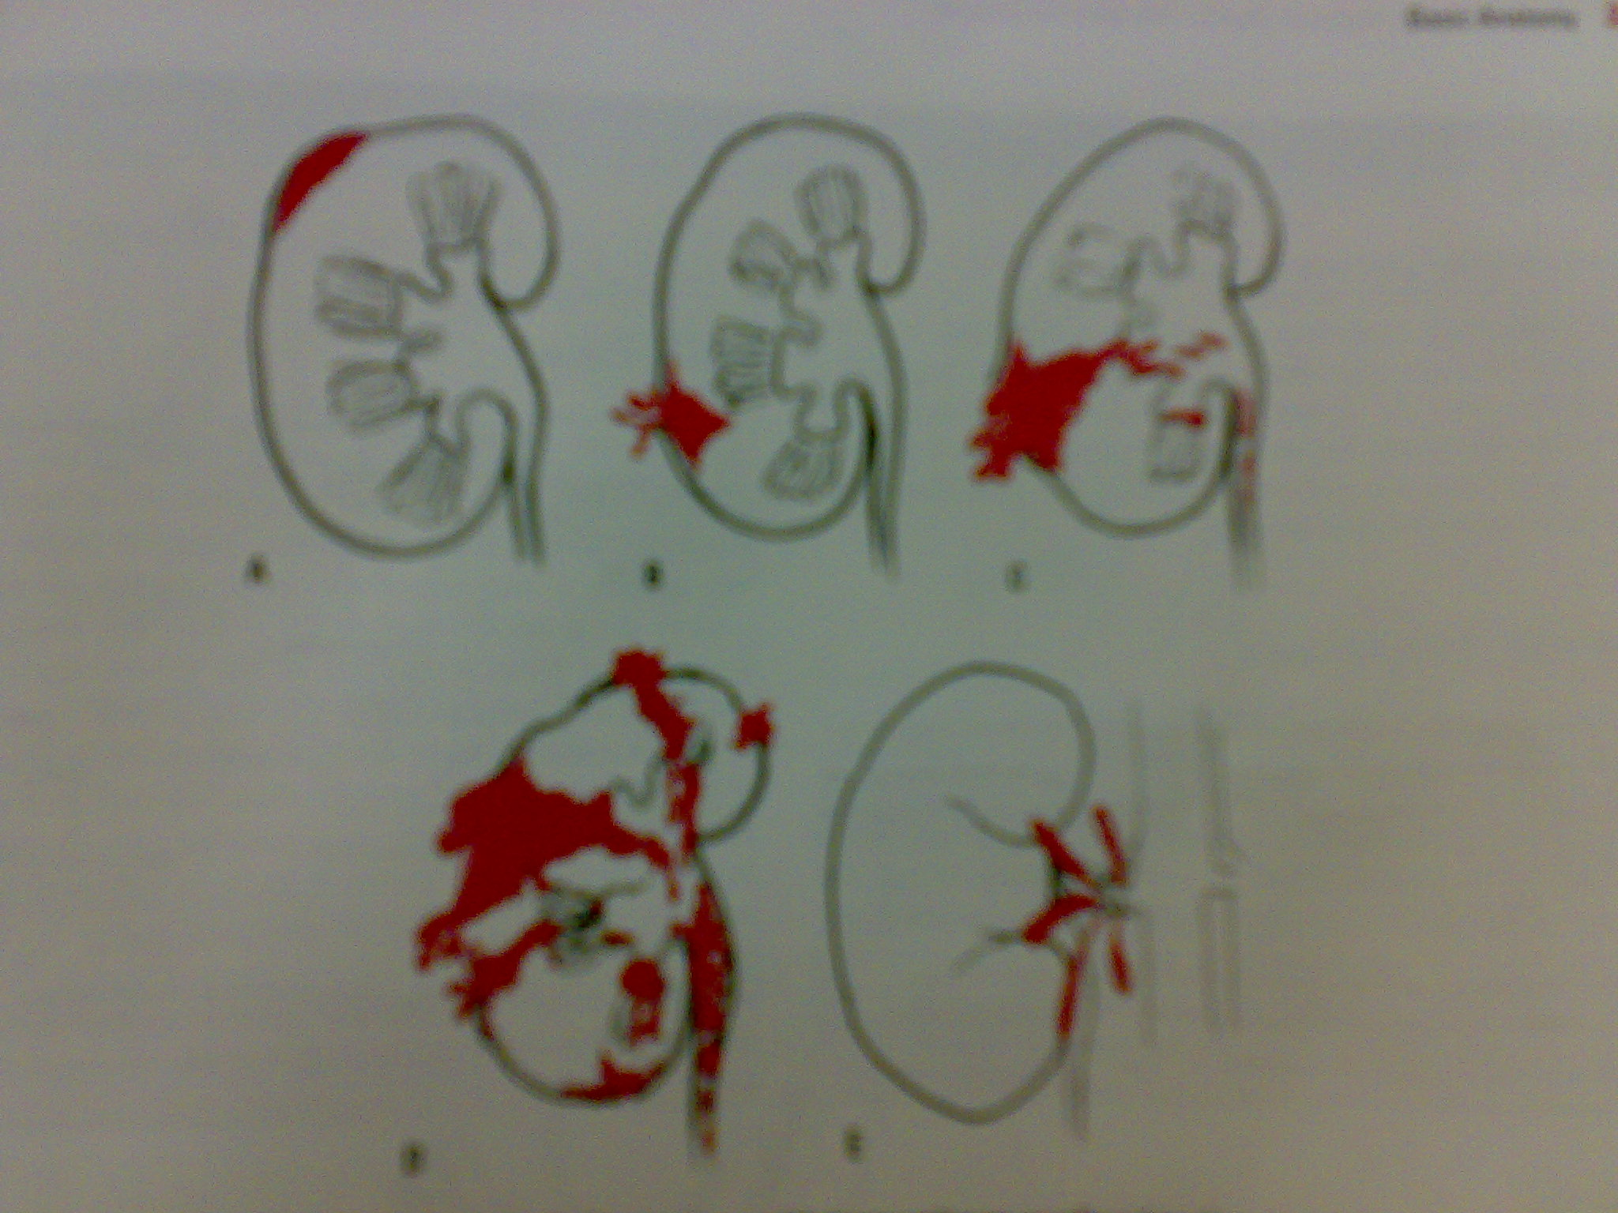

Slide 15
Renal Pain
It’s can be result from :
~stretching of the capsule.
~spasm of the smooth muscles in the renal pelvis.
The afferent nerve through the renal plexus lower splanchnic nerve spinal cord at level of T12.
Referred pain along the distribution of subcostal nerve( T12) to the flank and anterior abdominal wall.

Slide 16
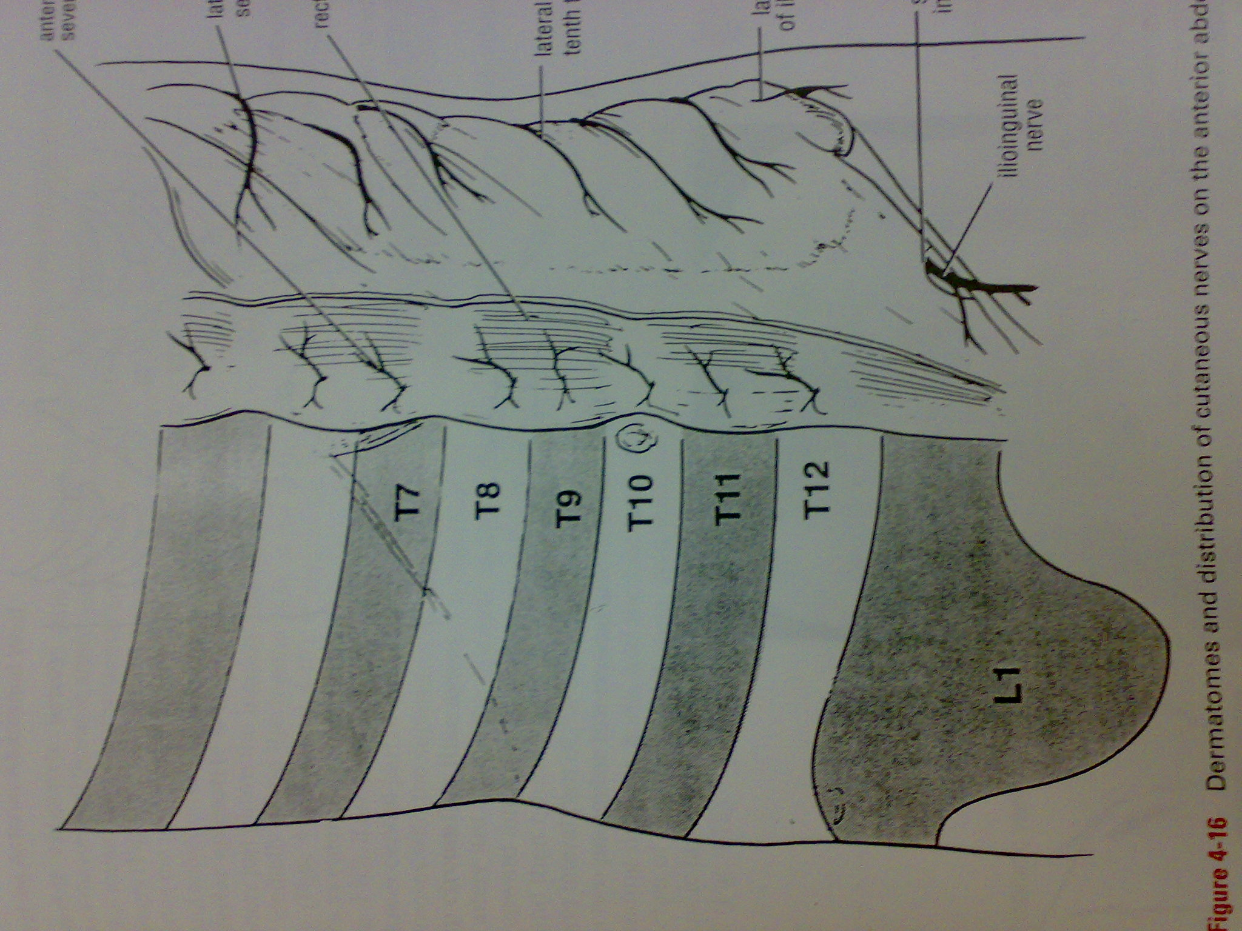

Slide 17
Ureteric Stones
There are 3 sites of anatomic narrowing of the ureter where the stone may be arrested :
~pelviureteral junction.
~the pelvic brim.
~when enter the bladder.
The intravenous pyelogram.

Slide 18
The ureter run down in front of the tip of the transverse processes of the lumbar vertebrae, crosses the region of the sacroiliac joint, swings out to the ischial spain, and then turn medially to the bladder.

Slide 19
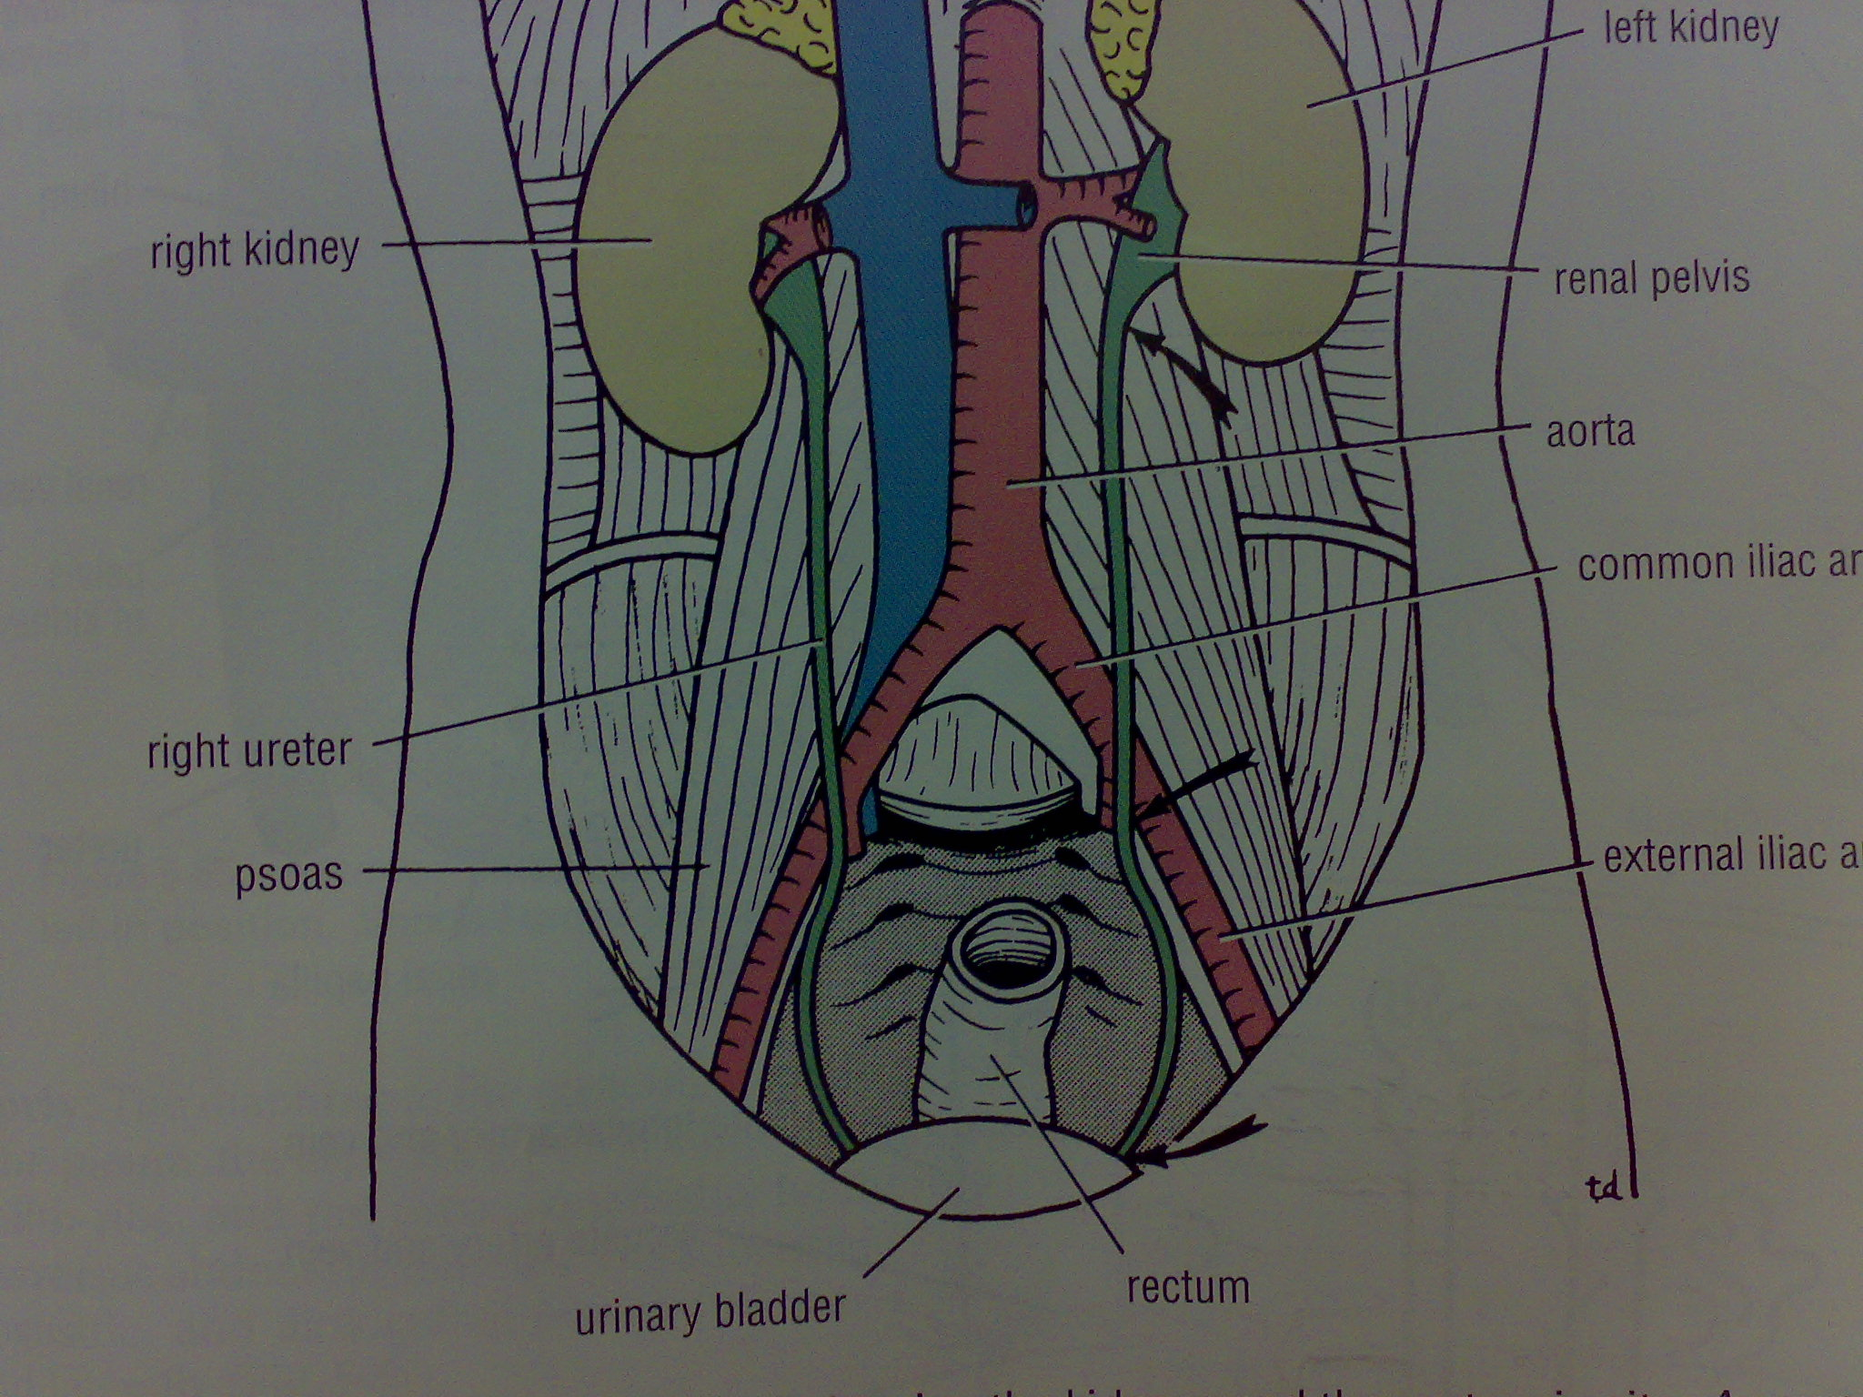

Slide 20
Renal Colic
Cause by spasm of the smooth muscles when it’s try to push the stone.
Renal pelvis and ureter send afferent nerves to spinal cord at (T11,T12,L1.L2) so the referred pain on the skin of flank, loin, groin.
When stone enter the lower part of ureter , the pain felt in the gonadal area.

Slide 21
Ureteral Pain
it’s referred pain along the front of the thigh because the femoral branch of the genitofemoral nerve(L1,L2).

Slide 23
شكراً لكم على إنصاتكم
ولا تنسونا من دعائكم

