Slide 1
DIGESTIVE SYSTEM i
Dr. Saeed Vohra

Slide 2
Primordial Gut
For descriptive purposes the primordial gut is divided into 3 parts:
Foregut
Midgut
Hindgut
Hox & ParaHox genes, regulate the regional
differentiation of the primordial gut to form the
different parts.

Slide 3
Foregut
The derivatives of foregut are:
The primordial pharynx and its derivatives
The lower respiratory system
The esophagus and stomach
The duodenum, proximal to the opening of the bile duct
The liver, biliary apparatus and pancreas

Slide 4
Esophagus
It develops from the foregut immediately caudal to the pharynx
Initially the esophagus is short
It elongates rapidly because of the growth, and descent of the heart and lungs
It reaches its final relative length by the 7th week
Its epithelium and glands are derived from the endoderm

Slide 5
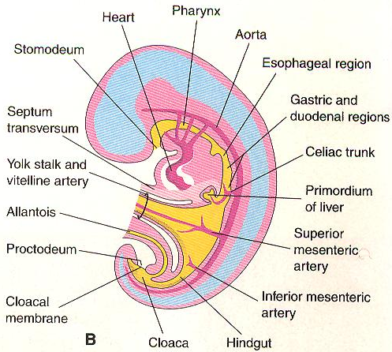
Esophagus
The epithelium proliferates and obliterates the lumen
Recanalization normally occurs by the end of the embryonic period
The striated muscles forming muscularis externa of the superior 3rd of the esophagus is derived from mesenchyme in the caudal pharyngeal arches
The smooth muscle develops from surrounding splanchnic mesenchyme
Both types of muscle are innervated by the branches of vagus nerves

Slide 6
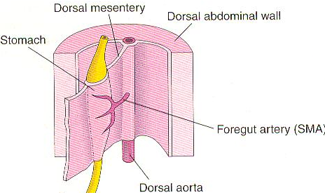
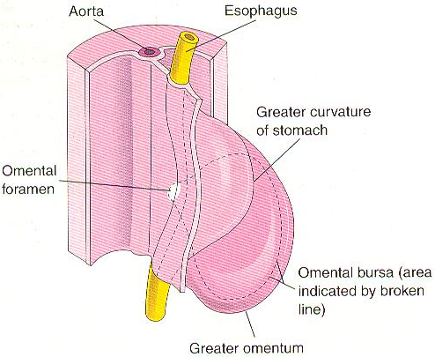
Stomach
During middle of the 4th week a slight dilation indicates the site of the stomach primordium
It first appears as a fusiform enlargement of the caudal part of the foregut
It initially oriented in the midian plane
It soon enlarges and broadens ventrodorsally
During the next 2 weeks its dorsal border grows faster than the ventral border
This demarcates the greater curvature of the stomach

Slide 7
Rotation of Stomach
As the stomach
enlarges and acquires
the adult shape it
slowly rotates 90
degrees in a clockwise
direction around its
longitudinal axis

Slide 8
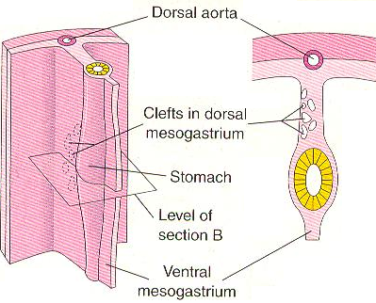
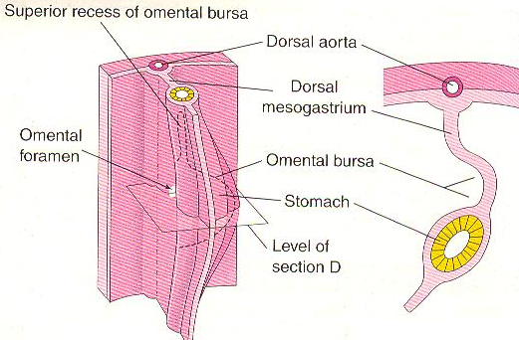
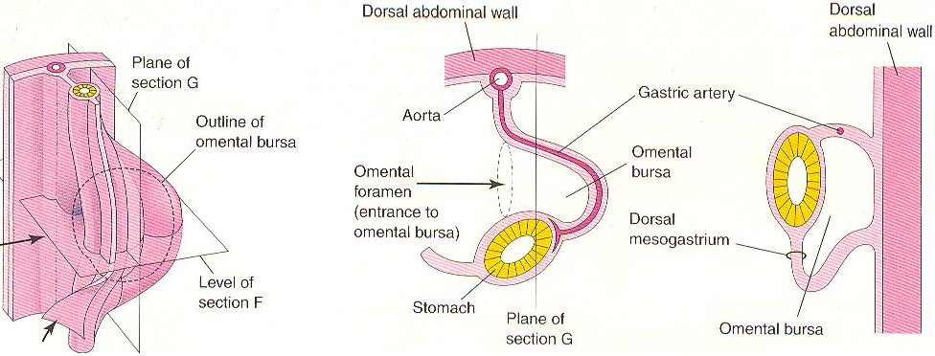
Effects of Rotation
The ventral border (lesser curvature) moves to the right
The dorsal border (greater curvature) moves to the left
The original left side becomes the ventral surface
The original right side becomes the dorsal surface

Slide 9
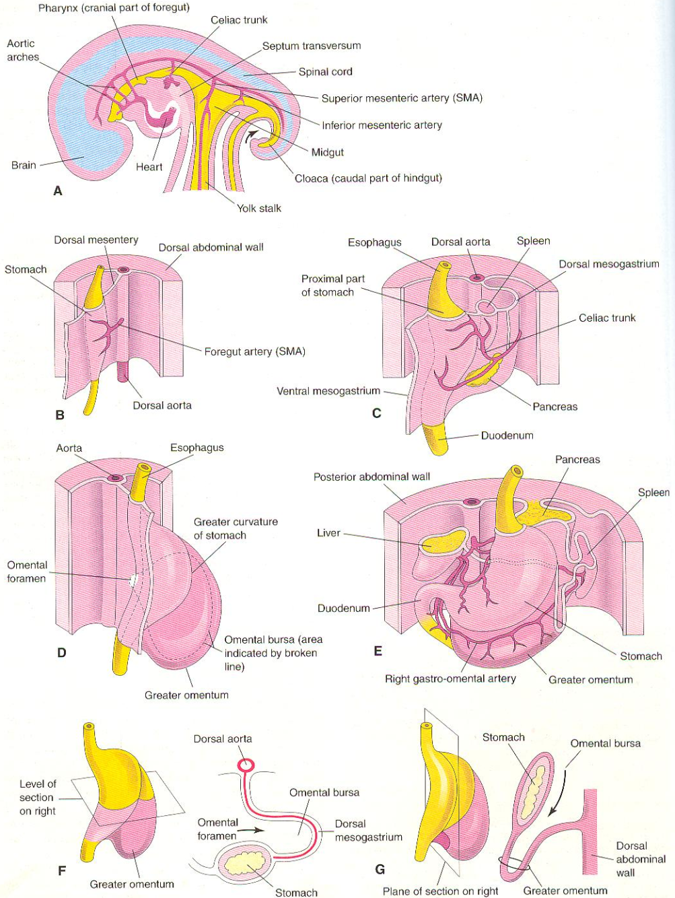
Effects of Rotation
Before rotation the cranial and caudal ends of the stomach are in median plane
After rotation the stomach assumes its final position with its long axis almost transverse to the long axis of the body
Rotation explains why the left vagus nerve supplies the anterior wall of the adult stomach and right vagus nerve innervates its posterior wall

Slide 10
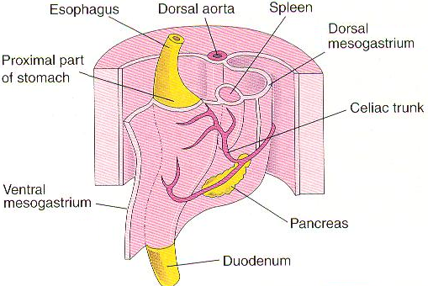
Mesenteries of Stomach
The stomach is suspended from the dorsal wall of the abdominal cavity by a dorsal mesogastrium
This mesentery is originally in the median plane but is carried to the left during rotation of the stomach
The ventral mesogastrium attaches the stomach and duodenum to the liver and the ventral abdominal wall

Slide 11
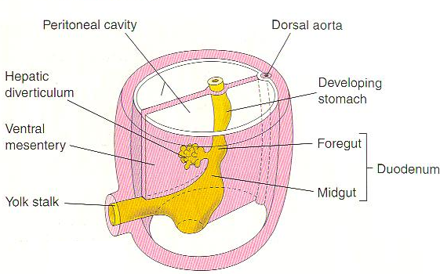
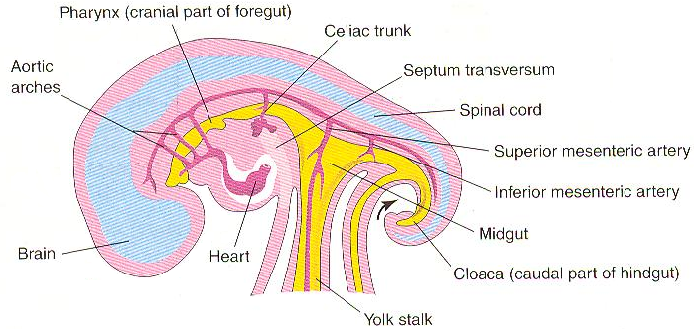
Duodenum
Early in the 4th week the duodenum begins to develop from the caudal part of the foregut, cranial part of the midgut
As the stomach rotates, the duodenal loop rotates to the right and comes to lie retroperitoneally
Because it is derived from the foregut & midgut, it is supplied by the branches of the celiac and superior mesenteric arteries

Slide 12
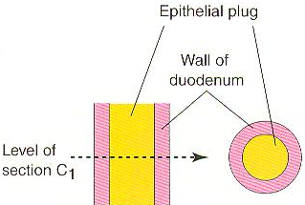
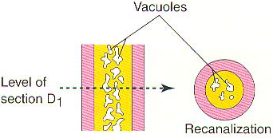
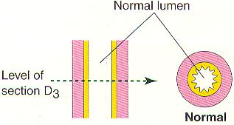
Duodenum
During the 5th and 6th weeks, the lumen of the duodenum is temporarily obliterated by proliferation of its epithelial cells
Normally vacuolation + degeneration of epithelial cells occur this results in recanalization of duodenum by the end of the embryonic period

Slide 13
Liver, Gallbladder & Biliary Apparatus
Early in the 4th week, the liver, gall bladder and biliary duct system arise as a ventral outgrowth (hepatic diverticulum) from the caudal part of the foregut
The hepatic diverticulum extends into the septum transversum a mass of mesoderm between the developing heart & midgut
Septum transversum forms the ventral mesentery in this region

Slide 14
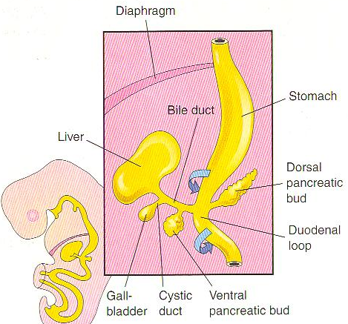
Liver, Gallbladder & Biliary Apparatus
The hepatic diverticulum enlarges rapidly into two parts as it grows between the layers of the ventral mesentery
The larger cranial part of the hepatic diverticulum is primordium of liver
The small caudal part of the hepatic diverticulum becomes the gallbladder

Slide 15
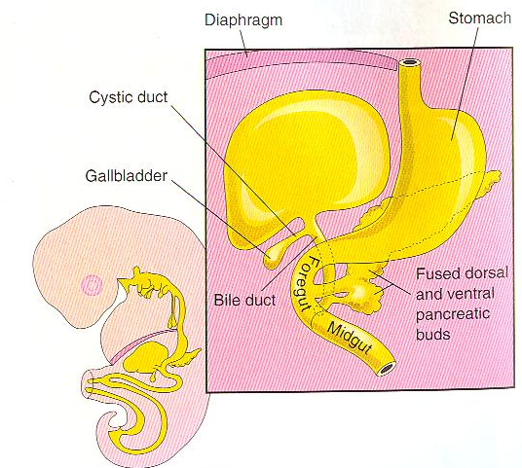
Liver, Gallbladder & Biliary Apparatus
The liver grows rapidly
During 5th to 10th weeks, it fills a large part of the upper abdominal cavity
Initially the right and left lobes are about the same size but right lobe soon becomes larger
Hematopoiesis begins during the 6th week, giving it a bright red appearance

Slide 16
Liver, Gallbladder & Biliary Apparatus
By the 9th week, liver accounts for about 10% of the total weight of the fetus
Bile formation by hepatic cells begins during the 12th week
Stalk of the diverticulum forms the cystic duct

Slide 17
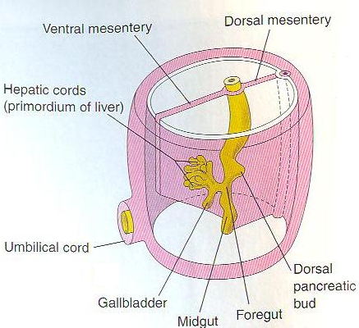
Liver, Gallbladder & Biliary Apparatus
Initially the extrahepatic biliary apparatus is occluded with epithelial cells
It is canalized due to degeneration of these cells
The stalk connecting the hepatic and cystic ducts to the duodenum becomes the bile duct
Initially this duct attaches to the ventral aspect of the duodenal loop

Slide 18
Liver, Gallbladder & Biliary Apparatus
As duodenum grows and rotates, the entrance of the bile duct is carried to the dorsal aspect of the duodenum
The bile entering the duodenum through the bile duct after 13th week gives the meconium (intestinal contents) a dark green color

Slide 19
Ventral Mesentery
This thin double layered membrane gives rise to:
The lesser omentum, passing from the liver to the lesser curvature of the stomach called hepatogastric ligament
From the liver to the duodenum the hepatoduodenal ligament
Falciform ligament extending from the liver to the ventral abdominal wall

Slide 20
Ventral Mesentery
Umbilical vein passes in the free border of the falciform ligament on its way from the umbilical cord to the liver
Ventral mesentery also forms the visceral peritoneum of the liver
The liver is covered by peritoneum except for the bare area

Slide 21
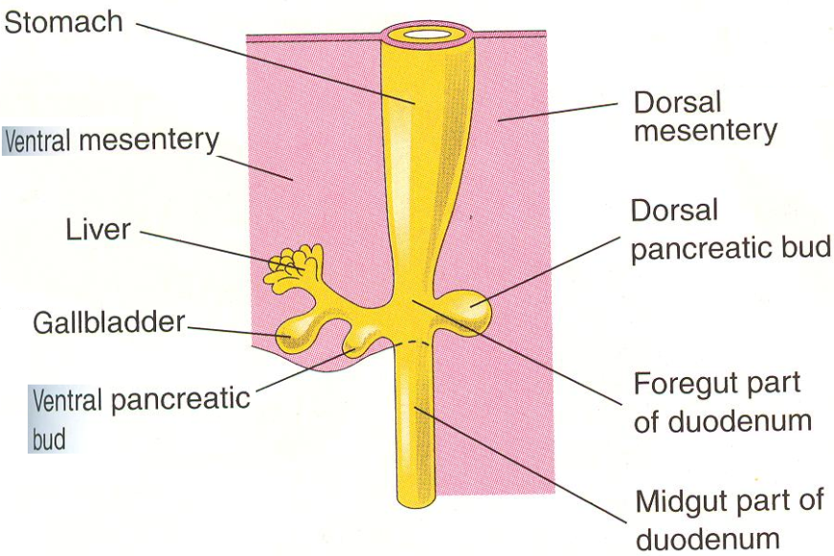
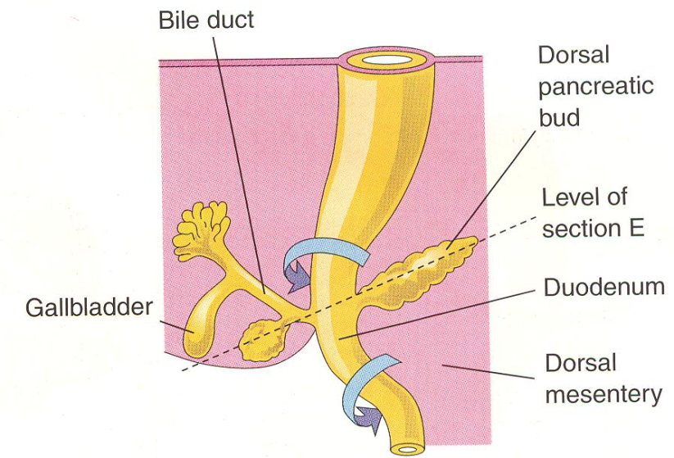
Pancreas
It develops between the layers of the mesentery from dorsal and ventral pancreatic buds of endodermal cells
These buds arise from the caudal part of the foregut
Most of the pancreas is derived from the dorsal pancreatic bud

Slide 22
Pancreas
The larger dorsal pancreatic bud appears first and develops a slight distance cranial to the ventral bud
It grows rapidly between the layers of dorsal mesentery
The ventral bud develops near the entry of the bile duct into the duodenum and grows between the ventral mesentery

Slide 23
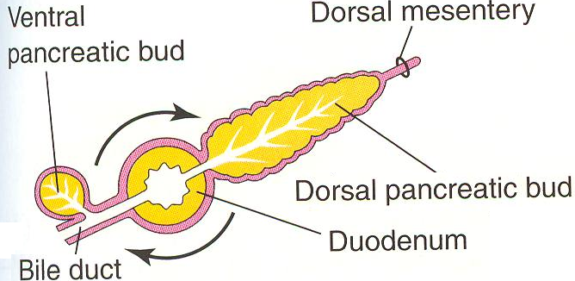
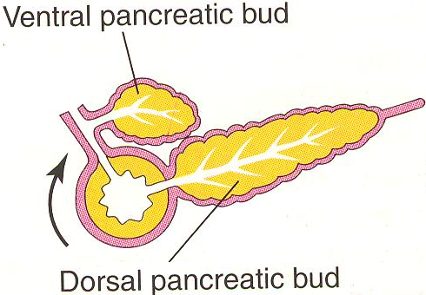
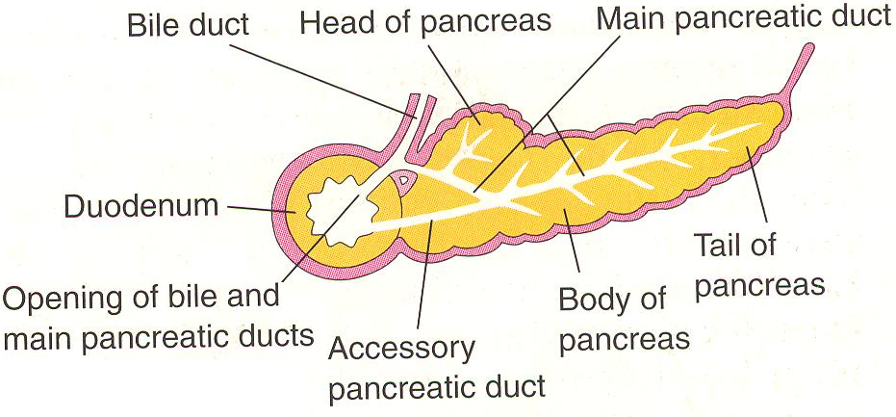
Pancreas
As the duodenum rotates to the right and becomes C-shaped, the ventral pancreatic bud is carried dorsally with the bile duct
It soon lies posterior to the dorsal pancreatic bud and later fuses with it
The ventral pancreatic bud forms the uncinate process and part of the head of the pancreas
As the stomach, duodenum and ventral mesentery rotate, the pancreas comes to lie along the dorsal abdominal wall

Slide 24
Pancreas
The main pancreatic duct forms from the duct of the ventral bud and the distal part of the duct of the dorsal bud
The proximal part of the duct of the dorsal bud often persists as an accessory pancreatic duct
The two ducts often communicate with each other
In about 9% of people, the pancreatic ducts fail to fuse

Slide 25
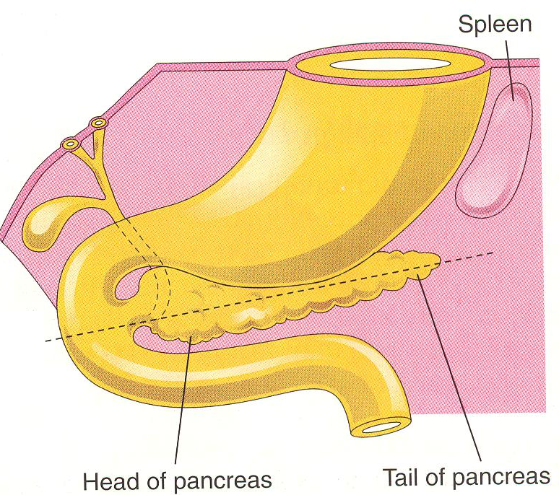
Spleen
Development of spleen is described with the digestive system because it is derived from a mass of mesenchymal cells located between the layers of the dorsal mesogastrium
It begins to develop during the 5th week
It does not acquire its characteristic shape until early in the fetal period
It is lobulated in the fetus but lobules disappear before birth

Slide 26
Spleen
The notches in the superior border of adult spleen are remnants of the grooves that separated the fetal lobules
As the stomach rotates, the left surface of mesogastrium fuses with the peritoneum over the left kidney
This fusion explains the dorsal attachment of the spelnorenal ligament

Slide 27
Thank you

