Slide 1
Digestive System: Alimentary Canal
Metallic 0 Mind

Slide 2
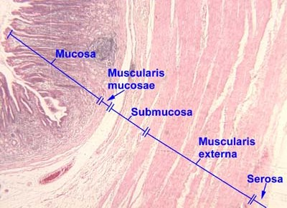
Alimentary Canal composed of
mucosa
submucosa
Muscularis externa
Serosa or (adventita)

Slide 3
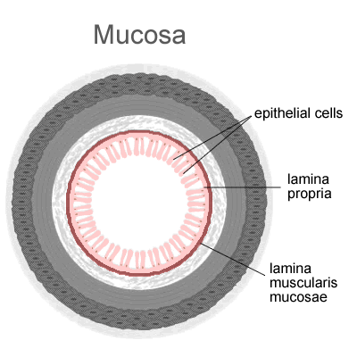
Submucosa:
Dense irregular fibroelastic connvtive tissue.
No glands Except in the esophagus and duodenum.
Meissner’s submucosal plexus: houses postganglionic nerve cell bodies.
Mucosa:
Lined by epithelium.
Deep is a loose connective tissue (Lamina Propria) that houses glands and lymph vessels.
Mucsularis mucosae surround lamina propria and composed of :
Inner circular layer.
Outer longitudinal layer

Slide 4
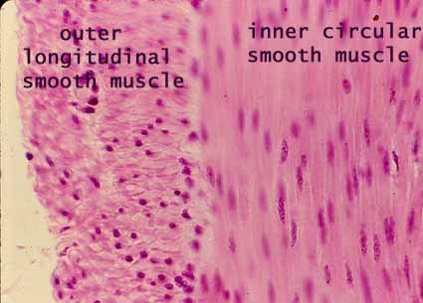
Connective tissue envelopes the muscularis externa that may or may not surrounded by squamous epithelium
If:
Muscularis Externa
Responsible for peristaltic activity.
Smooth muscle Except in the esophagus.
Interstitial cells of cajal are the pacemakers.
Arranged helically
Composed of
the organ is inraperitoneal it’s known as Serosa
The organ is retroperitoneal it’s known as adventitia
Between the muscle is auerbach’s myenteric plexus composed of postganglionic parasympatheric nerve cells.

Slide 5
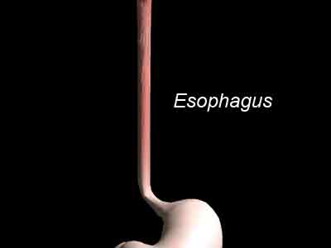
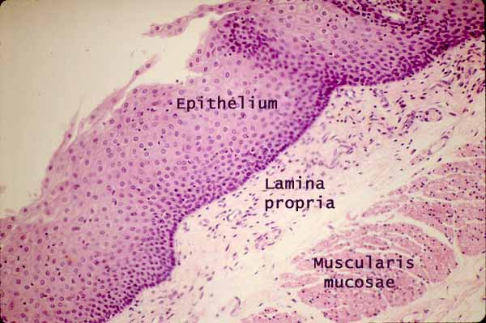
Mucousa:
Epithelium:
Stratified squamous nonkeratinized epithelium.
Lamina propria:
Unremarkable.
Houses esophageal cardiac glands in two clusters:
Near the pharynx.
Near its juncture with stomach.
Muscularis Mucosae:
Single layer of longitudinal smooth muscle.

Slide 6
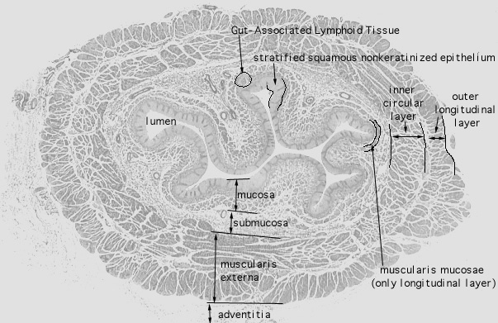
Submusosa:
Muscularis externa
fibroelastic connective tissue.
Houses esophageal glands proper.
Inner circular and outer longitudinal layers.
They have both skeletal and smooth.
In the upper third of esophagus it’s mostly skeletal
In the middle third it’s both skeletal and smooth
In the lowest third it’s only smooth
The esophagus it covered by and adventitia until it pierces the diaphragm after that it’s covered by serosa.

Slide 7
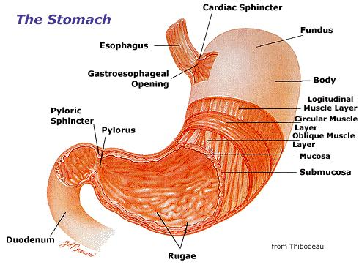
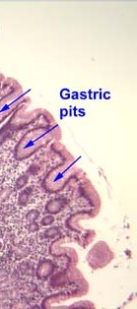
Stomach
Has 4 regions
Cardia
fundus
body
pylorus
Rugae:
Longitudinal folds (transverse in the anturm) of mucosa and submucosa.
Disappear in distended stomach.
Gastric Pits:
Formed by epithelial lining.
Gastric glands empty in the bottom of each gastric pit.

Slide 8
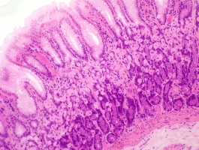
Fundic Mucosa
Epithelium :
Simple columnar epithelium.
surface lining cells : manufacture mucin.
No goblet cells.
Lamina propria:
Connective tissue.
Occupied by Fundic (oxyntic) Glands.
Fundic Glands:
short pits.
Simple or branched.
Have 3 regions:
Isthmus.
Neck.
Base.

Slide 9
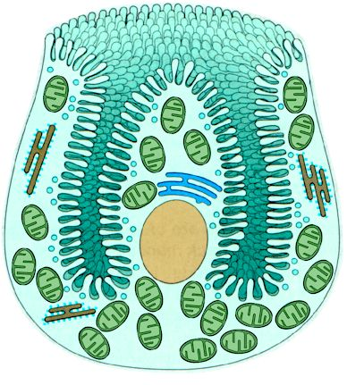
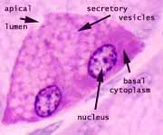
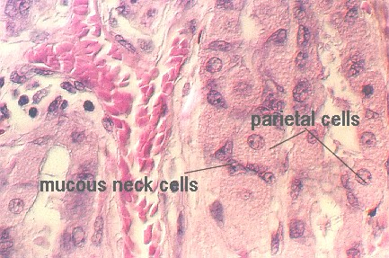
Fundic gland cells
Surface lining cells
Mucous neck cells
Regenerative cells
Parietal cells
Chief cells
DNES cells
Regenerative (stem) cells:
In the neck region.
Proliferate to replace all of the specialized cells
DNES cells (APUD or enteroendocrine cells)
In the base region.
Manufacture: endocrine, paracrine, neurocrine hormones.
Well-developed RER and golgi apparatus and numerous mitochondria.
Basal granules.
If:
Parietal (oxyntic) Cells:
at the periphery of the gland.
Produce (HCL) and intrinsic factors.
Basally located nuclei.
Acidophilic
Apical membrane invaginates to form intracellular canaliculi lined by microvilli.
Cytoplasm in the canaliculi has round and tubular vesicles tubulovesicular system.
Rich in mitochondria.
Cell Types | Region
Surface lining cells | Isthums
Mucous neck cells, regenerative cells, parietal cells | Neck
Chief cells, DNES cells | Base
Chief (zymogenic) cells:
In the base region.
Manufacture pepsinogen, renin, gastric lipase
Exhibit rich RER, golgi apparatus, apical granules.
Basophilic.
Mucous neck cells:
In the neck region.
Secrete mucous to lubricate gastric content.
Golgi apparatus , RER are present.
Mitochondria in the basal region of the cell.
Apical cytoplasm has secretory granules.
The cell reach the lumen of the gut called (the open type)
The cell doesn’t reach the lumen called (the closed type)

Slide 10
Submucosa of the stomach:
Dense, irregular collagenous connective tissue.
Muscularis Externa:
Three layers:
Cardiac region
Gastric pit are shallower
Fundus region
Gastric pit are shallow
There are chief cells
Pyloric region
Gastric pit are deeper
No chief cells.
No chief cells
Base of it’s galnd if highly coiled
Glands are highly convoluted
Mucous neck cells are dominant and they produced lysozyme.
Innermost Oblique muscle layer:
Not well defined except in the cardiac region.
Middle Circular muscle layer:
Especially pronounced where it forms the pyloric sphincter.
Outer longitudinal muscle layer
Serosa:
Thin loose subserous connective tissue.
Covered by wet smooth wet simple squamous epithelium.

Slide 11
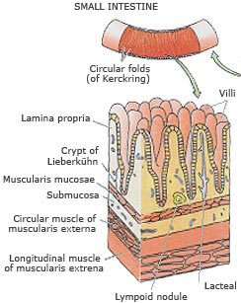
Small Intestine
3 types of modification are present in the small intestine to increase the surface area:
Plicae Circulares (valves of Kerckring)
Transverse folds of submucosa and mucosa.
Permanent.
Inncrease surface area by factor 2 to 3
Villi:
Protrusions of the lamina propria.
Epithelially covered.
The core composed of :
Capillary loops
Lymphatic channel (lacteal)
Few smooth muscle fibers.
Loose connective tissue rich in lymphoid cells
Numbers are greater in the duodenum.
Increase the surface area 10 times
Microvilli:
Increase by factor of 20
Invaginations of the epithelium into the lamina propria between villi form glands (crypts of Lieberkühn)

Slide 12
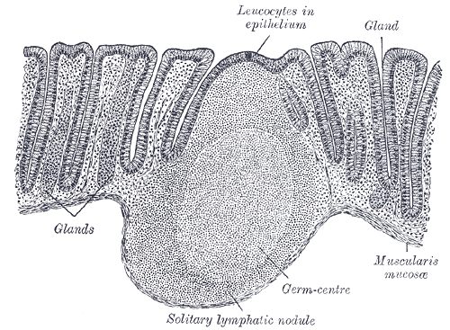
Intestinal mucosa
Simple columnar epithelium with 3 cells
Surface absorvative cells
Goblet Cells:
Duodenum has the smallest number
DNES Cells
in regions where lymphoid nodules abut the epithelium.
M cells replace simple columnar epithelial lining of the small intestine.
Function: presents antigen

Slide 13
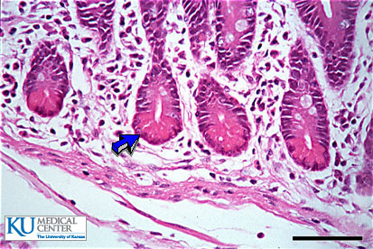
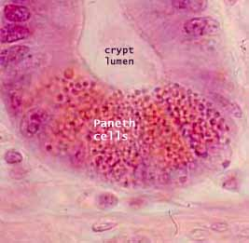
Lamina Propria
Loose connective tissue.
Crypts of Lieberkuhn:
Tubular (or branched) gland.
Open into the intervillus space.
The crypts composed of
Surface absorptive cells
Goblet cells
Regenerative cells
DNES cells
Paneth Cells
Paneth cells:
In the bottom of the crypts.
Acidophilic
Apical granules.
Manufacture lysozyme.

Slide 14
Muscularis mucoasae:
Inner circular layer.
Outer longitudinal layer
Submucosa:
Irregular fibroelastic connective tissue.
Submucosa of the duodenum houses glands known as Brunner’s Glands.
duodenum
Has brunners’s glands that secretes mucous and bicarbonate fluid
ileum
Has peyer’s patches which is lymph nodules located opposite the attachment of the mesentry
jejunum
No features
Muscularis Externa:
Inner circular layer.
Outer longitudinal layer.
Second and third part of the duodenum have adventitia.
Everything else has serosa.

Slide 15
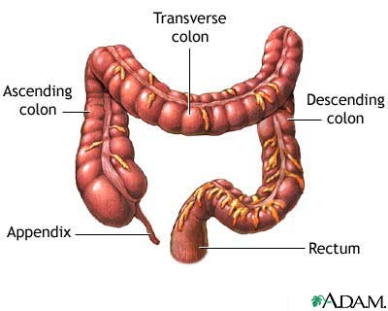
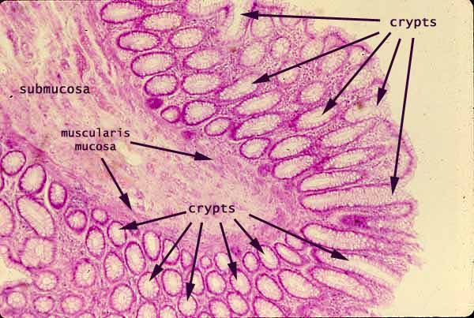
Large Intestine
Colon Histology:
No villi.
Have crypts of lieberkühn.
Absent Paneth cells.
Lamina propria, muscularis mucosa, submuosa resemble small intestine.
Muscularis externa:
have unusual outer longitudinal muscle layer.
The muscle gathered in three narrow ribbons known as taenie coli
Serosa has a fat-filled pouches called appendices epiploicae.

Slide 16
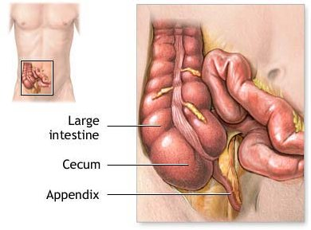
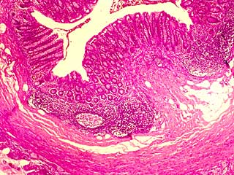
Appendix
Vermiform appendix
Mucosa:
Simple columnar epithelium consisting of surface absorptive , goblet cells, M cells.
Lamina propria : loose connective tissue with lymph nodules and crypts of liebekühn
Same muscularis mucosae as colon.
Same submucosa also it have lymphoid nodules and fatty infiltration.
Same muscularis externa.
Covered by serosa

Slide 17
Please Remember
Meissner’s plexus and Auerbach plexus present in all tissues of alimentary canal.
Goblet cells starts at the duodenum and increases gradually

