Slide 1
Female Reproductive System
HISTICS
Bilal Marwa
AbdulWahhab Idrees
AbdulAziz AlJo3ry
AlAnood AlSolaihim

Slide 2
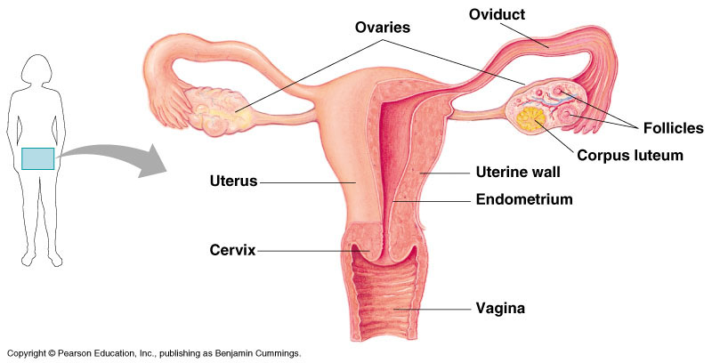
Ovaries
By 3rd week of intra-uterine life oogonia appear.
Ovarian covering :
By peritoneum “ visceral , parietal “

Slide 3
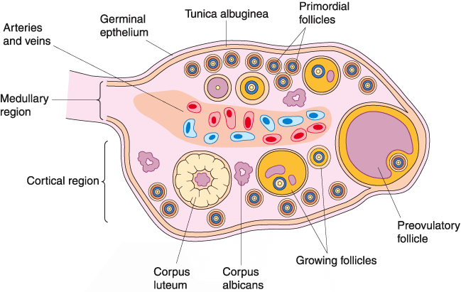
Epithelium
Tunica Albuginea
Medulla
Cortex

Slide 4
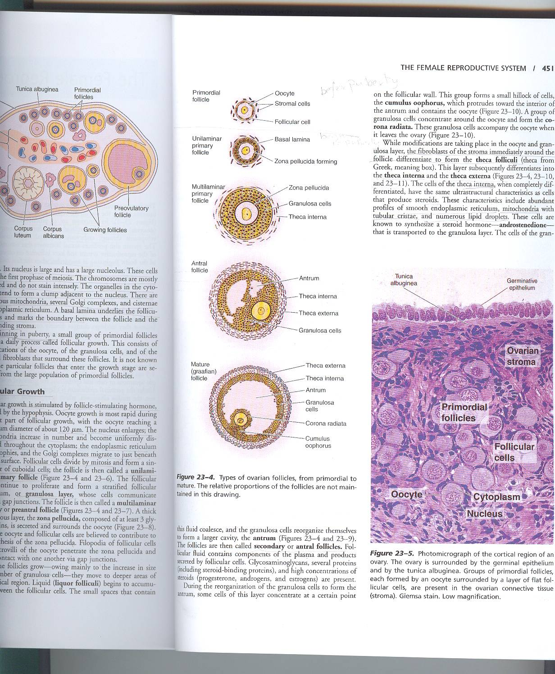
Ovary
Surface: germinal epithelium
(tunica vaginalis)
  Low cuboidal epithelium

Slide 5
Ovary
Tunica Albugine: dense fibrous C.T.
  Poorly vascularized

Slide 6
Ovary: Medulla
Medulla: loose vascular C.T.
Hilus cell:
  Like leydig cell in males
  Secrete Androgen like substance
No follicles, no ova, no oocytes in medulla (MCQ)
  (all follicles and ova are found in the cortex)

Slide 7
Ovary: cortex
Two types of cells
Ovarian follicles (next slide)
Interstitial cells between follicles
  Fibroblast like
  Also known as (stromal cell)

Slide 8
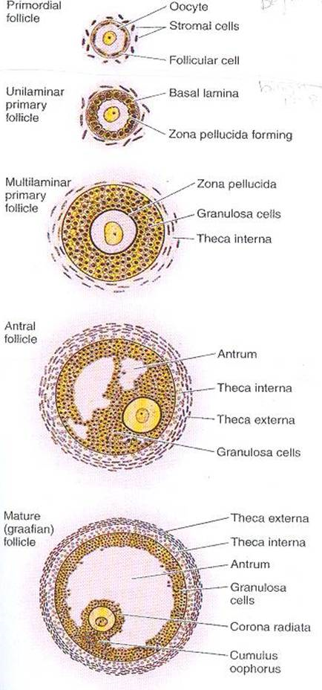
The ovarian follicles
Before the onset of puberty all the follicles are primordial follicles (so it is present before & after puberty) → non-growing – flat layer of cells
Follicles present only after puberty (growing) :
  Unilaminar primary follicles
  Multilaminar primary follicle
  Secondary Follicles
  Graffian Follices
    Then it ruptures, releasing the oocyte to become corpus luteum

Slide 9
Ovarian Follicles
Contain primary oocyte in the
prophae of meiosis I
  Except in the last stage in
  the mature (graafian folliicle) then it becomes a secondary oocyte
Each primary oocyte is surrounded by one or more layers of cells called follicular cells
Primary oocyte is separated from follicular cells by zona reticularis, made by the primary oocyte and the 1st layer of follicular cells
The follicular cells are seperated from the CT of the cortex (stroma) by a basal lamina

Slide 10


Primordial follicles:
Abundant before birth
Its primary oocytes:
  Spherical cell
  Nucleus: Large, vesicular, 1 prominent nucleolus
Follicular cells:
  squamous,
  attached by desmosomes,
  has basal lamina.

Slide 11
Growth of oocyte
It increases in size(120µm).
Increase of nuclear size.
Increase number of mitochondria.
Increase rER.
Increase Golgi apparatus which becomes peripheral in position.

Slide 12
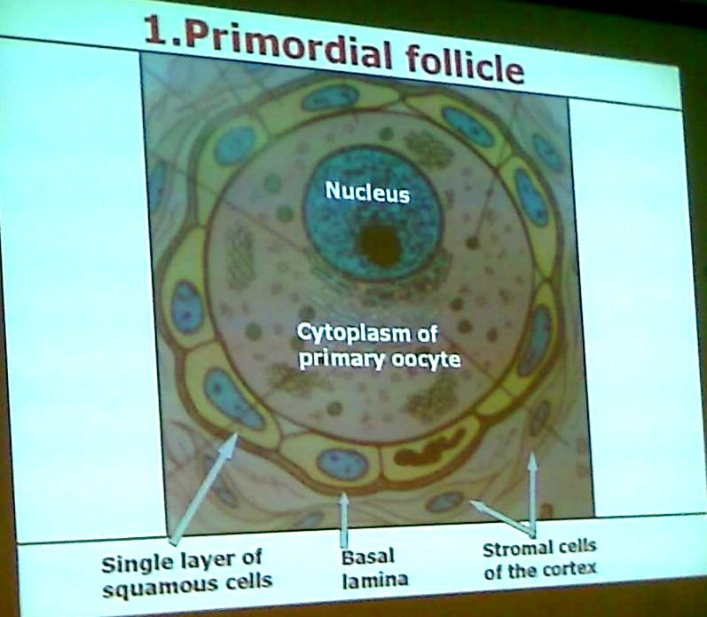
Primordial Follicle

Slide 13
Primary follicle
Primary oocyte enlarges.
Follicular cells become cuboidal .
Subdivided into:
  Unilaminar primary follicle: follicular cells arranged in 1 layer
  multilaminar primary follicle: More than one layer
Zona pellcida starts to be made in the unilaminar primary follicle,Follicular(granulosa) cells and oocyte secrete glycoproteins that surround the oocyte

Slide 14
Primary follicle
Stromal cells arranged around follicular cells forming:
  Theca interna (vascular)
  Theca externa (fibroblast)
Stromal cells: characteristics of steroid producing cells numerous lipid droplets “ lipid in nature “
Separated from follicular (granulosa) cells by basal lamina.
Theca interna: vascularized, more cellular, less fibrous , SER , mitochondria , pale cytoplasm
androstendion estrogen.
theca externa: less vascularized, less cellular, more fibrous
granulosa cells

Slide 15
Secondary (antral) Follicle
Intercellular space filled with liquor folliculi (liquid)
Oocyte surrounded by of granulose cells project into the fluid filled antrum known as cumulus oophorus
Single layer of granulose cells immediately surround oocyte known as corona radiate.
A- The oocyte is fixed in zona pellucida by microvilli.
B-The layer of granulosa cells adherent to zona pellucida is fixed into to it by filopodia.
NB-follicular fluid is formed of plasma, glycosaminoglycans, steroid-binding protein and steroid hormones (estrogen-progesterone-androgen)

Slide 16
Mature (graffian) follicle
Follicular cells of the wall of the follicles composed of membrana granulose
at ovulation the oocyte will be secondary

Slide 17
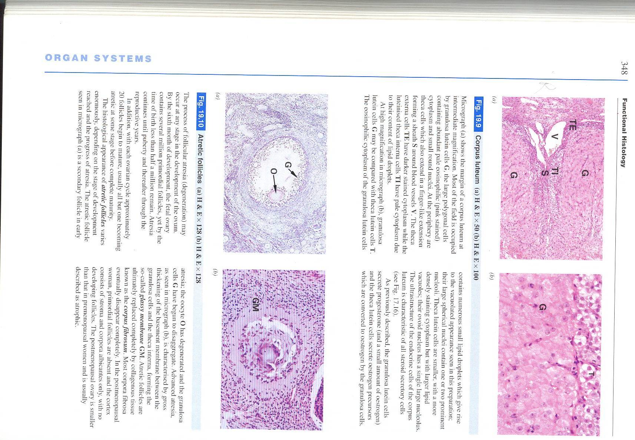
Corpus luteum
No pregnancy –> corpus of menstruation
There’s pregnancy ->corpus of pregnancy
remaining of graffian follicle
ruptured blood vessels form clot known as corpus hemorrhagicum
  clot removed by phagocytosis
LH converts hemorrhagicum into corpus luteum
Function as endocrine gland
Composed of :
  Granulosa lutein cells
  Theca lutein cells

Slide 18
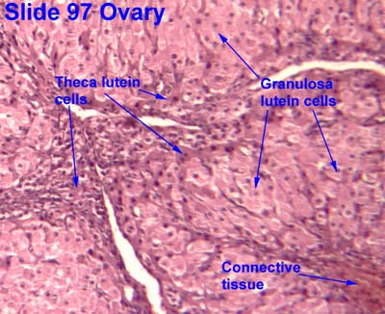
Granulosa cells
80%
Derived from granulose cells
Granulosa cells increase in size ( not in number) giving granulosa lutein cells
Microvilli, has the organelles of steroid producing cells
Some lipid droplets
Produce progesterone

Slide 19
Theca lutein cells
20%
Derived from theca interna cells (estrogen precursors)
Organelles of steroid producing cells ( rich in lipid droplets )
Produce progesterone , estrogen and androgens

Slide 20
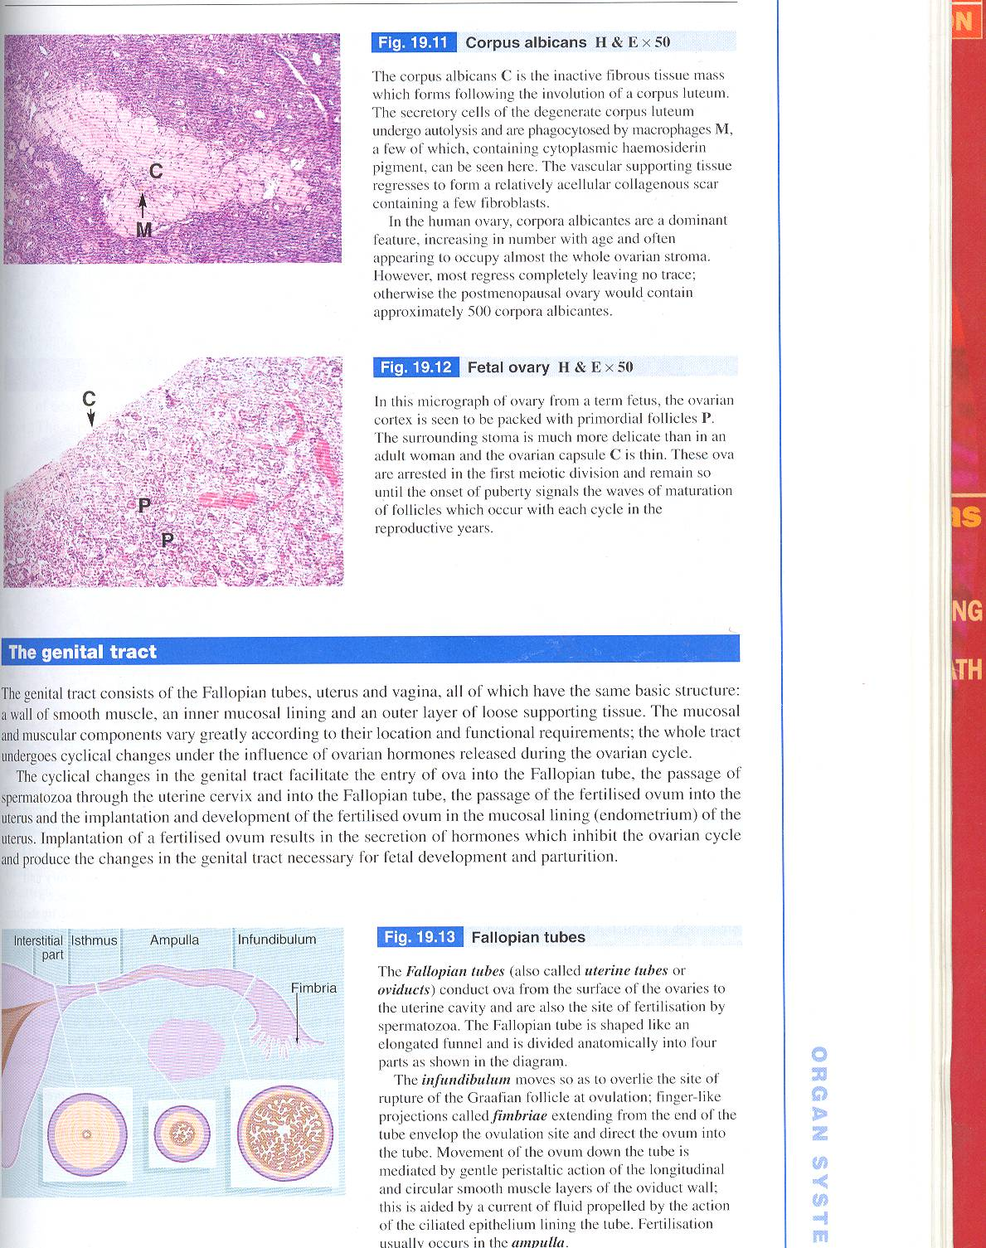
Corpus Albicans
Corpus luteum invaded by fibroblasts becomes fibrotic and is converted into corpus albicans ( degenerated corpus luteum )
So it is derived ONLY from corpus luteum

Slide 21
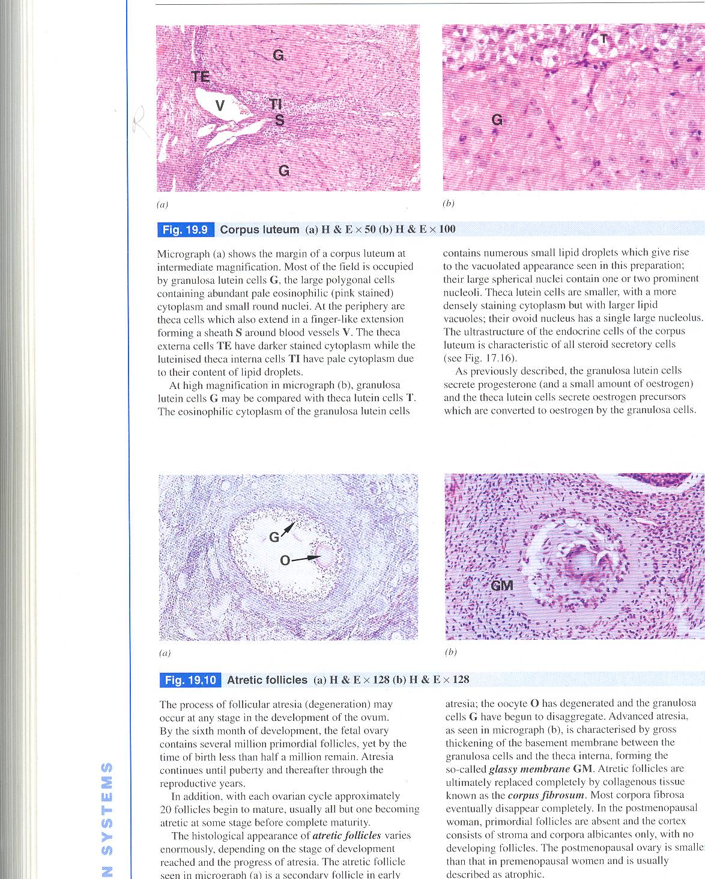
Atretic follicles
Most follicles degenerate before reaching mature stage
Forming atretic follicles
Theca interna Interstitial cells (secrete steroid hormone)
Eventually phagocytosed by macrophage

Slide 22
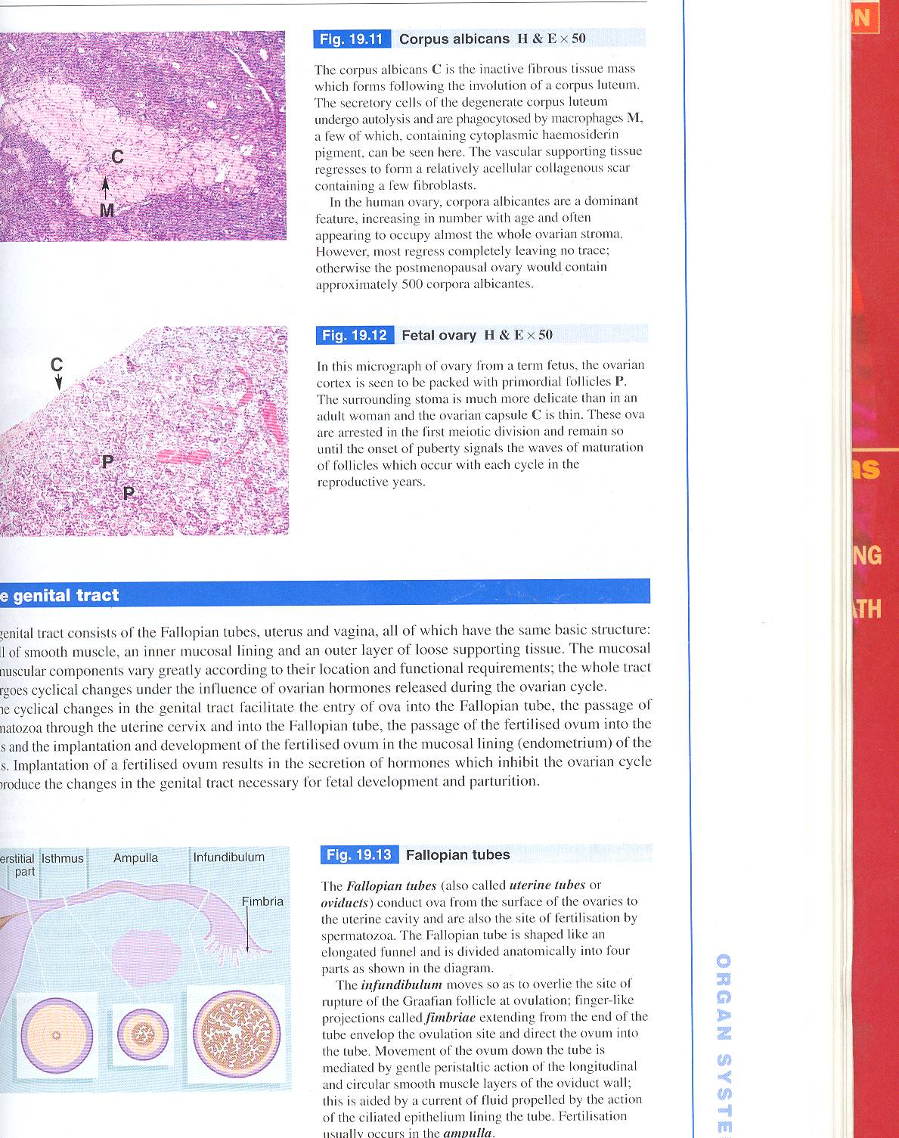
Oviducts
Continuous with the wall of the uterus
Divided into four regions:
Infundibulum has fimbriae
Ampulla where fertilization occur
Isthmus
Intramural
region

Slide 23
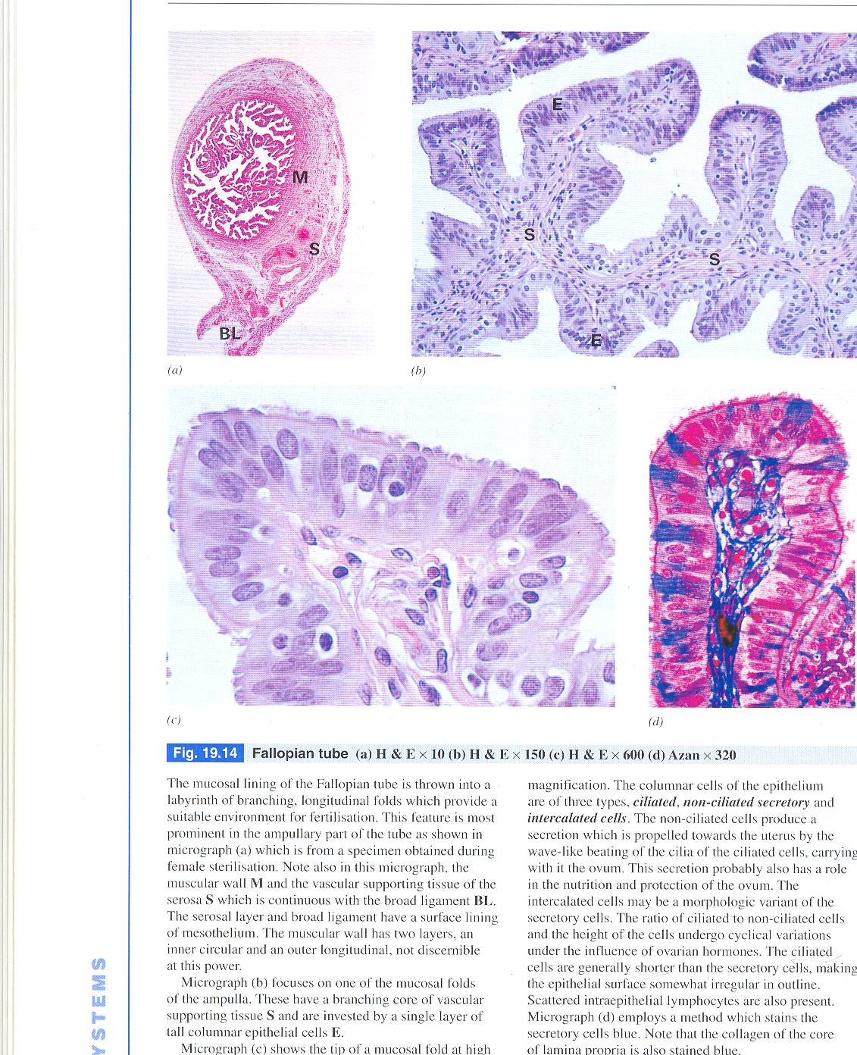
Oviduct
Has three layers:
Mucosa
Muscularis
Serosa
Mucosa: longitudinal folds, simple columnar epithelium, has two cells:
  Peg cells: have no cilia secretory function
  Columnar ciliated cells beat toward the uterus

Slide 24
Oviduct Mucosa
longitudinal folds (infudibulum & ampulla),
simple columnar epithelium, has two cells:
  Peg cells: have no cilia secretory function
  Columnar ciliated cells beat toward the uterus
Lamina propria: loose connective tissue contains fibroblasts mast cells lymphocytes and collagen . Highly vascular

Slide 25
Oviduct
2. Muscularis: inner circular outer longitudinal and connective tissue fills spaces between them (thick in isthmus)
3. Serosa: simple squamous epithelium, loose connective tissue has blood vessels and autonomic nerve fibers

Slide 26
Uterus
Divided into three regions:
  Fundus
  Body
  Cervix

Slide 27
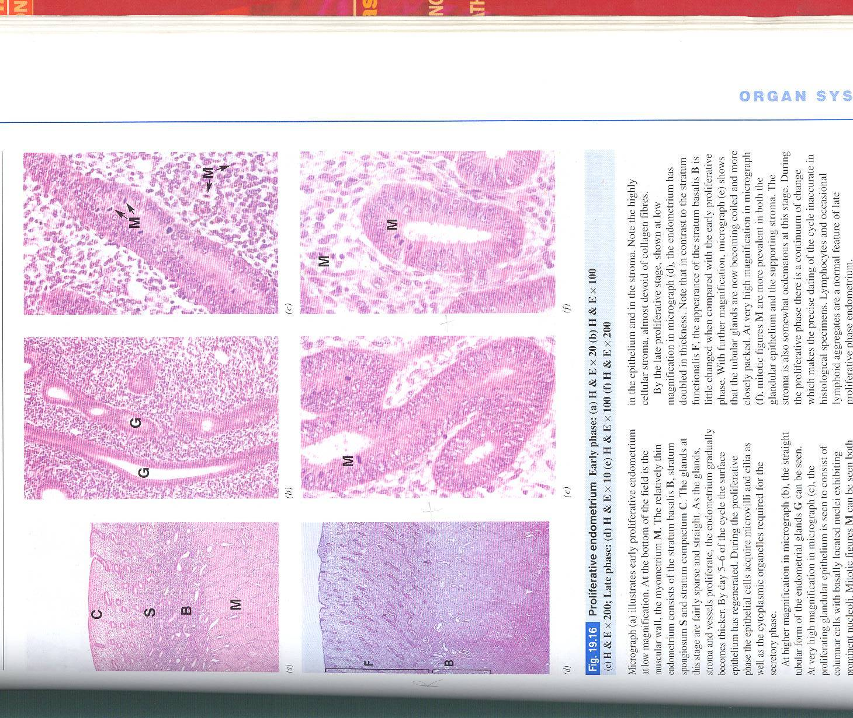
Late proliferative phase of endometrium | Early proliferative phase of endometrium
Gland is large | Proliferation of glands, stroma &vessels.(very thick & rich in glands )

Slide 28
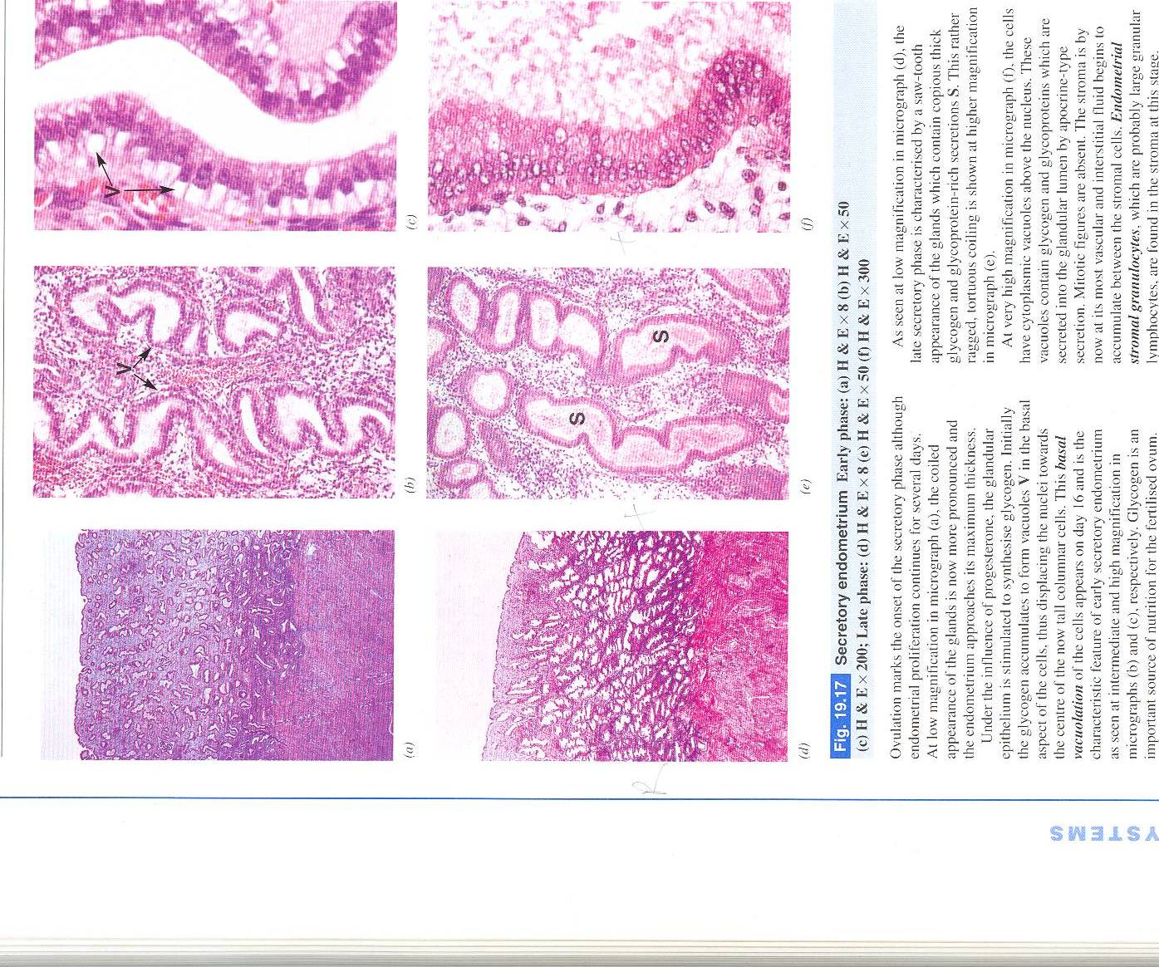
Late secretory phase of endometrium. | Early secretory phase of endometrium
The glands are tortuous and full of glycogen and glycoprotein. The stroma is highly vascular. | Increase the size and coiling of the glands. Glycogen accumulates in glandular epithelial cells

Slide 29
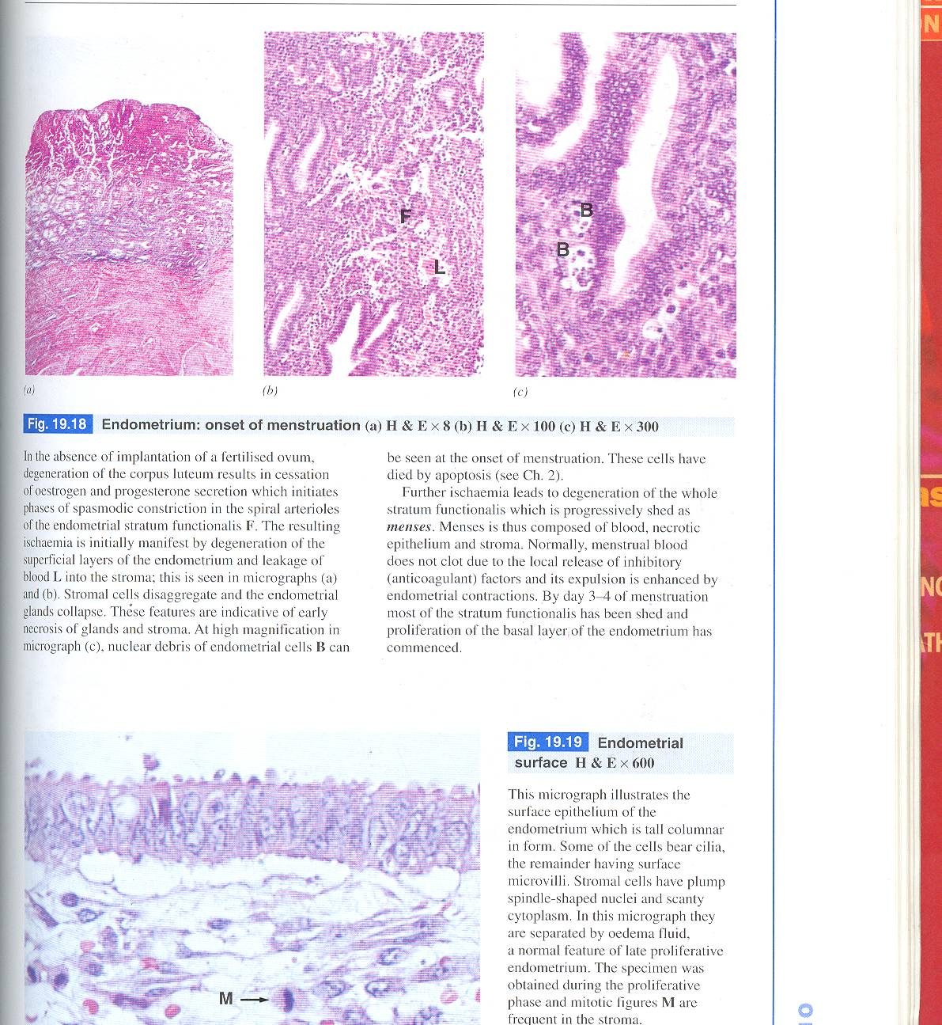
menstruation
Vasoconstriction in the spiral arterioles of the functionalis layer,leads to ischemia and degeneration of functionalis.
Leakage of blood.
Degeneration of stroma cells leads to collapse of the glands.
Shedding of the functionalis menses

Slide 30
Body and fundus: Endometrium
Simple columnar epithelium composed of nonciliated secretory columnar cells and ciliated cells
Lamina propria:
  dense irregular collagenous connective tissue highly cellular and contains star shaped cells , macrophages leukocytes and reticular fibers. Houses branched tubular glands
Consist of 2 layers:
  Functionalis thick superficial layer
  Basalis: deep narrow layer where glands and connective tissue regenerate the functionalis

Slide 31
Body and Fundus: Myometrium
Inner and outer longitudinal muscle layers
Middle circular
Highly vascularized region (stratum vasculare) houses arcuate arteries
When covered by serosa it will be squamous mesothelial cells resting on areolar connective tissue.

Slide 32
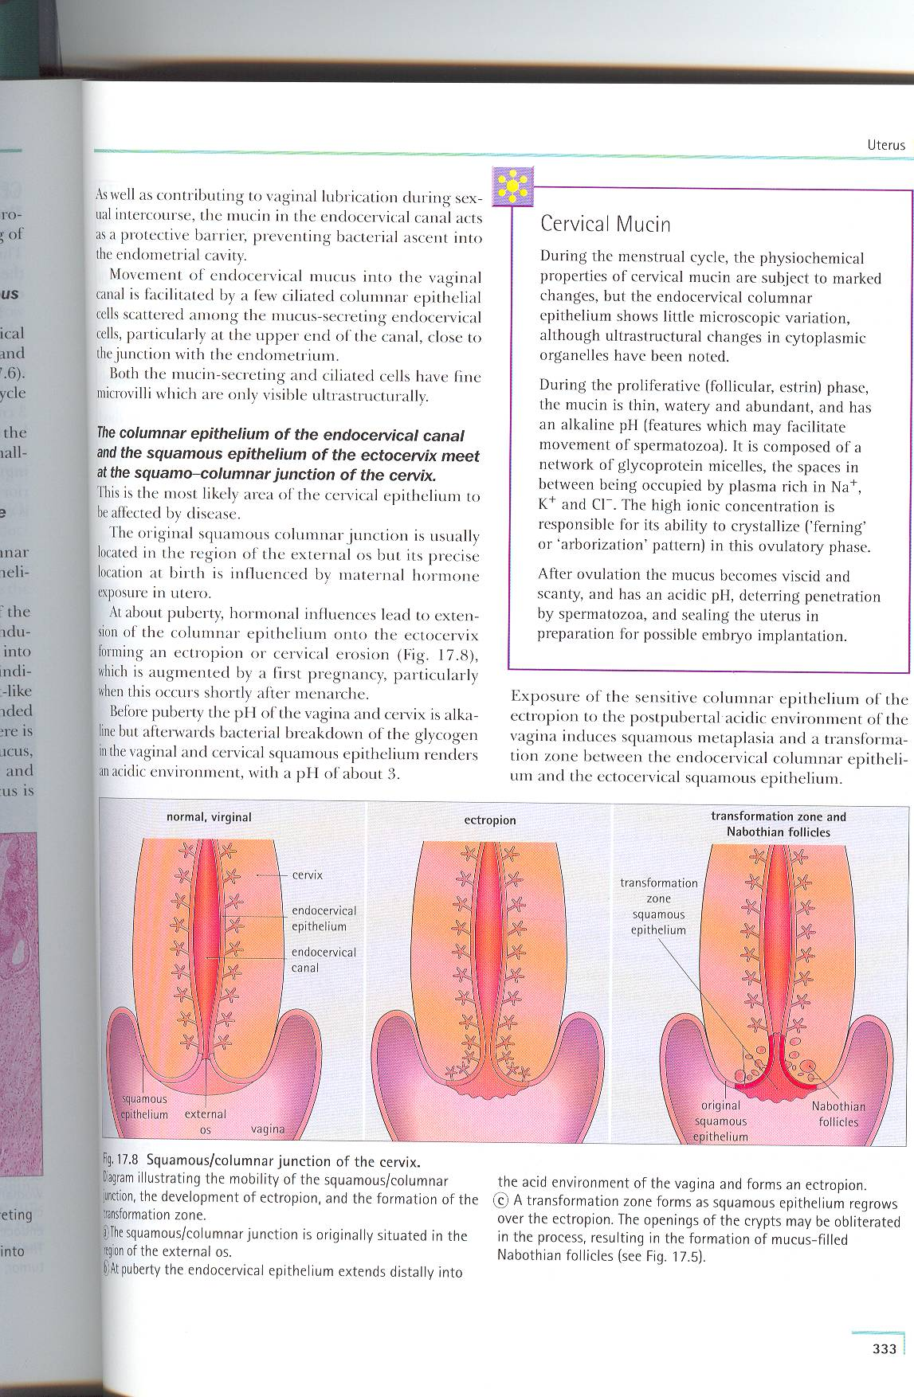
Cervix
Non – muscular
Lined by mucous secreting
simple columnar epithelium
External surface covered by stratified squamous nonkeratinized epithelium “ similar to wall of vagina “
Wall of the cervix dense collagenous connective tissue with many elastic fibers and few smooth muscle fibers
Cervix mucosa will not sloughed off during menses.

Slide 33
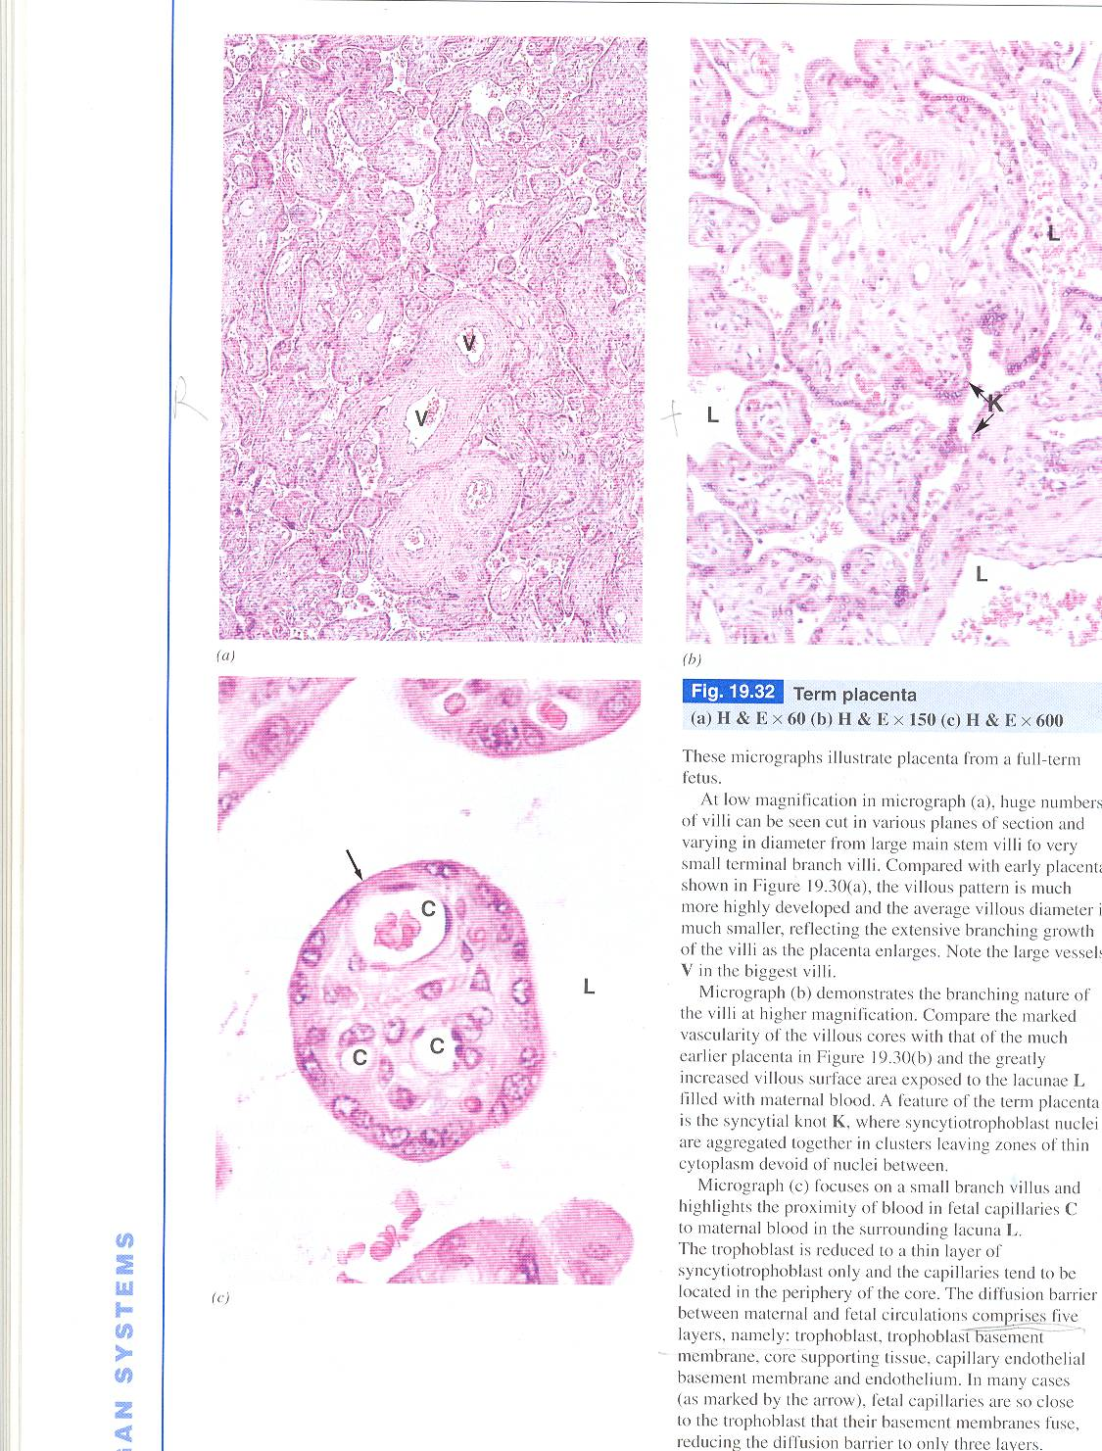
* Synctyiotrophoblast erodes maternal blood vessels
* from the remainder of trophoblasts chorion developes and gives rise to chorionic villi
at full term the placenta will not have
cytotrophoblast

Slide 34
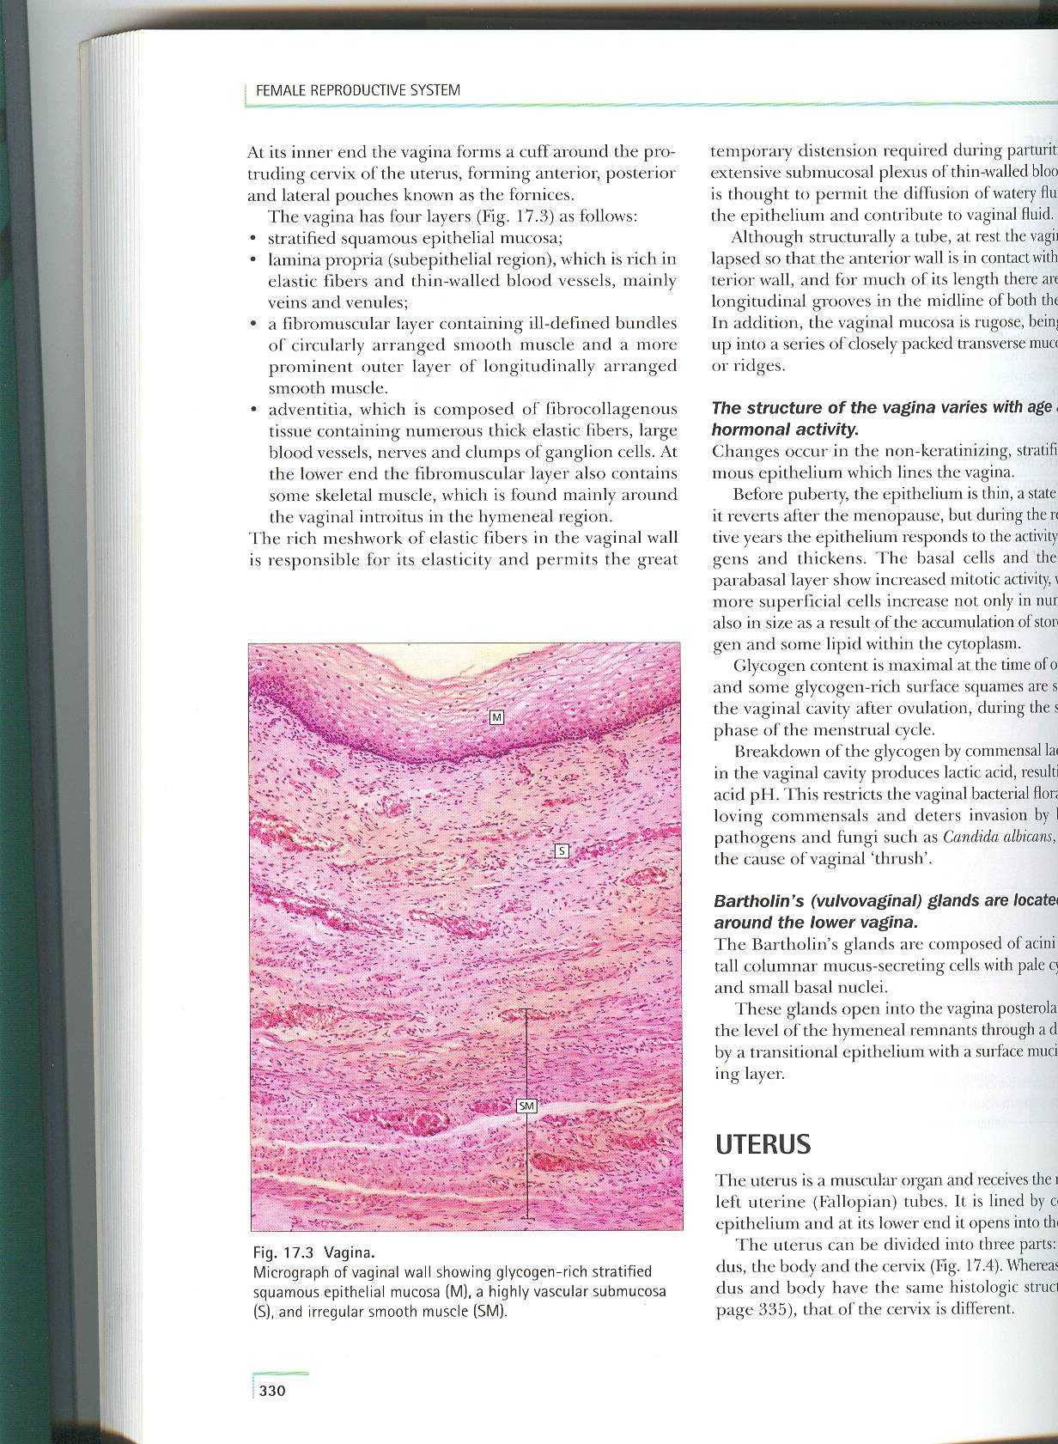
Vagina
lumen is lined by stratified squamous nonkeratinized epithelium
the cells store large deposits of glycogen
lamina propria: loose fibroelastic connective tissue with lymphocytes and neutrophill ,no glands, pale cytoplasm , acidic , no goblet cell
It’ kept wet by endometrium
muscularis: outer longitudinal inner circular “ not continous , interrupted by C.T “
adventitia: dense fibroelastic connective tissue

Slide 35
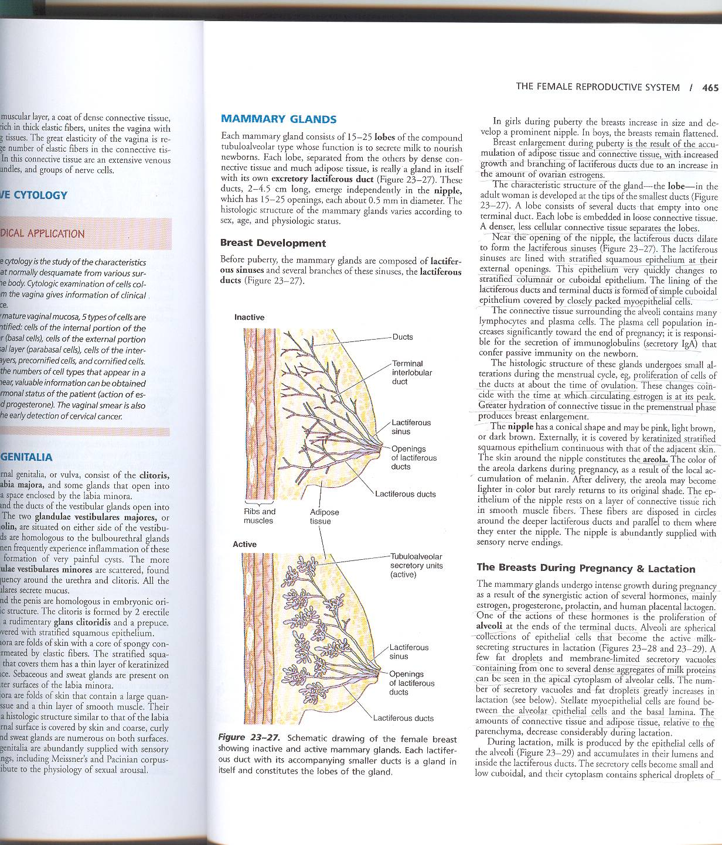
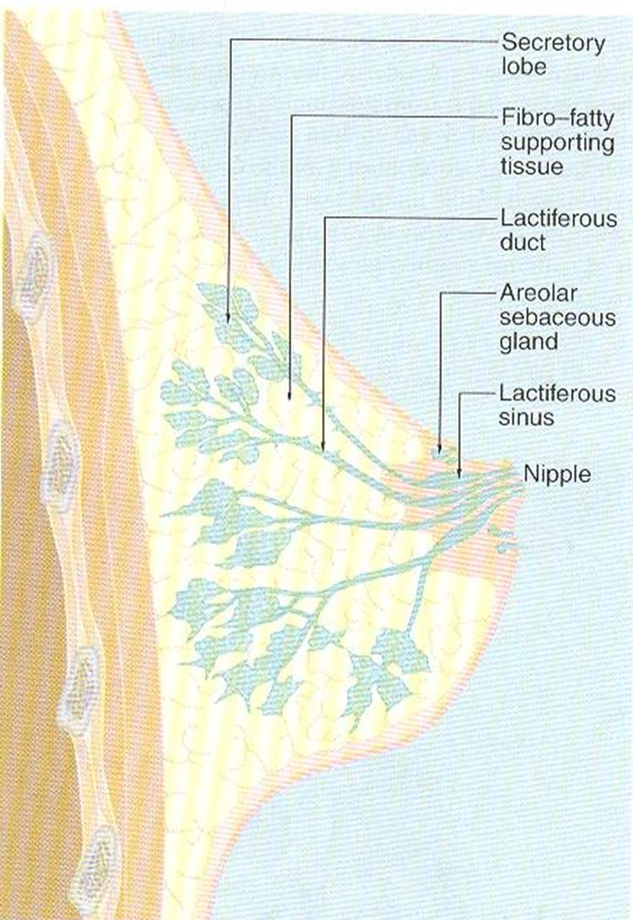
Mammary Glands
at puberty there is an increase in connective and adipose tissue , C.T
the glands within the breast are classified as compound tubuloalveolar glands,

Slide 36
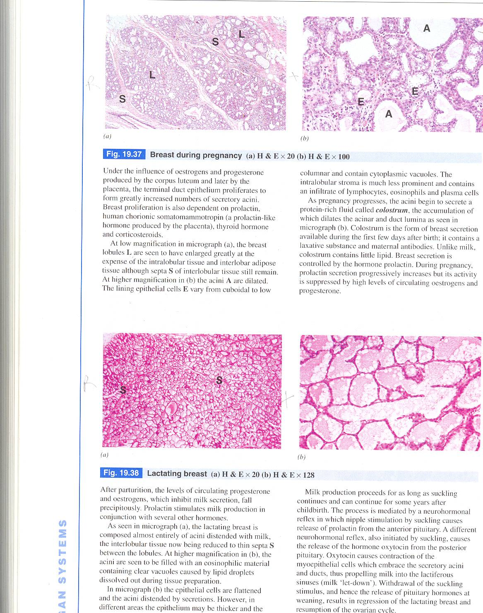
resting mammary glands:
lactiferous sinus and duct lined by stratified cuboidal epithelium
smaller ducts are lined by simple columnar epithelium
myoepithelial cells are present
Terminal ends of the ducts show dilated acini
Each lobule will be enlarged
while the inter and
intra-lobular
tissues are decreased.

Slide 37

active mammary glands:
Lactating
alveoli composed of cuboidal cells
secretion have two kinds : lipids and proteins
lipids secreted by apocrine mode
proteins secreted by merocrine mode
reduction of interlobular tissue. reduction of intralobular CT.distended acini (alveoli) with milk.Acini are lined with flat epith.
NB.Suckling stimulate prolactin
and oxytocin hormones secretion

Slide 38
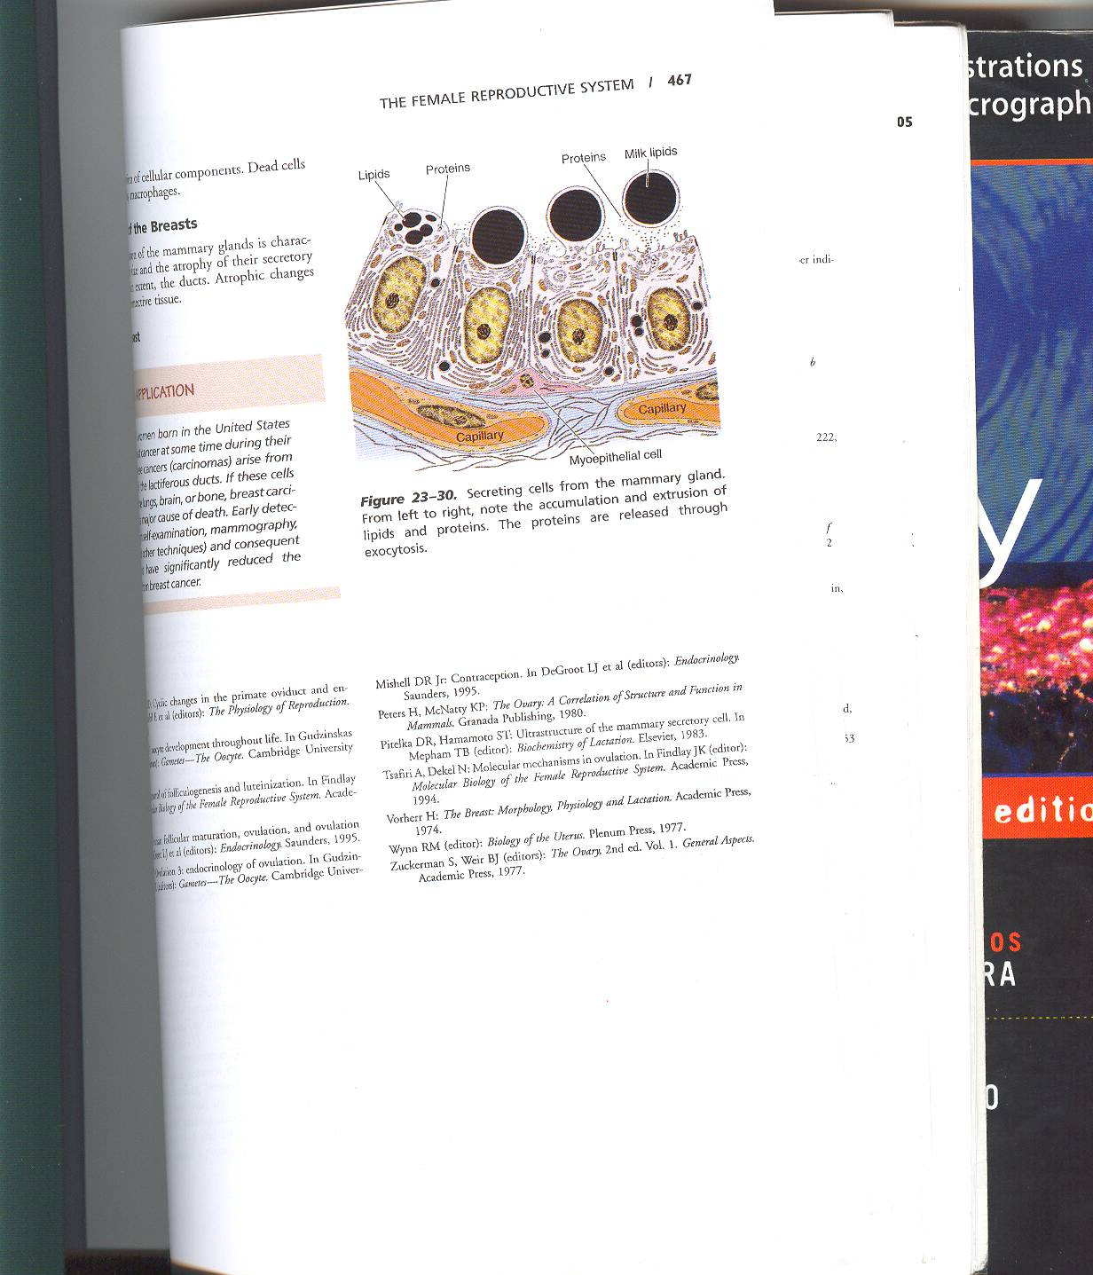
Mechanism of milk secretion
Contain protien , lipid , water , myoepithelial cell “ contractile “

