Slide 1
Integument
Metallic 0 Mind

Slide 2
integument composed of
skin
Sweat glands
Sebaceous glands
hair
nails

Slide 3
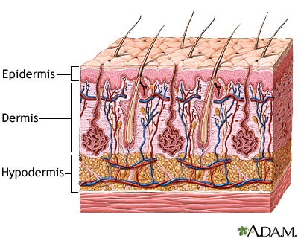
Skin
Composed of
Epidermis:
Stratified squamous keratinized epithelium
Dermis:
Irregular collagenous connective tissue
The interface between them is formed by dermal ridges (papillae) that interdigitate with epidermal ridges. The two types of ridges are called rete apparatus.
Hypodermis is Not from the skin it’s from superficial fascia and it’s loose connective tissue with fat

Slide 4
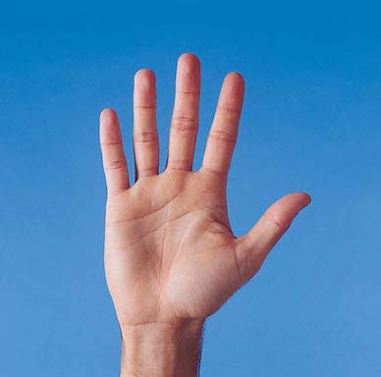
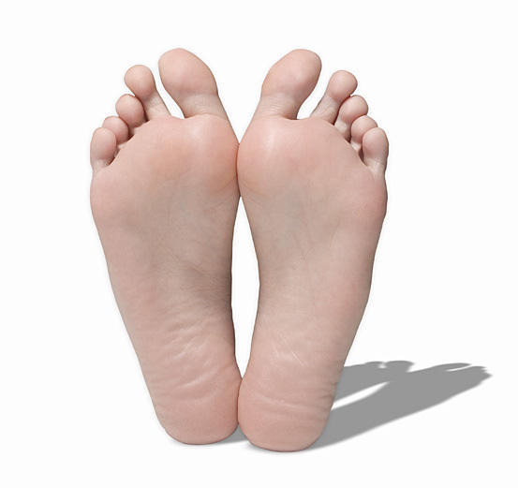
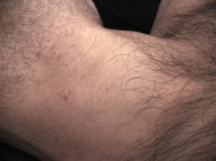
Types of Skin
1. Thick skin:
In the palms of the hand and soles of the feet.
No hair no sebaceous glands
No arrector pilli muscles
Have sweat glands
Has the five layers of epidermis.
2.Thin skin:
Lacks stratum lucidum and stratum granulosum
Has a thin startum corneum
Has hair, rector pilli muscles & glands

Slide 5
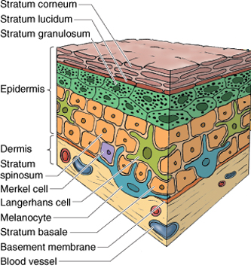
Epidermis
Stratified squamous keratinized epithelium composed of 4 cells
keratinocytes
Langerhans cells
melanocytes
Merkel cells
Keratinocytes:
Largest population.
Arranges in five layers.
Constantly renewed.

Slide 6
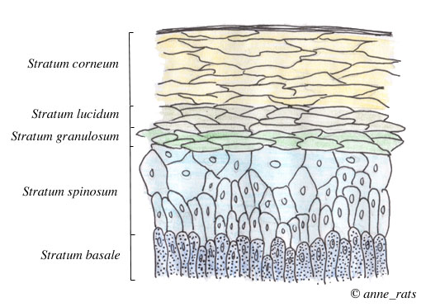
Layers of Epidermis
Stratum corneum
Stratum lucidum
Stratum granulosum
Stratum spinosum
Stratum basale

Slide 7
Keratinocytes migrate upward and begin to accumulate keratin filament and then they die

Slide 8
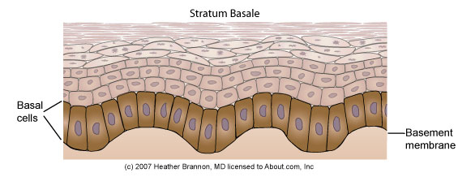
Stratum Basale (germinativum)
Deepest layer.
Supported by basement membrane which separates it from dermis
Forms inter-digitations with dermis
Single layer of low columnar to cuboidal cells.
Basophilic cytoplasm and large nucleus.
Has tonofilaments
Mitotically active
Have desmosomes and hemisdesmosomes

Slide 9
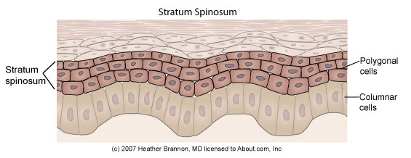
Stratum spinosum
Thickest layer.
Polyhedral to flattened cells.
Mitotically active.
With stratum basale together referred to as malpighian layer.
Rich in intermediate filaments (tonofilaments) that radiate through processes to adjacent cells forming intra-cellular bridges.
Tonofilaments → tonofibrils.
Eosinophilic
Has membrane-bounded granules (lamellar granules) (contain lipid)

Slide 10
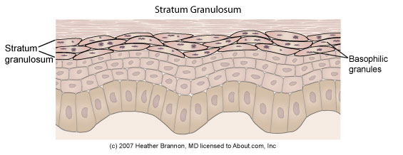
Stratum granulosum
3-5 layers of flattened cells.
Most superficial layer with cells that still posses nuclei.
Has coarse granules (keratohyalin granules)
Not membrane bounded
Basophilic
Keratin filaments pass through these granules.
Has membrane bounded granules which exocytose their contents (lipids) to be a waterproof barrier.

Slide 11
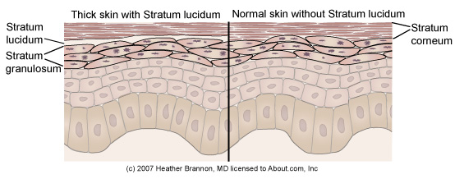
Stratum lucidum
Clear , homogenous , slightly staining .
Present only in thick skin
Flattened thin layer of cells.
No nuclei no organelles.
Contain eleidin: Dense “packed” keratin filaments

Slide 12
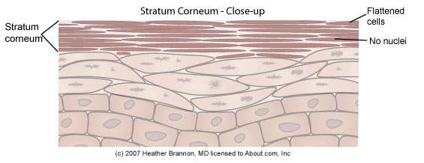
Stratum corneum
The most superficial .
Layers of flattened , keratinized cells with thick membrane ( thick plasmalemma)
No nuclei no organelles.
Filled with keratin filaments.
The cells far from the skin surface display desmosomes.
the cells near the surface called squames (horny) cells.
They lose their connections (desmosomes) and becomes desquamated (sloughed off).

Slide 13
Non-keratinocytes in epidermis
Cells other than keratinocytes in epidermis
Langerhans (dendertic ) cells
Merkel cells.
melanocytes

Slide 14
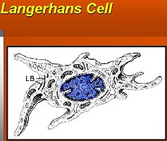
Located in stratum spinosum and dermis and
oral cavity, esophagus and vagina
Dense nucleus, pale cytoplasm, long processes
Langerhans cells
Few mitochondria, RER, no filaments, has lysosomes
Has membrane bound
Birbeck granules (vermiform granules)
Origin: bone marrow .
Function : immune cell antigen presenting cells
-> part of mononuclear phagocyte system

Slide 15
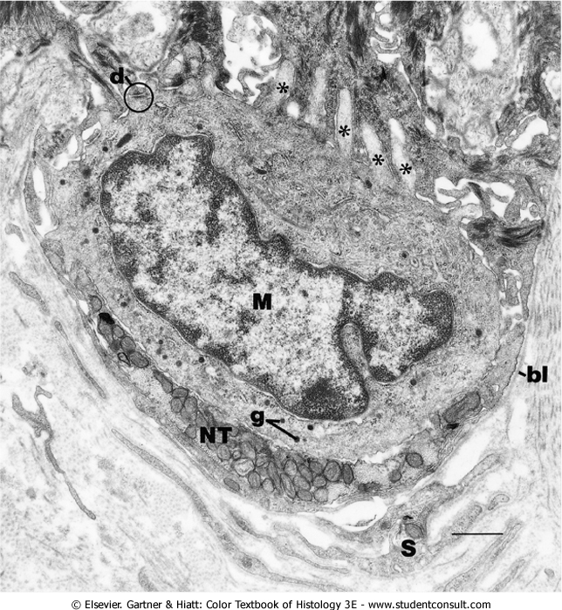
Merkel cells
Has processes and perinuclear granules
Function: mechano-receptors
Found in stratum basale, oral cavity, base of hair follicles
The nuclei are indented
Merkel cell-neurite complexes:
Unmylinated sensory nerves in the basale lamina .
Its processes extend between keratinocytes to which they attached by desmosomes

Slide 16
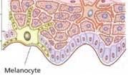
melanocytes
Found in stratum basale
Round to columnar cells has processes
Has oval granules (in red haired people it’s rounded)
Function produce melanin
Melanosomes contain tyrosinase enzyme that change tyrosine into melanin.
They contain melanosomes that leave melanocytes through the processes, penetrate the cytoplasm of str.spinosum cells.
Their long processes penetrate the intercellular spaces of str.spinosum.

Slide 17
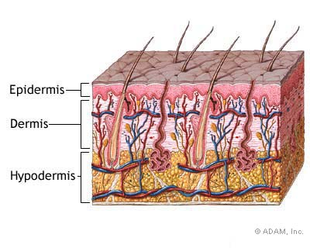
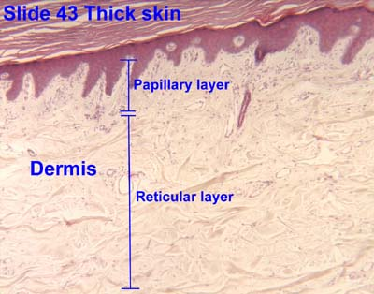
Dermis (corium)
Dense irregular collagenous connective tissue.
Type I collagen fibers and elastic fibers.
Thicker in men
Composed of two layers:
Papillary layer
Reticular layer

Slide 18
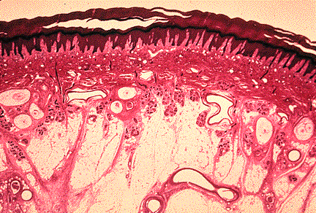
Papillary layer
Loose connective tissue with
Type III collagen (reticular), elastic→ form networks
type VII fibers: anchoring fibers, extends from the basal lamina into the papillary layer
The C.T interdigitate with epidrmis forming dermal papillae or ridges.
Contains: fibroblast, macrophages, plasma cells, mast cells
Has capillary loops.
Has 2 mechanoreceptors:
Meissner corpuscles.
Krause end bulb

Slide 19
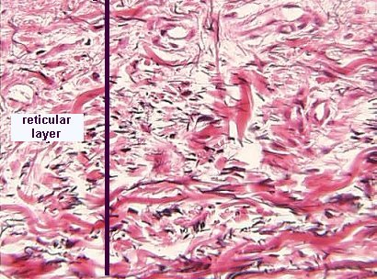
Reticular layer
Dense irregular collagenous connective tissue with Type I collagen and elastic fibers.
Rich in proteoglycan.
Contains: fibroblast, mast cells, lymphocytes, macrophages, fat cells
hair follicles , sweat & sebaceous glands..

Slide 20
Reticular layer (cont.)
Groups of smooth muscle fibers.
Striated muscle fibers in the face and neck also inserted in reticular layer (muscles of facial expression).
2 mechanoreceptors:
Pacinian corpuscle.
Ruffini corpuscle.

Slide 21
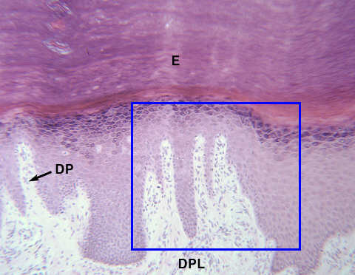
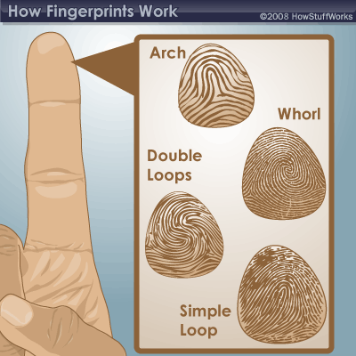
Epidermis-Dermis Interface
Interdigitation appear antiparallel on the skin as whorls, arches and loops like fingerprints (dermatoglyphs)
Papillary layer forms primary dermal ridges
Between the ridges are primary grooves house projections of epidermis
In the center of each ridge there is secondary groove witch receives invagination of epididimis known as interpapillary peg, where there are dermal papillae

Slide 22
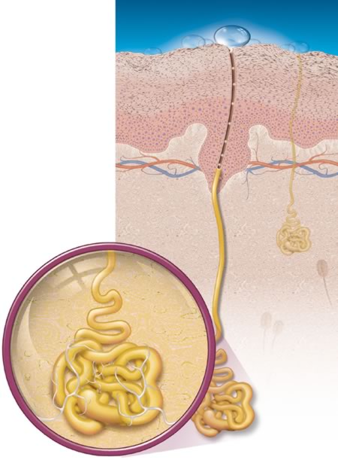
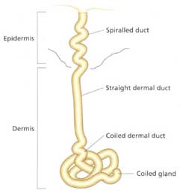
Sweat glands
Has 2 types
eccrine
apocrine
Eccrine glands:
Located in dermis and hypodermis.
Composed of:
Simple coiled tubular glands.
Coiled duct opens on the surface of the skin at a sweat pore.
merocrine secretion.

Slide 23
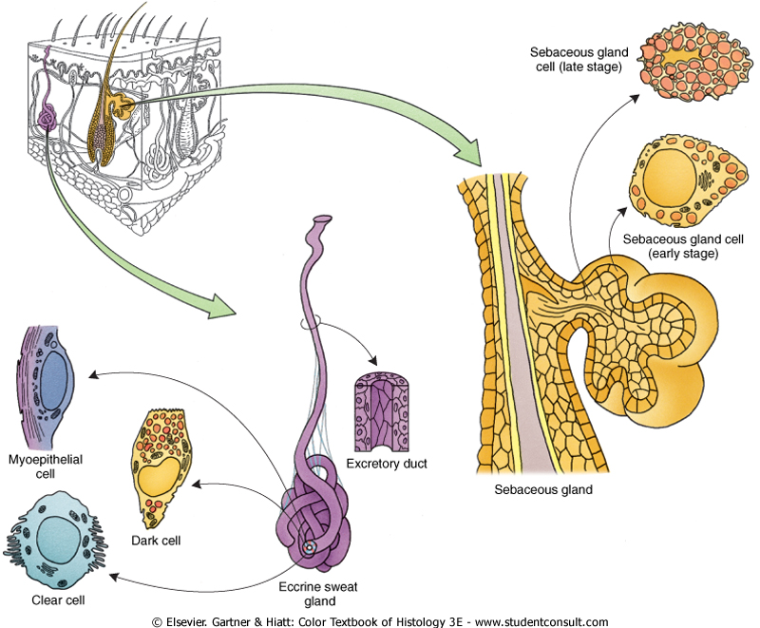
Secretory unit is simple cuboidal to low columnar composed of
Dark cells
Clear cells

Slide 24
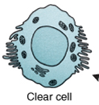
Clear Cells
Narrow end and broad base.
No granules.
Has accumulation of glycogen.
Similar in structure with dark cells except less RER.
Watery secretion
Dark Cells (mucoid cells)
Appear as inverted cone (broad end and narrow base)
RER, mitochondria, golgi apparatus, free ribosomes.
Apical granules.
Secrete mucous.
Myoepithelial cells to squeeze secretion
ducts composed of stratified cuboidal epithelium.

Slide 25
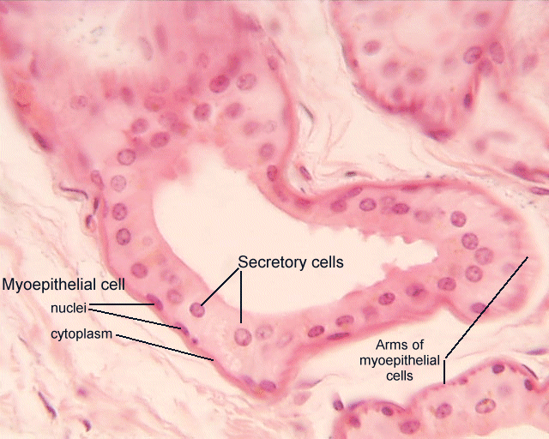
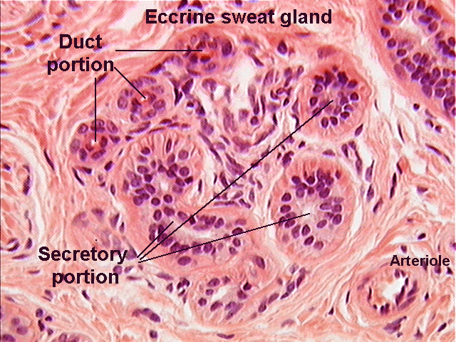

Slide 26
Coiled duct :
Stratified cuboidal epithelium with 2 layers:
Cells of basal layer has large nucleus and mitochondria.
Cells of the luminal layer irregular nucleus and few organelles

Slide 27
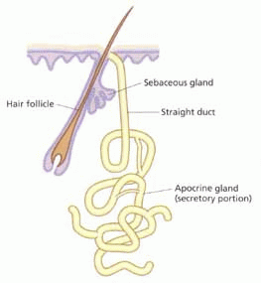
Apocrine Sweat Glands
Similarities with eccrine
Located in dermis and hypodermis
Same secretory cells
Different
Located in axilla, areola of the nipple and anal region
Glands open in hair follicles
Larger lumin
Apocrine secretion
Have myoepithelial cells
They are under the influnce of sex hormones so they appear after puberty
Modified apocrine glands include:
Ceruminous (wax glands of external auditory canal.
Glands of moll in the eyelid

Slide 28
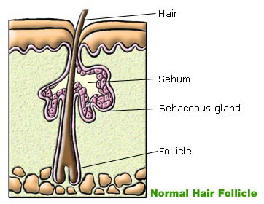
Sebaceous Glands
In most of the body except:
Palms of the hands.
Soles of the feet.
Side of the feet inferior to the hairline.
Located in dermis and hypodermis.
Secretes sebum.
the ducts open in the hair follicle canal.
They are lobular with clusters of acini opening into single short ducts.

Slide 29
Sebaceous gland
In a place with no hair follicles (Ex : lips, glans penis, areola of the nipples, labia minora, mucous surface of the prepuce) duct opens onto the surface of the skin.
Under influence of hormones
Holocrine secretion

Slide 30
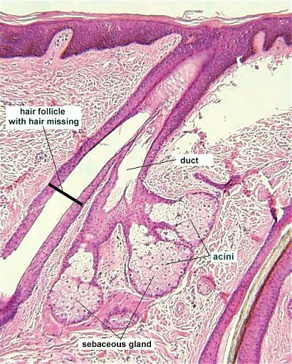
Sebaceous glands composed of
Clusters of acini
Short single duct
Stratified squamous epithelium
Composed of
Basal cells:
small
Located peripherally
Surround round cells.
Spherical nucleus.
SER, RER, glycogen and lipid droplets.
Able to divide.
Round cells:
Abundant SER.
Lipid droplets

Slide 31
