Slide 1
Male Reproductive System
Metallic 0 Mind
Bilal Marwa
Sarah Al-Morit

Slide 2
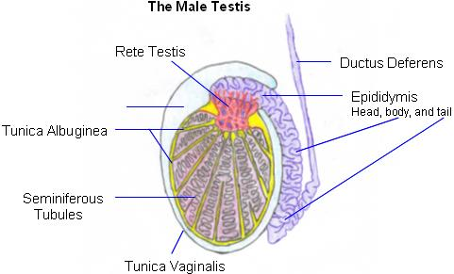
TESTIS
Covered by Tunica Vaginalis,
Covered by:simple squamous mesothelium,
surround the anterolateral aspect of the testis.
Testis is surrounded by a capsule of dense, irregular collagenous connective tissue known as Tunica Albugenia (white color)
Deep to tunica albugenia is a highly vascularized connective tissue tunica vasculosa

Slide 3
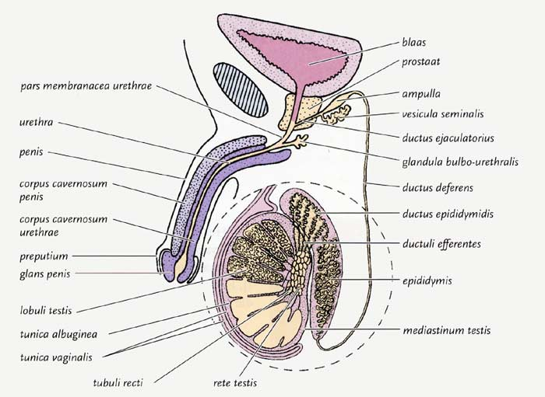
Mediastinum testis sends septa to subdivide the testis into 250 pyramid- shaped compartment known as lobuli testis
Tunica vasculosa thickens in the posterior aspect to form mediastinum testis.
Contents of a lobule
Seminiferous tubules
Connective tissue
# seminiferous → start blend → opened in the tubular structure (rete testis)

Slide 4
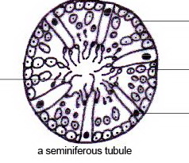
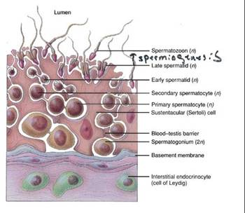
SEMINIFEROUS TUBULES
epithelium:
Several layers thick.
Two types of cells:
Sertoli cells (somatic)
Spermatogenic cells
tunica propria (C.T.):
Collagen type I
Fibroblasts
In animals other than human myoid cells are present, they are similar to smooth muscle cells.
Well developed basal lamina

Slide 5
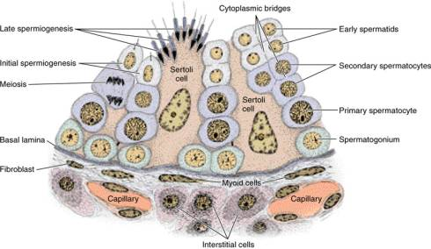
SERTOLI CELLS
Where?
Lie on basal lamina
Functions?
physical and nutritional suport for germ cells
Phagocytosis: excess cytoplasm (spermiogenesis)
establishment of blood testis barrier
synthesis of androgen binding protein (ABP), antimüllaerian hormone, inhibin and testicular transferrin.
secretion of fructose-rich medium

Slide 6
SERTOLI CELLS
STRUCTURE
A- pale basophilic
B-basally located oval nucelus with large central nuceolus.
C- inclustions: crystalloids of Charcot-Böttcher.
D- SER, limited RER, golgi apparatus, numerous mitochondria and vesicles and abundant cytoskeletal elements
E- abundant lysosomes
F- phagocytose excess cytoplasm in spermiogenesis

Slide 7
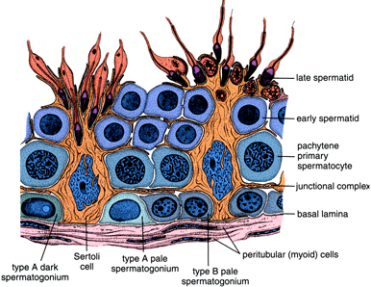
Sertoli cells form occludent junctions between them which divide the lumen of seminiferous tubule into
apical to occludent junctions
Sertoli cells cannot divide after puberty
1- Adluminal compartment
2- Basal compartment
Basal to occluden junctions
Blood-testis barrier: formed by junctions between sertoli cells.
Function: protect devloping gametes from the immune system

Slide 8
SPERMATOGENIC CELLS
Spermatogonia:
Located in basal compartment.
Diploid cells
Types of speratogonia
Dark type A:
Reserve cells
Pale type A:
Give rise to pale type A and B
Pale Type B:
Give rise to spermatocytes

Slide 9
SPERMATOGENIC CELLS
Priamry spermatocytes, secondary spermatocytes, spermatids and spermatozoa occupy the adluminal compartment.
Primary speramatocytes:
Largest cells.
Large vesicular nuclei.
Secondary spermatocytes:
Short-lived.
Do not replicate .
Enter the second mitotic division.

Slide 10
Spermiogenesis
Spermatids: small round haploid cells
Spermiogenesis: spermatids → spermatozoa
Formation of flagella
Formation of mitochondrial sheath
Elongation of nucleus
Vesicle cover the nucleus (acrosome)

Slide 11
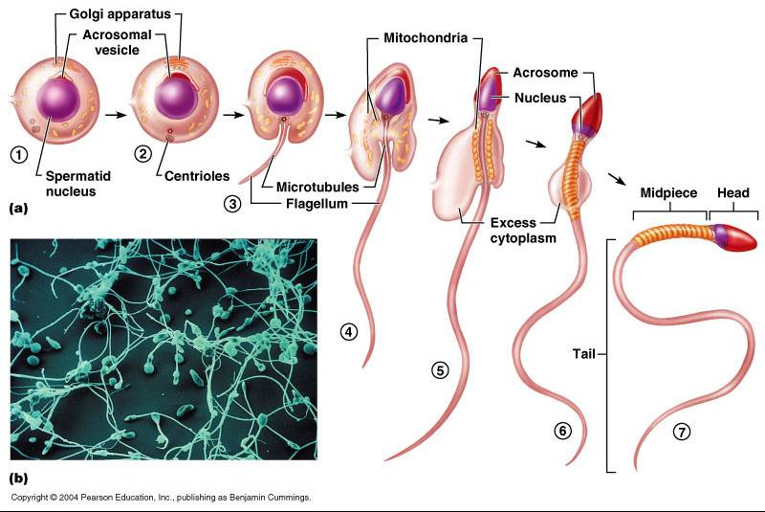

Slide 12
Spermatozoon
HEAD:
Surrounded by plasma lemma.
Contains nucleus
Acrosome surrounds the nucleus
MIDPIECE:
Contains the mitochondrial sheath
encircles the axoneme and outer dense fibers.

Slide 13
Spermatozoon
TAIL
Longest segment.
Contains axoneme surrounded by 7 outer dense fibers
END PIECE
Composed of axoneme surrounded by plasmalemma

Slide 14
Contents of a lobule: 2- connective tissue
Loose, vascularized connective tissue.
Contains: fibroblasts, mast cells and other things in loose connective tissue
(read epithelium and connective tissue lecture)
Also contains interstitial cells (leydig cells)

Slide 15
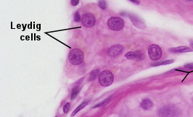
Interstitial cells (Leydig cells)
Polyhedral in shape
Single, vesicular nucleus.
May be binucleated.
Mitochondria with tubular cristae.
SER and golgi apparatus.
Some RER.
Numerous lipid droplets.
No secretory vesicles.
Crystals of Reinke.

Slide 16
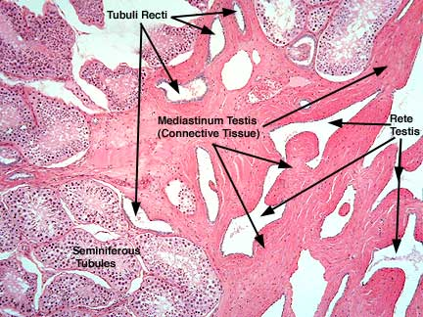
GENITAL DUCTS
Genital Ducts
Within the tesis (intratesticular):
connect seminferous tubule to the epididymis
External to the testis (extratesticular)
Tubuli Recti
Rete testis

Slide 17
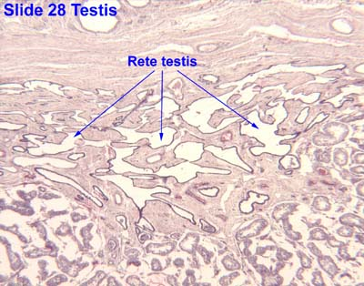
Intratestsicular Ducts
Tubuli recti:
Lined by sertoli cells in the first half.
The second half is lined by simple cuboidal epithelium
Rete testis:
Lined by simple cuboidal epithelium

Slide 18
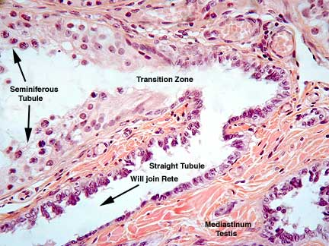
Ductuli Efferentes:
Conduct the sperm from rete testis to epididymis.
Lining: nonciliated cuboidal cells alternating with the regions of cilitaed columnar cells
Has basal lamina and connective tissue and thin layer of smooth muscle

Slide 19
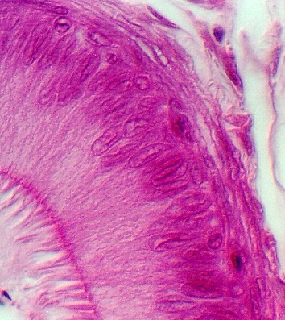
Epididimis
The lumen is lined by psuedostratified epithelium with 2 cells
Basal Cell
short pyramidal cells with round nuclei (heterochromatin).
They are stem cells
Principal cells:
Tall
RER,SER, golgi apparatus multivesicular bodies
have stereocilia which are nonmotile microvilli

Slide 20
Epididimis
Has a basal lamina which separates the epithelium from loose connective tissue
Has a layer of smooth muscle cells

Slide 21
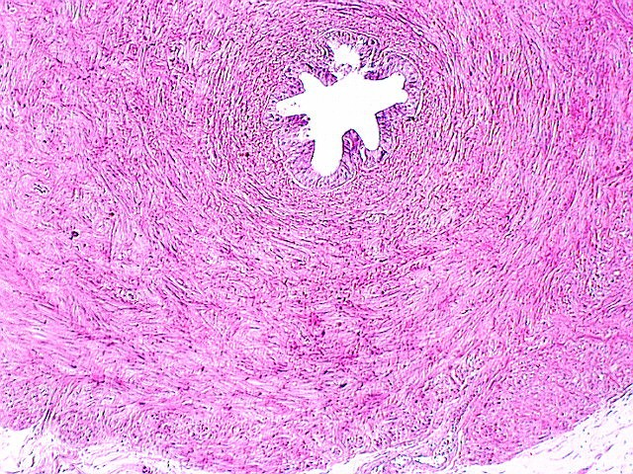
Vas (ductus) deferans
Epithelium:
Stereociliated pseudostratified columnar epithellium
Basal lamina
Loose fibroelastic connective tissue
has numerous folds
Smooth muscle has 3 layers :
Inner and outer longitudinal and middle circular
loose fibroelastic connective tissue
Ampulla: Has a highly folded, thickended epithelium

Slide 22
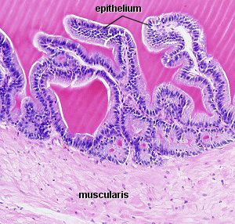
Seminal Vesicle
Mucusa is highly convoluted
No stereocilia
Epithelium:
Pseudostratified columnar epithelium with 2 types of cells:
1- basal cells
2- columnar cells
Subepithelial C.T. is fibroelastic

Slide 23
Seminal vesicle
Smooth Muscle layers:
1- inner circular
2- outer longitudinal
Smooth muscle cells surrounded by fibroelastic connective tissue

Slide 24
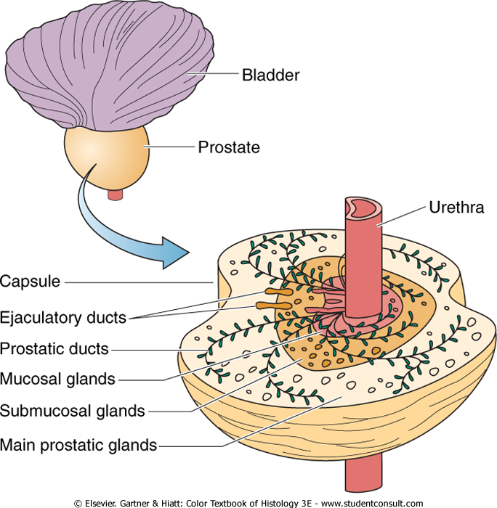
Prostate
Capsule:
dense,irregular collagenous C.T. interspersed with smooth muscle cells.
Prostate composed of compound tubolaveolar glands arranged into:
Mucosal
Submucosal
Main

Slide 25
Prostate
Mucosal glands
Closest to the urethra
Shortest of the glands
Submucousal glands:
Peripheral to mucousal glands.
Larger than mucosal glands.
Main Glands:
Largest and most numerous of the glands
Compose the bulk of the prostate
Lumina of the glands contains prostatic concretions (corpora amylacea) composed of calcified glycoprotein.

Slide 26
C.T. stroma of the gland:
Derived from the capsule and has the same structure
So it is enriched by smooth muscle fibers (+ C.T.)
Lining of the gland components:
Simple to psuedostratified columnar epithelium
Secretion: serous

Slide 27
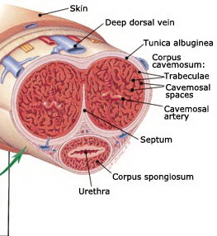
PENIS
Composed of 3 columns of erectile tissue
each column is enclosed by its own capsule: Tunica Albuginea: Dense, fibrous C.T.
The columns are:
2 corpora carnevosa
Located dorsally
Tunica albuginea not continuous
1 corpus spongiosum
Located ventrally
Houses penile urethra
Ends as glans penis

Slide 28
PENIS
The three columns are surrounded by a common sheath
Loose C.T.
No hypodermis
Erectile tissue:
Endothelially lined spaces
Seperated by trabeculae of connective tissue and smooth muscle cells and elastic fibers

Slide 29
PENIS
Covered by thin skin
Proximal region:
Has hair, sweat and sebaceous glands
Distal region:
Hairless
Few sweat glands

Slide 30
Thank You !

