Slide 1
بسم الله الرحمن الرحيم

Slide 2
URINARY SYSTEM

Slide 3
URINARY SYSTEM
1- Kidneys.
2- Ureters.
3- Urinary bladder.
4- Urethra.

Slide 4
KIDNEY

Slide 5
KIDNEY
Uriniferous tubules:
1- Nephron.
2- Collecting tubule.

Slide 6
NEPHRON
1- Renal corpuscle.
2- Proximal tubule.
3- Loop of Henle.
4- Distal tubule.

Slide 7
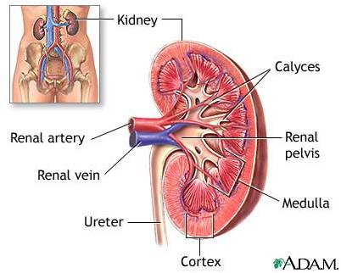

Slide 8
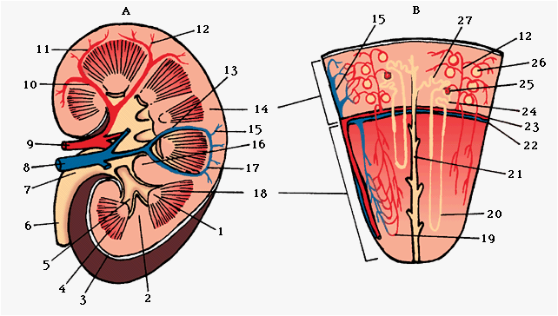
KIDNEY

Slide 9
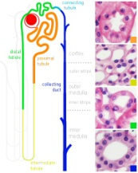

Slide 10
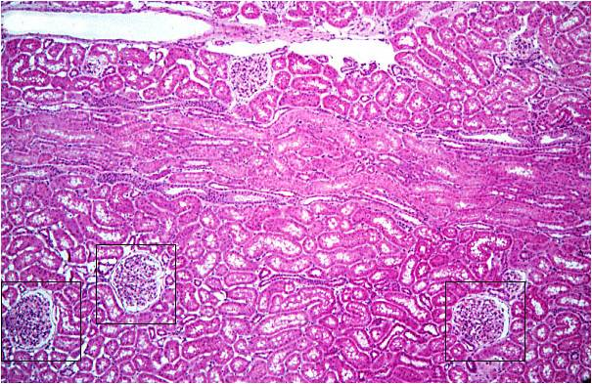
CORTEX OF THE KIDNEY

Slide 11
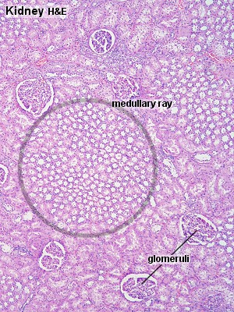

Slide 12
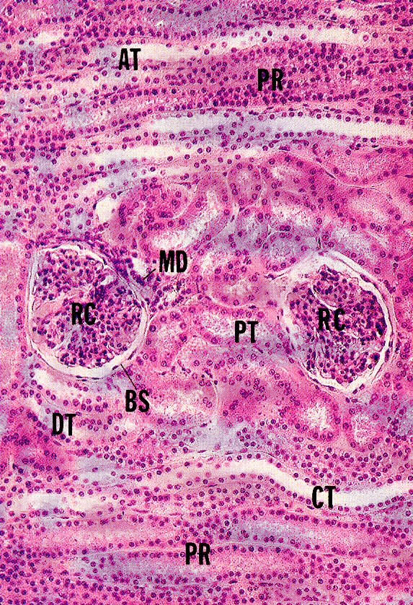
CORTEX OF THE KIDNEY

Slide 13
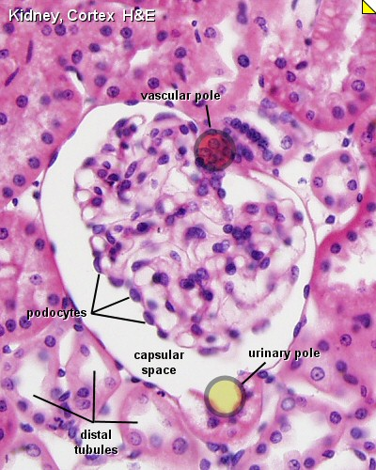

Slide 14
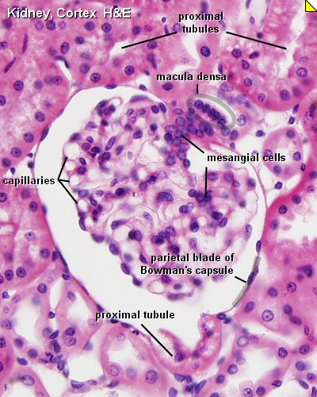

Slide 15
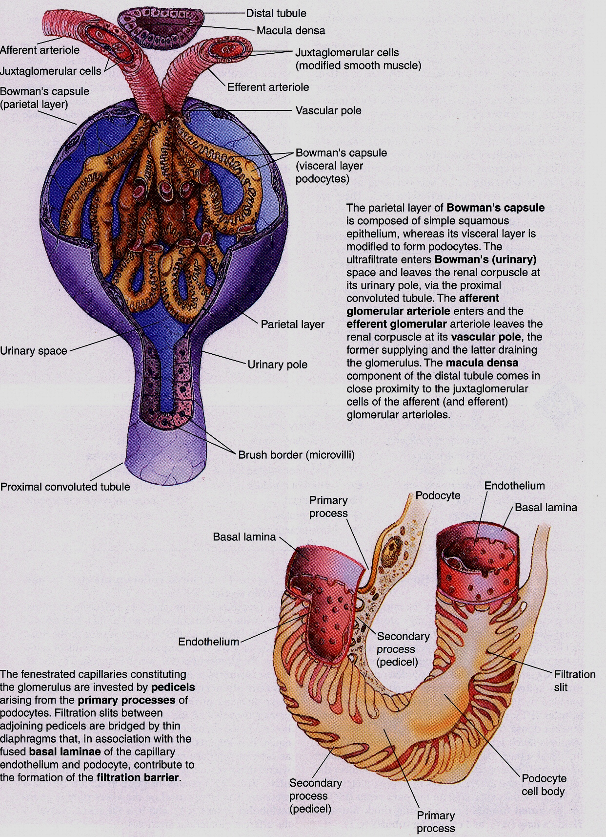

Slide 16
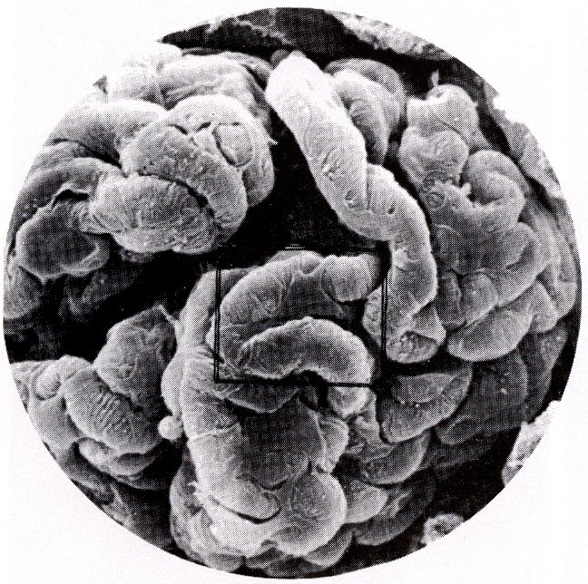
GLOMERULUS & PODOCYTES

Slide 17
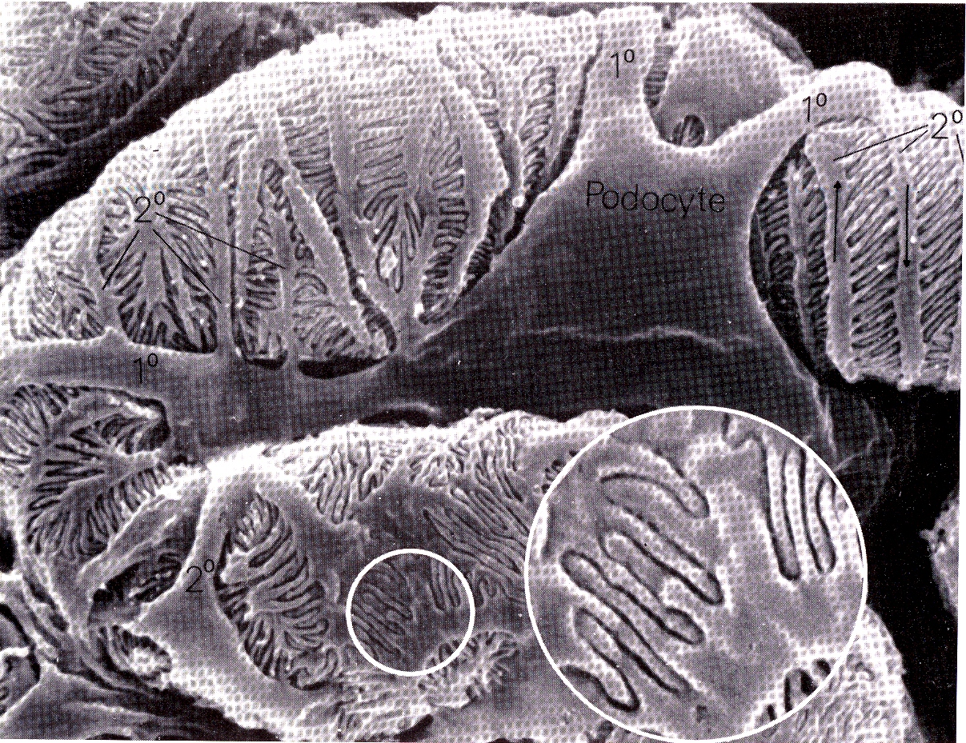
PODOCYTE

Slide 18
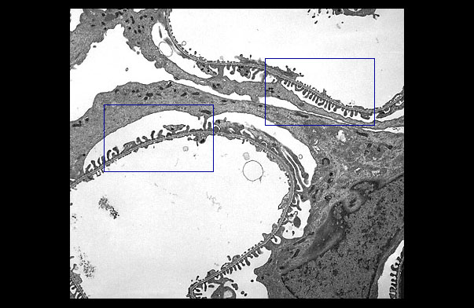
GLOMERULAR FILTRATION BARRIER

Slide 19
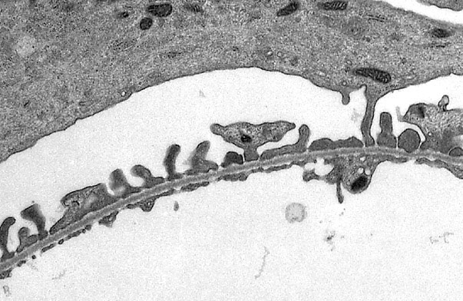
Podocyte & glom. capillary

Slide 20
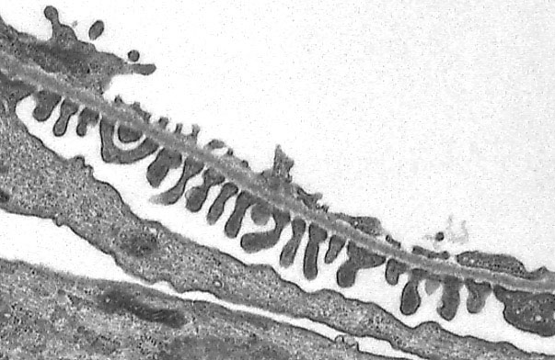
PODOCYTE & GLOMERULAR CAPILLARY

Slide 21
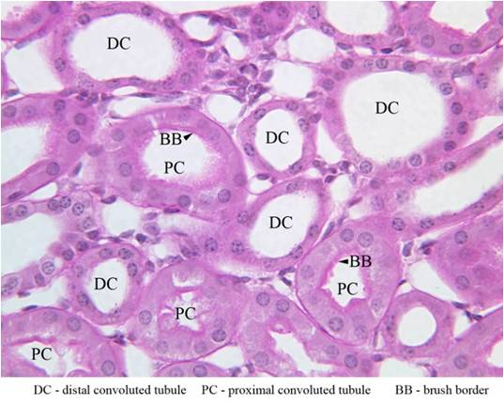
CORTEX OF THE KIDNEY

Slide 22
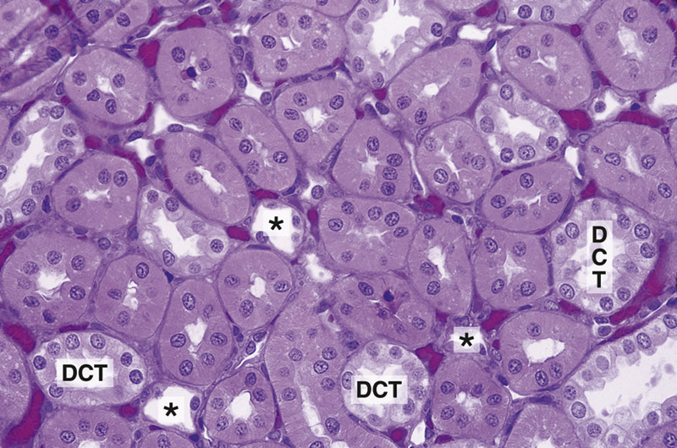
CORTEX OF THE KIDNEY

Slide 23
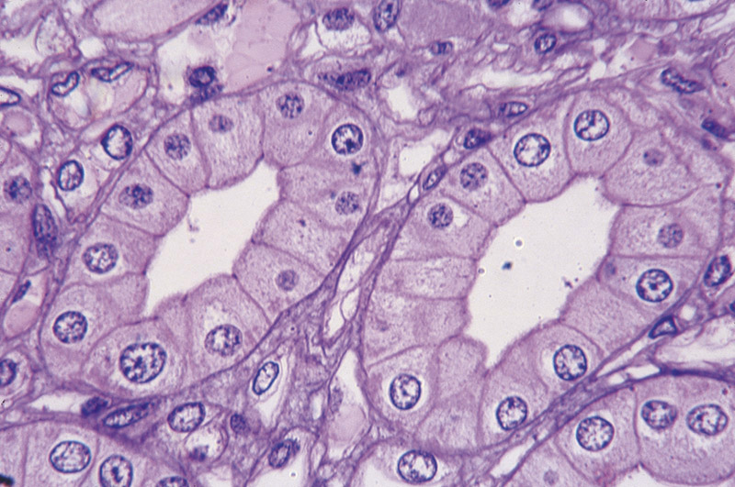
COLLECTING DUCT

Slide 24
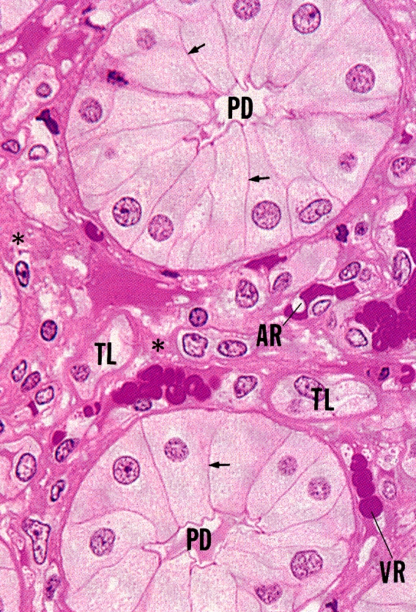
PAPILLARY DUCT (DUCT OF BELLINI)

Slide 25
JUXTAGLOMERULAR APPARATUS

Slide 29
URETER

Slide 30
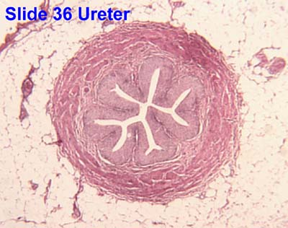
URETER

Slide 31
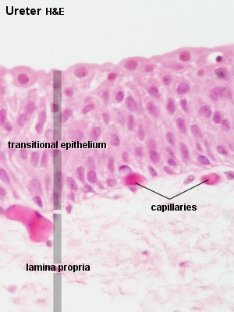

Slide 32
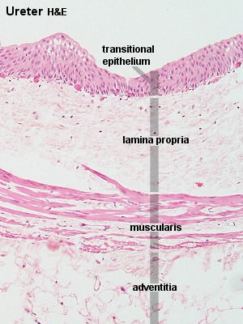

Slide 33
URINARY BLADDER

Slide 34
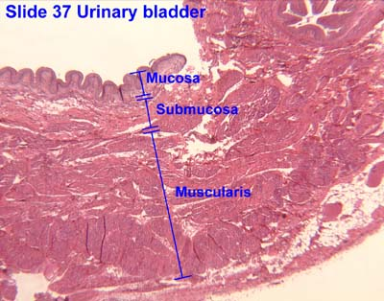

Slide 35
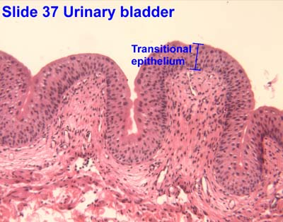

Slide 36
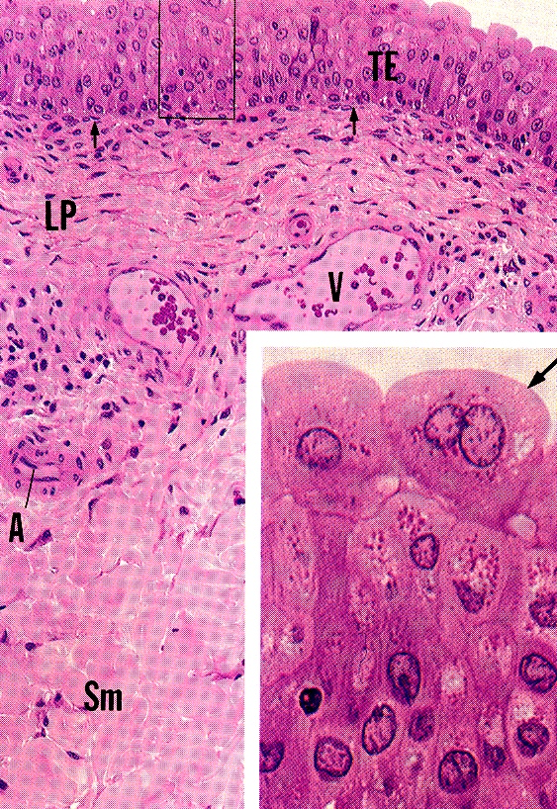
URINARY BLADDER

Slide 37
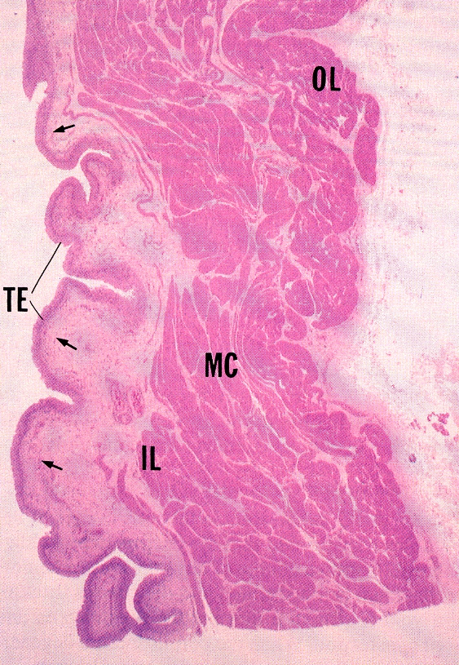

Slide 38
URETHRA
1- Male Urethra.
2- Female Urethra.

Slide 39
BEST WISHES

Slide 40
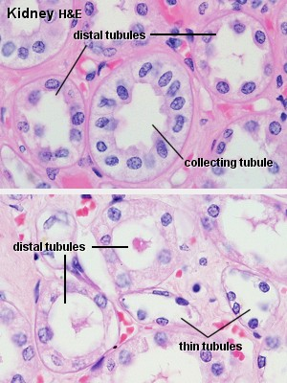

Slide 41
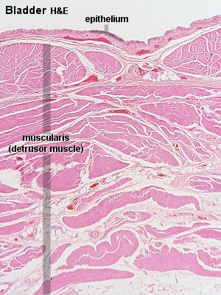

Slide 42
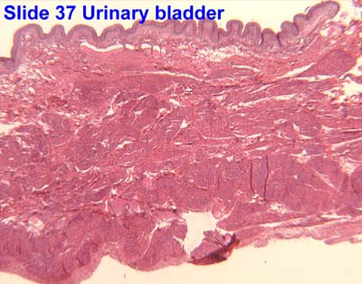

Slide 43
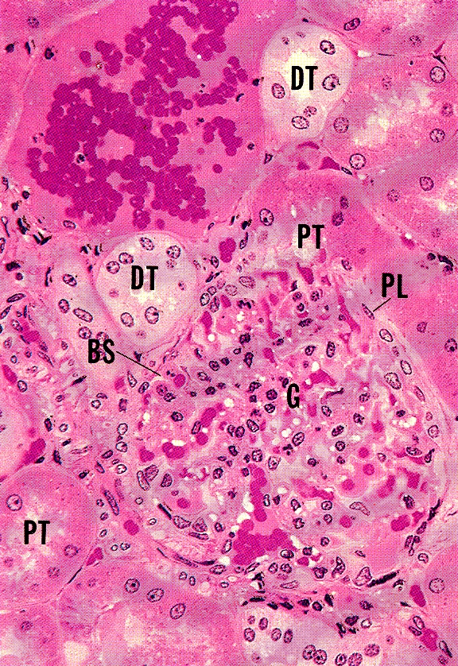

Slide 44
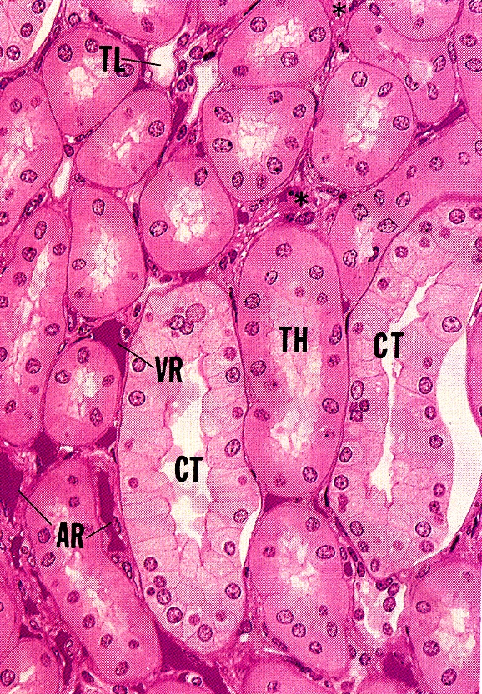

Slide 45
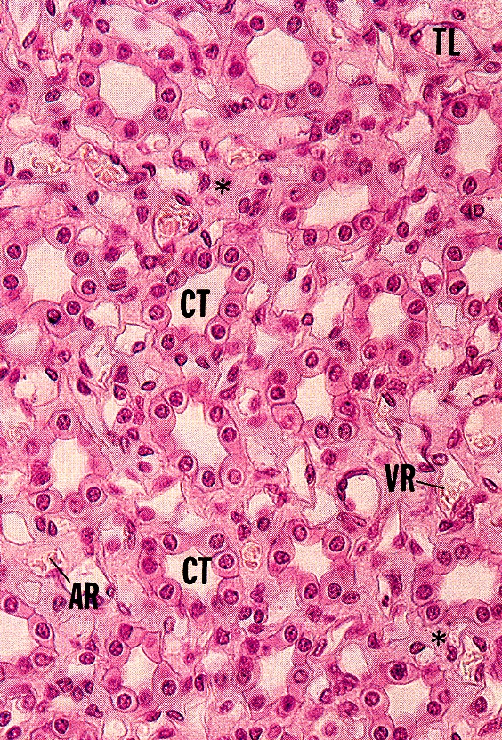

Slide 46
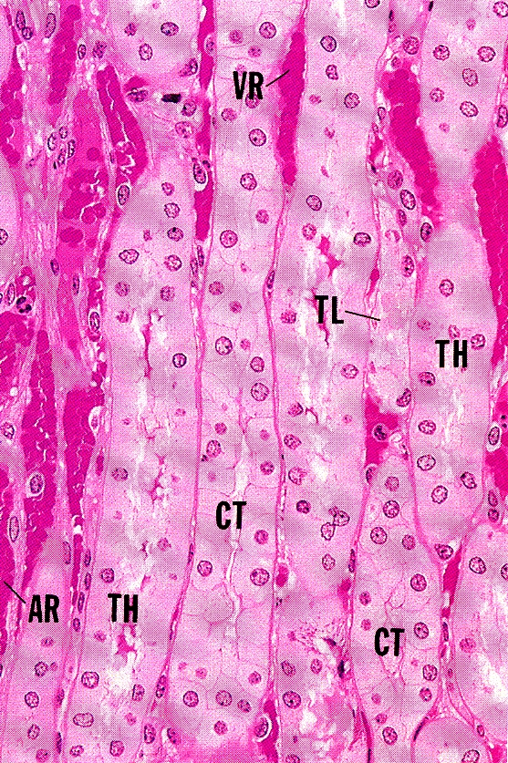

Slide 47
