Slide 1
Effects of calcium :-
1- Nerve and muscle excitability.
2- Neurotransmitter release from axons terminals.
3- serves as second or third messenger.
4- Some enzymes use calcium as a cofactor.
5- Major constituent of bone.
6- Excitation - contraction coupling in muscle cells.
Ca⁺⁺ affects the Na⁺ permeability of nerve
membranes.
↓ plasma Ca⁺⁺ → Generation of spontaneous
action potentials in nerves.

Slide 2
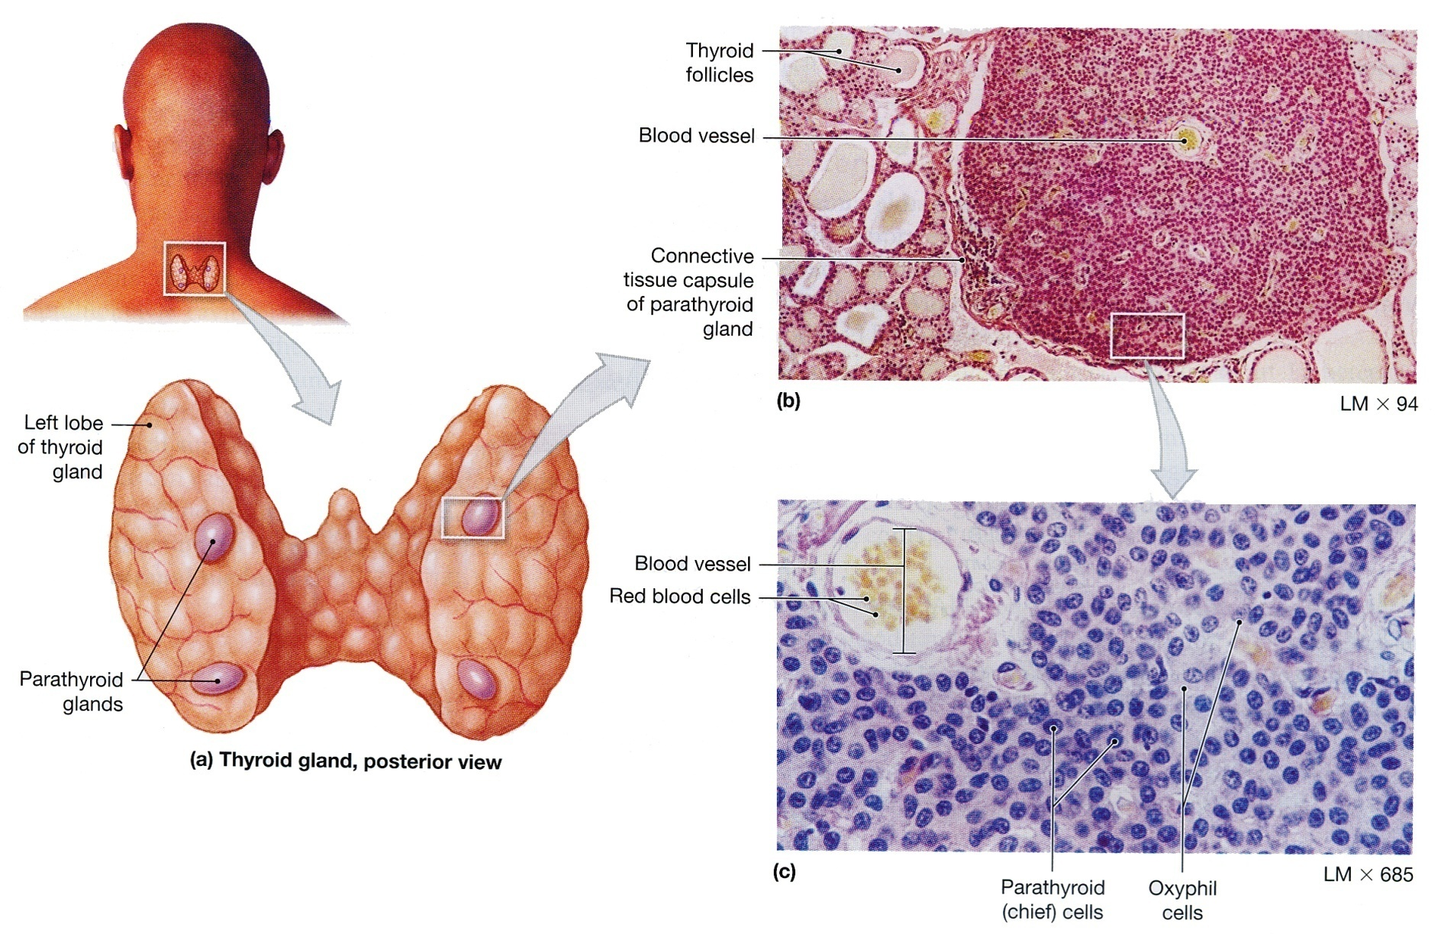
The Parathyroid Glands. (a) The location of the parathyroid glands on the posterior surfaces of the thyroid lobes. (The thyroid lobes are located anterior to the trachea). (b) Both parathyroid and thyroid tissues. (c) Parathyroid cells.

Slide 3
Calcium Homeostasis
The total Ca⁺⁺ conc. in blood is normally 10 mg / dl.
Free ionized Ca⁺⁺ is about 50% of the total [5mg/dl] it is the only form of Ca⁺⁺ which is biologically active.
Forms of Ca++ in Blood
Total Ca⁺⁺
Protein-bound [40%] Ultra filterable [60%]
Complexes to anions Ionized Ca++
[10%] [50%]
^{e.g. phosphate, sulfate}
^{and citrate}

Slide 4
↑ in protein conc. → ↑ in total Ca⁺⁺ conc.
↓ in protein conc. → ↓ in total Ca⁺⁺ conc.
Changes in anion conc. Alter the ionized Ca⁺⁺ conc.
e.g.
↑ Plasma phosphate conc. → ↑ conc. Of Ca⁺⁺
complex to phosphate → ↓ ionized Ca⁺⁺ conc.

Slide 5
Acid-base abnormalities alter the ionized Ca⁺⁺ con. by changing the fraction of Ca⁺⁺ bound to plasma albumin.
Albumin has negatively charged sites, which can bind either H⁺ ions or Ca⁺⁺ ions.
Acidosis Alkalosis
Ionized [ Ca⁺⁺] ionized [Ca⁺⁺]
Hyperventilation Respiratory alkalosis
↓ ionized Ca⁺⁺ → Tetany.
H
H
H
Ca⁺⁺
Albumin
H
Albumin
Ca⁺⁺
Ca⁺⁺
Ca⁺⁺
Ca⁺⁺
Ca⁺⁺

Slide 6
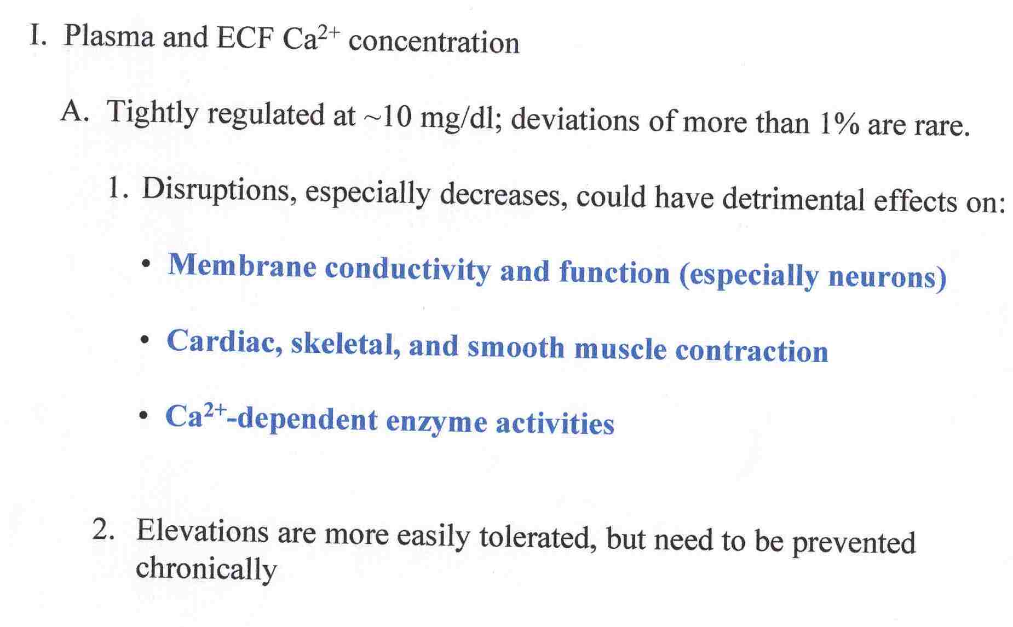

Slide 7
EFFECTS of Ca⁺⁺ in NEUROMUSCULAR EXCITABILITY
Low Ca⁺⁺ conc. in plasma [hypocalcaemia] →
Increase excitability of nerve and muscle cell
Membranes tetany, hyper reflexia,
spontaneous twitching, muscle cramps, tingling and
numbness.
Increase plasma Ca⁺⁺ conc. [Hypercalcaemia]
→ Cardiac arrhythmias, decrease neuromuscular excitability, lethargy, constipation, polyuria and polydepsia.

Slide 8
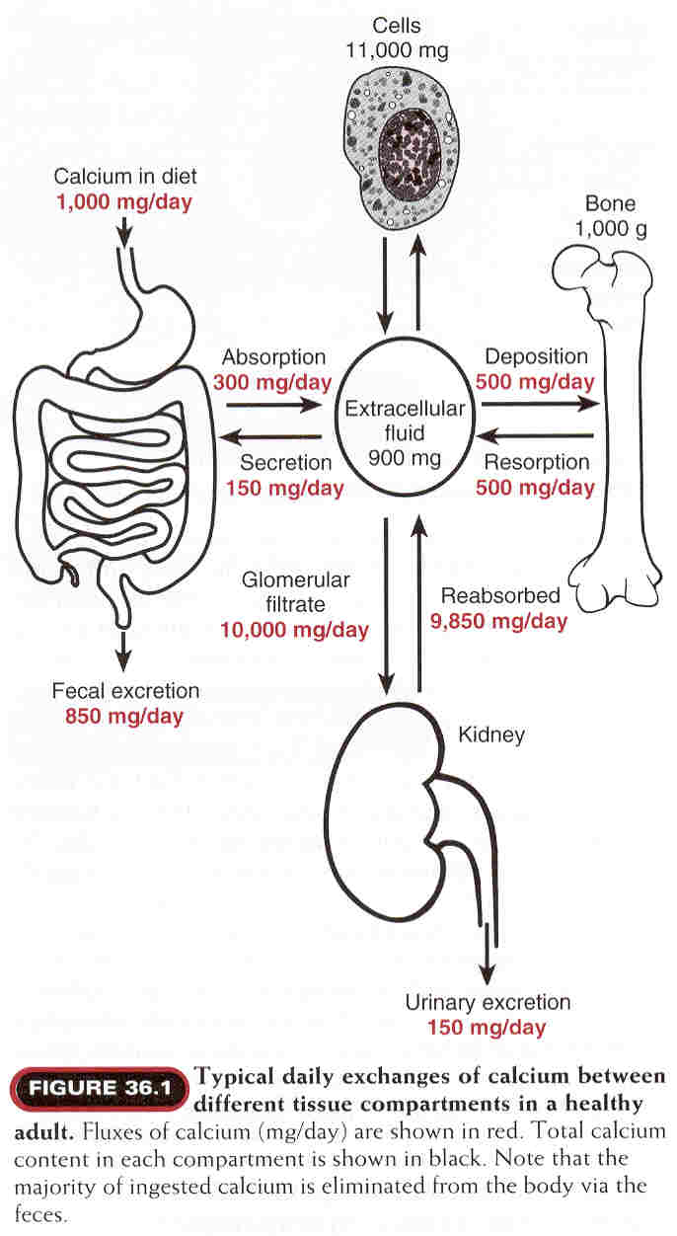

Slide 9
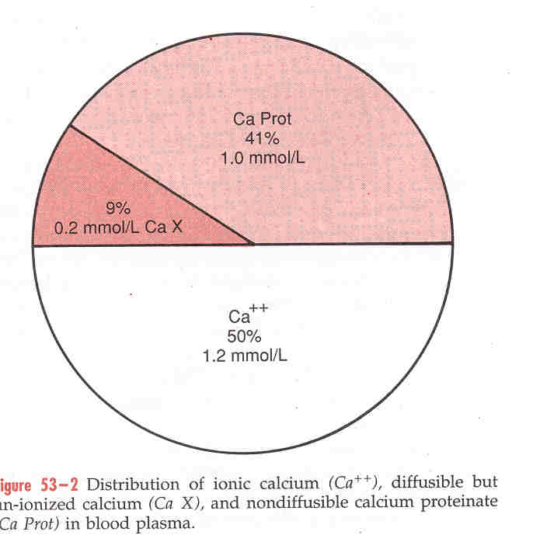

Slide 10
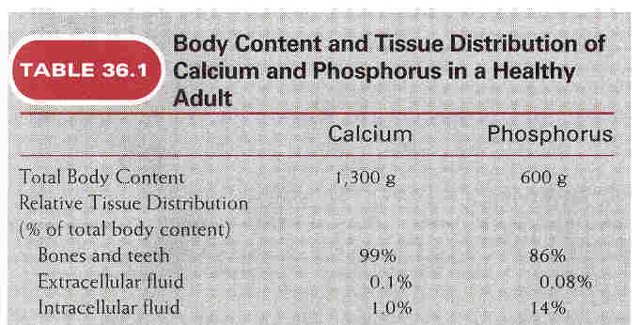

Slide 11
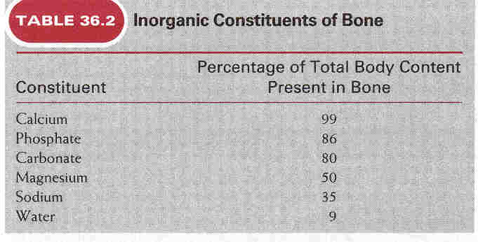

Slide 12
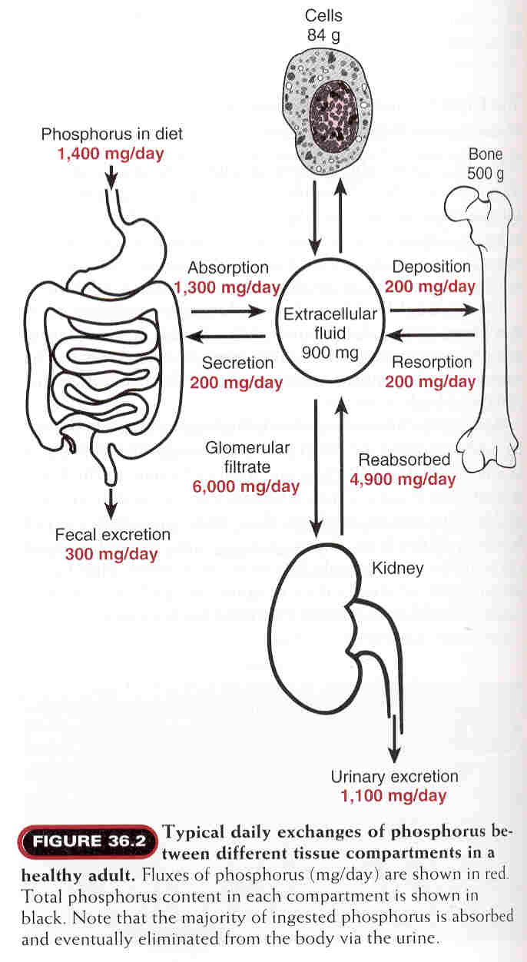

Slide 13
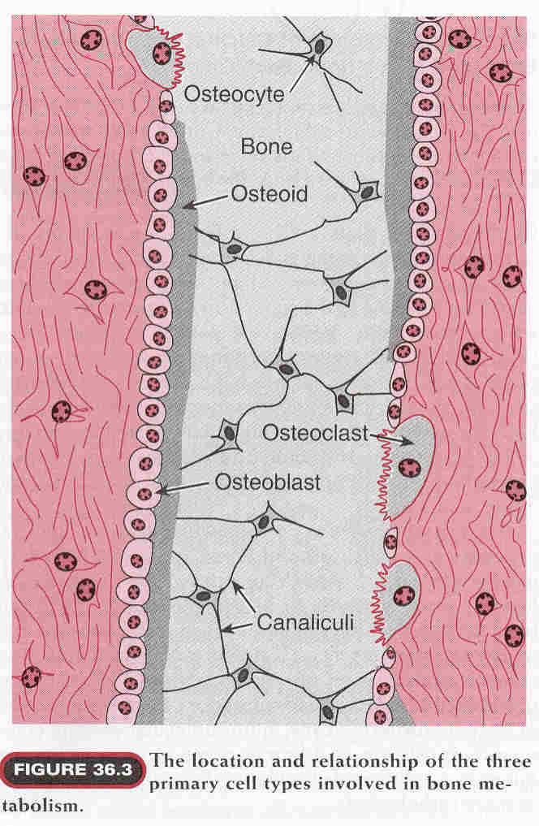

Slide 15
The Parathyroid Hormone :-
Secreted by the parathyroid glands.
Stimulated by hypocalcemia.

Slide 16
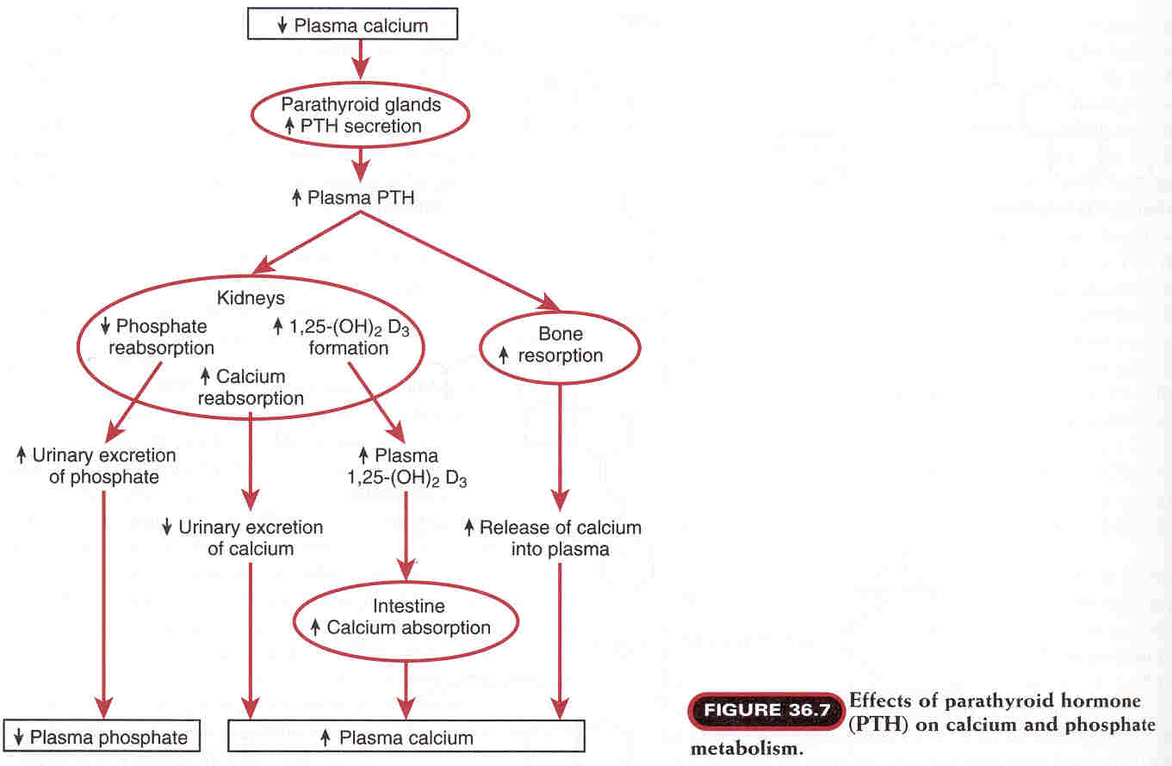

Slide 17
Calcitonin :-
Secreted by the parafollicular or C-cells
of the thyroid gland.
Stimulated by hypercalcemia.

Slide 18
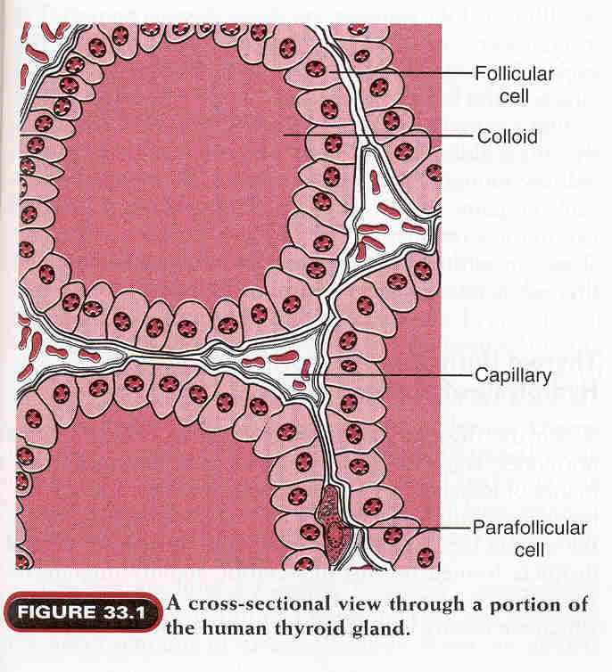

Slide 19
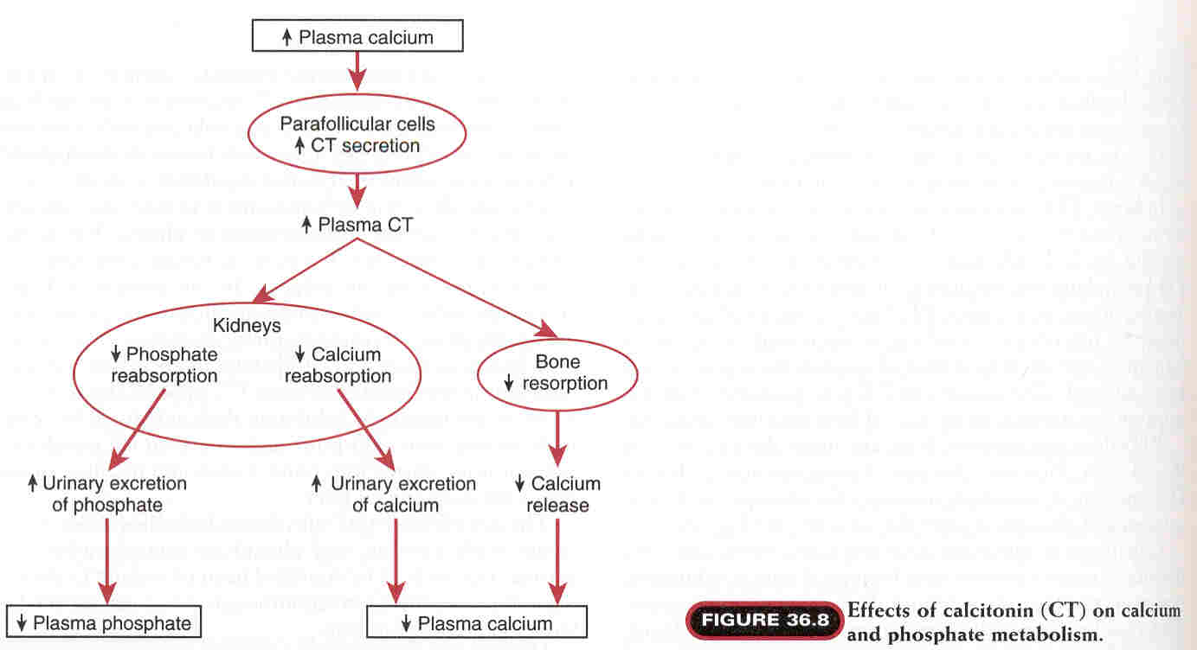

Slide 20
Vitamin D :-
Synthesized by the body or taken in food.
7- Dehydrocholestrol (in skin) + Ultraviolet light →
Vit. D₃ ( inactive form).
Hydroxylation of Vit. D₃ first in the Liver → 25,
hydroxycholicalciferol ( inactive form ).
Another hydroxylation of Vit.D₃ in the kidneys
→ 1,25 dihydroxycholicalciferol ( active form ).

Slide 21
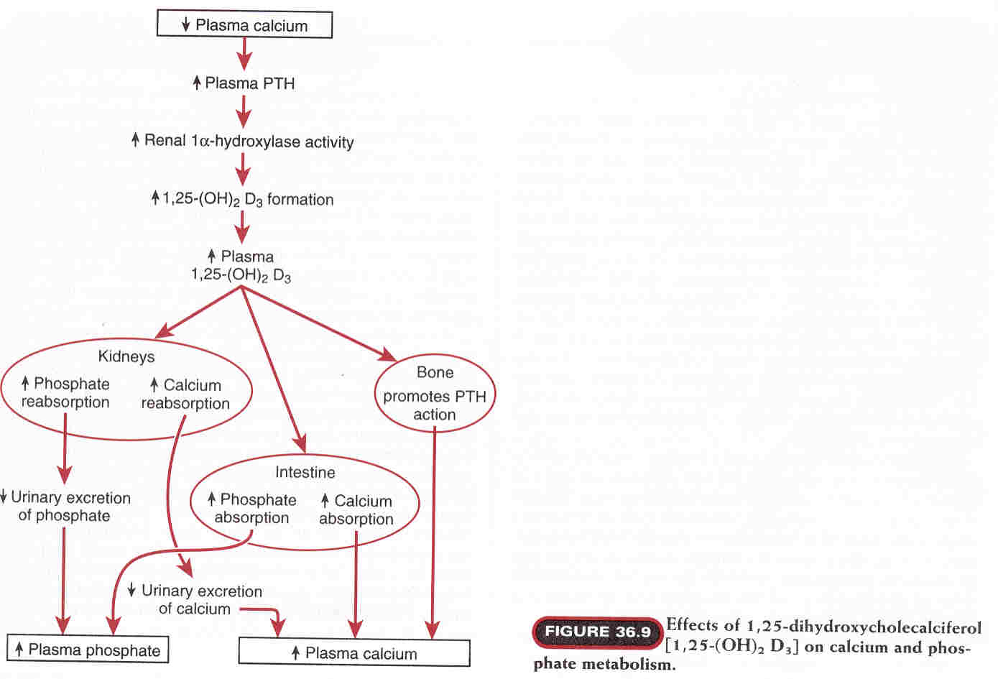

Slide 22
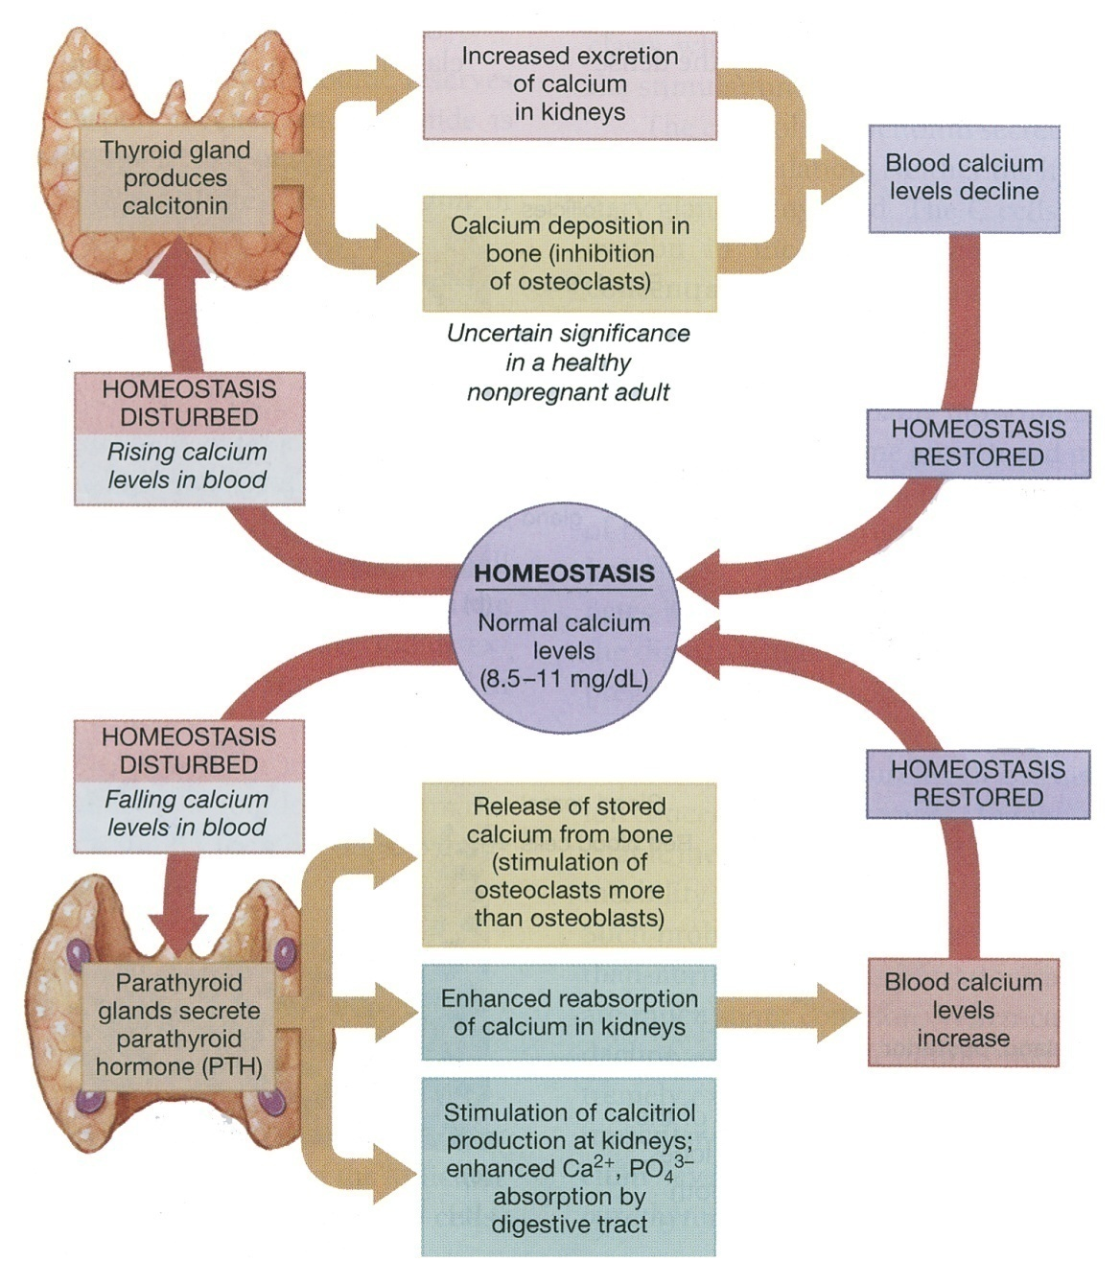
The Homeostatic Regulation of Calcium Ion Concentrations.

Slide 23
HYPO PARATHYROIDISM
Commonly occur accidentally after surgical removal of the
thyroid gland → Latent or overt tetany.
Characterized by hypersensitivity [Low threshold]
of nerves and muscles.
Can be demonstrated by two signs:-
Chvostek’s sign:-
Tapping the facial nerve as it emerge from the parotid gland
In front of the ear → Contraction of the facial muscles.
Trousseau’s sign:-
Arresting blood flow to the forearm for few minutes →
Flexion of the wrist, thumb and metacarpophalangeal joints.

Slide 24
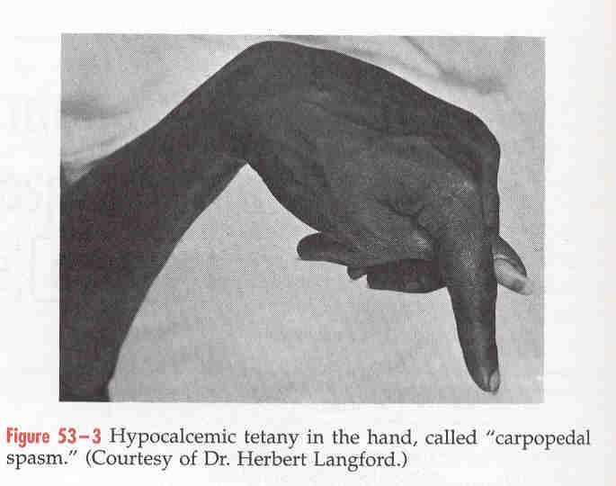

Slide 25
Vit. D deficiency → ↓ Plasma Ca⁺⁺ conc.
If this occur in children → Rickets in which
bones are soft, easily fractured and distorted →
( Bow legged ), due to the effects of weight
bearing in the legs.
Vit. D deficiency in adults → Osteomalacia, due
to inadequate bone mineralization → ↓ strength of
bone, and can be associated with severe bone
pain.

Slide 26
Osteoporosis :-
Is a reduction in bone mass due to loss of bone mineral
and organic matrix.
Causes :-
1- Long- term dietary calcium deficiency.
2- ↓ in the mechanical stress on bone → Bone loss
e.g. in immobilization, or disuse of limb such as with a
cast or paralysis → Localized osteoporosis.
3- Ageing, more in females than males due to ↓ estrogen.
4- Space flight due to weightlessness.
5- Vit. C deficiency, needed for normal collagen synthesis.

Slide 27
