Slide 1
MUSCLES INVOLVED IN RESPIRATION
Dr. Ahmed Fathalla Ibrahim
Associate Professor of Anatomy
College of Medicine
King Saud University
E-mail: ahmedfathala@gmail.com

Slide 2
OBJECTIVES
At the end of the lecture, students should:
Describe the components of the thoracic cage and their articulations.
Describe in brief the respiratory movements.
List the muscles involved in inspiration and in expiration.
Describe the attachments of each muscle to the thoracic cage and its nerve supply.
Describe the origin, insertion, nerve supply of diaphragm.

Slide 3
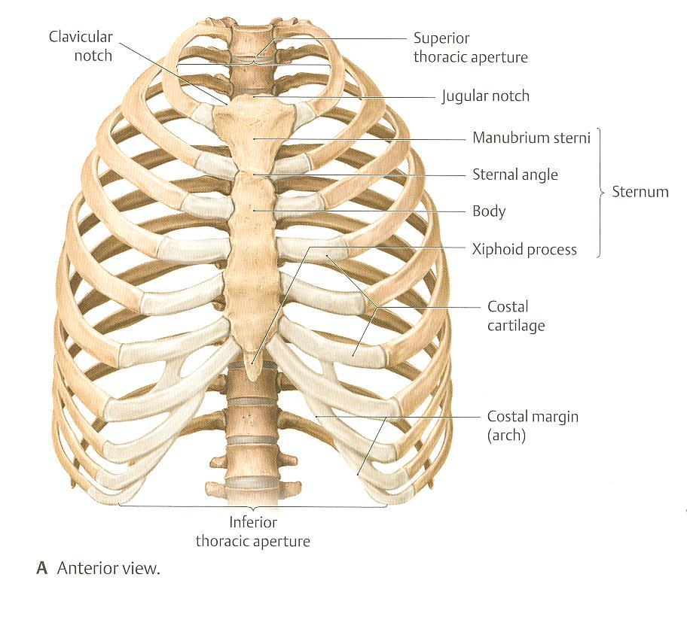
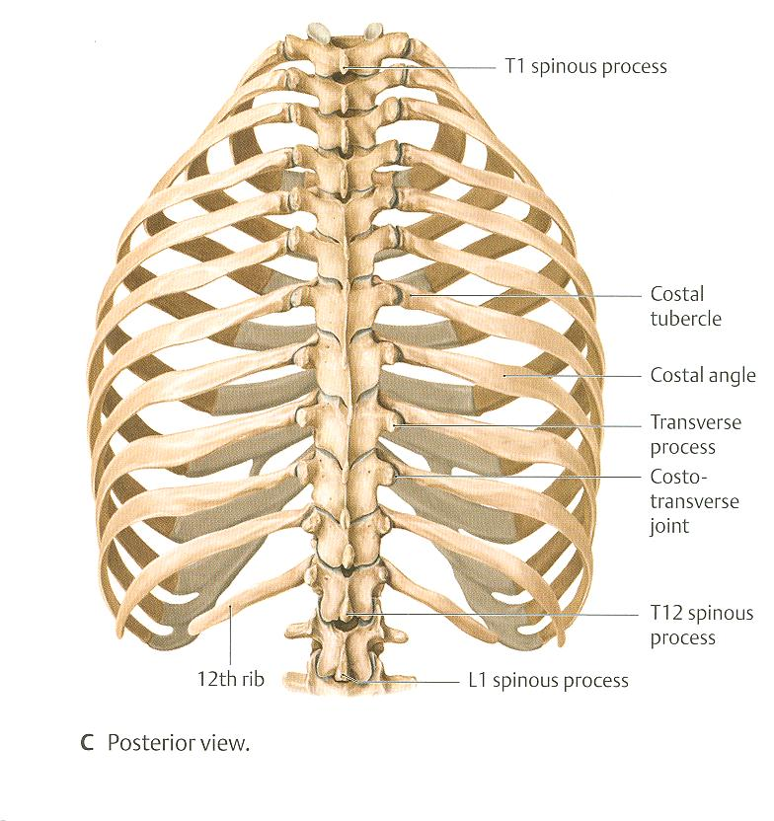
THORACIC CAGE
التفاصيل الشريحه القادمه
Vertebra
Rib

Slide 4
THORACIC cage
القفص الصدري مكون من :
1- sternum
2- rib
3- costal cartilage : يربط رقم 1 برقم 2
4- vertebra
تظهر بالاسهم الحمراء بالرسمه السابقه
فتحات القفص الصدري
الاسهم الصفراء : تشرح لاحقا

Slide 5
THORACIC CAGE
Conical قمعي in shape
Has 2 apertures (openings):
Superior علوي (thoracic outlet): narrow, open, continuous with neck
Inferior سفلي: wide, closed by diaphragm
Formed of:
Sternum & costal cartilages: anteriorly امامي
Twelve 12 pairs of ribs: laterally جانبي
Twelve thoracic vertebrae: posteriorly خلفي

Slide 6
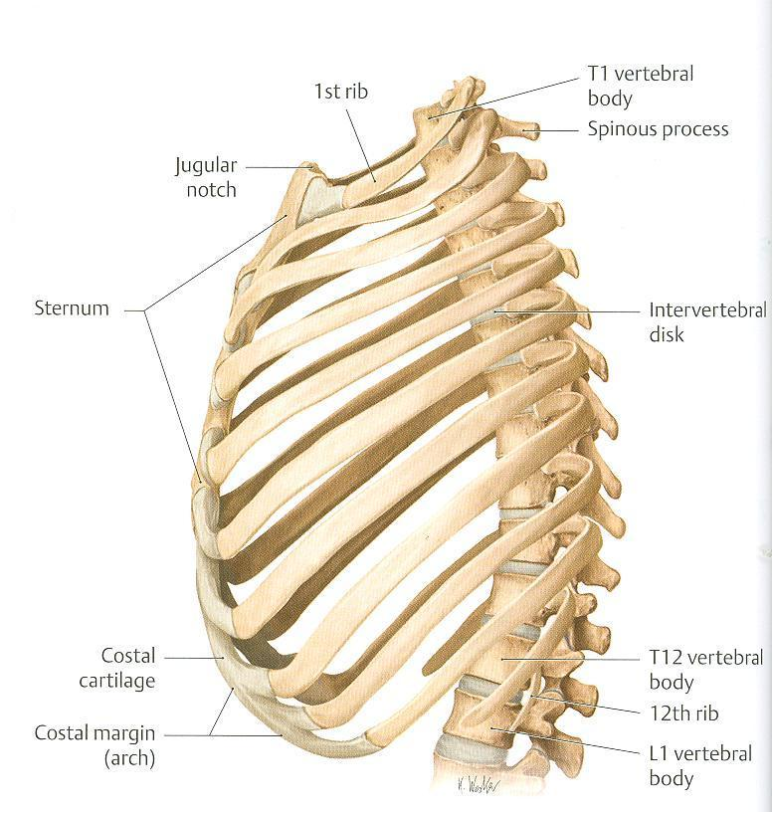
ARTICULATIONS المفاصل
بين عظمه القص والاضلاع
Costovertebral
Sternocostal
بين الاضلاع والعمود الفقري
Costochondral
بين الاضلاع والغضاريف

Slide 7
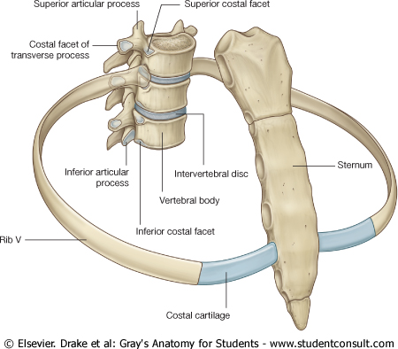
ARTICULATIONS
سيم سيم
Costovertebral
Costochondral
Sternocostal

Slide 8
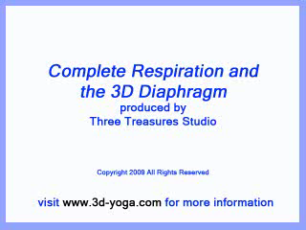
هذا اسم موقع مفيد
اللي فاضي يدخله ☺

Slide 9
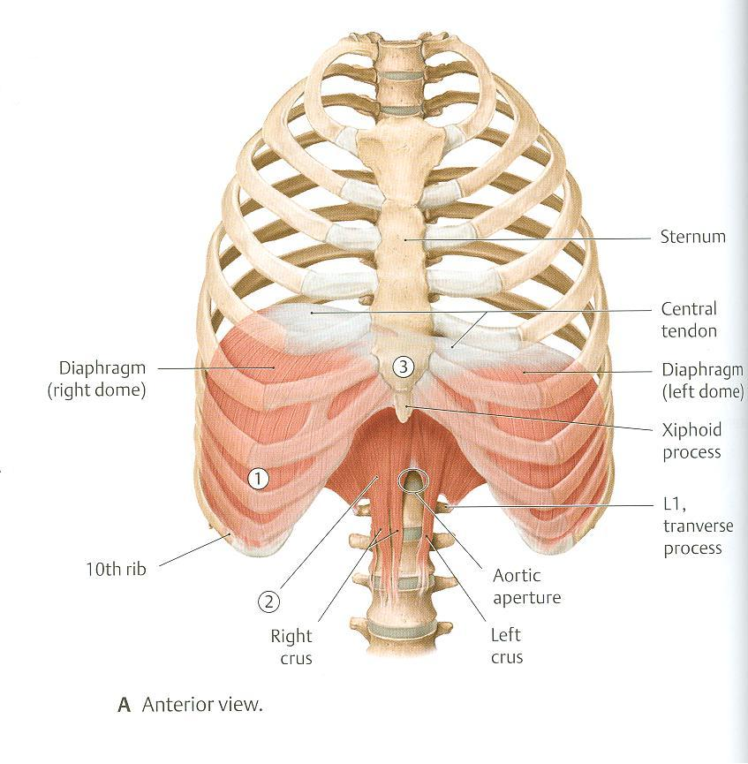
RESPIRATORY MOVEMENTS
A- MOVEMENTS OF DIAPHRAGM
Inspiration
Contraction (descent) of diaphragm
Increase of vertical diameter
of thoracic cavity
Relaxation (ascent)
of diaphragm)
Expiration

Slide 10
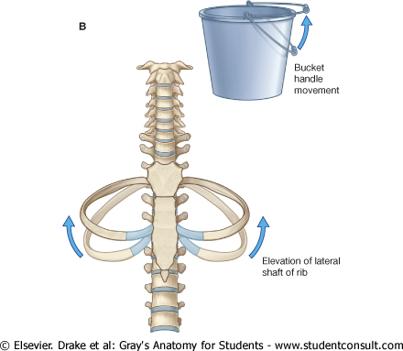
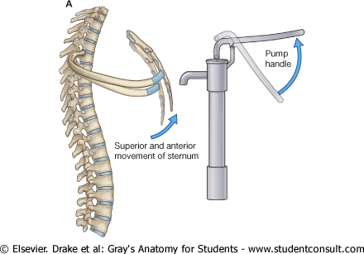
RESPIRATORY MOVEMENTS
B- MOVEMENTS OF RIBS
PUMP HANDLE MOVEMENT
Elevation of ribs
Increase in antero-posterior diameter of thoracic cavity
BUCKET HANDLE MOVEMENT
Elevation of ribs
Increase in lateral diameter of thoracic cavity

Slide 11
الهدف من الحركات السابقه هو زياده حجم القفص الصدري فيزداد الحجم فيقل الضغط ويحدث الشهيق

Slide 12
INSPIRATORY MUSCLES
Diaphragm (most important muscle)
Rib elevators: external intercostal muscles
Accessory muscles (only during forced inspiration): : انواعها
Muscles attaching cervical vertebrae to first & second rib: scalene muscles
Muscles attaching thoracic cage to upper limb: pectoralis major

Slide 13
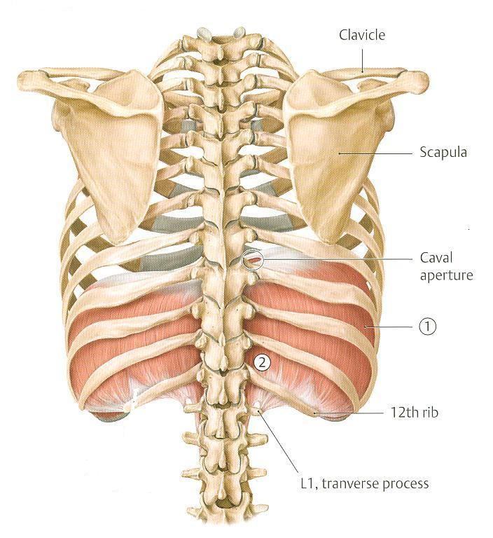
ORIGIN OF DIAPHRAGM
اهم اوريجن للحجاب الحاجز لانه ثابت ولا يتحرك ويحقق الهدف من الاورجن
1-L-R crus : اهم جزئين واليمنى اكبر من اليسري لان لها وظيفه واخرى وهي دعم الكبد
2-Arcuate ligaments : وظيفتها الربط
1) Costal: lower 6 costal cartilages
3) Sternal: xiphoid process of sternum
2) Vertebral: upper 3 lumbar vertebrae
(right & left crus + arcuate ligaments)
Lateral arcuate ligament
Medial arcuate
ligament
Lateral arcuate ligament
Medial arcuate ligament
Lateral arcuate ligament
Posterior view
B. Posterior view

Slide 14
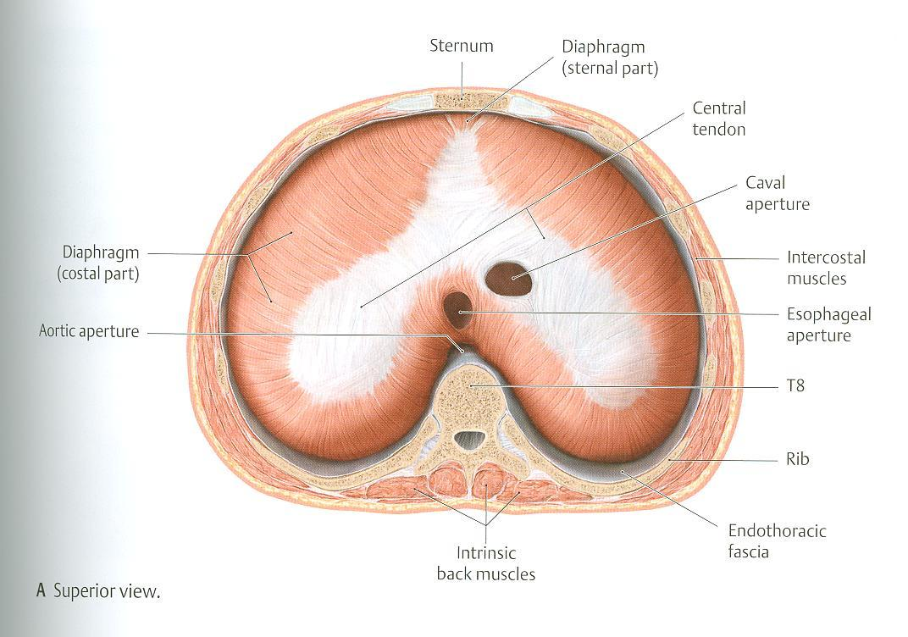
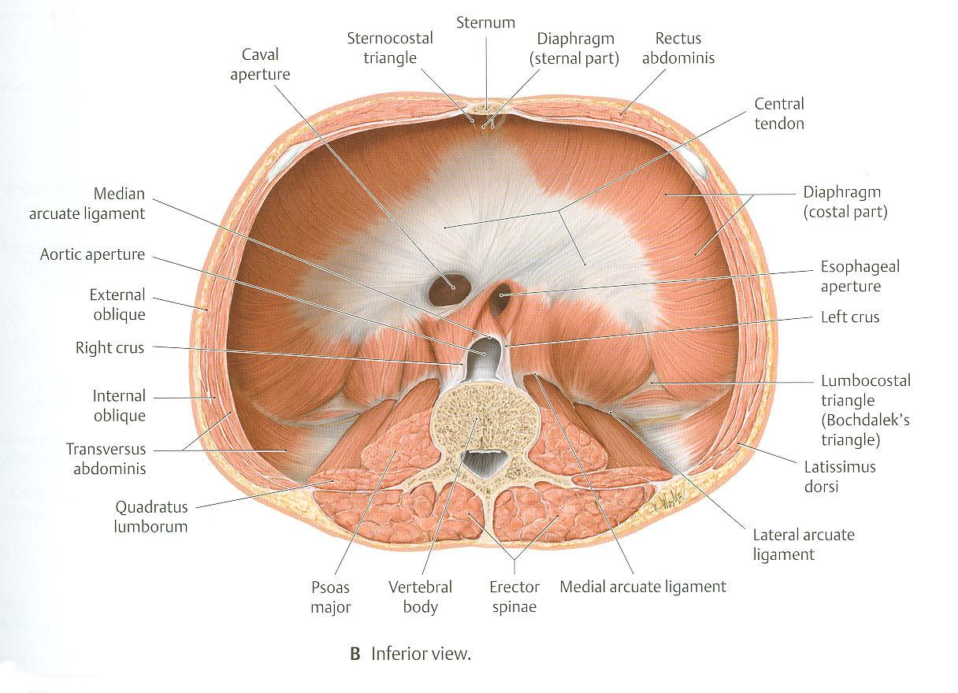
INSERTION OF DIAPHRAGM
(CENTRAL TENDON واحد فقط)

Slide 15
DIAPHRAGM
A musculotendinous partition between thoracic & abdominal cavity
Convex toward thoracic & concave toward abdominal cavity
Attached to: sternum, costal cartilages,12th rib & lumbar vertebrae
Fibers converge تميل الى to join the central tendon
Nerve supply: phrenic nerve (C3,4,5), penetrates diaphragm & innervates it from abdominal surface
Action: contraction (descent نزول) of diaphragm increase vertical diameter of thoracic cavity (essential for normal breathing)

Slide 16
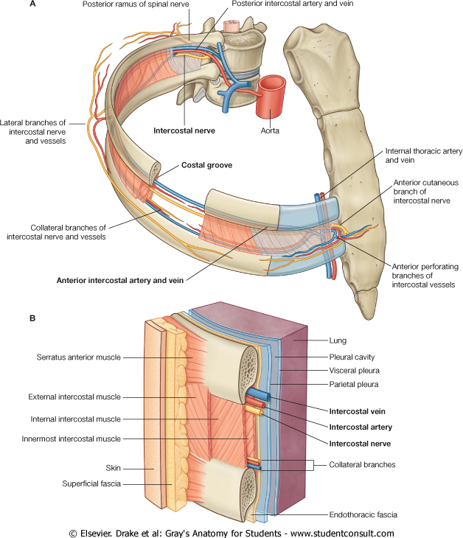
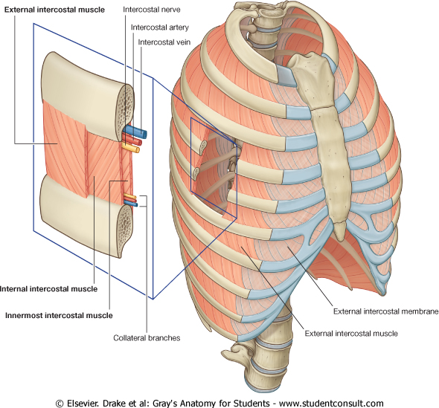
EXTERNAL INTERCOSTAL
Attachments: from lower border of rib above to upper border of rib below
Direction of fibers: downward & medially
Nerve supply: intercostal nerves
Action: rib elevators (inspiratory)

Slide 17
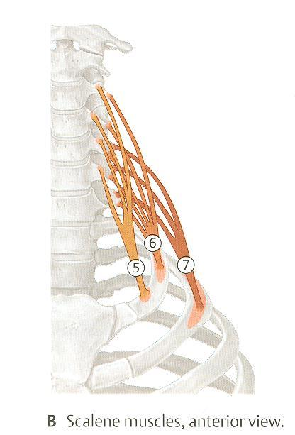
SCALENE MUSCLES
5- Scalenus anterior
6. Scalenus medius
7. Scalenus posterior
Origin: cervical vertebrae
Insertion: 1st & 2nd ribs
Action: elevates 1st & 2nd ribs (inspiratory)
Cervical vertebrae
1st rib
2nd rib

Slide 18
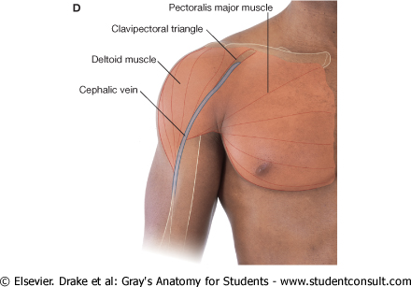
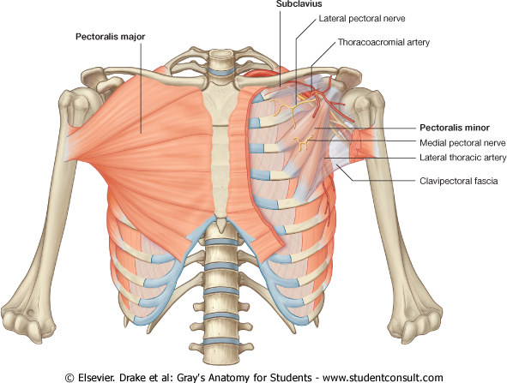
PECTORALIS MAJOR
Action: increases antero-posterior diameter of thoracic cavity, when arm is fixed (inspiratory)
Origin: sternum + costal cartilages
Insertion: humerus

Slide 19
EXPIRATORY MUSCLES لا تعمل الا عند الجهد فقط
Act only during forced expiration
Rib depressors:
Internal intercostal
Innermost intercostal
Subcostals
Transversus thoracis
Anterior abdominal wall muscles:
External oblique
Internal oblique
Transversus abdominis
Rectus abdominis

Slide 20
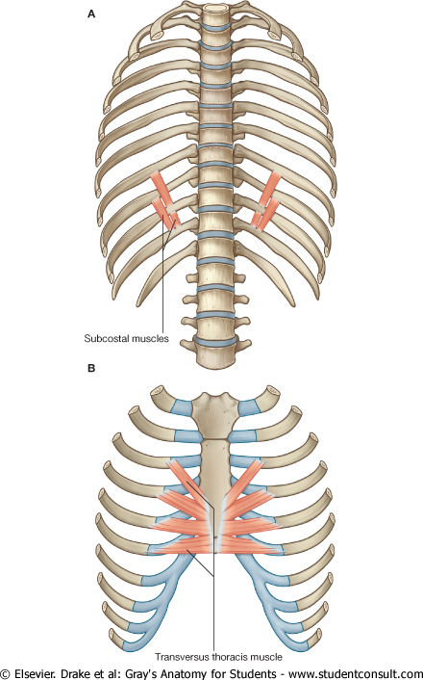
RIB DEPRESSORS: REST OF INTERCOSTAL MUSCLES
1. Internal intercostal
2. Innermost intercostal
Direction: upward & medially
3. Subcostal
4. Transversus thoracis
Nerve supply: intercostal nerves (ventral rami of T1-T11)

Slide 21
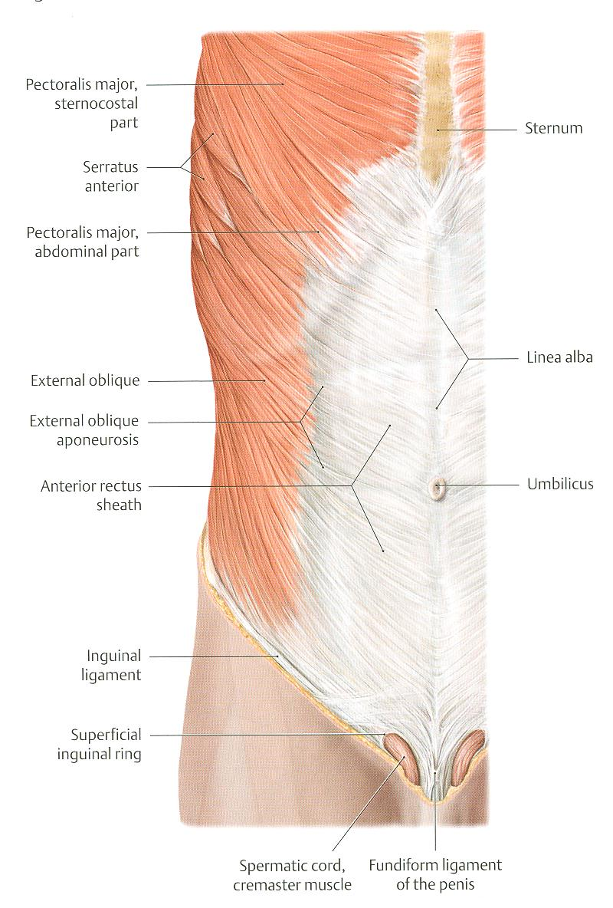
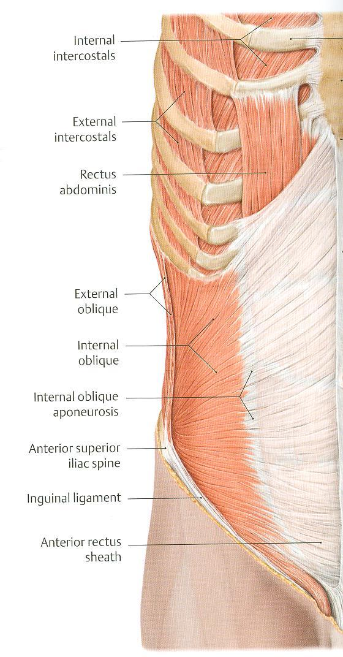
ANTERIOR ABDOMINAL WALL
External oblique (outer layer)
Direction: downward & medially
Internal oblique (middle layer)
Direction: upward & medially
Linea
alba
بسبب عدم وجود عظمه ترتبط بها العضلات البطنيه تقوم هذه العضلات بالاتصال مع بعض لتكون لينيا البا التي تقوم مقام العظم

Slide 22
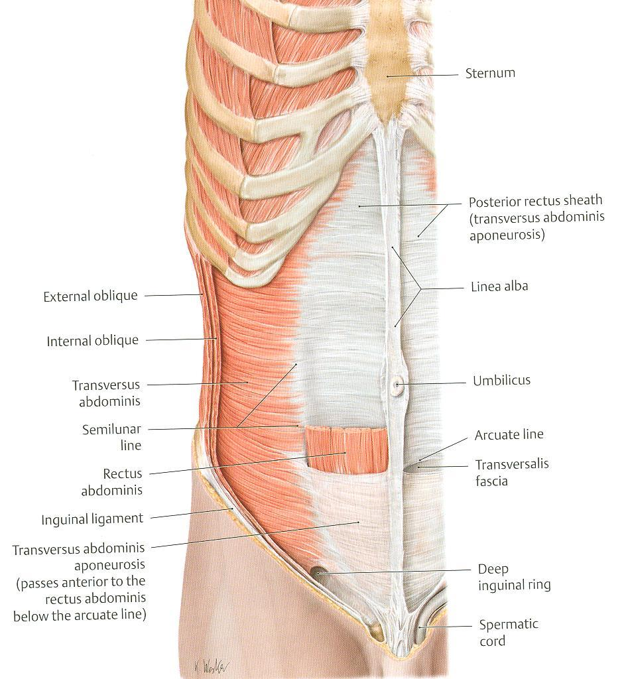
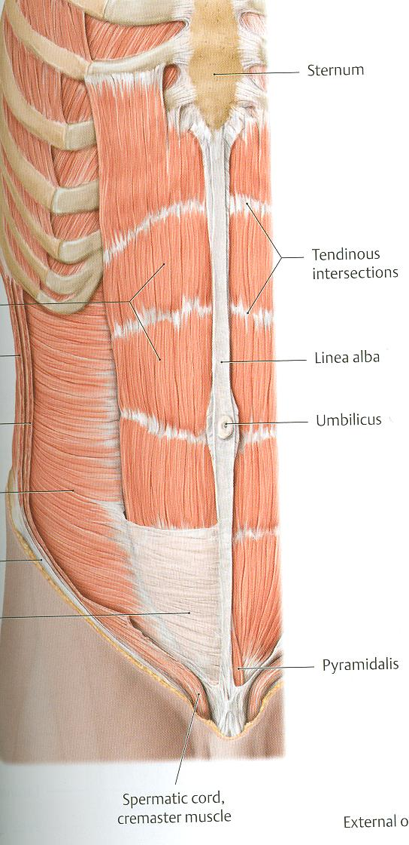
ANTERIOR ABDOMINAL WALL
Transversus abdominis (inner layer)
Direction: transverse
Rectus abdominis
Direction: vertical
Rectus abdominis
Transversus abdominis

Slide 23
Anterior abdominal wall
Is formed of 3 layers of muscles of fibers running in different directions (to increase strength of anterior abdominal wall)
The 3 muscles form a sheath in which a fourth muscles lies (rectus abdominis)
Muscles are attached to: sternum, costal cartilages and ribs + hip bones
The aponeurosis of the 3 muscles on both sides fuse in the midline to form linea alba
Action (during forced expiration): Compression of abdominal viscera to help in ascent of diaphragm (during forced expiration)
Nerve supply: lower intercostal nerves (T7 – T11), subcostal nerve (T12) and first lumbar nerve.

Slide 24
SUMMARY OF RESPIRATORY MOVEMENTS
Inspiration
Expiration
لاحظ عند السكون لا تعمل العضلات
Quiet Inspiration (active)
Quiet Expiration (passive)
Elastic recoil of lung
Relaxation of diaphragm & external intercostal
Forced Expiration (active):
Contraction of anterior Depression of ribs
abdominal wall muscles (rest of intercostal
muscles)
Compression of abdominal
viscera
Ascent of diaphragm
Contraction (Descent) Elevation of ribs
of diaphragm (external intercostal)
Increase in vertical Increase in:
diameter - anteroposterior
diameter
- lateral diameter
Forced Inspiration (active)
Accessory muscles of inspiration:
Pectoralis major
Scalene muscles

Slide 25
QUESTIONS
هذي اسئله قال الدكتور ابحثوا عنها
Are the following muscles have a respiratory role? If yes, what is it?
Levatores costarum.
Serratus posterior superior.
Serratus posterior inferior.
Pectoralis minor.
Serratus anterior.
Latissimus dorsi.
Quadratus lumborum.
Why diaphragm is supplied by cervical nerves?
Why right crus of diaphragm is larger than left crus? الجواب ذكرته من قبل وجبته من دكتور العملي

Slide 26
THANK YOU

