Slide 1
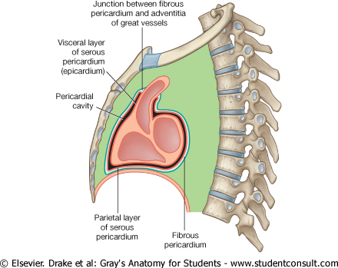
MEDIASTINUM
By Prof. Saeed Abuel Makarem
والنعم

Slide 2
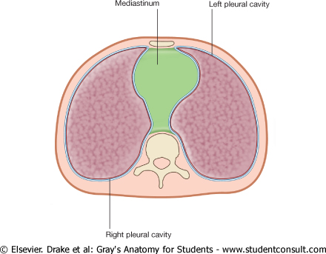
MEDIASTINUM
DEFINTION
The median partition القسم اللوسطي (septum) of the thorax between the two pleural sacs & lungs.
Boundaries
حدوده
Anterior : Sternum
Posterior: Thoracic
vertebrae
Superior: Thoracic inlet مدخل الصدر
Inferior: Diaphragm
On each side: pleural sacs

Slide 3
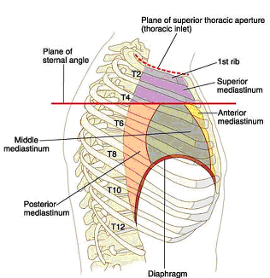
Divisions of the Mediastinum
For description purpose the mediastinum is divided into:
Superior علوي Mediastinum
Inferior سفلي Mediastinum
The inferior is further subdivided into:
Anterior امامي mediastinum
Middle وسطي mediastinum
Posterior خلفي mediastinum
هذه التقسيمه بواسطه الغشاء القلبي
يقسم الميدياستانيوم بواسطه خط وهمي اسمه :By Transverse horizontal ويسمى :(thoracic) plane ,ويعطي القسمين اي وبي?
Imaginary خيالي plane passing from sternal angle التي تتوازى مع الضلع رقم 2 ( انظر الصوره ) to the lower border of the body of T4 vertebrae. الخط الاحمر بالصوره

Slide 4
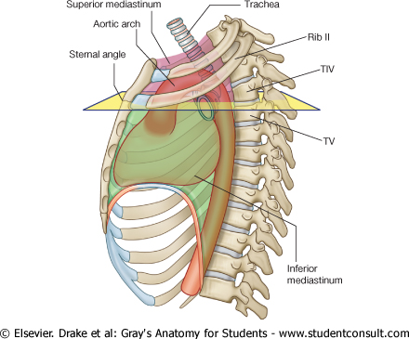
التفاصيل
:اولاSuperior Mediastinum
Boundaries
Anterior :
Manubrium sterni مقبض عظمه القص
Posterior :
Upper 4 thoracic vertebrae
Superior :
Thoracic inlet فتحه الصدر االعلويه
Inferior :
Transverse thoracic plane الخط الوهمي الذي سبق شرحه
On each side:
Pleural sacs

Slide 5
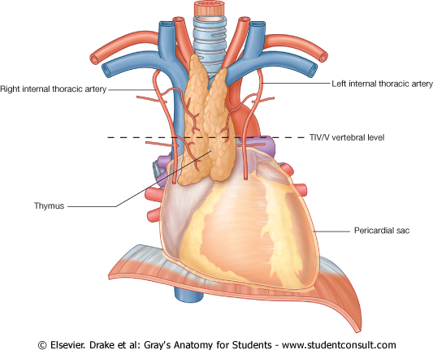
Contents مكونات of Superior Mediastinum
From anterior to posterior من الامام للخلف the main contents are:
Thymus الغدة الجنينيه
Great vessels وهي:
الاورده 1- Rt & LT Brachiocephalic veins
2- SVC
الشرايين Arch of aorta & its 3 branches:
Left subclavian artery
Left common carotid artery Brachiocephalic trunk
Vagus nerve
phrenic nerve
Cardiac plexus ظفيره of nerves
Left recurrent laryngeal nerve
Trachea
Esophagus
Thoracic duct
Prevertebral muscles

Slide 6
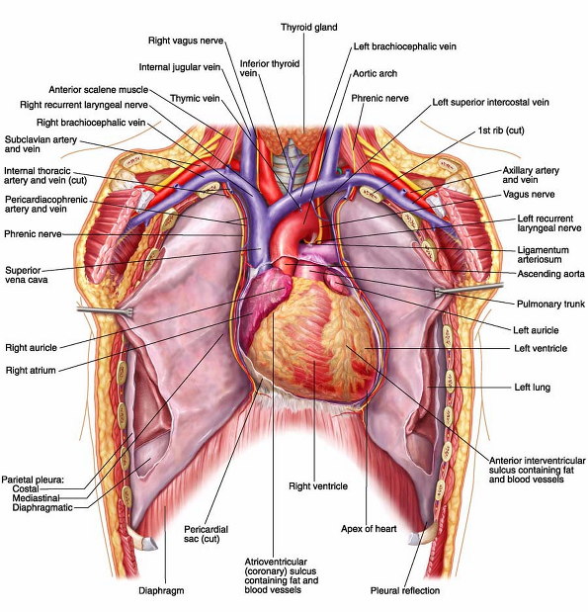
هذه الصوره مهمه جدا وتلخص الدرس ومهمه في العملي

Slide 7
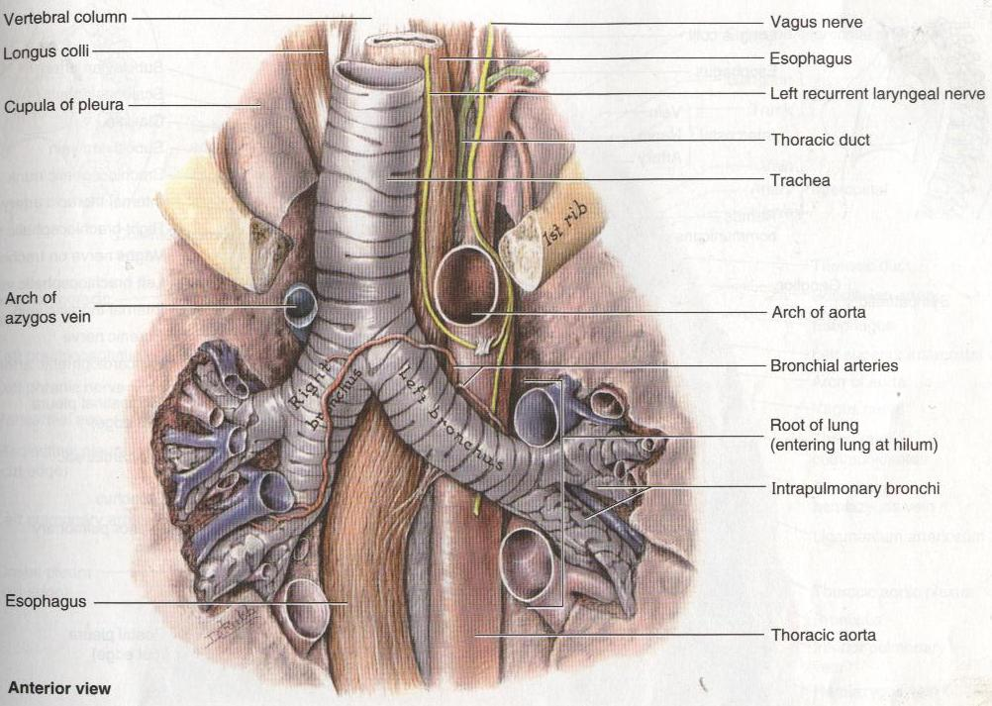
سيم سيم

Slide 8
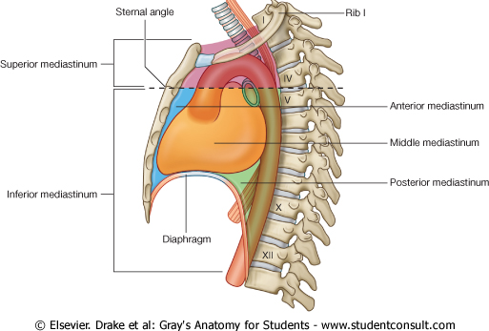
:ثانيا1-Anterior Mediastinum
A very narrow space in front of the pericardium
overlapped متداخلby the anterior borders of both lungs
Boundaries
Anterior:
Body of the sternum
Posterior:
Pericardium & heart
Superior:
Transverse thoracic plane
Inferior:
Diaphragm superior aspect
On each side:
Mediastinal pleurae

Slide 9
Contents of Anterior Mediastinum
Thymus الجزء السفلي منها
Sterno-percardial ligaments
Branches of the internal thoracic vessels
Fat
Lymph vessels & nodes

Slide 10
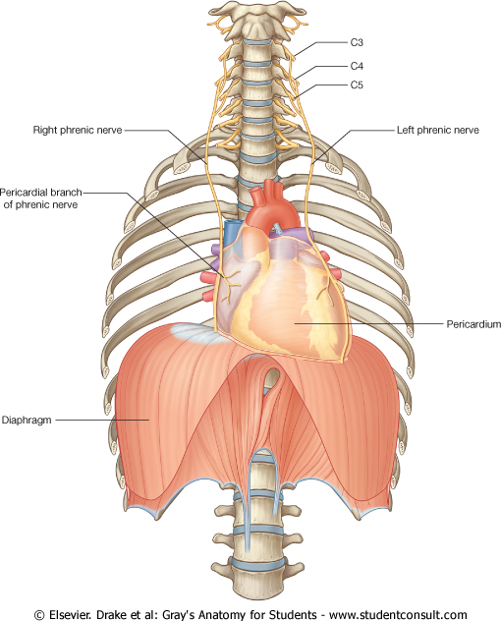
2- Middle Mediastinum
Occupied by the pericardium & its contents along with phrenic nerves & pericardiophrenic vessels
Contents
Heart
Ascending aorta,
Pulmonary trunk,
Pulmonary arteries
SVC
Azygos vein,
Pulmonary veins (4)
Phrenic nerve
Deep cardiac plexus
Lymph nodes
Bifurcation تشعب of trachea

Slide 11
3- Posterior Mediastinum
Lies between:
The pericardium anteriorly
and
The vertebral column Posteriorly

Slide 12
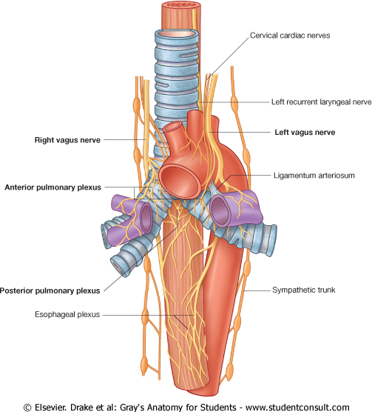
Boundaries
Posterior Mediastinum
Anterior:
Pericardium & bifurcation of
the trachea
Posterior :
Lower 8 thoracic vertebrae
On each side:
Mediastinal pleura
Inferior:
Diaphragm
Contents
Esophagus
Descending thoracic aorta and its branches
Azygos, Hemiazygos veins
Vagus nerve & splanchnic nerves
Thoracic duct

Slide 13
Structures seen in the Mediastinum
Right side
تلخص الدرس ومهمه بالعملي
Left side

Slide 14
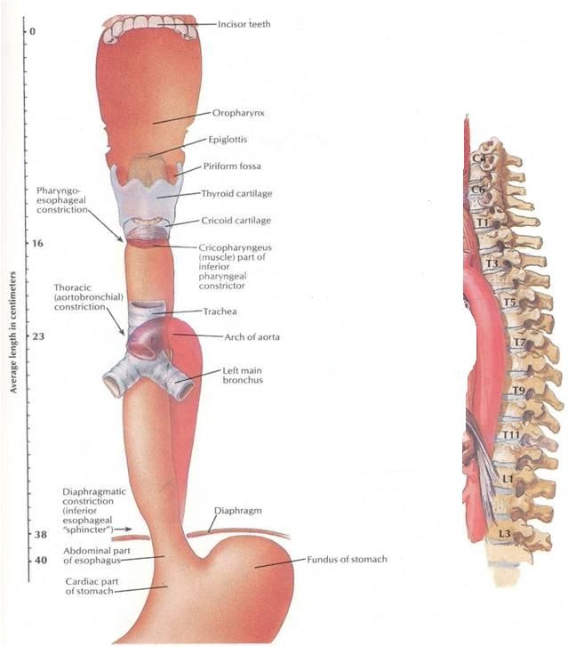
Esophagus
About 25 cm long tub.
Continuous above with pharynx opposite مقابل C6 vertebra
Passes through the diaphragm at the level of T10, to join the stomach
In thorax, passes downward & to the left through superior and posterior mediastinum
At the level of sternal angle, pushed to the midline by the arch of aorta

Slide 15
Sympathetic Trunk عصب يمتد من المخ لجميع الجسم وهو يشبه السبحه (Thoracic Part)
Continuous above with the cervical and below with the lumbar parts
Runs downward on the front of the heads of the ribs
Leaves the thorax at the side of the body of T12 vertebra by passing behind the medial arcuate ligaments التي تربط الكرست – راجع درس عضلات التنفس
Has 12 segmentally arranged ganglia, each with white and grey rami communicntes passing to the corresponding spinal nerves
The first ganglion is often fused with the inferior cervical ganglion to form the stellate ganglion

Slide 16
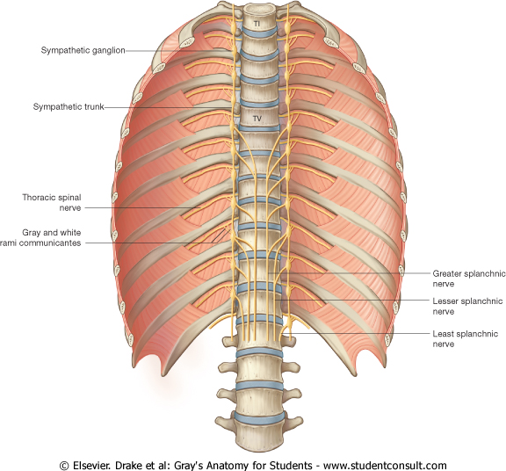
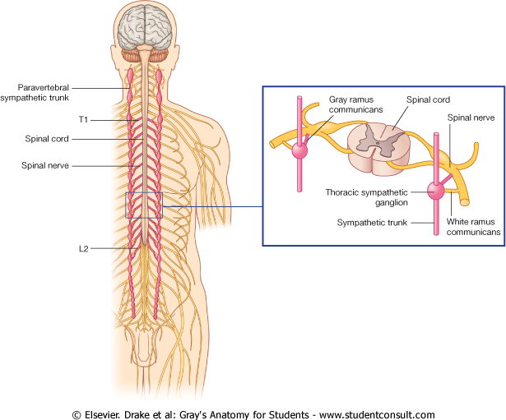
Sympathetic Trunk Branches
Grey rami communicantes (carry postganglionic fibers) to all thoracic spinal nerves
First five ganglia give postganglionic fibers to heart, lungs, esophagus and aorta
Lower eight ganglia give passage to preganglionic fibers which form three sets of splanchnic nerves that supply the abdominal viscera
Greater splanchnic from 5-9th ganglia
Lesser splanchnic from 10th &11th
ganglia
Lowest splanchnic from 12th ganglion

Slide 17
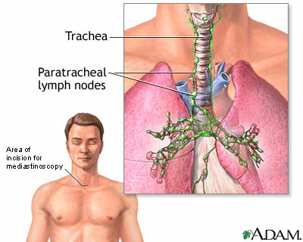
MEDIASTINOSCOPY
جهاز يستخدم لفحص منطقة الميدياستيرنيوم
Mediastinoscopy: a diagnostic procedure اجراء for exploration of the superior mediastinum and for obtaining الحصول على specimens عينه from the tracheobronchial lymph nodes.
The mediastinoscope is inserted through a small incision just above the suprasternal notch and can penetrate down to the bifurcation of the trachea.
Used to determine the spread of carcinoma السرطان عفانا الله of the bronchus.

