Slide 1
Radiological Anatomy of the chest
Anatomy Department
by
Essam eldin AbdelHady Salama

Slide 2
Objectives
By the end of this lecture the students must know; 1- Determination of bones of the thoracic cage.
2- Identification of superficial soft tissues.
3- Determination of trachea and lunge fields.
4-Visualization of mediastinum and the important heart shadows.
5- Brief knowledge about Bronchography.
6- Brief knowledge about Coronary angiography.

Slide 3
Radiography
Different views of the chest can be obtained يحصل عليها by changing the relative orientation توجيه الجسم of the body and the direction of the x-ray beams.
The most common views are
Posteroanterior(PA),
Anteroposterior (AP),
Lateral .

Slide 4
Radiography التصوير الاشعاعي
A chest x-ray may be used to help diagnose and plan treatment for various conditions, including:
Fractures كسور of the bones in the chest, including the ribs, sternum, clavicle and the vertebrae.
Lung disorders such as pneumonia, emphysema, tuberculosis and lung cancer.
Heart disorders such as congestive heart failure (which causes the heart to enlarge)
Chest radiographs are also used to screen for job-related lung disease in industries such as mining where workers are exposed to dust.

Slide 5
الطريقه الاولى لاخذ الصوره postero anterior radiograph
For postero anterior radiograph the following systems must be examined in order الاشياء التي يمكن ملاحظتها :.
Superficial soft tissues; the nipples حلمه الثدي in both sexes and the breast in female are seen superimposed منطقه ما فوق on the lung fields.

Slide 6
postero anterior radiograph (Bones)
Bones of the thoracic cage (anterior ribs, posterior ribs).
Thoracic vertebrae.
Costotransverse joints. مفاصل التي تربط الاضلاع بالعمود الفقري ( انظر الصوره )
Clavicles.
Medial side of the scapula.

Slide 7
postero anterior radiograph (Diaphragm)
The diaphragm appears as a dome-shaped shadow on each side; the right side is slightly higher than the left. بسبب وجود الكبد
مهمهBeneath the right dome is the homogeneous, dense shadow of the liver.
مهمهBeneath the left dome a gas bubble may be seen in the fundus of the stomach.

Slide 8
postero anterior radiograph (Diaphragm)
Note the costophrenic angle, where the diaphragm meets the thoracic wall
The angle become blunt غير حاده or obscured معتمة اللون due to pleural fluid or fibrosis.

Slide 9
postero anterior radiograph (Trachea)
The radiotranslucent, air-filled shadow of the trachea is seen in the midline of the neck as a dark area.
This is superimposed يقع فوق on the lower cervical and upper thoracic vertebrae.

Slide 10
postero anterior radiograph (Lungs)
Lung roots مكان دخول الاوعيه : relatively نسبيا dense shadows caused by the presence of the blood-filled pulmonary and bronchial vessels, the large bronchi, and the lymph nodes.
Left hilum lower margin is at the level of right hilum upper margin . مهمه
الايسر اعلى من الايمن

Slide 11
postero anterior radiograph (Lungs)
The lung fields, by virtue بفضل of the air they contain, readily permit تتيحthe passage of نفاذ x-rays, for this reason, the lungs are more translucent واضح on full inspiration than on expiration.
The pulmonary blood vessels are seen as a series of small, round, white shadows radiating from the lung root.
The large bronchi, are seen as similar round المحيط shadows.
The smaller bronchi are not seen

Slide 12
postero anterior radiograph (Mediastinum)
The right border of the mediastinum; consists of right brachiocephalic vein, superior vena cava, right atrium, and inferior vena cava.
The left border of mediastinum; the aortic knuckle (aortic arch), pulmonary trunk, left auricle, left ventricle.

Slide 13
postero anterior radiograph (Mediastinum)
The transverse diameter of the heart مسافه القلب العرضيه should not exceed تزيد على half the width of the thoracic cage. معلومه مههمه جدا
On deep insp iration, when the diaphragm descends, the vertical length of the heart increases and the transverse diameter is narrowed مهمه ايضا .

Slide 14
Bronchography and contrast ضوئي visualization of the esophagus;
Bronchography ;
It is special study of the bronchial tree by introduction of contrast مشع باين medium into a particular bronchus .

Slide 15
Bronchography and contrast visualization of the esophagus;
Contrast visualization of the esophagus by swallow بلع ( اللي قبل اسنتشاق ) a contrast media .
فائدتها :مهمه
Identification of the aortic arch and left bronchus.
Identification of enlargement of left atrium.

Slide 16
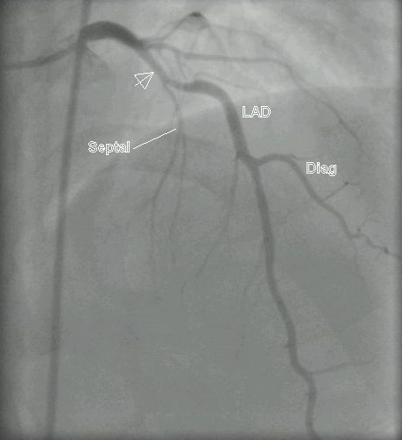
Coronary الشرايين المحيطه بالقلب angiography
The coronary arteries are visualized by introduction of radio-opaque material into their lumen.
: مفيده في Pathological narrowing or blockage of coronary artery can be identified.
آآآآآآآآآآآآسف على التاخير

