Slide 1
Fatty Acids Oxidation
Respiratory Block
Medical Biochemistry Course
معدله
المحاضره 1 + 2

Slide 2
Fatty acids: are stored in adipose tissue مهم : موقع التخزين, in the form of TAG (Glycerol + 3 Fatty Acids) مهم شكل التخزين TAG: provide concentrated كثيف storage of metabolic energy Complete oxidation of fatty acids to CO2 & H2O: 9 Kcal/gram of fat
Stored Fats

Slide 3
Fatty Acid oxidation

Slide 4
اولا Release of fatty acids from TAG in adipose tissue يتم تغيير شكل الدهون من ت ا ج الى فاتي اسد
By hormone-sensitive lipase (HSL) مهم ---- yields free fatty acids
glucagon & epinephrine phosph. HSL ACTIVE نشط
(in fasting state, no glucose) cAMP
Insulin dephosph. HSL INACTIVE
(fed state, glucose is available)
تضيف فسفور
تزيل الفسفور من الانزيم

Slide 5
Fate تحليل – نهايه of free fatty acids (released from TAG)
free Fatty acids
(from adipose tissue TAG)
Blood
(bound with albumin)
Cells of body
FA Oxidation (in mitochondria)
Ketone Bodies Acetyl CoA Kreb`s Cycle (TCA cycle)
(in liver) تشرح الدرس القادم
FFA is not used by RBCs (no mitochondria)
FFA is not used by the brain (BBB)

Slide 6
β-oxidation of fatty acids
Fatty acids in cytosol are transported to mitochondria مهم
β-oxidation of fatty acids occurs In the mitochondriaمهم
Two carbon fragments are successively removed from carboxyl end of the fatty acid producing acetyl CoAلاحظ الاسم بدون حرف تي, NADH & FADH2 عندما يدخل الفاتي اسد يتم تحليله على مراحل حيث يتم اكسده كربونتين من الفاتي اسد فيتحول الى ( اسايل –بدون تي - كو اي ) وينتج ناداتش وفاداتش ويستمر التحليل كربونتين كربونتين حتى ينتهي الفاتي اسد
FA (n carbons)
FA(n-ناقص2 carbons لانه تم تحليلهما) + Acetl CoA + NADH + FADH2

Slide 7
Transport of Fatty acids to mitochondria
1- Long-chain fatty acids
FAs longer than 12 carbons
Long-chain fatty acids are transported to the mitochondria by carinitine اسم الانزيم الذي يدخل الفاتي اسد للخليه
using carnitine shuttle يوصل ويرجع مكانه الاصلي ( سوف تشرح )
enzymes of the shuttle للايصال يحتاج انزيمين هما:
1-carnitine acyltransferase-I or carnitine palmotyltransferase-II
(CAT-I or CPT-I)
2-carnitine acyl transferase-II or carnitine palmotyltransferase-II
(CAT-II or CPT-II)

Slide 8
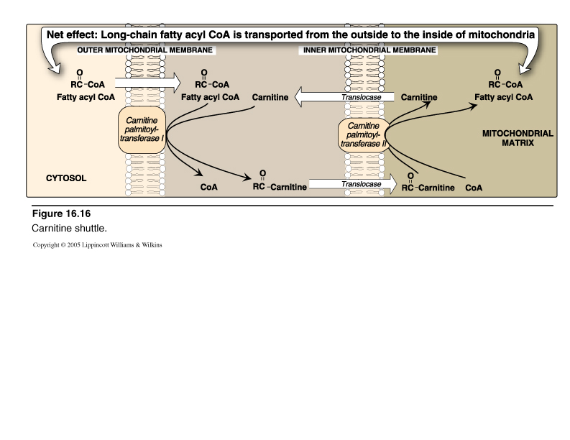
Carnitine Shuttle & Enzymes
الصوره تشرح عمليه الدخول والمربعات التي على الميمبرين هي الكات 1 والكات 2 ولاحظ الانزيم الموصل في الوسط بين الغلافين ( الميمبرين )

Slide 9
Inhibitor of carnitine shuttle
- occurrence of fatty acid synthesis in the cytosol
(indicated by malonyl CoA)
- increased acetyl CoA / CoA ratio

Slide 10
Sources of carinitine:
- diet (particularly in meat products)
- synthesized from amino acids lysine &
methionine in liver & kidney
BUT not in sk.ms & heart مهمه

Slide 11
Carnitine deficiencies نقص الانزيم الناقل للفاتي اسد
lead to decreased ability of tissues to use long-chain FA as a
source of fuel as they are not transported to the mitochondria
Secondary causes:
- liver diseases: decreased synthesis of carnitine
- malnutrition or strictly vegetarians: diminshed carnitine in food
- increased demand for carnitine e.g. In fever, pregnancy, etc
- hemodialysis due to removal of carnitine from blood

Slide 12
Primary carinitine deficiencies نقص بسبب خلقي :
caused by congenital deficiencies of :
- one of enzymes of the carnitine shuttle
- one of the components of renal tubular reabsorption o f carnitine
- one of the components of carnitine uptake of carnitine by cells

Slide 13
Genetic CPT-I deficiency نقص الانزيم كات 1 :
- affects the liver
- liver is unable to utilize long-chain fatty acids as a fuel
- So, liver cannot perform gluconeogenesis (synthesis of
glucose during fasting)
Hypoglycemia نقص نسبه الجلكوز بالدم ( خطير جدا ) occurs , might lead to coma

Slide 14
CPT-II deficiencyنقص كات 2
- Affects primarily the skeletal & cardiac muscles
- Symptoms : cardiomyopathy
muscle weakness

Slide 15
Treatment of carnitine deficiencies
- Avoiding prolonged fasting
- Diet should be rich in carbohydrates , low in long-chain fatty
acids & supplemented with medium chain fatty acids

Slide 16
2- Short- & medium- chain fatty acids
FA shorter than 12 carbons
can cross the inner mitochondrial membrane without aid of
Carnitine مباشره بدون اي انزيمات

Slide 17
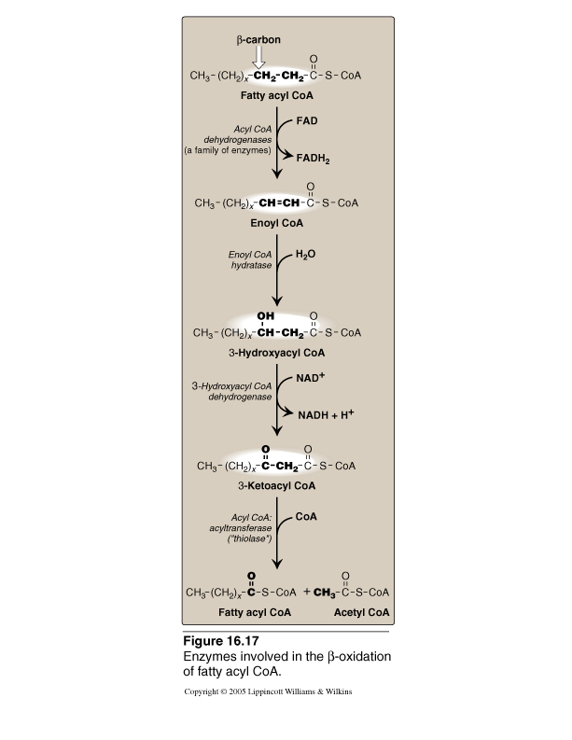
Reactions of β-oxidation
اقرا التفاعلات واحفظ الانزيم اللي عليه سهم فقط

Slide 18
Medium chain fatty acyl acyl CoA dehydrogenase deficiency (MCAD) مرض
Autosomal recessive disorder
One of the most common inborn errors of metabolism
The most common inborn error of fatty acid oxidation (1:40000 worldwide births)
Cause decrease of fatty acid oxidation
Severe hypoglycemia نقص جلكوز الدم occurs (as tissues do not get use fatty acids as a source of energy & must rely on glucose)
Infants مهم جدا يحدث للرضع بشكل اساسي are particularly affected by MCAD deficiency as they rely on milk which contains primarily MCADلانهم يعتمدون على الحليب بشكل اساسي والحليب يحتوي هذا النوع من الفاتي اسد ( الحجم المتوسط )
Treatment: carbohydrate rich diet

Slide 19
Energy yield from fatty acid oxidation
Palmitatic acid as an example:
Complete β-oxidation of palmotyl CoA (16 carbons) produces :
- 8 acetyl CoA ----- Kreb Cycle TCA cycle ------ 8 X 12 = 96 ATP
- 7 NADH ----------- ETC ----------------------------- 7 X 3 = 21 ATP
- 7 FADH2---------- ETC ----------------------------- 7 X 2 = 14 ATP
-------------
All yield ---------------------------------------------------------131 ATPs
Activation of fatty acid requires 2 ATP
Net energy gained: 129 ATPs from one molecule of palmitate

Slide 20
Oxidation of branched-chain fatty acids
Branched-chain fatty acids as phytanic acid
is catabolised by α-oxidation by α-hydroxylase
Deficiency of a-hydroxylase deficiency results in accumulation of phytanic acid in blood & tissues with mainly neurologic symptoms (Refsum disease)
It is treated by diet restriction to reduce disease progression

Slide 21
Ketone Bodies
المحاضره الثانيه

Slide 22
Ketone Bodiesتغيير شكل الاسايل كو اي للقيام بوظائف لا يقوم بها الاسايل كو اي ( فاتي اسد )
Liver mitochondria can convert acetyl CoA derived from the oxidation of fatty acids to ketone bodies which are التي توجد على هذه الاشكال :
1- Acetoacetate
2- 3-hydroxybutyrate (or β-hydroxybutyrate)
3- Acetone (nonmetabolized side product) لا يتحلل لشكل ابسط ويتميز بانه يخرج على شكل ابخره من الفم رائحته تشبه رائحه التفاح المتعفن ويعتبر دلاله على مرض السكر كما سيشرح لاحقا
Acetoacetate & 3-hydroxybutyrate synthesized in the liver are transported via blood to peripheral tissues جميع اعضاء الجسم ما عدا الكبد
In peripheral tissues, they can be converted to acetyl CoA
Acetyl CoA is oxidized by Kreb`s cycle (TCA cycle) to yield energy (ATPs)

Slide 23
Ketone bodies are important sources of energy for peripheral tissues جميع اعضاء الجسم ما عدا الكبد
1- soluble in aqueous مائيsolution, so do no need to be incorporated تدمج - تضمن into lipoproteins or carried by albumin as do other lipids
2- They are synthesized in the liver when amount of acetyl CoA exceeds تجاوز oxidative capacity of liver
3- They are important sources of energy during prolonged periods of
fasting especially for the brain as:
- can pass BBB: (while FAs cannot)
- Glucose in blood available in fasting is not sufficient

Slide 24
Synthesis of ketone bodies in the liver (KETOGNESIS)
During a fast الصيام , liver is flooded تشبع – تملأ by fatty acids mobilized from adipose tissue
FAs are oxidised to acetyl CoA in large amounts
Acetyl CoA does not find enough oxalacetate to be
incorporated in TCA cycle
So, excess acetyl CoA is shifted to ketone bodies formation

Slide 25
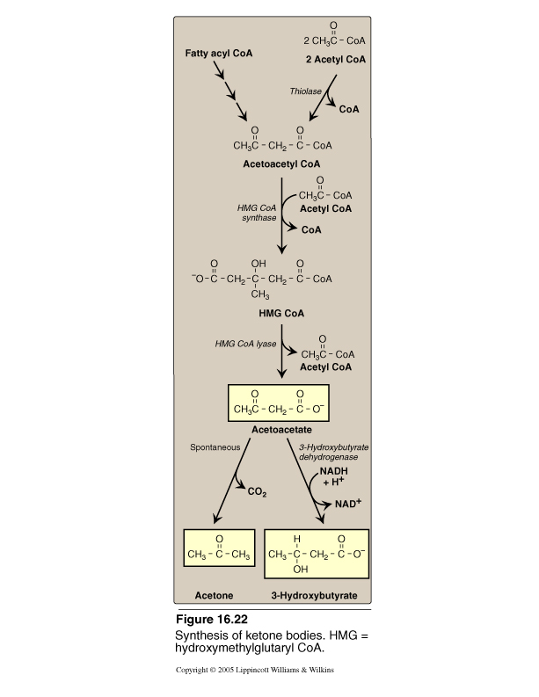
Reactions of ketone bodies synthesis
انزيم
Thiolase
يوجد في جميع انحاء الجسم ما عدا الكبد وهذا يفسر عدم قره الكبد على الاستفاده من
Ketone bodies

Slide 26
Use of Ketone bodies by peripheral tissues (KETOLYSIS)
Liver cannot use ketone bodies as a fuel
Use of ketone bodies occurs in peripheral tissues
3-hydroxybutyrate (KB)
Acetoacetate (KB)
acetoacetyl CoA
2 acetyl CoA

Slide 27
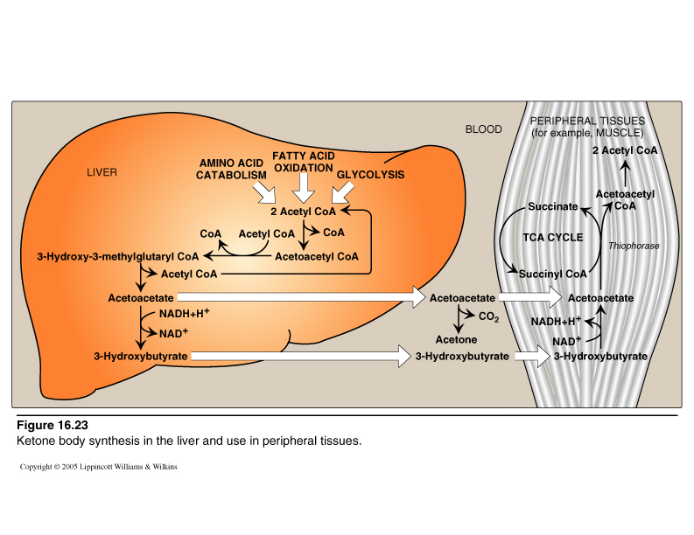
Ketogenesis & KETOLYSIS
رسمه تلخص الشريحتين السابقتين

Slide 28
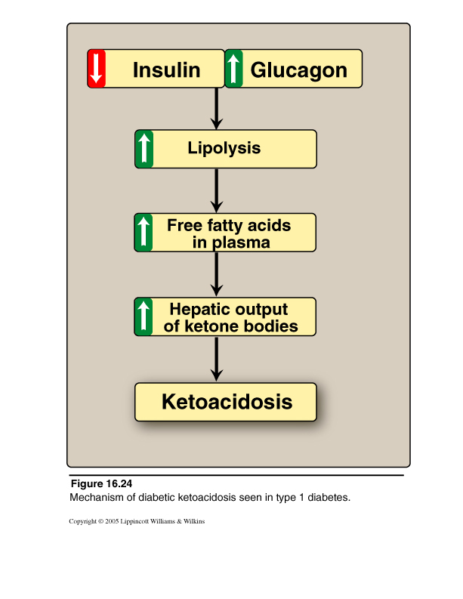
Excessive production of ketone bodies in diabetes mellitus علاقه مرض السكر بافراز اجسام كيتون
عندمايكثر السكر بالدم يفرز الانسولين ولكن في
Type I of diabetes mellitus
ينعدم وجود الانسولين لذلك يلجا الجسم لاستخدام اجسام كيتون بدلا من الجلكوز ويتم افراز اجسام كيتون بكميات كبيره لانتاج الطاقه هذا جيد حتى فتره لان اجسام كيتون تسبب زياده حامضيه الدم وهذا يسبب مضاعفات خطيره وخصوصا على الدماغ

Slide 29
Ketonemia (increased KB in blood)
occurs when
rate of production of ketone bodies (KETOGENESIS)
is greater than
rate of their use (KETOLYSIS)

Slide 30
In uncontrolled type 1 DM (Insulin-dependent DM)
Increased lipolysis in adipose tissues with increased FFAs in blood
high oxidation of fatty acids in liver
excessive amounts of acetyl CoA
+
depletion of NAD+ pool (required by Kreb`s cycle)
acetyl CoA is shifted to ketone bodies synthesis in liver
DIABETIC KETOACIDOSIS, DKA)
(with Ketonemia & ketonuria)

Slide 31
Manifestations مظاهر - اعراض of diabetic ketoacidosis
ketonemia: KB in blood more than 3 mg/dl, may reach 90 mg/dl
Ketonuria: KB in urine may reach 5000 mg/24 hours
Fruity odour on the breath :due to increased acetone production
Acidosis زياده الحموضه & acidemia حموضه الدم
Dehydration مهمه : due to increased urine volume due to excess
excretion of KB & glucose

