Slide 1
Treatment of Tuberculosis

Slide 2
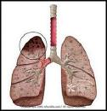
What is Tuberculosis ?
Tuberculosis is a common , chronic infectious disease caused by Mycobacterium tuberculosis (MTB) complex.
1/3 of human race infected مصابين وليسوا مرضى.
8 million infected per year.
About 2 million death per year
وهي ثاني اكثر بكتيريا انتشارا بعد جرثومه المعده.

Slide 3
Tuberculosis-continue
MTB usually attack the lungs, but other organs also affected such as, meninges , kidneys and lymph nodes.
It spreads through air.
Most infections are asymptomatic
1/3 المصابين progress to active disease.

Slide 4
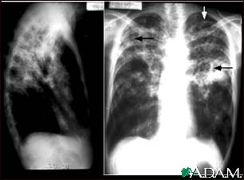
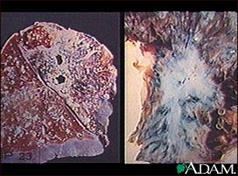
Pulmonary TB

Slide 5
M.tuberculosis
A small , aerobic , non-motile AFB ( acid fast bacilli) لا تصبغ بصبغات جرام وانما تعطي صبغه خاصه تسمى .
M.tuberculosis complex include : الدكتور يقول سؤال
M. tuberculosis ( human type),
M.bovis قل انتشارها لانها تنتقل عبر الحليب والحليب هذه الايام مبستر ,
M.africanum
M.microti
BCG ( BCGosis) هذا اسم لقاح المرض والغريب انه من الممكن ان يسبب مرض اذا كانت البكتريا لم تضعف بالشكل المطلوب او ان العائل مناعته ضعيفه جدا .

Slide 6
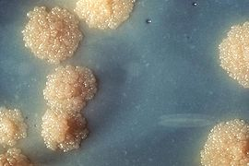
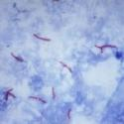
AFB اسم الصبغه ( smear and culture)

Slide 7
Principles مبادئ of Treatment of TB
The main goal of treatment is to kill tubercle bacilli rapidly.
1-To prevent emergence of drug resistance منع ظهور مقاومه للادويه وذلك باعطاء عده ادويه مع بعض كما سياتي لاحقا.
2-To control the spread from case to another.
3-To eliminate قتل persistent bacilli from the host’s tissues to prevent relapse عوده المرض.

Slide 8
Continue-
To achieve these effects requires a combination of 2-4 agents with specific activities be given for a sufficient period of time ( 6-12 months) so to prevent drug resistance & relapse عوده المرض.

Slide 9
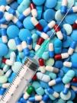
Antituberculosis Drugs
First- Line Drugs
Oral drugs
Second-Line Drugs
Injectable drugs
Isoniazid
Rifampin
Ethambutol
Pyrazinamide
Cycloserine
Ethionamide
P-aminosalicylic acid
Streptomycin
Caproeomycin

Slide 10
First-line drugs هي التي تستخدم بشكل اساسي مالم يكن هناك عارض مثل مشكله بالمريض او غيرها وسياتي تفصيلها لاحقا isoniazid (INH)اولا : اهم علاج
First line agent for all forms of TB caused by a susceptible organism.
Bactericidal مبيد للبكتيريا against rapidly dividing cells.
Used for adults, children and pregnant women.
Adverse effects:
- Liver toxicity
- Clinical hepatitis (in patient’s with previous liver disease).
- Peripheral neurotoxicity تسمم عصبي

Slide 11
ثانيا :Rifampin ( RIF) دواء المركز الثاني من حيث الاهميه
First –line agent and sterilizing for all forms of TB caused by a susceptible organisms.
Bactericidal يبيد against organisms that are dividing rapidly and semidormant نصف كامن bacterial populations.
Essential component of all short-course regimens نظام دوائي ( should not be used alone).
Safe to be used in children and pregnancy.

Slide 12
Adverse effects of RIF
Hepatotoxicity: hepatitis, hyperbilirubinemia
Orange discoloration of bodily fluids ,eg. Urine Can be used to prove برهان على compliance امتثال المريض with the treatment.

Slide 13
ثالثا: Pyrazinamide (PZA)
First line agent for all forms of TB caused by a susceptible organisms.
Has a great activity against dormant or semidormant populations within macrophages or the acidic environment of caseous foci البقع التجبنيه.

Slide 14
PZA- Adverse effects
Hepatotoxicity
Gastrointestinal symptoms ( nausea ,vomiting)
Dermatitis, transient rash.
Polyarthralgia
Acute gouty arthritis
Can be used during pregnancy.

Slide 15
رابعا : Ethambutol
A first-line drug for treatment of all forms of TB .
Included in the first initial regimen نظام علاجي to prevent emergence of RIF resistance when INH is resistant.
Proven for organisms resistant to either INH or RIF. نقطه مهمه
Safe to be used during pregnancy.

Slide 16
Adverse effects of Ethambutol هذا الدواء لا ييسبب تسمم الكبد
Decreased visual acuity or decreased red-green color discrimination.
Not recommended for children whom visual acuity cannot be monitored يضبط - يراقب.
Cutaneous هيجان جلدي reaction.

Slide 17
Common Combinations
INH+ RIF + Ethambutol or PZN for the first 2 months.
Then continue with INH + RIF for the rest 4 months. Duration may increase accordingly.
Regimen النظام الدوائي must be taken as prescribed by the doctor, and finish the course.
Antimicrobial susceptibility testing of the organism is important before the use of theses drugs.

Slide 18
Drug susceptibility حساسيه testing in the lab.
Using the comparative principle i.e. compare susceptibility of the pathogenic isolate يعزل with that of a known strain نسل.
Both fluid and solid media can be used for that.
It takes about 2-4 weeks to read.

Slide 19
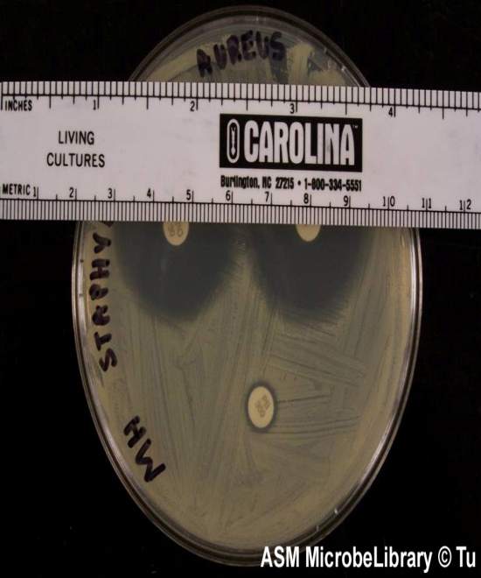
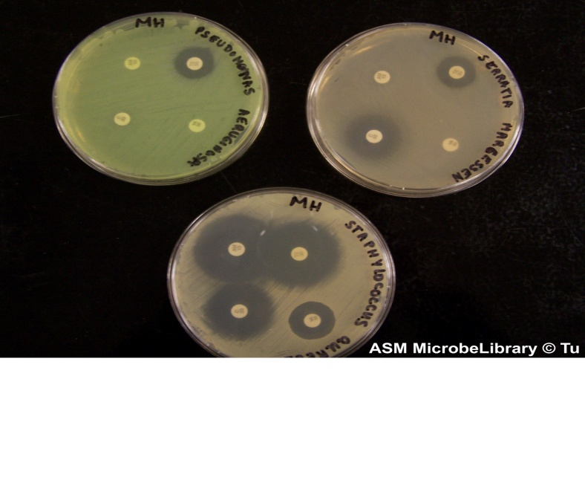
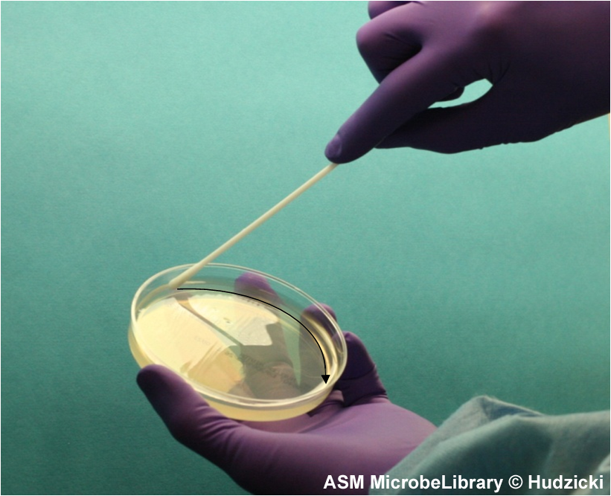
Comparative method

Slide 20
Second-Line Drugs عباره عن مضادات حيويه عاديه تستخدم عند :
متى تستخدم Used when the organisms develop resistance to the first line drugs.
May be used temporarily for patients with acute hepatitis.
More toxic.
احفظ اسمائها من الشريحه المقدمه

Slide 21
Drug resistant tuberculosis
The bacteria can become resistant to the anti-TB drugs. That is the drugs can no longer kill the bacteria.
Resistance develops when these drugs are misused اسيء استعمالها or mismanaged, examples:
When the patients do not complete their full course treatment.
Wrong prescriptions by doctors, wrong dose, long time taken of the drug, or poor quality.

Slide 22
Multidrug-resistant TB(MDR)
MDR TB is the TB that is resistant to at least 2 of the best anti-TB drugs, INH + RIF.
Extensively على نحو واسع drug-resistant TB ( XDR TB) is TB that is resistant to almost all drugs used including INH and RIF ,plus any fluroquinolone دواء قاتل او مانع لنمو البكتيريا and at least one of the 3 injectable second –line drugs.
Patients infected with XDR TB are left with much less options for treatment, risk of death.

Slide 23
Direct Observed Therapy (DOT) متابعه اخذ المريض لعلاجه
DOT is the strategy devised to help the patient adhere to treatment.
A designated اعتماد person watches TB patient swallow each dose of the prescribed drugs.
The goal of DOT is to ensure that the patient with active TB receives and adequately complete the treatment to minimize the risk of spreading disease to others and develop resistance.

Slide 24
DOT- continue
DOT is applied by the WHO in a trial to control and eliminate tuberculosis from the world.

Slide 25
Priority اولويه for use of DOT
Pulmonary TB patients with positive smears.
Treatment failure
Drug resistance
Relapse
TB + HIV infection
Psychiatric patients
Previous non-adherence to therapy
Children and adolescents المراهقين

Slide 26
Notes for consideration
DOT and monitoring of side effects important.
Regimen decided according to susceptibility testing.
Obtain sputum culture at the time of completion of initial course to identify risk of relapse.
Extended period of treatment recommended for patients with cavitation تجوف on chest-X-ray.

Slide 27
Continue-
Special consideration in patients with HIV , extra-pulmonary TB ,children , pregnancy and patients with hepatic diseases.
Patients with MDR TB.

Slide 28
هذي ورده من الدكتور كمبال

