Slide 1
Lower Respiratory tract Infection
Respiratory Tract Infection
Lower Respiratory Tract Infection
Upper Respiratory Tract
Infection
Dr Ali Somily

Slide 2
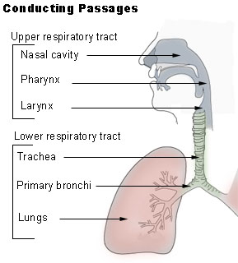
Objectives
To know the epidemiology and main causes of lower respiratory tract infections
The understated the clinical presentation of lower respiratory tract infection
To learn how to diagnose and treat lower respiratory tract infections

Slide 3
Causes of Respiratory Tract Infections
Bacteria
Viruses المسبب الرئيسي
Fungi (mainly in the immunocompromised)
Protozoa (in the immunocompromised

Slide 4
Community Acquired Pneumonia الالتهاب الرئوي المكتسب من المجتمع ( للمعلومات الاضافيه انظر الباثولوجي )
Occurs most frequently in the very young and the very old
May be caused by “typical” or “atypical” اعرف تفاصيلها مهمه جدا جدا جدا جدا pathogens
May secondary to a viral respiratory tract infection

Slide 5
Hospital Acquired Pneumonia الالتهاب الرئوي المكتسب من المستشفيات
Has the highest mortality معدل وفيات
Predisposing factors الاسباب المفترضه: include abnormal conscious وعي state, intubation ادخال انابيب في الجسم – مثل اللي عبر الجهاز التنفسي -, ventilation, surgery and immunosuppression
Is frequently caused by Gram negative organisms مهمه جدا
اعرف انها حاده وشديده وبسبب قرام السالبه

Slide 6
Causes of primary communityacquired pneumonia مهمه جدا احفظ اسماء التيبيكال واتيبكال
Typical pathogens
Atypical bacteria
S.pneumoniae
H.influenzae
M.catarrhalis
Staphlococcus aureus (post influenza)
M.pneumoniae (most common)
Chlamydia spp.
Legionaella spp.
Coxiella sp.
M.tuberculosis
Viruses
Influenza A and B
Parainfluenzae
Adenoviruses
Respiratory Syncytial Virus
Atypical : لا يوجد لديها جدار خلوي
Typical : يوجد لديها جدار خلوي
لذلك المضادات الحيويه التي تعمل على تدمير الجدار الخلوي مثل البيتا لاكتام ( البنسلين )ما تنفع مع الـ
atypical

Slide 7
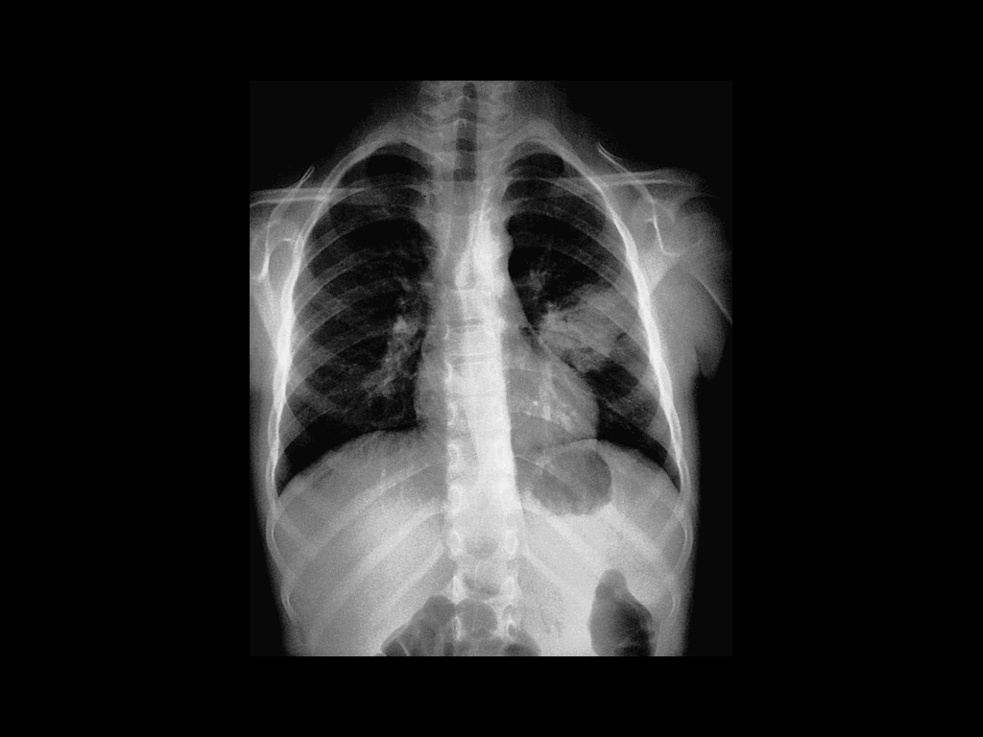
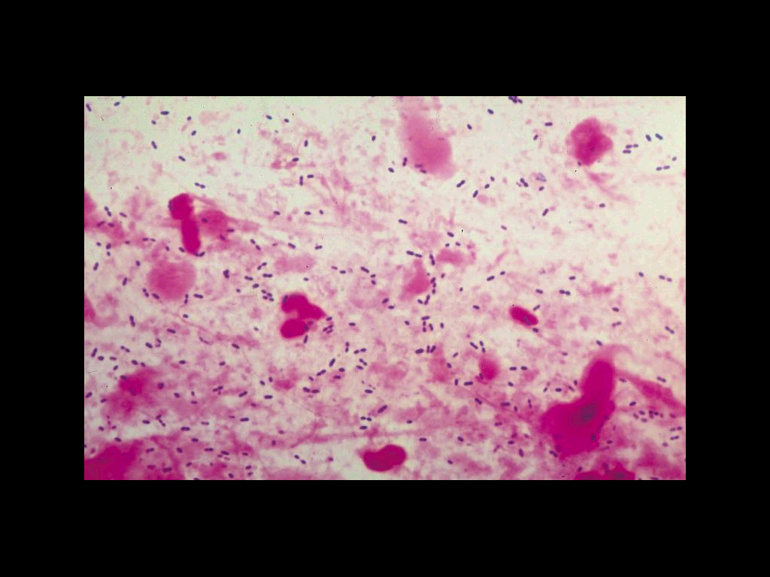
“Typical” community-acquired pneumonia
Classically presents with sudden onset of chills, followed by fever, pleuritic chest pain and productive cough.
White blood cell count usually ↑↑
Sputum, thick, purulent and sometimes rusty صديد coloured احيانا.
Chest x-rays show parenchymal involvement.
S.pneumoniae is the commonest cause. مهمه اوي

Slide 8
Atypical pneumonia
Various definitions, e.g.
Pneumonia not due to Streptococcus pneumoniae
Pneumonia not responding to beta-lactam therapy
Atypical pneumonia may be primary or
secondary

Slide 9
Atypical pneumonia
Usually, but not always, insidious onset.
Classically patients have non-productive cough, fever, headache and a chest x-ray more abnormal than suggested المتوقع by clinical examination.
Infection may be sub-clinical and resemble a non-specific viral infection.
M.pneumoniae is the most common organism مهمه اوي

Slide 10
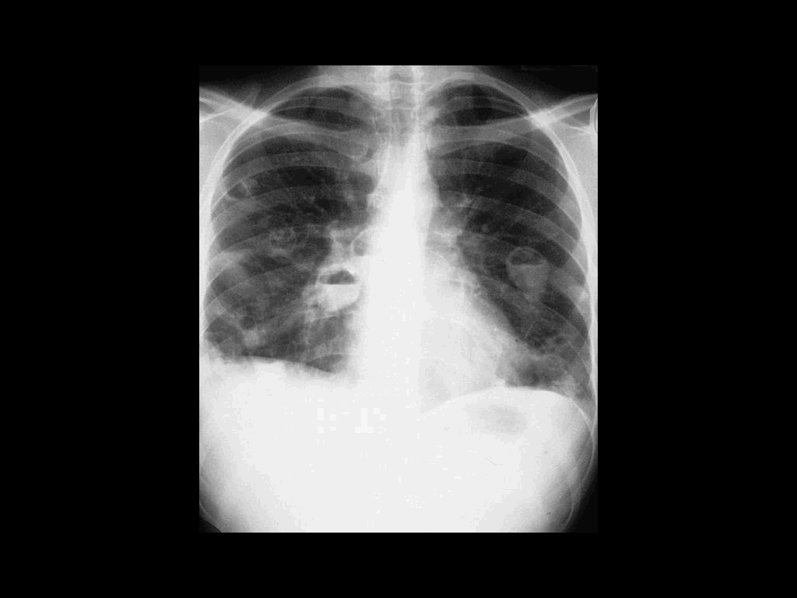
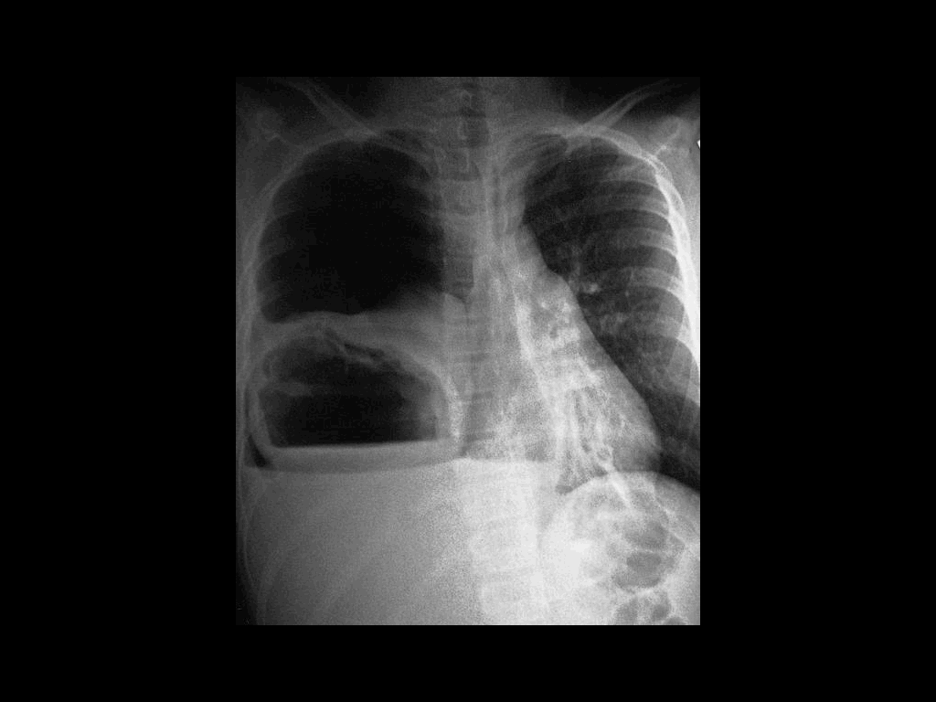
Pneumonia complications مضاعفات
Pleural effusion 3-5%: clear fluid +- pus cells
Empyema تجمع قيحي thoracis 1%: pus in the pleural space (-loculated)
Lung abscess: suppuration + destruction of lung parenchyma
single (aspiration) anaerobes, Pseudomonas
multiple (metastatic) Staphylococcus aureus

Slide 11
15% of Hospital acquired infection
mortality 20-50%
Immuno-compromised patients
General anaesthesia تخدير عام, intubation الكشف بالانابيب and ventilation predispose to infection respiratory tract
Gram-negatives, more resistant organisms e.g. Pseudomonas aeruginosa, Enterobacter.

Slide 12
Diagnosis of pneumonia
History and clinical examination
Chest x-ray
Hb, WBC, platelets U+Es, LFTs, ESR
Blood cultures
Sputum – microscopy, culture + sensitivity + virus isolation
Serodiagnosis / antigen detection – if atypical pneumonia suspected

Slide 13
Specimens for microbiology:
Sputum
Contamination ملوث with upper respiratory tract/oral flora
Invasive غرويه techniques for respiratory samples
Bronchoscopic lavage شطف
Transtracheal aspirate, percutaneous needle aspiration, open lung biopsy
Non-culture specimens e.g urine for Legionella antigen and pneumococcal antigen in severe disease and PCR for Mycobacterium tuberculosis

Slide 14
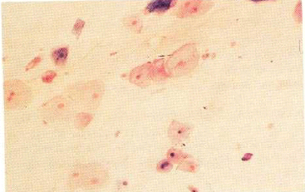
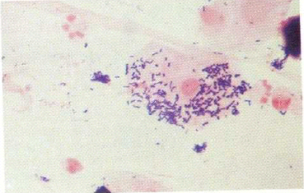
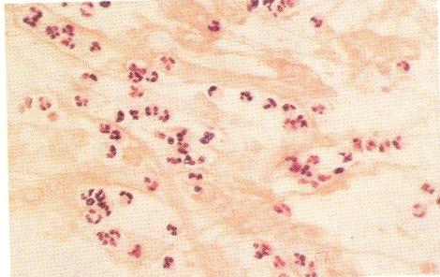
Sputum Specimen collection
اشياء يعملها المريض قبل اخذ العينه
Teeth brush
Mouthwash
Early morning
Induced sputum if needed
Sterile wide-mouth jar
Notes:
Our inability to adequately prevent contamination by oral secretions and difficulty in obtaining secretions representative of the lower respiratory tract significantly compromise the diagnostic utility of coughed and expectorated sputum samples for culture.
Having the patient brush his or her teeth and gargle with water immediately before obtaining the sputum specimen reduces the number of contaminating oropharyngeal bacteria.
Spada and colleagues222 showed a 1-log decrease in the mean concentration of contaminating bacteria from 3.6 ± 7.5 X 101 to 3.7 ± 7.2 X 107 in sputum samples obtained from patients immediately following a simple mouth wash.
They suggest that comparing the organisms recovered from "spit" and post-mouthwash sputum samples may provide a guideline for determining which bacterial species may be potentially important in causing pneumonia.
Avoid using proprietary mouthwashes or gargles that may contain antibacterial substances.
Early-morning sputum samples should be obtained because they contain pooled overnight secretions in which pathogenic bacteria are more likely to be concentrated. Twenty-four-hour collections should be discouraged because there is not only a greater likelihood
of contamination, but bacterial pathogens that may be in high concentration in one sample potentially become diluted with the addition of subsequent, more watery specimens.
When sputum production is scant, induction with nebulized saline may be effective in producing a sample more representative of the lower respiratory tract (avoid the use of "saline for injection," many preparations of which may contain antibacterialsubstances).187
Special sputum collection devices are commercially available through laboratory supply companies, or a sterile wide-mouth jar with a tightly fitted screw-cap lid can be used.
To prevent contamination of the out­side of the container, the patient should be instructed to press the rim of the container under the lower lip to catch all of the expectorated cough sample.4

Slide 15
Therapy of Community Acquired pneumonia
In practice it is often not easy to differentiate clinically between “typical” and “atypical” pneumonias.
“Blind therapy” علاج بدون معرفه البكتيريا المسببه ( حتى ظهور نتائج الكلتشر ) of severe community-acquired pneumonia therefore usually includes a beta-lactam agent + a macrolide.
If the patient is immunocompromised Pneumocystis carinii must be considered.
The above does not cover viral pneumonia

Slide 16
Therapy of Community Acquired Pneumonia (cont’)
Beta-lactams are sometimes given as
monotherapy e.g. amoxycillin. benzylpenicillin,
cefuroxime, cefotaxime, ceftriaxone but
They are inactive against M.pneumoniae as this does not have a cell wall and have poor activity against intracellular organisms such as Legionella spp. and Chlamydia spp.

Slide 17
Therapy of pneumonia (cont’)
Erythromycin + rifampicin or a quinolone as mono or combination therapy treatment can be used for pneumonia due to Legionella pneumophilia
Erythromycin or tetracycline or a quinolone can be used for pneumonia due to Chlamydia spp. or Mycoplasma pneumoniae

Slide 18
Mycoplasma pneumoniae تسبب اتيببكال نيمونيا
Acquired by droplet transmission. Epidemics الوباءoccur every 3-4 years. Occurs in school age children and young adults.
Classically presents with fever, headache, myalgia, earache, mild pharyngitis, dry cough and sometimes arthritis.
Skin rashes and haemolytic anaemia may occur.
Neurological complications occasionally happen.

Slide 19
Diagnosis of M.pneumoniae
Clinical and CXR shows a patchy bilateral bronchopneumonia
Culture fried egg colony (M.homonis)
Cold agglutinins may be present
IgM test
Serology

Slide 20
Legionellosis مرض يحدث بسبب اصابه ببكتيريا لها نفس الاسم
Caused by Legionella pneumophilia. Serogroup 1
L.pneumophilia may cause a multi-system disease with confusion, muscle aches, pneumonia, renal failure, liver involvement + diarrhoea and significant mortality.
L.pneumophilia may also cause Pontiac fever – a self-limiting disease.

Slide 21
Legionellosis diagnosis (general)
History (exposure to cooling towers, etc) and clinical.
Laboratory
Culture on buffered charcoal-yeast extract (BCYE) agar , serology or urine antigen detection ملاحظه – تزرع على كلتشر خاصه -
CXR Patchy interstitial involvement or consolidation
Hyponatraemia often present
Urea frequently raised
Liver function test is abnormal

Slide 22
Therapy for Pneumonia caused by Legionella Pneumophilia
In severe legionella pneumonia traditionally a combination of a parenteral macrolide and rifampicin is used
Fluoroquinolones may be better than macrolides

Slide 23
Chlamydia pneumoniae
Person-to-person spread occurs
Causes atypical pneumonia
Implicated as potential pathogen / co-pathogen in coronary artery disease and cerebrovascular disease
Diagnosis by immunofluorescence, cell culture using McCoy cell or serology

Slide 24
Chlamydia psittaci
Is a zoonosis acquired from birds مهمه جدا – تكتسب من الحيوانات -
Human disease acquired by inhalation of infected aerosols
Causes atypical pneumonia
Diagnosis is usually by serology دراسته التفاعل بين الانتي جين والانتي بودي .

Slide 25
Q fever
Caused by Coxiella burnetii
Transmitted via infected animals through milk, excreta, etc.
Can cause atypical pneumonia.
Diagnosis usually by serology

Slide 26
Exacerbations of Chronic Obstructive Pulmonary Disease
May be due to infection – viral or bacterial
Implicated bacteria include S.pneumoniae, H. influenzae. M. catarrhalis and coliforms
M. catarrhalis almost always produces betalactamase and so will not repond to amoxicillin therapy
اهم شيء بالمحاضره :
Best sputum
Causes of typical and atypical
Treatment of “”””””””””””””””””””””””””””

