Slide 1
Drugs Used in Asthma
By
Prof. Alhaider 1431 H

Slide 2
راجعها من الباثولوجي Chronic Lung Diseases
a. Bronchial Asthma
b. Chronic bronchitis
c. Emphysema
Type of Drugs used in Respiratory Diseases:
1) Bronchodilators موسعات الشعب
2) Anti-inflammatory drugs
3) Antibiotics
4) Drugs for Cough

Slide 3
Drugs Used for Asthma:
Definition of Asthma: Simply it is inflammation or hyper-reactivity of the airways .
Symptoms:
Coughing; shortness of Breath (dyspnea) and chest tightness and wheezing.
Pahtophysiology of Asthma: (it is the key to understand
Treatment).
:انواع الربو
1. Immunological model for immediate hypersensitivity (extrinsic asthma (Allergic Asthma) (see Figure)
What are the evidence supporting the inflammatory nature of bronchial asthma?
مسببات
خارجي

Slide 4
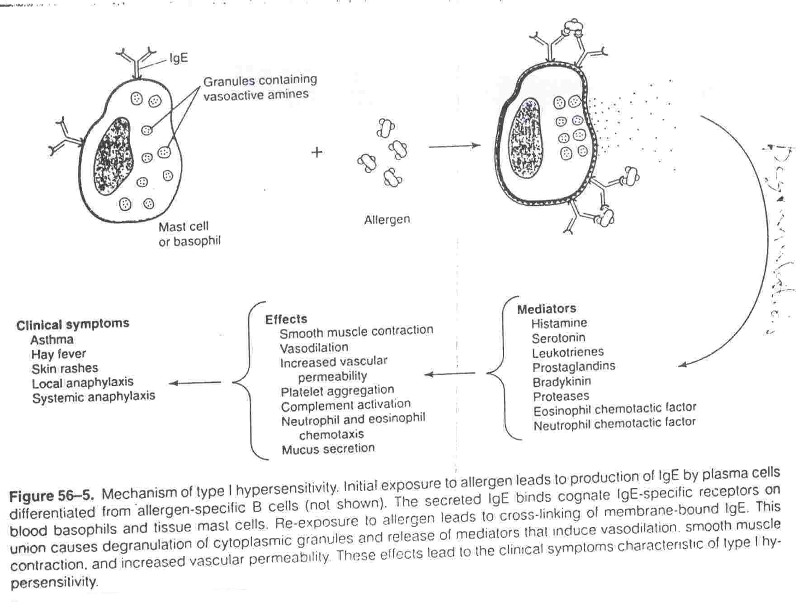
مخطط مهم
لاحظ ان الانتيجين يرتبط بـ 2 ( اي جي اي )
ابدا
بعد الارتباط تتحر المواد داخل الماست سيال

Slide 5
داخلي
مهمه
2. Non-specific hyper-reactivity (Intrinsic asthma (non-Allergic))
It may be triggered by anxiety, stress, exercise, cold air, dry air, hyperventilation, smoke, viruses (chest infection) or other irritants (e.g: cleaning agents; food preservatives). In non-allergic asthma, the immune system is not involved in the reaction.
Classification of Drugs Used for Asthma:
1. Bronchodilators
a. β2-adrenergic agonists
b. Methylxanthines
c. Muscarinic-receptor antagonists
2. Anti-inflammatory Drugs
a. Cromolyn or nedocromil
b. Corticosteriods
c. Leukotrienes antagonists
d. Anti-immunoglobulin E (monoclonal antibody)

Slide 6
1. Bronchodilators
Α. β2-adrenergic agonists
e.g.; Salbutamol; terbutaline (Short Acting, t1/2 4 hr)
Salmetrol; formetrol (Long Acting, t1/2 8 hr)
MOA (Mechanism of Action): Stim. β2-adrenoceptors leading to smooth muscle relaxation via c-AMP ( يزيد توسع الشعب ويسبب تضيق الاوعيه ) (see Figure 20-1). Also, may فرضيه فقط prevent activation of mast cells.
PK (Pharmacokinetics):
Available as injections or oral but inhaled or nebulizer forms are more common. WHY? لان تاثيره بالاستنشاق يؤثر الى الرئه فقط ولا يؤثر على اجزاء اخرى من الجسم مثل الجهاز الدوري وبذلك تقل الاعراض الجانبيه
Side Effects: tachycardia – truner رجفه
Can β2-adrenergic agonists be given for patients with COPD? نعم
الاسم التجاري ( فينتولين ) بخاخ الربو
انظر شريحه 8

Slide 7
B. Methyxanthins
e.g.: Theophyline; Aminophyline
MOA: انظر شريحه 8 للتوضيح
1. Bronchodilation via increasing the level of c-AMP by inhibition of phosphodieasterase. الانزيم المسؤول عن تكسير ( سي اي ام بي )
2. Theophyline is an universal antagonist at adenosine receptors ??, thus causing bronchial smooth muscle relaxation.
PK: Available in oral (e.g.: Sustained release) or injectable forms.
What is aminophyline? Theophyline +Ethylenediamine
It is a salt ملح يساعد الدواء على الذوبان.
Side Effects: Low therapeutic index عالي السميه ( تقارب بين الجرعه الفعاله والسامه ); GI upset; CNS stimulation; CVS as tachycardia and cardiac output; renal diuresis.
Why do theophyline not commonly used nowadays? بسبب سميته العاليه

Slide 8
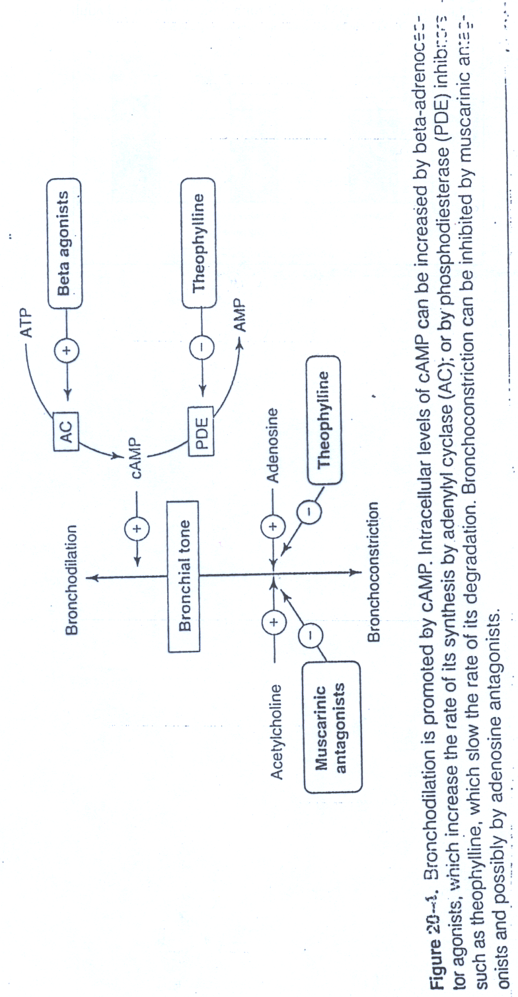
شريحه مهمه جدا وتلخص استخدامات الادويه السابقه

Slide 9
C. Antimuscarinic Drugs:
History: اصله من ماده ( الاتروبين ) ولكن مشكلتها انها تمتص عبر الجهاز الهضمي لانها ثلاثيه النتروجين
e.g.: تم تطوير هذه المركبات الرباعيه النتروجين التي لا تمتص عبر الجهاز الهضمي وتعمل عمل الاتروبين Ipratropium; Tiotropium (long Acting)
MOA: تسمى هذه المجموعه >>vegal antagonist
PK: Only to be given by inhalation or by nebulizer لانها لا تمتص عبر الجهاز الهضمي ; with slow onset and longer duration as compared to salbutamol.
Why Ipratropium or Tiotropium are good choices for patients with COPD? (see figure) لانها تقلل الافرازات

Slide 10
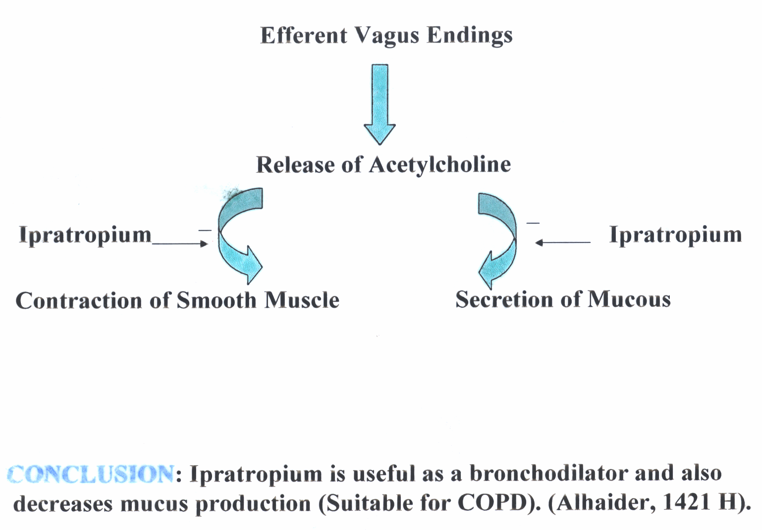
هذا سبب التفضيل لل
copd

Slide 11
2. Anti-inflammatory Drugs:
Since airway hypersensitivity is related to the degree of inflammation; anti-inflammatory drugs are considered one of the most effective drugs in the treatment of chronic and acute types of asthma? لانها تقضي على الانفلاميشين الذي يسبب ضيق الاوعيه الدمويه بواسطه عوامل الالتهاب
Notes:
These agents are not direct bronchodilators.
Some of them are not effective to overcome the signs and symptoms of existing attack of asthma (But should be used).
Mainly used as prophylactic agents عامل وقائي; thus therapeutic effects need weeks.
Inflammation mediators

Slide 12
Classification of Anti-inflammatory Drugs
a. Mast cell stabilizers معدل - بلوكر
e.g.: Sodium cromoglycate ( الاسم التجاريIntal^{R}) QID أربع مرات; Nedocromil ( الاسم التجاريTilade^{R}) BID مرتين .
How do these drugs work? See Figure 26-5 تمنع الماست سيلز من افراز عوامل الالتهاب انظر الرسمه للشرح
PK: Available as inhaled aerosol or nebulizer solution.
Side Effects: Not significant غير خطير
Disadvantage: Less effective in many asthmatics but better response in children. لا يعرف السبب لذلك

Slide 13
b. Corticosteriods مهم جدا:
e.g. Beclomethasone; Fluticasone et ct (see Table 3)
MOA: Inhibit the synthesis of arachidonic acid هذا الحمض هو الماده الاوليه لعديد من عوامل الالتهاب التي بعضها مفيد وبعضها مضر وهذا الدواء يحضرها كلها ; thus decrease leukocyte migration, phagolytic activity and inflammation) (See Figure); Also, they upregulate تزيد فاعليه β- adrenoceptors. So What?) لذلك يستخدم العلاجان مع بعض لانهما يساعدان بعض في اداء العلاج
PK: These drugs are available as injectable forms; oral
(for severe asthma يعطى بالحقن) but inhalation forms are the preferred to avoid side effects).
Injection: e.g.; Hydrocortisone
Oral: prednisolone (Why it is the preferred oral form?).
Inhalation:
Beclomethasone (as MDI);

Slide 14
Synthesis of eicosanoids and sites of inhibitory effects of anti-inflammatory drugs
شريحه مهمه جدا وتشرح عمل الدوائين السابقين المجموعه
A - B
Membrane lipid
Corticosteroids
Arachidonic acid
NSAIDs
Hydroperoxides Endoperoxides
(HPETES) (PGG, PGH)
Leukotrienes Prostacyclin Thromoxane
(LTB, LTC ,LTD, LTE) (PGI) (TXA)
Prostaglandins
(PGE, PGF)
Phospholipase A2
-
Cycloxygenase
Lipoxygenase
-
شرح
حمض الاركانويد يعمل كماده اوليه لعوامل الاتهاب ويقوم الدواء مجموعه بي بحظره ويمنع عوامل الالتهاب المفيده والمضره
مفيد
مضر

Slide 15
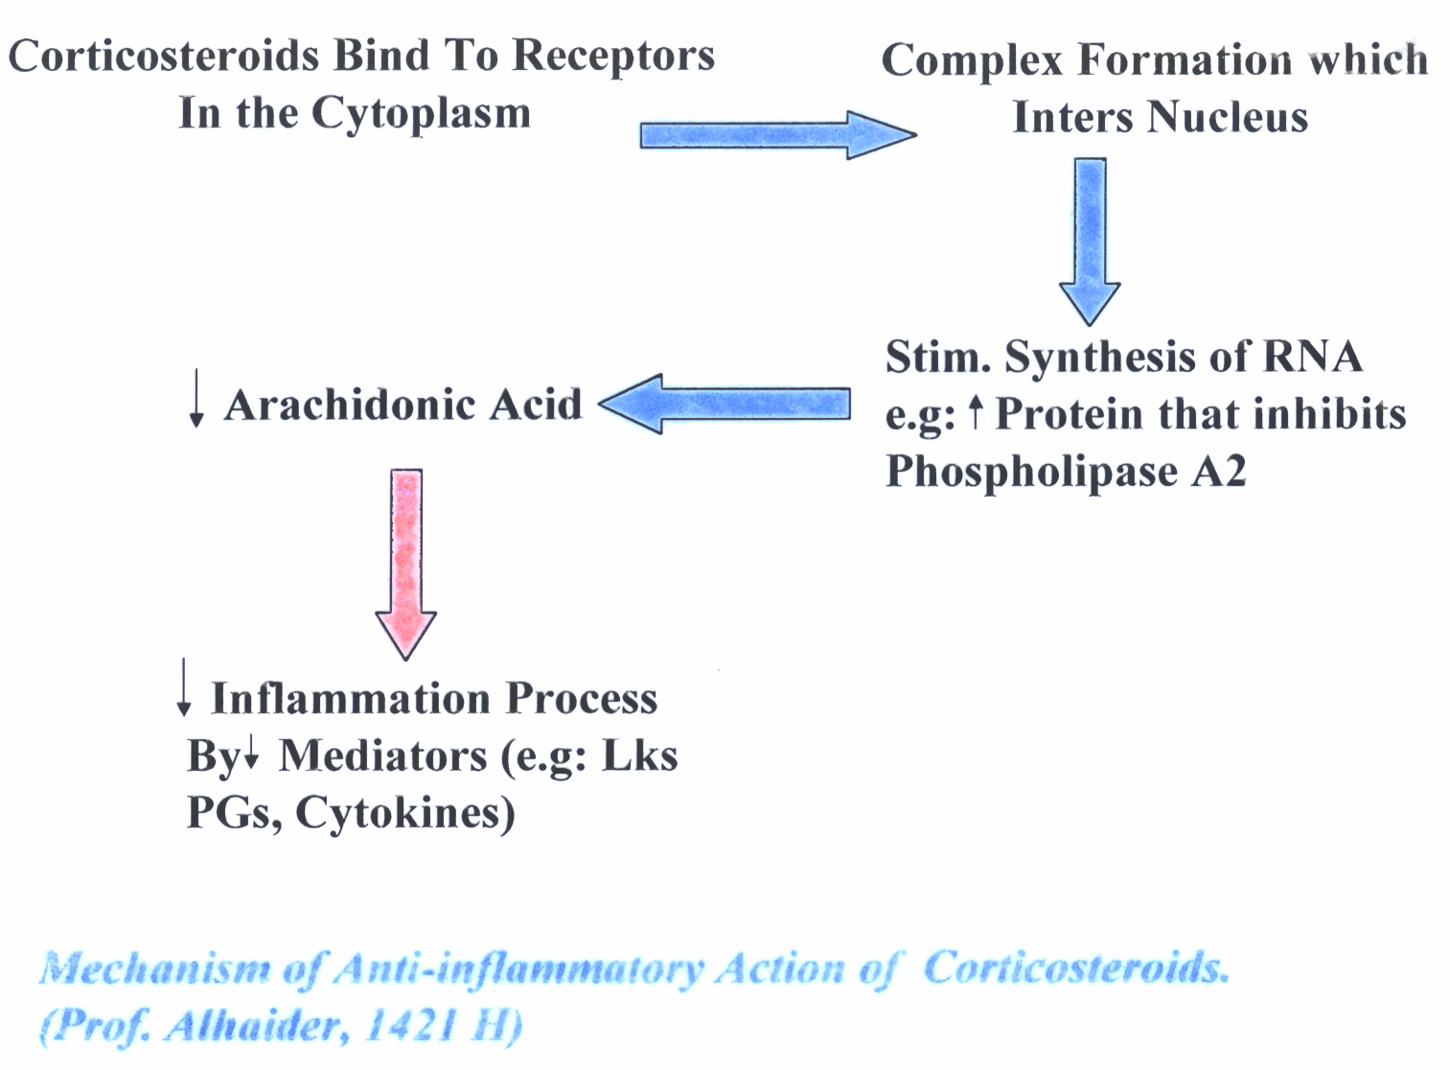
قراءه فقطِ غير مهمهِِِ

Slide 16
Table 3 : Types of inhaled corticosteriods that commonly used
Name of drug | Half life (hours) | Oral Bioavailability (%)
Flunisolide | 3.5 | 21
Triamcinolone | 3.9 | 10.6
Beclomethasone مهمه | 7.5 | 20
Budesonide | 5.1 | 11
Fluticasone | 10.5 | <1

Slide 17
Corticosteroids Inhalers are available in many forms. Sometimes, long acting β2-agonist mixed together in the same inhaler. يدمج الدوائين في بخاخ ربو واحد
Side effects of Inhaled corticosteroids:
Cough
difficult or painful speech (Dysphonia)
Possible growth retardation in children.
Oral candidiasis تحفز نمو الفطريات بالفم لان هذا الدواء يثبط المناعه
How could you taber تقلل بتدرج the dose of oral prednisolone? قراءه فقط
Simply -5 mg every day. Unless patient takes steroids for long time.

Slide 18
c. Leukotriene-modifying agents هذه المجموعه من الدواء تحظر عوامل الالتهاب المضره فقط
What is the effect of LKs on the bronchioles as compared to histamine?
انواع الدواء : مهمه
1) Leukotrience synthesis inhibitors (Lipooxygenase Inhibitors) e.g. Zileuton (Zylfo®)
2) Leukotrience Antagonists e.g Zafirlukast BID (Accolate®); Montelukast (Singulair®) OD;
MOA: (see Figure)
PK: These drugs are available as oral form but with side effects less than corticosteroids لان نطاق عملها اقل كما يوضح في الشريحه رقم 14
Side Effects:
-increase PT الصفيحات الدمويه if given with warfarin.
- Churg Strauss syndrome

Slide 19
Limitations of Leukotriens Antagonists:
Why Leukotriens Antagonists did not prove to be as effective as inhaled corticosteroids? الدكتور قال لانه يعمل على طريقه واحده
Indications: موانع الاستخدام
Preventive medication in those who have difficulty with inhalers or side effects from inhaled corticosteroids.
Management of aspirin sensitive asthma.
Question: غير مطلوب
Patients with aspirin-induced asthma, may show strong or week response to Leukotriens antagonists?
اقرا الملاحظات مهمه

Slide 20
Anti-immunoglobulin E (e.g. Omalizumab)
MOA:
Selective anti-IgE monoclonal antibody that binds to IgE and prevents its association with IgE receptors, thus preventing allergen from activating mast cells or basophiles
Decreases serum IgE
Due to the above effects, omalizumab decreases the numbers of eosinophils, T and B lymphocytes
Uses: for resistance type of asthma and allergic rhinitis.
Side effects and Limitations:
Infusion side effects and expensive غاليه بالحيل.
Chronic Obstructive Lung Diseases (COPD)
Does treatment of COPD differs from bronchial Asthma?

