Slide 1
RESPIRATORY PHYSIOLOGY
BLOCK
Dr. Tarig Ahmed Abdul Rahman

Slide 2
Specific Objectives.
Lecture 1: Functions and Organization of the Respiratory System
By the end of this lecture the Students should be able to:-
1- Understand the difference between internal and external respiration.
2- Describe the structures and functions of the conductive and respiratory zones.
3- Understand functions of the respiratory system, including non- respiratory functions, like clearance mechanism by mucus and cilia, production of surfactant and converting enzyme.

Slide 3
Lecture 2: Mechanics of breathing
By the end of this lecture the students should be able to:
1- List the muscles of respiration and describe their roles during inspiration and expiration.
2- Understand the importance of the following pressures in respiration:
Atmospheric, alveolar, intrapleural, and transpulmonary
3- Explain why intrapleural pressure is always subatmospheric under normal conditions, and the
significance of the thin layer of the intrapleural fluid surrounding the lung.
4- Describe pneumothorax.
5- Describe the pressure and volume relationships in a single respiratory cycle.
6- Define lung compliance and list the determinants of compliance.
7- Describe the physiological significance of surfactant and provide an example of abnormal lung function due to a deficiency of surfactant.

Slide 4
Lectures 3 & 4: Respiratory ventilation
By the end of these lectures the students should be able to: -
1-Define the various Lung Volumes and capacities and provide typical values for each.
2-Define ventilation rate, their typical values, and their measurement.
3- Describe FEV1.o and its role in differentiating obstructive and restrictive lung diseases
4- Understand air movement and airway resistance:
Definition, determinants, role of autonomic nervous system and mechanical factors
5- Describe the types of dead space. State a volume for the anatomical dead space.
6- Define the term minute ventilation and state a typical value.
7- Distinguish minute ventilation from alveolar ventilation.
8-Understand the work of breathing

Slide 5
Lecture 5: Gas transfer
By the end of this lecture the students should able to: -
1-Define partial pressure of a gas. Describe how partial pressure of a gas is influenced by
altitude.
2- Understand that the pressure exerted by each gas in a mixture of gases is independent of the pressure exerted by the other gases (Dalton's Law)
3- Understand that gases in a liquid diffuse from higher partial pressure to lower partial pressure (Henry’s Law)
4- Describe the factors that determine the concentration of a gas in a liquid.
5- Describe the components of the alveolar-capillary membrane (i.e., what does a molecule of gas pass through).
6- Knew the various factors determining gas transfer: -
Surface area, thickness, partial pressure difference, and diffusion coefficient of gas
7- State the partial pressures of oxygen and Carbon dioxide in the atmosphere, alveolar gas, at
the end of the pulmonary capillary, in systemic capillaries, and at the beginning of a pulmonary
capillary.

Slide 6
Lecture 6: Oxygen and Carbon dioxide Transport
By the end of this lecture the students should be able to: -
1- Understand the forms of oxygen transport in the blood, the importance of each form and,
2- Describe: -
a- The relationship between PO2 and % saturation of hemoglobin with oxygen (Oxygen- hemoglobin dissociation curve), and the significance of the shape of this relationship
b- How DPG, temperature, H+ ions and PCO2 affect affinity of O2 for Hemoglobin and the physiological importance of these effects.
3- Differentiate between O2 capacity, O2 content and O2 saturation.
4- Define the P50 and its significance.
5- Know the significance of fetal Hb and adult myoglobin.
6-Describe the three forms of Carbon dioxide that are transported in the blood, and the chloride shift.
7- Describe the role of the enzyme carbonic anhydrase, and the CO2 dissociation curve.
8-Describe how H+ is transported in the blood.
9- Define respiratory acidosis and respiratory alkalosis, and explain how these are related to hypoventilation and hyperventilation respectively.
10- Enumerate the differences between the dissociation curves for O2 andCO2.

Slide 7
Lecture 7: Control of breathing
By the end of this lecture the students should be able to: -
1- Understand the role of the medulla oblongata in determining the basic pattern of respiratory activity.
2- Describe the pacemaker activity of the medullary inspiratory neurons.
3- List some factors that can modify the basic breathing pattern like e.g.
a- The Hering-Breuer reflexes, b- The proprioreceptor reflexes, and c- The protective reflexes, like the irritant, and the J-receptors.
4- Understand the respiratory consequences of changing PO2, PCO2,
and pH.
5- Describe the locations and roles of the peripheral and central chemoreceptors.
6- Compare and contrast metabolic and respiratory acidosis and metabolic and respiratory alkalosis.

Slide 8
Lectures 8 & 9: Alveolar - Arterial equilibration
By the end of this lecture the students should be able to:
1-Define hypoxia and list its various causes.
2-Define hypo and hyper-ventilation in terms of arterial PCO2 and PO2.
3- Define cyanosis
4-Understand regional variations in alveolar ventilation and blood flow.
5-List causes of abnormal ventilation/perfusion (V͎/Q) ratios.

Slide 9
Lecture 10: Effects of low and high gas pressure on the body.
By the end of this lecture the students should be able to: -
1-Describe the effects of exposure to low and high barometric pressures on the body.
2-Describe the body acclimatization to low barometric pressure.
3-Define decompression sickness and explain how it can be avoided.
4-Understand the effects of high nitrogen pressure, and nitrogen narcosis.

Slide 10
Lecture 11: Effects of exercise on the respiratory system.
By the end of this lecture the students should be able to:
1-Understand the difference between dynamic and isometric exercise.
2- Describe the effects of moderate and severe exercise on oxygen consumption, and ventilation volumes.
3- Describe the effects of exercise on arterial PO2, PCO2 and H+ ions.
4- Define the diffusing capacity of the respiratory membrane, and its typical values at rest, and explain why it change in exercise.
5 -Explain causes of hyperventilation in exercise.
.

Slide 11
Lecture 12: Parameters for measuring work capacity.
By the end of this lecture the students should be able to:
1-Know aerobic and anaerobic energy sources.
2-Understand the relationship between exercise intensity and energy sources.
3-Know energy expenditure at rest and during exercise.
4-Understand the factors determining aerobic fitness.
5-Understand the other major components of physical fitness
6-Know how to measure total body fat and lean body mass.
7-Define oxygen debt, and oxygen deficit, and explain how they differ between athletes and non-athletes.

Slide 12
The Respiratory System
Definition of respiration :-
:انواع التنفس 1-External respiration :-
The movement of air into and out of the lungs.
2- Internal respiration :-
The utilization استعمال - استغلال of oxygen and the liberation طرد - تحرير of CO₂ by the tissues.

Slide 13
Respiration include :-
1- Pulmonary ventilation دخول وخروج الهواء من الرئه.
2- Transfer of oxygen and CO₂ in the lungs.
3- Transport of O₂ from the lungs to the tissues and CO₂ from the tissues to the lungs.
4- Regulation of respiration.

Slide 14
الجهاز التنفسي له شكل شجري
Tree like structure
والجهاز التنفسي يتكون من تركيبين شجريين هما :
1- airway tree القنوات الهوائيه
2- vesicular tree الاوعيه الدمويه

Slide 15
The right branch is more straight استقامه than left one
الاجسام الغريبه تتجه للرئه اليمنى بشكل اكبر لان التفرع لها اكثر استقامه
( كما في الصوره )

Slide 16
انواع تفرعات القناه الهوائيه
1-عند دخول الهواء من الفم حتى دخول الرئه في القصيبات الهوائيه تحديدا حتى التفرع رقم 16
تسمى : : conducting zone
وظيفتها فقط توصيل الهواء للـ
Respiratory zone
2- من التفرع رقم 17 وحتى ادق التفرعات يتغير شكل الاوعيه وتمتلك الحويصلات الهوائيه وتسمى :
Respiratory zone
وظيفتها تبادل الغازات
انظر الصوره الشريحه القادمه

Slide 18
Types of blood circulation in lungs:
1- pulmonary circulation :
هذه الدوره تنقل الغازات للدم الذي ينقلها للقلب
هذه الدوره تغذي قسم :
Respiratory zone
2- bronchial circulation :
هذه الدوره تغذي الرئه نفسها وتغذي منطقه :
Conducting zone

Slide 19
Respiratory passageways have to be
patent (open).
The semi-circular cartilage in the
trachea and the small bronchi prevent
the airways from collapsing الانطباق ( الاغلاق ).

Slide 20
Epinephrine and nor-epinephrine + sympathetic stimulation
→ dilatation of bronchial tree and decrease secretions.
تذكر : هذه المؤثرات تسبب تضيق للاوعيه الدمويه
parasympathetic → mild to moderate constriction تضيق of the bronchioles and increase secretions. في الاوعيه الدمويه العكس
Local Factors:-
1- Histamine. تسبب تضيق للمجرى الهوائي
2- Slow Reacting substance of anaphylaxis. سيم سيم
Both are released by mast cells التي في الاصل هي ايزينزفيلزdue to allergic reactions → Allergic asthma.

Slide 21
Functions of the respiratory system
Role in body defense مناعه:-
1- The nose:- Presence of hair, Mucus, and cilia, → Filter, humidify ترطيب, and warm the inspired air.
2- The conductive zone:- Presence of mucus and cilia
→ Filter and humidify the inspired air.
Cilia is inhibited by cigarette smoking. لا للتدخين :)
3- The respiratory zone:- Presence of alveolar
macrophages → Destroy bacteria.
Also inhibited by cigarette smoking. لا للتدخين ☺

Slide 23
Other Functions of the Respiratory System
1- Regulation of H+ ions. تتحكم بالحموضه ( بي اتش ) تفصل لاحقا
2- produce تنتج ماده >> surfactant.
تعريفها It is a mixture خليطof several phospholipids المركب الاساسي, proteins, and ions.
Produced by type 11 مهمه alveolar cells.
It reduces the surface tension سطح التوتر of the water layer of the alveoli → easy
expansion of the alveoli الحويصلات.
هذه الماده تفصل الماء عن الهواء في الحويصلات حتى تقلل توتر الماء الذي يسبب تضيق الحويصلات
In humans, surfactant appears at about week 34 (a full-term
pregnancy is 40 weeks). لذلك الخدج لا يوجد لديهم هذه الماده فيسبب المرض اللي بالاسفل
Deficiency of surfactant → Respiratory Distress Syndrome (RDS).
علاج الخدج يكون باعطائهم هذه الماده
Rapid shallow breathing التنفس السريع غير العميق → ↓ Spread يقلل انتشار of surfactant →. Atelectasis : : من القاموسAtelectasis is a collapse of lung tissue affecting part or all of one lung
لذلك Advice patients after major chest or abdominal surgery to take deep breath from
time to time to enhance تحفز spread of surfactant.

Slide 25
Surfactant is a mixture of phospholipids , proteins and ions. It reduces the surface tension of the water layer of the alveoli leading to easy expansion of the alveoli In human, Surfactant appears at about week 34 (a full term pregnancy is 40 weeks). Deficiency leads to Respiratory Distress Syndrome (RDS)

Slide 26
الضغط
pressure
Tention التوتر
Radius
نصف القطر
النقطه المهمه في هذا القانون :
Small alveolus collapse earlier than large alveolus because of pressure
مهمه

Slide 27
3- Produce the converting enzyme
↓
Angiotensin 1 → Angiotensin 11: الذي يحفز هذا التفاعل
4- Vocalization انتاج الاصوات (speech) الكلام :-
Phonation اصدار صوت by the vocal cords.
Articulation تلفظ by the lips,tonge, and soft palate.
Block of nasal sinuses → Change quality of voice.
5- inactivate bradykinin, serotonin, and prostagladins.
6- Act as blood reservoir حافظ → 500ml.(10%) of circulating blood is in pulmonary circulation.
تابع وظائف الرئه

Slide 28
Muscles of respiration
Inspiratory muscles :-
1- The diaphragm. اهم عضله
في الوضع الطبيعي تنخفض 1 – 2 سم وعند الجهد يصل الانخفاض لـ 10 حتى 12 سم
2- External intercostals. Always active during
Inspiration .
3- Sternocleidomastoids.
4- Scalene. تحرك الضلع الاول والثاني
مهمه Contract only during forceful inspiration.

Slide 29
Expiratory muscles :-
1- Internal intercostals.
2- Abdominal muscles.
Contract only during forceful expiration فقط.
لا يوجد عضلات تعمل عند الشهيق في الوضع الطبيعي – العضلات تعمل عند الجهد فقط
Normal resting expiration is due to passive
recoil of the lungs.
Obesity, pregnancy, and tight clothing الملابس الضيقه affect muscles of respiration.

Slide 30
Mechanics of Breathing
Inspiration :-
Diaphragm pushes downward, lowering
Intrapulmonary داخل الرئه pressure.
Expiration :-
Diaphragm relaxes, raising intrapulmonary
pressure.

Slide 31
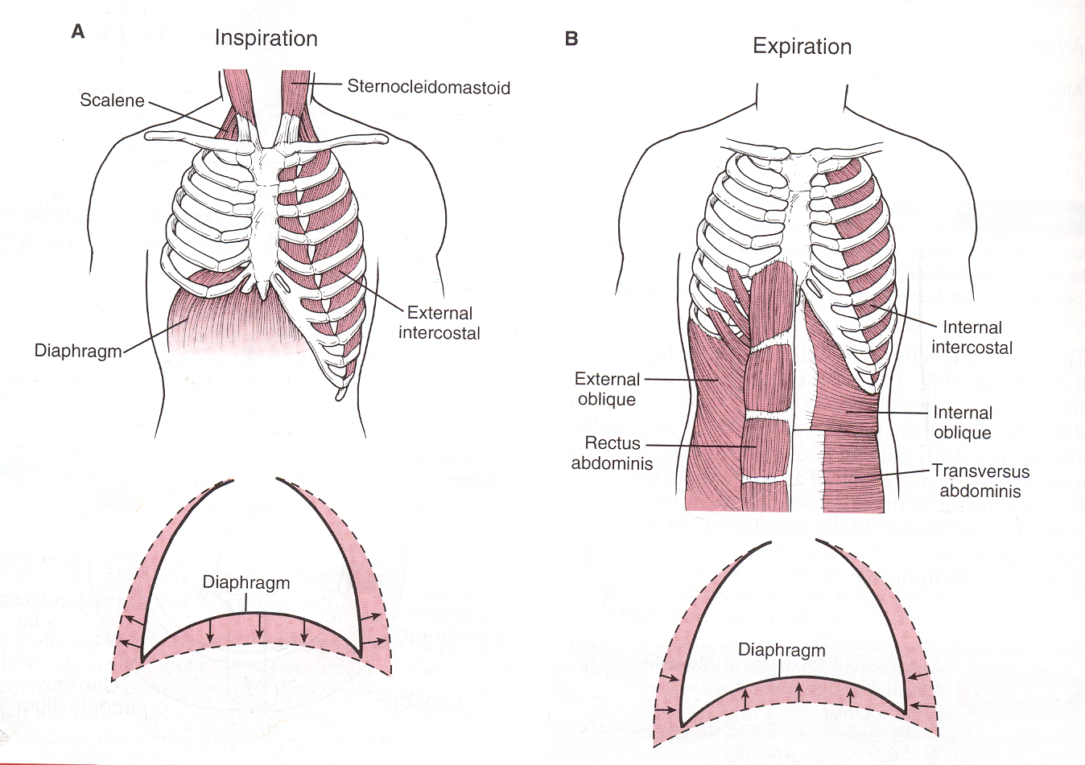

Slide 32
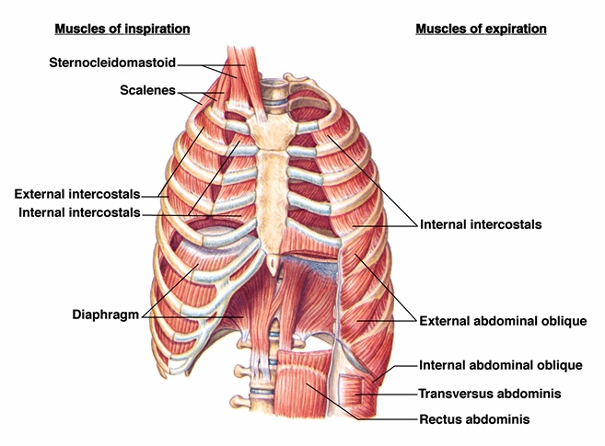
Muscles of Respiration
Fig 10.7

Slide 34
Resistance مقاومه to Airflow تدفق الهواء
Largely determined by airway diameter.
Is greatest in the large and medium sized
airways. بسبب وجود الغضاريف واما الحجم الصغير المقاومه فيها صغيره لانها >> smooth musuls
At low lung volumes airways are compressed تنضغط → ↑ Airway resistance.
مهمه Airway resistance is inversely عكسيا related to lung volume.

Slide 36
انواع الضغط في الرئه
انظر الشريحه القادمه لرسومات توضح هذا
1- Intraplular ( plular ) pressure : هذا الضغط اللي يوجد بين غشاء الرئه والرئه نفسها
هذا النواع من الضغط دائما سالب ويكون اكثر سالبيه في الشهيق ( هذه السالبيه بسبب :
Force of elastic recoil of the lung and elastic recoil of chest wall هذه القوتان عكس بعض ولذلك تسببان هذا الضغط
2- Intrapulmonary ( alveoli ) pressure : هذا الضغط الذي يوجد داخل تجويف الرئه
عند السكون = 0 , عند الشهيق = سالب , عند الزفير= موجب
3- transpulmonary pressure = Alveoli P – Plular P
هو الفرق بين الضغط داخل الرئه والضغط داخل الغلاف الرئوي
هذا الضغط دائما موجب ووظيفته منع خروج الهواء من الرئه بشكل كلي لان الرئه اذا فرغت من الهواء حدث لها انقباض
هذا الضغط يصبح صفر عند حدوث خرق للرئه
ملاحظه : الضغط الجوي يساوي صفر الذي يساوي 760 مم زئبق اقل من هذه القيمه يعتبر سالب واكبر يعتبر موجب

Slide 37
الضغط الجوي =0
عند السكون
عند الشهيق
صفر
سالب
دائما سالب
اكثر سالبيه
عند الزفير
احفظ نسب الضغط ( كلا نوعيه ) عند الشهيق والزفير والسكون
ركز على كونها موجب او سالب او صفر
موجب
سالب

Slide 38
رسمه تلخص الشريحه 36

Slide 41
QUIZ :-
If the alveolar pressure(Intrapulmonary) =
−1.0 cm.H₂o, and the Intrapleural pressure =
−7.0 cm. H₂o.
What is the transpulmonary pressure?
Transpulmonary pressure = −1.0 − (−7.0 ) =
+ 6.0 cm.H₂o. للاحظ انه دائما مووووجب

Slide 42
هذا الكلام يعيد ما ذكر في الشريحه 36 ولكن انصح بقر ائته

Slide 43
Valsalva maneuvre حاله يصبح فيها الضغط في الغلاف الرئوي موجب ( فسيولوجيه )
Forceful قوي expiration زفير against a closed glottis الحنجره → يسبب +ve intrapleural pressure → ↓ venous return. مهمه جدااا
Can be harmful in patients with heart disease.
Occur during heavy weight lifting, or straining
during labor الولاده or defecation انزال ركاب ☺ -----etc.

Slide 44
Ventilation دخول وخروج الهواء من الرئه
Is influenced تتاثر ب by physical properties of the lungs,
which include عددها ثلاثه وهي مهمه جدا :-
1-Lung Elasticity : recoil تساعد في
, 2-Compliance مسؤوله عن توسع الرئه لاستيعاب الهواء : المطاوعه
, and 3-Surface Tension التوتر . كلما زاد التوتر قلت المطاوعه
اولا : التفاصيل Lung Elasticity :-
Due to their high content of elastin Proteins, they are
very elastic and resist يقاوم distension . التمدد

Slide 45
2- Lung compliance
It is the ability of the lung to stretch التمدد .
It is a change in lung volume per unit change
in pressure.
Cι = ∆v/∆p
Normally = 0.2liters/cm.H₂o in normal
adults.

Slide 46
Compliance decrease in :-
1- Decrease lung volumes due to :-
Fibrosis, Pul.edema, consolidationاتصلب الرئه بسبب البكتيريا , ↑intra-abdominal pressure.
2- Severe obesity.
3- Constrictive bandages. الملابس الضيقيه
Compliance increase in :-
Emphysema المرض الذي يدمر النسيج الالاستيكي ( المرن ), and ageing.

Slide 47
شريحه غير مهمه

Slide 49
Lung volumes and capacities
Lung Volumes :- عددها اربعه
1- Tidal volume:- The volume of air inspired or expired/breath كل نفس= 500 mls. At rest.
2- Inspiratory reserve volume:- The volume of air
inspired by maximum inspiration after normal
inspiration = 3000 mls.
3- Expiratory reserve volume:- The volume of air
expired by maximum expiration after normal
expiration = 1100 mls.
4- Residual volume :- the volume of air remaining in the lungs after maximum expiration= 1200 mls. فوائده:
1- يمنع الرئه من الانكماش وتسهل دخول الهواء 2- يحفز دوام تبادل الغازات ( لا توقف ابدا )
هذا الحجم لا يمكن قياسه بالالات

Slide 50
Lung capacities : مجموع اثنين او اكثر من الفوليوم ( اللي بالشريحه السابقه )
1- Inspiratory Capacity = TV + IRV = 3500 mls.
2- Functional Residual Capacity :- الهواء الباقي بعد الزفير الطبيعي
= ERV + RV = 2300 mls.
3- Vital Capacity :-
Is the volume of air expired by maximum expiration
after maximum inspiration.
= IRV + TV + ERV = 4600 mls.
4- Total Lung Capacity = TV + IRV + ERV + RV = 5800 mls.

Slide 51
1-Tidal volume=500mls.
2-Inspiratory Reserve Volume=3000mls.
3-Expiratory reserve volume=1100mls.
4-Residual volume=1200mls.
Lung capacities
1-Inspiratory capacity=TV+IRV=3500mls.
2-Functional residual capacity=ERV+RV=2300mls.
3-Vital capacity=IRV+TV+ERV=4600mls.
4-Total lung capacity=TV+IRV+ERV+RV=5800

Slide 53
Obstructive خلل بالزفير and Restrictive تضيق حجم الرئه Lung Disease
Measurement of FVC : (force vital capicaty : وضعت كلمه فورس لانه يطلب من المريض ان يتنفس باقوى ما يمكن), FEV₁ ⁄ FVC ( fev1: force expiratory volume in 1 sec ), and FEF₂₅₋₇₅ ( force expiratory flowrate ) ,
are used to detect obstructive & restrictive disorders.
In Obstructive Disorders صعوبه في الزفير ولا يوجد مشكله بالشهيق ( يحدث لمرضى الربو خصوصا والانفيزما ) :-
FEF₂₅₋₇₅ is significantly decreased, and the FEV₁ ⁄FVC
ratio is low, with ↑ residual volume.
In Restrictive Disorders:- صغر حجم الرئه
RV, TLC, and FVC are reduced.
FEV₁ ⁄ FVC ratio is normal or increased.

Slide 54
الشخص السليم
هذه المخططات جيده وتلخص الشريحه السابقه والنسب اللي عليها اسهم مهمه بالحيل
obstructive
restrictive

