Slide 2
SKELETAL MUSCLES

Slide 3
Dr. JAMILA H. EL MEDANY
Associate Professor of Anatomy
College of Medicine
King Saud University

Slide 4
OBJECTIVES
At the end of the lecture, students should:
Describe the main criteria of skeletal muscles.
Describe the attachments of skeletal muscles.
Describe the different directions of skeletal muscle fibers.
Describe the mode of action of skeletal muscles.
Describe briefly the naming of skeletal muscles.
Describe briefly the nerve supply of skeletal muscles.

Slide 5
I
MAIN CRITERIA OF SKELTAL MUSCLES
Voluntary.
Striated.
Supplied by somatic nerves.
Attached to skeleton.
Produce movement of skeleton.

Slide 6
ATTACHMENTS
MOSTLY TWO:
ORIGIN: Least movable, mostly fleshy, proximal end.
INSERTION: Most movable, mostly fibrous, distal end.

Slide 7
TYPES OF ATTACHMENTS
Muscles are attached to bones, cartilage or ligaments by:
(1) Tendons : cords of fibrous tissue.
(2) Aponeurosis : a thin and strong sheet of fibrous tissue.
(3) Raphe : an interdigitation of the tendinous ends of the flat muscles.

Slide 8
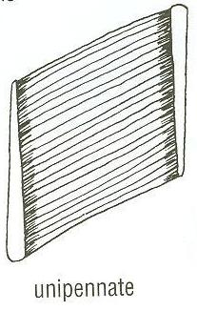
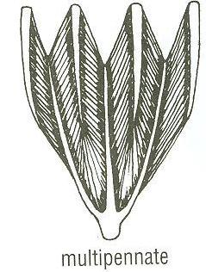
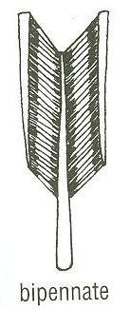
DIRECTION OF MUSCLE FIBERS
Parallel to line of pull: More range of movement, less powerful.
Pennate (oblique to line of pull): More powerful, less range of movement.
Unipennate.
Bipennate.
Multipennate.
parallel

Slide 9
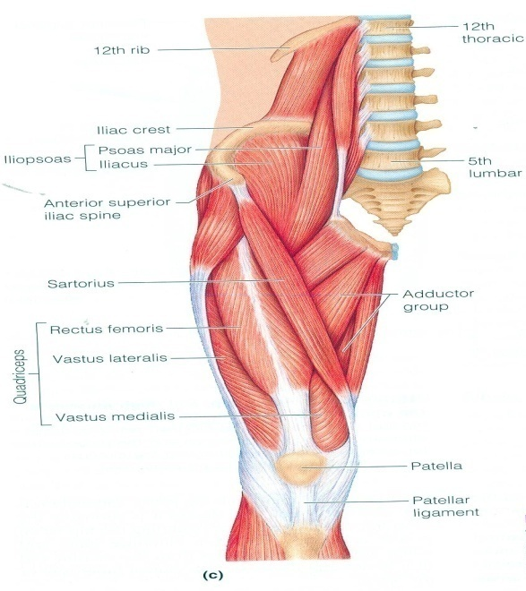
MODE OF ACTION
Prime mover :
It is the chief muscle responsible for a particular movement (Quadriceps Femoris is the prime mover for extension of the knee joint).

Slide 10
MODE OF ACTION
Antagonist :
It opposes the action of the prime mover (Biceps Femoris opposes the action of quadriceps when the knee joint is extended).

Slide 11
MODE OF ACTION
Synergist :
Prevents unwanted movement in an intermediate joint crossed by the Prime Mover (Flexor and Extensor carpi on the Wrist joint).

Slide 12
MODE OF ACTION
Fixator :
Its contraction does not produce movement by itself but it stabilizes the origin of the prime mover so that it can act effectively (muscles attaching the shoulder girdle to the trunk act as Fixator to allow the deltoid to act on the shoulder joint).

Slide 13
NAMING OF MUSCLES
Shape:
Deltoid (triangular).
Teres (rounded)
Rectus (straight).
Number of heads:
Biceps (2 heads).
Triceps (3 heads).
Quadriceps (4 heads).
Attachments:
Coracobrachialis (from coracoid process to arm).
Action:
Flexor digitorum: flexion of digits.

Slide 14
NAMING OF MUSCLES
Size:
Major or maximus (large).
Minor or minimus (small).
Latissimus (broad).
Longus (long).
Brevis (short).
Position:
Pectoralis (pectoral region)
Depth:
Superficialis (superficial).
Profundus (deep).
Externus (external).

Slide 15
NERVE SUPPLY
The nerves supplying the skeletal muscles are Mixed.
60% are Motor.
40% are Sensory.
It contains some Autonomic fibers (Sympathetic).
The nerve enters the muscle at about the middle point of its deep surface.

Slide 16
SUMMARY
Skeletal muscles are striated, voluntary muscles attached to & move the skeleton.
They have 2 attachments: origin & insertion.
Their fibers may be parallel or oblique (pennate) to the line of pull.
According to mode of action, they are classified as: prime mover, antagonist, synergist or fixator.
They may be named according to: size, shape, number of heads, position, attachments, depth or action.
They are supplied by a mixed nerve.

Slide 17
QUESTION 1
The skeletal muscle is:
unvoluntary.
not striated.
always named according to its attachments.
supplied by a mixed nerve.

Slide 18
QUESTION 2
The muscle responsible for a particular movement is:
antagonist.
prime mover.
synergist.
fixator.

Slide 19
THANK YOU

