Slide 1
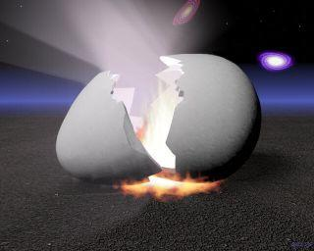
Bilaminar & trilaminar Discs & Their Derivatives
Khaleel Alyahya, PhD, MEd
Jamila Elmedany, PhD

Slide 2
Objectives
At the end of the lecture, students should:
Define the Bilaminar and Trilaminar discs
Define Gastrulation
Describe the characteristics of Gastrulation
Describe the Primitive Streak (development, functions & fate)
Describe the intraembryonic mesoderm (origin, differentiation & distribution)
Define the Notochord
List the derivatives of the Ectoderm, Mesoderm and Endoderm

Slide 3
BILAMINAR DISC
At the (8th) day, the Inner Cell Mass is differentiated into a circular bilaminar plate of cells composed of Two layers :
(a) Hypoblast
Small cuboidal cells adjacent to the blastocyst cavity (Yolk Sac).
(b) Epiblast
High columnar cells adjacent to the amniotic cavity.

Slide 4
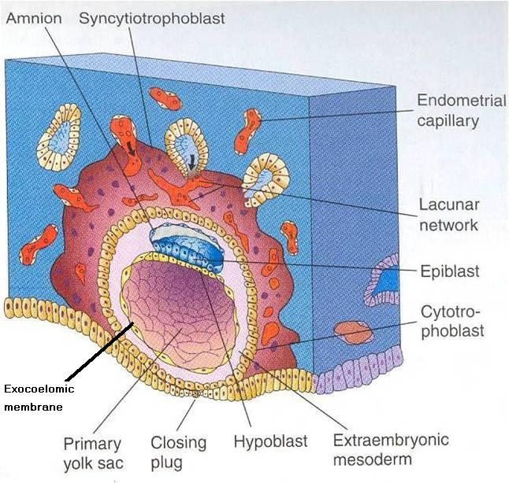
EXTRA EMBRYONIC MESODERM
A loosely arranged connective tissue.
Arises from the yolk sac.
It fills all the space between the Trophoblst externally and the Exocoelomic membrane and amnion internally.
It surrounds the amnion and yolk sac.

Slide 5
EXTRA EMBRYONIC COELOM
Isolated spaces appear within the Extraembryonic mesoderm.
These spaces fuse and form the Extraembryonic Coelom.
It surrounds the amnion and yolk sac.

Slide 6
GASTRULATION
It is the process through which the Bilaminar embryonic disc is converted into a Trilaminar disc.

Slide 7
TRILAMINAR DISC
Composed of Three Germ Layers :
Embryonic Ectoderm
Intraembryonic Mesoderm.
Embryonic Endoderm.
Cells in these layers will give rise to all tissues and organs of the embryo.

Slide 8
GASTRULATION
It is Associated with:
1- Appearance of Primitive Streak.
2- Differentiation of the Three Germ layers.
3- Development of Notochord.
4. Formation of Prechordal Plate.

Slide 9
PRIMITIVE STREAK
It appears in (15-16 day) as a Thickening on the surface of the Epiblast.
It appears at the Caudal End of embryonic disc.
The proliferated cranial end of this primitive streak is called Primitive Node.

Slide 10
FUNCTIONS OF PRIMITIVE STREAK
(A) It Differentiates:
1. Craniocaudal Axis of the embryo.
2. Cranial and Caudal ends.
3. Dorsal and Ventral surfaces.
4.Right and Left sides.
(B) It Forms: Intraembryonic mesoderm

Slide 11
INTREMBRYONIC MESODERM
By the end of (3^{rd) week.}
Invagination of Epiblastic cells of Primitive Streak –
gives rise to Mesenchymal cells that migrate between Epiblast & Hypoblast to form a Third germ layer - Intraembryonic Mesoderm (IEM)

Slide 12
INTREMBRYONIC GERM LAYERS
The Invaginated cells Differentiate as follows:
(a) Some displace the Hypoblast to create the Embryonic Endoderm.
(b) Others lie between the Epiblast and the new endoderm to form the Mesoderm.
C. Cells remaining in the Epiblast form the Ectoderm.

Slide 13
FATE OF PRIMITIVE STREAK
The primitive streak diminishes in size and becomes an insignificant structure in the sacrococcygeal region of the embryo.
Normally it disappears by the end of the Fourth week.

Slide 14
SACROCOCCYGEAL
TERATOMA
It is developed from remnants of primitive streak.
It is mostly a benign tumor containing elements of incomplete differentiated (3) germ layers.
It is the most common tumor in newborn, mostly female.
It is usually diagnosed on ultrasonograph.
It is usually surgically removable and the prognosis is good.

Slide 15
NOTOCHORD
Formed early in the 3rd w.
from Notochordal Process:
A median cellular cord from Mesenchymal cells of the Primitive Node and Pit.
The process extends cranially from the primitive node to the Prechordal Plate between the ectoderm & endoderm.

Slide 16
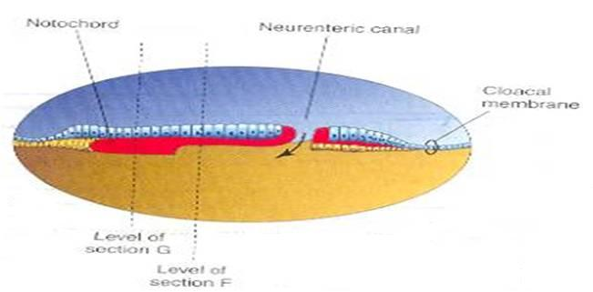
FUNCTIONS OF
NOTOCHORD
1. Define the Primordial Axis of the embryo and gives it some rigidity.
2. Serves as the basis for the development of the Axial Skeleton (skull& vertebral column).
3.Indicates the future site of the Vertebral Bodies.
4. Forms the Neural Plate (Primordium of the CNS).

Slide 17
PRECHORDAL PLATE
It is a localised thickening of the Hypoblast.
It indicates :
1. The future Cranial end of the embryo.
2. The future site of the Mouth.
It is an important organiser of the Head

Slide 18
DISTRIBUTION OF IEM
It exists between the Ectoderm and the Endoderm
Except AT :
1. Oropharyngeal membrane (future opening of the oral cavity).
2. Cloacal membrane (future site of the anus). .

Slide 19
DIFFERENTIATION OF IEM
1-Medial part (Paraxial Mesoderm). 2-Middle part : (Intermediate mesoderm).
3-lateral part (Lateral mesoderm).

Slide 20
SOMITES
Paired Cuboidal masses formed in the Paraxial Mesoderm
on each side of the Notochord.

Slide 21
DIFFERENTIATION OF SOMITES
1-Sclerotome (Ventromedial part)
Forms:
Vertebral column (Axial Skeleton =C.T + Cartillage + Bone ).
2-Myotome (Intermediate part )
Forms: Striated or Skeletal muscles .
3.Dermatome (Dorsolateral part).
Forms: Dermis of Skin.

Slide 22
LATERAL MESODERM
By the end of 3rd week:
Isolated Coelomic Spaces begin to appear in lateral mesoderm.
These Spaces coalesce to form a single horseshoe-shaped cavity Intra embryonic Coelom.

Slide 23
INTRAEMBRYONIC COELOM
Divides the lateral mesoderm into 2 layers
1- Somatic (Parietal layer) : continuous with extraembryonic mesoderm covering Amnion. 2- Splanchnic (Visceral layer) : continuous with extraembryonic mesoderm covering Yolk sac.

Slide 24
EMBRYONIC WALLS
Somatic (Parietal) mesoderm + overlying Ectoderm form…. Embryonic body wall (=Muscles + C.T ) or / Somatopleure.
Splanchnic (Visceral) mesoderm + underlying Endoderm form…. Embryonic gut wall (walls of viscera = smooth muscle +C.T+ serous membranes) or / Splanchnopleure.

Slide 25
DIFFERENTIATION OF IEC
During 2nd month, I.E.C is differentiated into Three Body Cavities: Pericardial.
Pleural.
Peritoneal.

Slide 26
DERIVATIVES OF SURFACE ECTODERM
1-Epidermis of Skin, Hairs, nails.
2. Cutaneous & Mammary Glands.
3. Anterior part of Pituitary Gland.
4-Enamel of Teeth.
5-Lens of Eye & Internal Ear.

Slide 27
Derivatives of Surface
MESODERM
Connective tissues.
Smooth muscular coats.
Vessels associated with tissues and organs.
Most of cardiovascular system.
Skeleton and striated muscles.
Reproductive and excretory organs.

Slide 28
DERIVATIVES OF MESODERM

Slide 29
Derivatives of Surface
ENDODERM
Epithelium lining respiratory passage & gastrointestinal tract.
Glands opening to GI tract.
Glandular cells associated organs such as liver and pancreases.
Most of cardiovascular system.
Skeleton and striated muscles.
Reproductive and excretory organs.

Slide 30
DERIVATIVES OF ENDODERM

Slide 31
That’s all folks!
QueSTioN?

