Slide 1
JOINTS
Dr. JAMILA H. EL MEDANY
Associate Professor of Anatomy
College of Medicine
King Saud University

Slide 2
OBJECTIVES
At the end of the lecture, students should:
Define the term “Joint”.
Describe the classification of joints & give an example of each.
Describe the characteristics of synovial joints.
Describe the classification of synovial joints & give an example of each.
List factors maintaining stability of joints.
Recite “Hilton’s law” for nerve supply of joints.

Slide 3
DEFINITION
It is the site where two or more bones come together, whether or not movement occurs between them.

Slide 4
CLASSIFICATION
Joints are classified according to the tissues that lie between the bones into:
Fibrous.
Cartilaginous.
Synovial.

Slide 5
FIBROUS JOINTS
The articulating surfaces are joined by fibrous tissue.
Sutures of the vault of the skull: No movement, temporary joints (ossify later).
Inferior tibiofibular joints (syndesmosis): Little movement, permanent joints.

Slide 6
CARTILAGINOUS JOINTS
Primary Cartilaginous
The bones are united by a plate or bar of hyaline cartilage.
No movement, temporary joints (ossify later).
Between the Epiphysis and Diaphysis of a growing bone.
Between the First Rib and the Sternum (1st sternocostal joint).

Slide 7
CARTILAGINOUS JOINTS
Secondary Cartilaginous
The bones are united by a plate of fibrocartilage.
Their articulating surfaces are covered by a thin plate of hyaline cartilage.
Little movement, permanent joints.
Midline joints.
Joints between the Vertebral Bodies (Intervertebral discs).
Symphysis Pubis.

Slide 8
SYNOVIAL JOINTS
Characteristic features:
Freely movable joints.
A fibrous capsule attached to margins of articular surfaces & enclosing the joint.
The articular surfaces are covered by a thin layer of hyaline cartilage (articular cartilage).
A joint cavity enclosed within the capsule.
Capsule
Articular cartilage
Articular cartilage

Slide 9
SYNOVIAL JOINTS
A thin vascular synovial membrane lining the inner surface of capsule.
A lubricating synovial fluid produced by synovial membrane in the joint cavity. It minimizes friction between articular surfaces.
Synovial membrane
Capsule
containing synovial fluid

Slide 10
CLASSIFICATION OF SYNOVIAL JOINTS
Synovial joints are classified according to the range of movement into:
Plane synovial joints.
Axial synovial joints.

Slide 11
PLANE SYNOVIAL JOINTS
The articulating surfaces are flat and the bones slide on one another, producing a gliding movement.
Intercarpal Joints.
Sternoclavicular and Acromioclavicular joints.

Slide 12
AXIAL SYNOVIAL JOINTS
Movements occur along axes:
Transverse: flexion & extension occur.
Longitudinal: rotation occurs.
Antero-posterior: abduction & adduction occur.
Axial joints are divided into:
Uniaxial.
Biaxial.
Multi-axial (polyaxial).

Slide 13
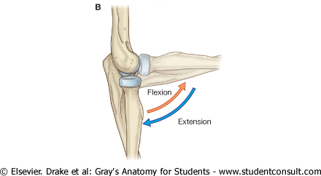
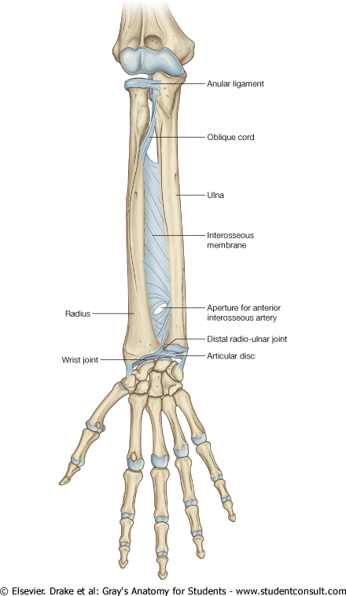
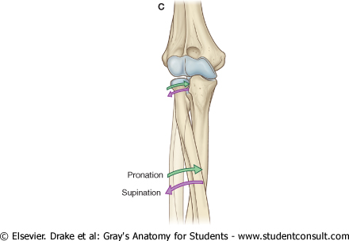
UNIAXIAL SYNOVIAL JOINTS
Hinge joints:
Axis: transverse.
Movements: flexion & extension.
Example: elbow joint.
Pivot:
Axis: longitudinal.
Movements: rotation.
Example: radio-ulnar joints

Slide 14
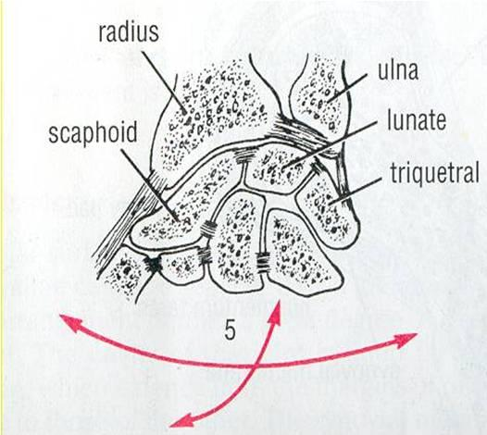
BIAXIAL SYNOVIAL JOINTS
Ellipsoid joints:
An elliptical convex fits into an elliptical concave articular surface.
Axes: Transverse & antero-posterior.
Movements: Flexion & extension + abduction & adduction.
Example: Wrist joint.

Slide 15
BIAXIAL SYNOVIAL JOINTS
Saddle joints:
The articular surfaces are reciprocally concavoconvex.
They resemble a saddle on a horse’s back.
Movement: As ellipsoid joints (Flexion & extension + abduction & adduction) + a small range of dependant rotation rotation.
Example: Carpometacarpal joint of the Thumb.

Slide 16
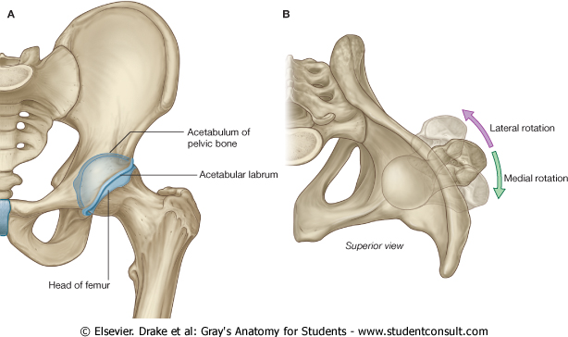
POLYAXIAL SYNOVIAL JOINTS
Ball-and-socket joints:
A ball –shaped head of one bone fits into a socket like concavity of another.
Movements: Flexion & extension + abduction & adduction) + rotation along a separate axis.
Examples:
Shoulder joint.
Hip Joint.

Slide 17
STABILITY OF SYNOVIAL JOINTS
The shape of articular surfaces:
The ball and socket shape of the Hip joint is a good examples of the importance of bone shape to maintain joint stability.
The shape of the bones forming the Knee joint has nothing to do for stability.

Slide 18
STABILITY OF SYNOVIAL JOINTS
The strength of ligaments:
They prevent excessive movement in a joint.

Slide 19
STABILITY OF SYNOVIAL JOINTS
The tone of the surrounding muscles:
In most joints, it is the major factor controlling stability.
The short muscles around the shoulder joint keeps the head of the humerus in the shallow glenoid cavity.

Slide 20
NERVE SUPPLY OF JOINTS
The capsule and ligaments receive an abundant sensory nerve supply.
Hilton’s Law:
“A sensory nerve supplying a joint also supplies the muscles moving the joint and the skin overlying the insertions of these muscles.”

Slide 21
SUMMARY
Joint is the site where two or more bones come together, whether or not movement occurs between them.
Joints are classified according to the tissues that lie between the bones into: fibrous, cartilaginous & synovial.
Synovial joints are freely movable & characterized by the presence of : fibrous capsule, articular cartilage, synovial membrane & joint cavity containing synovial fluid.

Slide 22
SUMMARY
Synovial joints are classified according to the range of movement into: plane & axial.
Axial are divided according to the number of axes of movements into: uni-, bi- & polyaxial.
Stability of synovial joints depends on: shape of articular surfaces, ligaments & muscle tone.
Joints have same nerve supply as muscles moving them.

Slide 23
QUESTION 1
In the synovial joint :
articular surfaces are united by a plate of fibrocartilage.
the synovial membrane is not vascular.
stability is not related to muscle tone.
movement is free.

Slide 24
QUESTION 2
The elbow joint:
is a fibrous joint.
is a secondary cartilaginous joint.
allows only flexion & extension.
Is a synovial pivot joint.

Slide 25
THANK YOU

