Slide 1
INTRODUCTION TO PATHOLOGY
Dr. Maha Arafah
Assistant Professor
Department of Pathology
King Khalid University Hospital and King Saud University
Email: marafah@ksu.edu.sa
marafah @hotmail.com

Slide 2
INTRODUCTION TO PATHOLOGY
Objectives:
Understands the definition of pathology.
Understands the concept of disease.
Become familiar with the important terminology which are used to study a disease like: epidemiology, aetiology, pathogenesis and prognosis.
Understands the meaning of idiopathic or essential disease.
Be familiar with the classification of diseases which is usually based on their pathogenesis.
Have an organized framework for thinking and acquiring information about diseases.

Slide 3
Introduction to Pathology
Learning Resources:
a) Textbooks:
Robbins. Basic Pathology.
(Required Text Book)
Robbins. Pathologic basis of disease.
(Reference)
b) laboratory
Glass slides
Museum for gross examination of organs

Slide 4
Introduction to Pathology
You can access the college website for extra reference and materials at: http://www.ksu.edu.sa/sites/Colleges/Medicine/Pathology/
You can visit my faculty member’s website as follow:
http://faculty.ksu.edu.sa/drarafah

Slide 5
Introduction to Pathology
Other websites that can be visited include:
http://www.pathweb.ubc.edu
http://www.path.uiowa.edu/virtualslidebo
http://library.med.utah.edu/WebPath/webpath.html
http://www.mic.ki.se/PATHOL.html
http://www.cap.medical.org/
http://www.objectivepathology.ca/PublicClientImages/
http://www.palms.med.usyd.edu.au/pathology_museum/
http://pathorama.ch/
http://www.pathmax.com
http://www.oncolink.upenn.edu/
http://www.afip.org/
http://www.cttr.org/

Slide 6
INTRODUCTION TO PATHOLOGY
Objectives:
Understands the definition of pathology.
Understands the concept of disease.
Become familiar with the important terminology which is used to study a disease like: epidemiology, aetiology, pathogenesis and prognosis.
Be familiar with the classification of diseases which is usually based on their pathogenesis.
Understands the meaning of idiopathic or essential disease.
Have an organized framework for thinking and acquiring information about diseases.

Slide 7
PATHOLOGY
Pathology is the study of disease processes.
It provides the link between basic biological sciences and the practice of medicine.
It discusses the disease particularly in terms of etiology (what causes the disease), and pathogenesis (mechanisms that result in the signs and symptoms of the disease), as well as classification and prevention.

Slide 8
Health, illness and disease
Normal health or well being is a state which most of us experience most of the time.
In contrast, Illness is the subjective state of not feeling well and sickness is a state of social dysfunction, i.e. a role that the individual assumes when ill.

Slide 9
Health, illness and disease
There is a wide range of normality and the human body can readily adapt to changes in the environment
(e.g. by an increase in hemoglobin at an altitude where oxygen levels are low).
Disease or ill health occurs when these adaptations are defeated.

Slide 10
PATHOLOGY
Disease is defined as a physiological or psychological dysfunction.
It can be caused by an obvious structural abnormality such as a broken bone or a tumour or may be less well defined, as in the case of anorexia nervosa.

Slide 11
PATHOLOGY
Aspects of disease:
Epidemiology.
Etiology.
Pathogenesis.
Morphological changes
Clinical manifestation
Diagnosis
Clinical coarse

Slide 12
A lesion is any abnormal tissue found on or in an organism, usually damaged by disease or trauma.
Lesion is derived from the Latin word laesio which means injury.

Slide 13
INTRODUCTION TO PATHOLOGY
Objectives:
Understands the definition of pathology.
Understands the concept of disease.
Become familiar with the important terminology which is used to study a disease like: epidemiology, aetiology, pathogenesis, clinical manifestation and prognosis.
Be familiar with the classification of diseases which is usually based on their pathogenesis.
Understands the meaning of idiopathic or essential disease.
Have an organized framework for thinking and acquiring information about diseases.

Slide 14
Epidemiology
Epidemiology provides a broad context for understanding pathology.
Both (pathology and epidemiology) provide a useful framework for classifying and understanding mechanisms of disease.
Epidemiology include sex and age distribution, incidence and prevalence of a particular disease in addition to geographics distribution.

Slide 15
Epidemiology
Incidence: is a measure of the risk of developing some new condition within a specified period of time.
Prevalence : means the number of cases in a population at any one time

Slide 16
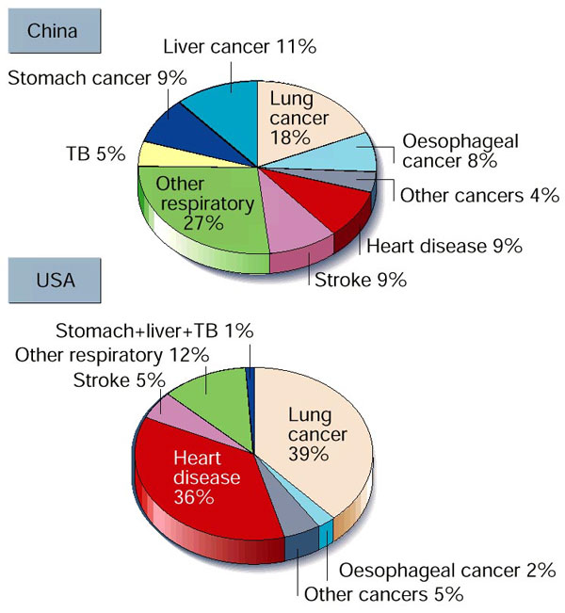
Epidemiology

Slide 17
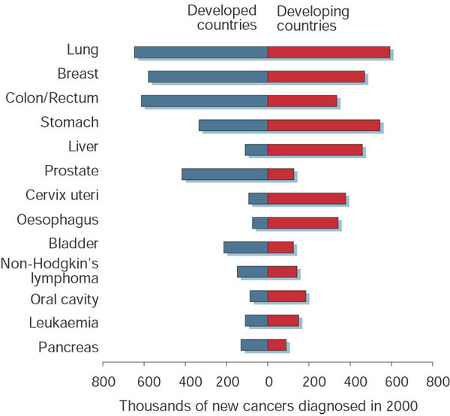
Epidemiology

Slide 18
Factors which affect the incidence and prevalence of disease include:
Time: how the disease has varied over the course of time.
Place: how the disease varies geographically.
Person: what are the personal characteristics of those who suffer from the disease and how they differ from those who do not suffer from the disease, e.g. in age, sex, occupation, race, social class, behavior.

Slide 19
Why may the incidence of a disease change through time?
preventative measures, such as immunization programmes, or may reflect changes in social conditions.
For example, increased smoking has led to an increase in heart disease and lung cancer.
Many diseases show significant geographical variations: in developed countries, heart disease, cancer and psychiatric illnesses are common whereas in underdeveloped countries, malnutrition and infection are often the commonest health problems. Different infectious agents are common in different geographical areas.

Slide 20
Why may the incidence of a disease change through time?
There are many well documented associations between diseases and occupation:
Ship builders and insulation workers: asbestosis (asbestos-related scarring in the lungs); mesothelioma (malignant tumour of the lung pleura).
Rubber and dye workers: bladder cancer through the effect of chemicals.
Hardwood manufacturing: nasal cancer as a result of inhalation of wood dust.

Slide 21
Epidemiology
Epidemiology provides a wider context for the study, classification and diagnosis of diseases.
Data recorded about incidence, prevalence, morbidity and mortality relate to populations, rather than individuals.
Why is epidemiology important?

Slide 22
Why is epidemiology important?
Providing clues for the cause
Identifying risk factors.
Planning disease prevention.
Providing adequate health care facilities.
Setting up population screening programmes.
Evaluating health care interventions.

Slide 23
INTRODUCTION TO PATHOLOGY
Objectives:
Understands the definition of pathology.
Understands the concept of disease.
Become familiar with the important terminology which is used to study a disease like: epidemiology, aetiology, pathogenesis, clinical manifestation and prognosis.
Understands the meaning of idiopathic or essential disease.
Be familiar with the classification of diseases which is usually based on their pathogenesis.
Have an organized framework for thinking and acquiring information about diseases.

Slide 24
Etiology (causes of disease)
Diseases result from the interaction between individuals and their environment.
Some diseases are the inevitable result of environmental factors (e.g. being run over by a bus)
whereas others result from an environmental or behavioural factor acting in conjunction with a genetic predisposition, (e.g. smokers with a strong family history of heart disease.)

Slide 25
Etiology
Examples of etiology:
biological agents – bacteria, virus.
Physical forces – trauma, burn, radiation.
Chemical agents – poison, alcohol, nutritional disturbances
Genetic: Down's syndrome (extra chromosome 21).
- Etiologies can be specific or non-specific
- Most diseases are multi-factorial (e.g. cancer, diabetes)

Slide 26
Etiology
Idiopathic disease: unknown cause of a disease.
Other words meaning the same: cryptogenic, essential and spontaneous.

Slide 27
Pathogenesis
The development of a disease. The origin of a disease and the chain of events leading to that disease.

Slide 28
Pathogenesis
There are a few fundamental processes which underlie most diseases:
Inflammation: response to injury in living vascularized tissue.
Degeneration: deterioration of cell function resulting from metabolic disease or ageing.
Carcinogenesis: process of transformation of cells from the normal, controlled to the neoplastic autonomous state.
Immune reactions: specific responses to foreign organisms or material.

Slide 29
INTRODUCTION TO PATHOLOGY
Objectives:
Understands the definition of pathology.
Understands the concept of disease.
Become familiar with the important terminology which is used to study a disease like: epidemiology, aetiology, pathogenesis, clinical manifestation and prognosis.
Be familiar with the classification of diseases which is usually based on their pathogenesis.
Understands the meaning of idiopathic or essential disease.
Have an organized framework for thinking and acquiring information about diseases.

Slide 30
Clinical Manifestation
A symptom is a feeling which is noticed by a patient, indicating the presence of disease or abnormality.
A sign is a manifestation that is noted by an observer.

Slide 31
Clinical course
The clinical course describes the evolution of a disease
The disease could be acute or chronic.
Prognosis is a medical term denoting the doctor's prediction of how a patient's disease will progress, and whether there is a chance of recovery.

Slide 32
Prognosis:
natural history of disease, disease outcome.
Diseases are often discussed in terms of their morbidity (degree of "illness" involved) and mortality.
5- and 10-year survival rates are often used as an expression of the disease outcomes.
E.g., in some types of lung cancer, the 5-year survival rate is 0%.

Slide 33
INTRODUCTION TO PATHOLOGY
Objectives:
Understands the definition of pathology.
Understands the concept of disease.
Become familiar with the important terminology which is used to study a disease like: epidemiology, aetiology, pathogenesis and prognosis.
Be familiar with the classification of diseases which is usually based on their pathogenesis.
Have an organized framework for thinking and acquiring information about diseases.

Slide 34
Classification of Diseases
Congenital diseases are present at birth even though they may not be recognized or recognizable at that time.
Acquired diseases only occur after birth.

Slide 35
Type | Basis | Examples
Congenital | Genetic | Reduction or absence of blood clotting factor VIII leads to haemophilia A (X chromosome linked).
 | Non-genetic | Cleft lip and palate.
Acquired | Inflammatory | Dermatitis (eczema, inflammation of the skin), rheumatoid disease (inflammation of joints/arthritis).
 | Vascular | Atherosclerosis (deposition of lipid with thickening of blood vessels) leading to a cerebrovascular accident (stroke), myocardial infarction (heart attack).
 | Growth disorder | Cancer.
 | Degenerative | Alzheimer's disease, Parkinson's disease.
 | Drug induced | Bone marrow suppression, skin rashes, renal failure.
 | Infective | Viral, bacterial or fungal diseases.
 | Metabolic | Gout: deposition of uric acid crystals in joints and tissues. Diabetes mellitus: abnormal metabolism of carbohydrates and lack of insulin.

Slide 36
Idiopathic disease
Idiopathic disease. In some instances, the underlying cause of a disease is obscure.
Also called essential, cryptogenic and spontaneous.
i.e. Cause unknown

Slide 37
INTRODUCTION TO PATHOLOGY
Objectives:
Understands the definition of pathology.
Understands the concept of disease.
Become familiar with the important terminology which are used to study a disease like: epidemiology, aetiology, pathogenesis and prognosis.
Be familiar with the classification of diseases which is usually based on their pathogenesis.
Understands the meaning of idiopathic or essential disease.
Have an organized framework for thinking and acquiring information about diseases.

Slide 38
The diagnostic process
Patients present with symptoms and a clinical examination elicits signs which suggest a diagnosis.
A list of possible diagnoses is constructed, known as the differential diagnosis.

Slide 39
The diagnostic process
The clinician then works through a series of questions:
Which organ system is most likely to be affected?
Which category of disease do the signs and symptoms most likely suggest, e.g. inflammation, malignancy or poisoning?
Do other factors such as race, age, sex, behavioural patterns or occupation of the patient provide clues to the diagnosis?

Slide 40
Diagnosis:
the act of identifying a disease in an individual patient and is based on clinical history, physical examination and investigation.

Slide 41
Diagnosis involves clinical skills and laboratory tests.
Specialist pathological techniques can aid in diagnosis.

Slide 42
The role of the Pathologist
The pathologist can help the clinician to make a diagnosis by looking at samples of tissue (biopsies) and by using a range of specialized laboratory techniques to refine the differential diagnosis.
Pathology includes a large number of sub-specialities.
For example, haematologists are concerned with disorders of the blood, whilst immunologists are concerned with disorders of the body's immune system.

Slide 43
The diagnostic process
The clinical diagnosis can often only be made after several samples of blood, urine and tissue have been examined and the results assessed in the light of the patient history and the clinical findings.

Slide 44
Diagnostic Pathology
Blood
- blood cells
- plasma
- serum
Excretion and secretions
- urine and faeces
- sputum

Slide 45
Diagnostic Pathology
Effusions and exudates
- protein levels
- cytological examination
- microbiology and culture

Slide 46
Diagnostic Pathology
Biopsies
- needle biopsy
- endoscopic biopsy
- incisional biopsy
Organ resection
Frozen Section
Cytology
- exfoliate cytology
- fluid cytology
- washing cell
- fine needle aspiration cytology

Slide 47
Techniques in Pathology
Anatomic Pathology
Light Microscopy
Immunohistochemistry & immunofluorescence
Electron microscopy
Molecular pathology

Slide 48
Electron microscopy
Electron Microscopes (EM) are scientific instruments that use a beam of highly energetic electrons to examine objects on a very fine scale

Slide 49
Length
- meter(m), millimeter(mm) =10⁻³m, micrometer(µm) =10⁻⁶ m
- nanometer(nm) = 10⁻⁹ m, picometer(pm) = 10⁻¹² m.
- Angstrom = 10⁻¹⁰ m
Sizes of living cells
- atom - 0.1 nm
- molecules - 0.5-10 nm
- viruses - 30-80 nm
- bacteria - 2 µm
- animal and plant cells- 10-30 µm

Slide 50
Autopsy
The examination of the body after death.
The main purpose of the autopsy is :
to determine the cause of death.
confirm a clinical diagnosis made in life.
identifying diseases or conditions which were not apparent in life.
Discussions between clinicians and pathologists about autopsy findings often lead to new insights into the causes and outcomes of disease.
Autopsies provide useful material for teaching.

Slide 51
Summary
Pathology is the study of changes which occur in cells and tissues as a result of inborn genetic, extraneous environmental or behavioural damage.
Pathology constitutes a logical and scientific basis of medicine.

Slide 52
TAKE HOME MESSAGES
Pathology is an important discipline which help in the understanding and diagnosis of diseases.
A disease is defined as a physiological or psychological dysfunction.
Study of disease requires an understanding of epidemiology, aetiology and pathogenesis of the illness.
Classification of diseases is usually based on their pathogenesis.

