Slide 1
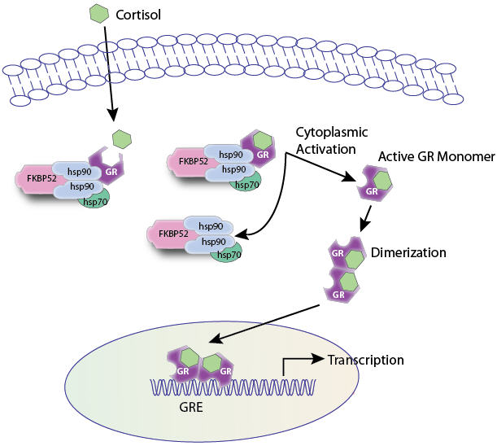
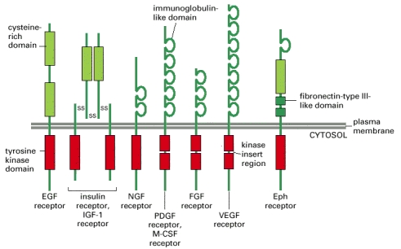
RECEPTOR FAMILIES
RECEPTOR FAMILIES
RECEPTOR FAMILIES
Prof. Dr. OMNIA NAYEL

Slide 2
ilos
By the end of this lecture you will be able to :
Classify receptors into their main superfamilies
Recognize their different transduction mechanism
Identify the nature & time frame of their response

Slide 3
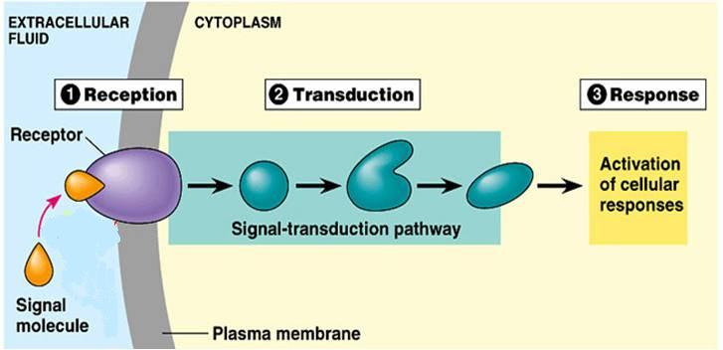
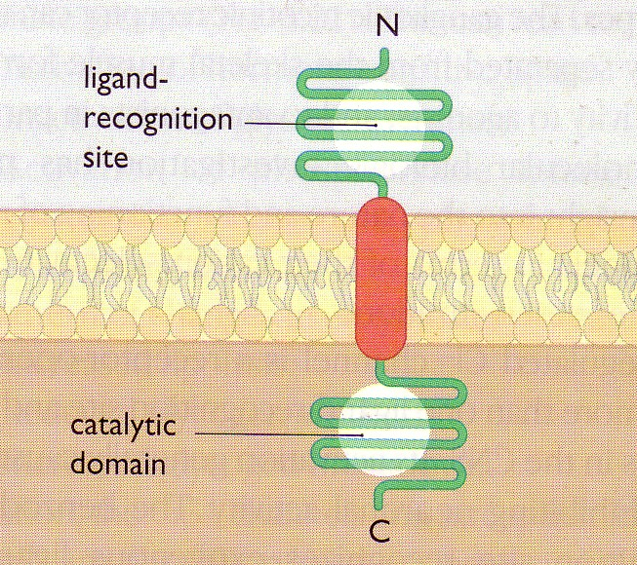
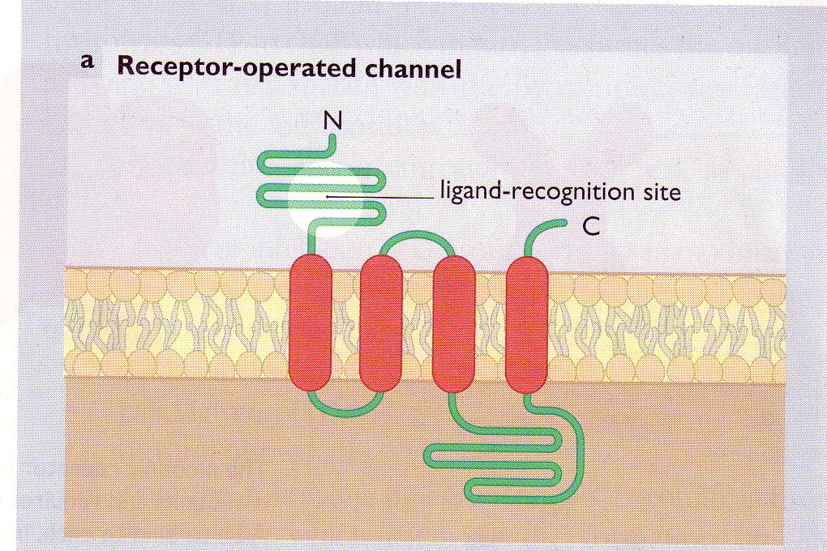
A RECEPTOR
◉
Its Structure:
2
3
4
2. Reception
3. Transduction
4. Response
1
1. Recognition
Direct
◉
Coupler Transduction

Slide 4
RECEPTOR FAMILIES
Classified according to their
Location
Structure
Transduction Mechanism
Nature of Response
Time scale of Response
 4 Main SUPERFAMILIES
Channel-Linked Receptor
G-Protein Coupled Receptors
Enzyme-Linked Receptors
Nuclear Receptors

Slide 5
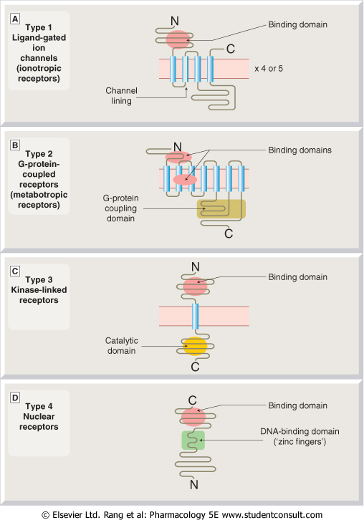
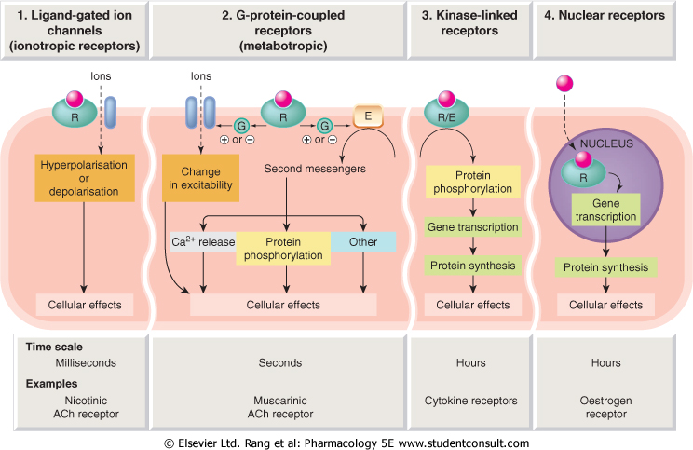
1
2
3
4
Conductance
Cell Signal  
Cell Signal 
Transcription
& Translation
Minutes / Hours
Hours / Days

Slide 6
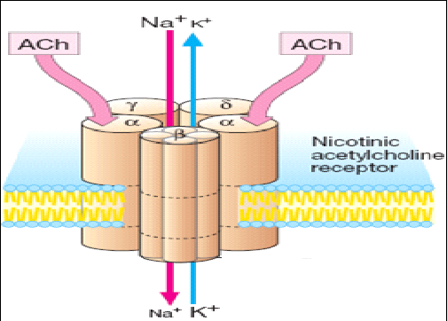
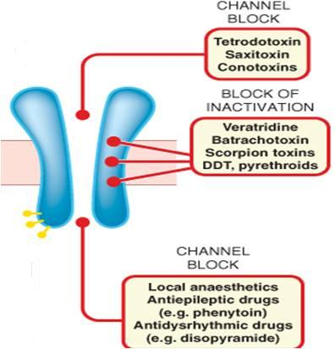
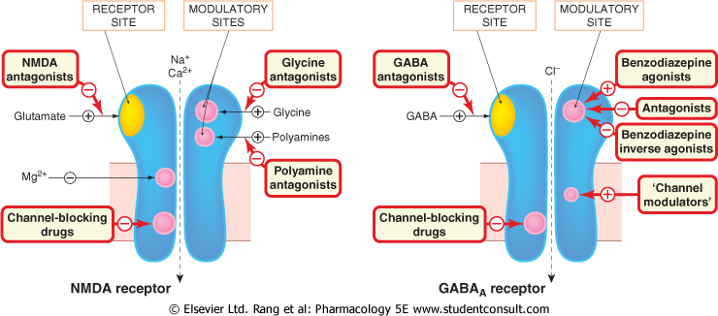
Channel-Linked Receptor
1
Ionotropic Receptor
Ligand-Gated-Ion Channel
Involved in fast synaptic neurotransmittion occuring over milliseconds
It is activated directly when a ligand comes to bind to receptors that are incorporated as part of its structure
Different from Voltage-Gated Ion Channel
That is activated by a change in action potential
Not by occupancy of a ligand

Slide 7
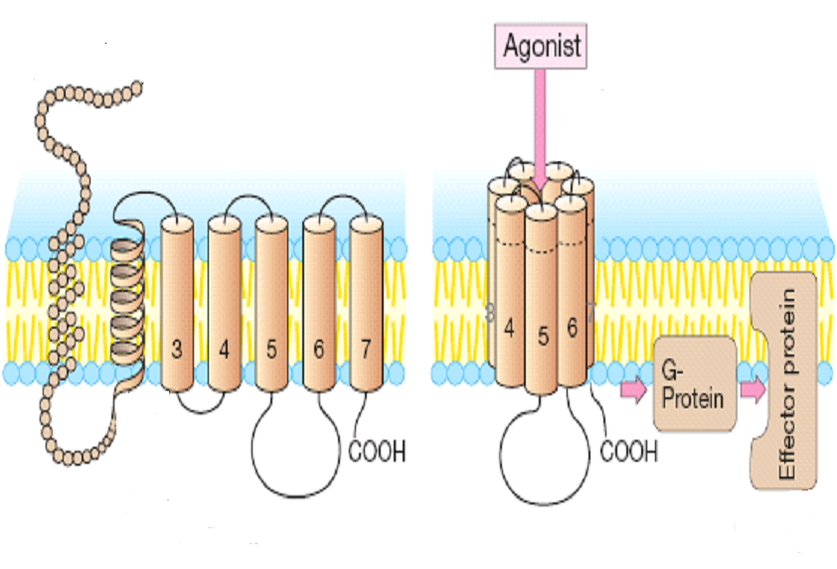
G-Protein-Coupled Receptor
2
Agonist
Metabotropic Receptor
Go-between proteins
Coupler
Involved in less rapid transmission of
mAch R, amine transmitters, Adr R, Dopa-
minergic R, histamine R, 5-HT R…
Neuropeptide R, prostanoid R, purine R,…
Hormones; glycogen
G-Protein
An enzyme  2nd messenger   
Adenyl cyclase (AC) cAMP  PKA
Phospholipase C (PLC)IP₃ Ca⁺⁺ intacellular Ca²⁺/CaMCAMPK
DAG  PKC
?
?
RESPONSE
PHOSPHORYLATION OF TARGET PROTEINS

Slide 8





G-Protein-Coupled Receptor
Adenyle cyclase
R
G-Protein
E
α
β
γ
ATP
ATP
ATP
ATP
3 subunits [α β γ]
◉ + GDP

Slide 9

?
?
R
Channels
E
α
α
α
P
β
γ
ATP
ATP
ATP
ATP
cAMP
Enzymes
P
PKA
Cytoskeletal Proteins
P

Slide 10
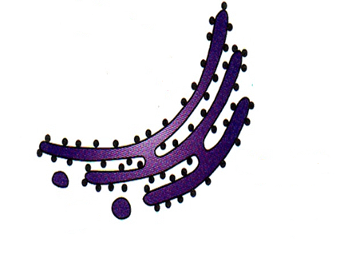
G-Protein-Coupled Receptor
Phospholypase C
E
α
α
PIP₂
DAG
Channels
β
γ

Phosphatidic a
Inositol
↑
P
IP₃
PKC
?
?
Ca⁺⁺
+CaM
CAMPK
P
P
Enzymes
P
Cytoskeletal Proteins

Slide 11
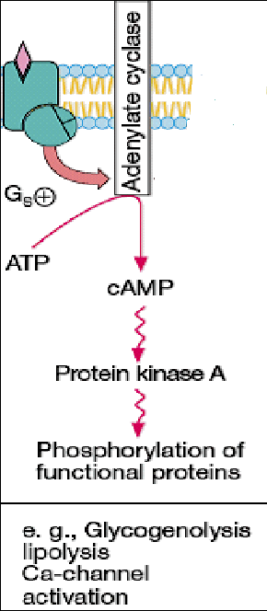
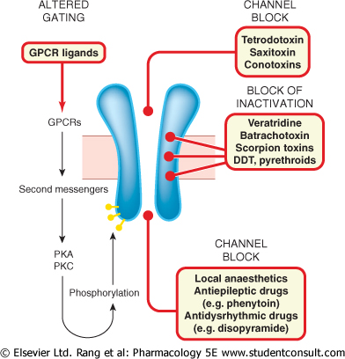

RESPONSE
They can modulate activity of voltage-gated ion channels

Slide 12
G-Protein-Coupled Receptor
Are the Most Abundant Type
Different Classes of Receptors
Ach R  m Adrenergic R  α & β
Dopaminergic R  D₁ & D₂ 5-HT  5-HT₁₋₂ / 5-HT ₄₋₇
Different Receptors Subtypes
mAch; m₁, m₂, m₃, m₄,
Adrenergic receptors; α₁ & α₂ / β₁ & β₂
5-HT_{1;} 5-HT_{1A} – _{1D} receptor
Different in G-Protein Classes
Divided according to their α-subunits into G_{s}, G_{i} and G_{q}
G_{s} and G_{i} produce, respective, stimulation and inhibition of AC
G_{q} is linked to activation of PLC-IP₃ -Ca⁺⁺ CaM & PKC
Show selectivity to receptors & effectors with which they couple
The a₁ Adrenoceptors couple to G_{q} to stimulate PLC.

Slide 13
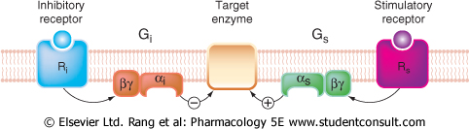
G-Protein-Coupled Receptor
Adr
Inhibitory Receptor
Stimulatory Receptor
G_{i}
G_{s}
AC
α₂ Adrenoceptor
β Adrenoceptor
+
= / # TISSUES
cAMP
↑cAMP
Ach
BIDIRECTIONAL CONTROL OF A RESPONSE
Adr
Stimulatory Receptor
Stimulatory Receptor
G_{q}
G_{q}
PLC
PLC
M₁ Ach receptor
α₁ Adrenoceptor
+
+
Bronchi
↑Ca ⁺⁺
↑Ca ⁺⁺
Blood Vessel

Slide 14
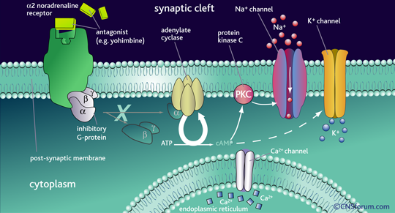
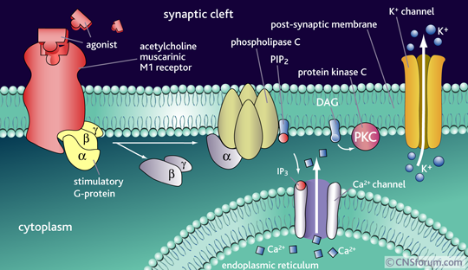
= TISSUES
α₁, α₂ & β Adrenoceptors
Differ from each other both in ligand selectivity among drugs and in coupling to G proteins (G_{q}, G_{i}, and G_{s}, respectively)
M₁ and M₃ Ach receptors activate the G_{q}-PLC-IP₃-Ca²⁺ pathway
M₂ and M₄ Ach receptors activate G_{i} to reduce the activity of AC

Slide 15
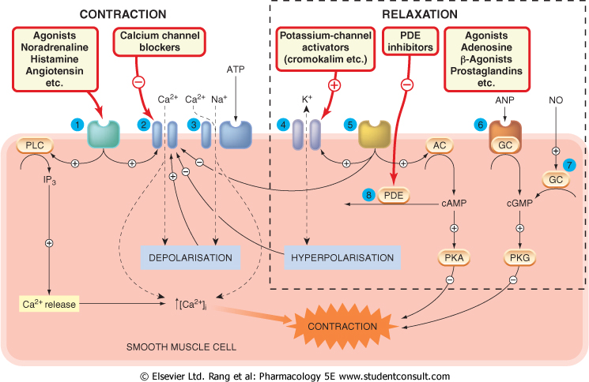
Complexity of a response is governed by many ligands, receptors & effectors

Slide 16
Enzyme-Linked Receptors
3
Involved in slow action of; hormones (insulin), growth factors, cytokines, …..
Their cytosolic domain either:
Associate directly with an enzyme (guanyl cyclase)
Possess intrisic kinase activity (as tyrosine or serine/threonine kinase) that
can phosphorylate itself & / or other proteins that they dock.
They control many cellular functions as motility, growth, differentiation, division & morphogenesis.
This usually require many intracellular signaling steps that take time to process.
Tyrosine Kinase-Linked Receptors

Slide 17
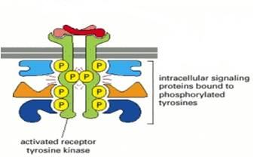
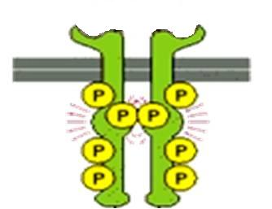
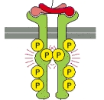
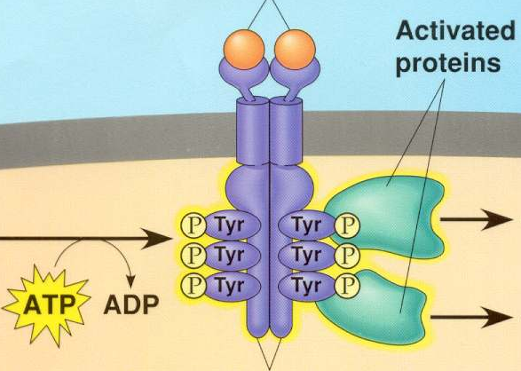
3
Enzyme-Linked Receptors
Tyrosine Kinase-Linked Receptors
Ligands dimerize receptors
Activated Receptor autophosphorylates
Phosphorylate other proteins that it docks
Phosphorylated docked proteins
RESPONSE

Slide 18
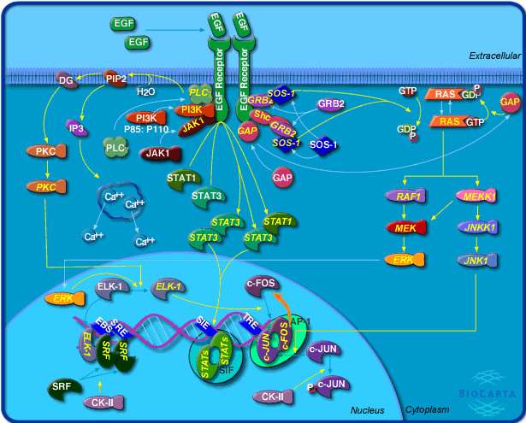
3
Enzyme-Linked Receptors
Tyrosine Kinase-Linked Receptors
Epidermal Growth Factor [EGF] R

Slide 19
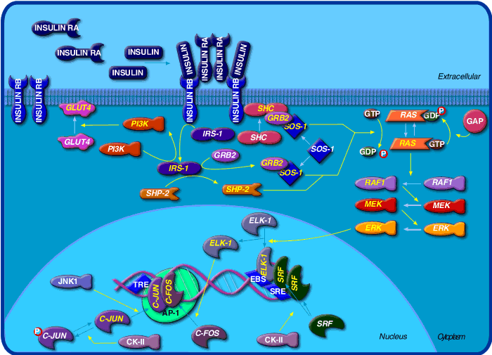
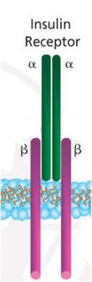
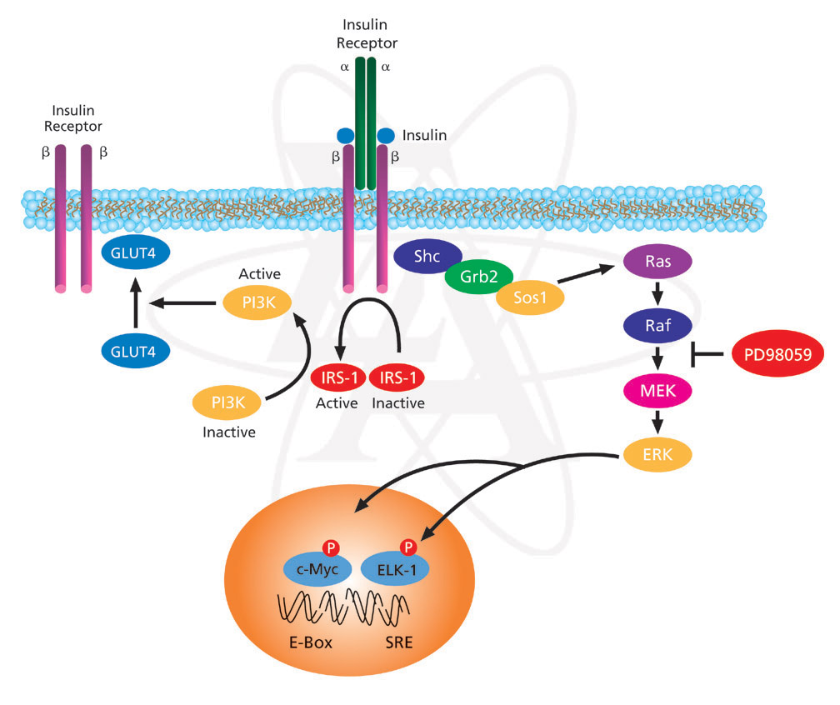
3
Enzyme-Linked Receptors
Non activated Insulin Receptor
Activated
Insulin Receptor
Tyrosine Kinase-Linked Receptors
INSULIN RECEPTOR
Insulin

Slide 20
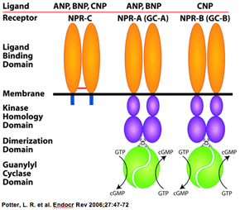
Enzyme-Linked Receptors
3
Guanyle cyclase-Linked Receptors
Atrial Natriueretic Peptide [ANP] RECEPTORS
They that have a single transmembrane spanning element.
These have integral intrinic guanylate cyclase activity .
Their 2nd messenger is cGMP
→ activates PKG
→ phosphorylate down stream
protein signaling molecules.
↑cGMP

Slide 21
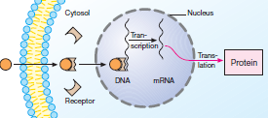
Are intra-cellularly located whether in cytosol or the nucleus.
Nuclear Receptors
4
Their ligands are usually either:
Extracellular lipophylic hormones; steroids, thyroids, …etc
Intracellular 2nd messenger developed along signaling
cascade of cell membrane receptors.
They possess a conserved area
that recognizes specific DNA
sequence in the nucleus
→ once bound to their ligands
they react as
TRANSCRIPTION FACTORS
expressing or repressing
target genes.
◆ By this they are involved in regulation of PROTEIN SYNTHESIS
→so are the most slowest in action.
Protein
Transcription into a mRNA
Translation into a protein

Slide 22
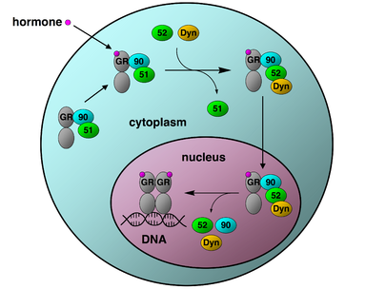
Nuclear Receptors
4
GLUCOCORTICOID RECEPTOR
CYTOSOLIC
proteins
Translation
The activated GR complex
◆ Up-regulates expression of anti-
inflammatory proteins
◆ Represses expression of pro-inflammatory proteins in cytosol ( preventing the translocation of other transcription factors from the cytosol into the nucleus).
GCRE
Transcription

Slide 23
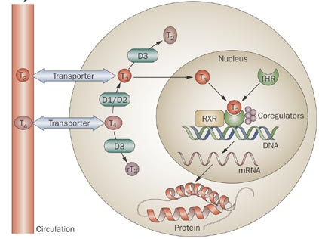
Nuclear Receptors
4
THYROID HORMONE
RECEPTOR
Nuclear

Slide 24
RECEPTOR FAMILIES
L
G
U
O
C
O
K
D

