Slide 1
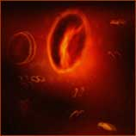
B L O O D
D R . S H A H A B S H A I K H

Slide 2
White Blood Cells
also called as LEUKOCYTES
protect against disease
interleukins and colony-stimulating factors stimulate development
Total WBC count: 4000 – 11000 /cu mm
LEUCOCYTE | % AGE | ABSOLUTE
NEUTROPHILS | 50 to 70
EOSINOPHILS | 1 to 4
BASOPHILS | 0 to 1
MONOCYTES | 4 to 8
LYMPHOCYTES | 20 to 45
CLASSIFICATION:
WHITE BLOOD CELLS
GRANULOCYTES
NEUTROPHILS
EOSINOPHILS
BASOPHILS
AGRANULOCYTES
LYMPHOCYTES
T-LYMPHOCYTES
B-LYMPHOCYTES
MONOCYTES

Slide 3
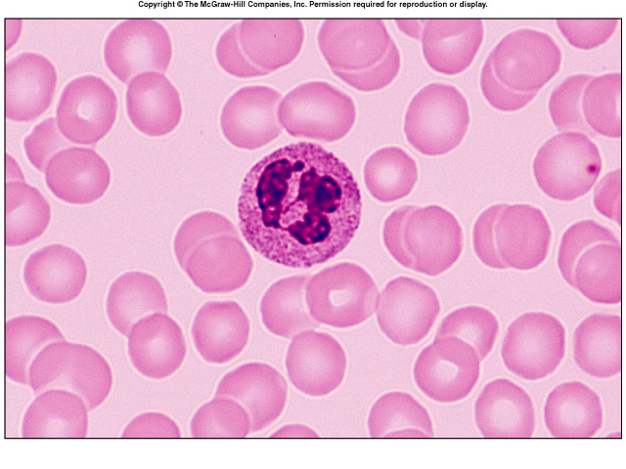
Neutrophils
fine violet colored granules in acid-base stain
multilobed nucleus 2-5 lobes
10 TO 12 µ DIAMETER i.e 2 X RBC
Also called as polymorphonuclear leukocyte
first to arrive at infections
phagocytic
50% - 70% of leukocyte
elevated in bacterial infections

Slide 4
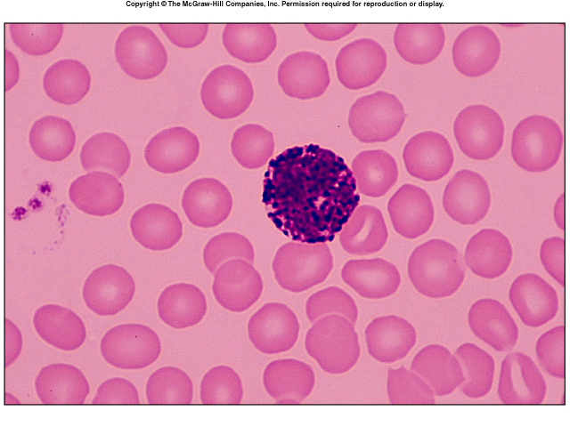
Basophils
deep blue coarse granules
Bilobed nucleus
8-10 µ DIAMETER i.e 2 X RBC
release histamine
release heparin
0 to1 % of leukocytes

Slide 5
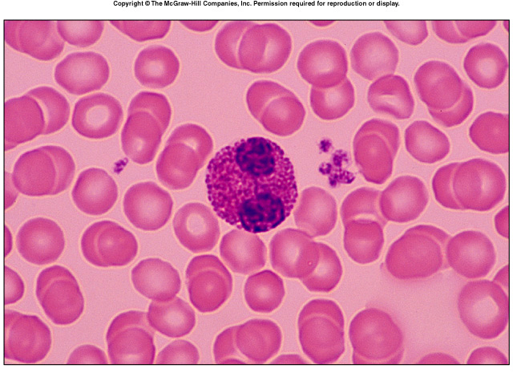
Eosinophils
Coarse deep red granules in acid stain
bilobed nucleus spectacle shaped
Size 10 TO 14 µ DIAMETER i.e 2 X RBC
1% - 4% of leukocytes
elevated in parasitic infestations and allergic reactions

Slide 6
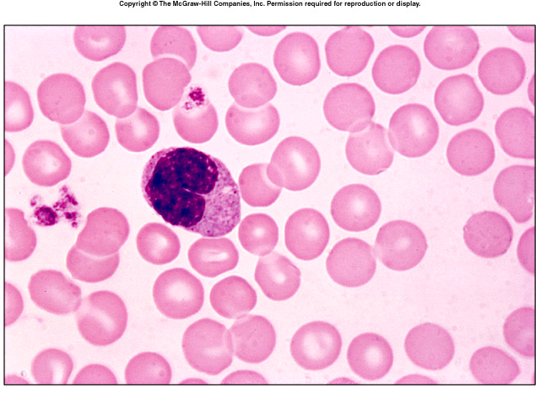
Monocytes
largest blood cell
14 TO 18 µ DIAMETER i.e 2-3 X RBC
Clear cytoplasm
kidney-shaped or oval nuclei
leave bloodstream to become macrophages
4% - 8% of leukocytes
elevated in Typhoid fever, Malaria, Tuberculosis

Slide 7
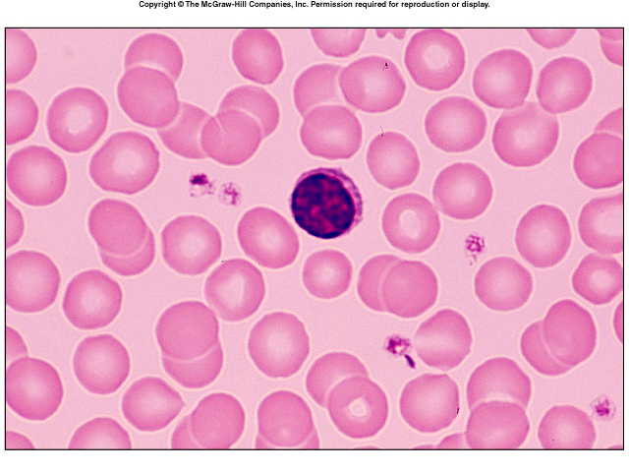
Lymphocytes
about the size of RBC
large spherical nuclei
thin rims of cytoplasm
T cells
B cells
important in immunity
20% - 45% of leukocytes
decreased T Cells in AIDS

Slide 8
Clinical Application
Leukemia
Myeloid Leukemia
bone marrow produces too many immature granulocytes
leukemic cells crowd out other blood cells
anemia
bleeding
susceptible to infections
Lymphoid Leukemia
lymphocytes are cancerous
symptoms similar to myeloid leukemia
Treatments
blood transfusions
marrow transplants
anti-cancer drugs
stem cell transplants

Slide 9
Body Defenses: Overview
Physical barriers: skin & epithelial linings & cilia
Chemical: acids, mucous & lysozymes
Immune defenses – internal
Innate, non-specific, immediate response (min/hrs)
Acquired – attack a specific pathogen (antigen)
Steps in Immune defense
Detect invader/foreign cells
Communicate alarm & recruit immune cells
Suppress or destroy invader

Slide 10
Lymphatic System: Overview of Immune Defense Organs & Cells
Bone marrow
Thymus
Lymph nodes
Spleen
Lymph vessels
Leukocytes:
(white blood cells – WBCs)

Slide 11
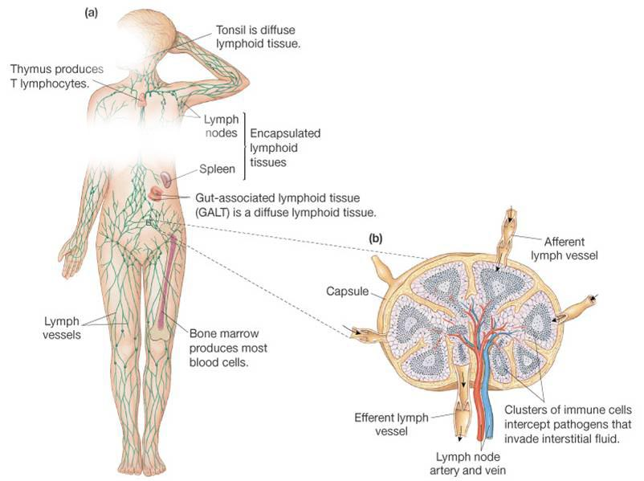
Lymphatic System: Overview of Immune Defense Organs & Cells

Slide 12
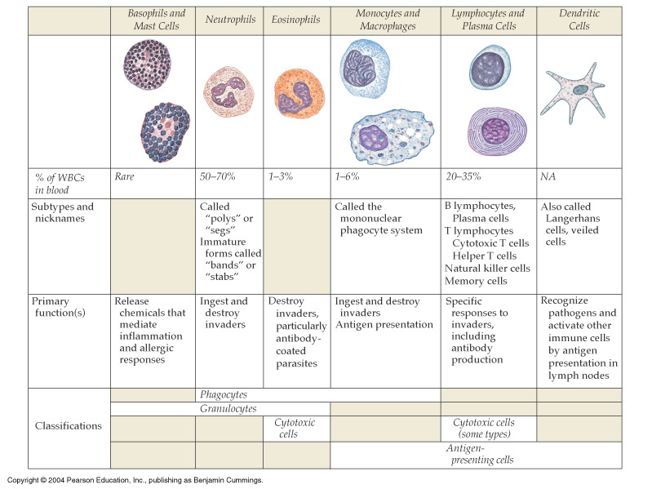
Key Cells & Overview of their Function in Immune Defense
Figure 24-4: Cells of the immune system

Slide 13
Innate Immunity: Phagocytosis & Inflammation
Physical & chemical barriers
Phagocytosis: macrophages, neutrophils, NK cells
Engulf and digest recognized "foreign" cells – molecules
Inflammatory response

Slide 14
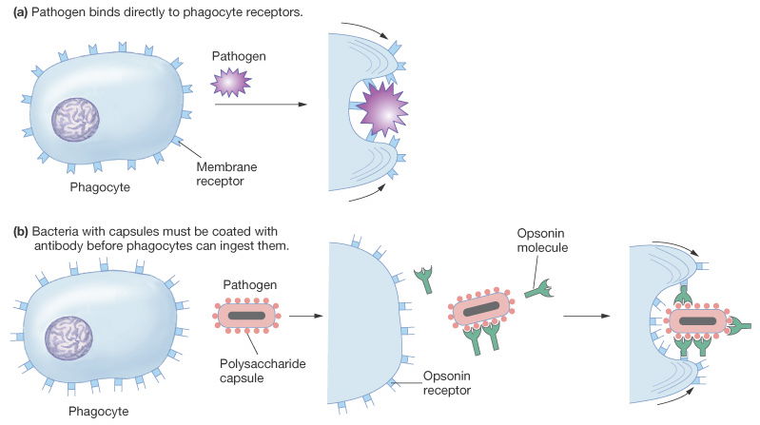
Innate Immunity: Phagocytosis & Inflammation
Figure 24-6: Phagocytosis

Slide 15
Inflammatory Response: Cytokines Signal Initiation
Histamines: from mast cells → swelling, edema, b. v . dilation
Interleukins: fever, ↑b.v. gaps → WBC's & proteins → infection
Bradykinin: pain & swelling
Membrane attack complex proteins

Slide 16
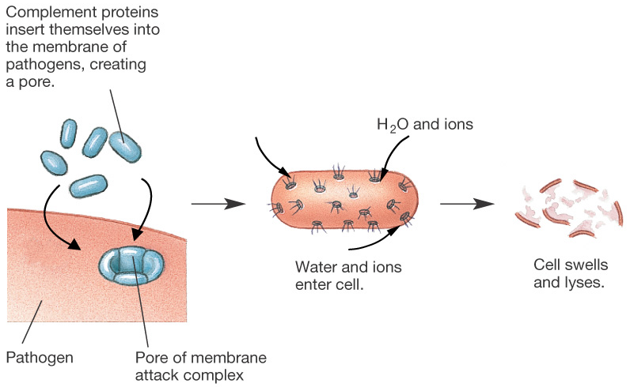
Inflammatory Response: Cytokines Signal Initiation
Figure 24-8: Membrane attack complex

Slide 17
Acquired Immunity:
Activate T lymphocytes: direct attack
Activate B lymphocytes to become:
Memory cells:
Plasma cells:
Produce antibodies – attack the pathogen

Slide 18
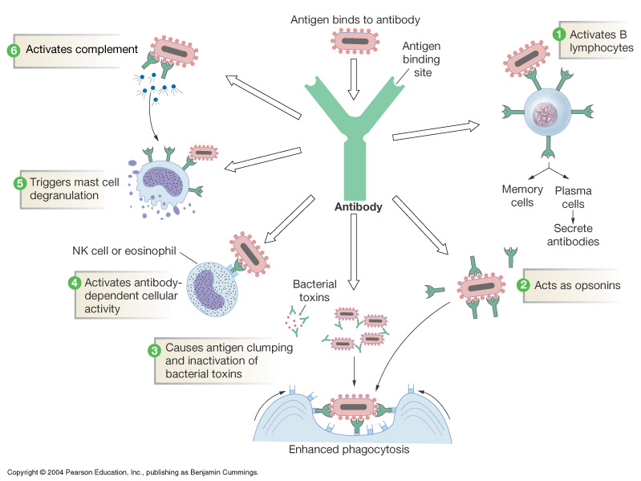
Acquired Immunity: Antigen-Specific Responses
Figure 24-13: Functions of antibodies

Slide 19
T Lymphocytes: Cell Mediated Immunity
T cell receptors: cell activated to antigen
Major histocompatability complex (MHC)
Helper T cells:
Cytotoxic T cells: perforins, granzymes, (apoptosis) & Fas

Slide 20
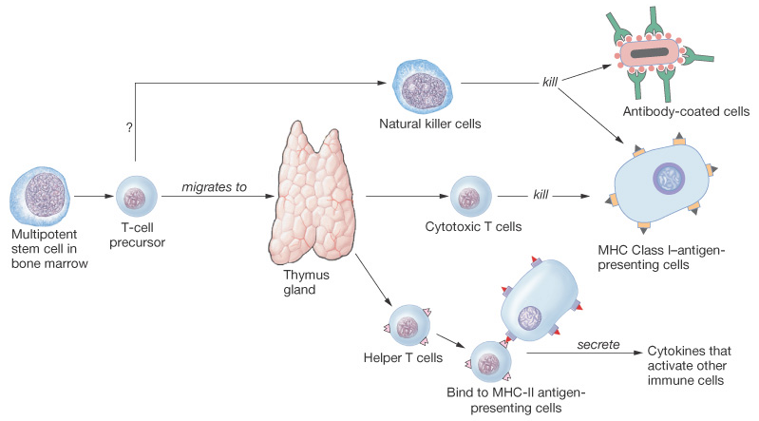
T Lymphocytes: Cell Mediated Immunity
Figure 24-16: T lymphocytes and NK cells

Slide 21
Viral Defense: Summary of Innate & Acquired Responses
Circulating antibodies inactivate or target virus (opsins)
Macrophage → inflammation, interferon, cell activation
Helper, cytotoxic T, NK & B cells → plasma c.→ antibodies

Slide 22
Allergic Response: Inflammation Reaction to Non-pathogen
First exposure: sensitization
Activation
Clone B cells
Form antibodies
Memory cells
Re-exposure
Many antibodies
Activated Ts
Intensified
Inflammation

Slide 23
Autoimmune Diseases: Failure of “Self-Tolerance”
Some diabetes mellitus – attack β- cells
Graves disease – mimics TSH→hyperthyroidism
Multiple sclerosis – attack on myelin nerve sheath
Rheumatoid arthritis – attack joint cartilage
Myasthenia gravis – ACh-receptors at endplate attacked

Slide 24
Summary
Body defends itself with barriers, chemicals & immune responses
WBCs and relatives conduct direct cellular attack: phagocytosis, activated NK & cytotoxic T cells and produce attack proteins (i.e. antibodies, complement, & membrane attack complex)

Slide 25
Summary
Cytokines, communicate cell activation, recruitment, swelling, pain, & fever in the inflammation response
Defense against bacteria is mostly innate while viral defense relies more on acquired immune responses
Autoimmune diseases are a failure of self-tolerance

