Slide 1
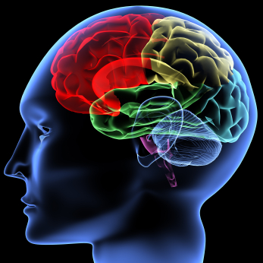
Nervous System

Slide 2
OBJECTIVES
At the end of the lecture, students should be able to:
List the subdivisions of the nervous system.
Define the terms: grey matter, white matter, nucleus, ganglion, tract and nerve.
List the parts of the brain.
Identify the external and internal features of spinal cord.
Enumerate the cranial nerves
Describe the parts and distribution of the spinal nerve.
Define the term ‘dermatome’
List the structures protecting the central nervous system

Slide 3
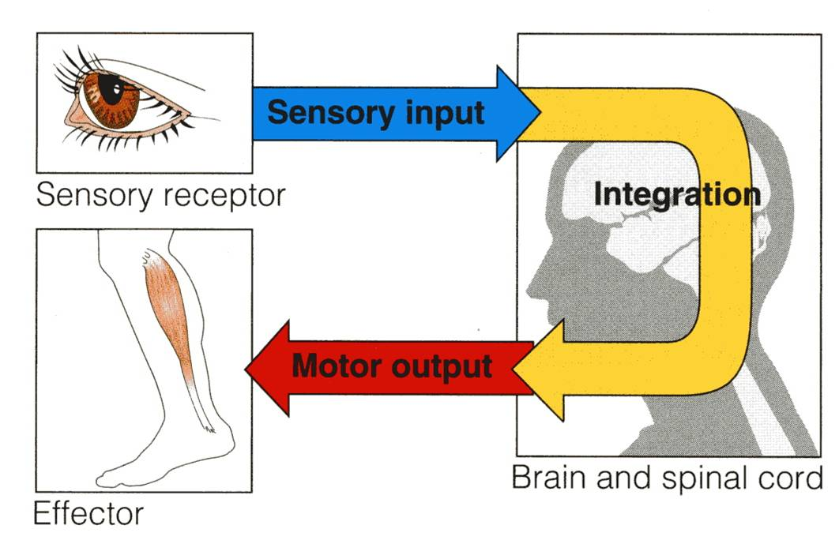
FUNCTIONS
The nervous system has three functions:
Collection of Sensory Input:
Identifies changes occurring inside and outside the body by using sensory receptors. These changes are called stimuli
Integration:
Processes, analyses and interprets these changes and makes decisions
Motor Output:
It then effects a response by activating muscles or glands (effectors) via motor output

Slide 4
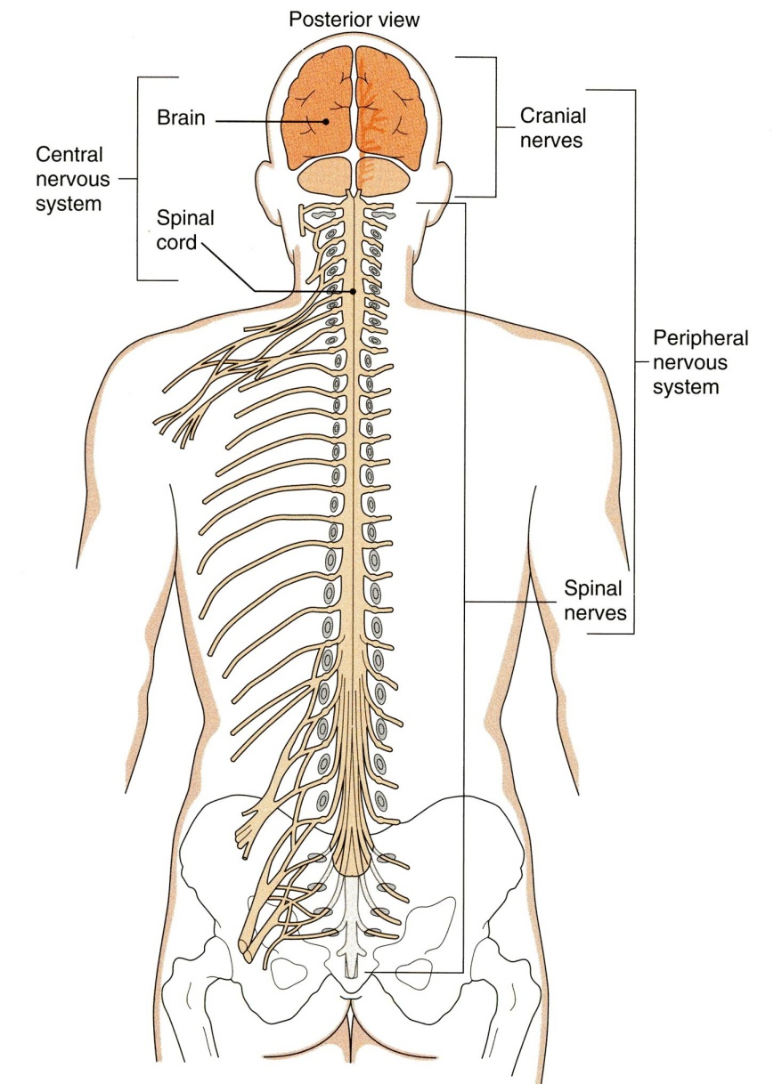
ORGANIZATION
STRUCTURAL
Central Nervous System (CNS)
Brain & Spinal Cord
Peripheral Nervous System (PNS)
Nerves & Ganglia

Slide 5
ORGANIZATION
FUNCTIONAL
Sensory Division (Afferent)
Motor Division (Efferent)
Autonomic
Somatic

Slide 6
NERVOUS TISSUE
Nervous tissue is organized as:
Grey matter: which contains the cell bodies & the processes of the neurons, the neuroglia and the blood vessels.
White matter: which contains the processes of the neurons (no cell bodies), the neuroglia and the blood vessels.

Slide 7
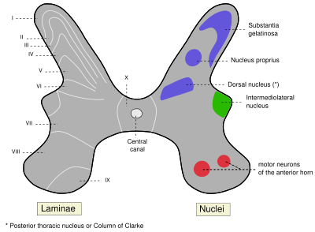
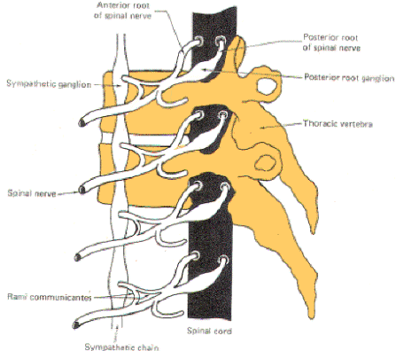
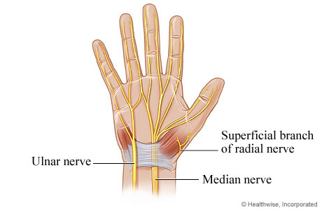
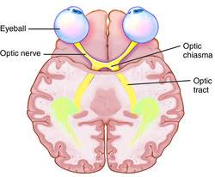
Ganglion
A group of neurons outside the CNS
Nucleus
A group of neurons within the CNS
Nerve
A group of nerve fibers (axons) outside the CNS
Tract
A group of nerve fibers (axons) within the CNS

Slide 8
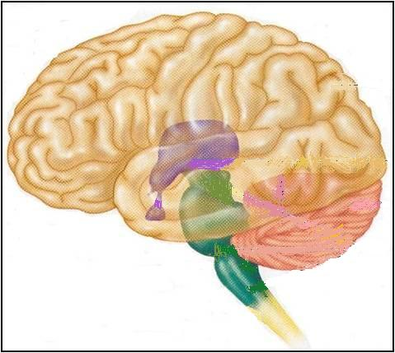
THE BRAIN
Large mass of nervous tissue located in the cranial cavity.
Has four major regions.
Cerebrum
(Cerebral hemispheres)
Diencephalon: Thalamus, Hypothalamus, Subthalamus & Epithalamus
Cerebellum
Brainstem: Midbrain, Pons & Medulla oblongata

Slide 9
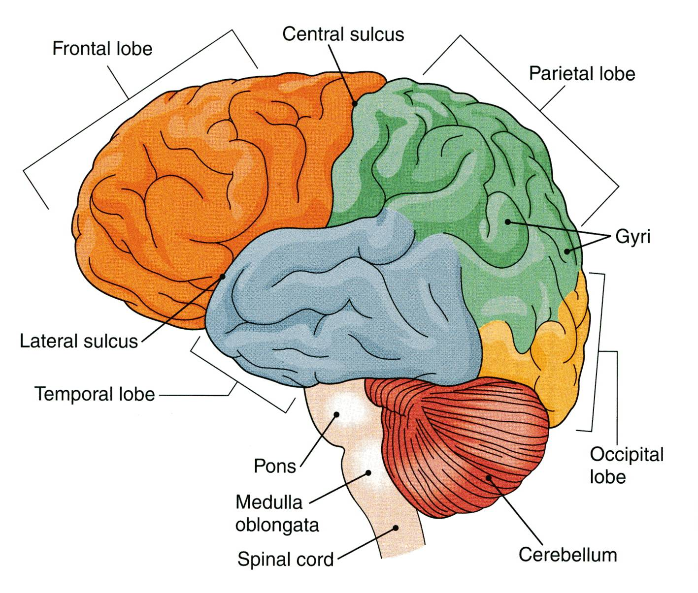
CEREBRUM
The largest part of the brain, and has two hemispheres.
The cerebral hemispheres are connected by a thick bundle of nerve fibers called corpus callosum.
The surface shows ridges of tissue, called gyri, separated by grooves called sulci.
Divided into 4 lobes by deeper grooves.

Slide 10
Tissue of Cerebral Hemispheres
The outermost layer is called gray matter or cortex.
Deeper is located the white matter, composed of fiber tracts (bundles of nerve fibers)
Carrying impulses to and from the cortex.
Located deep within the white matter are masses of grey matter called the basal nuclei .
They help the motor cortex in the regulation of voluntary motor activities

Slide 11
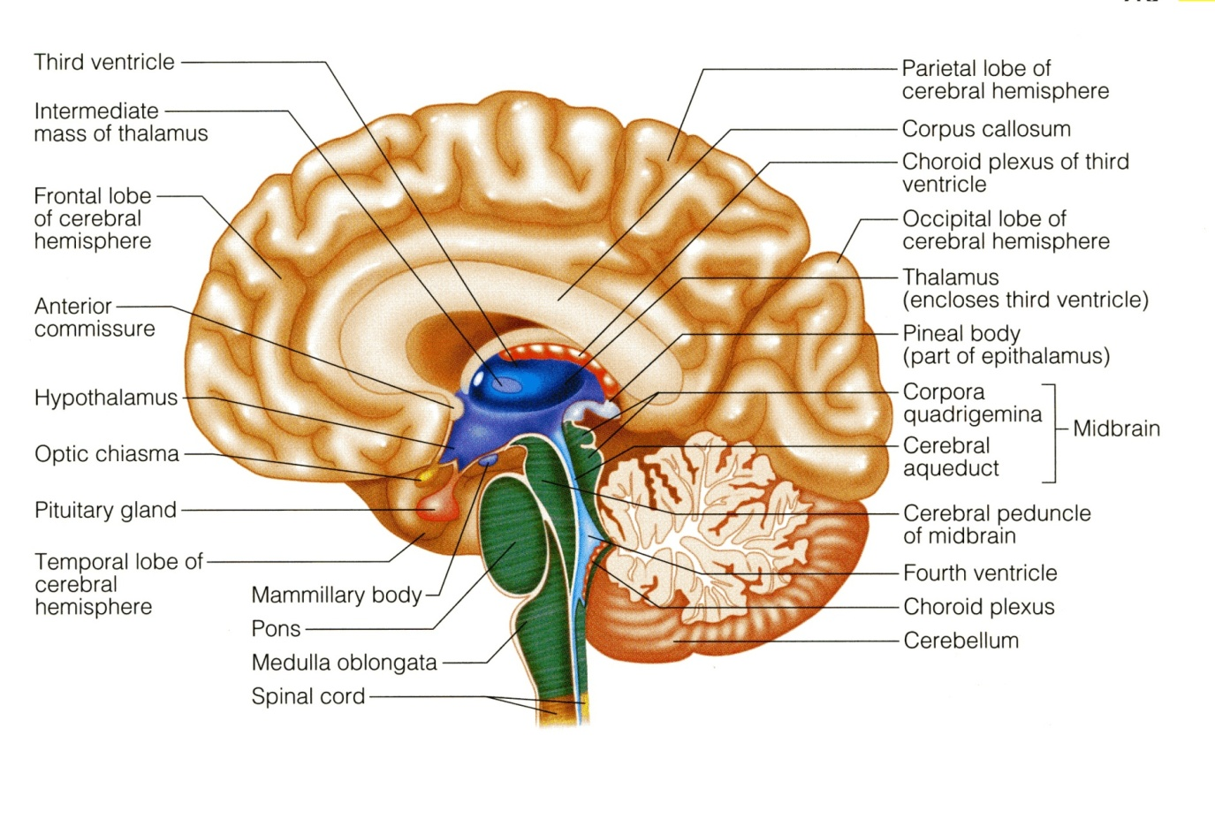
CEREBLLUM
The cerebellum has 2 hemispheres and a convoluted surface.
It has an outer cortex made from gray matter and an inner region of white matter.
It provides precise coordination for body movements and helps maintain equilibrium.

Slide 12
QUESTION 4 REVIEW!
Whish statement of the following is NOT true?
Cerebrum has five major regions.
White matter contains the cell bodies & the processes of the neurons, the neuroglia and the blood vessels.
The innermost layer of cerebrum is called gray matter or cortex.
Cerebellum provides precise coordination for body movements and helps maintain equilibrium.

Slide 13
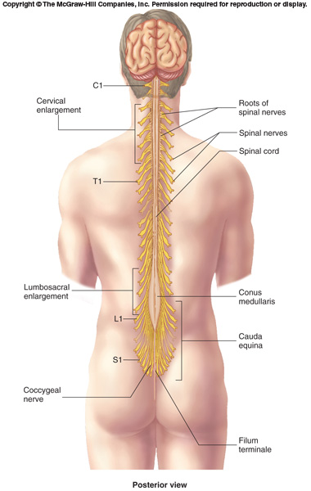
SPINAL CORD
It is a two-way conduction pathway to the brain & a major reflex center
42-45 cm long, cylindrical in shape, lies within the vertebral canal.
Extends from foramen magnum to L2 vertebra
Continuous above with medulla oblongata
Caudal tapering end is called conus medullaris
Has 2 enlargements: cervical and lumbosacral
Gives rise to 31 pairs of spinal nerves
Group of spinal nerves at the end of the spinal cord is called cauda equina

Slide 14
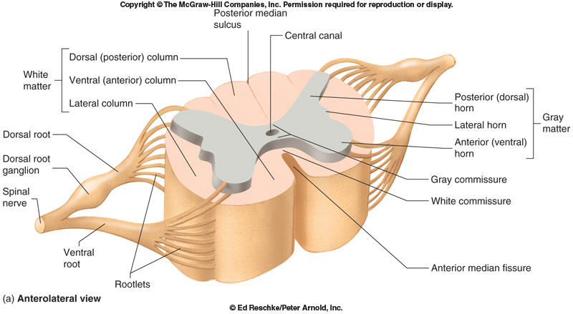
CROSS SECTION OF SPINAL CORD
The spinal cord is incompletely divided into two equal parts, anteriorly by a short, shallow median fissure and posteriorly by a deep narrow septum, the posterior median septum.
Composed of grey matter in the center surrounded by white matter
The arrangement of grey matter resembles the shape of the letter H, having two posterior, two anterior and two lateral horns/columns.

Slide 15
PEREPHERAL NERVES
May be sensory, motor or mixed
Two types:
Cranial: 12 pairs, attached to brain, named, and numbered from1-12
Spinal: 31 pairs, attached to spinal cord named and numbered according to the region of the spinal cord

Slide 16
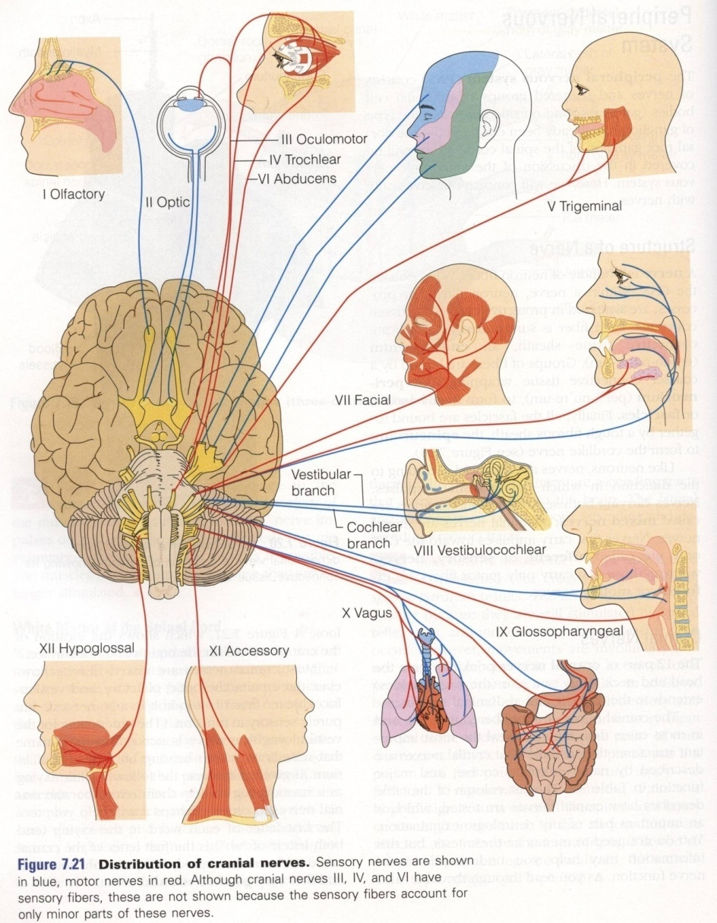
CRANIAL NERVES
12 pairs
4 pairs are mixed
trigeminal nerve. (5th)
facial nerve. (7th)
glossopharyngeal nerve. (9th)
vagus nerve. (10th)
5 pairs are motor
occulomotor nerve. (3rd)
trochlear nerve. (4th)
abducent nerve. (6th)
accessory nerve. (11th)
hypoglossal nerve. (12th)
3 pairs are sensory
olfactory nerve. (1st)
optic nerve. (2nd)
vestibulocochlear nerve. (8th)

Slide 17
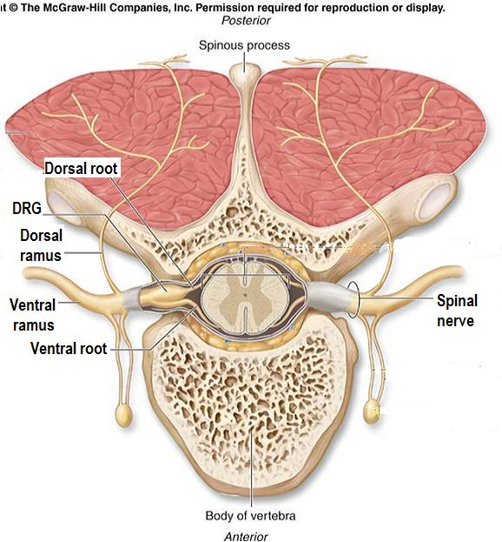
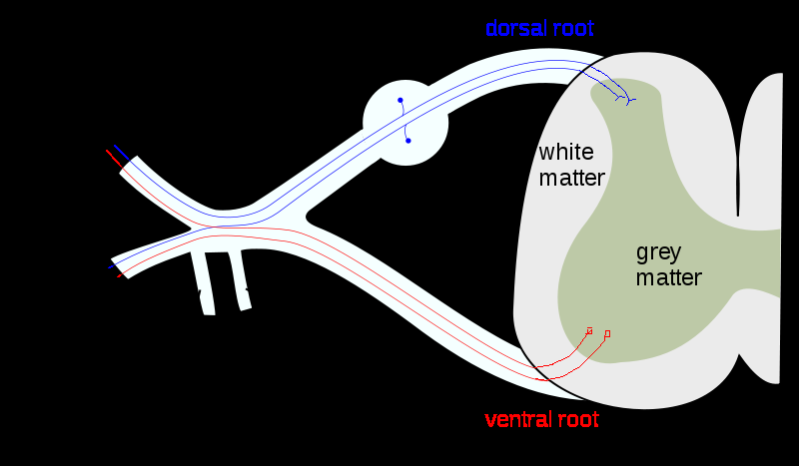
SPINAL NERVES & NERVE PLEXUES
31 pairs
Each spinal nerve is attached by two roots:
Dorsal (sensory)
Ventral (motor)
Dorsal root bears a sensory ganglion
Each spinal nerve exits from the intervertebral foramen and divides into a dorsal and ventral ramus
The rami contain both sensory and motor fibers

Slide 18
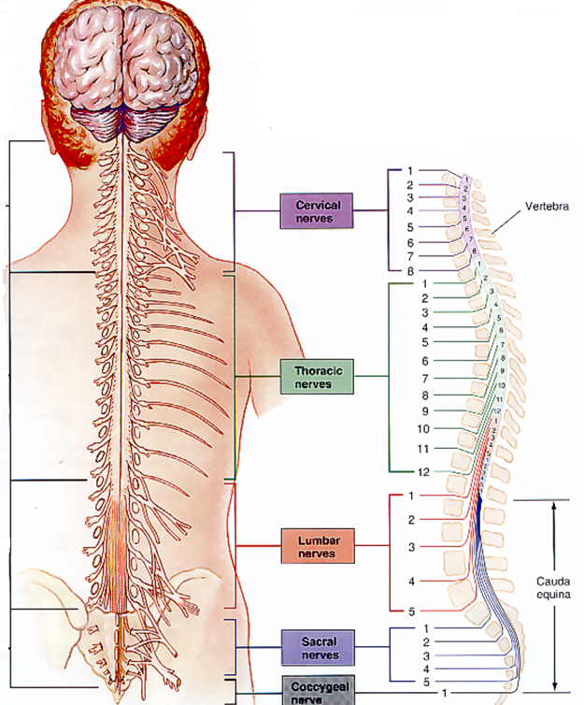
SPINAL NERVES & NERVE PLEXUES
The dorsal rami are distributed individually.
Supply the skin and muscles of the back
the ventral rami form plexuses (except in thoracic region where they form the intercostal nerves)
Supply the anterior part of the body

Slide 19
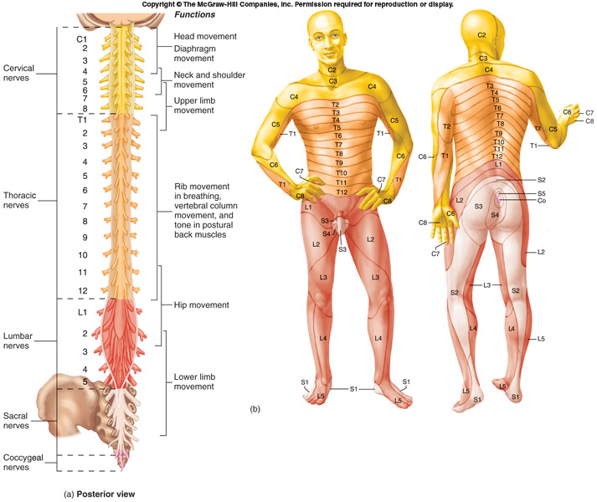
DERMATOME
Dermatome is a segment of skin supplied by one spinal nerve.

Slide 20
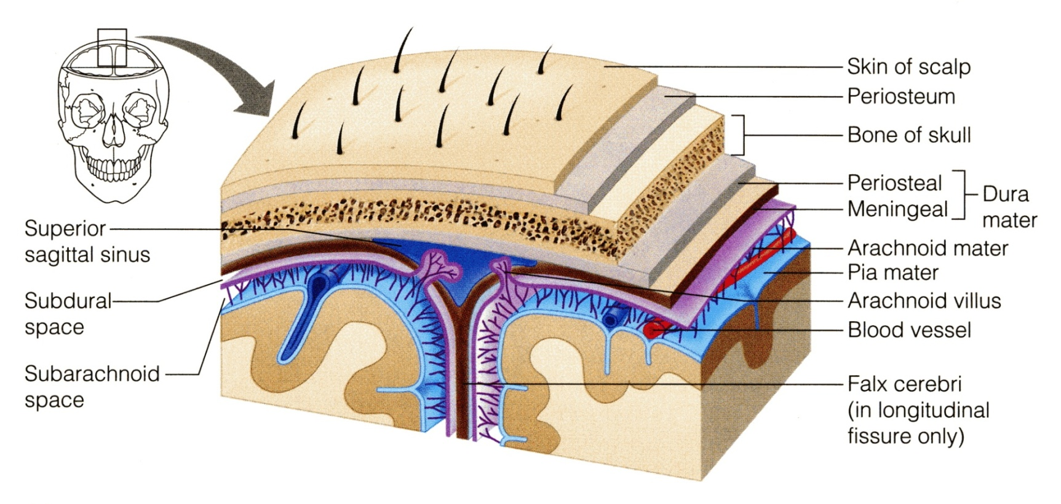
PROTECTION OF CNS
THE CNS IS PROTECTED BY:
Skull and the vertebral column (bone)
Meninges (membranes): 3 layers
dura mater (outermost)
arachnoid mater (middle
pia mater (innermost)
Cerebrospinal fluid in the subarachnoid space

Slide 21
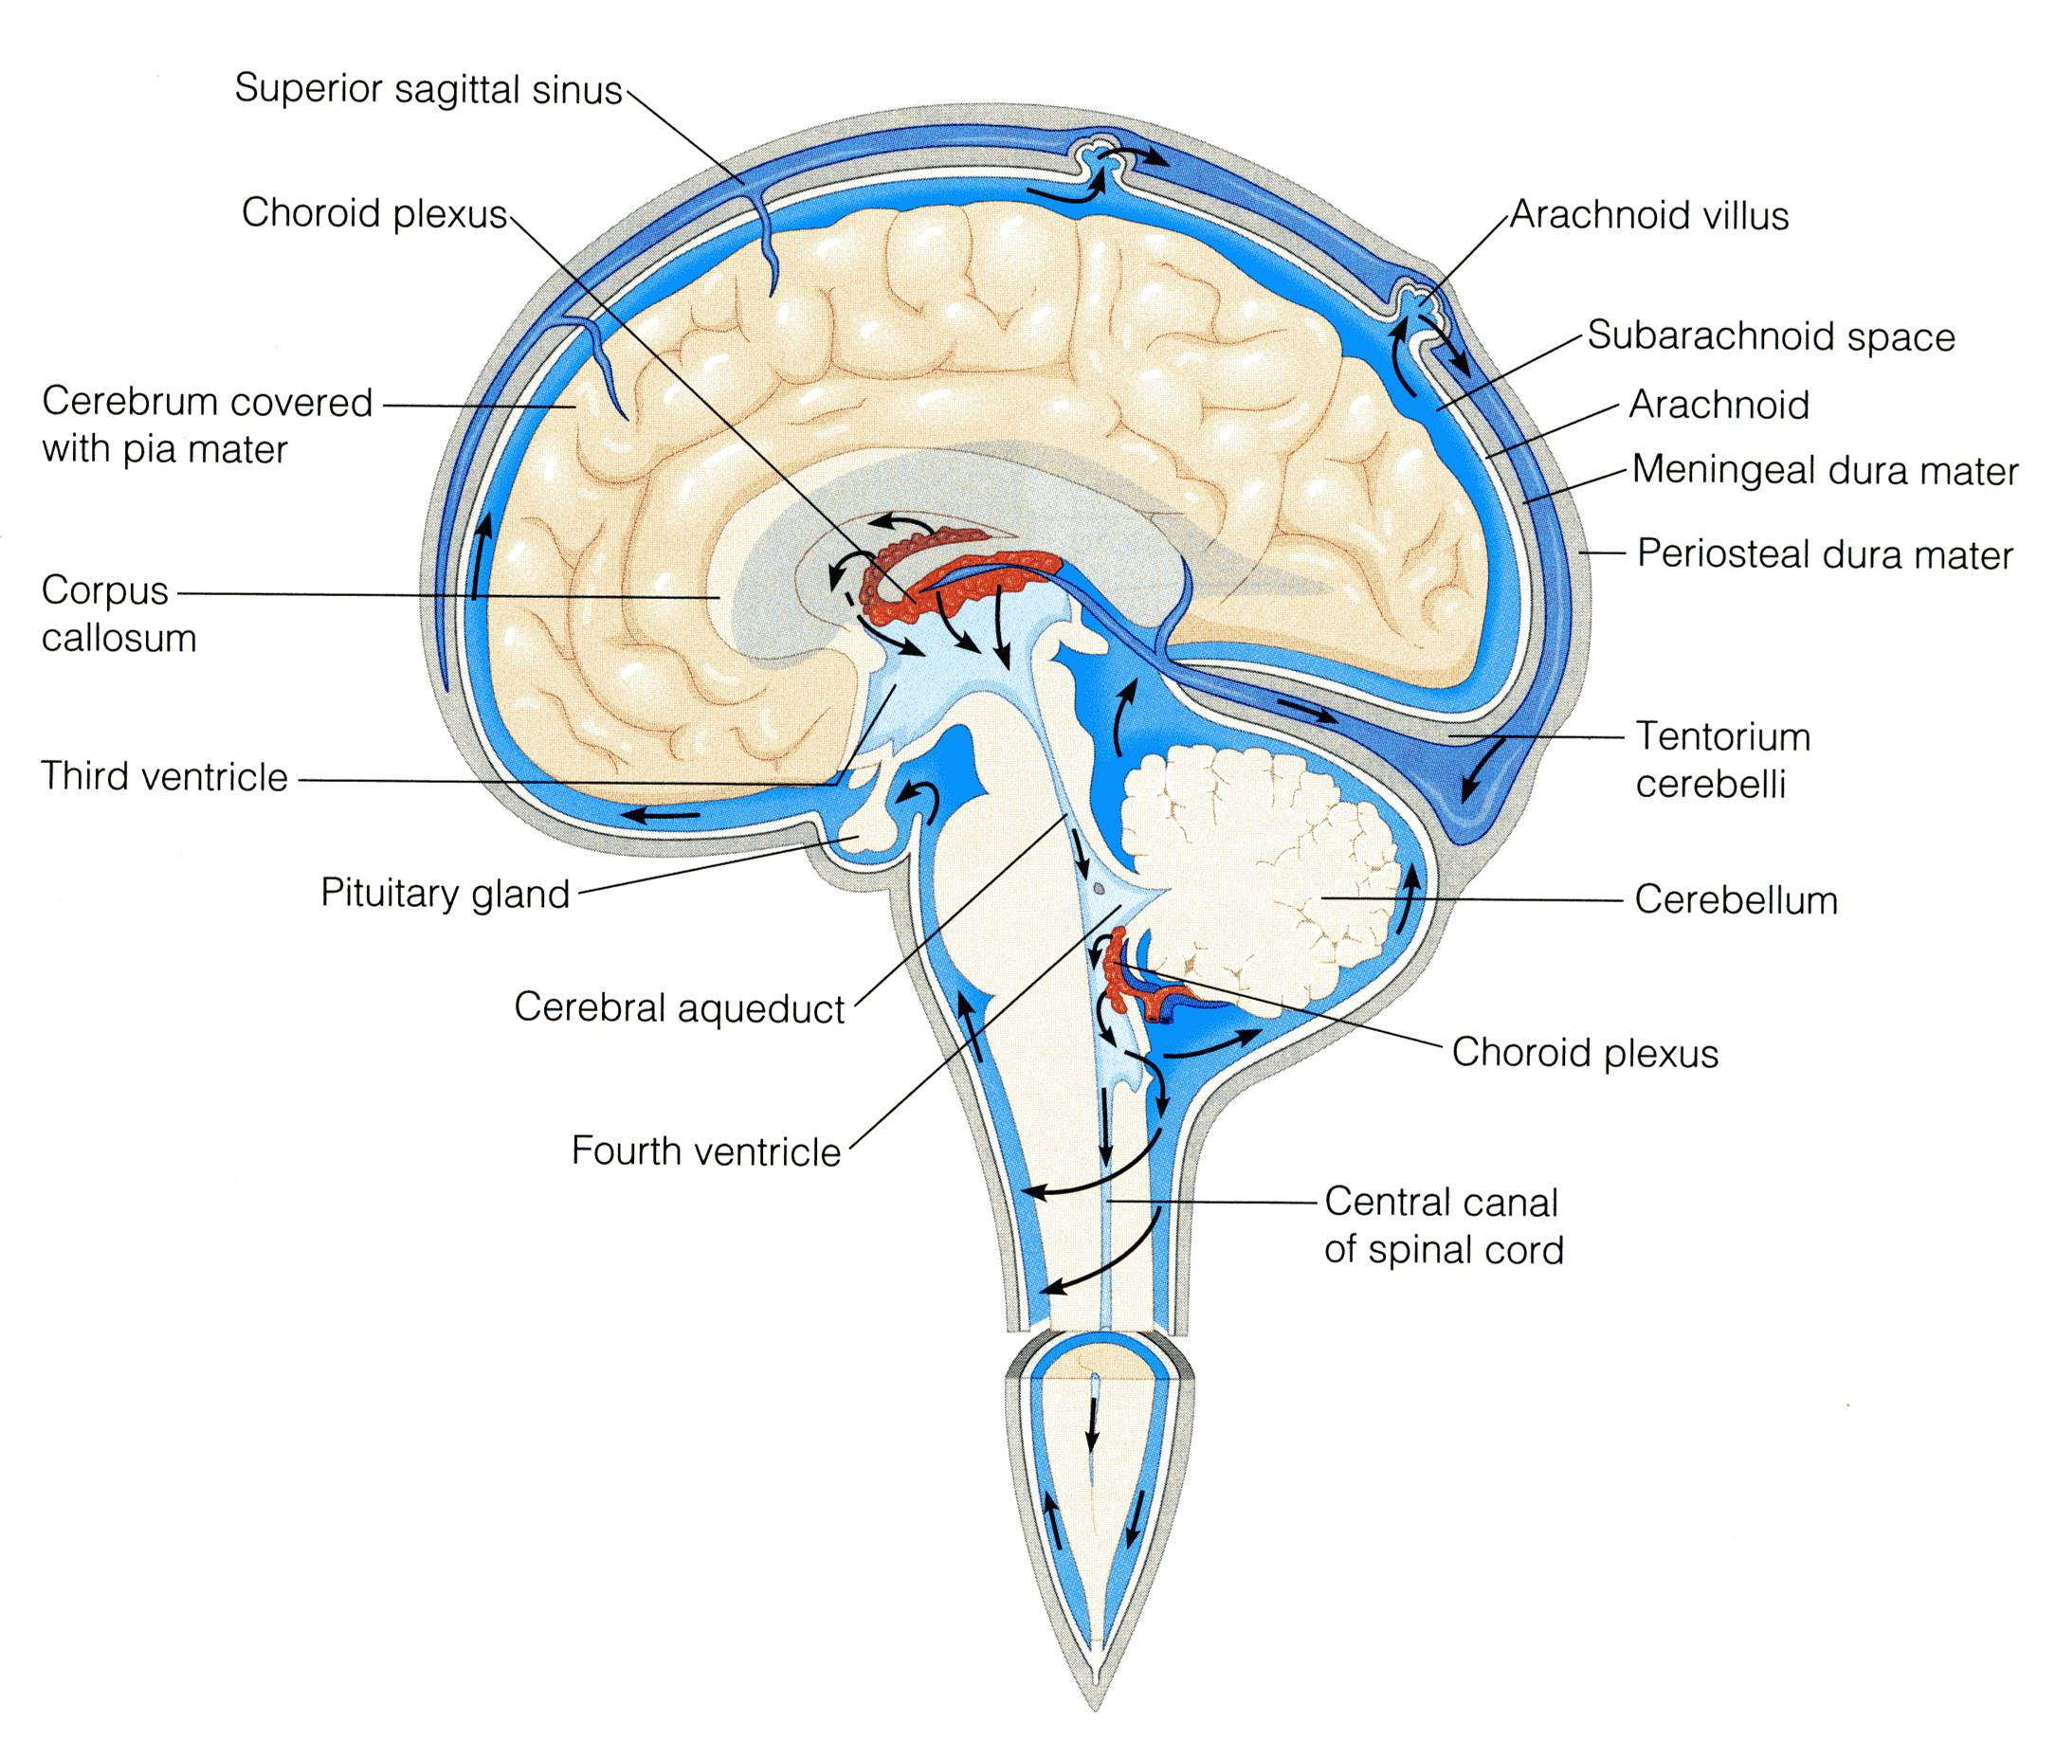
CEREBRAL FLUID
CSF is constantly produced by the choroid plexuses inside the ventricles of brain.
Most of the CSF drains from the ventricles into the subarachoid space around the brain and spinal cord. A little amount flows down in the central canal of the spinal cord.
CSF is constantly drained into the dural sinuses through the arachnoid villi.

Slide 22
QUESTION 4 REVIEW!
Whish statement of the following is true?
Spinal Cord extends from foramen magnum to L2 vertebra
Dermatome is a segment of skin supplied by one spinal nerve.
CSF is constantly produced by the choroid plexuses outside the ventricles of brain.
Spinal Cord is incompletely divided into two equal parts, anteriorly by median fissure and posteriorly by posterior median septum.

Slide 23
Questions!

