Slide 2
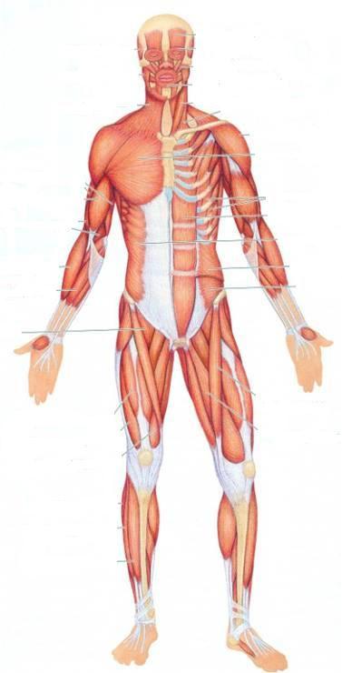
SKELETAL MUSCLES
Dr. Jamila EL Medany
Dr. Khaleel Alyahya
&

Slide 3
OBJECTIVES
At the end of the lecture, students should:
Describe the main criteria of skeletal muscles.
Describe the attachments of skeletal muscles.
Describe the different directions of skeletal muscle fibers.
Describe the mode of action of skeletal muscles.
Describe briefly the naming of skeletal muscles.
Describe briefly the nerve supply of skeletal muscles.

Slide 4
MUSCULAR SYSTEM
Composed of two main types :
1. Involuntary:
(a) Smooth: Found in the walls of viscera.
(b) Cardiac: Found only in the heart.
2. Voluntary (skeletal)
SMOOTH
SKELETAL
CARDIAC

Slide 5
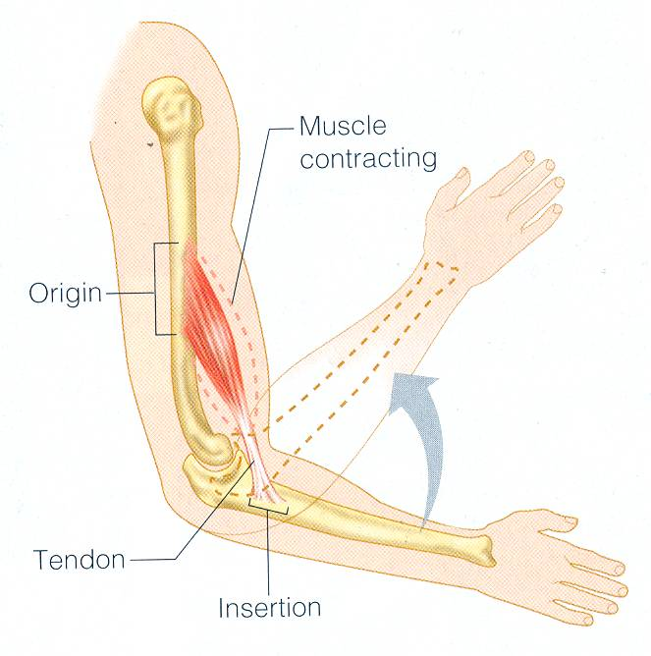
I
MAIN CRITERIA OF SKELTAL MUSCLES
Voluntary.
Striated.
Attached to skeleton.
Produce movement of skeleton.
Supplied by somatic nerves.

Slide 6
ATTACHMENTS
MOSTLY TWO:
ORIGIN: Least movable, mostly fleshy, proximal end.
INSERTION: Most movable, mostly fibrous, distal end.

Slide 7
TYPES OF ATTACHMENTS
Muscles are attached to bones, cartilage or ligaments by:
(1) Tendons :
cords of fibrous tissue.
(2) Aponeurosis :
A thin and strong sheet of fibrous tissue.
(3) Raphe :
An interdigitation of the tendinous ends of the flat muscles.

Slide 8
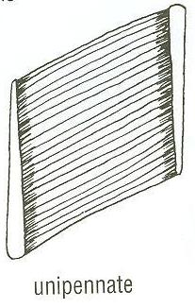
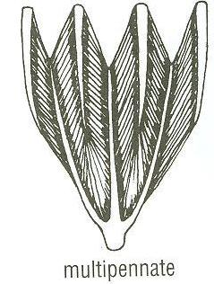
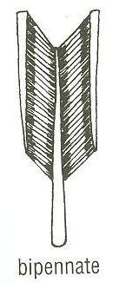
DIRECTION OF MUSCLE FIBERS
Parallel to line of pull: More range of movement, less powerful.
Pennate (oblique to line of pull): More powerful, less range of movement.
Unipennate.
Bipennate.
Multipennate.
parallel

Slide 9
MODE OF ACTION
Prime mover (Agonist) :
It is the chief muscle responsible for a particular movement
Example: Quadriceps Femoris is the prime mover for extension of the knee joint.

Slide 10
MODE OF ACTION
Antagonist :
It opposes the action of the prime mover.
Before contraction of prime mover, antagonist must be relaxed.
Example: Biceps Femoris (Flexor of knee) opposes the action of quadriceps when the knee joint is extended.

Slide 11
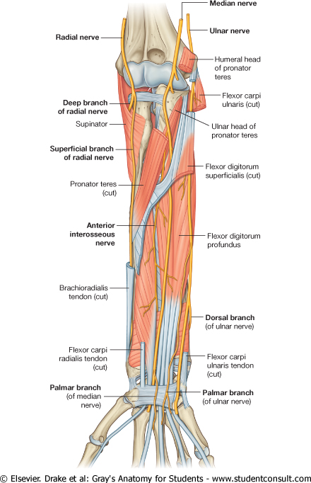
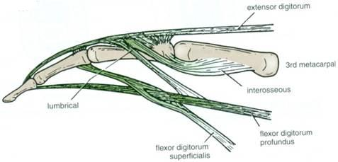
MODE OF ACTION
Synergist :
Prevents unwanted movement in an intermediate joint crossed by the Prime Mover.
Example: Flexors and Extensors of wrist joint contract to fix wrist joint in order that flexors and extensors of fingers works efficiently.

Slide 12
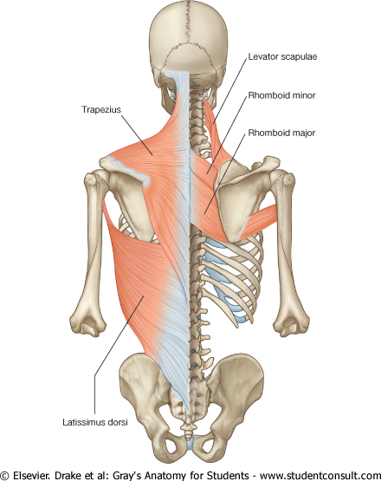
MODE OF ACTION
Fixator :
Its contraction does not produce movement by itself but it stabilizes the origin of the prime mover so that it can act efficiently.
Example: Muscles attaching the shoulder girdle to the trunk contract to fix shoulder girdle, allowing deltoid muscle (taking origin from shoulder girdle) to move shoulder joint (humerus).

Slide 13
NAMING OF MUSCLES
Size:
Major or maximus (large).
Minor or minimus (small).
Latissimus (broad).
Longus (long).
Brevis (short).
Position:
Pectoralis (pectoral region)
Depth:
Superficialis (superficial).
Profundus (deep).
Externus (external).

Slide 14
NAMING OF MUSCLES
Shape:
Deltoid (triangular).
Teres (rounded)
Rectus (straight).
Number of Heads:
Biceps (2 heads).
Triceps (3 heads).
Quadriceps (4 heads).
Attachments:
Coracobrachialis (from coracoid process to arm).
Action:
Flexor digitorum: flexion of digits.

Slide 15
NERVE SUPPLY
The nerves supplying the skeletal muscles are Mixed.
60% are Motor.
40% are Sensory.
It contains some Autonomic fibers (Sympathetic).
The nerve enters the muscle at about the middle point of its deep surface.

Slide 16
SUMMARY
Skeletal muscles are striated, voluntary muscles attached to & move the skeleton.
They have 2 attachments: origin & insertion.
Their fibers may be parallel or oblique (pennate) to the line of pull.
According to mode of action, they are classified as: prime mover, antagonist, synergist or fixator.
They may be named according to: size, shape, number of heads, position, attachments, depth or action.
They are supplied by a mixed nerve.

Slide 17
THANK YOU

